Slide 1
Martin Meyer
Docker
2014-12-18
Notes:
Vagrant Box:
https://bitbucket.org/inftec/vagrant-playground/branch/docker-demo
VM: \\192.168.0.200\Public\2014-12-18 Workshop Docker
DEPRECATED:
Preparation:
Windows: Install boot2docker: https://github.com/boot2docker/boot2docker
Optional: Clean images and containers from installation
Pull required Images
docker pull ubuntu
docker pull training/webapp

Slide 2
Agenda
What is Docker?
  Docker vs. Virtual Machine
  History, Status, Run Platforms
  Hello World
Images and Containers
Volume Mounting, Port Publishing, Linking
Around Docker, Docker Use Cases
Hands-On Workshop

Slide 3
What is Docker?
Docker is an open-source project that automates the deployment of applications inside software containers, by providing an additional layer of abstraction and automation of operating system–level virtualization on Linux.
[Source: en.wikipedia.org]

Slide 4
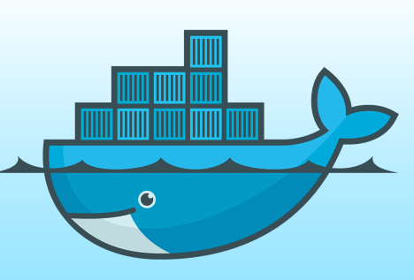
Docker: Name
[www.docker.com]
docker [naut.]: der Dockarbeiter, der Hafenarbeiter
Source: leo.org
Provide a uniformed wrapper around a software package: «Build, Ship and Run Any App, Anywhere» [www.docker.com]
  Similar to shipping containers: The container is always the same, regardless of the contents and thus fits on all trucks, cranes, ships, ...

Slide 5
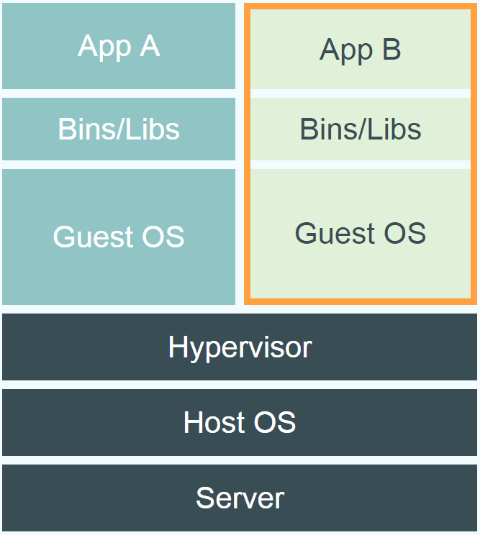
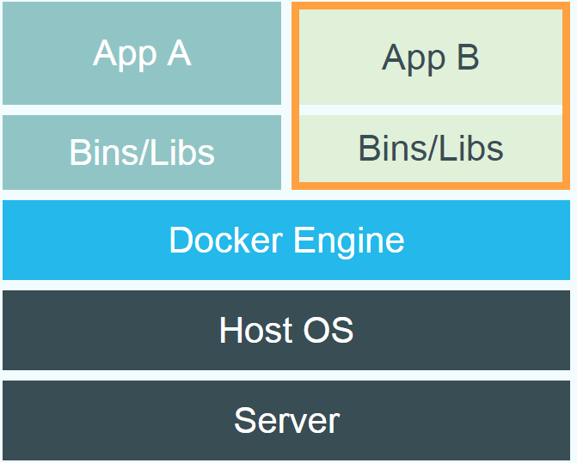
Docker vs. Virtual Machine
Source: https://www.docker.com/whatisdocker/
Notes:
Virtual Machines
Each virtualized application includes not only the application - which may be only 10s of MB - and the necessary binaries and libraries, but also an entire guest operating system - which may weigh 10s of GB.
Docker
The Docker Engine container comprises just the application and its dependencies. It runs as an isolated process in userspace on the host operating system, sharing the kernel with other containers. Thus, it enjoys the resource isolation and allocation benefits of VMs but is much more portable and efficient.
Docker provides base images that contain OS installations we can start from: The OS is not more than an application running on the Kernel...

Slide 6
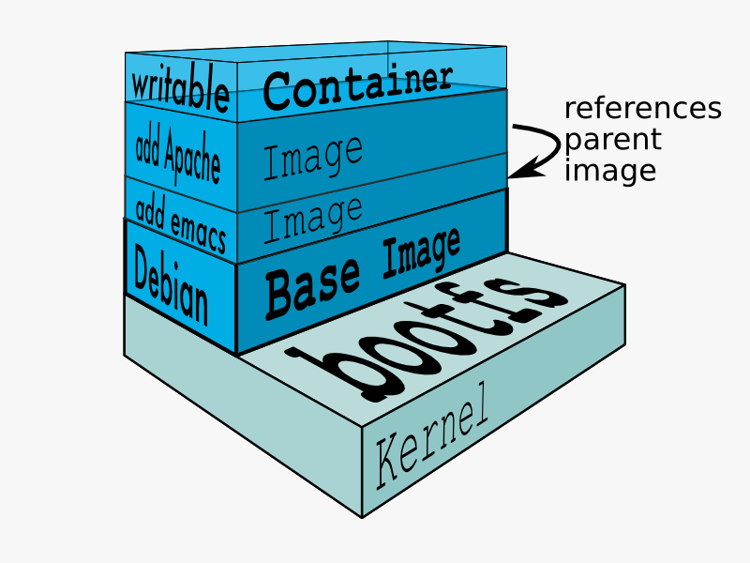
Docker Technology
libvirt: Platform Virtualization
LXC (LinuX Containers): Multiple isolated Linux systems (containers) on a single host
Layered File System
[Source: https://docs.docker.com/terms/layer/]

Slide 7
Docker History
2013-03: Releases as Open Source
2013-09: Red Hat collaboration (Fedora, RHEL, OpenShift)
2014-03: 34th most starred GitHub project
2014-05: JAX Innovation Award (most innovative open technology)

Slide 8
Technology Radar
2014-01: Assess
2014-07: Trial
Source: http://www.thoughtworks.com/radar/tools/docker

Slide 9
Run Platforms
Various Linux distributions (Ubuntu, Fedora, RHEL, Centos, openSUSE, ...)
Cloud (Amazon EC2, Google Compute Engine, Rackspace)
2014-10: Microsoft announces plans to integrate Docker with next release of Windows Server
Notes:
Windows: http://www.zdnet.com/docker-cto-why-microsofts-docker-plans-for-windows-will-matter-to-you-7000035150/
"That's why the result of the Microsoft announcement will not allow a container that runs on Linux to run seamlessly on Windows or vice versa. But that's OK because in the context of distributed applications that's not what developers are asking for."

Slide 10
Hello World
Simple Command - Ad-Hoc Container
docker run ubuntu echo Hello World
  docker images [-a]
  docker ps –a
Notes:
Immediately exits
docker ps
docker ps –a
Re-attach: docker start –i stoic_wozniak
docker commit –m «message» containerId imageName(e.g. mytest/test1:1.0)
New Image
docker images

Slide 11
Terminology - Image
Persisted snapshot that can be run
  images: List all local images
  run: Create a container from an image and execute a command in it
  tag: Tag an image
  pull: Download image from repository
  rmi: Delete a local image
    This will also remove intermediate images if no longer used

Slide 12
Terminology - Container
Runnable instance of an image
  ps: List all running containers
  ps –a: List all containers (incl. stopped)
  top: Display processes of a container
  start: Start a stopped container
  stop: Stop a running container
  pause: Pause all processes within a container
  rm: Delete a container
  commit: Create an image from a container
Notes:
docker run --rm to remove container after termination

Slide 13
Image vs. Container
Base Image
ubuntu:latest
run
Container
cid1
base image
cmd → new state
New Image
iid1
commit
Container
cid1
run
Container
cid2
Container
cid3
Container
cid4

Slide 14
Dockerfile
Create images automatically using a build script: «Dockerfile»
Can be versioned in a version control system like Git or SVN, along with all dependencies
Docker Hub can automatically build images based on dockerfiles on Github

Slide 15
Dockerfile Example
Dockerfile:
  FROM ubuntu
  ENV DOCK_MESSAGE Hello My World
  ADD dir /files
  CMD ["bash", "someScript"]
docker build [DockerFileDir]
docker inspect [imageId]
Notes:
docker run -ti d97 /bin/bash
testFile.txt -> present
set -> env Variable PROVIDER set
docker run –P -d d97

Slide 16
Mount Volumes
docker run –ti –v /hostLog:/log ubuntu
Run second container: Volume can be shared
  docker run –ti --volumes-from firstContainerName ubuntu
Notes:
Use docker start, docker attach to reuse container
Change script to echo ... >> /log/hello3.log

Slide 17
Publish Port
docker run –t –p 8080:80 ubuntu nc –l 80
  Map container port 80 to host port 8080
  Check on host: nc localhost 8080
Link with other docker container
  docker run -ti --link containerName:alias ubuntu
  See link info with set
Notes:
Use ifconfig -> eht1 to access from host

Slide 18
Around Docker
Docker Images: Docker Hub
Vagrant: «Docker for VMs»
Automated Setup
  Puppet, Chef, Ansible, ...
Docker Ecosystem
  skydock / skydns
  fig
Notes:
skydock / skydns: Docker discovery by lightweight DNS server
fig: fig.xml: discribe how to build or retrieve each service’s Docker image

Slide 19
Docker Hub
Public repository of Docker images
  https://hub.docker.com/
  docker search [term]
Automated: Has been automatically built from Dockerfile
  Source for build is available on GitHub
Notes:
Automatically build a Docker image on Docker-Hub:
Example: playground-docker-echoey in Bitbucket: https://bitbucket.org/inftec/playground-docker-echoey/overview
Automated Build Repository on Docker Hub: https://registry.hub.docker.com/u/pazoozoo/playground-docker-echoey/
Build took around 5 minutes...
Run on AWS Elastic Beanstalk:
Need to ZIP Dockerfile and dependencies (ADD files)
Beanstalk environment expects HTTP service on first EXPOSEd port though → not working with dummy echo service

Slide 20
Resource Usage
top / ps / free -m
Start 100 WebServer containers
  docker run -d -p $hostPort:5000 -e "PROVIDER=$provider" training/webapp
docker ps [containerId]
top / ps / free -m
Notes:
cat /proc/meminfo
serverCount=1
startDate=$(date)
for n in $(seq 1 1 $serverCount)
do
hostPort=$(($n + 10000))
provider="World #$n"
echo Starting $n. Host Port: $hostPort, Message: $provider
docker run -d -p $hostPort:5000 -e "PROVIDER=$provider" training/webapp
done
echo
echo Started $n containers. Start time: $startDate, end time: $(date)
Stop all: docker stop $(docker ps –q)
Remove all stopped: docker rm $(docker ps –aq)
Test run:
free –m: 1494
1 Container: 1480
100 Containers: 124

Slide 21
Docker Use Cases
Development Environment
Environments for Integration Tests
Quick evaluation of software
Microservices
Multi-Tenancy
Unified execution environment (dev → test → prod (local, VM, cloud, ...)

Slide 22
Documentation
Docker homepage: https://www.docker.com/
  Introduction: https://www.docker.com/whatisdocker/
  Online tutorial: https://www.docker.com/tryit/
  Installation and user guide: https://docs.docker.com/
InfTec TecBoard: https://inftec.atlassian.net/wiki/display/TEC/Docker
  Includes this presentation

Slide 23
Hands On
https://bitbucket.org/inftec/vagrant-playground/branch/docker-demo
Multi-Container-Setup
  Logging-Container
  Echo-Container
  Client-Container

