Slide 1
2.4: CIDR and Aggregation
유자은
2015010659

Slide 2
Background
In the early 90s, the Internet started facing problems.
  ① Over half of all class B addresses had already
  allocated.
  ② 32-bit IPv4 address was thought to be inadequate
  to handle the size of the Internet.
  ③ The number of entries in the global routing table
  (one per network number) was growing, and
  routing performance would suffer.
Solutions
- Remove the class of IP addresses, and aggregate
hierarchically assigned IP addresses.(①, ③)
- IPv6(②)

Slide 3
2.4.1 Prefixes
To Relieve the pressure on the availability of IPv4 addrs,
  The classful addressing scheme was generalized using a scheme similar to VLSM.
  The routing system was extended to support Classless Inter-Domain Routing (CIDR).
Any address range is not predefined as being part of a class but instead requires a mask similar to a subnet mask, called a CIDR mask.
CIDR masks are visible to the global routing system, so the core Internet routers must be able to process masks in addition to network numbers.

Slide 4
2.4.1 Prefixes
Eliminating the predefined separation (network/host) makes finer-grain allocation of IP address ranges possible.
Dividing the address space into chunks is achieved by grouping numerically contiguous addresses.
Grouping are commonly expressed using a prefix of the address space.
An n-bit prefix is a predefined value for the first n bits of an address.
The length of the prefix is typically expressed as an integer in the range 0-32(IPv4), 0-128(IPv6)

Slide 5
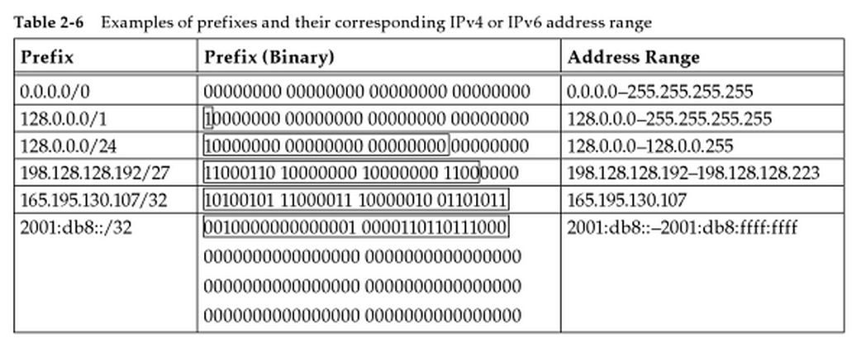
2.4.1 Prefixes
Length of prefix generally appended to the base IP address following a ‘/‘ character.
The classful addressing is easily generalized by prefix.
(e.g. class A and B can be expressed using /8 and /16)

Slide 6
2.4.2 Aggregation
Removing the classful structure didn’t reduce the number of routing table entries (problem ③)
The router inspects the destination IP address, finds a matching routing table entry, and from the entry extracts the “next hop” for the datagram.
Using hierarchical routing, the network topology are arranged as a tree and addresses are assigned in a “sensitive” way.
Very small routing tables could be used while still maintaining shortest-path routes.

Slide 7
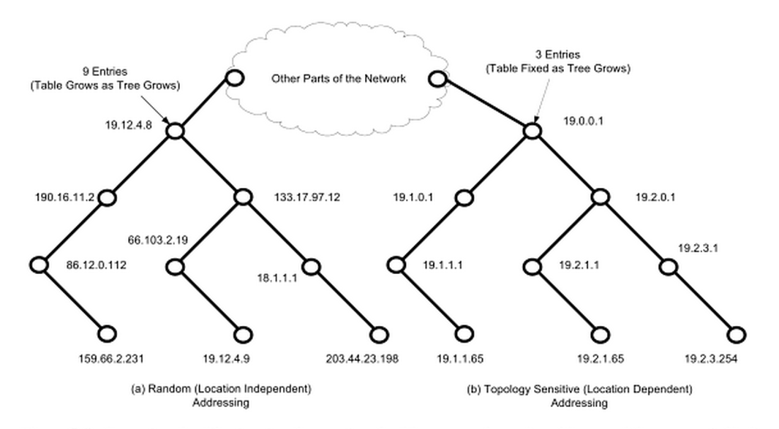
2.4.2 Aggregation
(a) needs nine entries.
(b) needs three entries.

Slide 8
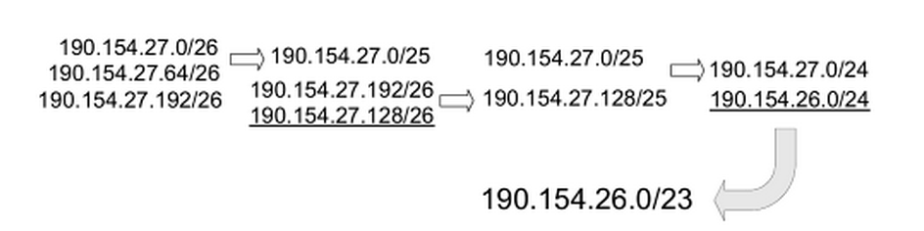
2.4.2 Aggregation
Hierarchical routing can reduce the number of routing entries and it is accomplished by a procedure known as route aggregation.
It works by joining multiple numerically adjacent IP prefixes into a single shorter prefix that covers more address space. (called an aggregate or summary)
27.0 0 0 0 0 0 0 0 0
27.64 0 1 0 0 0 0 0 0
27.192 1 1 0 0 0 0 0 0
27.0/25 0 0 0 0 0 0 0 0
190.154.27.0/24
27.128/25 1 0 0 0 0 0 0 0
27.128 1 0 0 0 0 0 0 0

