Slide 1
Section 8.5 : Neighbor Discovery in IPv6
김민수
2015011159

Slide 2
8.5 Neighbor Discovery in IPv6
Neighbor Discovery in IPv4 bring two functions
  Router Discovery and Redirect mechanisms of ICMPv4
  Address-mapping capabilities provided by ARP
Supporting Mobile IPv6
Designed to find each other
  Bi-directional connectivity
  Become inoperative or unavailable
Provided by ICMPv6 at the network layer or above
  Largely independent of the particular line-layer technology
Neighbor Solicitation / Advertisement (NS/NA)
Router Solicitation / Advertisement (RS/RA)
Notes:
Contrast to ARP and IPv4, ICMPv6 makes extensive use of multicast addressing, at both network and link layers.
NS/NA – ARP like function of mapping between network and link layer address
RS/RA -

Slide 3
8.5.1 Router Solicitation and Advertisement
ICMPv6 Types 133, 134
Router Advertisement (RA)
  Indicate the presence and capabilities of a nearby router
  Are sent periodically by routers, or in response to a Router Solicitation message
Router Solicitation (RS)
  Used to induce on-link routers to send RA messages

Slide 4
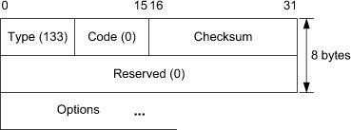
8.5.1 Router Solicitation and Advertisement
ICMPv6 Router Solicitation (RS) message
RS message are sent to the all Routers multicast address, ff02::2 or unicast address of the requesting host
Contains a Source Link-Layer Address option
Contain an MTU option if an unusual MTU value is in use on the link

Slide 5
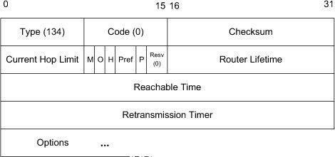
8.5.1 Router Solicitation and Advertisement
ICMPv6 Router Advertisement (RA) message
RA message are sent by routers to the all nodes multicast address (ff02:1) or unicast address of the requesting host.
Send periodically by routers or in response to a Router Solicitation(RS)
The message include three flags
  M : Managed address configuration
  O : Other stateful configuration
  H : Home Agent
Notes:
requesting host = if the advertisement is sent in response to a solicitation

Slide 6
8.5.2 ICMPv6 Neighbor Solicitation and Advertisement
ICMPv6 Types 135, 136
Neighbor Solicitation message in ICMPv6 replace the ARP Request messages used with IPv4
Used for:
  Convert IPv6 address to link-layer addresses
  Detecting whether nearby nodes can be reached
  Whether can be reached bi-directionally

Slide 7
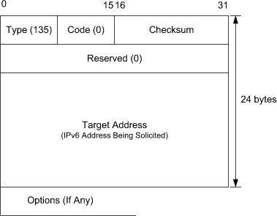
8.5.2 ICMPv6 Neighbor Solicitation and Advertisement
ICMPv6 Neighbor Solicitation message (NS)
Sent to the Solicited-Node multicast address
(prefix f02::1:f/104, combined low order 24bits of the solicited IPv6 address)
Contains a target IPv6 address
Messages are sent to Solicited-Node multicast address to provide ARP-like functionality
Unicast address to test
reachability to other nodes
Contain a source Link-Layer
address option
Notes:
pre

Slide 8
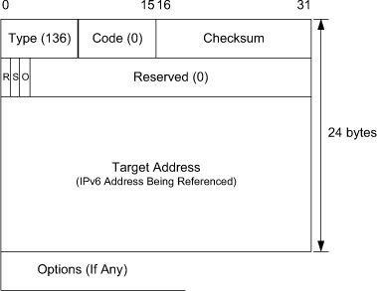
8.5.2 ICMPv6 Neighbor Solicitation and Advertisement
ICMPv6 Neighbor Advertisement message (NA)
Purpose of the ARP Response message in IPv4 and helping with unreachability detection
Sent as a response to an NS message or sent asynchronously when a node’s IPv6 address changes
Message contains three flags
  R : Is sender a router
  S : Is advertisement a response
  to a solicitation
  O : Override other cached
  address mappings

Slide 9
8.5.3 ICMPv6 Inverse Neighbor Discovery Solicitation / Advertisement
ICMPv6 Types 141, 142
For determine IPv6 addresses given link-layer address on Frame Relay networks.
Resembles reverse ARP used with IPv4
Main function is ascertain the network-layer address(es) corresponding to a known link-layer address

Slide 10
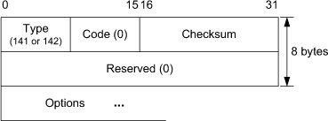
8.5.3 ICMPv6 Inverse Neighbor Discovery Solicitation / Advertisement
Inverse Neighbor Discovery Solicitation (IND Solicitation)
IND Solicitation sent to the all nodes multicast address at the IPv6 layer
Is encapsulated in a unicast link-layer address
Must contain both a Source Link-Layer Address option and a Destination Link-Layer Address option

Slide 11
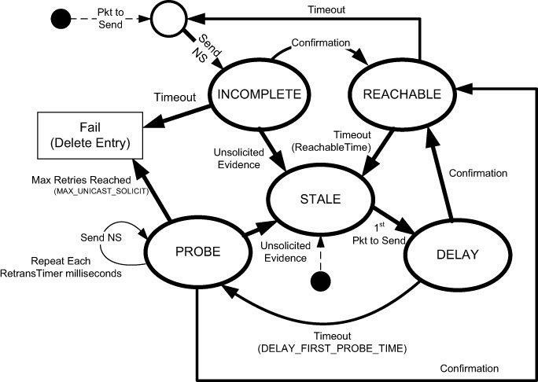
8.5.4 Neighbor Unreachability Detection
Detect when reachability between two systems on the same link hast become lost or asymmetric
Used to manage the neighbor cache present on each node
Five states : INCOMPLETE, REACHABLE, STALE, DELAY, PROBE

Slide 12
8.5.4 Neighbor Unreachability Detection
Initial states to be either INCOMPLETE or STALE
Exist entry and on-link -> REACHABLE
No entry but on-link -> INCOMPLETE and send NS
  After send NS and receive NA -> REACHABLE

Slide 13
8.5.4 Neighbor Unreachability Detection
Temporary states
  DELAY : packet is sent but ND has no current evidence to suggest that reachability is possible
  PROBE : ND sends periodic NS message (default 3) and no evidence has been received -> Fail (Delete Entry)

Slide 14
8.5.5 Secure Neighbor Discovery
Secure Neighbor Discovery (SEND)
Providing additional security for ND messages.
Help resist various spoofing attacks, specifically aims to protect against nodes masquerading as other when responding to NS messages
Operates with three assumptions
  Each SEND-capable router has a certificate or cryptographic credential
  Each host is also equipped with a trust anchor-configuration information enabling the credential to be verified
  Each node generates a public/private key pair when configuring the IPv6 addresses
Cryptographically Generated Addresses (CGAs)
Certification Path Solicitation/Advertisement

Slide 15
8.5.5.1 Cryptographically Generated Addresses (CGAs)
SEND uses an entirely different type of IPv6 address called a cryptographically generated address (CGA)
[RFC3972] [RFC4581]
CGA Based on a node’s public key information
CGA technique allows for the address owner’s public key to be self-generated, so can be used without an public key infrastructure (PKI) or other trusted third party

Slide 16
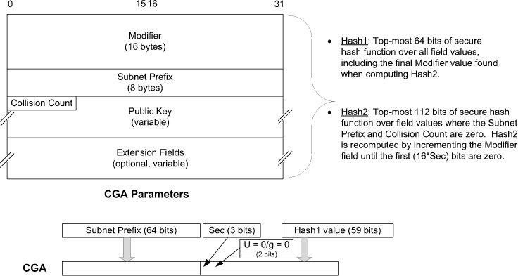
8.5.5.1 Cryptographically Generated Addresses (CGAs)
CGA interface identifier is computed using a secure hash function called Hash1 with input from the node’s public key and special CGA parameters data structure
Hash2 provides a hash extension technique
  Modifier filed initialized with a random value
  Collision Count filed is initialized to 0

Slide 17
8.5.5.2 Certification Path Solicitation/Advertisement
SEND defines Solicitation and Advertisement messages to help hosts determine certificates constituting a certification path
Used for a host to verify the authenticity of router advertisements

Slide 18
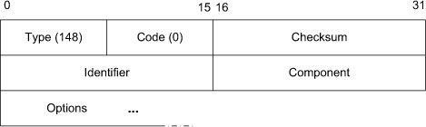
8.5.5.2 Certification Path Solicitation/Advertisement
Certification Path Solicitation message
Random Identifier filed used for matching solicitations with advertisements.
Component field provides an index to the point in the certification path
  value 65535 if certificates for the entire path are desired

Slide 19
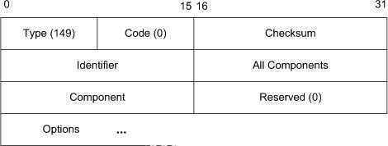
8.5.5.2 Certification Path Solicitation/Advertisement
Certification Path Advertisement message
Provides a method to express one component (certificate) in a multicomponent advertisement
Messages are sent in response to a solicitation or periodically by a SEND-capable router
When sent in response to solicitation, the destination IPv6 address is the Solicited-Node multicast address of the receiver

Slide 20
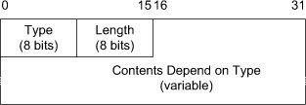
8.5.6 ICMPv6 Neighbor Discovery Options
ND messages may contain zero or more options
ND options are variable-length, so the length field give the total length of the option in 8-byte units
Official list may be found in [ICMP6TYPES]

Slide 21
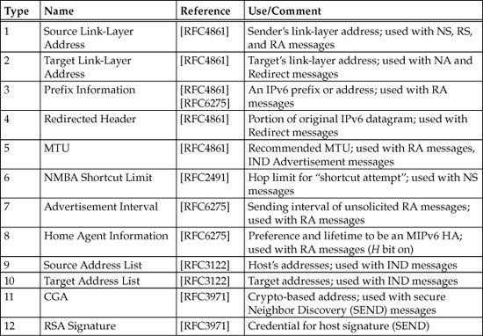
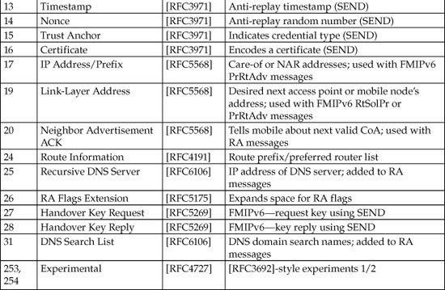

Slide 22
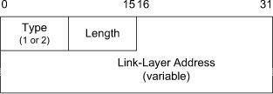
8.5.6.1 Source/Target Link-Layer Address Option (Types 1, 2)
Supposed to be included in ICMPv6 RS messages, NS messages, and RA messages whenever used on a network supporting link-layer addressing.
Specifies a link-layer address associated with the message
The Source (type1), Target (type2)
Must be provided in an NA message when responding to multicast solicitations
IEEE Ethernet-type address would have the value of 1 in the Length filed

Slide 23
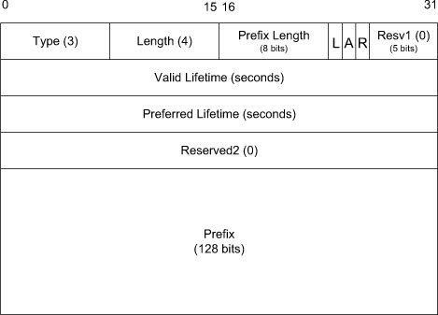
8.5.6.2 Prefix Information Option (Type 3)
Provided on RA messages and Mobile Prefix Advertisement messages
Contains an IPv6 address prefix in use on the local network and complete IPv6 address of individual nodes present on the link
Multiple option may be included in a single message
Message contains three flags
  L : Indicate the prefix is acceptable
  for use in on-link determination
  A : Autonomous auto-configuration
  R : Indicate the included prefix
  is the entire global IPv6 address
  of the sending router
Notes:
A : Autonomous autoconfiguration – indicate that the provided prefix may be used for autoconfiguration
A value of 0xFFFFFFFF for either field indicate infinity

Slide 24
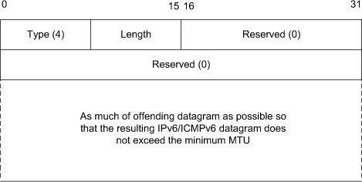
8.5.6.3 Redirected Header Option (Type 4)
Used to include a copy of (or part of) the original IPv6 datagram that caused a Redirect message to be generated
Ignored appears in any other type of message.
Limited to at most the minimum IPv6 MTU
(currently 1280 bytes)

Slide 25

8.5.6.4 MTU Option (Type 5)
Provided on RA messages and ignored otherwise.
Provides the MTU to be used by hosts, assuming that a configurable MTU size is supported

Slide 26

8.5.6.5 Advertisement Interval Option
(Type 7)
Included in RA messages and is ignored otherwise
Specifies the maximum interval between unsolicited multicast router advertisements gives the number of milliseconds
Used by Mobile IPv6 nodes in its movement detection algorithms [RFC6275]

Slide 27

8.5.6.6 Home Agent Information Option
(Type 8)
Included in RA messages being sent from routers willing to act as Mobile IPv6 home agents [RFC6275] and ignored otherwise
  set the H bit field in their RA messages
At Home Agent Preference filed larger values indicate a greater degree of preference for using the sending router as a home agent.

Slide 28
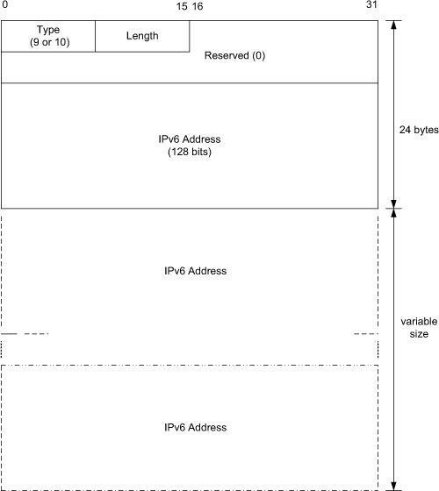
8.5.6.7 Source/Target Address List Options
(Types 9, 10)
Included with an IND message [RFC3122]
Type 9 : Source Address List Option contains a list of the IPv6 address identified by the Source Link-Layer Address option
Type 10 : Target Address List option contains a list of the IPv6 address identified by the Destination Link-Layer Address option

Slide 29
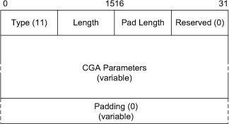
8.5.6.8 CGA Option (Type 11)
Used with SEND
Carry the CGA parameters necessary for a verifier to perform CGA validation and signature validation

Slide 30
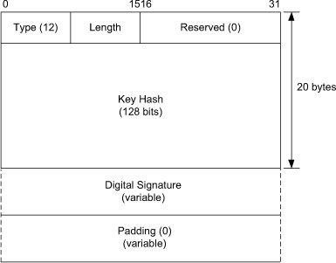
8.5.6.9 RSA Signature Option (Type 12)
Used with SEND
Carry an RSA signature that a verifier can use
Used to verify that the sender possesses the matching private key and is consequently the correct owner of the CGA

Slide 31
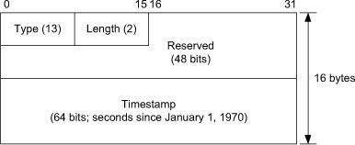
8.5.6.10 Timestamp Option (Type 13)
Used with SEND
Provide the current time of day known to the sending system for using to guard against replay attacks

Slide 32

8.5.6.11 Nonce Option (Type 14)
Used with SEND
Holds a recently generated random number used in pairs of SEND
Used to guard replay attacks against SEND

Slide 33
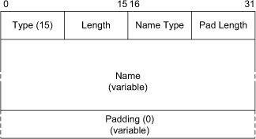
8.5.6.12 Trust Anchor Option (Type 15)
Used with SEND for a host to verify the authenticity of RA messages
Name Type defined:
  1 : DER X.502 names
  2 : fully qualified domain name (FQDN)

Slide 34
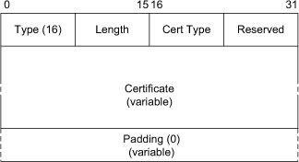
8.5.6.13 Certificate Option (Type 16)
Used with SEND
Providing a cryptographic certificate comprising one component of a certification path
Cert Type field indicates the type of certificate used and currently used one value (1, X.509v3)

Slide 35
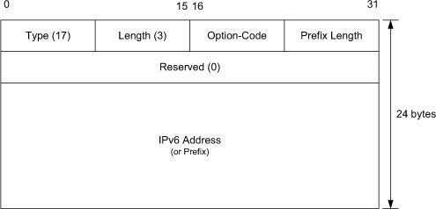
8.5.6.13 IP Address/Prefix Option (Type 17)
Used with FMIPv6 messages
Option holds a prefix or IPv6 address of the next access router or care-of address used by a mobile node
Option-Code defined
  1 : old care-of address
  2 : new care-of address
  3 : new access router’s (NAR’s) IPv6 address
  4 :NAR’s prefix (in PrRtAdv)

Slide 36

8.5.6.15 Link-Layer Address (LLA) Option
(Type 19)
Used with FMIPv6 messages (ICMPv6 type 154) [RFC5568]
Option-code value indicates what entity is associated with the address
  0 : wildcard
  1 : address of the new AP
  2 : address of the mobile node
  3 : address of the new access router
  4 : address of the source of the RtSolPr/PrRtAdv message
  5 : address is current for the router
  6 : no prefix information available for the AP
  7 : no fast handovers available for the AP addressed

Slide 37
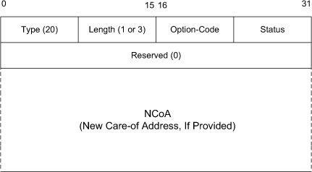
8.5.6.16 Neighbor Advertisement ACK (NAACK) Option (Type 20)
Used with FMIPv6 messages (ICMPv6 type 154) [RFC5568]
When a mobile node moves from a previous access router to a new access router and proposes to use a particular new care-of address, the new router indicates the acceptability of the proposed address
Status defined :
  1 : NCoA is invalid (perfom address configuration)
  2 : NCoA is invalid (use NCoA supplied in IP Address option)
  3 : NCoA is invalid (use NAR’s address as NCoA)
  4 : PCoA supplied
  128 : link-layer address
  unrecognized

Slide 38
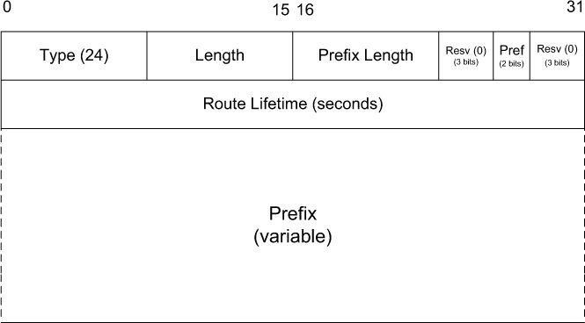
8.5.6.17 Route Information Option (Type 24)
Used with RA messages to indicate which off-link prefixes reachable through a particular router [RFC4191]
Useful in cases where multiple default routers are available and perform differently in reaching the same destinations

Slide 39
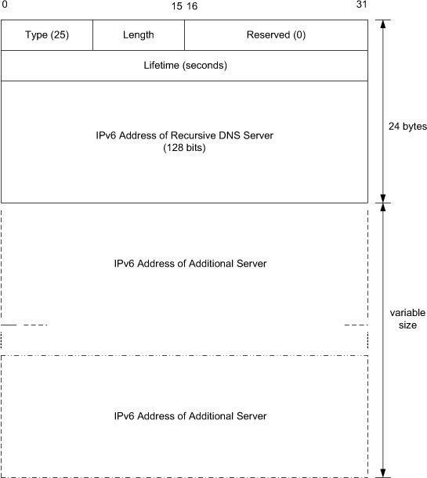
8.5.6.18 Recursive DNS Server Option (RDNSS) (Type 25)
Can be used with RA messages to enhance stateless auto-configuration by providing the IPv6 address of one or more DNS servers
Multiple RDNSS options
may be included with
an RA message

Slide 40
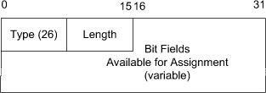
8.5.6.19 Router Advertisement Flags Extension Option (EFO) (Type 26)
Used in RA messages [RFC5175]
Provides an arbitrary amount of additional space for defining future RA flags

Slide 41
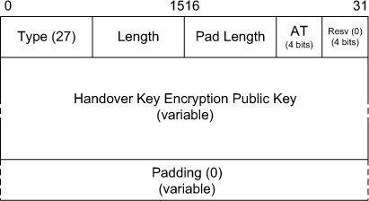
8.5.6.20 Handover Key Request Option (Type 27)
Used with FMIPv6 messages that use SEND to secure signaling information [RFC5269]
A router uses this information in forming a handoff key that is provided encrypted for a mobile node

Slide 42
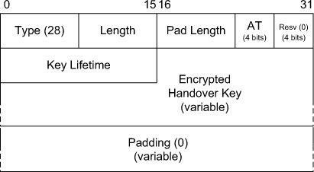
8.5.6.21 Handover Key Reply Option
(Type 28)
Used with FMIPv6 messages that use SEND to secure signaling information [RFC5269]

Slide 43
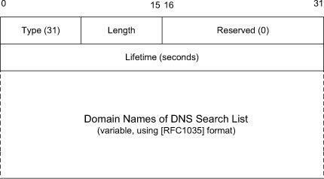
8.5.6.22 DNS Search List Option (Type 31)
Used to indicate a list of domain name extensions to be added to DNS queries a host might issue
Provides a list of default domain name extensions used when configuring host’s DNS parameters

Slide 44
8.5.6.23 Experimental Values
(Types 253, 254)
Used only for experimentation as described in
[RFC3692]

