Slide 1
Broadcasting and multicasting
9강

Slide 2
Broadcasting
Only in IPv4
All broadcast IP addresses are mapped to ff:ff:ff:ff:ff:ff on the link layer
  Limited
  Directed
    E.g. 10.0.0.127 with subnet mask 255.255.255.128

Slide 3
Broadcasting
Try ping –b 255.255.255.255 on Linux
  Not possible on Windows
  Try directed broadcast (IPv4) and see what happens on Wireshark with filter “icmp”
    Then execute “arp –a”
  Try “ping -6 ff02::1” and see what happens on Wireshark with filter “icmpv6”

Slide 4
Multicasting
More complex than broadcasting
Models
  Any source multicast (ASM) : does not care who sent it, only destination address matters to receive a multicast packet
  Source specific multicast (SSM) : additionally checks the source for filtering

Slide 5
Multicast address translation
IPv4: Figure 9-2
  32:1 mapping → needs additional filtering
MAC address for IANA
  01:00:5e:00:00:00 ~ 01:00:5e:7f:00:00
IPv6: Figure 9-3

Slide 6
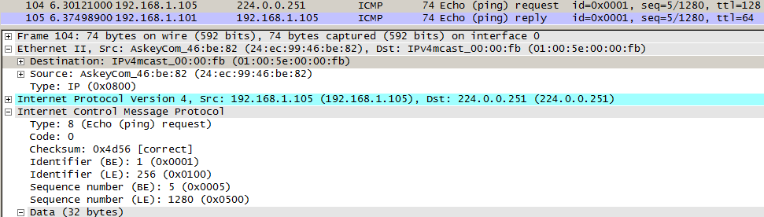
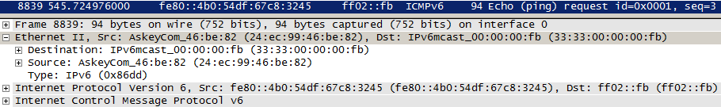
IPv6 multicast address
Fig. 9-3
2⁸⁰:1 mapping to 33:33 + lowest 32 bits of group address

Slide 7
Sending and receiving multicast datagrams
Sending
  Look at routing table (“route print -4”, or -6)
Receiving: process
  Joins or leaves
  Membership is associated with an interface

Slide 8
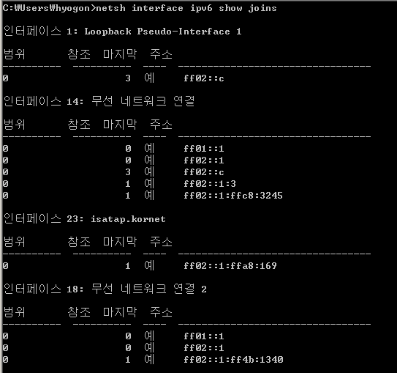
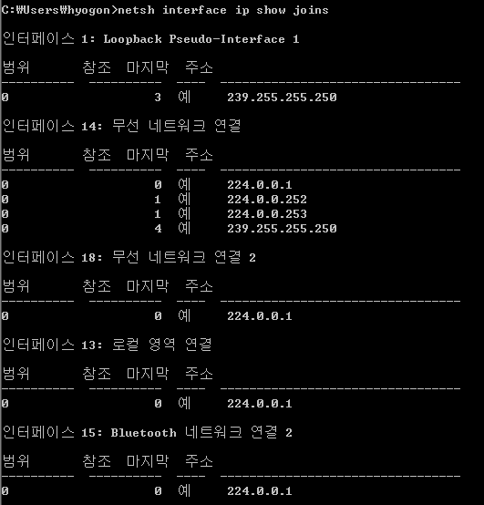
Receiving multicast datagrams
Try “netsh interface ipv6 show joins”

Slide 9
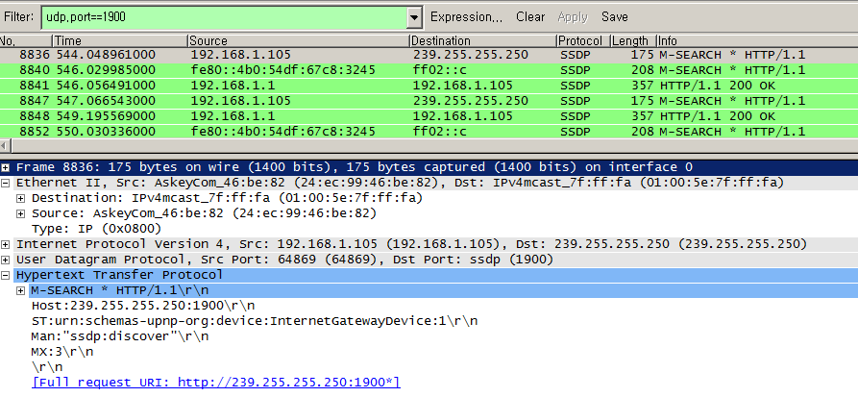
Receiving multicast datagrams
SSDP

Slide 10
Host address filtering
32:1 (v4) or 2⁸⁰:1 (v6) mapping → NIC can’t filter perfectly
  Host (device driver in kernel) filtering is required
Check is made at the interface

Slide 11
IGMP and MLD
First, read the separate slide set provided on the course site: “IP multicast”
  Discussions will proceed with the assumption that you read it

Slide 12
IGMP and MLD
No IGMP in IPv6
  ICMPv6 implements it
  The part is called Multicast Listener Discovery (MLD)
This happens on the first hop (edge) only!
  Not further inside the Internet
  TTL=1
  IP Router Alert option

Slide 13
IGMP and MLD
(Multicast) router needs to know whether or not there is a subscriber on its subnet
  Not the number of subscribers
Uses link layer multicast to deliver
IGMPv2 ~ MLDv1
  IGMPv3 ~ MLDv2

Slide 14
IGMP and MLD
IGMPv1
  Only join
  Leave is implicit: timer expiry w/o membership refresh
IGMPv2
  Leave: to reduce leave latency
IGMPv3
  SSM support
  Backward compatibility with v1/v2
    E.g. reverts to earlier versions if detected
    Suppression, message format

Slide 15
IGMP and MLD
MLD
  Uses Hop-by-Hop extension header to hold Router Alert option

Slide 16
IGMP and MLD
Processing rules for
  Group member host
    Report changes in interest
    Respond to periodic queries
  Multicast router
    Send queries to ascertain membership
      Any group, group-specific, source-specific
    Interact with multicast routing protocols

Slide 17
IGMP and MLD: member processing
Reports contain a vector of group records
  Group record = type (see Table 9-1) + multicast addr + list of sources
    Source filtering: include or exclude mode
  Fig. 9-8

Slide 18
Source filtering
Include mode
  Only sources from which traffic should be accepted
  Leave = include(none)
Exclude mode
  Ones to be filtered out
  Simple join = exclude (none)

Slide 19
Source filtering
Table 9-1
When using SSM, types 0x02 and 0x04 are not used
  Only a single source is assumed for any group

Slide 20
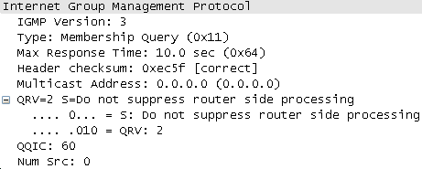
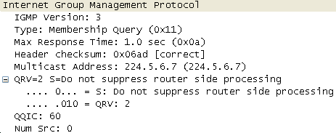
IGMP and MLD: router processing
Fig. 9-10 (query)
General query
  Group address = 0
  Sent to 224.0.0.1
Source specific query
  Sent to the group to be terminated

Slide 21
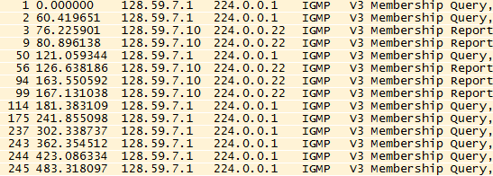
IGMP and MLD: router processing
S indicates that they are to suppress the normal timer updates they perform upon hearing a Query
At most QRV queries are sent, QQIC seconds apart

