Slide 1
Exploiting Ephemeral Link Correlation for Mobile Wireless Networks
Wei Liu et al.
ACM SenSys 2012

Slide 2
Contents
Background & Motivation
Main Idea : ProSeer
  Channel Prediction
  Scheduling
Experimental Setup and Results
Trace Driven Evaluation
Conclusion

Slide 3

Background
Uneven Distribution of cotton cultivation
  Leads to massive long-distance transportation
  Fire accidents
    Severe damages and casualties during transportation
    Detection during incipient stage is very difficult
    Real-time detection and delivery of warning messages are very important in our system

Slide 4
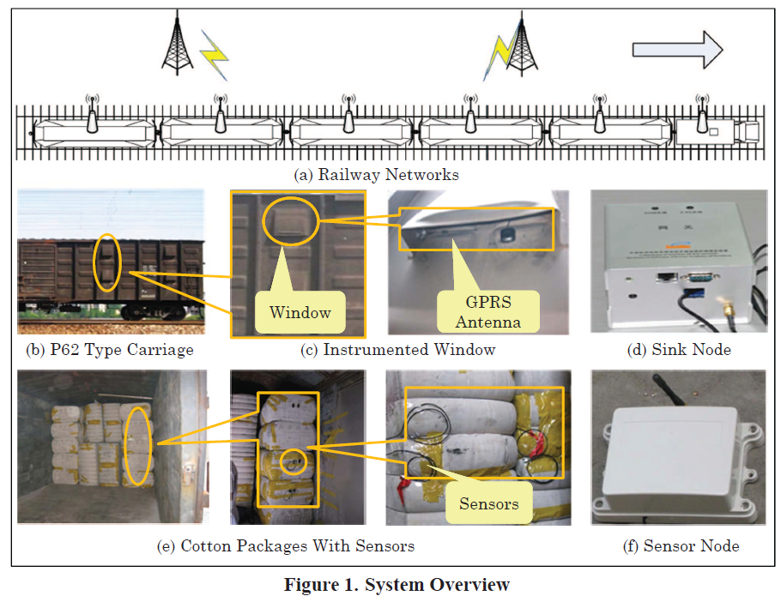

Slide 5
Motivation
To prevent and warn the fire hazard in real time
  Wireless system
    Dedicated sink node
      GPRS capability
      Upload data to server
      Information exchange using ZigBee with sink node and sensor
    Tens of normal sensor nodes to monitor about 120 cotton packages
      Collect readings of temperature, humidity and fume density
      Transmit readings to sink node using ZigBee
  But powered by only batteries
    To save energy, sink nodes only need to determine the best time to transmit

Slide 6
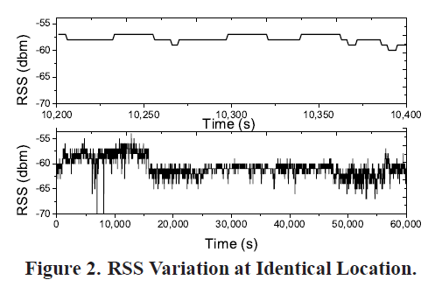
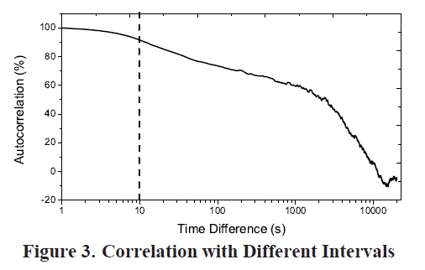
Prior Work
Long-term spatial link correlation at one location is limited
  Due to changes of the environment over time such as humidity and temperature
Short-term spatial link correlation does exist and can be very useful for channel prediction

Slide 7
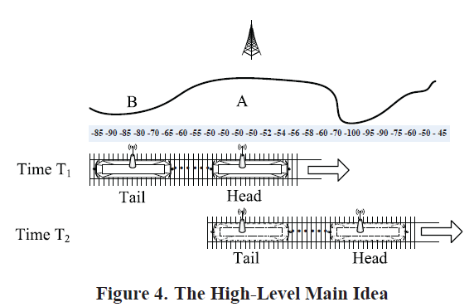
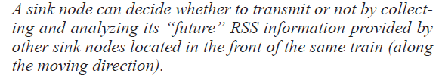
Main Idea

Slide 8
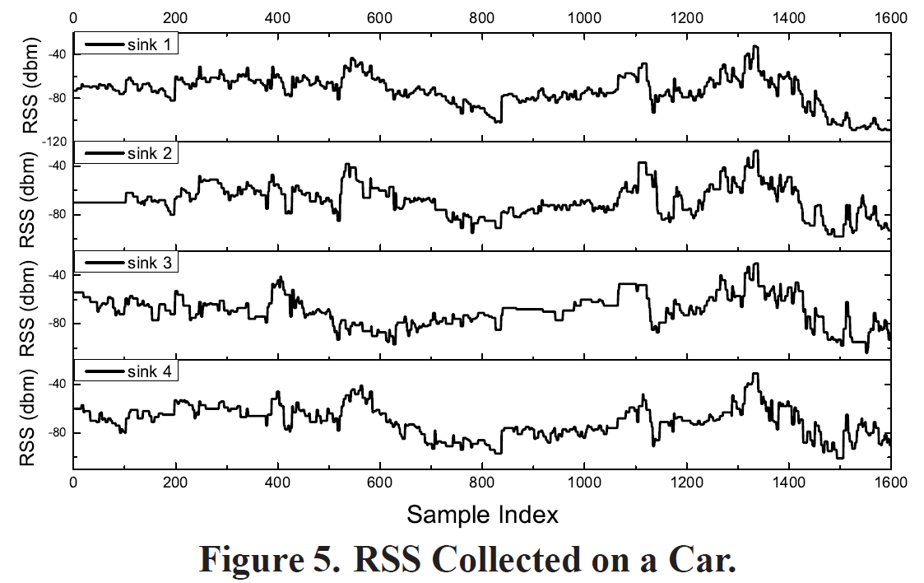
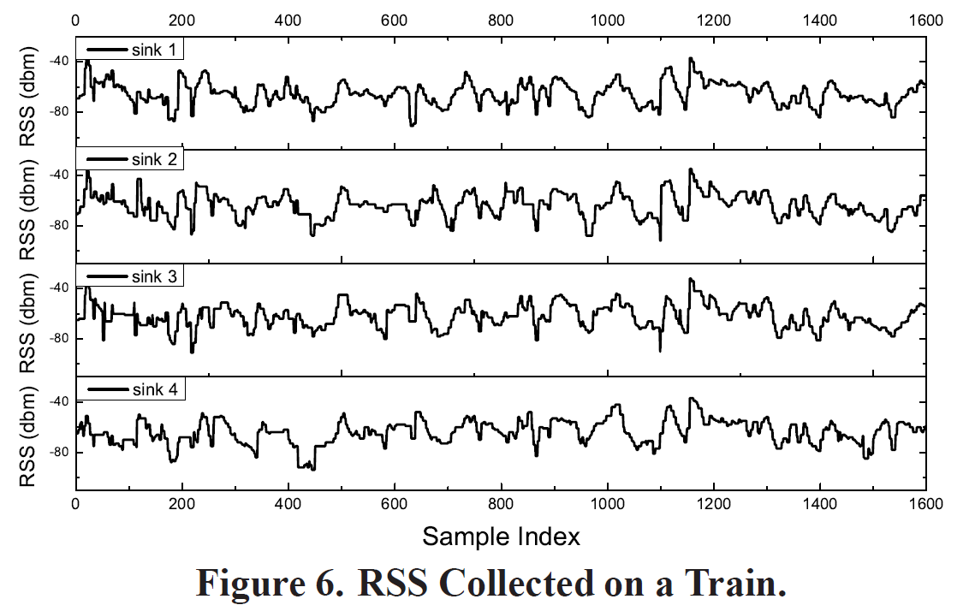
Observation
Location-dependent fading and multi-path effects
  Four GPRS receivers with GPS devices
    1) Setup four receiver sin a car (Figure 5)
    2) Attached to a train (Figure 6)
The RSS is correlated with the sampling location even with different receivers
The RSS varies slowly, but can change considerably after a while

Slide 9
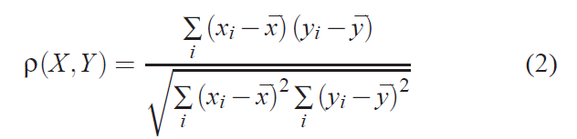

Correlation Evaluation
Correlation Coefficient
  Two series X, Y
  Similar trend between two series can be considered as having similar increasing (or decreasing) rate at the same time
Average Absolute Relative Deviation (AARD)
  An average of absolute values of relative deviations between two series
  Deviation between the real values (say Y) and the predictions (say X)

Slide 10
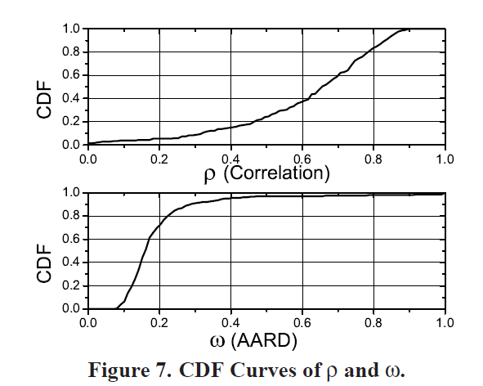
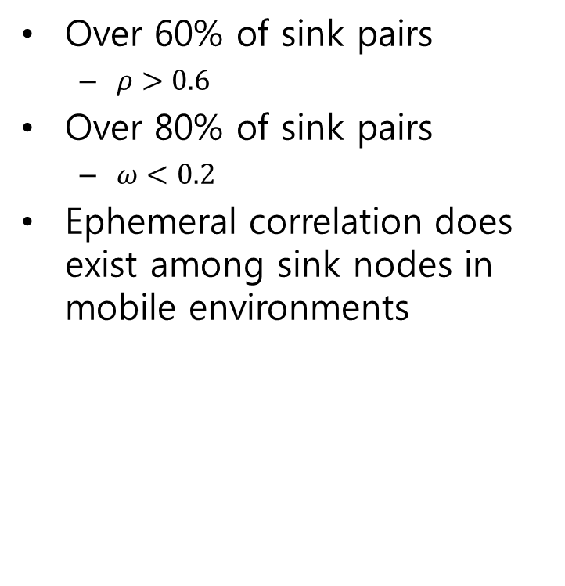
Correlation Evaluation
Over 60% of sink pairs
  $ρ>0.6$
Over 80% of sink pairs
  $ω<0.2$
Ephemeral correlation does exist among sink nodes in mobile environments

Slide 11
Design Overview
1) Predicting future channel status of a sink node based on RSS information of sink nodes ahead
2) Scheduling its transmission in a real-time manner based on the channel prediction

Slide 12
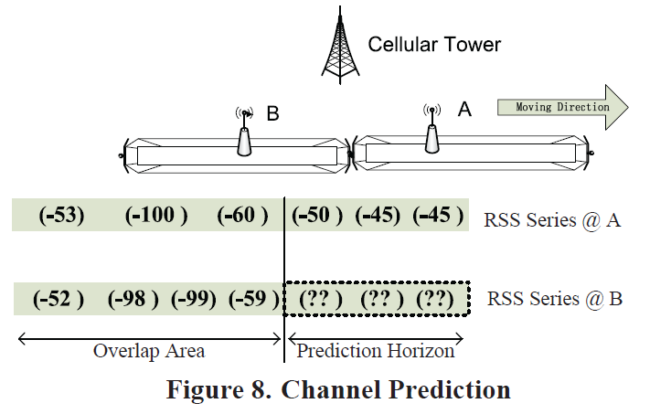
Channel Prediction
Prediction Algorithm
Challenge
  The Lack of location information
    GPS devices are very energy-hungry
    Desire RSS series are spatially aligned
Solution
    Identify the corresponding RSS vales obtained by the ahead sink at the same location
    “RSS series mapping”

Slide 13
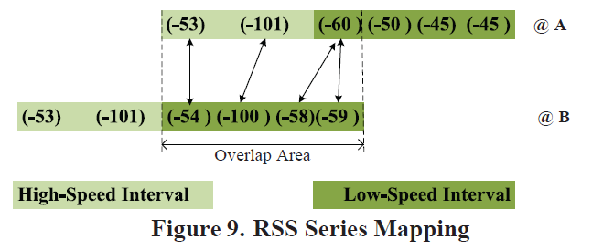
General Architecture and Challenges
A train : Changes its speeds and Travels different distances in the different time slots
  Different sinks measure RSS values at locations with spatial offsets
The mapping between RSS series may not be one-to-one but any-to-any
  Coarse-Grained mapping : a handover-based localization approach
  Fine-Grained mapping : Derivative Dynamic Time Warping(DDTW)

Slide 14
Coarse-Grained RSS Series Mapping
RSS series will be divided to partitions
Derive an one-to-one mapping for partitions
Different sinks may exhibit similar handover from one base station to another at similar locations
  Can be used as landmarks to partition the RSS series
Handover-based RSS mapping can partition the RSS series with reasonable accuracy
  The limitation is that the handover happens infrequently

Slide 15

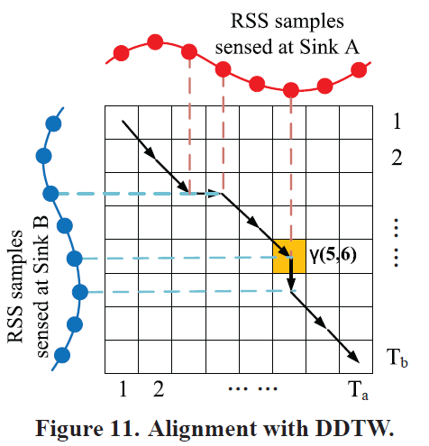
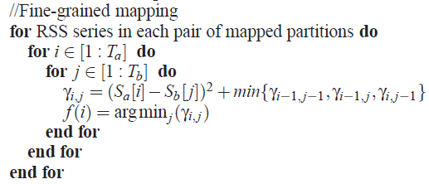
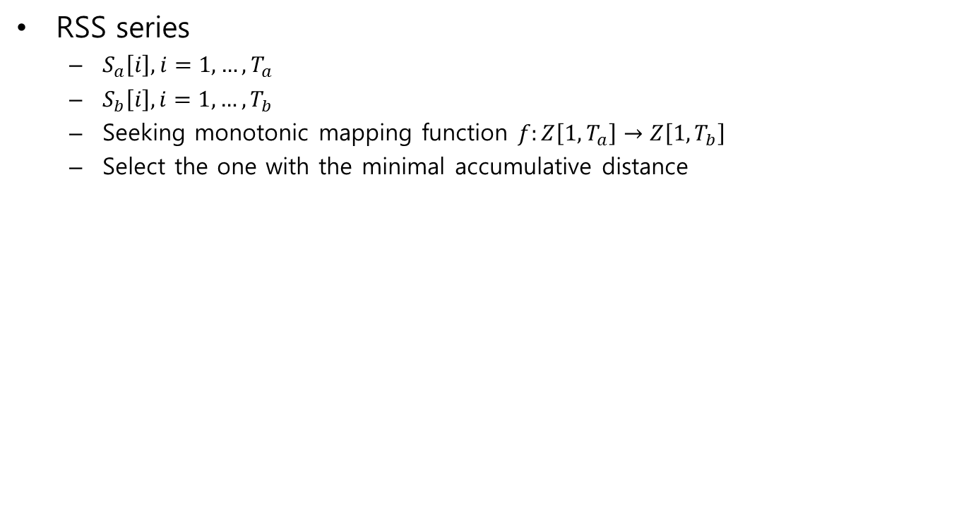
Fine-Grained RSS Series Mapping
RSS series
  $S_{a}\left[i\right], i=1,…,T_{a}$
  $S_{b}\left[i\right], i=1,…,T_{b}$
  Seeking monotonic mapping function $f:Z\left[1,T_{a}\right]→Z\left[1, T_{b}\right]$
  Select the one with the minimal accumulative distance

Slide 16

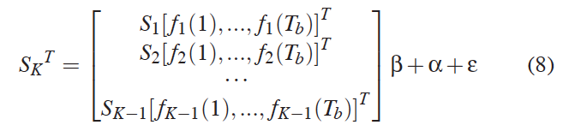
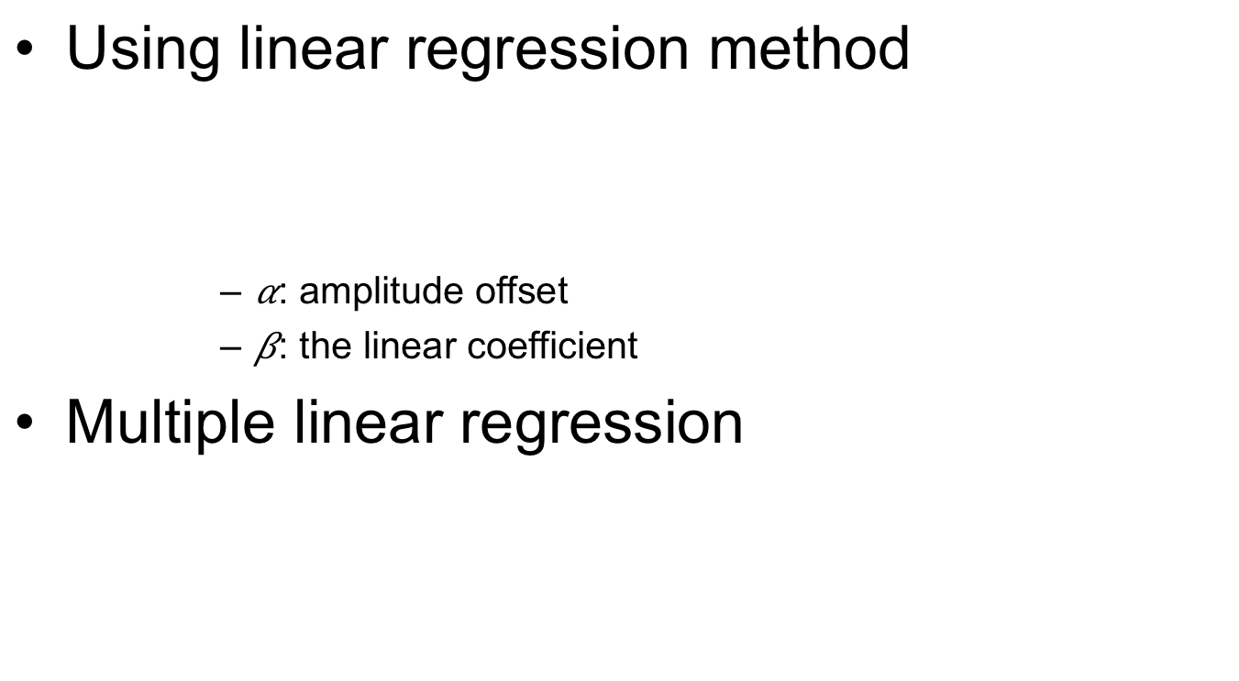
Prediction with Two RSS Series
Using linear regression method
      : amplitude offset
      : the linear coefficient
Multiple linear regression

Slide 17
Scheduling Algorithm
How to well utilize the RSS prediction in transmission scheduling
Energy efficient scheduling algorithms
  Off-line scheduling
    For ideal environments with the given full knowledge
    Can hardly be applied in real environments directly
  On-line scheduling
    Exploit statistic information for better scheduling
    Statistic information may hardly reflect the instant link condition
In this paper
  The intelligence from both worlds by utilizing the prediction results to guide an online scheduling algorithm

Slide 18
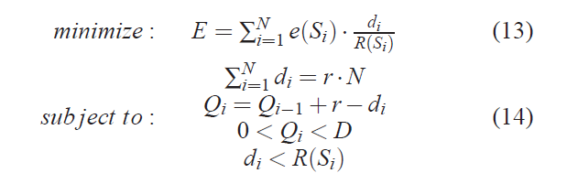
Modeling

Slide 19
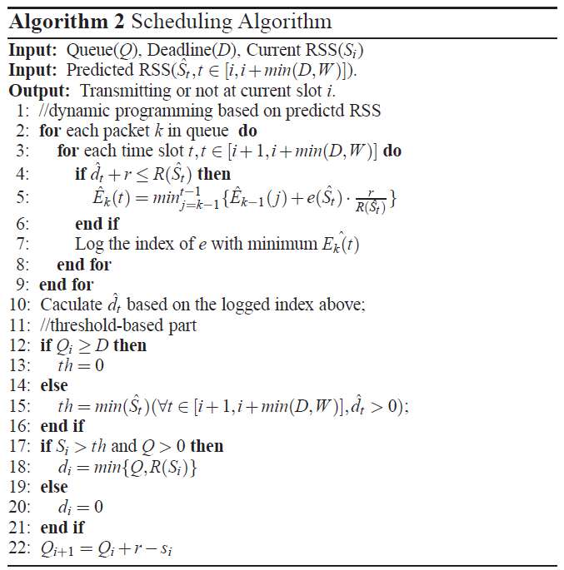
Algorithm Description

Slide 20
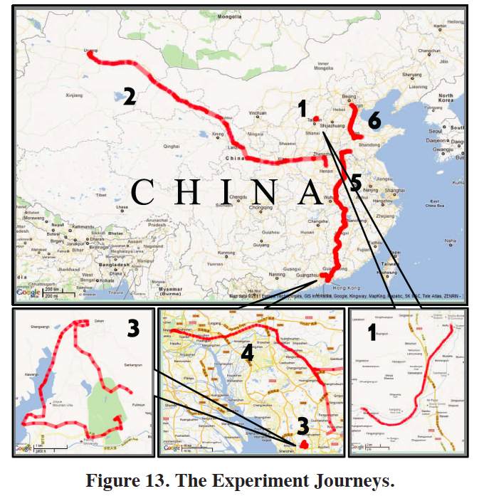
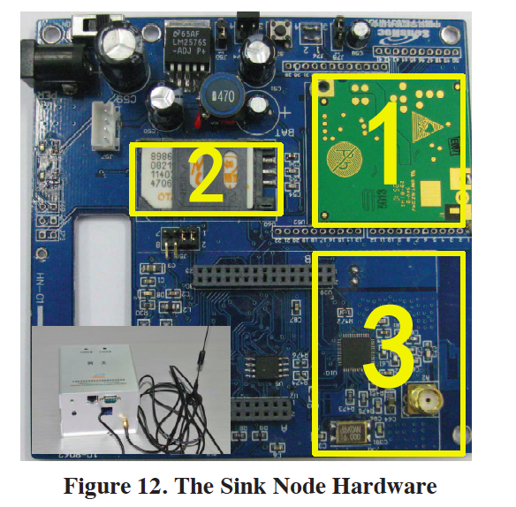
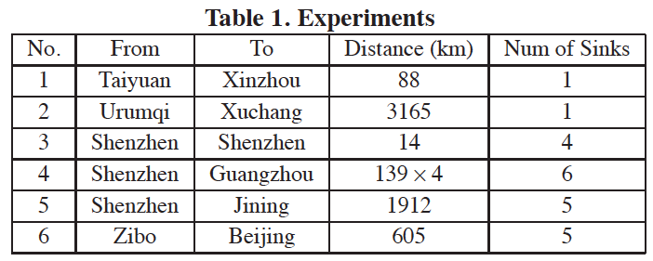
Experiment Setup

Slide 21
Experimental Results
With same packet loss rate
  CC2420 Zigbee Module : 17.4 and 19.7mA (Tx and Rx current)
  RT3070 WiFi Module : 31 and 37mA (Tx and Rx current)
    The energy consumption is less than 10-4J
  GPRS packet (500 bytes)
    The energy cost is 0.1J
    Worthwhile to spend energy for RSS sharing in exchange of a better GRPS communication

Slide 22
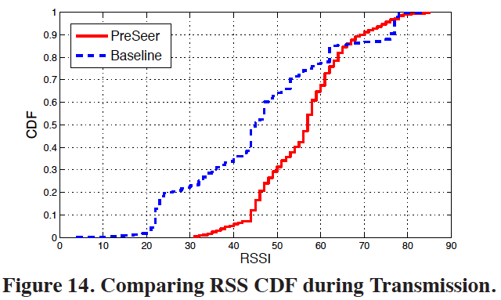
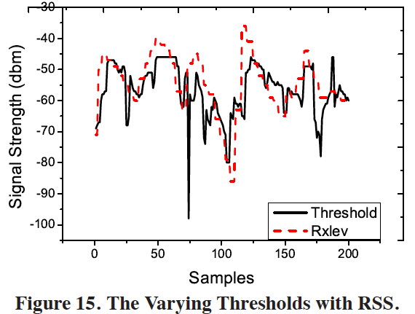
Experiment Results

Slide 23


Trace Driven Evaluation
400,000 records into 87 small data sets, 4000 records each
Compared with 3 reference scheduling algorithm
  Baseline Scheduling : Worst case upper bound for the energy cost
  Ideal Scheduling : Best case lower bound
  ProSeer w/ and w/o error tolerance
G, alpha : the system parameters (G = 21, alpha = 0.7, PMAX = 36)
Es : the energy cost when applying Baseline Scheduling
E : the energy cost of any other algorithm

Slide 24
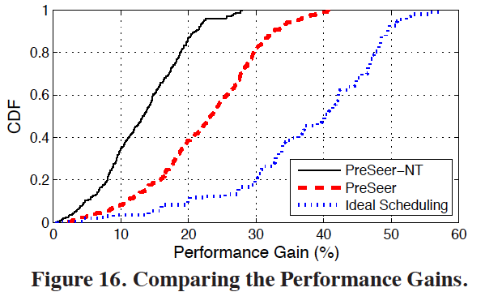
Performance of PreSeer
Ideal Scheduling assumes accurate and real-time knowledge about
  the future channel
  incoming sensor data rate
While PreSeer faces double challeges
  Inevitable channel prediction error
  Unpredictable incoming data rate
PreSeer and PreSeer-NT
  Threshold-based conversion scheme mitigates the negative impact of channel prediction error

Slide 25
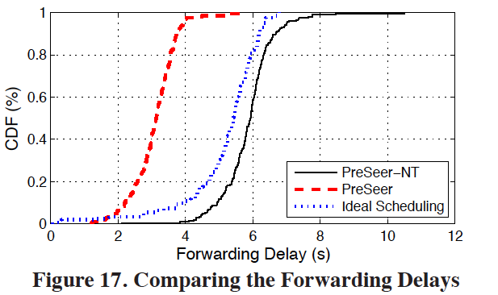
Performance of PreSeer
ProSeer use the first time slot with sufficiently good channel quality for transmission
Ideal Scheduling can make better use of allowed delay to achieve optimal energy efficiency
ProSeer-NT is more conservative than ProSeer
  To employ only the best predicted TXOP in the near future
  But schedule a transmission based on its currently buffered sensing data
  Sensing data collected after the scheduling operation will be delayed

Slide 26
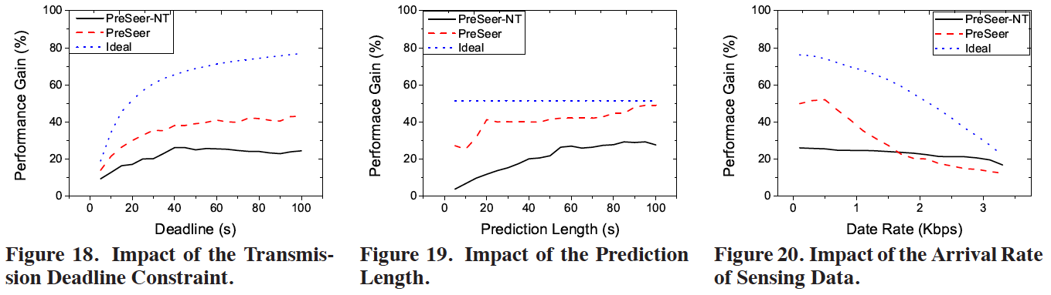
Impact of Working Conditions
Figure 18 : 100s prediction, 1Kbps incoming data rate
  Transmission deadline extension beyond 40s in this system may not help too much
Figure 19 : 100s deadline constraints, 1Kbps incoming data rate
  Get improved as large as varying prediction length from 5 to 100 seconds
Figure 20 : 100s deadline constraints, 100s prediction length
  PreSeer is not better than PreSeer-NT when the data arrival rate is more than 1.8Kbps
  Data is sent over on “acceptable” channels instead of optimal condition due to higher data arrival rate

Slide 27
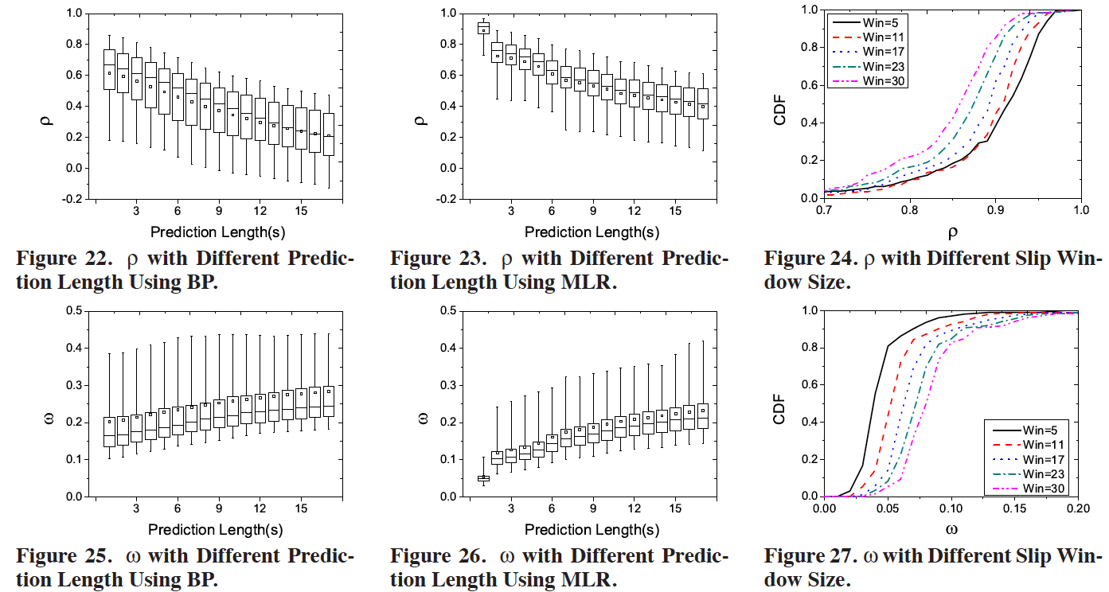
Accuracy of Channel Prediction
a

Slide 28
Conclusion
In this paper
  Present ProSeer, a versatile scheduling algorithm
    Leveraging ephemeral link correlation
    Mobile sink nodes can predict its channel condition according to channel sensing results from other sink nodes
  Collect 400,000 data records from railways routes over 7,000 km
As a result, PreSeer reduces energy consumptions at sink nodes by as much as 40 %

