Slide 1
IODetector : A generic Service for Indoor Outdoor Detection
Pengfei Zhou†, Yuanqing Zheng†, Zhenjiang Li†, Mo Li†, and Guobin Shen‡
†Nanyang Technological University, Singapore
‡Microsoft Research Asia, Beijing, China
fpfzhou, yuanqing1, lzjiang, limog@ntu.edu.sg, jackysh@microsoft.com
Presesented by KimTaeheon

Slide 2

CONTENTS
Introduction
Motivation
System design
Evaluation
Related work
Conclusion

Slide 3
1. Introduction
What is the IODetector?
  A generic and light-weight service for Indoor/Outdoor Detection for mobile applications.
  Use of 3 types of light sensors, cellular module, magnetic sensor
Why is this necessary?
  An effective indoor/outdoor detection scheme can provide primitive environment information for a variety of mobile applications, and thus potentially improve the performance of mobile phones

Slide 4
2. Motivation
It can provide essential information for upper-layer mobile app
  Before turning on GPS
  Searching WiFi AP
  Etc.
Why does not use GPS?
  Slow and inefficient
    Consume amount of energy
    Take minutes to warm up

Slide 5
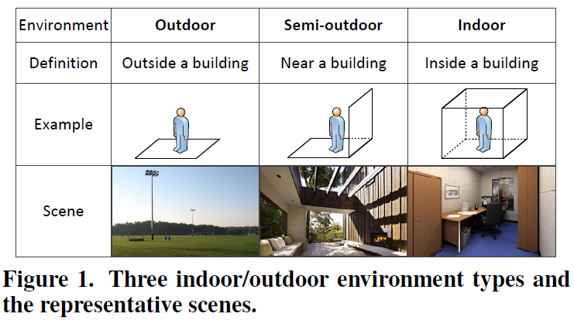
2. Motivation
Design requirements
  High accuracy
  Prompt response
  Energy efficiency
  Universal applicability
Define the I/O environments types

Slide 6
3.System design
System overview
Light detector
Cellular detector
Magnetism detector
Aggregated IODetector

Slide 7
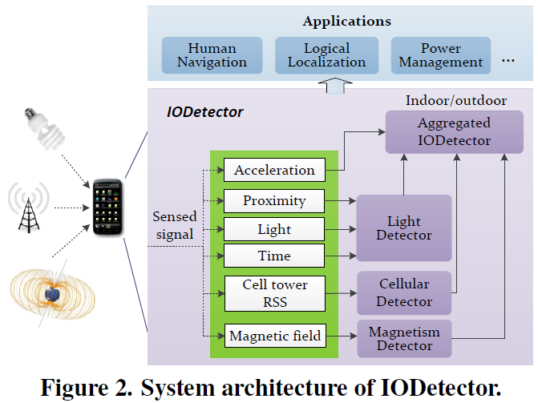
3.1. System overview
System Architecture

Slide 8
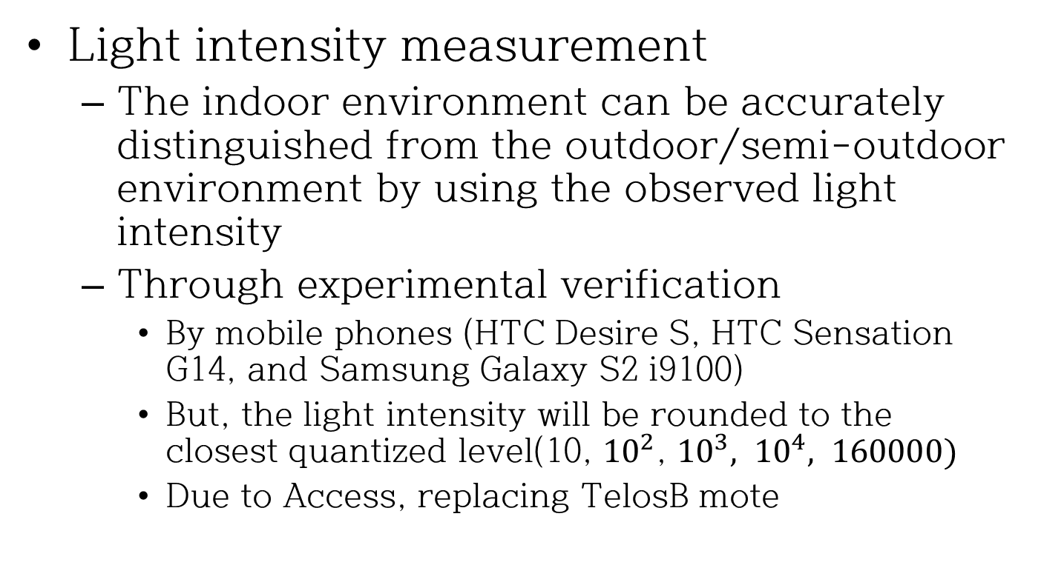
3.2. Light detector
Light intensity measurement
  The indoor environment can be accurately distinguished from the outdoor/semi-outdoor environment by using the observed light intensity
  Through experimental verification
    By mobile phones (HTC Desire S, HTC Sensation G14, and Samsung Galaxy S2 i9100)
    But, the light intensity will be rounded to the closest quantized level(10, ${10}^{2}$, ${10}^{3}, {10}^{4}, 160000)$
    Due to Access, replacing TelosB mote

Slide 9
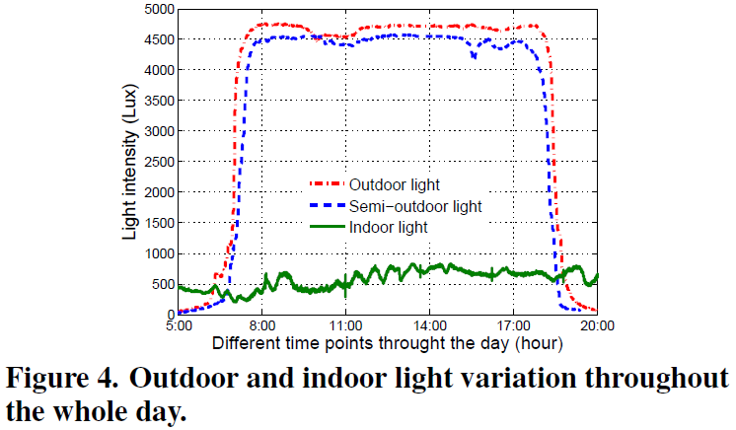
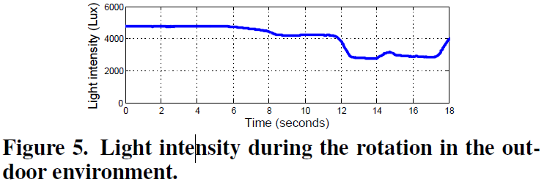
3.2. Light detector
Light intensity measurement
  The light intensities in both the outdoor and semi-outdoor scenarios are above 2000Lux and much higher than that in the indoor environment in the daytime
  When the light sensor is opposite to the sun, the light intensity is relative high as well

Slide 10
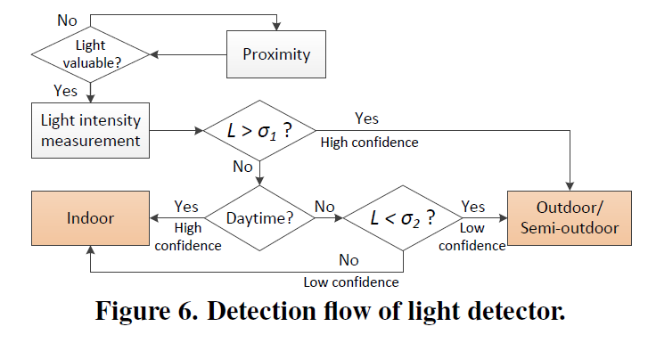
3.2. Light detector
Detection process in light detector

Slide 11
3.3. Cellular detector
Utilize the information about visible cell towers and their signal strength for localization and tracking
  Dividing wall effect
Cell tower signal is available with no additional energy cost

Slide 12
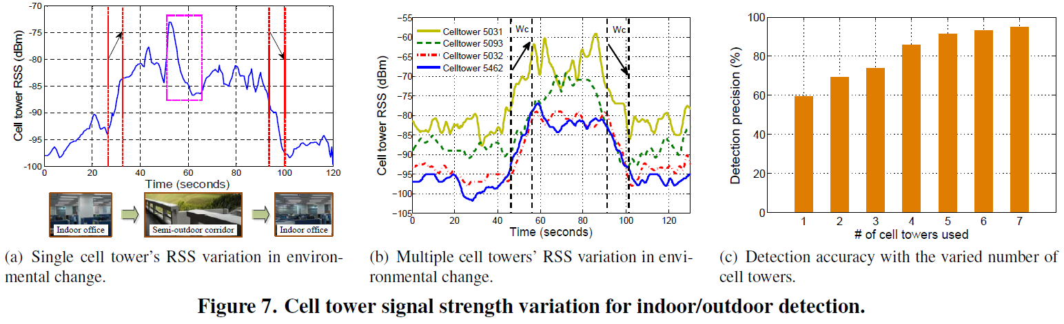
3.3. Cellular detector
Associated cell tower signal strength
  The RSS(Received cellular Signal Strength) variation within a short period of time normally indicates the context transition
  Problems
    Handover from one cell tower to another
    Corner effect

Slide 13
3.3. Cellular detector
Visible cell tower signal strength
  Taking a full advantage of all visible cell towers to improve the detection accuracy
  Through the experiments
    Variation of the cell tower = 15dB.
    Time interval = 10sec.

Slide 14
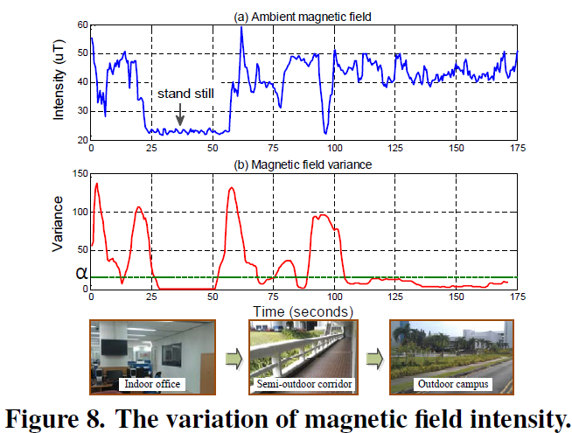
3.4. Magnetism detector
The magnetic field exhibits distinct patterns in indoor/outdoor environments
  In the indoor, the Earth’s geomagnetic field varies at different positions

Slide 15
3.4. Magnetism detector
Threshold is too small
  Most indoor/semi-outdoor environments will be correctly classified
  But miss the detection of many outdoor environments
Threshold is too large
  Most outdoor environments will be correctly classified
  But miss the detection of many indoor/semi-outdoor environments
Select an empirical threshold 18 to achieve a balance

Slide 16
3.5. Aggregated IODetector
Each of the three detectors shows unique advantages and disadvantages
Call the three individual detectors as sub-detectors and integrate them so as to output an arbitrated decision
Classify 2types
  Stateless
  Stateful

Slide 17
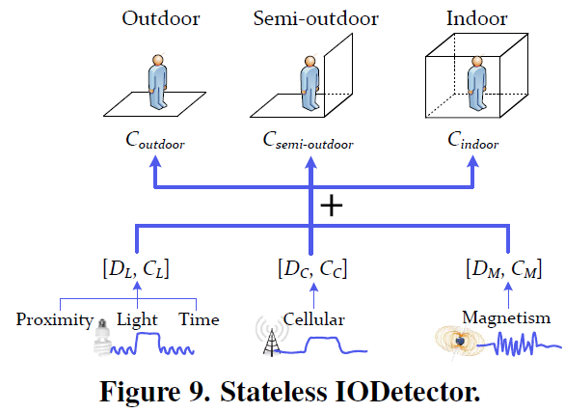
3.5. Aggregated IODetector
Stateless IODetector
  Provides instant detection results
  Ensures the energy efficiency
  Do not consider previous states, may suffer from noises

Slide 18
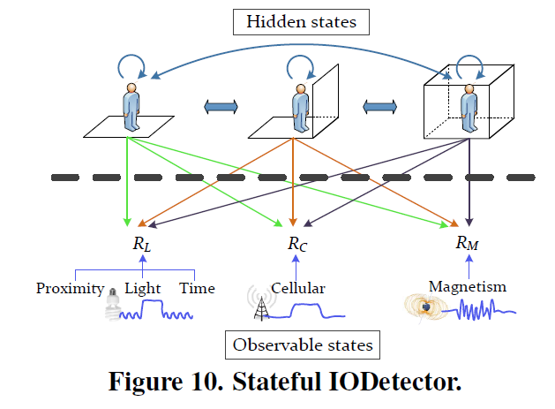
3.5. Aggregated IODetector
Stateful IODetector
  Three sub-detectors which makes decisions on top of both current and previous observations
  Use the Hidden Markov Model (HMM)
  Do not keep all the sensors on, use accelerometer as a trigger

Slide 19
3.5. Aggregated IODetector
Stateful IODetector
  Extra reference
    Transition probability
    Emission probability
    Viterbi algorithm

Slide 20
4.Evaluation
Experimental methodology
System performance
Case study : inferring GPS availability

Slide 21
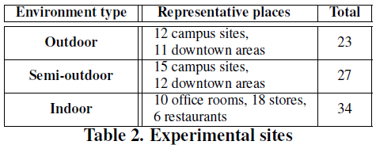
4.1. Experimental methodology
Hardware types
  Samsung Galaxy S2 i9100
  HTC Desire S
  HTC Sensation G14
Each equipped with
  Light sensors
  Proximity sensors
  Magnetism sensors
  Accelerometers
  Etc.
Experiment environment.
  19 different walking traces and collect sensor readings from these
    23 outdoor segments
      Covering football fields
      Downtown squares
      Etc.
    27 semi-outdoor segments
      Covering corridors
      Paths near buildings
    34 indoor segments
      Including offices
      Shopping malls
  During the period 5:00 to 22:00
  In 30 days
  With different weather conditions
  * The users walk along these traces and the mobile phones perform continuous detection for the experimental sites along the traces

Slide 22
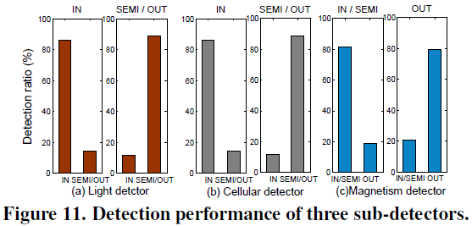
4.2. System performance
Performance of sub-detectors

Slide 23
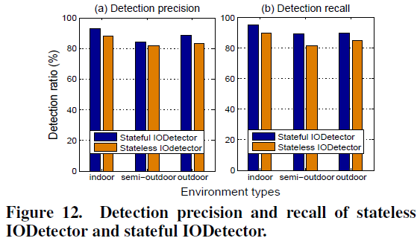
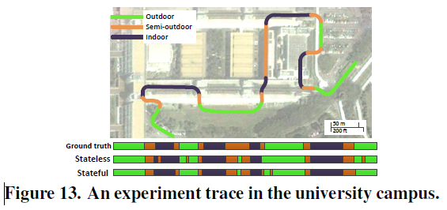
4.2. System performance
Performance of aggregated IODetector
Stateful IODetector slightly higher than Stateless IODetector
The stateless IODetector suffers from mis-detection of some semi-outdoor environments
The stateful IODetector is better than stateless IODetector
But not always

Slide 24
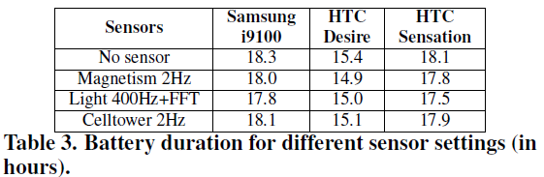
4.2. System performance
Performance of aggregated IODetector
  Include these
    Detection latency
      Takes 10 seconds to warm up and then starts reporting detection results
    System overhead
      No sensor does not differ significantly from others

Slide 25
4.3. Case study : inferring GPS availability
Indoor/outdoor dependent performance
  GPS normally needs more than 4 clear line-of-sight paths to GPS satellites
    But, there are many variables
  In the indoor environment, there is normally no line-of-sight path to satellites
  Mobile phones greatly benefit from a priori knowledge of the ambient environment types with minimal overhead

Slide 26
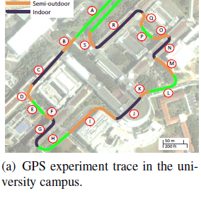
4.3. Case study : inferring GPS availability
GPS availability and localization accuracy
  Experiment path in our campus
  The length of the walking path
    Total : 1600m
    Outdoor : 620m
    Semi-outdoor : 380m
    Indoor segments : 600m
  With different mobile phone models
  Under different weather conditions
  During the 1 month

Slide 27
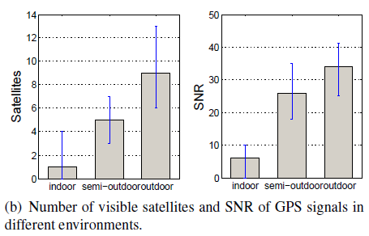
4.3. Case study : inferring GPS availability
GPS availability and localization accuracy
  The SNR value is a normalized value from the android API indicating the signal to noise ratio of the received satellite signal

Slide 28
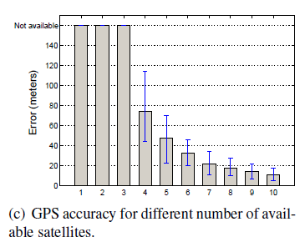
4.3. Case study : inferring GPS availability
GPS availability and localization accuracy
  GPS availability and localization accuracy are highly correlated to the environment types

Slide 29
4.3. Case study : inferring GPS availability
IODetector-augmented GPS: IO-GPS
  Can simply leverage IODetector to infer the GPS with accurate indoor/outdoor awareness
  Mobile applications invoke IODetector before switching on the GPS module
  Can track the localization accuracy and energy consumption of the traditional GPS and the IO-GPS scheme
  Use stateful IODetector

Slide 30
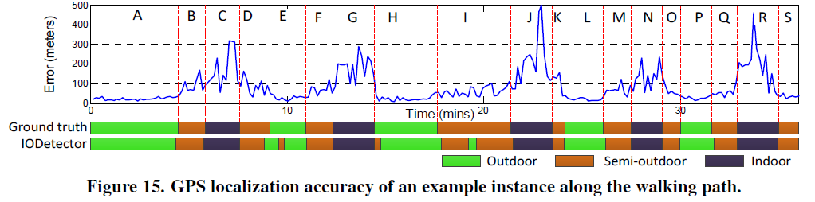
4.3. Case study : inferring GPS availability
IODetector-augmented GPS: IO-GPS
  The GPS localization error varies across different path segments
  Can find a two-stage jump of the localization error
  (P → Q→ R)
  In the indoor environment the GPS localization error is much larger than that in the semi-outdoor or outdoor environment

Slide 31
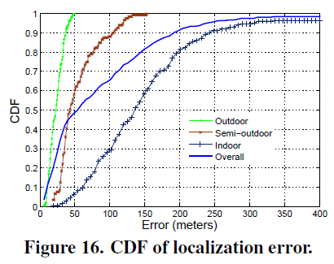
4.3. Case study : inferring GPS availability
IODetector-augmented GPS: IO-GPS
  summarizes the localization error from the 10 experiments
  Augmented by IODetector, the IO-GPS performance would be closer to that in the outdoor/semi-outdoor environment

Slide 32
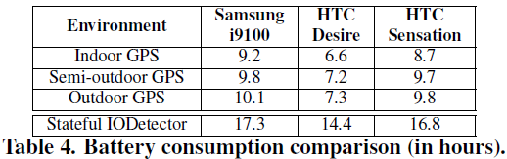
4.3. Case study : inferring GPS availability
IODetector-augmented GPS: IO-GPS
  Energy consumption
    Measure the power consumption when we run the GPS module during the experiment
      With the screen set to the minimum brightness.
    GPS drains the battery rapidly in all the environments
    With the awareness of the indoor/outdoor environment, IO-GPS may avoid unnecessarily switching on the GPS module and save the energy consumption in the indoor environment

Slide 33
5. Related work
Environment detection
Localization and tracking
Context awareness and activity recognition

Slide 34
6. Conclusions
Present the design an indoor/outdoor environment detection system
  Which efficiently takes input from a variety of lightweight sensors to derive the indoor/outdoor information
Achieves prompt and accurate
  By intelligently aggregating the sub-detectors
Test and evaluate IODetector through a prototype implementation
Conduct a case study
  IODetector results to infer the GPS availability and accuracy under various indoor/outdoor environment

Slide 35
Q & A
Thank you for listening

