Slide 1

Chapter 10
Error
Detection
And
Correction
Copyright © The McGraw-Hill Companies, Inc. Permission required for reproduction or display.

Slide 2
Chapter 10: Outline
10.1 INTRODUCTION
10.2 BLOCK CODING
10.3 CYCLIC CODES
10.4 CHECKSUM
10.5 FORWARD ERROR CORRECTION

Slide 3

Chapter 10: Objective
The first section introduces types of errors, the concept of redundancy, and distinguishes between error detection and correction.
The second section discusses block coding. It shows how error can be detected using block coding and also introduces the concept of Hamming distance.
The third section discusses cyclic codes. It discusses a subset of cyclic code, CRC, that is very common in the data-link layer. The section shows how CRC can be easily implemented in hardware and represented by polynomials.

Slide 4
Chapter 10: Objective (continued)
The fourth section discusses checksums. It shows how a checksum is calculated for a set of data words. It also gives some other approaches to traditional checksum.
The fifth section discusses forward error correction. It shows how Hamming distance can also be used for this purpose. The section also describes cheaper methods to achieve the same goal, such as XORing of packets, interleaving chunks, or compounding high and low resolutions packets.

Slide 5
    10-1 INTRODUCTION
Let us first discuss some issues related, directly or indirectly, to error detection and correction.

Slide 6
10.1.1 Types of Errors
Whenever bits flow from one point to another, they are subject to unpredictable changes because of interference. This interference can change the shape of the signal. The term single-bit error means that only 1 bit of a given data unit (such as a byte, character, or packet) is changed from 1 to 0 or from 0 to 10. The term burst error means that 2 or more bits in the data unit have changed from 1 to 0 or from 0 to 10. Figure 10.1 shows the effect of a single-bit and a burst error on a data unit.

Slide 7
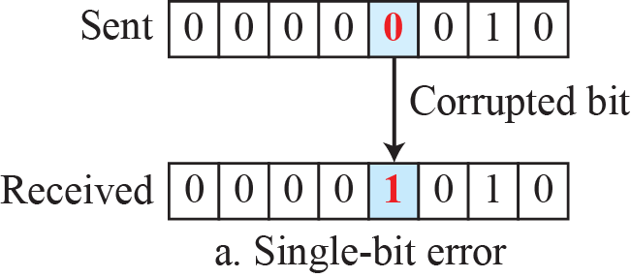
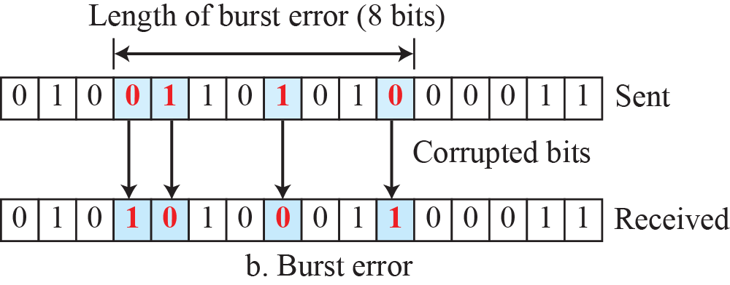
Figure 10.1: Single-bit and burst error

Slide 8
10.1.2 Redundancy
The central concept in detecting or correcting errors is redundancy. To be able to detect or correct errors, we need to send some extra bits with our data. These redundant bits are added by the sender and removed by the receiver. Their presence allows the receiver to detect or correct corrupted bits.

Slide 9
10.1.3 Detection versus Correction
The correction of errors is more difficult than the detection. In error detection, we are only looking to see if any error has occurred. The answer is a simple yes or no. We are not even interested in the number of corrupted bits. A single-bit error is the same for us as a burst error. In error correction, we need to know the exact number of bits that are corrupted and, more importantly, their location in the message.

Slide 10
10.1.4 Coding
Redundancy is achieved through various coding schemes. The sender adds redundant bits through a process that creates a relationship between the redundant bits and the actual data bits. The receiver checks the relationships between the two sets of bits to detect errors. The ratio of redundant bits to data bits and the robustness of the process are important factors in any coding scheme.

Slide 11

    10-2 BLOCK CODING
In block coding, we divide our message into blocks, each of k bits, called datawords. We add r redundant bits to each block to make the length n = k + r. The resulting n-bit blocks are called codewords. How the extra r bits are chosen or calculated is something
we will discuss later.
Detect errors using $2^{n}−2^{k}$ unused codewords

Slide 12
10.2.1 Error Detection
How can errors be detected by using block coding? If the following two conditions are met, the receiver can detect a change in the original codeword.
1. The receiver has (or can find) a list of valid
codewords.
2. The original codeword has changed to an invalid
one.

Slide 13
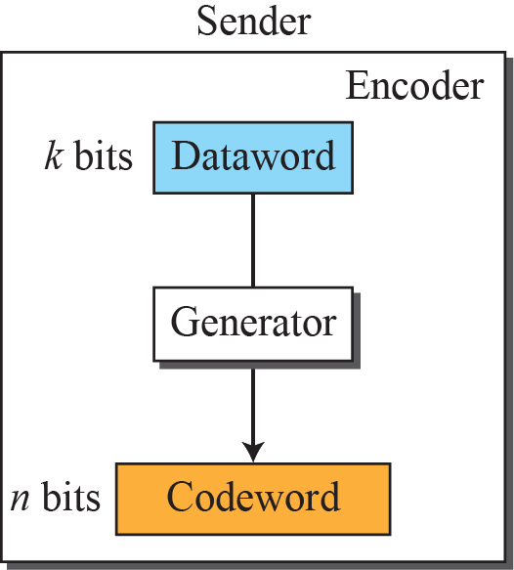
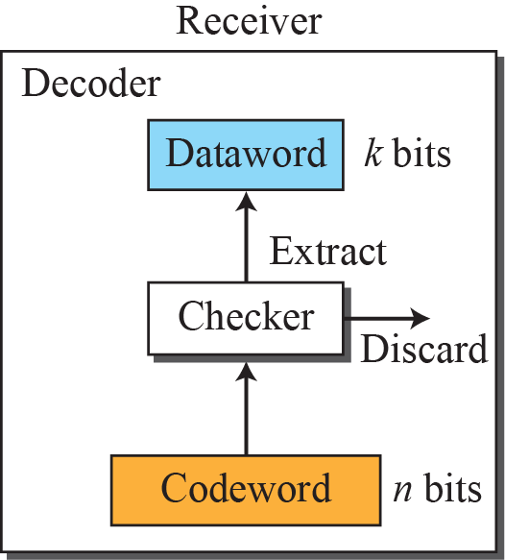

Figure 10.2: Process of error detection in block coding
10.13

Slide 14
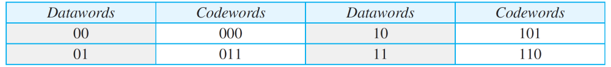
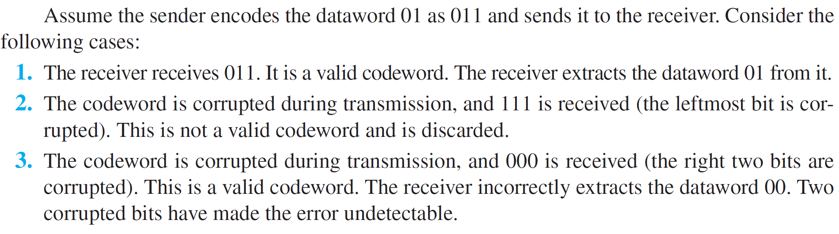
Example 10.1
Let us assume that k = 2 and n = 3. Table 10.1 shows the list of datawords and codewords. Later, we will see how to derive a codeword from a dataword.
Table 10.1: A code for error detection in Example 10.1
10.14

Slide 15
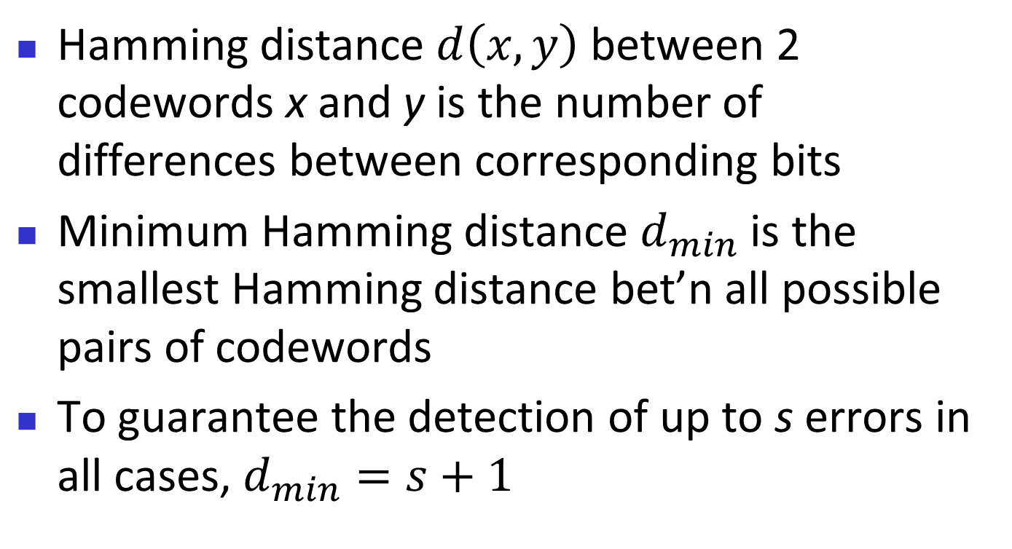
Hamming Distance
Hamming distance $d\left(x,y\right)$ between 2 codewords x and y is the number of differences between corresponding bits
Minimum Hamming distance $d_{min}$ is the smallest Hamming distance bet’n all possible pairs of codewords
To guarantee the detection of up to s errors in all cases, $d_{min}=s+1$

Slide 16
Example 10.2
Let us find the Hamming distance between two pairs of words.
10.16

Slide 17
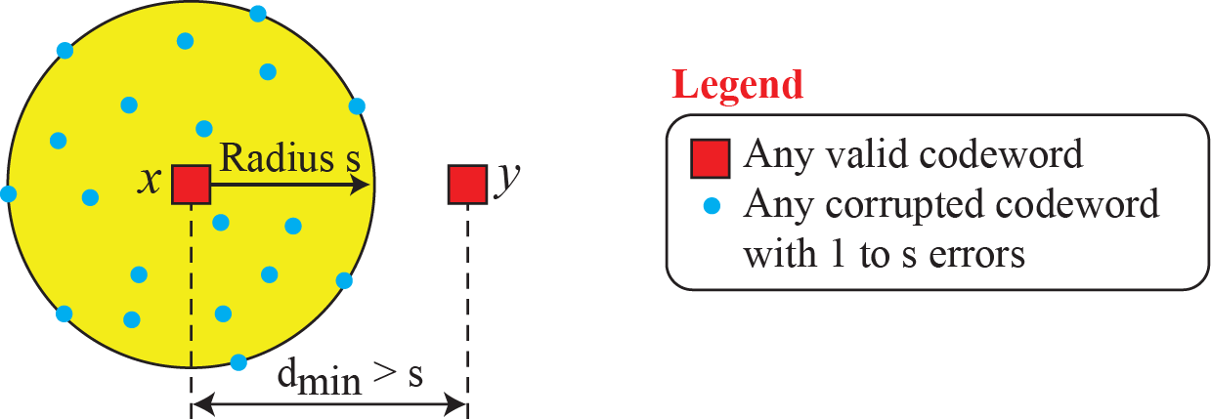
Figure 10.3: Geometric concept explaining dmin in error detection

Slide 18
Example 10.3
The minimum Hamming distance for our first code scheme (Table 10.1) is 2. This code guarantees detection of only a single error. For example, if the third codeword (101) is sent and one error occurs, the received codeword does not match any valid codeword. If two errors occur, however, the received codeword may match a valid codeword and the errors are not detected.
10.18

Slide 19
Example 10.4
A code scheme has a Hamming distance dmin = 4. This code guarantees the detection of up to three errors (d = s + 1 or
s = 3).
10.19

Slide 20
Linear Block Codes
Linear Block code is a code in which the XOR of 2 valid codewords creates another valid codeword
Minimum Hamming distance of a LBC is the number of 1s in the nonzero valid codeword with the smallest number of 1s

Slide 21
Example 10.5
The code in Table 10.1 is a linear block code because the result of XORing any codeword with any other codeword is a valid codeword. For example, the XORing of the second and third codewords creates the fourth one.
10.21

Slide 22
Example 10.6
In our first code (Table 10.1), the numbers of 1s in the nonzero codewords are 2, 2, and 2. So the minimum Hamming distance is dmin = 2.
10.22

Slide 23
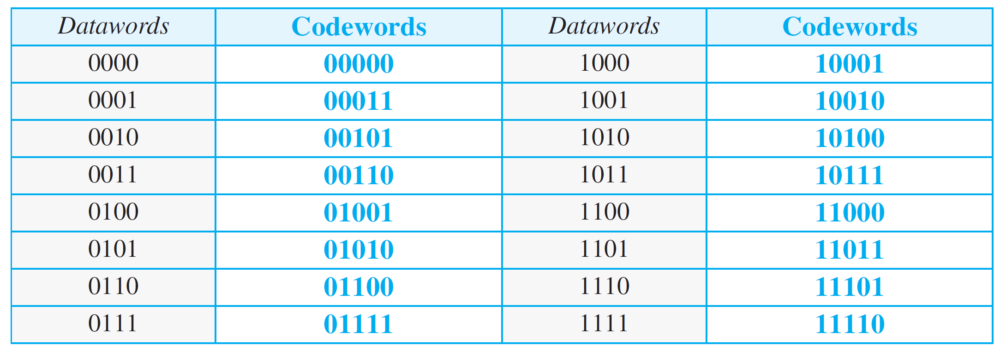
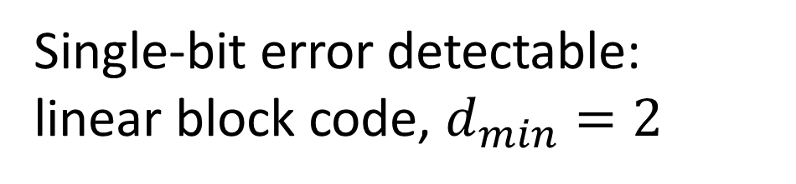
Table 10.2: Simple parity-check code C(5, 4)
Single-bit error detectable: linear block code, $d_{min}=2$
10.23

Slide 24
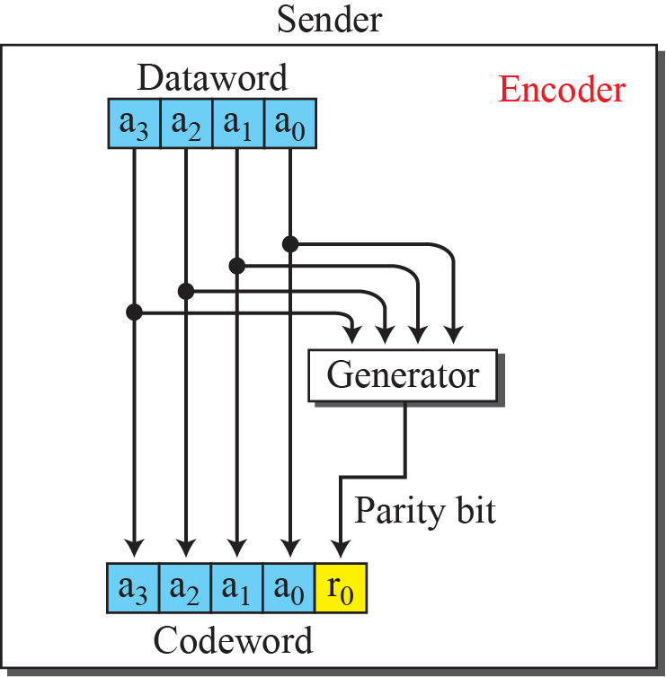
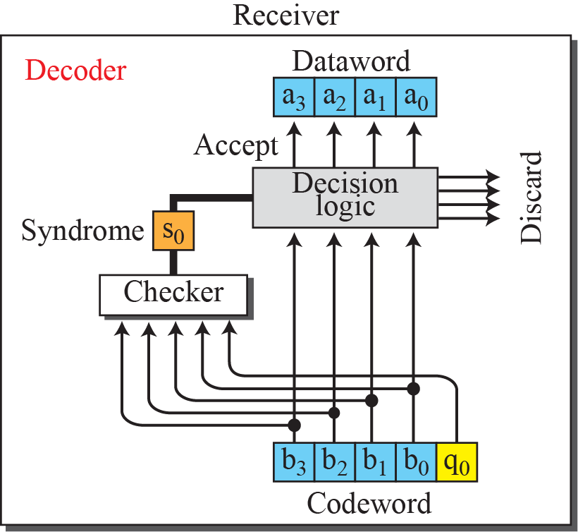
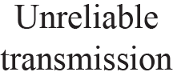
Figure 10.4: Encoder and decoder for simple parity-check code

Slide 25
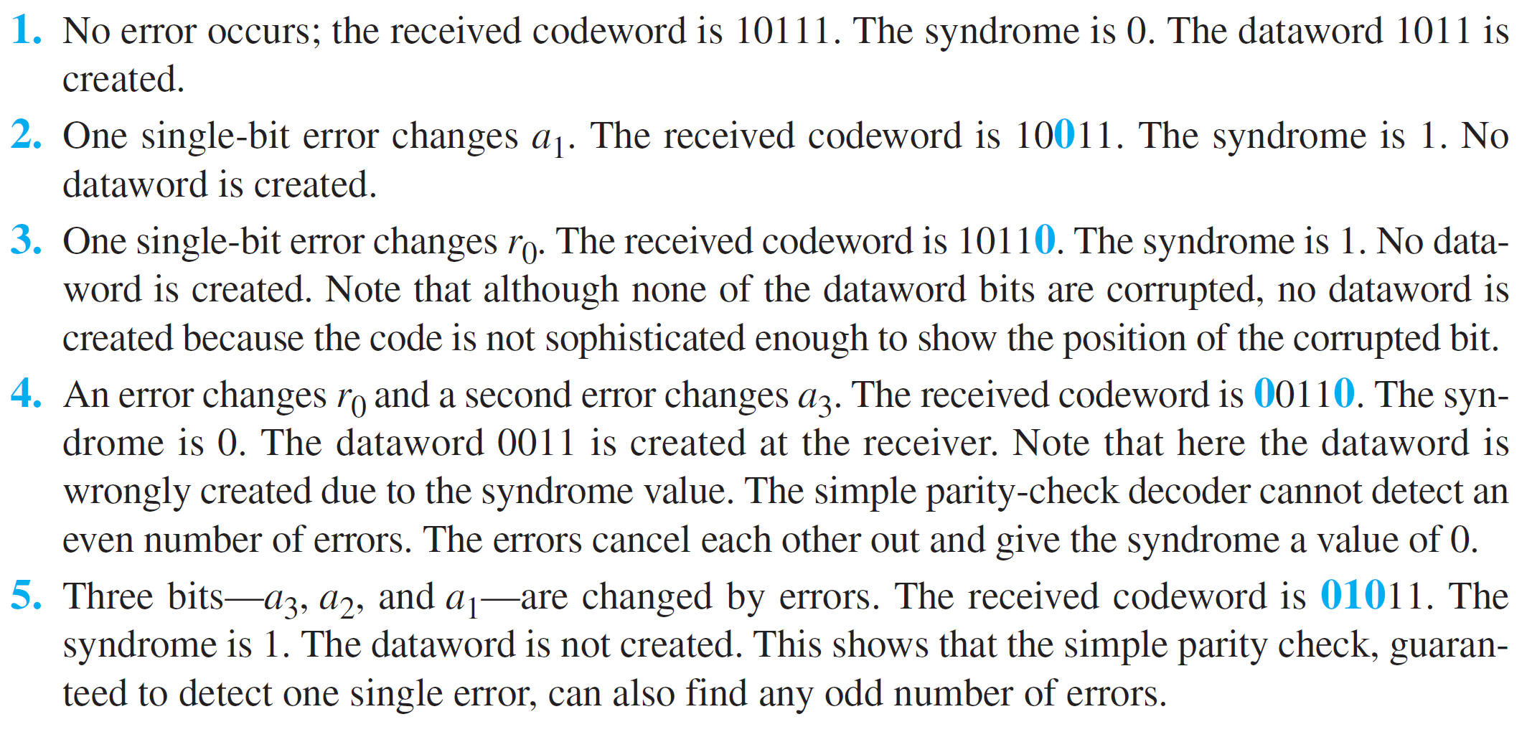
Example 10.7
Let us look at some transmission scenarios. Assume the sender sends the dataword 10110. The codeword created from this dataword is 10111, which is sent to the receiver. We examine five cases:
10.25

Slide 26
    10-3 CYCLIC CODES
Cyclic codes are special linear block codes with one extra property. In a cyclic code, if a codeword is cyclically shifted (rotated), the result is another codeword. For example, if 1011000 is a codeword and we cyclically left-shift, then 0110001 is also a codeword.

Slide 27
10.3.1 Cyclic Redundancy Check
We can create cyclic codes to correct errors. However, the theoretical background required is beyond the scope of this book. In this section, we simply discuss a subset of. cyclic codes called the cyclic redundancy check (CRC), which is used in networks such as LANs and WANs.

Slide 28
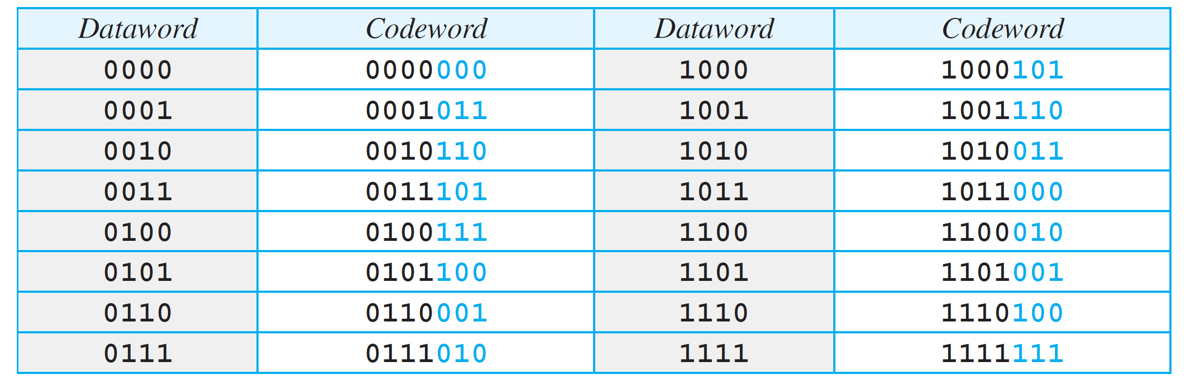
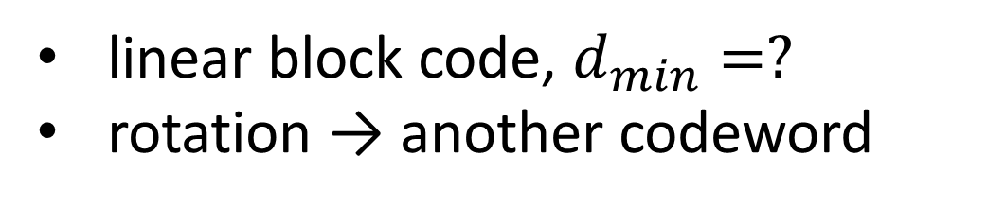
Table 10.3: A CRC code with C(7, 4)
linear block code, $d_{min}=?$
rotation → another codeword
10.28

Slide 29
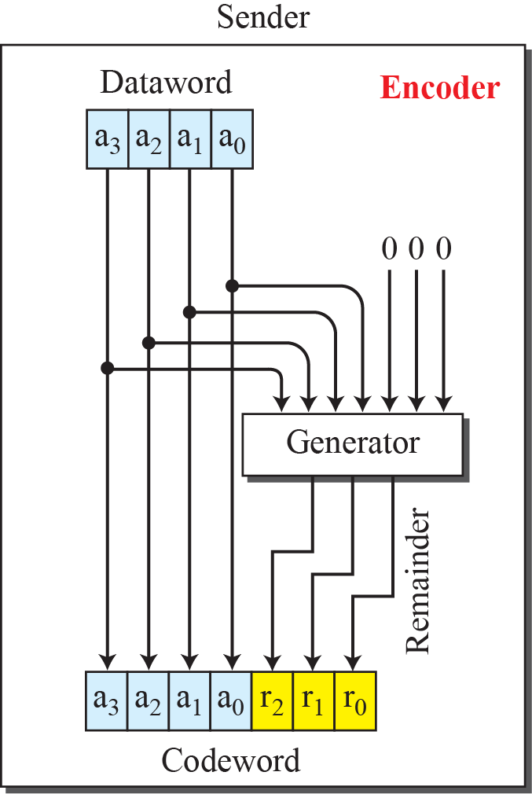
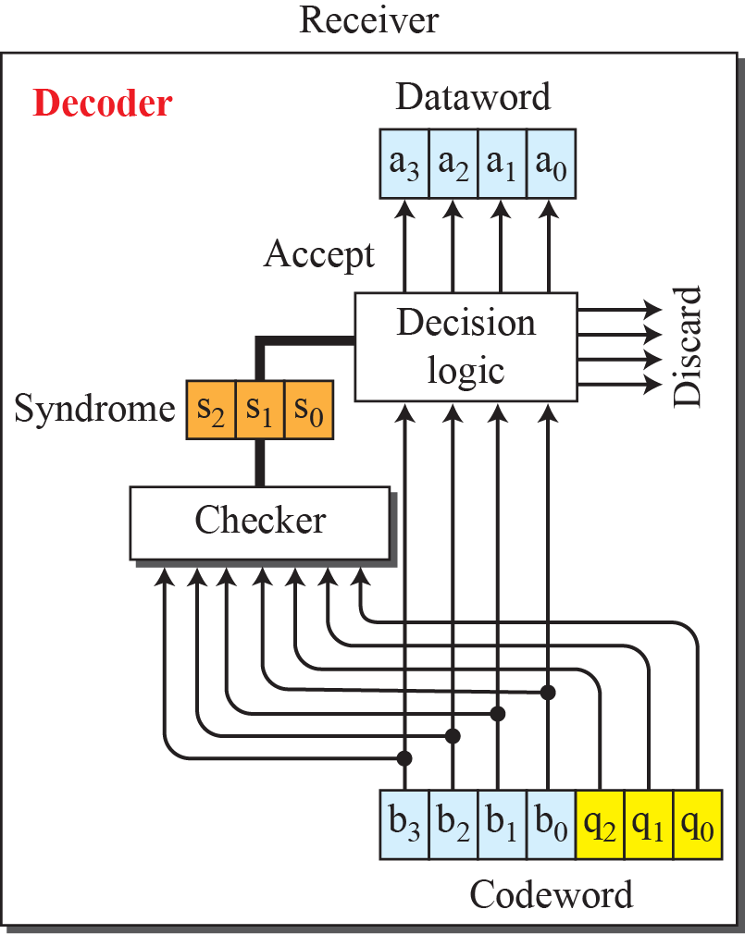
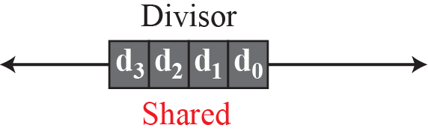
Figure 10.5: CRC encoder and decoder

Slide 30
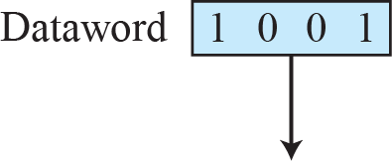
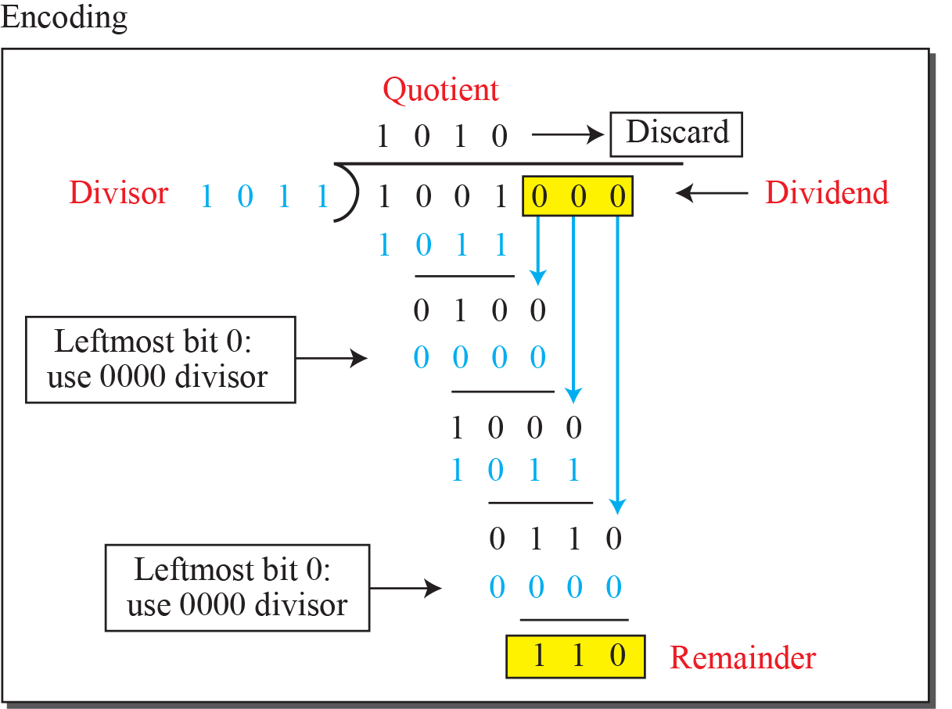
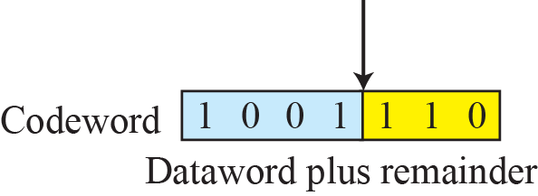
Figure 10.6: Division in CRC encoder

Slide 31
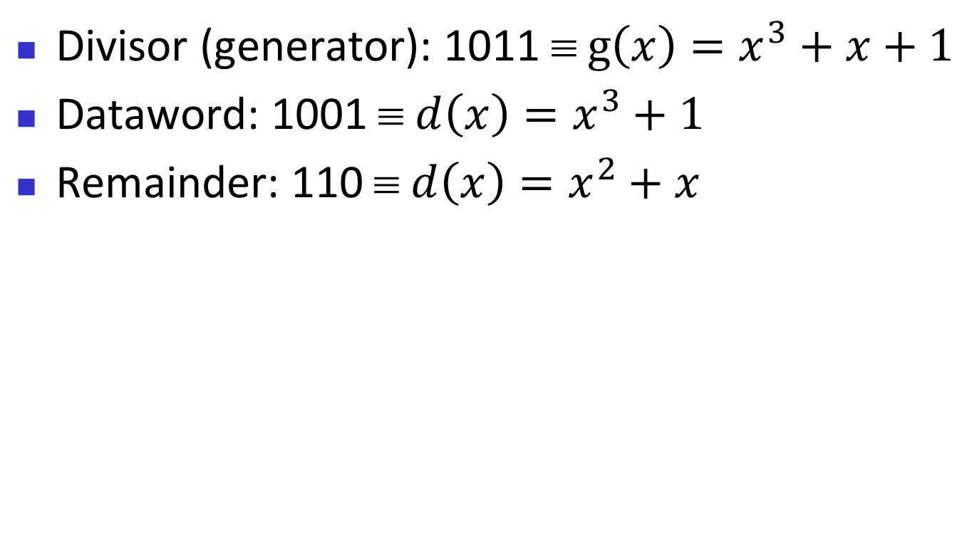
In polynomial
Divisor (generator): 1011 ≡ $g\left(x\right)=x^{3}+x+1$
Dataword: 1001 ≡ $d\left(x\right)=x^{3}+1$
Remainder: 110 ≡ $d\left(x\right)=x^{2}+x$

Slide 32
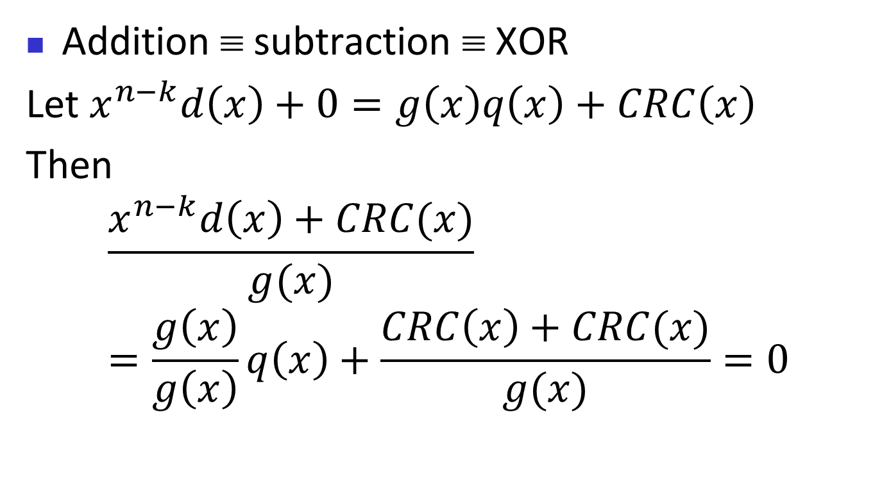
Modulo-2 logic for the polynomial
Addition ≡ subtraction ≡ XOR
Let $x^{n−k}d\left(x\right)+0=g\left(x\right)q\left(x\right)+CRC\left(x\right)$
Then
$$\frac{x^{n−k}d\left(x\right)+CRC(x)}{g(x)}=\frac{g\left(x\right)}{g\left(x\right)}q\left(x\right)+\frac{CRC\left(x\right)+CRC(x)}{g(x)}=0$$

Slide 33
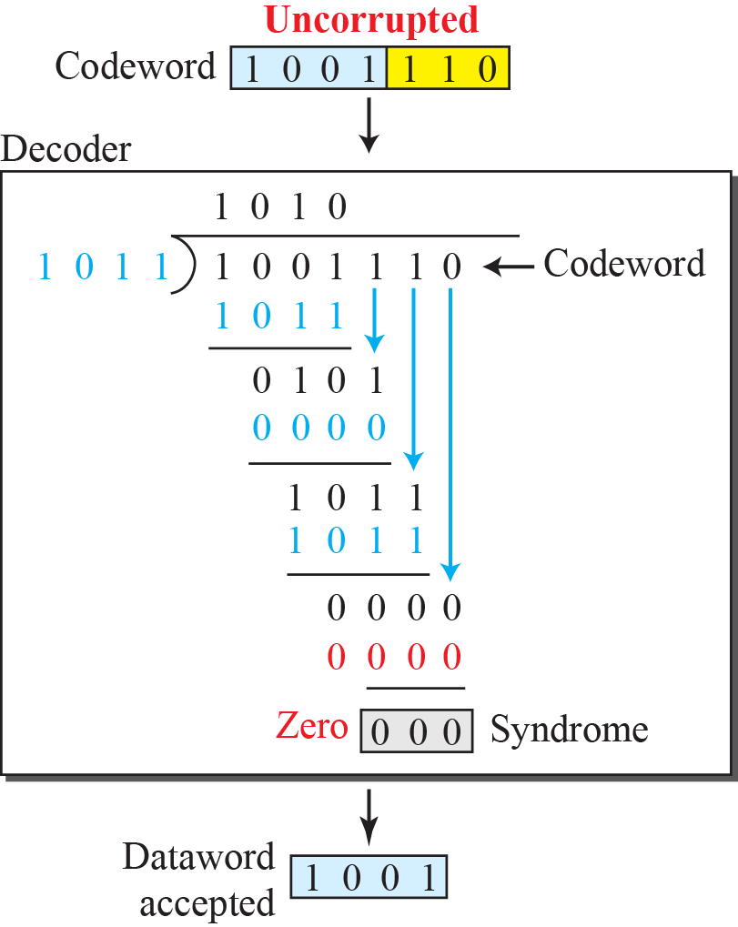
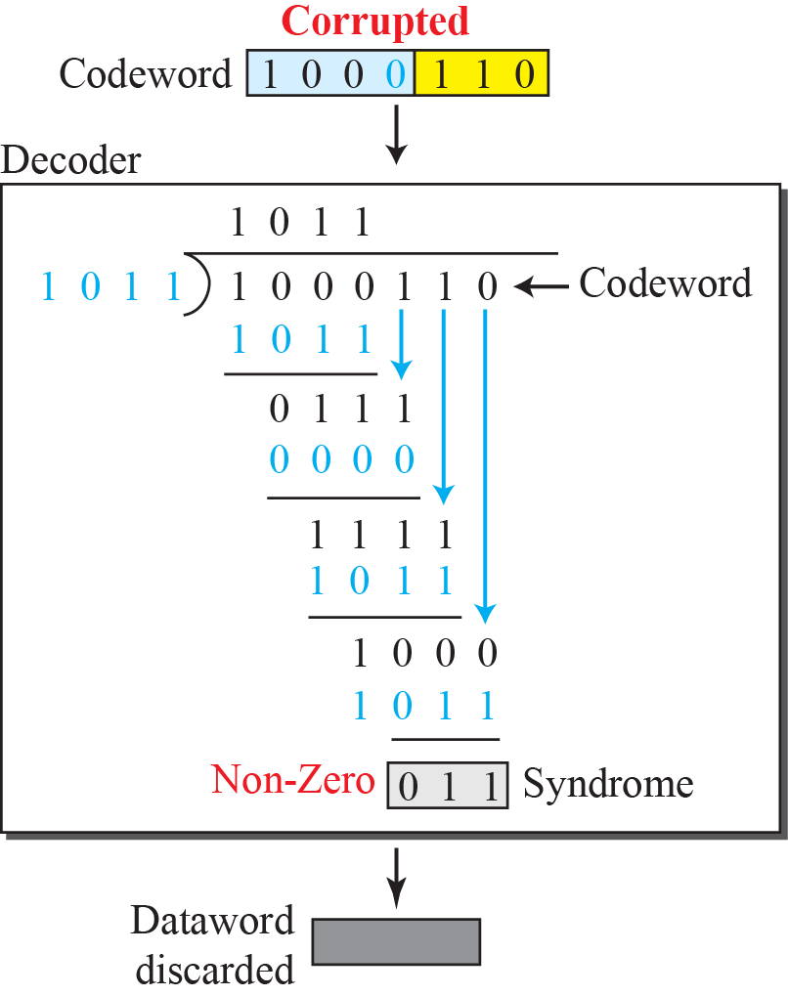
Figure 10.7: Division in the CRC decoder for two cases

Slide 34
10.3.2 Polynomials
A better way to understand cyclic codes and how they can be analyzed is to represent them as polynomials. A pattern of 0s and 1s can be represented as a polynomial with coefficients of 0 and 10. The power of each term shows the position of the bit; the coefficient shows the value of the bit. Figure 10.8 shows a binary pattern and its polynomial representation.

Slide 35
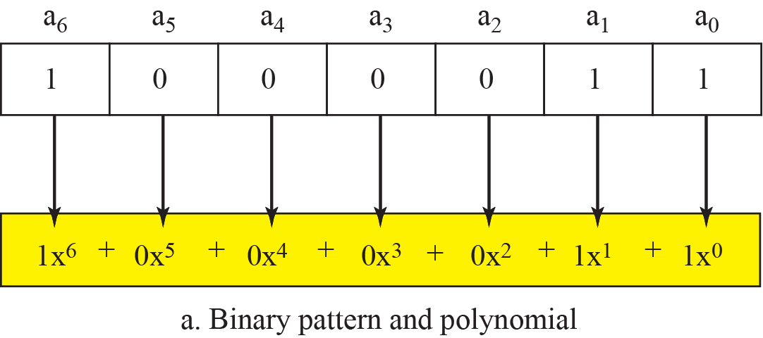
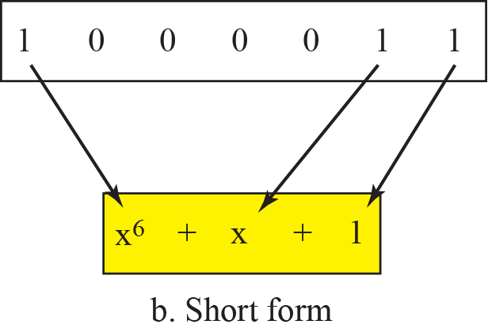
Figure 10.8: A polynomial to represent a binary word

Slide 36
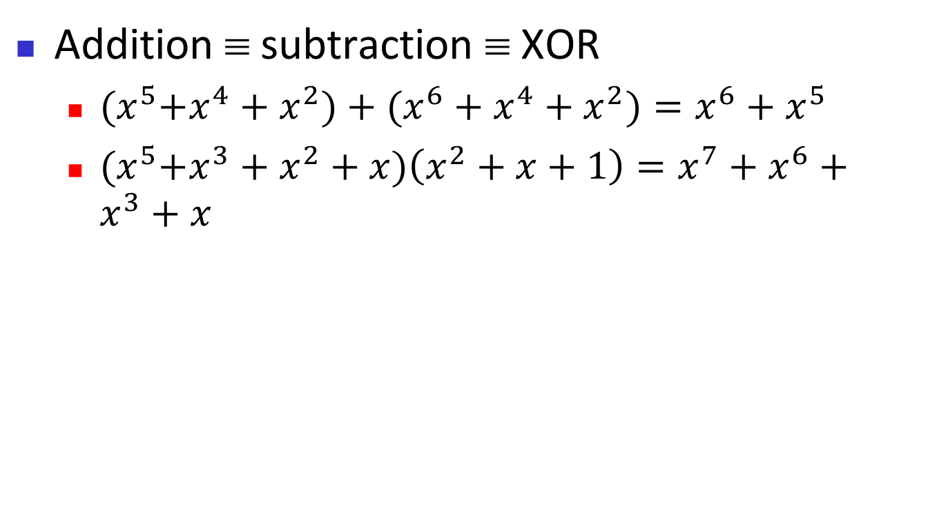
Modulo-2 logic for the polynomial
Addition ≡ subtraction ≡ XOR
  ${(x}^{5}+x^{4}+x^{2})+(x^{6}+x^{4}+x^{2})=x^{6}+x^{5}$
  ${(x}^{5}+x^{3}+x^{2}+x)\left(x^{2}+x+1\right)=x^{7}+x^{6}+x^{3}+x$

Slide 37
Figure 10.6: Division in CRC encoder

Slide 38
In polynomial
Divisor (generator): 1011 ≡ $g\left(x\right)=x^{3}+x+1$
Dataword: 1001 ≡ $d\left(x\right)=x^{3}+1$
Remainder: 110 ≡ $d\left(x\right)=x^{2}+x$

Slide 39
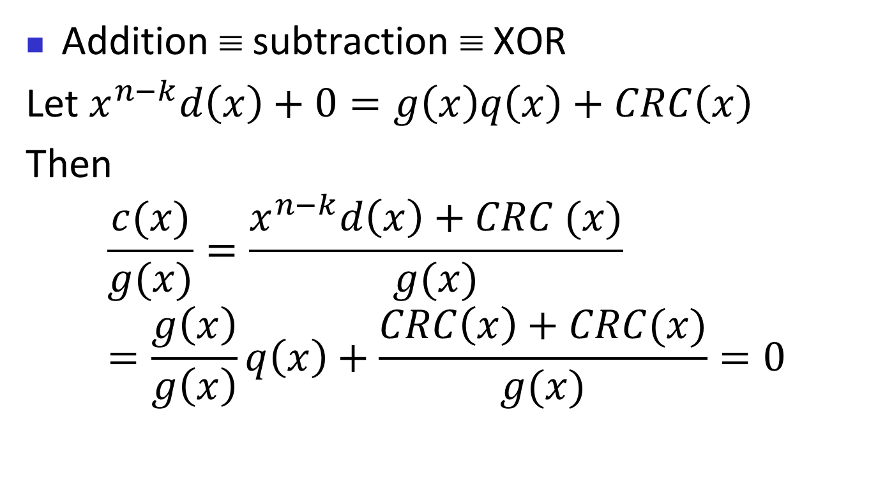
Modulo-2 logic for the polynomial
Addition ≡ subtraction ≡ XOR
Let $x^{n−k}d\left(x\right)+0=g\left(x\right)q\left(x\right)+CRC\left(x\right)$
Then
$$\frac{c(x)}{g(x)}=\frac{x^{n−k}d\left(x\right)+CRC (x)}{g(x)}=\frac{g\left(x\right)}{g\left(x\right)}q\left(x\right)+\frac{CRC\left(x\right)+CRC(x)}{g(x)}=0$$

Slide 40
10.3.3 Encoder Using Polynomials
Now that we have discussed operations on polynomials, we show the creation of a codeword from a dataword. Figure 10.9 is the polynomial version of Figure 10.6. We can see that the process is shorter.

Slide 41
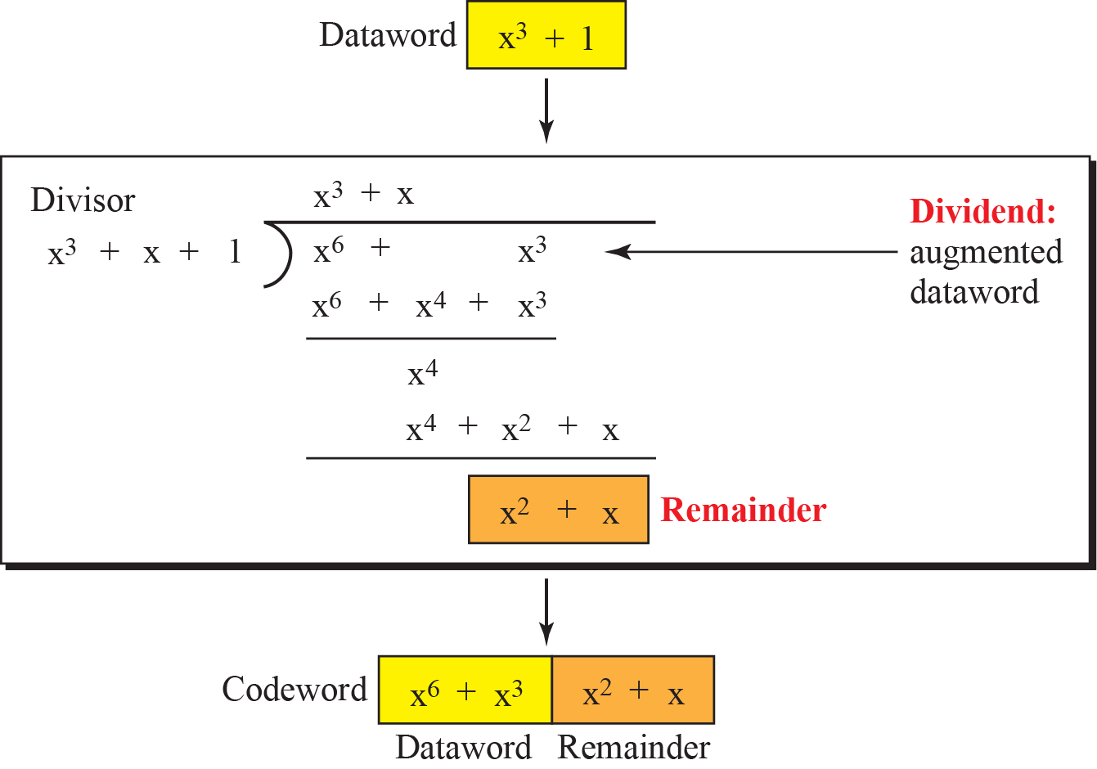
Figure 10.9: CRC division using polynomials

Slide 42


10.3.4 Cyclic Code Analysis
We can analyze a cyclic code to find its capabilities by using polynomials. We define the following, where f(x) is a polynomial with binary coefficients.

Slide 43
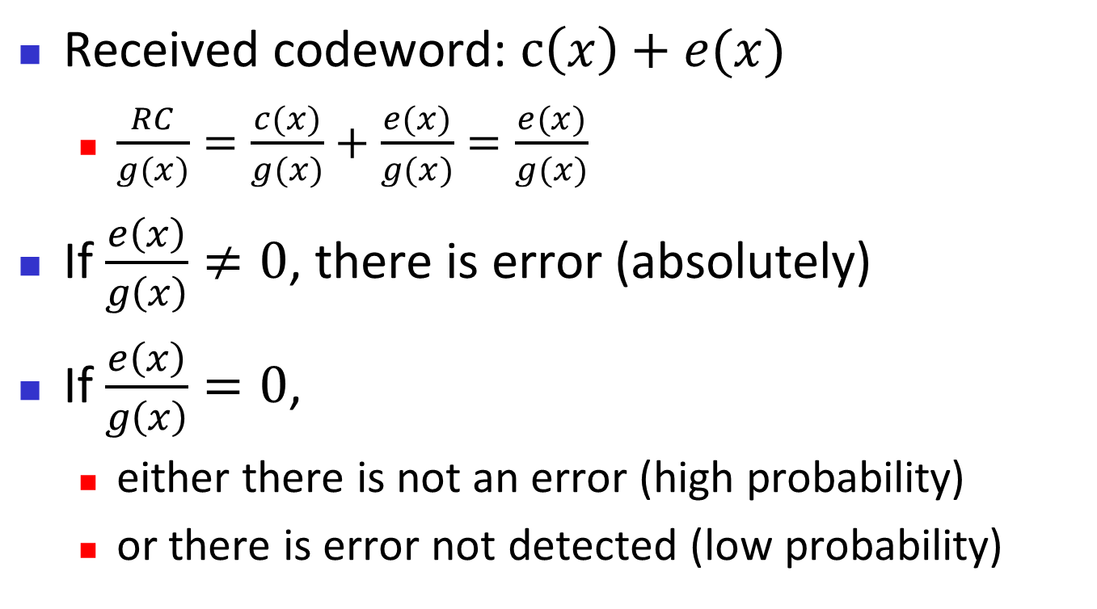
At the receiver …
Received codeword: $c\left(x\right)+e(x)$
  $\frac{RC}{g(x)}=\frac{c(x)}{g(x)}+\frac{e(x)}{g(x)}=\frac{e(x)}{g(x)}$
If $\frac{e\left(x\right)}{g\left(x\right)}≠0$, there is error (absolutely)
If $\frac{e\left(x\right)}{g\left(x\right)}=0$,
  either there is not an error (high probability)
  or there is error not detected (low probability)

Slide 44
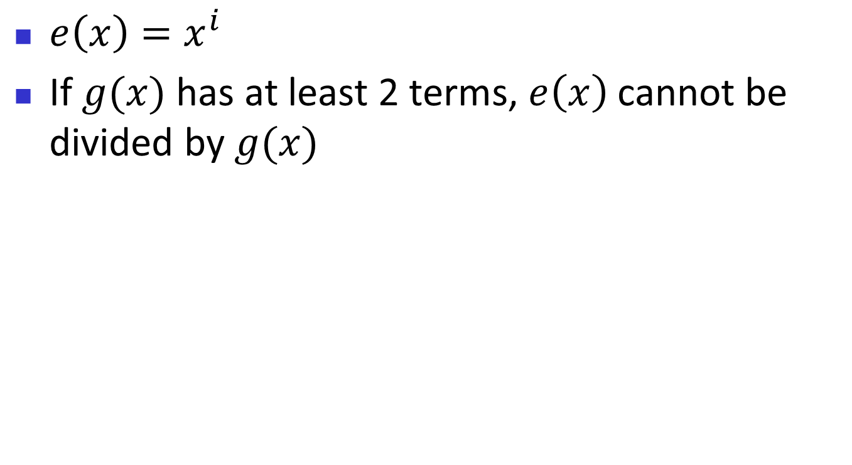
Single-bit error
$e\left(x\right)=x^{i}$
If $g(x)$ has at least 2 terms, $e\left(x\right)$ cannot be divided by $g(x)$

Slide 45
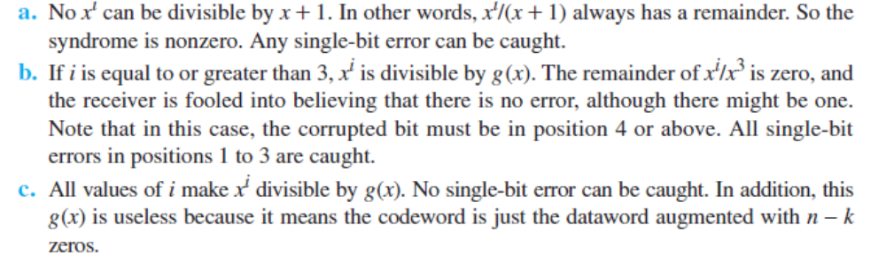
Example 10.8
Which of the following g(x) values guarantees that a single-bit error is caught? x + 1, x³ and 1
Solution
10.45

Slide 46
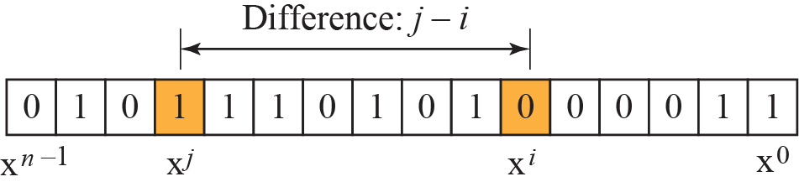
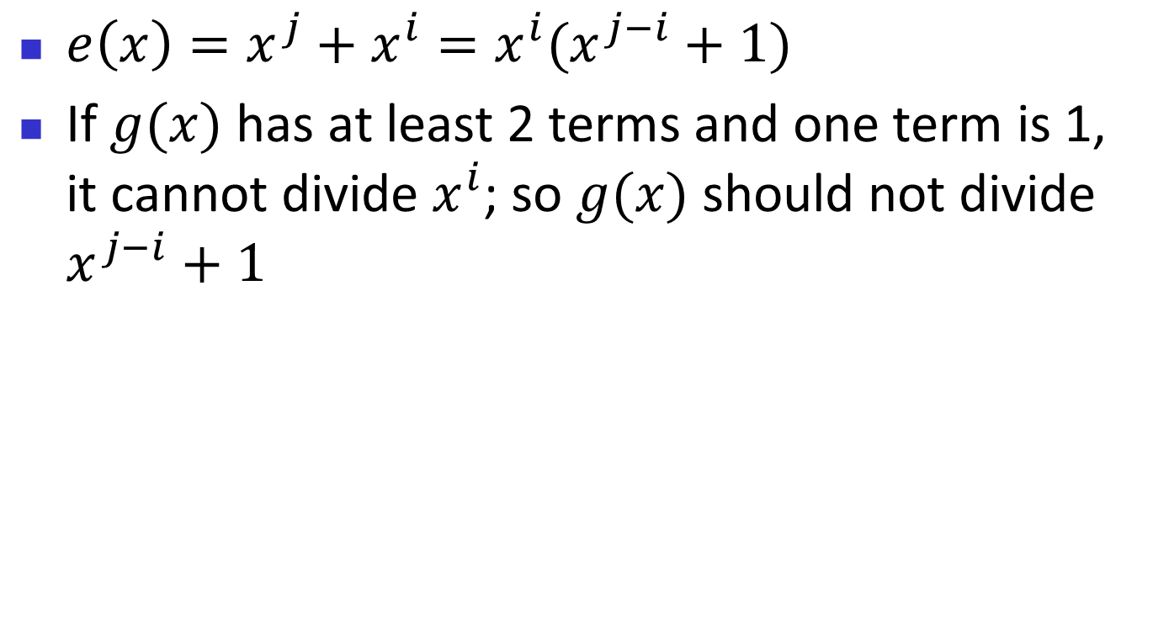
Two isolated single-bit errors
$e\left(x\right)=x^{j}+x^{i}=x^{i}(x^{j−i}+1)$
If $g(x)$ has at least 2 terms and one term is 1, it cannot divide $x^{i}$; so $g(x)$ should not divide $x^{j−i}+1$

Slide 47
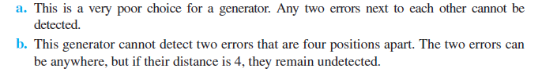
Example 10.9
Find the status of the following generators related to two isolated, single-bit errors: x + 1, x⁴ + 1
Solution
10.47

Slide 48
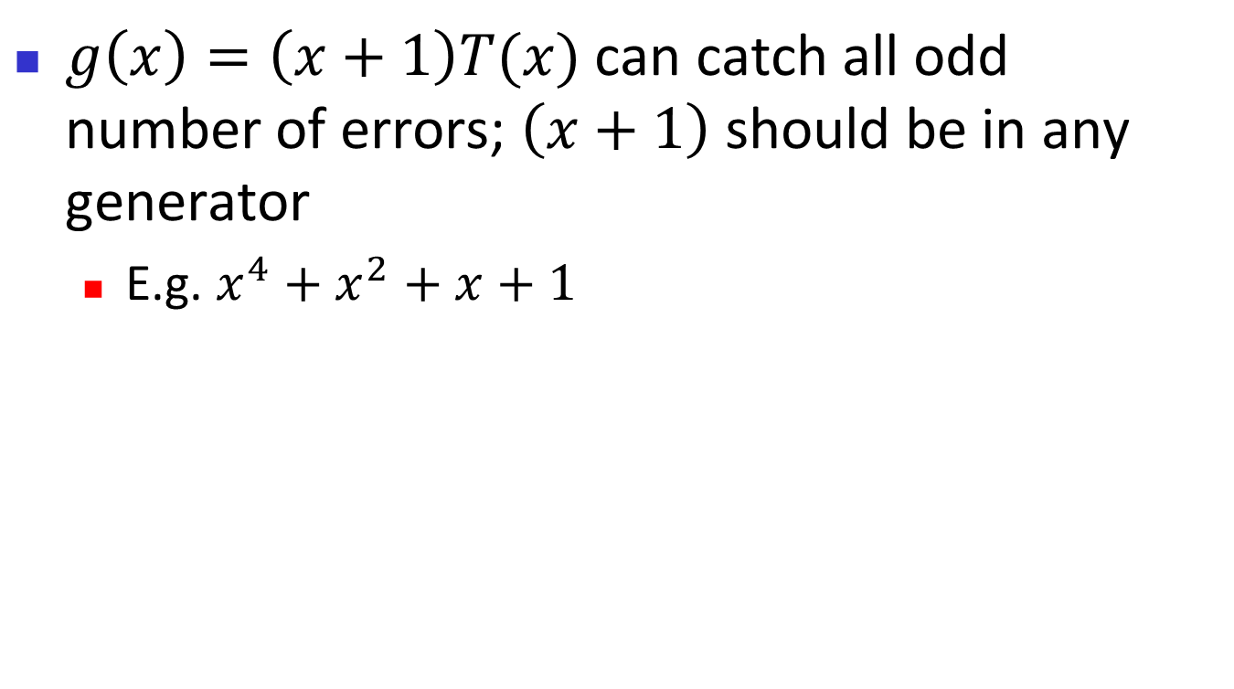
Odd number of errors
$g\left(x\right)=\left(x+1\right)T(x)$ can catch all odd number of errors; $\left(x+1\right)$ should be in any generator
  E.g. $x^{4}+x^{2}+x+1$

Slide 49
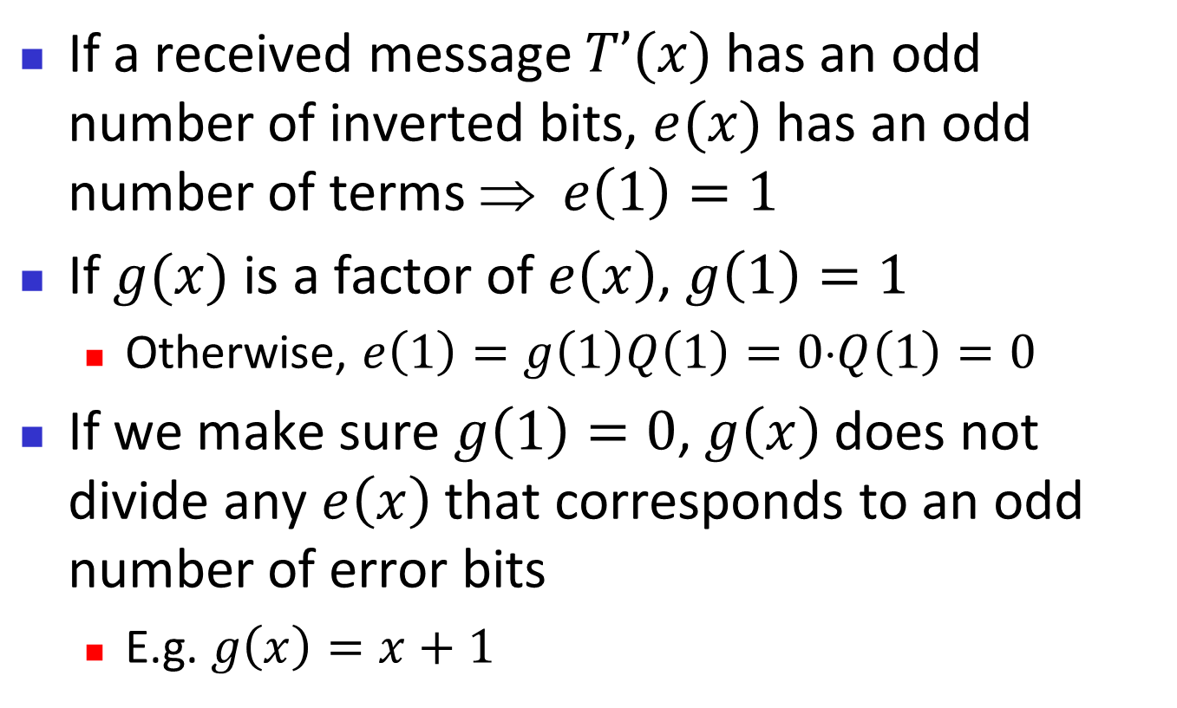
Proof
If a received message $T’(x)$has an odd number of inverted bits, $e(x)$ has an odd number of terms $ e\left(1\right)=1$
If $g(x)$ is a factor of $e\left(x\right)$, $g\left(1\right)=1$
  Otherwise, $e\left(1\right)=g\left(1\right)Q\left(1\right)=0⋅Q\left(1\right)=0$
If we make sure $g\left(1\right)=0$, $g\left(x\right)$does not divide any $e\left(x\right)$ that corresponds to an odd number of error bits
  E.g. $g\left(x\right)=x+1$

Slide 50
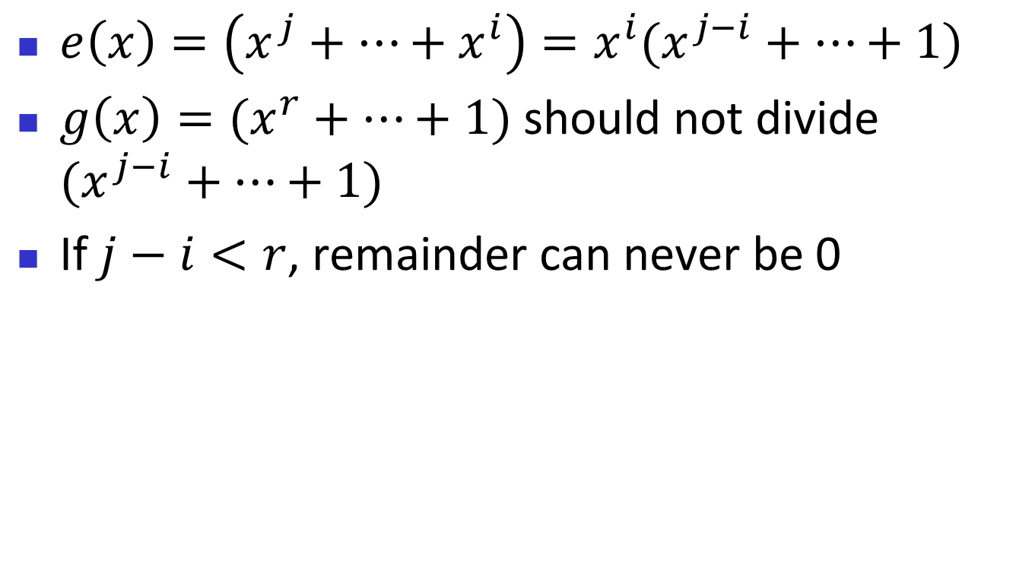
Burst errors
$e\left(x\right)=\left(x^{j}+…+x^{i}\right)=x^{i}(x^{j−i}+…+1)$
$g\left(x\right)=(x^{r}+…+1)$ should not divide $(x^{j−i}+…+1)$
If$j−i<r$, remainder can never be 0

Slide 51
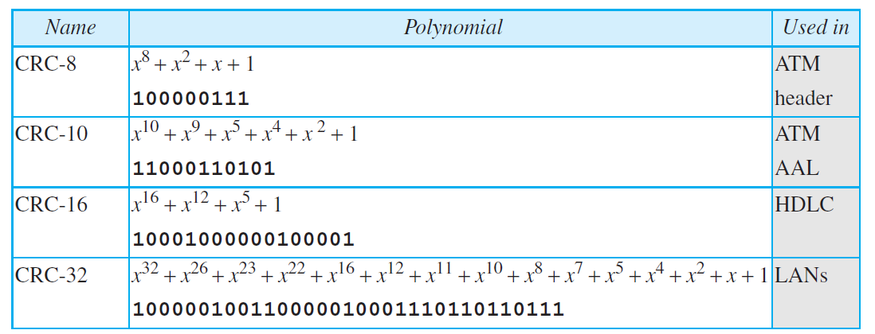
Table 10.4: Standard polynomials
10.51

Slide 52
10.3.5 Advantages of Cyclic Codes
We have seen that cyclic codes have a very good performance in detecting single-bit errors, double errors, an odd number of errors, and burst errors. They can easily be implemented in hardware and software. They are especially fast when implemented in hardware. This has made cyclic codes a good candidate for many networks.

Slide 53
    10-4 CHECKSUM
Checksum is an error-detecting technique that can be applied to a message of any length. In the Internet, the checksum technique is mostly used at the network and transport layer rather than the data-link layer. However, to make our discussion of error detecting
techniques complete, we discuss the checksum in this chapter.

Slide 54
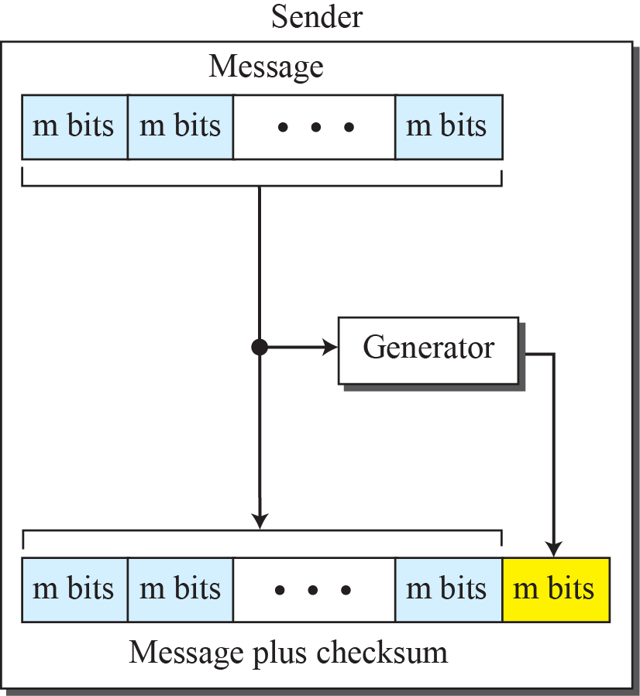
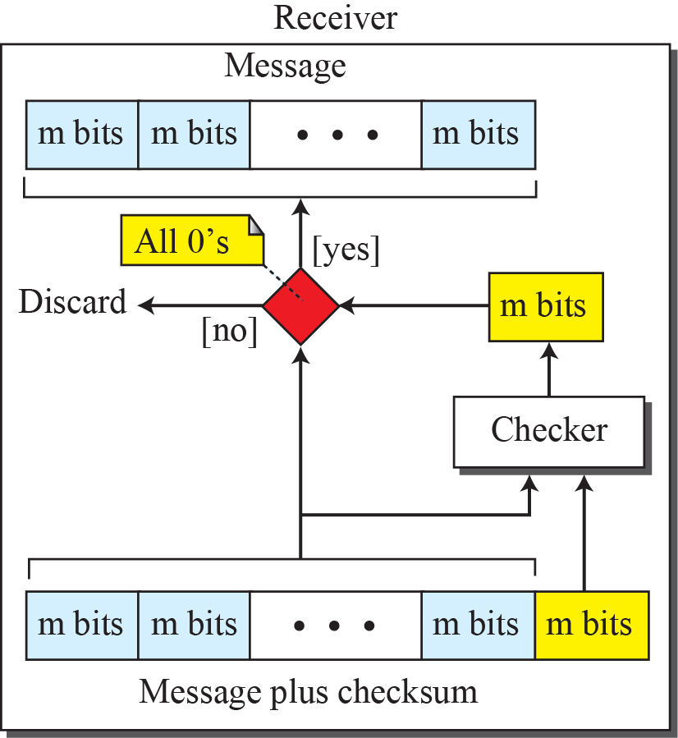
Figure 10.15: Checksum

Slide 55
10.4.1 Concept
The idea of the traditional checksum is simple. We show this using a simple example.

Slide 56
Example 10.11
Suppose the message is a list of five 4-bit numbers that we want to send to a destination. In addition to sending these numbers, we send the sum of the numbers. For example, if the set of numbers is (7, 11, 12, 0, 6), we send (7, 11, 12, 0, 6, 36), where 36 is the sum of the original numbers. The receiver adds the five numbers and compares the result with the sum. If the two are the same, the receiver assumes no error, accepts the five numbers, and discards the sum. Otherwise, there is an error somewhere and the message not accepted.
10.56

Slide 57
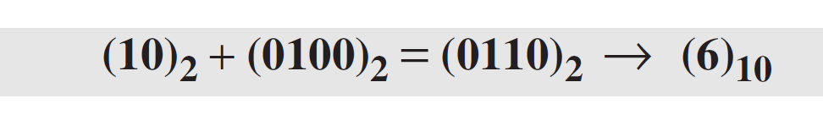
Example 10.12
In the previous example, the decimal number 36 in binary is (100100)2. To change it to a 4-bit number we add the extra leftmost bit to the right four bits as shown below.
Instead of sending 36 as the sum, we can send 6 as the sum (7, 11, 12, 0, 6, 6). The receiver can add the first five numbers in one’s complement arithmetic. If the result is 6, the numbers are accepted; otherwise, they are rejected.
10.57

Slide 58
Example 10.13
Let us use the idea of the checksum in Example 10.12. The sender adds all five numbers in one’s complement to get the sum = 6. The sender then complements the result to get the checksum = 9, which is 15 − 6. Note that 6 = (0110)2 and
9 = (1001)2; they are complements of each other. The sender sends the five data numbers and the checksum (7, 11, 12, 0, 6, 9). If there is no corruption in transmission, the receiver receives (7, 11, 12, 0, 6, 9) and adds them in one’s complement to get 15 (See Figure 10.16).
10.58

Slide 59
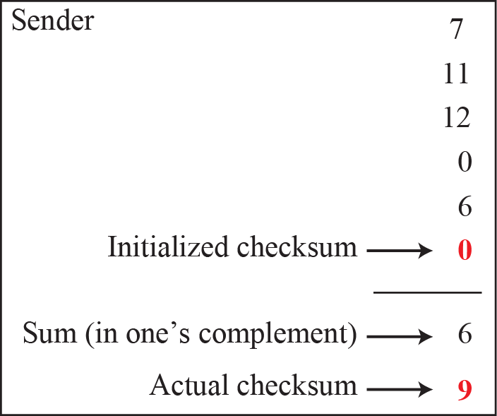
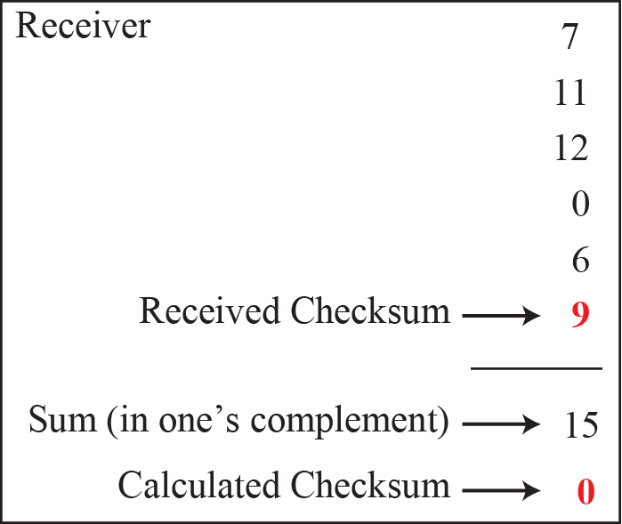
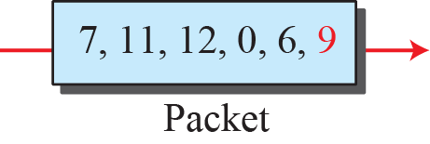
Figure 10.16: Example 10.13

Slide 60
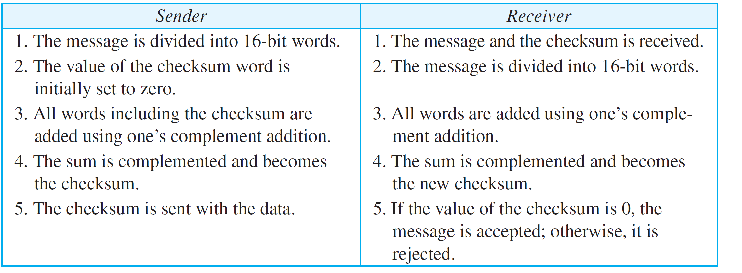
Table 10.5: Procedure to calculate the traditional checksum
10.60

Slide 61
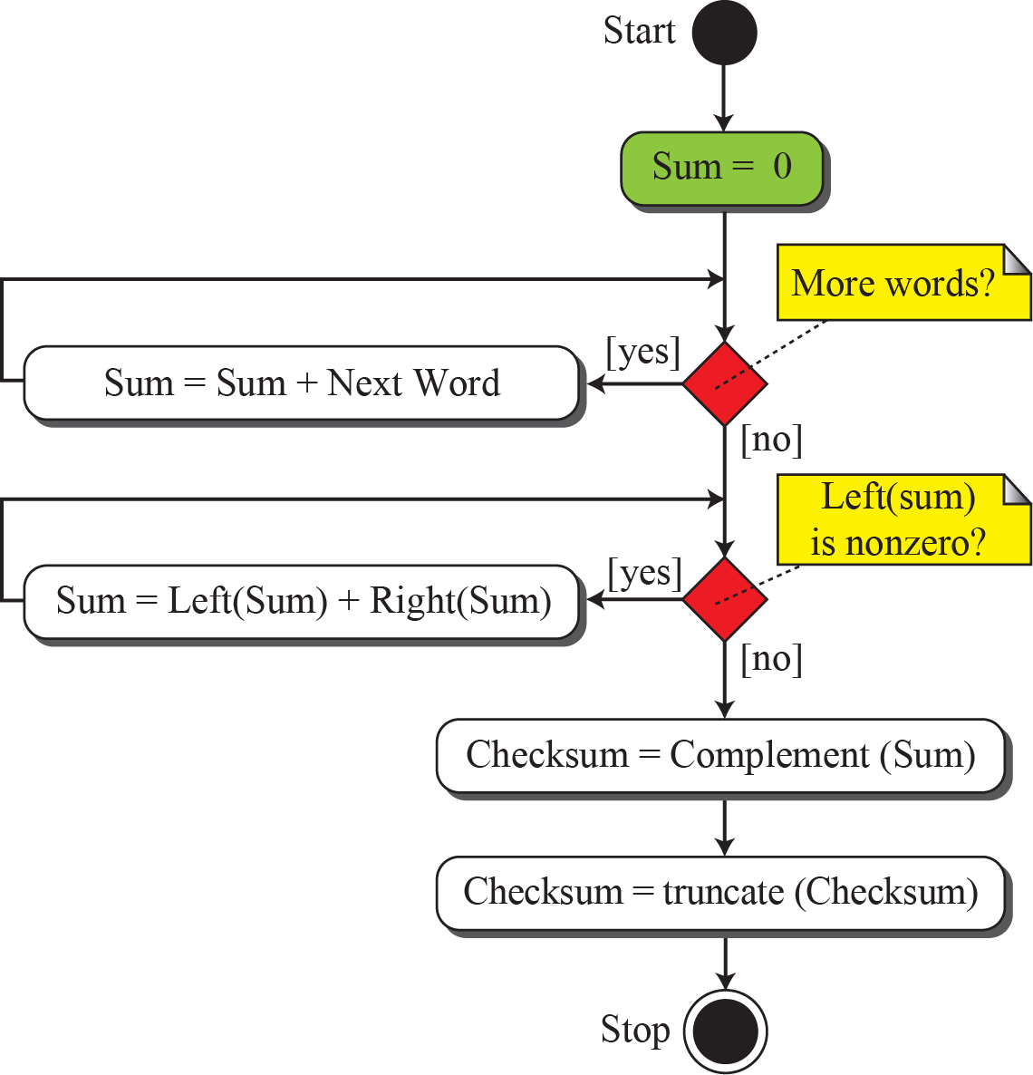
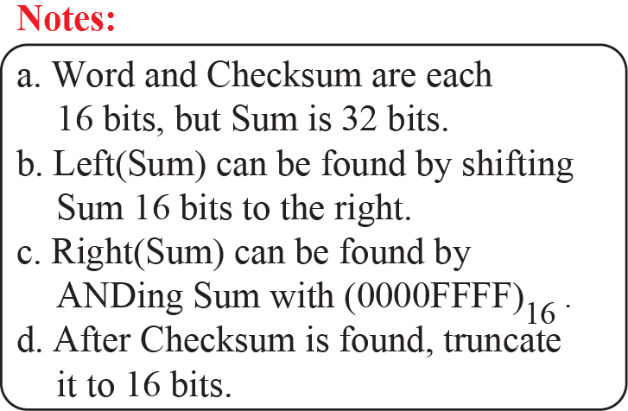
Figure 10.17: Algorithm to calculate a traditional checksum

Slide 62
    10-5 FORWARD ERROR CORRECTION
We discussed error detection and retransmission in the previous sections. However, retransmission of corrupted and lost packets is not useful for real-time multimedia transmission. We need to correct the error or reproduce the packet immediately.

Slide 63
10.5.1 Using Hamming Distance
We earlier discussed the Hamming distance for error detection. For error detection, we definitely need more distance. It can be shown that to detect t errors, we need to have d_{min} = 2t + 1. In other words, if we want to correct 10 bits in a packet, we need to make the minimum hamming distance 21 bits, which means a lot of redundant bits need to be sent with the data. the geometrical representation of this concept.

Slide 64

Figure 10.20: Hamming distance for error correction

Slide 65


10.5.2 Using XOR
Another recommendation is to use the property of the exclusive OR operation as shown below.
This means:

Slide 66
10.5.3 Chunk Interleaving
Another way to achieve FEC in multimedia is to allow some small chunks to be missing at the receiver. We cannot afford to let all the chunks belonging to the same packet be missing; however, we can afford to let one chunk be missing in each packet.

Slide 67

Figure 10.21: Interleaving

Slide 68
10.5.4 Combining
Hamming distance and interleaving can be combined. We can first create n-bit packets that can correct t-bit errors. Then we interleave m rows and send the bits column by column. In this way, we can automatically correct burst errors up to m × t bits of errors.

Slide 69
10.5.5 Compounding
Still another solution is to create a duplicate of each packet with a low-resolution redundancy and combine the redundant version with the next packet. For example, we can create four low-resolution packets out of five high-resolution packets and send
them as shown in Figure 10.22.

Slide 70


Figure 10.22: Compounding high-and-low resolution packets

