Slide 1
Section 11.5: The DNS Protocol
(11.5.6.11 ~ 11.5.8.3)
이상욱
2014010243

Slide 2
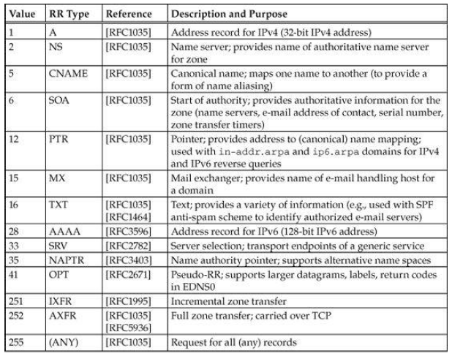
Resource Record Types
There are many types of resource records, and a single name may have multiple matching RRs

Slide 3
Name Authority Pointer (NAPTR) Record
NAPTR RR
  Used when DNS supports a Dynamic Delegation Discovery System (DDDS)
  DDDS is a general, abstract algorithm for applying dynamically retrieved string transformation rules to strings provided by applications and using the results
  NAPTR resource record type is used to hold the transformation rules
  An algorithm in DDDS directs how an application-unique string (AUS) is processed by rules contained in a database
  The result can be either a terminal string or another nonterminal string used to retrieve another rule that is applied to the AUS

Slide 4
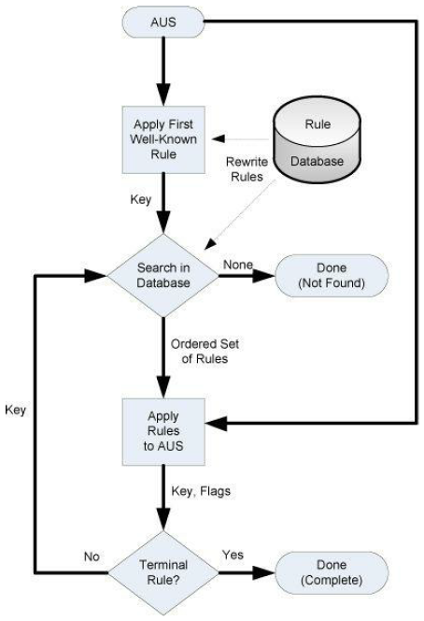
Name Authority Pointer (NAPTR) Record
Operation of the DDDS algorithm

Slide 5
Name Authority Pointer (NAPTR) Records
NAPTR RR fields
  Order
    Specifies which NAPTR record to use before others
  Preference
    Influences the order of records containing the same order number
  Flags
    Defined by the application
  Services
    Indicates which type of service is being described
  Regular Expression
    Substitution expression or output string
  Replacement
    Indicates next server to query for NAPTR records

Slide 6
ENUM and SIP
ENUM DDDS
  Used to map phone numbers to URI information
  AUS : E.164-format telephone number
  The First Well-Known Rule
    Removing any dashes or other non-digit characters
    Inserting dot (.) characters between each digit
    Reversing the result
    Adding the suffix “.e164.arpa”
  The resulting domain name is used to query for NAPTR records
< example >
+1-415-555-1212 → 2.1.2.1.5.5.5.5.1.4.1.e164.arpa

Slide 7
ENUM and SIP
ENUM DDDS
  Final output is an absolute URI
    Example
Linux% host -t naptr 1.1.1.1.1.5.8.3.7.0.2.4.e164.arpa
1.1.1.1.1.5.8.3.7.0.2.4.e164.arpa has NAPTR record
50 50 "u" "E2U+sip" "!^\\+(.*)$!sip:\\1@osu.cz!".
1.1.1.1.1.5.8.3.7.0.2.4.e164.arpa has NAPTR record
100 50 "u" "E2U+sip""!^\\+(.*)$!sip:\\1@cesnet.cz!".
1.1.1.1.1.5.8.3.7.0.2.4.e164.arpa has NAPTR record
200 50 "u" "E2U+h323" "!^\\+(.*)$!h323:\\1@gk1ext.cesnet.cz!".
In the case of 2nd record…
Order : 100
Preference : 50
Flags : u
Services : E2U+sip
Regexp : "!^\\+(.*)$!sip:\\1@cesnet.cz!"
→ sip:420738511111@cesnet.cz

Slide 8
URI/URN Resolution
URI/URN DDDS
  Defined for resolving URIs (including URNs)
  AUS : URI or URN
  The First Well-Known Rule
    URI DDDS
      Scheme Name
      ex) http://www.pearson.com → http
    URN DDDS
      Name Space Identifier
      ex) urn:foo:foospace → foo
  Flags
    S : Result is the domain name to use for fetching an SRV Record
    A : Result is the domain name to use fetching an IP address
    U : Result is the domain name to use fetching an URI
    P : Processing of the DDDS algorithm is to be discontinued

Slide 9
S-NAPTR
An application wishes to determine the particular host, protocol, and port number to use for reaching a service within a domain. but …
    CNAME, A, or AAAA record types don’t convey any indication of which transport protocol or port number to use
    SRV record type contains only domain name
S-NAPTR
  Specifies a DDDS application for mapping domain “labels” that contain a service name
  Output is the information necessary to contact a particular application service within a domain
  Example
Linux% host -t naptr areg.iris.arpa
reg.iris.arpa NAPTR 100 10 "" "AREG1:iris.xpc:iris.lwz" "" areg.nro.net

Slide 10
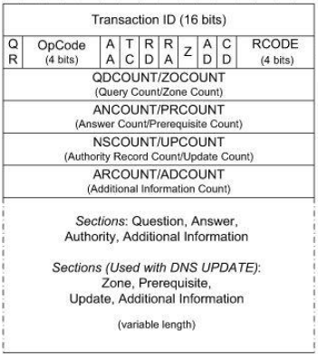
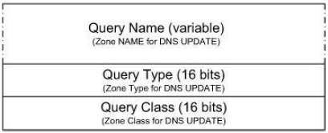
Dynamic Updates (DNS UPDATE)
DNS Update (Zone Update)
  Accomplished by sending dynamic update DNS messages to an authoritative DNS server for a zone
  The structure of messages is the same as for a conventional DNS message, except the header fields and sections have different names
Query(Zone) section
in DNS message
DNS message

Slide 11
Dynamic Updates (DNS UPDATE)
5 types of prerequisite (in Prerequisite section)
  RRSet exist (value-independent)
  RRSet exist (value-dependent)
  RRSet does not exist
  Name is in use
  Name is not in use
4 types of update (in Update Section)
  Add RR to RRSet
  Delete RRset
  Delete all RRSets from a name
  Delete RR from RRSet

Slide 12
Zone Transfers and DNS NOTIFY
Zone transfers
  Used to copy a set of RRs for a zone from one server to another
  The purpose of doing so is to keep multiple servers in sync with respect to a zone’s contents
  Multiple servers provide resiliency to failure, in case a server should go down
  Performance can also be improved as multiple servers can be used to share the processing load for incoming queries
  The latency of a DNS query/response can potentially be reduced if servers are placed in locations close to clients

Slide 13
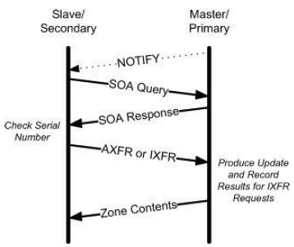
Zone Transfers and DNS NOTIFY
Operation of zone transfers

Slide 14
Zone Transfers and DNS NOTIFY
Full zone transfer
  An All Zone Transfer DNS message (a standard query containing type AXFR in the Question section) is used to request a complete zone transfer using TCP
  Using the host program to see such a message
  The -l flag asks the host program to perform a full zone transfer from a local DNS server
Linux% host –l home

Slide 15
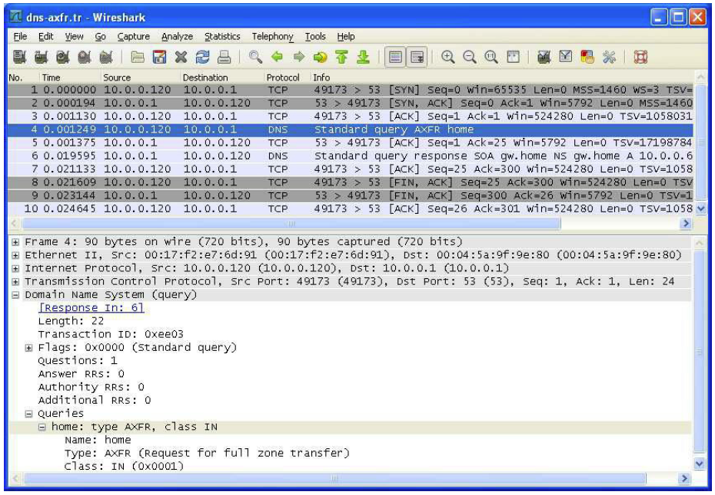
Zone Transfers and DNS NOTIFY
Full zone transfer : Query

Slide 16
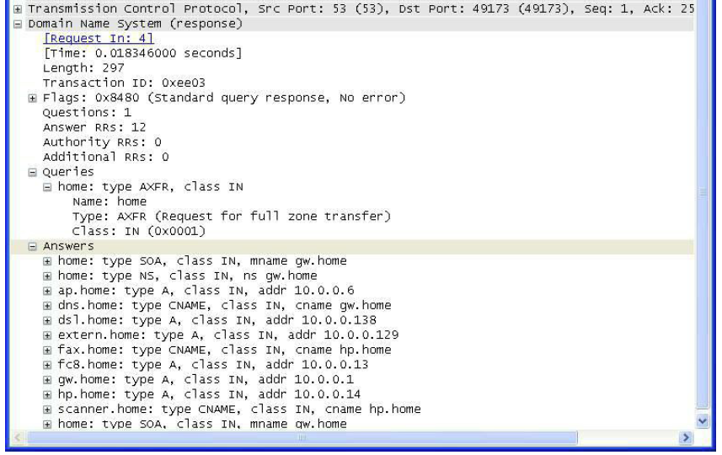
Zone Transfers and DNS NOTIFY
Full zone transfer : Response

Slide 17
Zone Transfers and DNS NOTIFY
Incremental zone transfer
  To improve the efficiency of zone transfers, defines the use of incremental zone transfers
  Using incremental zone transfers and the IXFR message type, only the changes in a zone are provided
  To execute an incremental zone transfer, the client must provide its current serial number for the zone

Slide 18
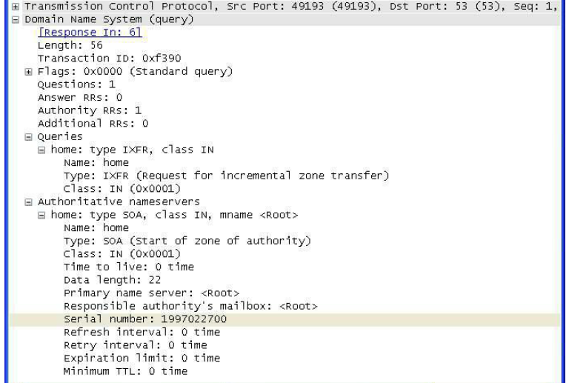
Zone Transfers and DNS NOTIFY
Incremental zone transfer : Query

Slide 19
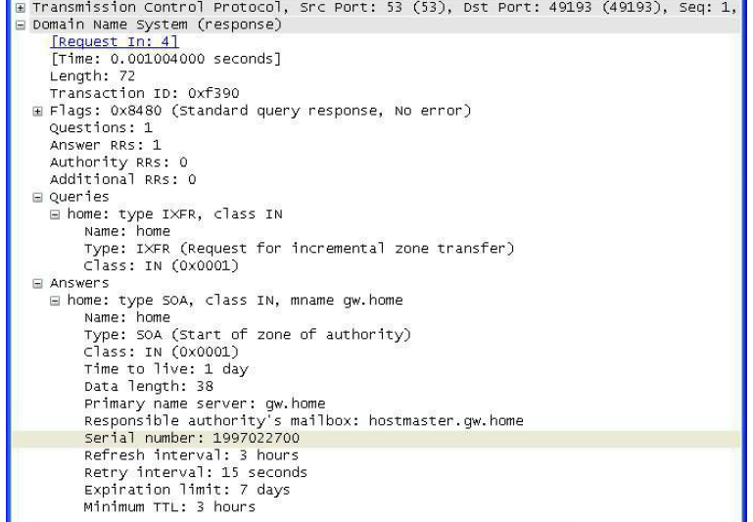
Zone Transfers and DNS NOTIFY
Incremental zone transfer : Response

Slide 20
Zone Transfers and DNS NOTIFY
DNS NOTIFY
  Allows a server with modified zone contents to notify slave servers that an update has been made and a zone transfer should be initiated
  More specifically, if enabled, a notification message is sent to a set of interested servers if the SOA RR for a zone changes (e.g., if the serial number increases)
  This allows zone transfers to be initiated easily when required
  The DNS NOTIFY mechanism defaults to using UDP, an unreliable protocol

Slide 21
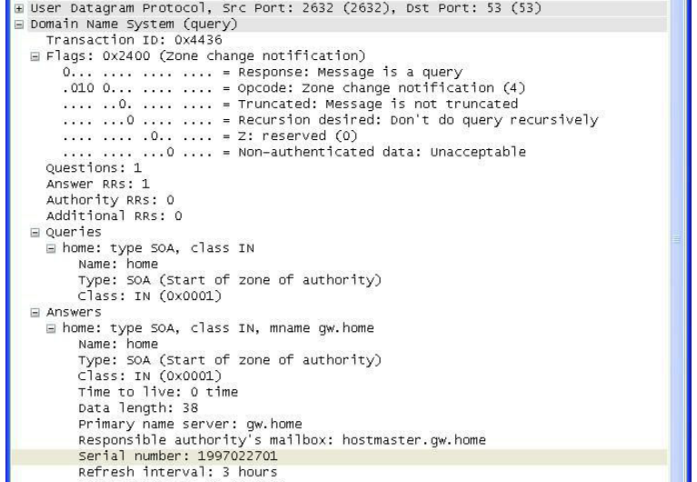
Zone Transfers and DNS NOTIFY
DNS NOTIFY

