Slide 1
Modeling Web Quality-of-Experience on Cellular Networks
MobiCom‚ 2014
Presenter : Jihye Kim

Slide 2
Contents
Introduction
Extracting User Experience Metric
Analyzing Network Factors
Modeling Web QoE
Discussion
Limitations
Conclusion

Slide 3
Introduction
Web browsing is one of the most prominent cellular applications
To understand how radio network characteristics influence user’s web browsing Quality-of-Experience (web QoE) is important
In this paper, devise a machine-learning-based mechanism to infer web QoE metrics from network traces accurately

Slide 4


Extracting User Experience Metrics
Two central engagement metrics
  Session length
  (i.e., the number of pages a user clicks through)
  Abandonment or bounce rate
  (i.e., if a user leaves the website after only visiting the landing page)

Slide 5
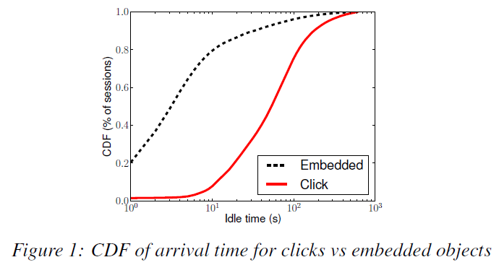
Detecting Click
Previous Technique
  Use the idle time between requests
  Based on the assumption that the idle time for requests for embedded objects will be extremely short, whereas requests generated by clicks would typically have higher idle time
Limitation
  In modern mobile web page, a non-trivial fraction of embedded objects have idle times as long as many user clicks (e.g., requests generated by periodic beacons from third-party analytic services)
Clicks
Requests that are initiated by user activity
Embedded Objects
Requests that are initiated automatically by the browser

Slide 6
Detecting Click: Approach
Approach
  Based on observation that most the embedded objects are hosted by third party service
  (such as advertising agencies, Content Distribution Networks (CDNs) and analytics services)
  to distinguish embedded objects from clicks by inspecting request URLs.
Step 1: Grouping Sessions
  Group requests into different sessions using the anonymized IMEI and Referer header information
Step 2: Extracting Features
  In order to perform text classification, extract two set of features from the requested URLs
  Feature simple
    www.blog.xyz.com/my/blog/abc.html → <blog, xyz, com>
  Feature diverse
    www.blog.xyz.com/my/blog/abc.html → domain = <blog, xyz, com>
    www.blog.xyz.com/my/blog/abc.html → urn = <my, blog, abc.html>
    www.blog.xyz.com/my/blog/abc.html → type = html
IMEI
International Mobile Equipment Identity
WCDMA(3G) 휴대폰에 내장되어 있는 15자리 숫자로 된 번호이며 단말기 고유 일련번호
Referer header field
이전 URL 정보를 알 수 있는 지표
‘HTTP_REFERER’ 라는 변수로 표현
Syntax) urn:<NID>:<NSS>
EX) urn:isbn:0451450523
=>The 1968 book The Last Unicorn, identified by its book number.

Slide 7
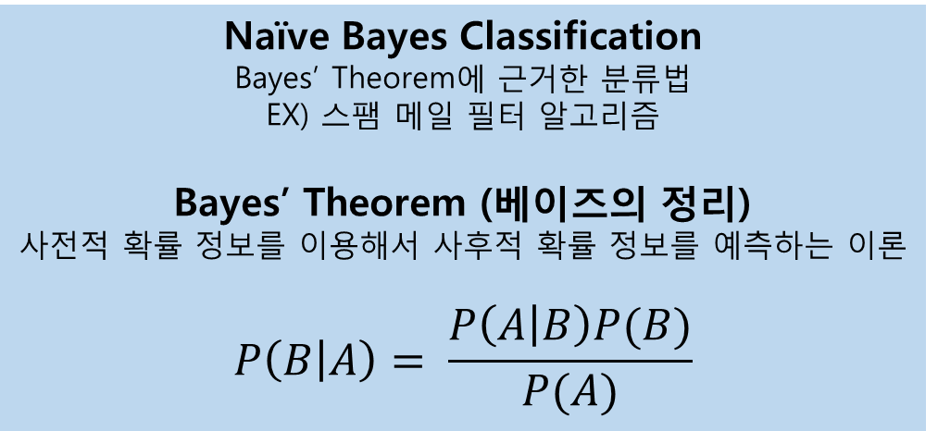
Detecting Click: Approach
Step 3: Automatic Labeling to Obtain Training Set
  Inspect only the very first 10 seconds of every web session
  Assume that only the first request during this time frame was a click and remaining requests are for embedded objects
  Enable approach to be applied to any website without any manual labeling or ground truth
Step 4: Running Classification Algorithm
  First, learn the classifier model using the training set
  And then, input the entire dataset and classify each request as the click of embedded object
  After testing with multiple machine learning algorithms, pick Naïve Bayes to perform the best
Naïve Bayes Classification
Bayes’ Theorem에 근거한 분류법
EX) 스팸 메일 필터 알고리즘
Bayes’ Theorem (베이즈의 정리)
사전적 확률 정보를 이용해서 사후적 확률 정보를 예측하는 이론
$$P\left(B | A\right)= \frac{P\left(A | B\right)P(B)}{P(A)}$$

Slide 8
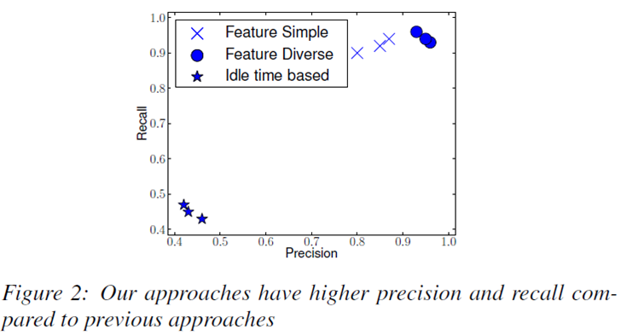
Detecting Click: Validation
To validate approach, apply it to the three web sites
Precision: the number of correct clicks identified by the total number of clicks identified
Recall: the number of correct clicks identified by the total number of clicks
Feature diverse has higher precision than Feature Simple because it just uses features from the domain name

Slide 9
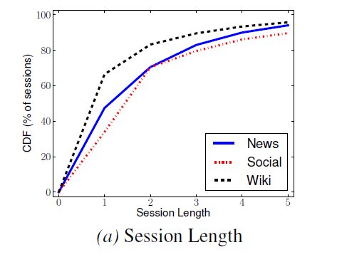
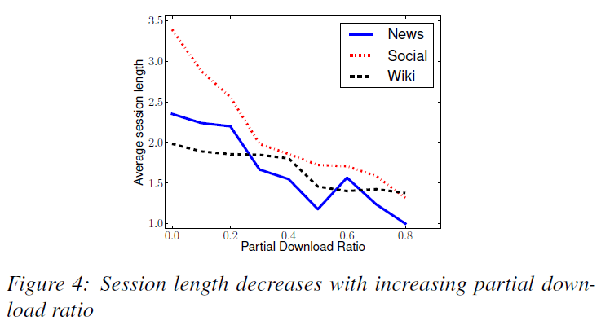
Measuring User Experience
Session length and abandonment rate are two important metrics that the web industry recognizes as representative of user engagement
Partial Download Ratio is a useful proxy metric for user engagement
Highlight the need for a user engagement metric that can highlight network problems in sessions of length one

Slide 10
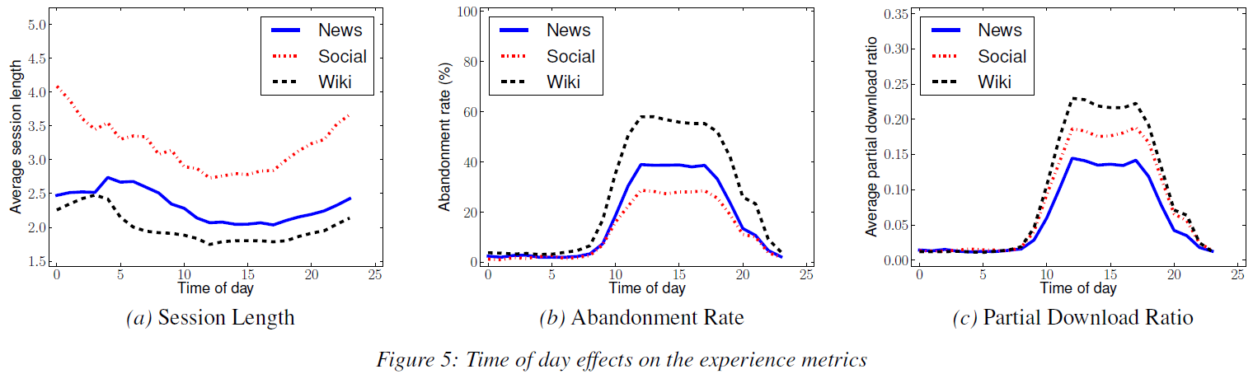
Measuring User Experience
Observe that the web QoE metrics are different across different websites
User experience is dependent on factors other than network quality, such as how mobile-friendly the website is, the number of objects, type of objects etc

Slide 11
Analyzing Network Factors
Itemize all radio network factors which may effect web QoE
  Number of soft handovers (SOHO)
  Number of inter-frequency handovers (IFHO)
  Number of inter-radio access technology (IRAT) handovers
  Average Received Signal Code Power (RSCP)
  Average received energy per chip of the pilot channel over the noise power density (ECNO)
  Average received Signal Strength Indicator (RSSI)
  Average uplink and downlink radio data throughput
  Average number of users in active state

Slide 12
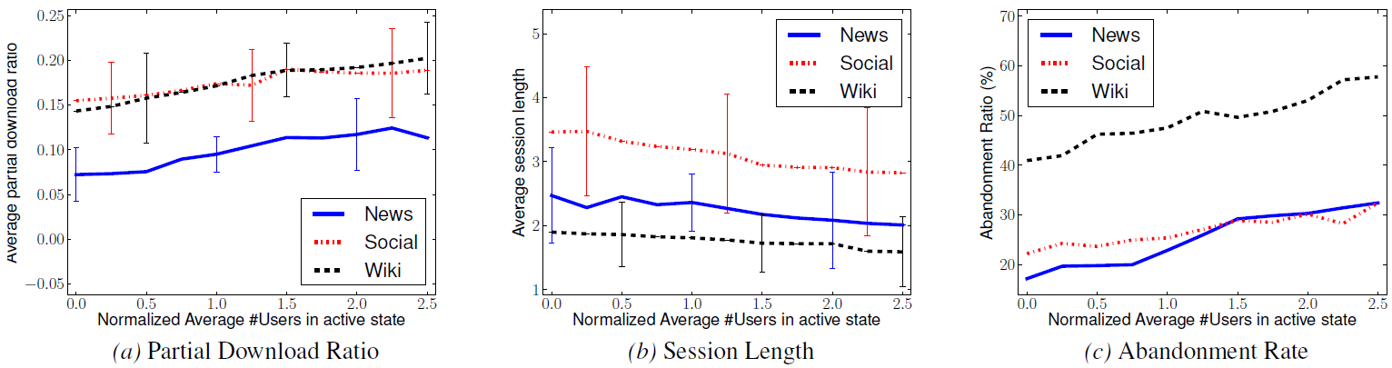
How network factors impact web QoE
Higher network load results in worse web QoE
Result: cellular network operators can improve web QoE by decreasing cell load by deploying more radio cells or re-distributing users across cells

Slide 13
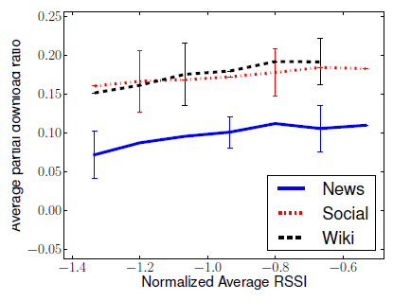
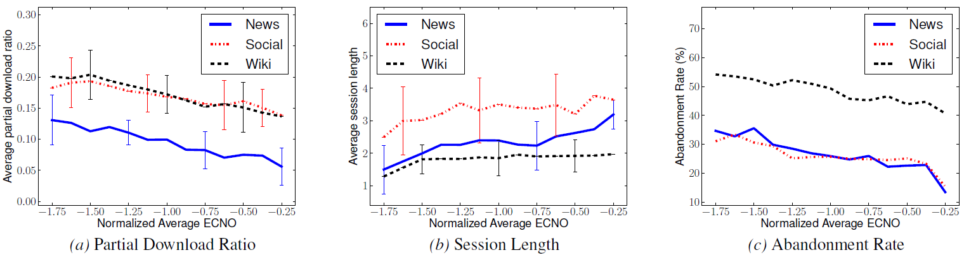
How network factors impact web QoE
Higher signal strength (RSSI) does not necessarily correlate with better user experience, but higher signal energy to interference (ECNO) does
Result: Web QoE is interference and noise limited, not power(i.e., coverage) limited

Slide 14
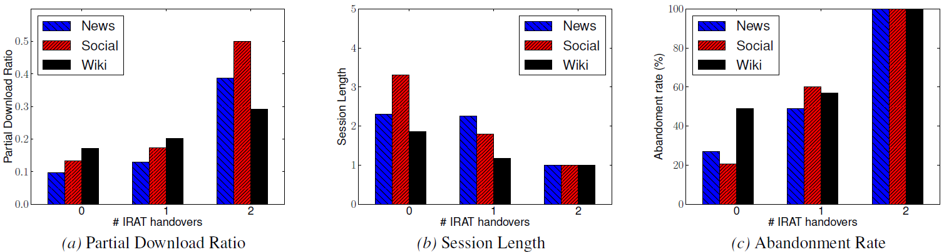
How network factors impact web QoE
IRAT handovers lead to worse web QoE

Slide 15
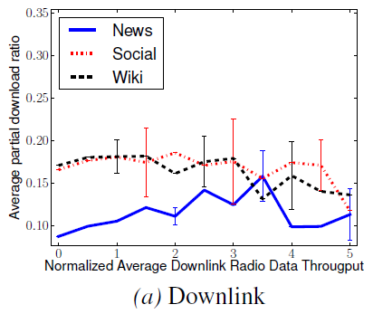
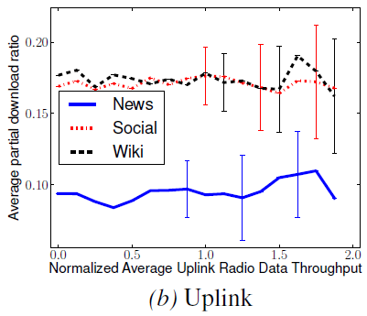
How network factors impact web QoE
Higher radio data rate does not necessarily lead to better web QoE
Result: Web browsing traffic is more latency-limited than throughput-limited

Slide 16
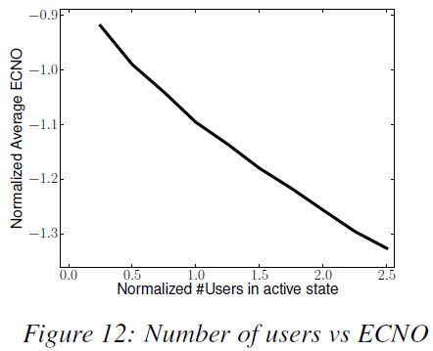
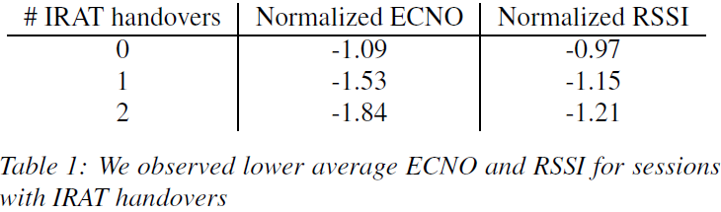
Dependencies and Other Factors
The number of users in active state in a cell and ECNO are dependent on each other
Session that experience IRAT handovers also experience lower signal strength (RSSI) and lower signal energy to interference (ECNO)

Slide 17
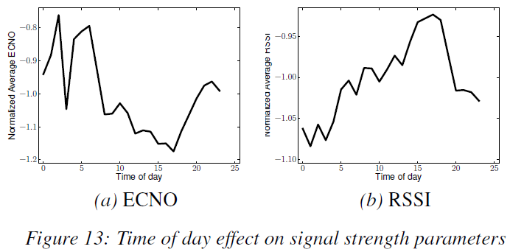
Dependencies and Other Factors
Complex interdependencies between network factors as well as external factors (e.g. time of day) make it very challenging to understand and quantify the true impact of each network factor using correlation analysis

Slide 18
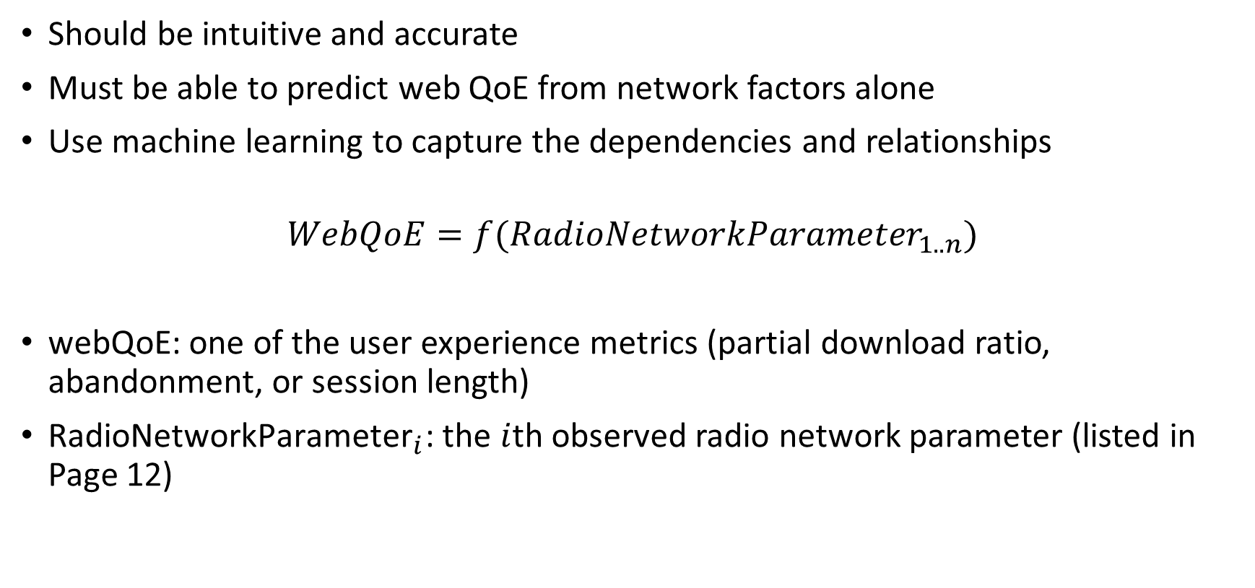
Modeling Web QoE
Should be intuitive and accurate
Must be able to predict web QoE from network factors alone
Use machine learning to capture the dependencies and relationships
$$WebQoE=f({RadioNetworkParameter}_{1..n})$$
webQoE: one of the user experience metrics (partial download ratio, abandonment, or session length)
${\text{RadioNetworkParameter}}_{i}$: the $i$th observed radio network parameter (listed in Page 12)

Slide 19
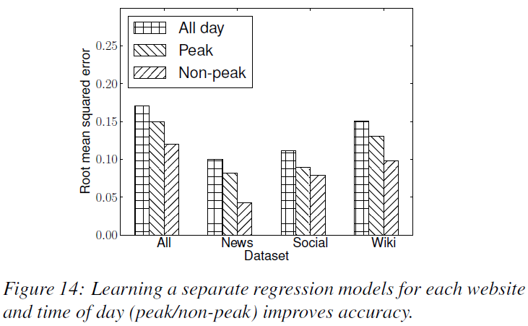
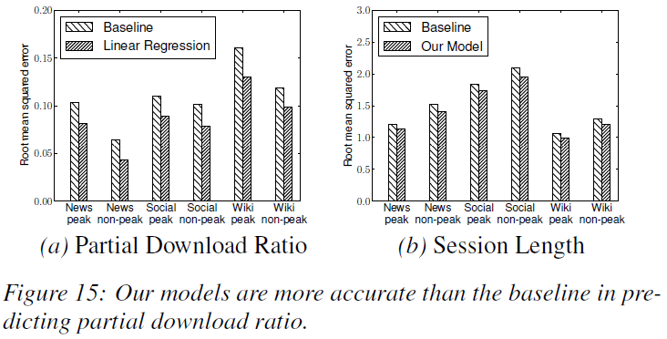
Modeling Web QoE: Evaluation
Evaluating Linear Regression Models
  To measure the “goodness-of-fit” of linear regression, use the standard measure of root mean squared error (RMSE), where lower RMSE values indicate better prediction
RMSE
평균 제곱근 오차(Root Mean Square Error)
모델이 예측한 값과 실제 환경에서 관찰되는 값의 차이를 다룰 때 흔히 사용하는 측도
정밀도(precision)를 표현하는데 적합
Linear regression
선형 회귀 분석
두 변량 사이의 관계가 직교 좌표 상에 직선으로 표시되는 관계
EX) 연봉 - 키

Slide 20
Discussion
Other websites
  Can be easily applied to other websites
New technologies
  Expect this methodology and results to generally apply to newer technologies such as 4G Long Term Evolution (LTE)
    Radio network parameters in UMTS have analogous parameters in LTE
    Since web browsing is more latency-limited than throughput-limited,
    higher throughput offered by LTE may not have a significant impact on web QoE

Slide 21
Limitations
One of the main constraints faced by a network operator is the lack of client-side instrumentation
  This makes it difficult to differentiate between the abandonment caused by the lack of user interest from the ones cause by network issues
Network operators cannot identify cellular-to-WiFi handovers from cellular network traces alone, and would mistakenly mark such handovers as abandonments
Nonetheless, a few false positives or negatives introduced by these limitations are unlikely to significantly alter the behavior of aggregate metrics

Slide 22
Conclusion
Developed and evaluated text-classification-based mechanism
  To extract mobile web browsing session and estimate various web QoE metric from network trace
  Classification approach has 20% higher precision than precious state-of-the-art
Analyzed the impact of various radio network factor on web QoE
  Observed that web QoE is sensitive to IRAT handovers, ECNO and load in the cell
Developed accurate and intuitive machine learning model that can predict various web QoE metrics from network factors alone
  This model can be used by network operators to monitor web QoE and prioritize improvement of network factors that have the highest impact

