Slide 1
7.5 #: Configuring Packet-Filtering Firewalls and NATs
허완
2015010644

Slide 2
7.5.1 Firewall Rules (1)
A packet-filtering firewall must be given a set of instructions indicating criteria for selecting traffic to be dropped or forwarded.
ACL(Access Control List)
  Consists of set of rules
  Each rule contains pattern-matching criteria and action
    The matching criteria allow the rule to express the values of packet fields at either the network or transport layer and a direction specification
    The direction pattern matches traffic in a direction-dependent manner and allows for a different set of rules to apply for incoming versus outgoing traffic

Slide 3
7.5.1 Firewall Rules (2)
When a packet arrives,
  The matching criteria in the appropriate ACL are consulted in order
    For most firewalls, the first matching rule is acted upon.
  Typical actions include a specification to block or forward the traffic and may also adjust a counter or write a log entry.
    Some firewalls may include additional features as well, such as having some packets directed to applications or other hosts.

Slide 4
iptables (1)
One of the popular systems for building firewalls
(included with modern versions of Linux)
Built using a network filtering capability called NetFilter
Provides stateless and stateful packet-filtering support as well as NAT and NAPT

Slide 5
iptables (2)
Overview(Cont’d)
  Includes the concepts of filter tables and filter chain
  A table contains several predefined chains and may contain zero or more user-defined chains
  Three predefined tables are names as follows :
  filter, nat, and mangle
    filter : is for basic packet filtering and contains the predefined chains INPUT, FORWARD, and OUTPUT.
    nat : contains the chains PREROUTING, OUTPUT, and POSTROUTING
    mangle : has all five chains. It is used for arbitrary rewriting of packets

Slide 6
iptables (3)
Overview
  Each filter chains is a list of rules, and each rule has matching criteria and an action
    Action(called target)
      ACCEPT means the packet is forwarded
      DROP means the packet is dropped
      QUEUE means the packet is delivered to a user program for arbitrary processing
      RETURN means that processing continues in a previously invoked chain, which forms a sort of packet filter chain subroutine call

Slide 7
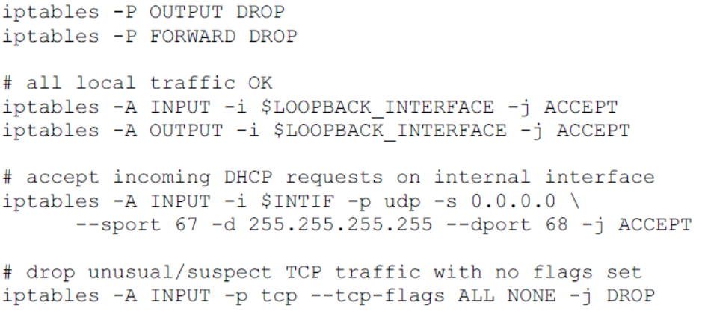
iptables (4)
An example
-A : Append one or more rules to the end of the selected chain
-j : This specifies the target of the rule
-i : Name of an interface via which a packet was received

Slide 8
7.5.2 NAT Rules
Called Internet Connection Sharing (ICS) in windows
Called IP masquerading in Linux
NAT in Windows 10
  Assigns the internal IPv4 address as 192.18.0.1 to the machine running ICS and starts a DHCP server and DNS server
  Other computers are assigned addresses in the 192.168.0.0/24 subnet, with the ICS machine as DNS server
    ICS should not be enabled on networks where these services are already being provided by another computer or router, or where the addresses might conflict

Slide 9
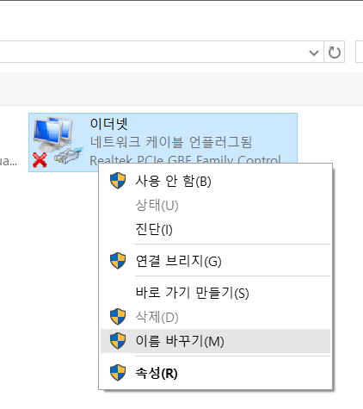
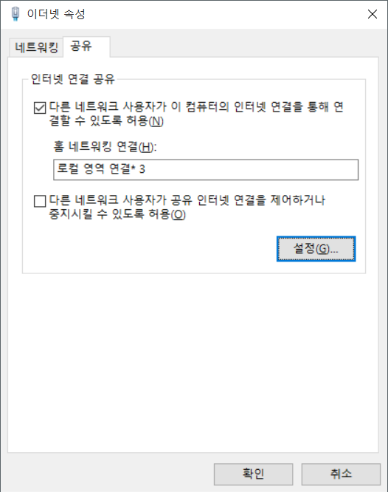
NAT in Windows 10

Slide 10
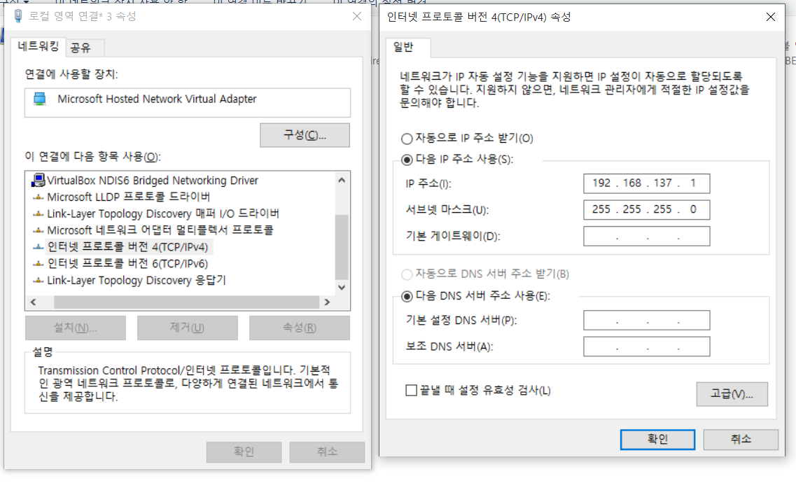
NAT in Windows 10 (2)

Slide 11
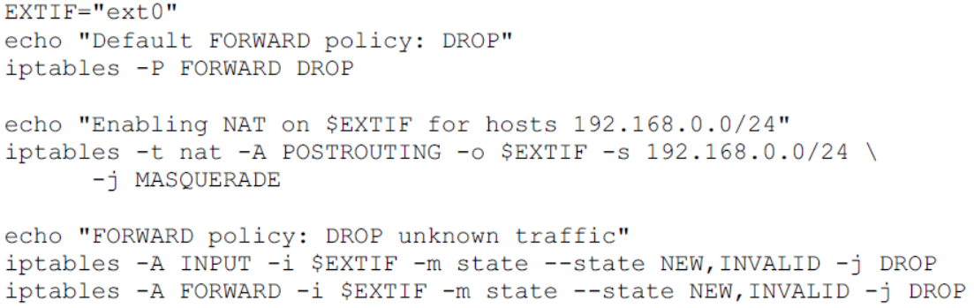
NAT in Linux
The following script configures masquerading in a simple manner.
Note that this script is only for illustration and is not recommended for production use
-t : This option specifies the packet matching table which the commmand
should operate on
-m : Specifies a match to use, that is, an extension module that
tests for a specific property

Slide 12
7.5.3 Direct Interaction with NATs and Firewalls: UPnP, NAT-PMP, PCP
A number of protocols have been developed for supporting communication between clients and firewalls
Universal Plug and Play (UPnP)
  Has native support on Windows
  Can be added to Mac OS and Linux
NAT Port Mapping Protocol (NAT-PMP)
  Supported by most Mac OS X

Slide 13
Universal Plug and Play (UPnP)
With UPnP, controlled devices are configured with IP addresses based first upon DHCP
  Using dynamic link-local address configuration if DHCP is not available
Simple Service Discovery Protocol (SSDP) [XIDS] announces the presence of the device to control points and allows the control points to query the devices for additional information

Slide 14
Universal Plug and Play (UPnP)
Subsequent control and event notification (“eventing”) is controlled by the General Event Notification Architecture (GENA), which uses the Simple Object Access Protocol (SOAP)
SOAP supports a client/server remote procedure call (RPC) mechanism and uses messages encoded in the Extensible Markup Language (XML)

Slide 15
NAT Port Mapping Protocol (NAT-PMP)
NAT-PMP provides an alternative specifically targeted at programmatic communications with NAT devices
NAT-PMP is part of Apple’s set of Bonjour specifications for zero configuration networking
NAT-PMP does not use a discovery process
  as the device being managed is usually a system’s default gateway as learned by DHCP
It also supports a basic eventing mechanism that notifies listeners when a NAT outside address changes
  This is accomplished using a UDP multicast message sent to address 224.0.0.1 (the All Hosts address) when the outside address changes
NAT-PMP uses UDP port 5350 for client/server interactions and 5351 for multicast event notification

