Slide 1
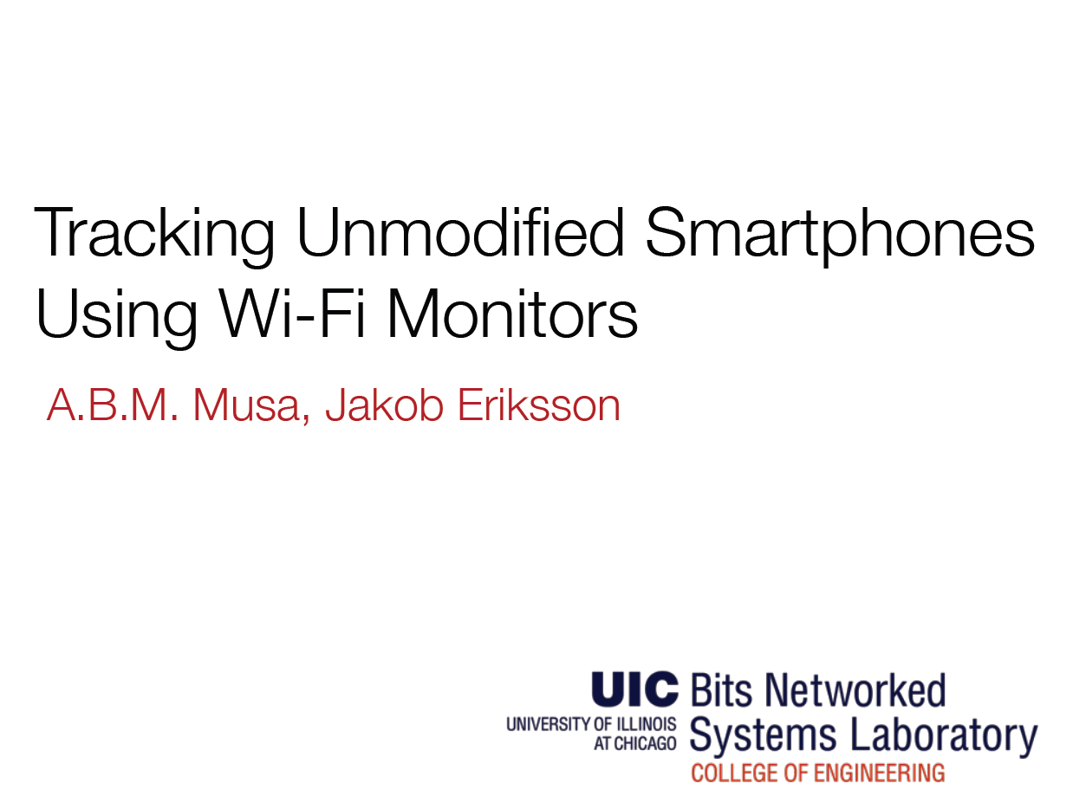
SenSys’12
2013.04.30
Presented by hyemin Kim
Notes:
Good morning.
I’ll begin my presentation.
The topic of presentation is Tracking unmodified smartphones using wi-fi monitors.
This paper is sensys’ 2012
Let me introduce myself. I’m hyemin kim. My lab is wireless data communications.

Slide 2
Introduction
Smartphone with Wi-Fi enabled periodically transmit Wi-Fi message
  12-hour trial on a bus road
    7000 devices were detected by a single road-side monitoring station
    1 device for every 5 vehicles
By deploying Wi-Fi monitoring equipment in an area of interest
  Possible to detect these transmission
    Providing a coarse-gained location trace
Notes:
Now, let me begin the presentation by showing you some environment result.
This paper show that author tests 12 hour trial on a bus road
So, result 7000 devices were detected by a single road-side monitoring station.
By deploying Wi-Fi monitoring equipment in an area of interest, it is possible to detect these transmissions, providing a coarse-grained location trace for each phone that passes through the area without modifying the phones.

Slide 3
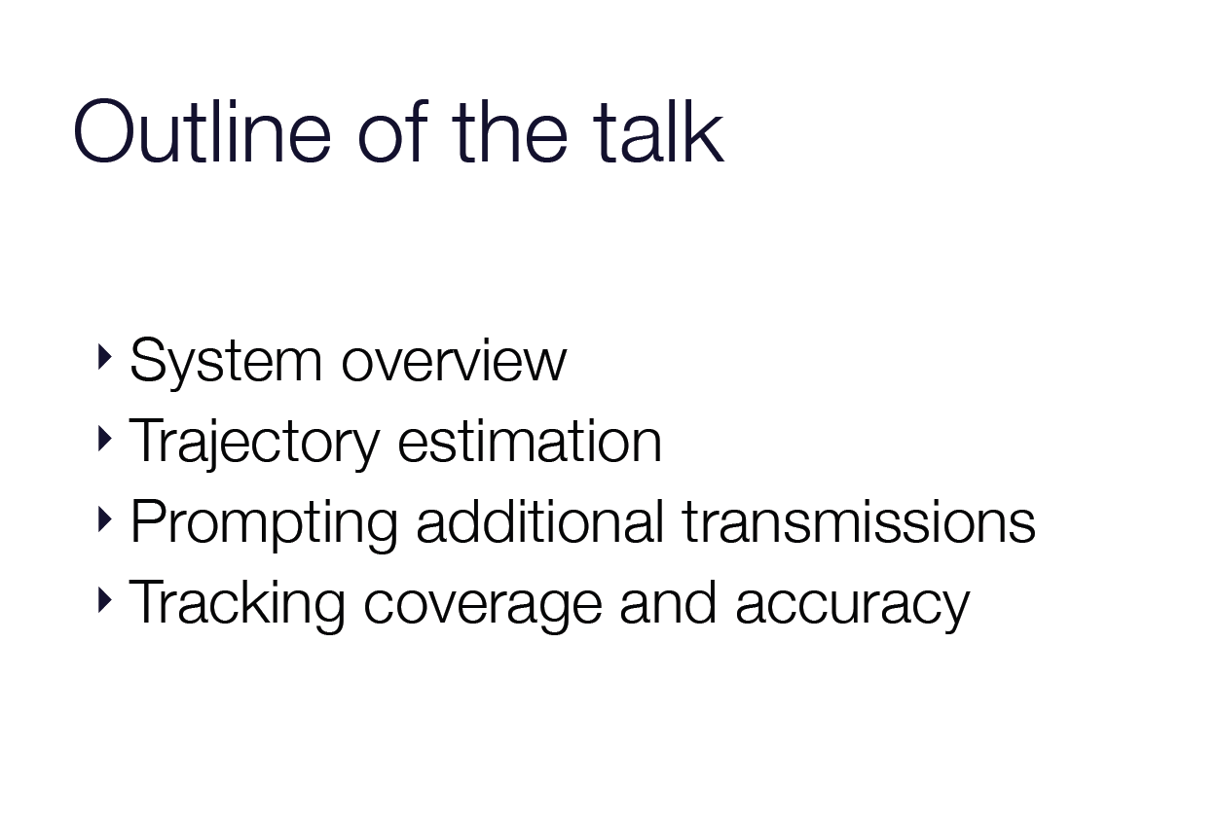
Notes:
There are four main things dealt with in my presentation
First system overview
Second trajectory estimation
Third prompting additional transmission
And lastly tracking coverage and accuracy

Slide 4
System Overview
Passive Wi-Fi tracking system
  Number of Wi-Fi monitors
    Transmissions all carry a device-unique address(MAC address)
      Enabling device re-identification across monitors
      Detected range : 300 meters
  Central tracking server
    detection processing turns a series of detections of a single phone
      Analogous to a GPS trace for each detected phone
Notes:
passive wifi tracking system configures number of wifi monitors and center tracking server
Device detections are made by capturing Wi-Fi transmissions from the device in question: such transmissions all carry a device-unique address (MAC address), enabling device re-identification across monitors.
Wi-Fi transmissions from a cellphone may be received at up to 300 meters, or may be too faint to detect at 20 meter range depending on transmit power, path loss and fading effects.
detection processing at the server turns a series of detections of a single phone, into a single consistent and highly likely spatio-temporal trajectory, analogous to a GPS trace for each detected phone

Slide 5
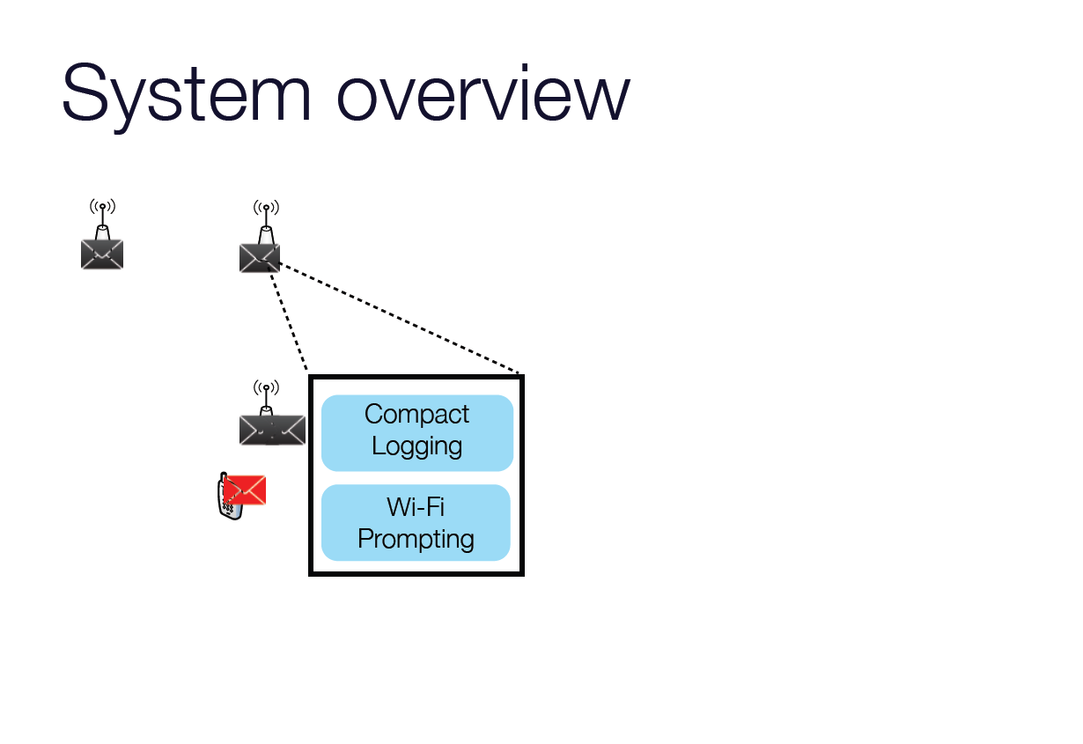
Successfully received transmission is logged as a detection
  Reported to the central server on a second by second basis
Notes:
Figure gives an operational overview of the passive Wi-Fi tracking system.
As a phone travels along a spatial network of roads or paths, it passes by a series of Wi-Fi monitors deployed in the region of interest.

Slide 6
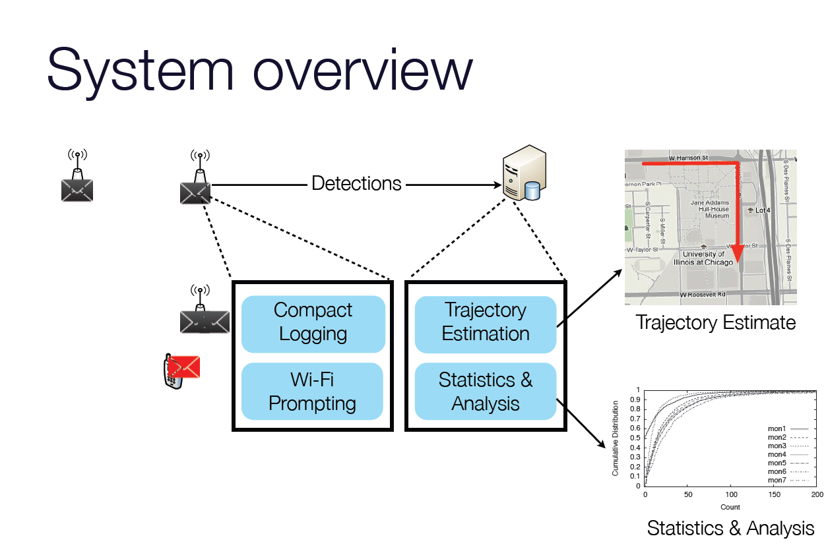
Server processes the data from the monitors
  To reproduce the vehicle’s most likely trajectory
  To export location trace

Slide 7
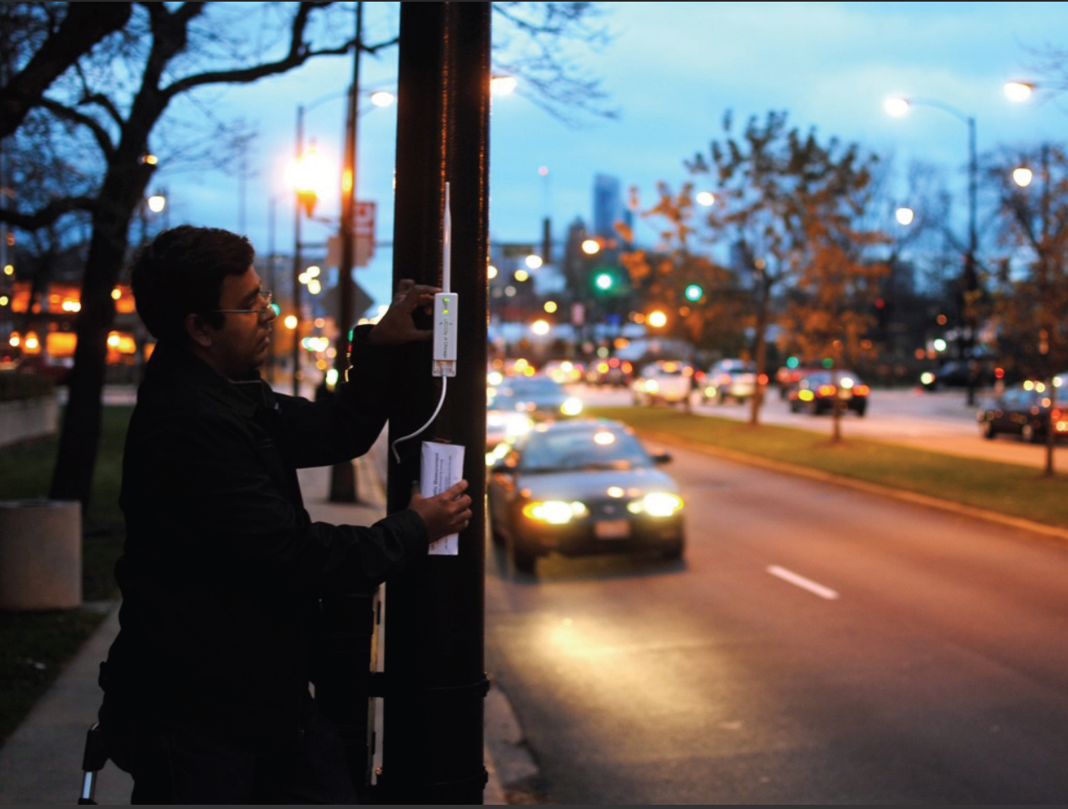

Slide 8
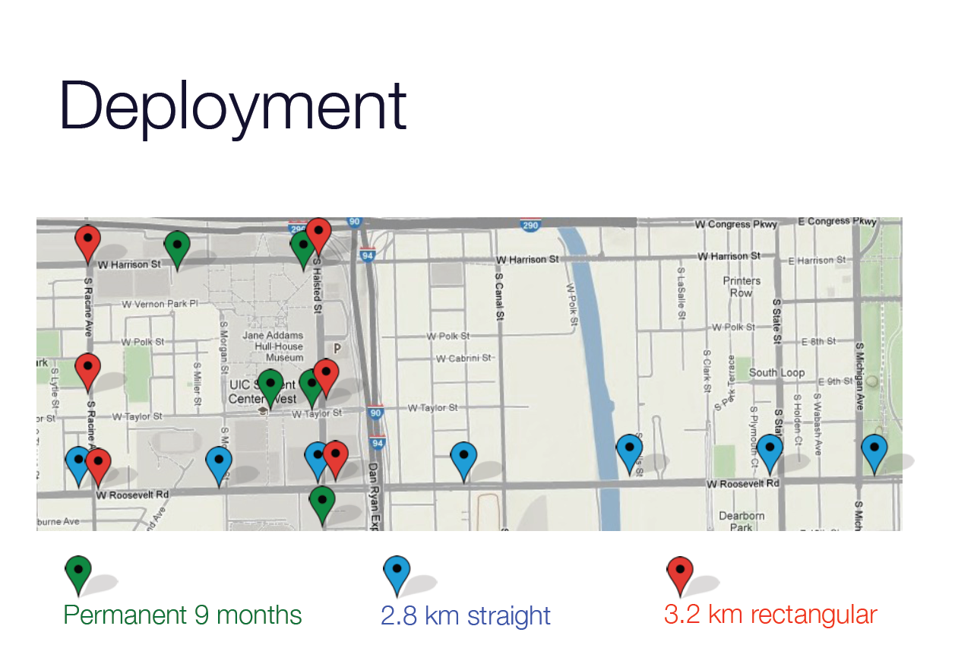

Slide 9
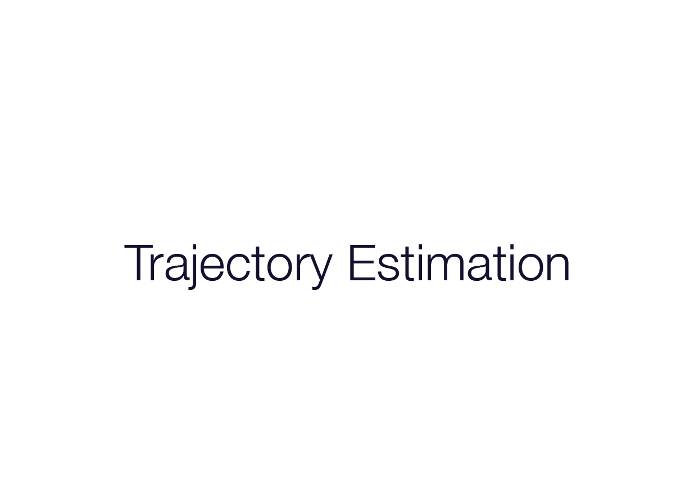
Notes:
This brings me to my next point, which is trajectory estimation

Slide 10
Estimating Smartphone Trajectories
Wi-Fi monitors detect transmissions from passing phone
  Assumption that phones travel along a spatial network of road or paths
    Goal : to produce an accurate second-by-second estimate of the phone’s location
      Difficult by several factors
        Temporal Sparsity of Detections
        Overlap
        Unpredictable path loss
        Fading
Notes:
Temporal Sparsity of Detections
: When a phone does transmit, it may transmit only a few packets, over a very short duration.
Often times, a phone may pass by a monitor without being detected at all.
Overlap
: The measured Wi-Fi packet reception range in our experiments is 250-300 meters.
Thus, if a pair of monitors are spaced more closely than 600 meters, a transmission may be detected by two monitors simultaneously.
Unpredictable path loss Differences
: in phone placement, immediate surroundings and transmission power contribute to significant differences in received power between
devices at the same range from a monitor
So, From the list above, it is clear that no passive Wi-Fi tracking system can guarantee accurate tracking performance.

Slide 11
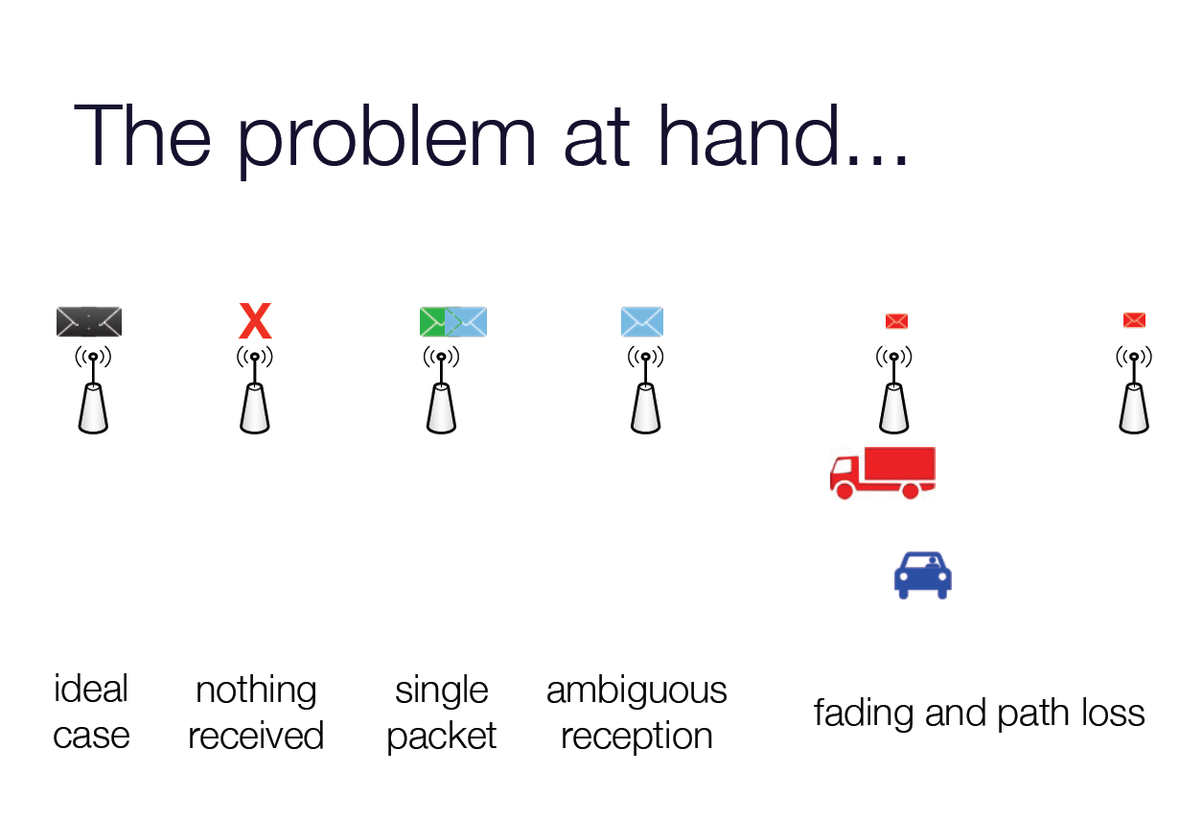
Notes:
3 case : overlap

Slide 12
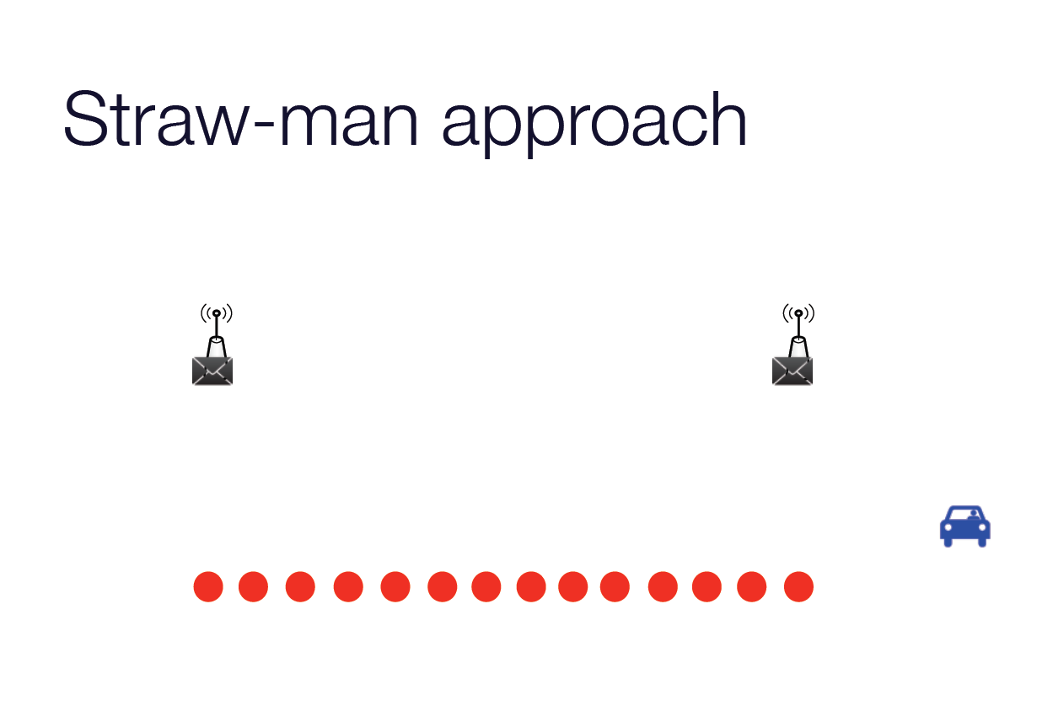
Whenever a detection is made, take the detecting
monitor’s location as the phone’s location
Interpolate phone locations between detections
Notes:
But, This is a poor solution for several reasons.

Slide 13
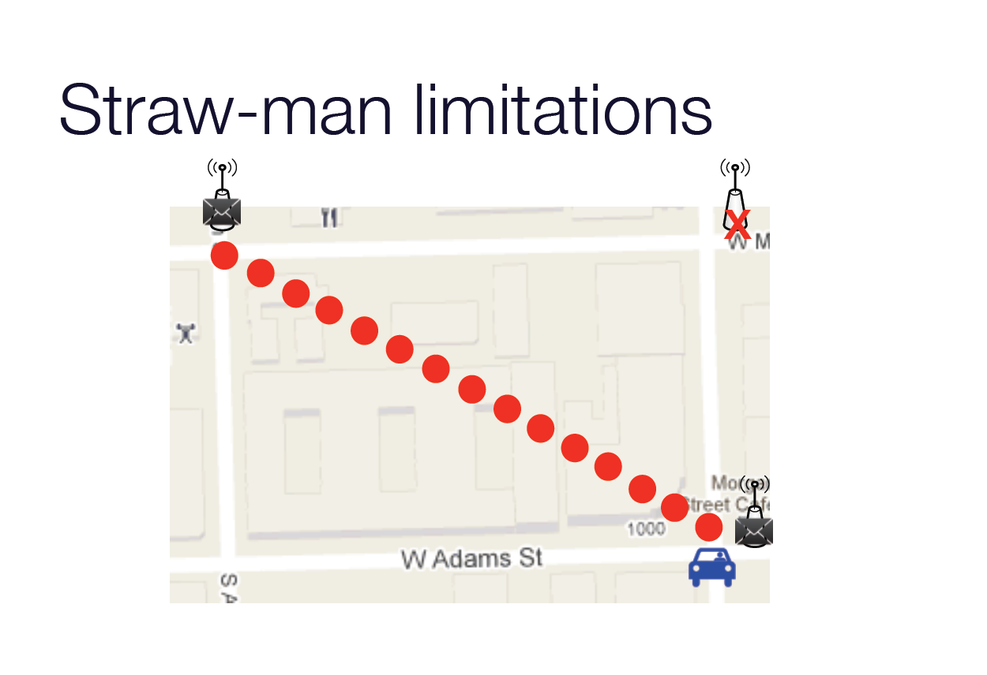

Slide 14
Basic Trajectory Estimation Algorithm
Rather than directly assign the phone to a single location
  Model the distribution of possible location over time
    Extract the maximum probability trajectory
      To reduce the possible set of location
        Restrict movements
      To produce an accurate trajectory
        Phones travel along a known spatial network
          Road map, trail map
Notes:
In essence, rather than directly assign the phone to a single location at each instance in time, the paper model the distribution of possible locations over time, and extract the maximum probability trajectory from this model.
To reduce the possible set of locations, restrict movements and so help produce an accurate trajectory, we assume that phones travel along a known spatial network such as a road or trail map.
A model of this spatial network, consisting of spatially located vertices connected by directional edges, is taken as input.

Slide 15
Basic Trajectory Estimation Algorithm
Spatial network
  Trajectory estimation problem bears a measure of similarity to map-matching
  Trajectory estimation method
    Inspired by Viterbi map-matching
    Using Hidden Markov Model of states
    Viterbi’s algorithm
      To find the maximum probability path traversed

Slide 16
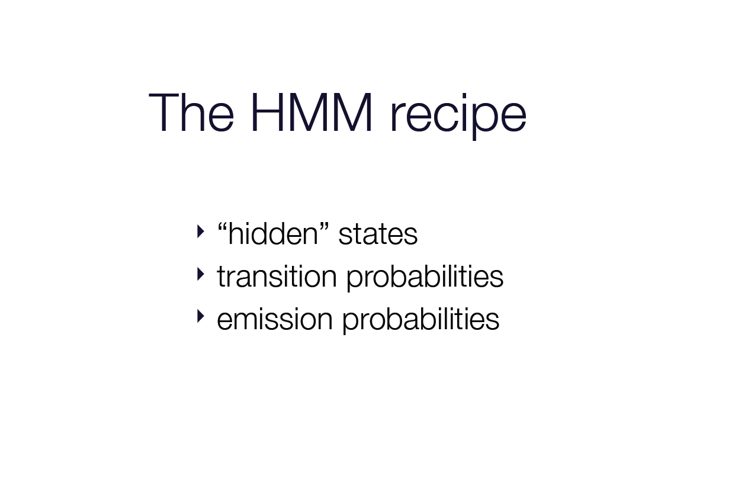
Notes:
Hidden Markov Model

Slide 17
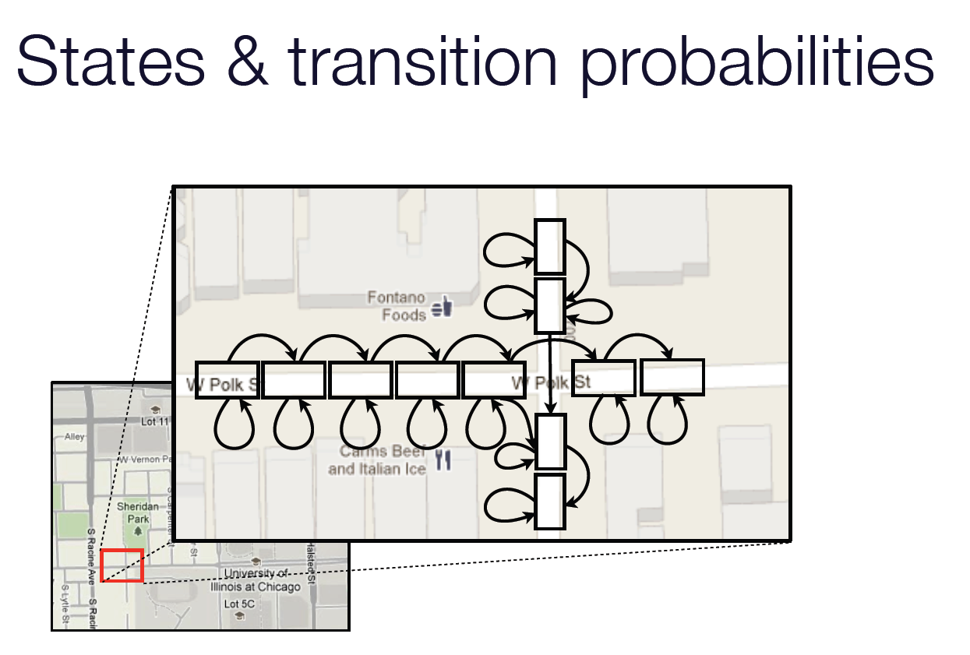
Notes:
The zoomed in section of the map contains two one-way roads going south and east.
Here, the two east-bound street segments on either side of the intersection are divided into multiple sub-states.
Each sub-state represents a rectangular area in which a phone may be located, and a road segment may only be traversed
by passing through each of its sub-states in sequence.
Turn restrictions are maintained for the final sub state of any segment.

Slide 18
Hidden State :
Cut-up Road Segments
This accomplish two things
  It increases the granularity of the HMM such that an approximate location along the street can be produced
  It enforces a speed-limit of sorts
    HMM, transition happen in lock-step with incoming sensor reading, at regular interval
      Limiting travel speed to one sub-state length per second

Slide 19
Emission Probabilities
Probability p(obs|s)
  Observation obs
    The set of observation of the phone in question, by all monitors, at the present time
  Current state s
    A part of a road segment
  Probability distribution of the phone’s location across the entire spatial network, for each second
Notes:
Question : “if the phone was here, what is the probability that we would have mad the detection we just made ? “

Slide 20
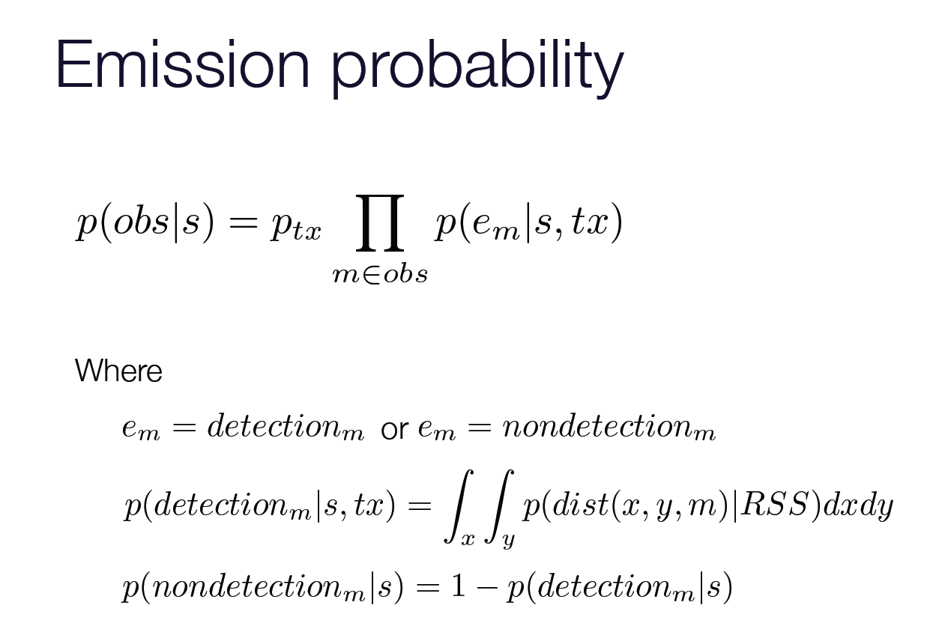
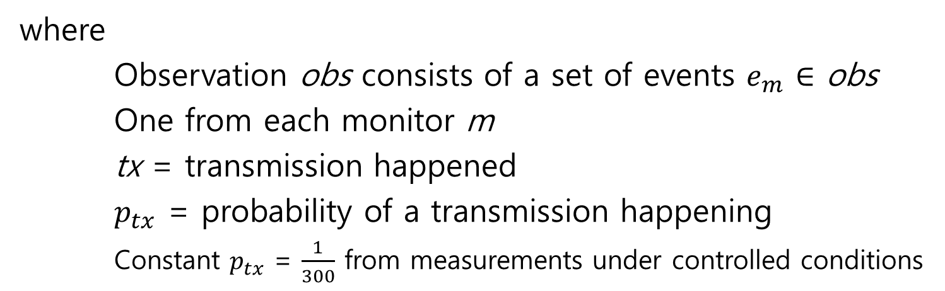
where
Observation obs consists of a set of events $e_{m}$ $∈$ obs
One from each monitor m
tx = transmission happened
$p_{tx}$ = probability of a transmission happening
  Constant $p_{tx}$ = $\frac{1}{300}$ from measurements under controlled conditions
Notes:
One over three hundred

Slide 21
Notes:
Received signal strength(RSS)

Slide 22
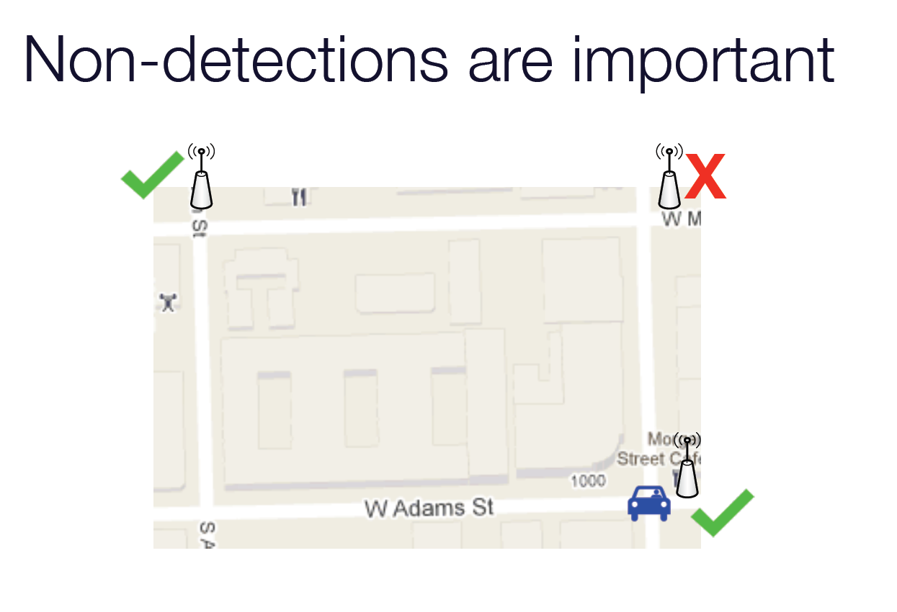
Notes:
Figure illustrates a motivating example for this design.
The phone enters the area at monitor 1, where it is detected.
It then travels to monitor 3 along an unknown path, and is not detected until it reaches monitor 3.
Here, the fact that no detection is made between monitors 1 and 3 carries some information.
All other things being equal, it is more likely that the phone traveled the route with no intermediate detector.

Slide 23
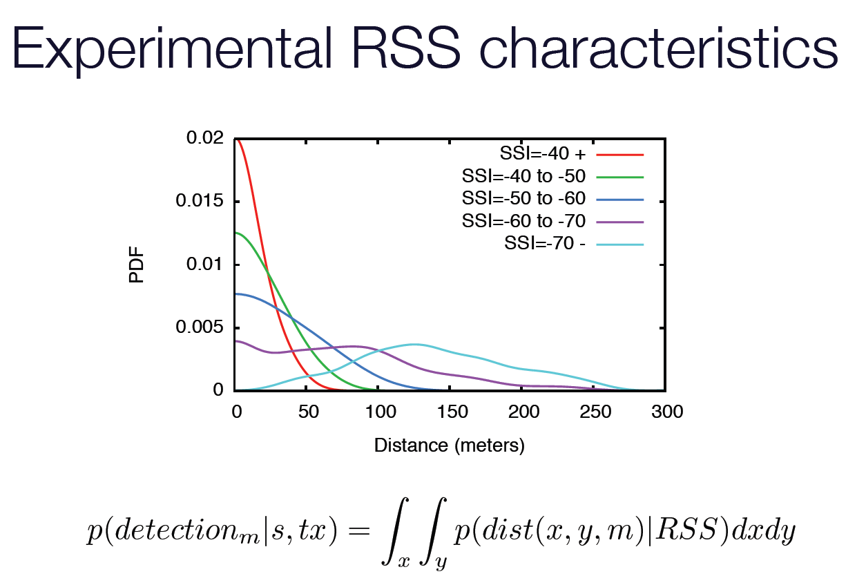
Notes:
Figure illustrates, for a received packet at a given RSS, the probability density of the transmitter being at a certain distance, p(dist).
To create this plot, we repeatedly drove and walked past several monitors at approximately constant velocity, carrying several smartphones configured to transmit packets periodically.

Slide 24
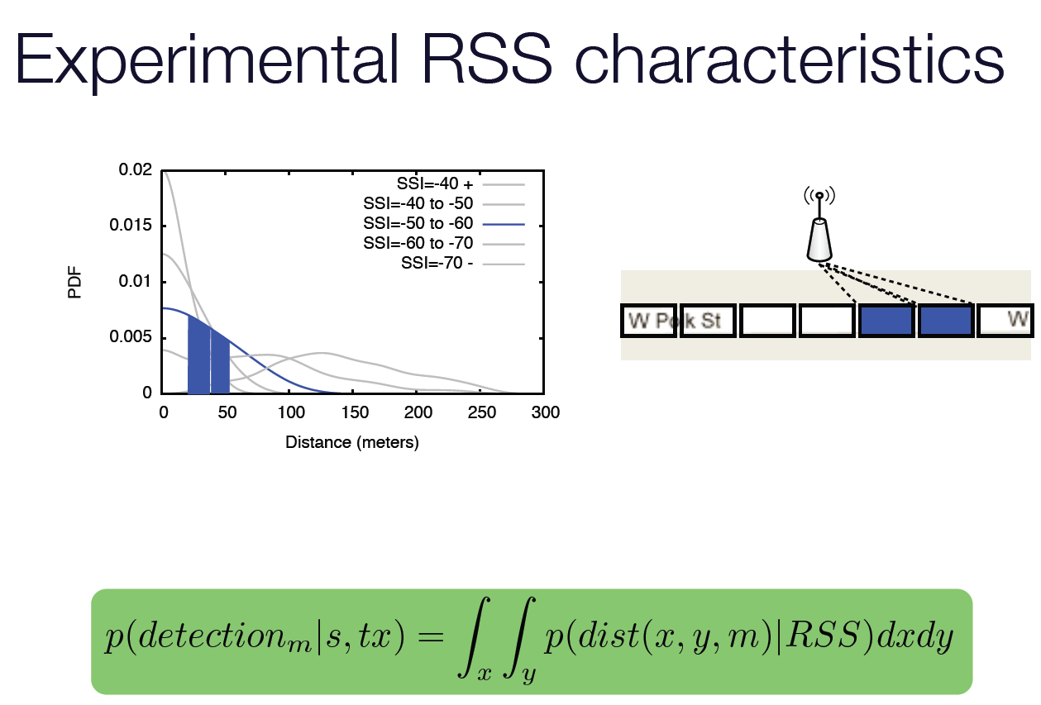

Slide 25
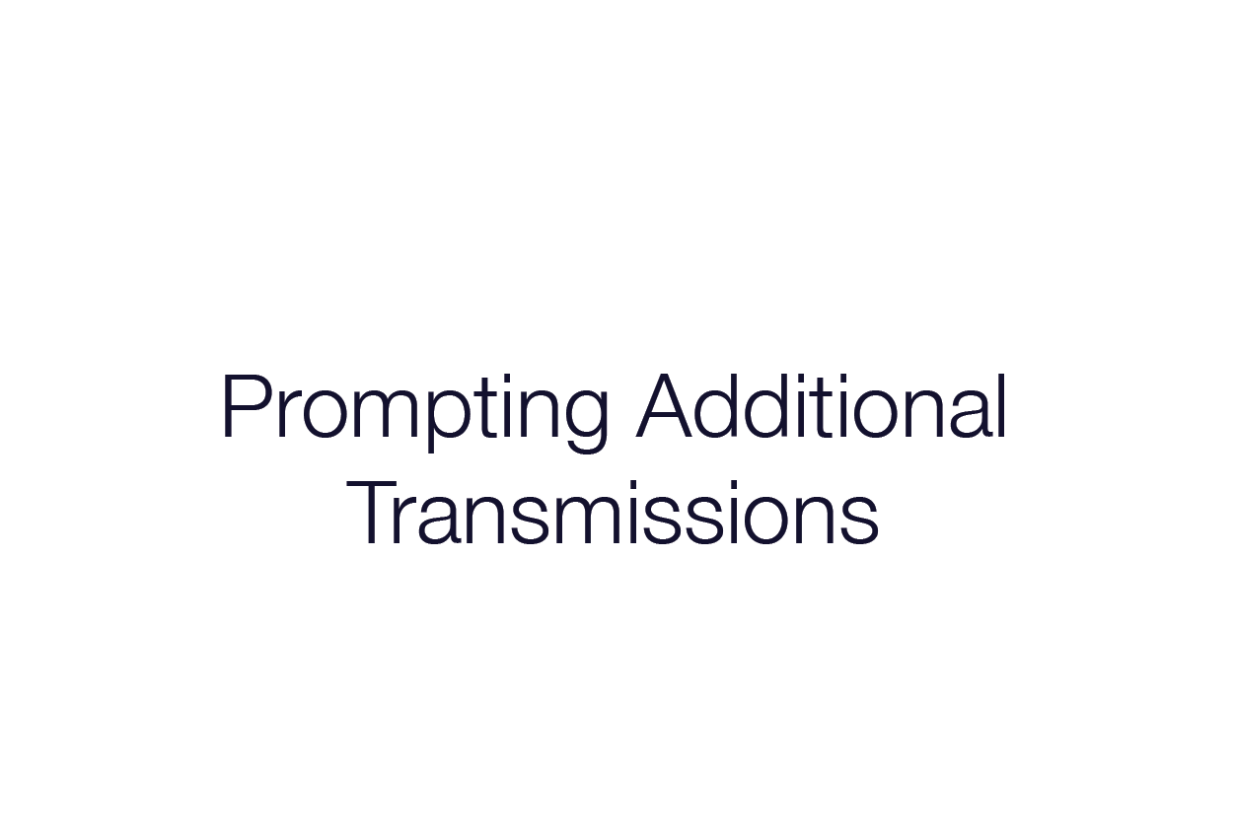
Notes:
This brings me to my next point, which is Prompting Additional transmission

Slide 26
Prompting Additional Transmission
The performance of passive Wi-Fi tracking
  Coverage
    The number or percentage of phones tracked
  Accuracy
    Location error over time
Techniques in the Wi-Fi monitor in addition to passive monitoring
  Advertise two popular access point SSID’s
    Attwifi, tmobile
  Emulate APs with SSID for which a directed probe-request is made by a phone
Notes:
Cellular data network of mobile operators are struggling to keep up with the increasing data demands of smartphones and tablets.
One mechanism mobile operators use to alleviate this problem is Wi-Fi data offloading.
For example, AT&T provides free open Wi-Fi access at Starbucks and other public places.
These not only provide convenient Internet access to people but also allow offload data demands from the cellular network

Slide 27
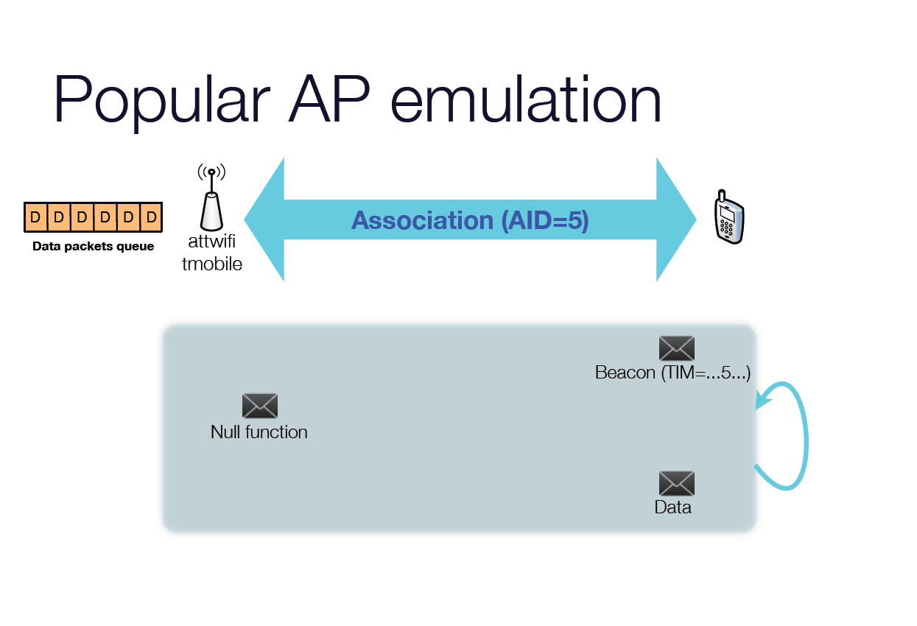
Notes:
By transmitting beacons advertising popular SSID’s such as “attwifi” and “tmobile”, any phone with an active receiver tuned to the correct channel becomes aware of these two “virtual” APs.
Many times, the phone will then send an association request, increasing chances of a phone being detected by a monitor.

Slide 28
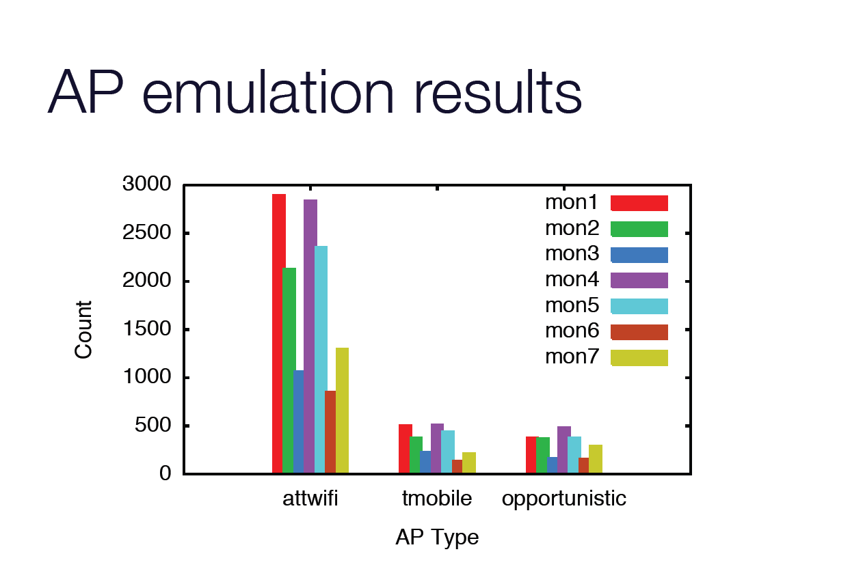
Notes:
Figure shows the number of unique devices associated with our emulated APs (attwifi, tmobile), for a 12 hour deployment using 7 monitors. Here, attwifi dominates due to its significant iPhone presence, but tmobile produces a measurable number of associations as well.

Slide 29
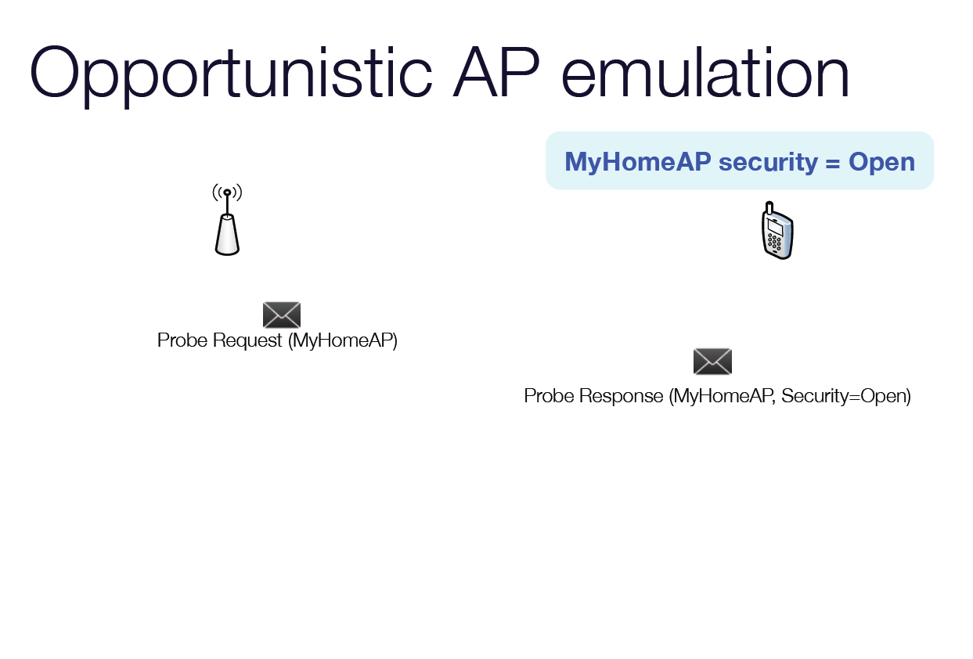
Association
Notes:
For open authentication, there is no security protocol, and the station gets associated with the AP as in the popular SSID case above.
But for securedWi-Fi networks, the smartphone will not try to associate if the security protocol does not match with the devices’ remembered security protocol.
Hence we emulate multiple APs with same SSID but different security protocols for each observed SSID so that one of the emulated APs matches with the station’s remembered APs and the device associates with the emulated AP.

Slide 30
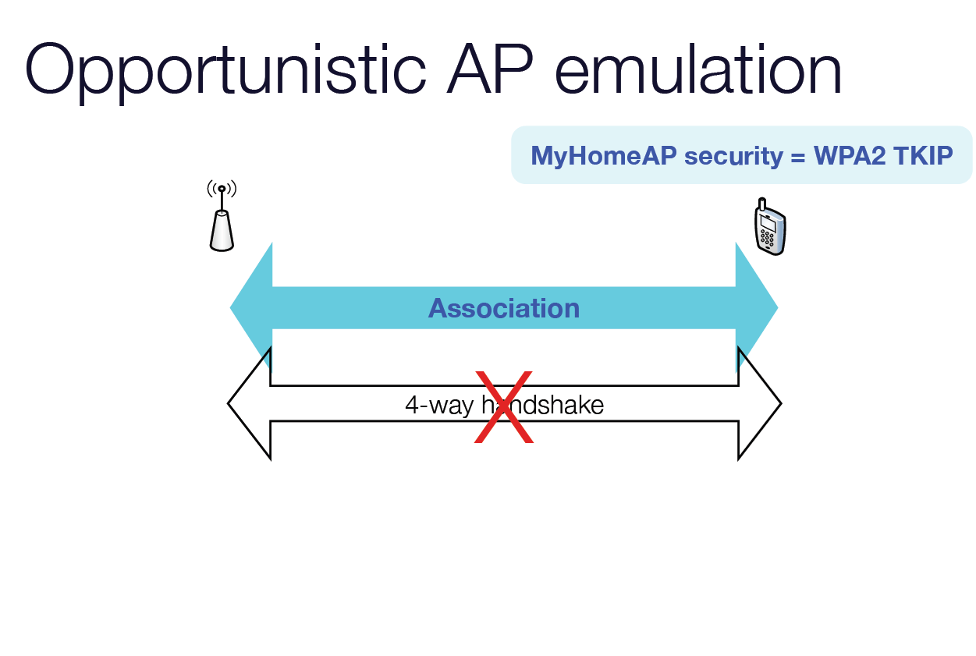
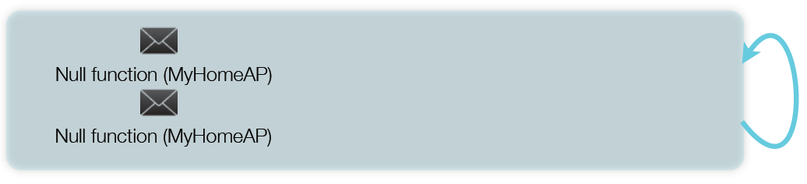
Notes:
if the AP does not start 4-way handshake, the station stays at rectangle box , which sends null packets continuously to see if the AP is still there. This satisfies our goal of getting additional packets from the phone.

Slide 31
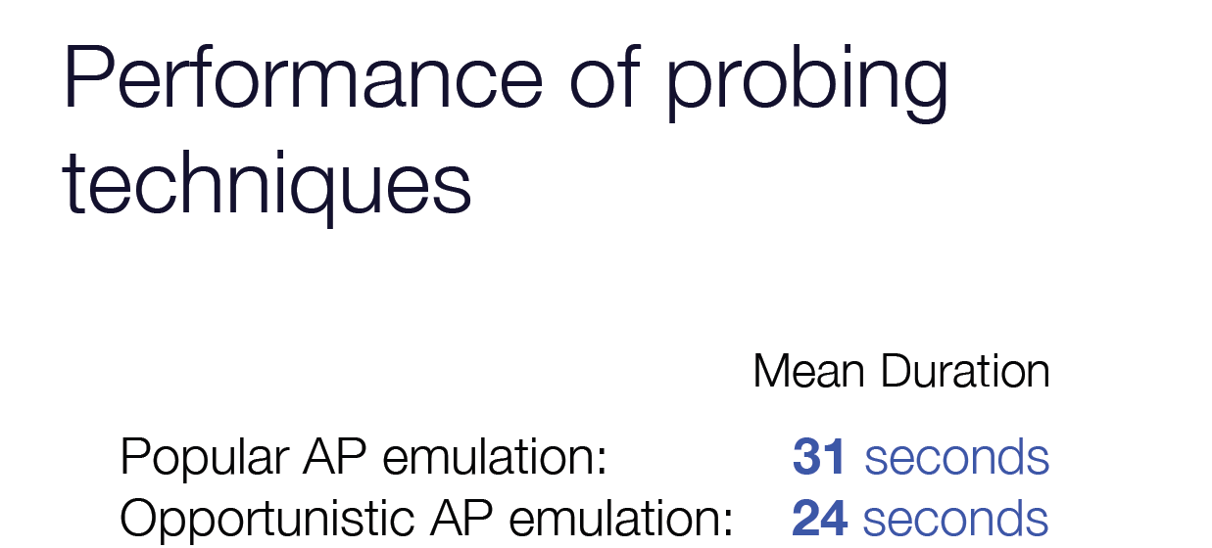

Slide 32


Slide 33
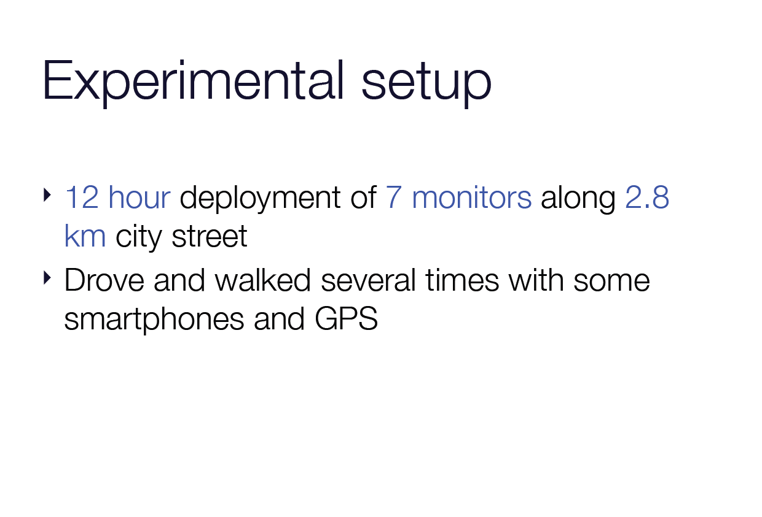

Slide 34
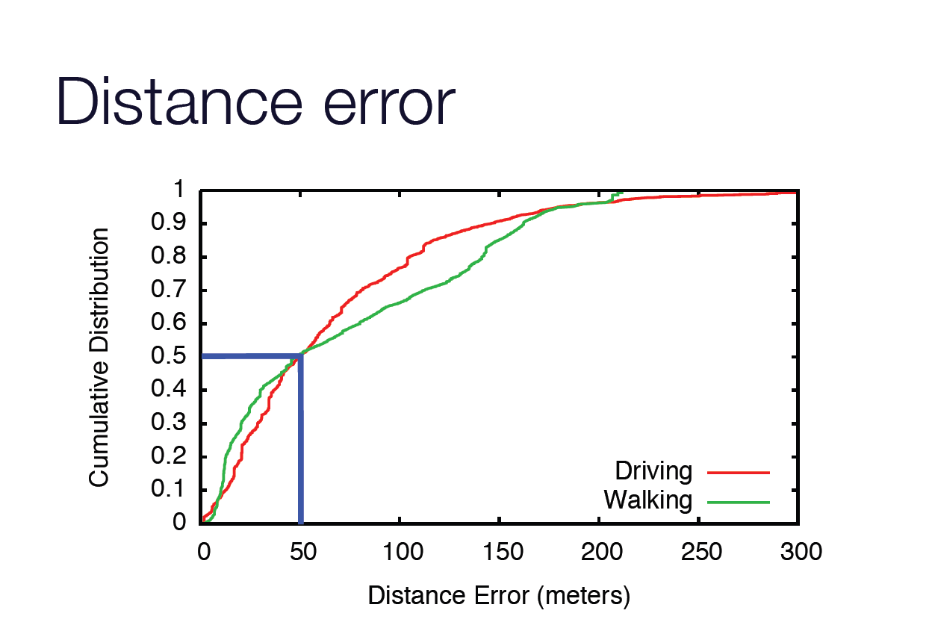
Notes:
Figure shows the CDF of this distance error, separated by driving and walking traces.
The mean error is across all traces is 69 meters, or about one over seventh of the distance between monitors.
The difference in distribution between walking and driving traces is primarily explained by the relatively slower speed of walking.

Slide 35
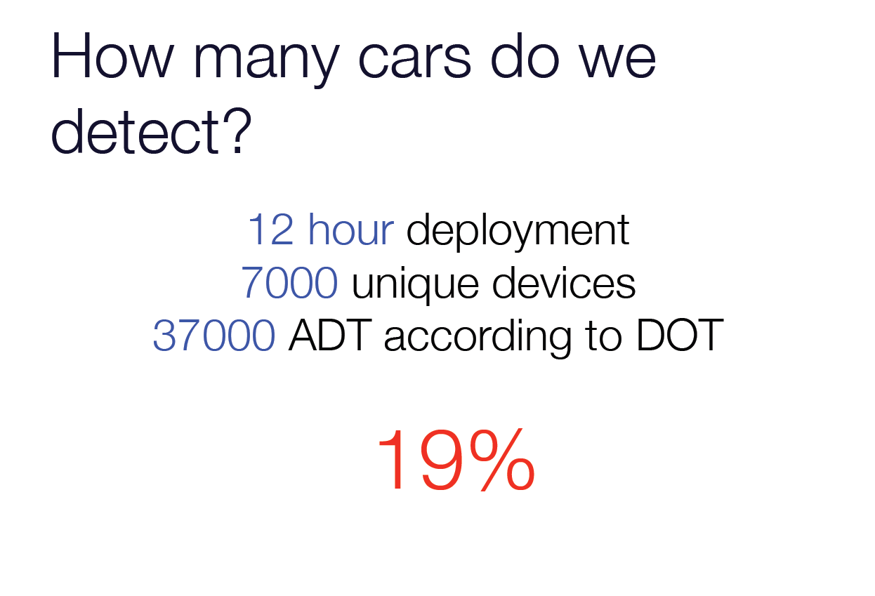
Notes:
average daily traffic count 37,000 according to the state DOT

Slide 36
