Slide 1
PPP Implementation &
Serial Communication
Term project #2

Slide 2
Serial Communication
Open serial device
#include <stdio.h> #include <stdlib.h>
#include <fcntl.h> #include <string.h>
#include <termios.h>
#define BAUDRATE B38400
#define SERIALDEVICE /dev/ttyS0
int main(void) {
int fd;
struct termios tio;
fd = open(SERIALDEVICE, O_RDWR | O_NOCTTY | O_NONBLOCK);
if (fd < 0) { perror(SERIALDEVICE); exit(-1); }
…
}

Slide 3
Serial Communication
Device control and file description
  Given a pathname for a file(or a device), open() returns a file descriptor
  The file descriptor is used in device control functions (system calls such as read(), write() )
The termios structure
  data structure containing terminal configuration
  c_cflag/c_iflag :control mode/input mode flags

Slide 4
Serial Communication
Serial device settings
  tcflush(): discards data in the fd
    TCIFLUSH : flushes data received but not read
  tcsetattr(): sets the parameters associated with the terminal
bzero(&tio, sizeof(tio));
tio.c_cflag = BAUDRATE | CRTSCTS | CS8 | CLOCAL | CREAD;
tio.c_iflag = IGNPAR | ICRNL;
tcflush (fd, TCIFLUSH);
tcsetattr (fd, TCSANOW, &tio);

Slide 5
Serial Communication
Read/write serial device
  read(int fd, void *buf, size_t count)
    reads up to count bytes from a fd into the buf, returns the number of bytes successfully read
  write(int fd, const void *buf, size_t count)
int res, snd, buf_size;
unsigned char buf[255];
res = read(fd, buf, 255);
snd = write(fd, buf, buf_size);

Slide 6
PPP Implementation
AHDLC frame Receiving procedure
  Some byte streams are arrived
  Assemble sequential bytes into a AHDLC PPP frame (between flag/delimiter 7Es)
  Check the CRC using CRC-16 mechanism
  Remove escape codes
  Check protocol field
    LCP : LCP negotiation process
    IPCP : IPCP negotiation process

Slide 7
Example of AHDLC frame receiving procedure
RCVD: 7e ff 7d 23 c0 21 7d 21 7d 21 7d 20 7d 2e
RCVD: 7d 22 7d 26 7d 20 7d 20 7d 20 7d 20 7d 27
RCVD: 7d 22 7d 28 7d 22 70 34 7e ff 7d 23 c0 21
7e ff 7d 23 c0 21 7d 21 7d 21 7d 20 7d 2e 7d 22 7d 26 7d 20 7d 20 7d 20 7d 20 7d 27 7d 22 7d 28 7d 22 70 34 7e
CRC check : 70 34 is good crc
7e ff 03 c0 21 01 01 00 0e 02 06 00 00 00 00 07 02 08 02 70 34 7e
Protocol field : c0 21 -> LCP procedure

Slide 8
PPP Implementation
AHDLC frame sending procedure
  Get original data from upper protocols (LCP, IPCP)
  Convert original data to escape code if ACCM is on
  Append a CRC code
    Convert to escape code if ACCM is on
  Add flag/delimiter 7E to the frame

Slide 9
PPP Implementation
LCP implementation
  Must implement a PPP state machine
    connection/termination transition must be covered
  LCP negotiation procedure follows transition of the PPP state machine
  LCP should be able to handle ACCM, pcomp, accomp options

Slide 10
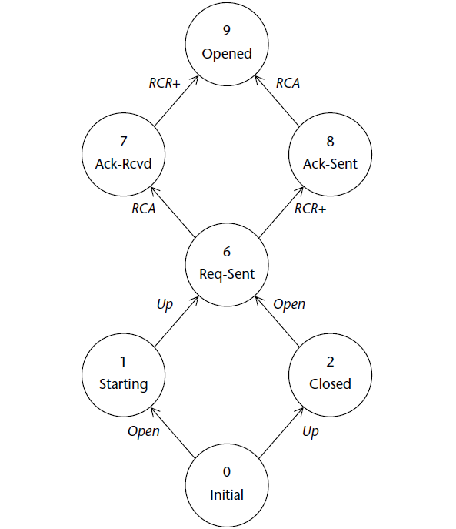
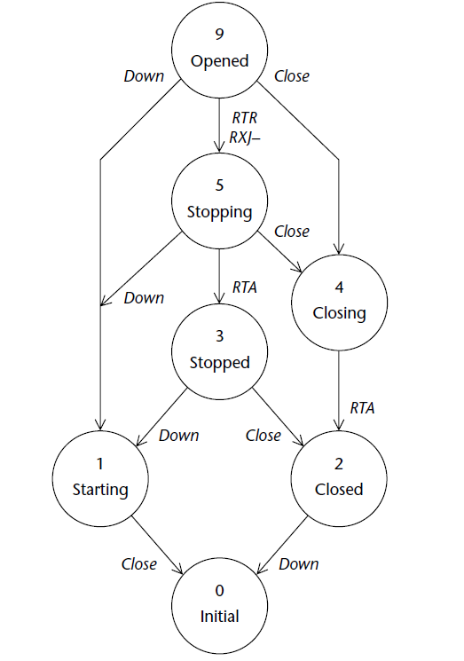
PPP state machine

Slide 11
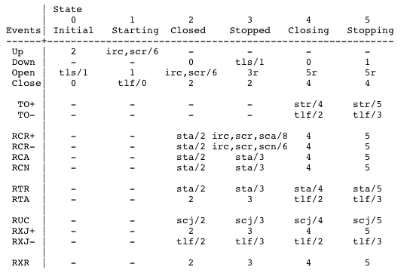
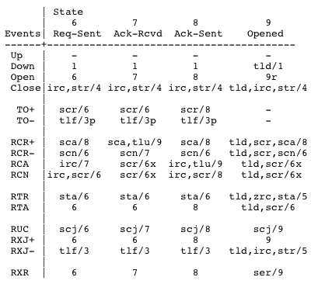
PPP state machine

Slide 12
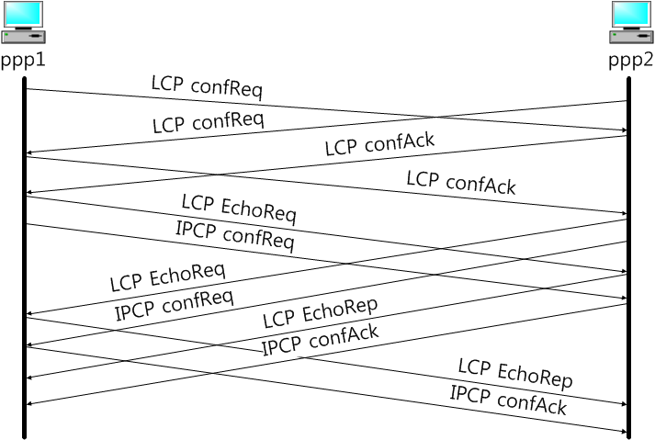
Connection Establishment

Slide 13
Homework #2
Implement PPP
  Implement a basic PPP protocol included LCP, IPCP and connect to the pppd program to complete PPP connection establishment and termination.
  Implementation components
    AHDLC PPP framing with CRC-16 and character escaping process
    LCP negotiations with PPP state machine (connection establishment/termination)
    IPCP negotiations
    Print hex codes of send/recv frame and analyze messages like debug of pppd

Slide 14
Homework #2
Test & Result
  Connect your developed program to a pppd of virtual machine
  The program should be able to negotiate accomp, pcomp options.
submission
  Result screenshot
    Execution results : both of pppd and your program results
    Show hex codes, message exchanges, analysis of messages
  Report
    Explain your program : what components is implemented, especial points(functions, algorithms, codes, and so on)

Slide 15
References
RFC 1661, RFC 1662, RFC 1332
James Carlson, “PPP Design, Implementation, and Debugging 2nd edition,” Addison-Wesley, July 2000.
http://www.tldp.org/HOWTO/Serial-Programming-HOWTO/

