Slide 1
Observing Resources in CoAP draft-ietf-core-observe-16
OVERVIEW:
2015. 02. 06. 박해월

Slide 2
Contents
Introduction
Observe Option
Requirements (Client/Server)
  Request / Notifications
  Caching
  Reordering
  Transmission
  Cancellation
Intermediaries
Other
Reference

Slide 3
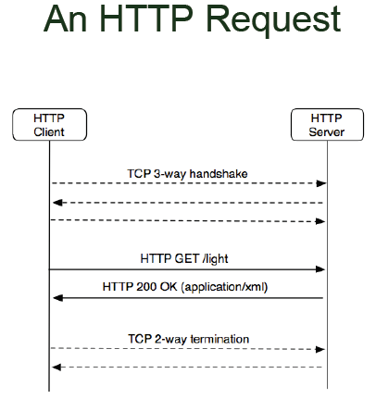
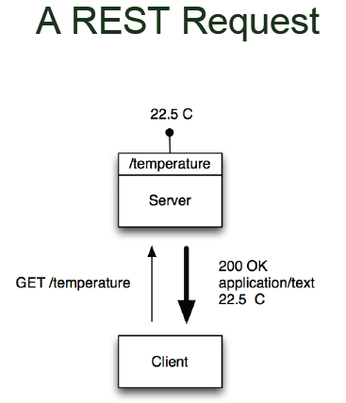


Introduction - CoAP
CoAP is a RESTful Web protocol.
Representational State Transfer (REST) architecture

Slide 4
Introduction - CoAP
CoAP is a protocol for constrained environment, especially considering energy, building automation, and other machine-to-machine (M2M) applications.
Constrained RESTful Environments (CoRE)
Constrained Nodes: e.g. 8-bit microcontrollers with limited small amounts of RAM and ROM
Constrained Networks: e.g. 6LoWPAN
  High packet error rates, a typical throughput of 10s of kbit/s
Fulfill M2M requirements in constrained environments
Low header overhead and parsing complexity

Slide 5
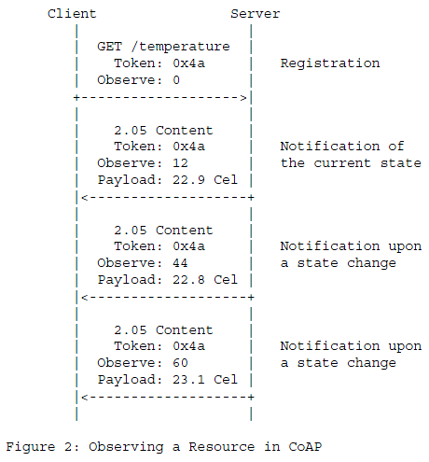
Introduction – Observe Resources in CoAP
CoAP client “observe” a resource on a CoAP server
+ add the client to the list of observers of the resource

Slide 6
Introduction – Consistency Model
Goal: To keep the resource state observed by the client as closely in sync with the actual state at the server as possible.
Client and server become out of sync at times:
Some latency between the change of the resource state and the receipt of the notification
Notifications get lost
Server erroneously come to the conclusion that the client is no longer interested in the resource
Address this issue as follows:
Best-effort approach
Label notifications with a Max-Age
Eventual consistency

Slide 7
Introduction – Observable Resources
o <coap://server/temperature>, which changes its state every few seconds to a current reading of the temperature sensor;
o <coap://server/temperature/felt>, which changes its state to "COLD" whenever the temperature reading drops below a certain preconfigured threshold, and to "WARM" whenever the reading exceeds a second, slightly higher threshold;
o <coap://server/temperature/critical?above=42>, which changes its state based on the client-specified parameter value: every few seconds to the current temperature reading if the temperature exceeds the threshold, or to "OK" when the reading drops below;
o <coap://server/?query=select+avg(temperature)+from+Sensor.window: time(30sec)>, which accepts expressions of arbitrary complexity and changes its state accordingly.

Slide 8
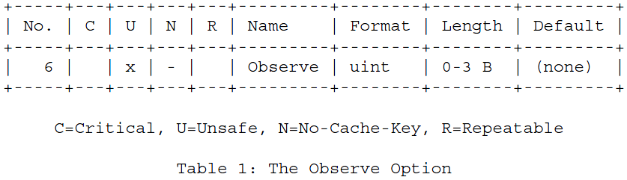
The Observe Option
If included in a GET request:
  0 (register) adds the entry to the list, if not present;
  1 (deregister) removes the entry from the list, if present.
If included in response
  Identify the message as a notification

Slide 9
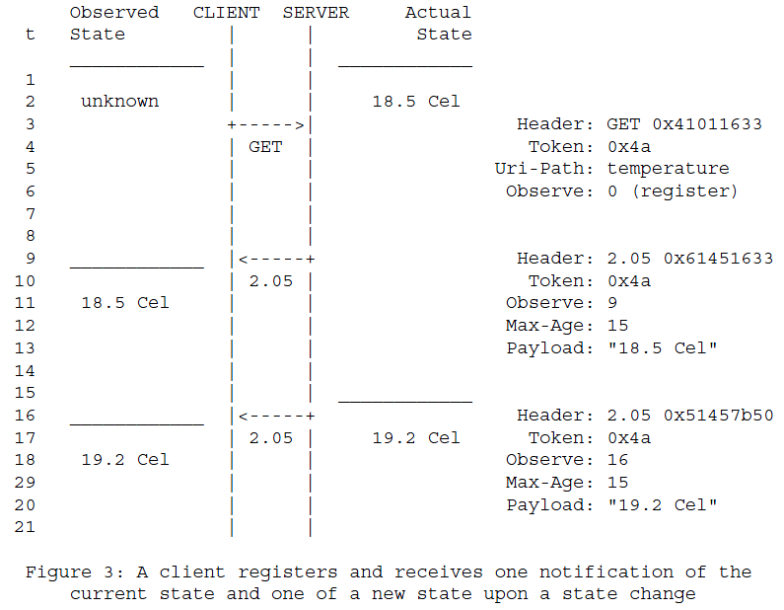
Request / Notifications

Slide 10
Request / Notifications

Slide 11
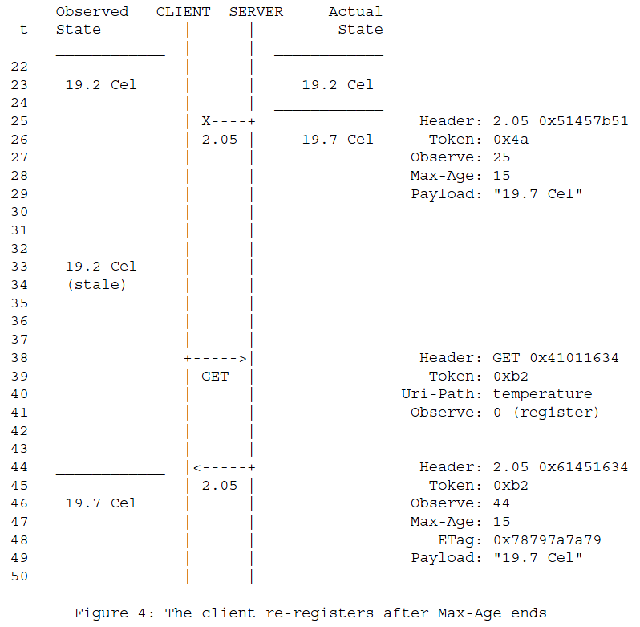
Caching - Freshness
Random amount of time between 5 and 15 seconds

Slide 12
Caching - Freshness
Selected response

Slide 13
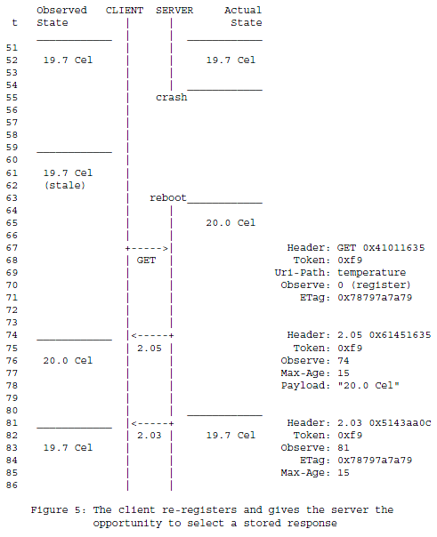
Caching - Validation

Slide 14
Reordering
Observe Option of each notification to the 24 least-significant bits of a strictly increasing sequence number
Incoming notification is more fresher if:
(V₁ < V₂ and V₂ – V₁ < 2²³) or
(V₁ > V₂) and V₁ – V₂ > 2²³) or
(T₂ > T₁ + 128 seconds)
where,
V1: the value of the Observe Option in the freshest notification so far
V2: the value of the Observe Option in the incoming notification
T1: a client-local timestamp for the freshest notification so far
T2: a client-local timestamp for the incoming notification

Slide 15
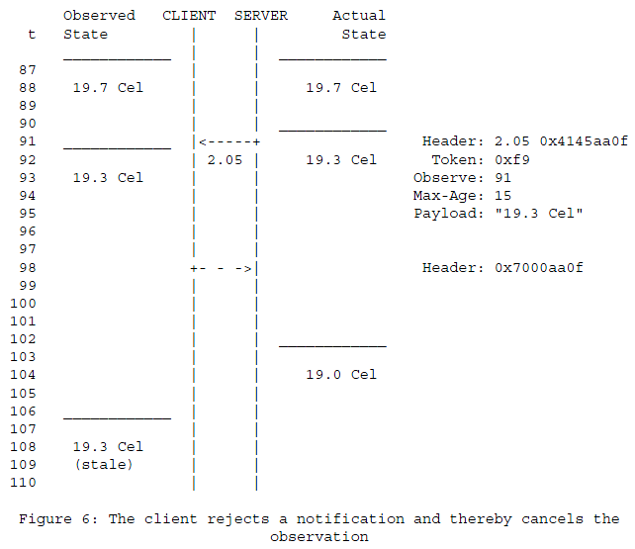
Transmission / Cancellation
CON, NON, ACK, RST

Slide 16
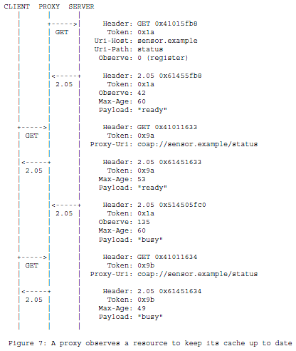
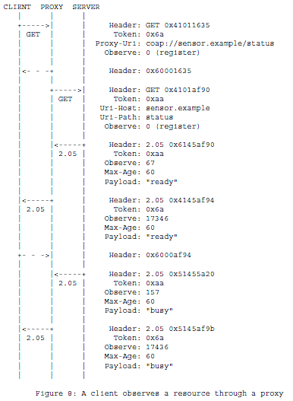
Intermediaries

Slide 17
Other
Security
Congestion Control
- CoAP (RFC 7272)

Slide 18
Backup

Slide 19
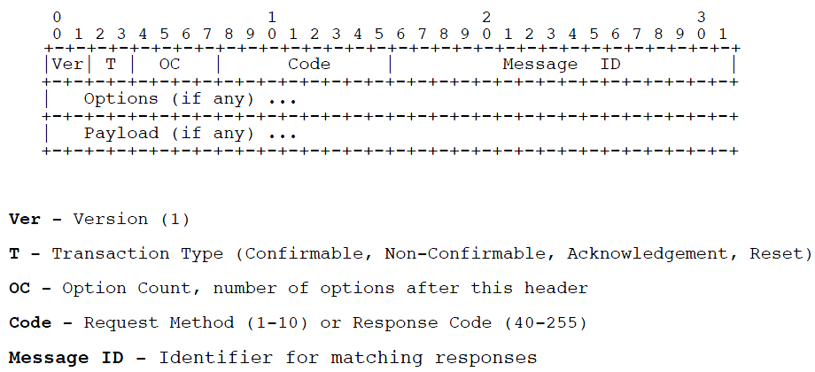
Message Header

Slide 20
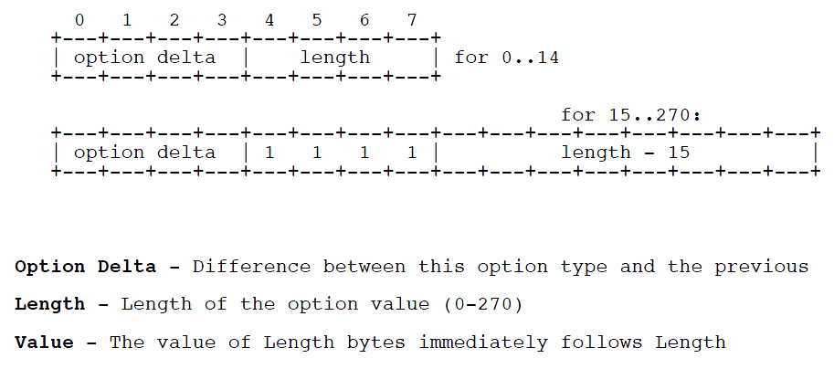
Option Header

