Slide 1
Border Gateway Protocol (BGP)
Chapter 6

Slide 2

6.1 Two-Layer Structure of Internet Routing
Border gateway: A gateway router from an organization's network to the Internet
Autonomous system (AS): An organization's network
  Only for networks that advertise their own prefix to the global Internet(advertise)
    e.g.) Korea University: 163.152.0.0/16
  BGP advertised via
  AS number (ASN) assigned → BGP uses it

Slide 3

6.1 Two-Layer Structure of Internet Routing
C:\Users\User>tracert -w 100 www.ufl.edu Maximum 30hops over virtual-l1wvi-prod-core-public.osg.ufl.edu [128.227.9.98]() Tracing route to: 1 3 ms 2 ms 1 ms 172.30.1.254 2 8 ms 9 ms * 125.143.149.126 3 6 ms 8 ms 7 ms 61.78.43.71 4 7 ms 6 ms 6 ms 112.189.15.53 5 * * * Request timed out. 6 6 ms 6 ms 7 ms 112.174.82.126 7 14 ms 6 ms 8 ms 112.174.84.34 8 143 ms 142 ms * 112.174.87.250 9 145 ms 151 ms 41 ms 10ge12-17.core1.lax1.he.net [66.220.2.169] 10 * 164 ms 148 ms 100ge14-1.core1.lax2.he.net [72.52.92.122] 11 * 155 ms 152 ms 100ge0-36.core2.phx2.he.net [184.105.81.178] 12 * 186 ms 189 ms 100ge10-1.core1.dal1.he.net [184.105.81.174] 13 186 ms * 182 ms 100ge8-1.core1.atl1.he.net [184.105.81.169] 14 194 ms 193 ms * 100ge0-36.core2.jax1.he.net [184.105.213.186] 15 213 ms 208 ms * florida-lambdarail.10gigabitethernet3-2.core1.jax1.he.net [64.71.158.82] 16 221 ms * 212 ms con-ufl-gnv-internet-v1804.net.flrnet.org [108.59.29.243] 17 199 ms 202 ms * ssrb230a-pel-asr9001-1-v16-1.ns.ufl.edu [128.227.236.204] 18 211 ms * 214 ms ssrb230a-nexus-msfc-1-v15-1.ns.ufl.edu [128.227.236.202] 19 206 ms * 206 ms ssrb230a-dcpopl3-7009-1-vdc2-v601-1.ns.ufl.edu [128.227.236.155] 20 209 ms * 209 ms virtual-l1wvi-prod-core-public.osg.ufl.edu [128.227.9.98] Trace complete.
Tracert results showing the two-layer structure
  Total 4 networks
    KT, HE, FLRNET, UFL
  Hurricane Electric (HE) internal
    7 routers traversed
  KT internal
    7 routers traversed

Slide 4
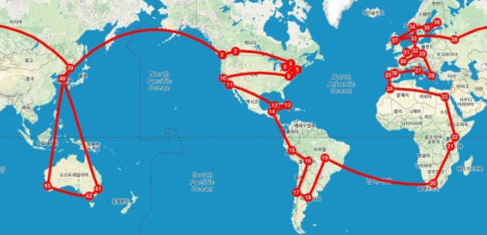
6.1 Two-Layer Structure of Internet Routing
Inter-network routing uses BGP + Intra-network routing uses OSPF/IS-IS
  BGP uses policy(policy) -based routing
    Connections between networks are strictly based on business agreements and contracts
  OSPF/IS-IS uses efficiency (i.e., shortest path) -based routing
Two-layer structure scalability
  Enables routing despite the enormous size of the Internet
  Routing changes within a network rarely affect inter-network routing

Slide 5

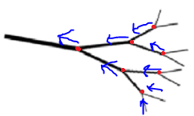
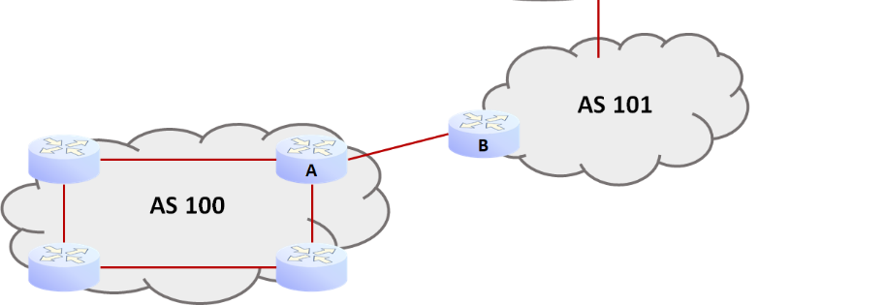
6.2 Network-Level Internet Connection Structure
BGP's role: a network's prefix into worldwide core routers
Method: Flooding worldwide core routers with prefix information
  Leaving “arrows” in the opposite direction of propagation
    Just-traversed network's “arrow” : the next AS to traverse (AS)
AS Types
  Stub
  Transit

Slide 6
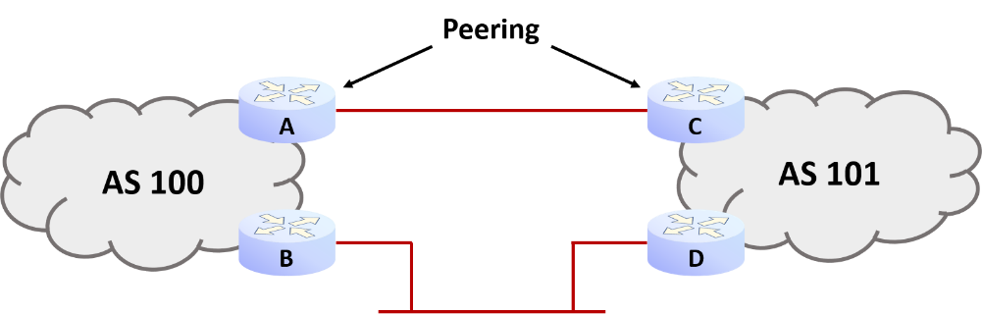
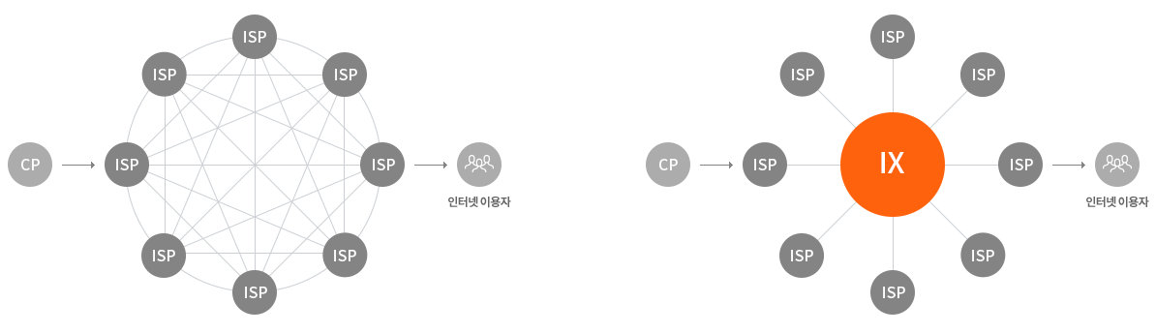
6.2 Network-Level Internet Connection Structure
AS Relationships
  Hierarchical relationship: A smaller AS is a customer of a larger AS's customer
  Equal connection (peer)
Peering
  Private
  Public: Internet Exchange (IX) used
    e.g.) KINX

Slide 7
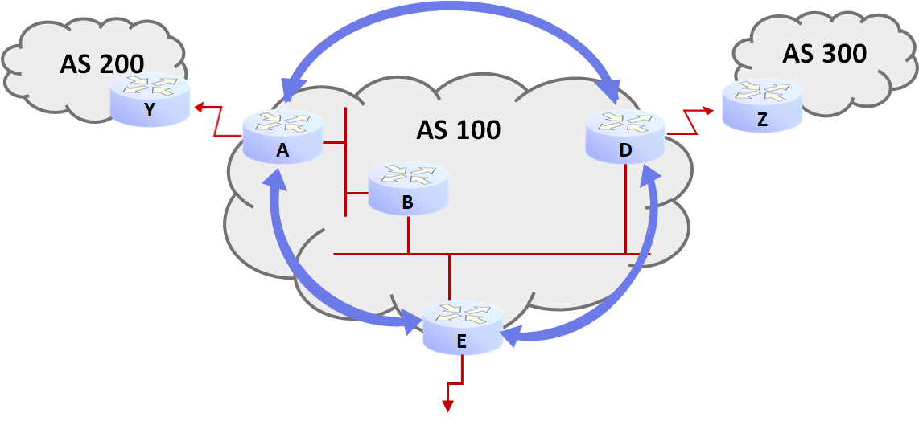
6.2 Network-Level Internet Connection Structure
BGP peering
  A pair of routers communicating via adjacent AS to determine BGP network-level routing

Slide 8
6.3 BGP Protocol Characteristics
Policy (policy) -based protocol
  BGP decides whether to accept or discard route announcements (announcement) delivered via BGP
    The shortest path is not always selected
Path vector (path vector) protocol
  Announcement traversed through AS's path to detect and eliminate loop
  AS path's various attribute examined to accept policy-compliant routes
    e.g.) AS path is long , prefer shorter ones, etc.

Slide 9
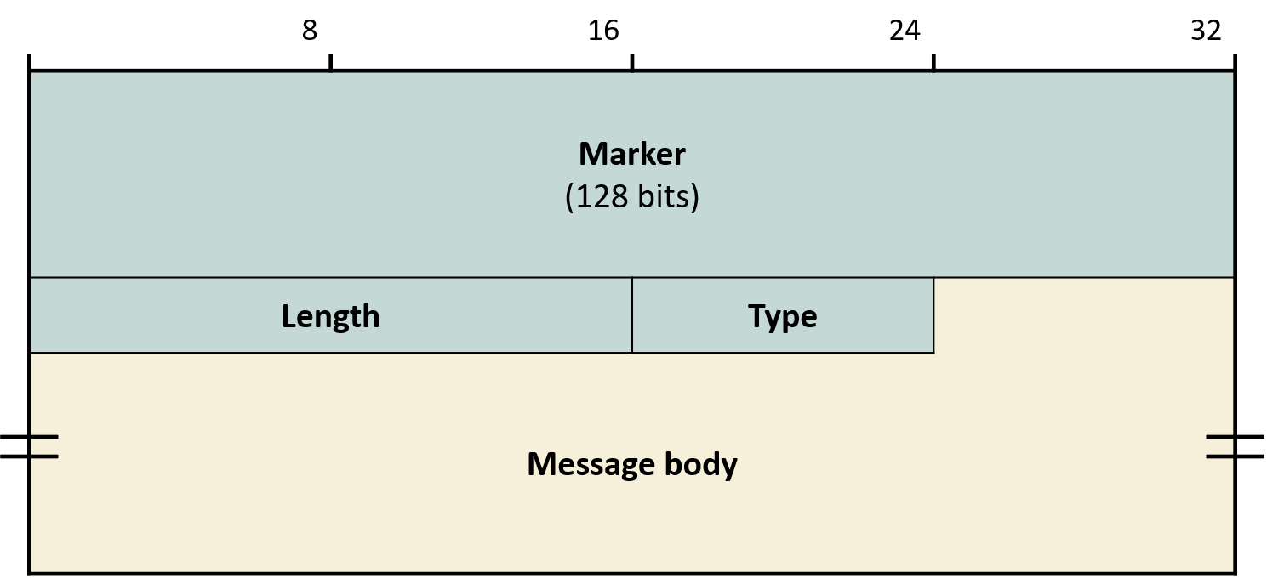
6.4 BGP Message Format
BGP Message General Format
  Marker: For authentication ((initial value 111111…..1) or BGP boundary marker between BGP messages
    Changed to a unique pattern after mutual authentication
    BGP session hijacking prevention
  Length = Header + Body
  Type
    1=Open (Open)
    2=Update (Update)
    3=Notification (Notification)
    4=Keepalive (header only)

Slide 10
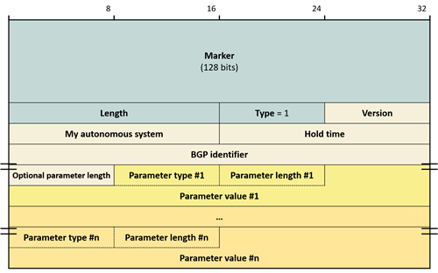
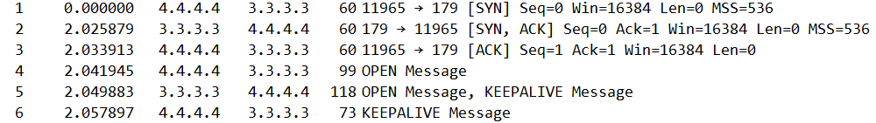
6.4 BGP Message Format
Open Message Purpose
  BGP session created between peers
  Session parameter negotiation
Open response
  Positive= Keepalive
  Negative= Notification

Slide 11
6.4 BGP Message Format
Version=4
AS Number: Open AS number of the BGP router that sent the Open messageAS's Number
Hold time: default=180 seconds
  BGP peer: update not received, time to abandon the session
  Update: If no update but want to maintain session, send 1/3 of hold time, send keepalive
    0= No timeout
BGP Identifier: IP address of the sender BGP router's IP address
Parameters
  e.g.) Authentication method desired by sender: Marker field calculation method

Slide 12
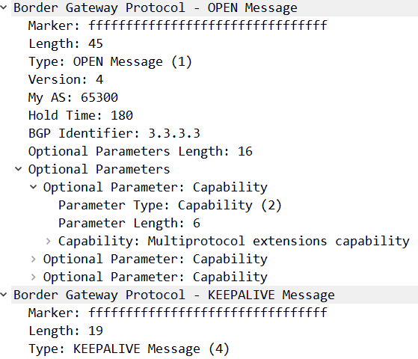
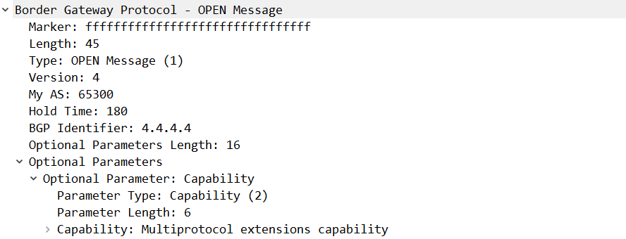
6.4 BGP Message Format
Open Message Example

Slide 13
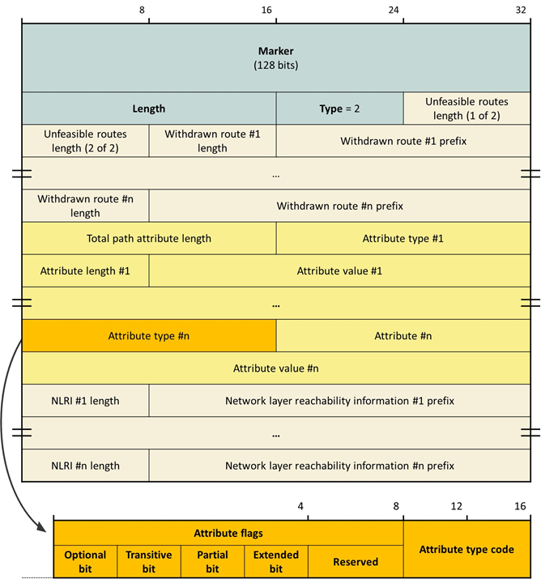
6.4 BGP Message Format
Update Message Purpose
  BGP Informs peers of its selected routes and their attributes
Types
  Route attributes (announcement)
  Unreachable prefixes (withdrawal)

Slide 14
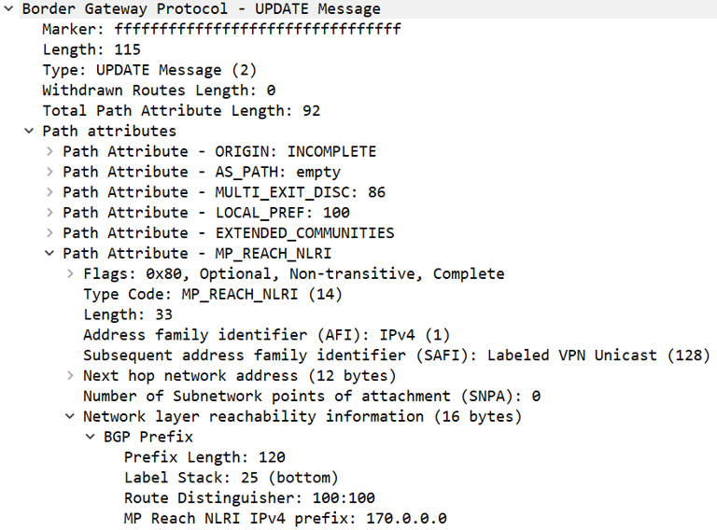
6.4 BGP Message Format
NLRI's attributes are important
  Network Layer Reachability Information

Slide 15
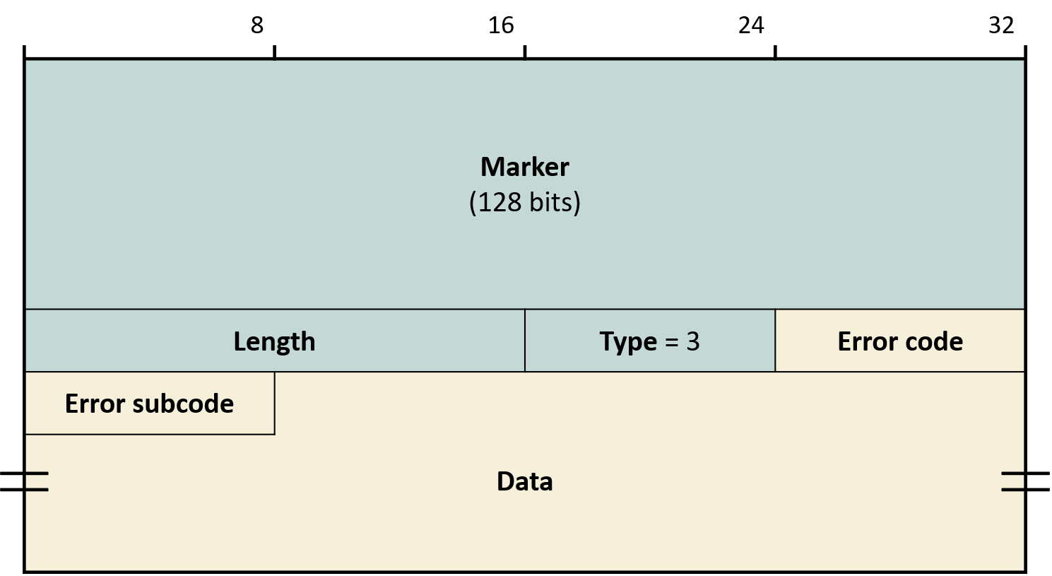
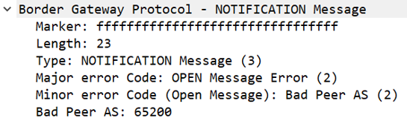
6.4 BGP Message Format
Notification Message Purpose
  Error
Keepalive Message Purpose
  Open acceptance
  Signals that the session is alive

Slide 16
6.5 BGP Route Attributes
Types
  Well-known: All BGP routers must recognize and implement, may be included in Update
    Mandatory: All route entries must include
      ORIGIN, AS-PATH, NEXT-HOP
    Discretionary: All BGP routers must recognize, inclusion not mandatory
      LOCAL-PREF, ATOMIC-AGGREGATE
  Optional: Update may not be included in Update, not required to be supported by all BGP routers
    Transitive: If unrecognized, must still forward to other BGP routers
      AGGREGATOR, COMMUNITY
    Non-transitive : If unrecognized, propagation to other BGP routers is prohibited
      MULTI-EXIT-DESC

Slide 17
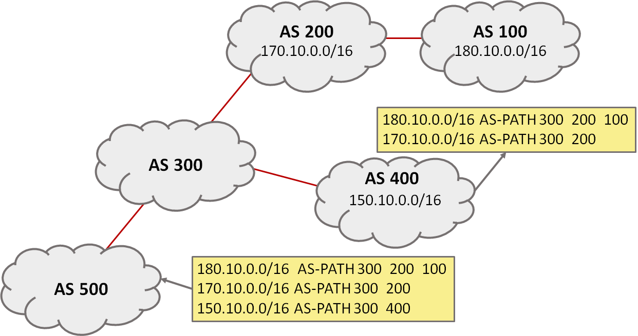
6.5 BGP Route Attributes
AS-PATH
  BGP announcement path the announcement has traversed through AS path
    BGP is a “path vector” protocol
  Routing loop detection

Slide 18
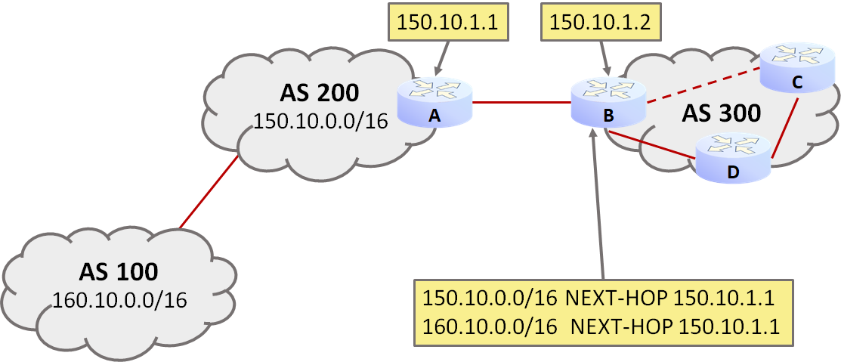
6.5 BGP Route Attributes
NEXT-HOP
  IP address of the next-hop prefix router to reach the distributed router's IP address
  Specifically, eBGP → IP address of the link on the same eBGP peer's IP address
  If the next hop is not on the same link → recursive route lookup → Use recursive route lookup
    C: 160.10.0.0/16 → NH=150.10.1.1 → (IGP routing lookup) → NH=“D”

Slide 19
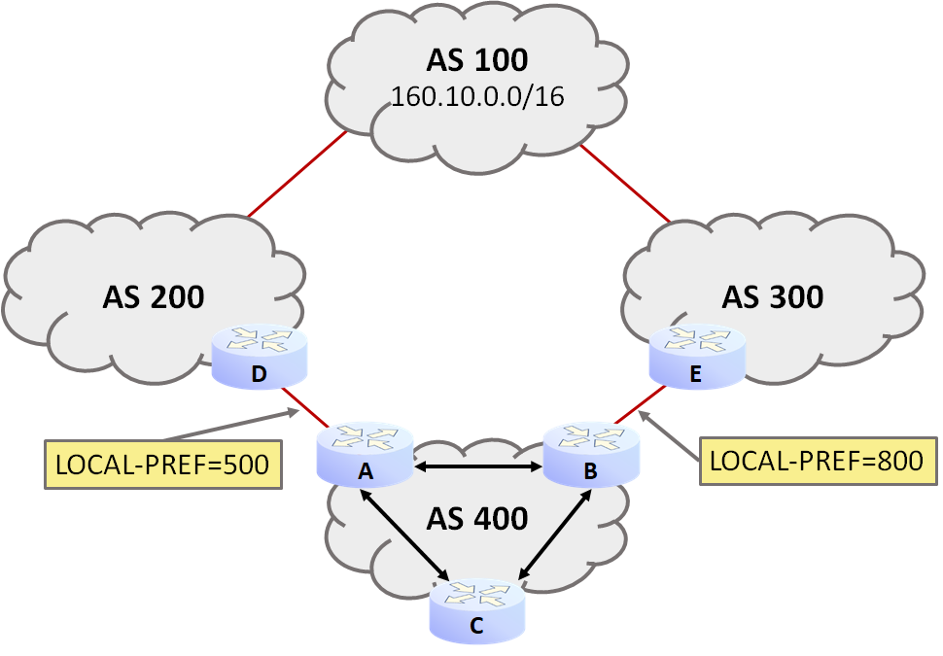
6.5 BGP Route Attributes
LOCAL-PREF
  Preference of the exit route from the current prefix toward a specific destination AS
    Higher is better
  AS Only affects decisions within the AS

Slide 20
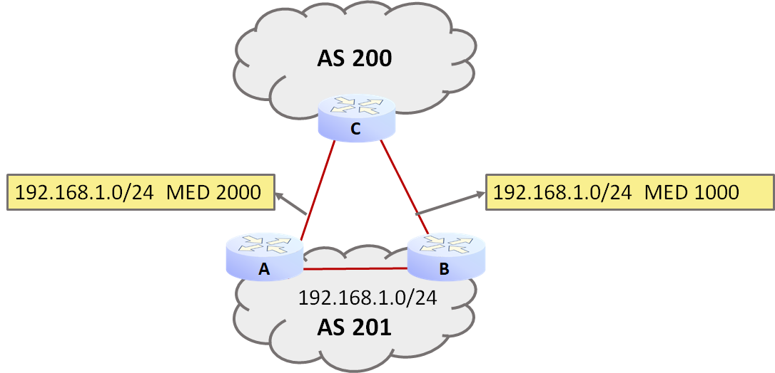
6.5 BGP Route Attributes
MULTI-EXIT-DISC (MED)
  Attribute used to request another AS to choose among entry routes into the current AS
    Lower is better
    IGP metric value (7Ch. for reference) can be used

Slide 21
6.5 BGP Route Attributes
ORIGIN
  Prefix Indicates the original source from which the prefix information was obtained
  Types
    IGP originated
    EGP originated (no longer used)
    Other
      e.g.) OSPF, Imported from static routes

Slide 22
6.6 BGP Route Selection
BGP announcement Processing
  Peer AS: Received from peer AS → Update internal routing information → Propagate to other AS
Best route selection rules
  Higher LOCAL-PREF > Shorter AS-PATH > Smaller ORIGIN > Smaller MED > [eBGP learned > iBGP learned] > Closer NEXT-HOP > Smaller Router ID

