Slide 1
Ad hoc and Sensor Networks
Chapter 2: Single node architecture
Holger Karl

Slide 2
Goals of this chapter
Survey the main components of the composition of a node for a wireless sensor network
  Controller, radio modem, sensors, batteries
Understand energy consumption aspects for these components
  Putting into perspective different operational modes and what different energy/power consumption means for protocol design
Operating system support for sensor nodes
Some example nodes
Note: The details of this chapter are quite specific to WSN; energy consumption principles carry over to MANET as well

Slide 3
Outline
Sensor node architecture
Energy supply and consumption
Runtime environments for sensor nodes
Case study: TinyOS

Slide 4
Sensor node architecture
Main components of a WSN node
  Controller
  Communication device(s)
  Sensors/actuators
  Memory
  Power supply
Memory
Communication
device
Sensor(s)/
actuator(s)
Controller
Power supply

Slide 5
Ad hoc node architecture
Core: essentially the same
But: Much more additional equipment
  Hard disk, display, keyboard, voice interface, camera, …
Essentially: a laptop-class device

Slide 6
Controller
Main options:
  Microcontroller – general purpose processor, optimized for embedded applications, low power consumption
  DSPs – optimized for signal processing tasks, not suitable here
  FPGAs – may be good for testing
  ASICs – only when peak performance is needed, no flexibility
Example microcontrollers
  Texas Instruments MSP430
    16-bit RISC core, up to 4 MHz, versions with 2-10 kbytes RAM,
    several DACs, RT clock, prices start at 0.49 US$
  Atmel ATMega
    8-bit controller, larger memory than MSP430, slower

Slide 7
Communication device
Which transmission medium?
  Electromagnetic at radio frequencies?
  Electromagnetic, light?
  Ultrasound?
Radio transceivers transmit a bit- or byte stream as radio wave
  Receive it, convert it back into bit-/byte stream
ü

Slide 8
Transceiver characteristics
Capabilities
  Interface: bit, byte, packet level?
  Supported frequency range?
    Typically, somewhere in 433 MHz – 2.4 GHz, ISM band
  Multiple channels?
  Data rates?
  Range?
Energy characteristics
  Power consumption to send/receive data?
  Time and energy consumption to change between different states?
  Transmission power control?
  Power efficiency (which percentage of consumed power is radiated?)
Radio performance
  Modulation? (ASK, FSK, …?)
  Noise figure? NF = SNR_{I}/SNR_{O}
  Gain? (signal amplification)
  Receiver sensitivity? (minimum S to achieve a given E_{b}/N₀)
  Blocking performance (achieved BER in presence of frequency-offset interferer)
  Out of band emissions
  Carrier sensing & RSSI characteristics
  Frequency stability (e.g., towards temperature changes)
  Voltage range

Slide 9
Transceiver states
Transceivers can be put into different operational states, typically:
  Transmit
  Receive
  Idle – ready to receive, but not doing so
    Some functions in hardware can be switched off, reducing energy consumption a little
  Sleep – significant parts of the transceiver are switched off
    Not able to immediately receive something
    Recovery time and startup energy to leave sleep state can be significant
Research issue: Wakeup receivers – can be woken via radio when in sleep state (seeming contradiction!)

Slide 10
Example radio transceivers
Almost boundless variety available
Some examples
  RFM TR1000 family
    916 or 868 MHz
    400 kHz bandwidth
    Up to 115,2 kbps
    On/off keying or ASK
    Dynamically tuneable output power
    Maximum power about 1.4 mW
    Low power consumption
  Chipcon CC1000
    Range 300 to 1000 MHz, programmable in 250 Hz steps
    FSK modulation
    Provides RSSI
  Chipcon CC 2400
    Implements 802.15.4
    2.4 GHz, DSSS modem
    250 kbps
    Higher power consumption than above transceivers
  Infineon TDA 525x family
    E.g., 5250: 868 MHz
    ASK or FSK modulation
    RSSI, highly efficient power amplifier
    Intelligent power down, “self-polling” mechanism
    Excellent blocking performance

Slide 11
Example radio transceivers for ad hoc networks
Ad hoc networks: Usually, higher data rates are required
Typical: IEEE 802.11 b/g/a is considered
  Up to 54 MBit/s
  Relatively long distance (100s of meters possible, typical 10s of meters at higher data rates)
  Works reasonably well (but certainly not perfect) in mobile environments
  Problem: expensive equipment, quite power hungry

Slide 12
Wakeup receivers
Major energy problem: RECEIVING
  Idling and being ready to receive consumes considerable amounts of power
When to switch on a receiver is not clear
  Contention-based MAC protocols: Receiver is always on
  TDMA-based MAC protocols: Synchronization overhead, inflexible
Desirable: Receiver that can (only) check for incoming messages
  When signal detected, wake up main receiver for actual reception
  Ideally: Wakeup receiver can already process simple addresses
  Not clear whether they can be actually built, however

Slide 13
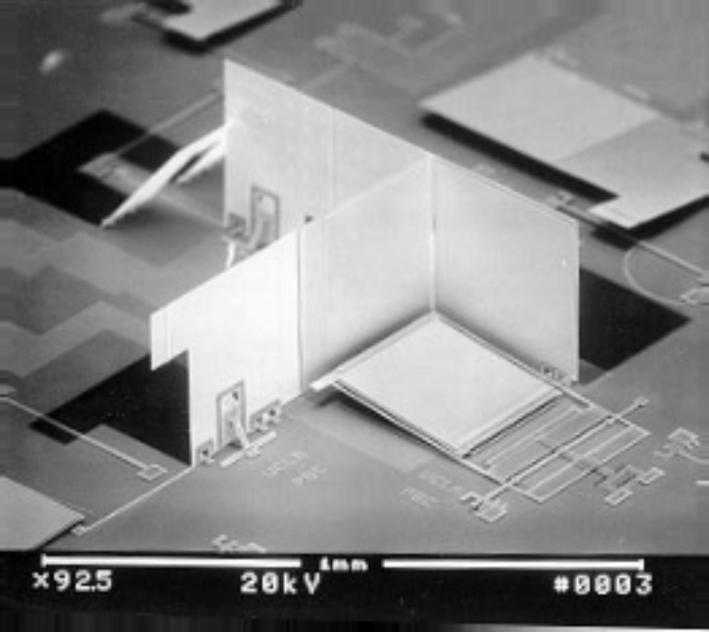
Optical communication
Optical communication can consume less energy
Example: passive readout via corner cube reflector
  Laser is reflected back directly to source if mirrors are at right angles
  Mirrors can be “titled”
  to stop reflecting
  ! Allows data to be
  sent back to
  laser source
200 µm

Slide 14
Ultra-wideband communication
Standard radio transceivers: Modulate a signal onto a carrier wave
  Requires relatively small amount of bandwidth
Alternative approach: Use a large bandwidth, do not modulate, simply emit a “burst” of power
  Forms almost rectangular pulses
  Pulses are very short
  Information is encoded in the presence/absence of pulses
  Requires tight time synchronization of receiver
  Relatively short range (typically)
Advantages
  Pretty resilient to multi-path propagation
  Very good ranging capabilities
  Good wall penetration

Slide 15
Sensors as such
Main categories
  Any energy radiated? Passive vs. active sensors
  Sense of direction? Omidirectional?
  Passive, omnidirectional
    Examples: light, thermometer, microphones, hygrometer, …
  Passive, narrow-beam
    Example: Camera
  Active sensors
    Example: Radar
Important parameter: Area of coverage
  Which region is adequately covered by a given sensor?

Slide 16
Outline
Sensor node architecture
Energy supply and consumption
Runtime environments for sensor nodes
Case study: TinyOS

Slide 17
Energy supply of mobile/sensor nodes
Goal: provide as much energy as possible at smallest cost/volume/weight/recharge time/longevity
  In WSN, recharging may or may not be an option
Options
  Primary batteries – not rechargeable
  Secondary batteries – rechargeable, only makes sense in combination with some form of energy harvesting
Requirements include
  Low self-discharge
  Long shelf live
  Capacity under load
  Efficient recharging at low current
  Good relaxation properties (seeming self-recharging)
  Voltage stability (to avoid DC-DC conversion)

Slide 18
Battery examples
Energy per volume (Joule per cubic centimeter):
Primary batteries
Chemistry | Zinc-air | Lithium | Alkaline
Energy (J/cm³) | 3780 | 2880 | 1200
Secondary batteries
Chemistry | Lithium | NiMHd | NiCd
Energy (J/cm³) | 1080 | 860 | 650

Slide 19
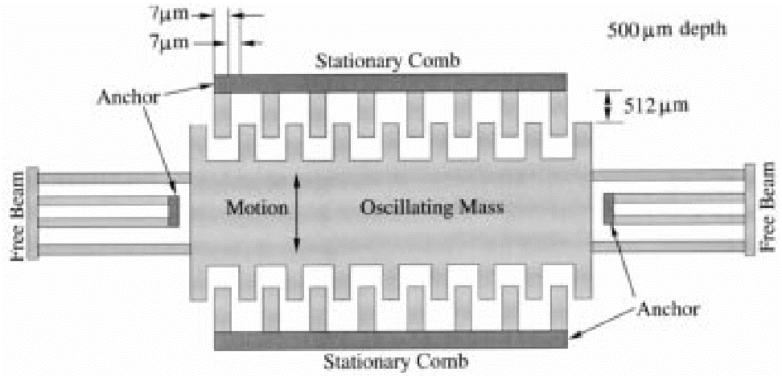
Energy scavenging
How to recharge a battery?
  A laptop: easy, plug into wall socket in the evening
  A sensor node? – Try to scavenge energy from environment
Ambient energy sources
  Light ! solar cells – between 10 μW/cm² and 15 mW/cm²
  Temperature gradients – 80 μ W/cm² @ 1 V from 5K difference
  Vibrations – between 0.1 and 10000 μ W/cm³
  Pressure variation (piezo-electric) – 330 μ W/cm² from the heel of a shoe
  Air/liquid flow
  (MEMS gas turbines)

Slide 20
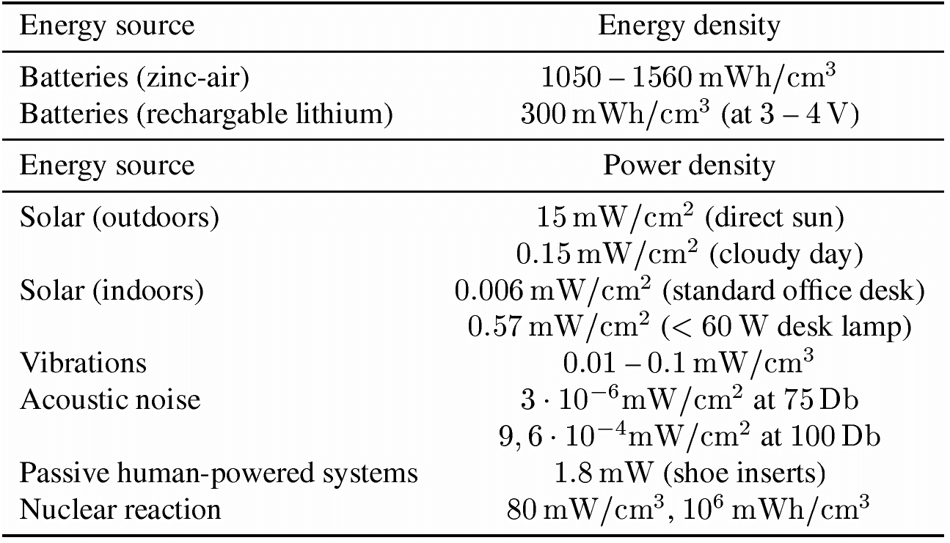
Energy scavenging – overview

Slide 21
Energy consumption
A “back of the envelope” estimation
Number of instructions
  Energy per instruction: 1 nJ
  Small battery (“smart dust”): 1 J = 1 Ws
  Corresponds: 10⁹ instructions!
Lifetime
  Or: Require a single day operational lifetime = 24¢60¢60 =86400 s
  1 Ws / 86400s ¼ 11.5 μW as max. sustained power consumption!
Not feasible!

Slide 22
Multiple power consumption modes
Way out: Do not run sensor node at full operation all the time
  If nothing to do, switch to power safe mode
  Question: When to throttle down? How to wake up again?
Typical modes
  Controller: Active, idle, sleep
  Radio mode: Turn on/off transmitter/receiver, both
Multiple modes possible, “deeper” sleep modes
  Strongly depends on hardware
  TI MSP 430, e.g.: four different sleep modes
  Atmel ATMega: six different modes

Slide 23
Some energy consumption figures
Microcontroller
  TI MSP 430 (@ 1 MHz, 3V):
    Fully operation 1.2 mW
    Deepest sleep mode 0.3 μW – only woken up by external interrupts (not even timer is running any more)
  Atmel ATMega
    Operational mode: 15 mW active, 6 mW idle
    Sleep mode: 75 μW

Slide 24
Switching between modes
Simplest idea: Greedily switch to lower mode whenever possible
Problem: Time and power consumption required to reach higher modes not negligible
  Introduces overhead
  Switching only pays off if E_{saved} > E_{overhead}
Example:
Event-triggered
wake up from
sleep mode
Scheduling problem
with uncertainty
(exercise)
E_{saved}
E_{overhead}
P_{active}
P_{sleep}
t₁
t_{event}
time
τ_{down}
τ_{up}

Slide 25
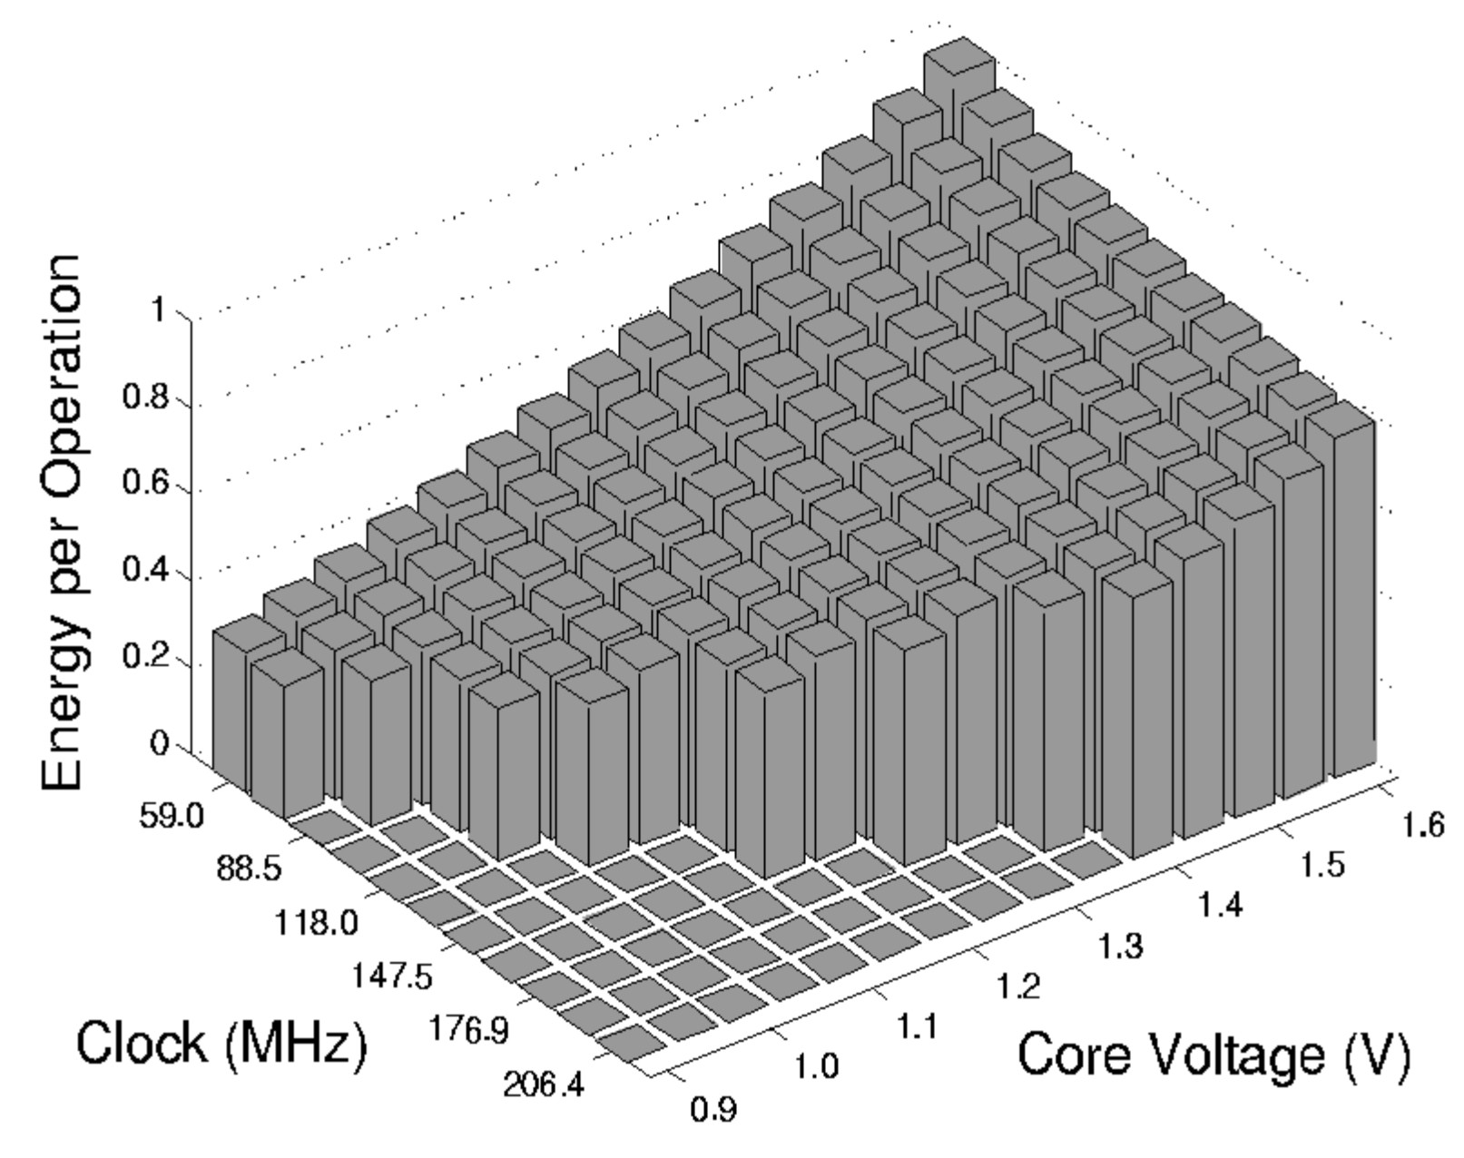
Alternative: Dynamic voltage scaling
Switching modes complicated by uncertainty how long a sleep time is available
Alternative: Low supply voltage & clock
  Dynamic voltage scaling (DVS)
Rationale:
  Power consumption P
  depends on
    Clock frequency
    Square of supply voltage
    P / f V²
  Lower clock allows
  lower supply voltage
  Easy to switch to higher clock
  But: execution takes longer

Slide 26
Memory power consumption
Crucial part: FLASH memory
  Power for RAM almost negligible
FLASH writing/erasing is expensive
  Example: FLASH on Mica motes
  Reading: ¼ 1.1 nAh per byte
  Writing: ¼ 83.3 nAh per byte

Slide 27
Transmitter power/energy consumption for n bits
Amplifier power: P_{amp} = α_{amp} + β_{amp} P_{tx}
  P_{tx} radiated power
  α_{amp}, β_{amp} constants depending on model
  Highest efficiency (η = P_{tx} / P_{amp} ) at maximum output power
In addition: transmitter electronics needs power P_{txElec}
Time to transmit n bits: n / (R ¢ R_{code})
  R nomial data rate, R_{code} coding rate
To leave sleep mode
  Time T_{start}, average power P_{start}
! E_{tx} = T_{start} P_{start} + n / (R ¢ R_{code}) (P_{txElec} + α_{amp} + β_{amp} P_{tx})
Simplification: Modulation not considered
Notes:
A = 174, beta= 4 -> berechne effizienz

Slide 28
Receiver power/energy consumption for n bits
Receiver also has startup costs
  Time T_{start}, average power P_{start}
Time for n bits is the same n / (R ¢ R_{code})
Receiver electronics needs P_{rxElec}
Plus: energy to decode n bits E_{decBits}
! E_{rx} = T_{start} P_{start} + n / (R ¢ R_{code}) P_{rxElec} + E_{decBits} ( R )

Slide 29
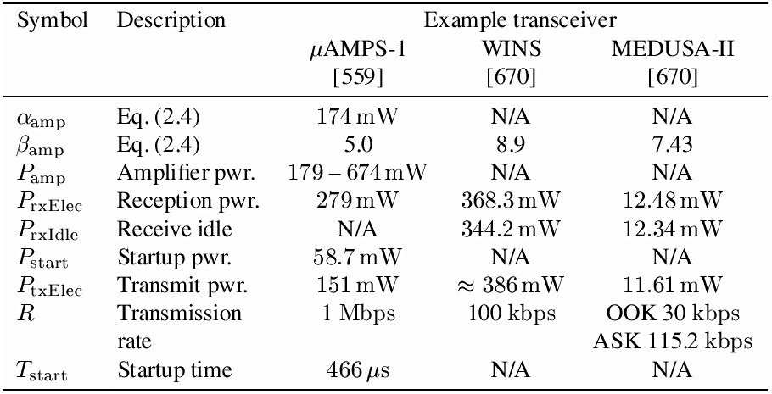
Some transceiver numbers

Slide 30
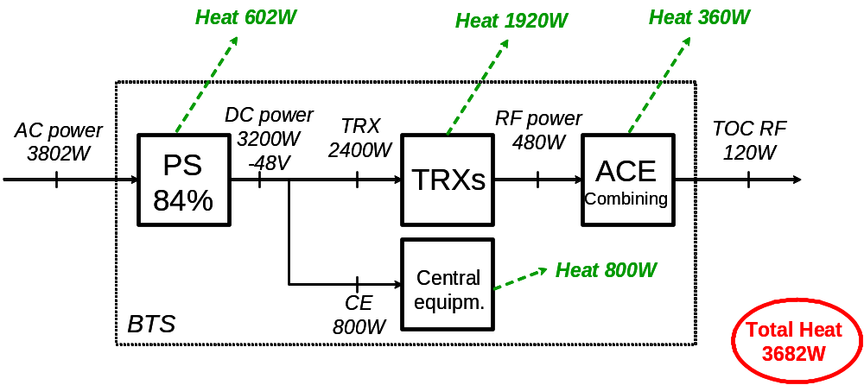
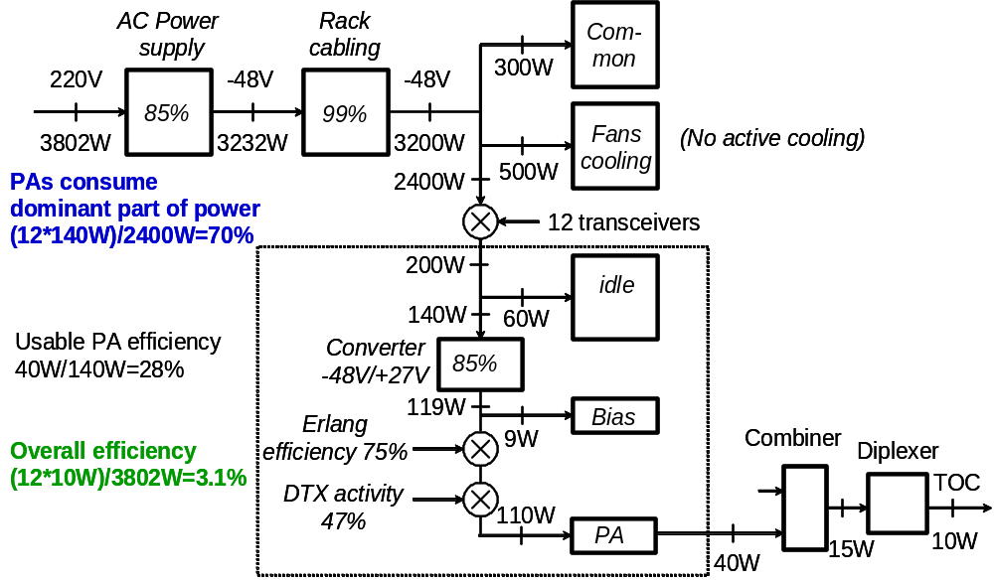
Comparison: GSM base station power consumption
Overview
Details
(just to put things
into perspective)

Slide 31
Controlling transceivers
Similar to controller, low duty cycle is necessary
  Easy to do for transmitter – similar problem to controller: when is it worthwhile to switch off
  Difficult for receiver: Not only time when to wake up not known, it also depends on remote partners
  ! Dependence between MAC protocols and power consumption is strong!
Only limited applicability of techniques analogue to DVS
  Dynamic Modulation Scaling (DSM): Switch to modulation best suited to communication – depends on channel gain
  Dynamic Coding Scaling – vary coding rate according to channel gain
  Combinations

Slide 32
Computation vs. communication energy cost
Tradeoff?
  Directly comparing computation/communication energy cost not possible
  But: put them into perspective!
  Energy ratio of “sending one bit” vs. “computing one instruction”: Anything between 220 and 2900 in the literature
  To communicate (send & receive) one kilobyte
  = computing three million instructions!
Hence: try to compute instead of communicate whenever possible
Key technique in WSN – in-network processing!
  Exploit compression schemes, intelligent coding schemes, …

Slide 33
Outline
Sensor node architecture
Energy supply and consumption
Runtime environments for sensor nodes
Case study: TinyOS

Slide 34
Operating system challenges in WSN
Usual operating system goals
  Make access to device resources abstract (virtualization)
  Protect resources from concurrent access
Usual means
  Protected operation modes of the CPU – hardware access only in these modes
  Process with separate address spaces
  Support by a memory management unit
Problem: These are not available in microcontrollers
  No separate protection modes, no memory management unit
  Would make devices more expensive, more power-hungry
! ???

Slide 35
Operating system challenges in WSN
Possible options
  Try to implement “as close to an operating system” on WSN nodes
    In particular, try to provide a known programming interface
    Namely: support for processes!
    Sacrifice protection of different processes from each other
    ! Possible, but relatively high overhead
  Do (more or less) away with operating system
    After all, there is only a single “application” running on a WSN node
    No need to protect malicious software parts from each other
    Direct hardware control by application might improve efficiency
Currently popular verdict: no OS, just a simple run-time environment
  Enough to abstract away hardware access details
  Biggest impact: Unusual programming model

Slide 36
Main issue: How to support concurrency
Simplest option: No concurrency, sequential processing of tasks
  Not satisfactory: Risk of missing data (e.g., from transceiver) when processing data, etc.
  ! Interrupts/asynchronous operation has to be supported
Why concurrency is needed
  Sensor node’s CPU has to service the radio modem, the actual sensors, perform computation for application, execute communication protocol software, etc.
Poll sensor
Process
sensor
data
Poll transceiver
Process received
packet

Slide 37
Traditional concurrency: Processes
Traditional OS: processes/threads
  Based on interrupts, context switching
  But: not available – memory overhead, execution overhead
But: concurrency mismatch
  One process per protocol entails too many context switches
  Many tasks in WSN small with respect to context switching overhead
And: protection between processes not needed in WSN
  Only one application anyway
Handle sensor
process
Handle packet
process
OS-mediated
process switching

Slide 38
Event-based concurrency
Alternative: Switch to event-based programming model
  Perform regular processing or be idle
  React to events when they happen immediately
  Basically: interrupt handler
Problem: must not remain in interrupt handler too long
  Danger of loosing events
  Only save data, post information that event has happened, then return
  ! Run-to-completion principle
  Two contexts: one for handlers, one for regular execution
R
a
d
i
o
S
e
n
s
o
r
e
v
e
n
t
e
v
e
n
t
I
d
l
e
/
R
e
g
u
l
a
r
R
a
d
i
o
e
v
e
n
t
h
a
n
d
l
e
r
p
r
o
c
e
s
s
i
n
g
S
e
n
s
o
r
e
v
e
n
t
h
a
n
d
l
e
r

Slide 39
Components instead of processes
Need an abstraction to group functionality
  Replacing “processes” for this purpose
  E.g.: individual functions of a networking protocol
One option: Components
  Here: In the sense of TinyOS
  Typically fulfill only a single, well-defined function
  Main difference to processes:
    Component does not have an execution
    Components access same address space, no protection against each other
  NOT to be confused with component-based programming!

Slide 40
API to an event-based protocol stack
Usual networking API: sockets
  Issue: blocking calls to receive data
  Ill-matched to event-based OS
  Also: networking semantics in WSNs not necessarily well matched to/by socket semantics
API is therefore also event-based
  E.g.: Tell some component that some other component wants to be informed if and when data has arrived
  Component will be posted an event once this condition is met
  Details: see TinyOS example discussion below

Slide 41
Dynamic power management
Exploiting multiple operation modes is promising
Question: When to switch in power-safe mode?
  Problem: Time & energy overhead associated with wakeup; greedy sleeping is not beneficial (see exercise)
  Scheduling approach
Question: How to control dynamic voltage scaling?
  More aggressive; stepping up voltage/frequency is easier
  Deadlines usually bound the required speed form below
Or: Trading off fidelity vs. energy consumption!
  If more energy is available, compute more accurate results
  Example: Polynomial approximation
    Start from high or low exponents depending where the polynomial is to be evaluated

Slide 42
Outline
Sensor node architecture
Energy supply and consumption
Runtime environments for sensor nodes
Case study: TinyOS

Slide 43
Case study embedded OS: TinyOS & nesC
TinyOS developed by UC Berkely as runtime environment for their “motes”
nesC as adjunct “programming language”
Goal: Small memory footprint
  Sacrifices made e.g. in ease of use, portability
  Portability somewhat improved in newer version
Most important design aspects
  Component-based system
  Components interact by exchanging asynchronous events
  Components form a program by wiring them together (akin to VHDL – hardware description language)

Slide 44
TinyOS components
Components
  Frame – state information
  Tasks – normal execution program
  Command handlers
  Event handlers
Handlers
  Must run to completion
  Form a component’s interface
  Understand and emits commands & events
Hierarchically arranged
  Events pass upward from hardware to higher-level components
  Commands are passed downward
init
start
stop
fired
TimerComponent
Command
handlers
Frame
Tasks
Event
handlers
setRate
fire

Slide 45
Handlers versus tasks
Command handlers and events must run to completion
  Must not wait an indeterminate amount of time
  Only a request to perform some action
Tasks, on the other hand, can perform arbitrary, long computation
  Also have to be run to completion since no non-cooperative multi-tasking is implemented
  But can be interrupted by handlers
  ! No need for stack management, tasks are atomic with respect to each other

Slide 46
Split-phase programming
Handler/task characteristics and separation has consequences on programming model
  How to implement a blocking call to another component?
  Example: Order another component to send a packet
  Blocking function calls are not an option
! Split-phase programming
  First phase: Issue the command to another component
    Receiving command handler will only receive the command, post it to a task for actual execution and returns immediately
    Returning from a command invocation does not mean that the command has been executed!
  Second phase: Invoked component notifies invoker by event that command has been executed
  Consequences e.g. for buffer handling
    Buffers can only be freed when completion event is received

Slide 47
Structuring commands/events into interfaces
Many commands/events can add up
nesC solution: Structure corresponding commands/events into interface types
Example: Structure timer into three interfaces
  StdCtrl
  Timer
  Clock
init
start
stop
fired
StdCtrl
Timer
Build configurations by wiring together corresponding interfaces
TimerComponent
Clock
setRate
fire

Slide 48
Building components out of simpler ones
Wire together components to form more complex components out of simpler ones
New interfaces for the complex component
StdCtrl
Timer
CompleteTimer
StdCtrl
Timer
TimerComponent
Clock
Clock
HWClock

Slide 49
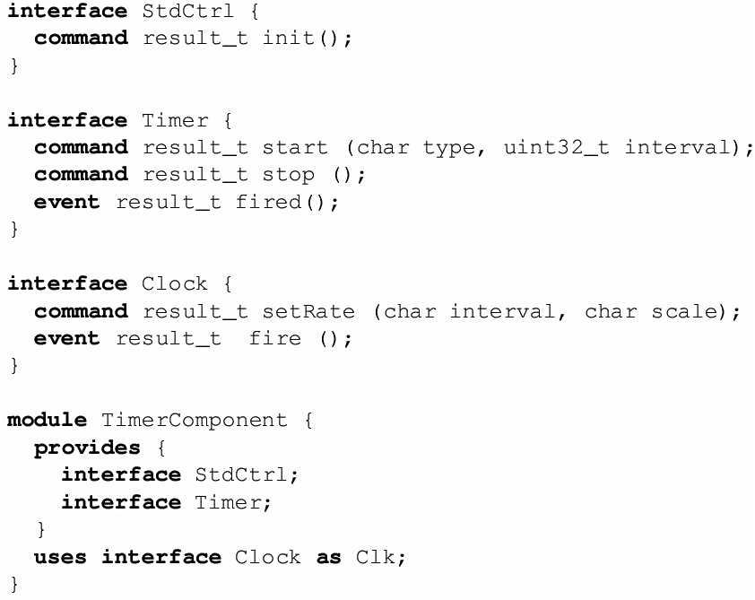
Defining modules and components in nesC

Slide 50
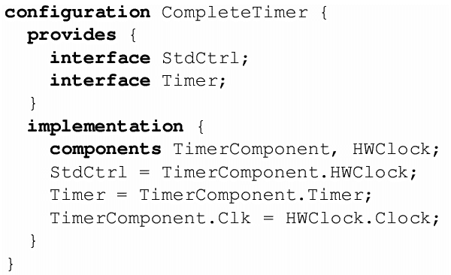
Wiring components to form a configuration

Slide 51
Summary
For WSN, the need to build cheap, low-energy, (small) devices has various consequences for system design
  Radio frontends and controllers are much simpler than in conventional mobile networks
  Energy supply and scavenging are still (and for the foreseeable future) a premium resource
  Power management (switching off or throttling down devices) crucial
Unique programming challenges of embedded systems
  Concurrency without support, protection
  De facto standard: TinyOS

