Slide 1
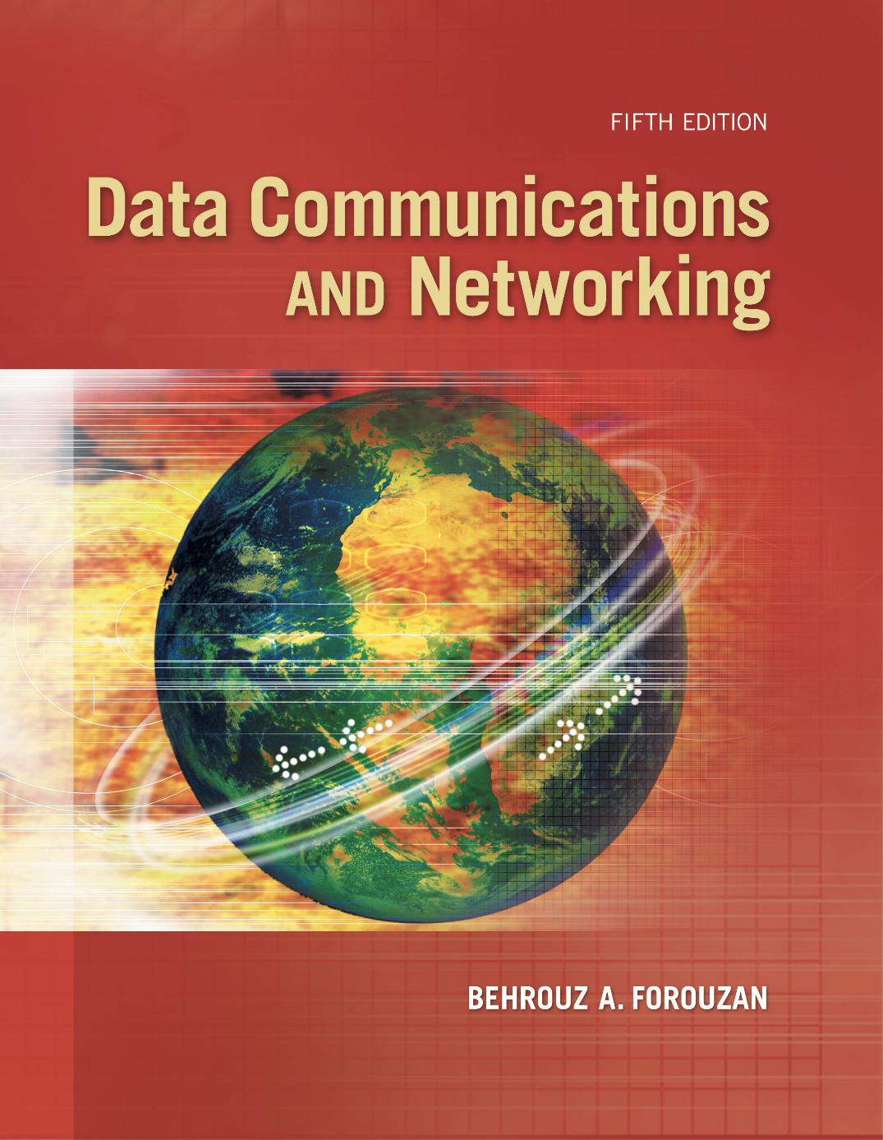
Chapter 1
Introduction
Copyright © The McGraw-Hill Companies, Inc. Permission required for reproduction or display.

Slide 2
Chapter 1: Outline
1.1 Data Communications
1.2 Networks
1.3 Network Types

Slide 3
    1-1 DATA COMMUNICATIONS
When we communicate, we are sharing information. This sharing can be local or remote. The term telecommunication, which includes telephony, telegraph, and television, means communication at a distance.
Data communications are the exchange of data between two devices via some form of transmission media.

Slide 4
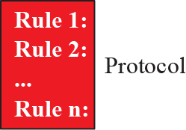
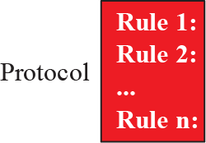



1.1.1 Components
A data communications system has five components (see Figure 1.1).

Slide 5
1.1.2 Data Representation
Information today comes in different forms such as text, numbers, images, audio, and video.

Slide 6
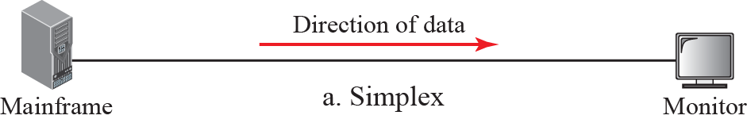
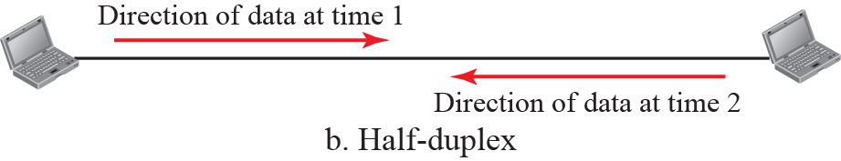
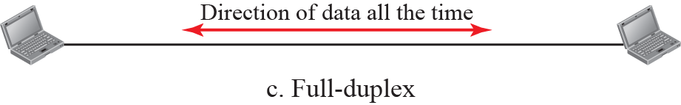
1.1.3 Data Flow
Communication between two devices can be simplex, half-duplex, or full-duplex as shown in Figure 1.2.

Slide 7
    1-2 NETWORKS
A network is the interconnection of a set of devices capable of communication. In this definition, a device can be a host such as a large computer, desktop, laptop, workstation, cellular phone, or security system. A device in this definition can also be a connecting device such as a router a switch, a
modem that changes the form of data, and so on.

Slide 8
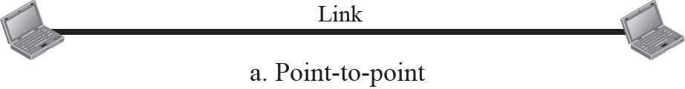
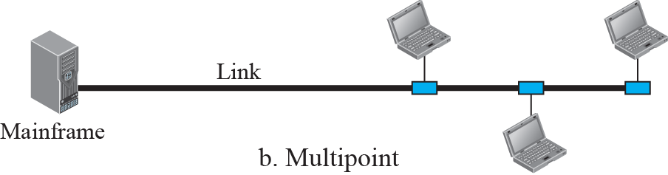
1.2.2 Physical Structures
Before discussing networks, we need to define some network attributes.

Slide 9
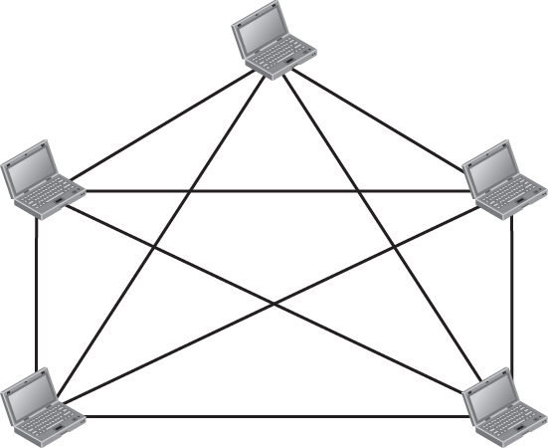


Figure 1.4: A fully-connected mesh topology

Slide 10
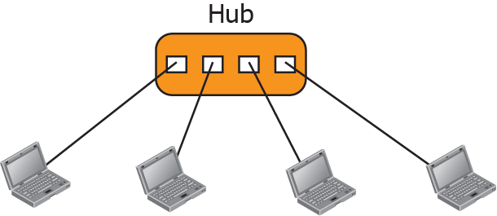
Figure 1.5: A star topology

Slide 11
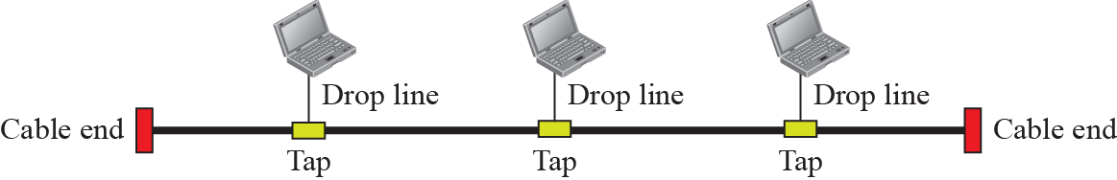
Figure 1.6: A bus topology

Slide 12
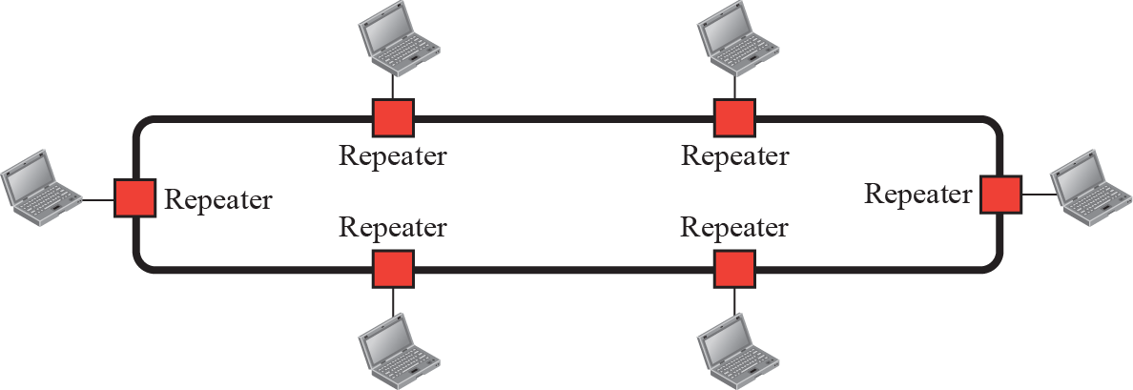
Figure 1.7: A ring topology

Slide 13
    1-3 NETWORKS TYPES
After defining networks in the previous section and discussing their physical structures, we need to discuss different types of networks we encounter in the world today. The criteria of distinguishing one type of network from another is difficult and sometimes confusing. We use a few criteria such as size, geographical coverage, and ownership to make this distinction.

Slide 14
1.3.1 Local Area Network
A local area network (LAN) is usually privately owned and connects some hosts in a single office, building, or campus. Depending on the needs of an organization, a LAN can be as simple as two PCs and a printer in someone’s home office, or it can extend throughout a company and include audio and video devices. Each host in a LAN has an identifier, an address, that uniquely defines the host in the LAN. A packet sent by a host to another host carries both the source host’s and the destination host’s addresses.

Slide 15
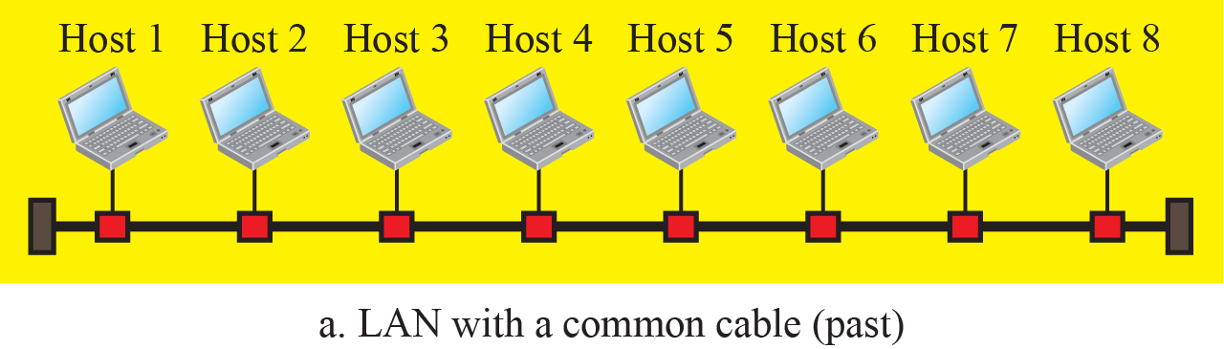
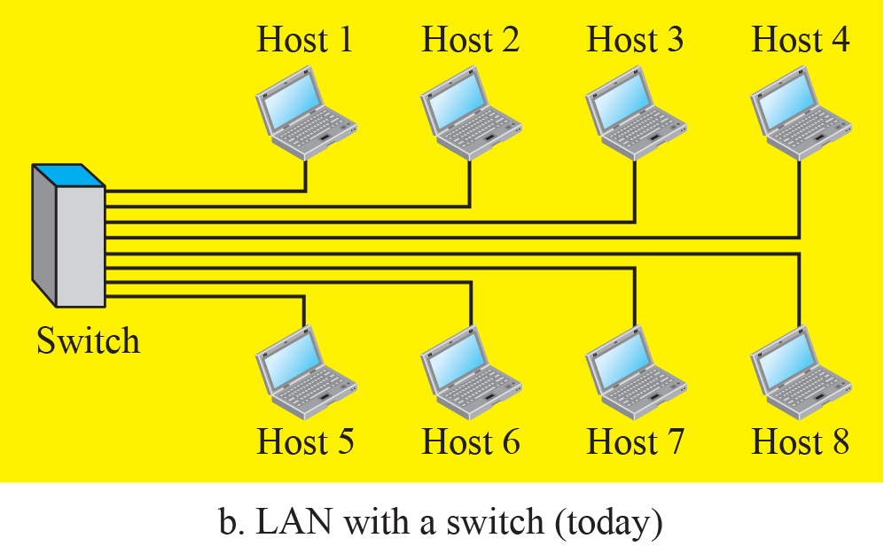
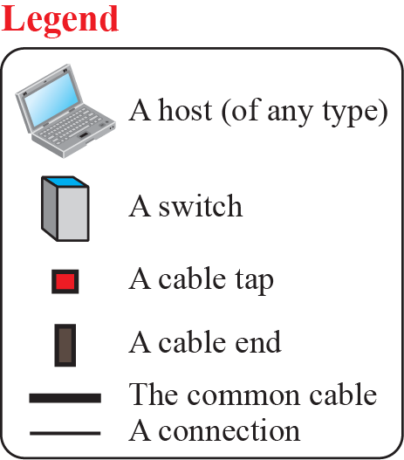
Figure 1.8: An Isolated LAN in the past and today

Slide 16
1.3.2 Wide Area Network
A wide area network (WAN) is also an connection of devices capable of communication. However, there are some differences between a LAN and a WAN. A LAN is normally limited in size; a WAN has a wider geographical span, spanning a town, a state, a country, or even the world. A LAN interconnects hosts; a WAN interconnects connecting devices such as switches, routers, or modems. A LAN is normally privately owned by the organization that uses it; a WAN is normally created and run by communication companies and leased by an organization that uses it.

Slide 17
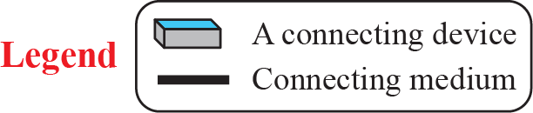
Figure 1.9: A Point-to-Point WAN

Slide 18
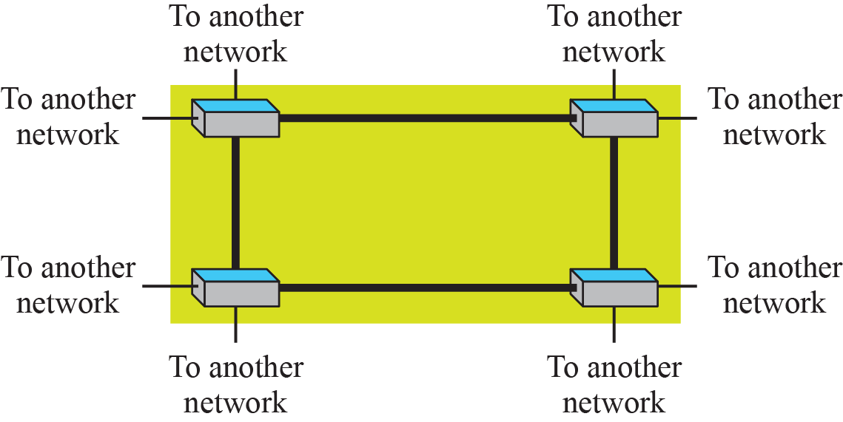
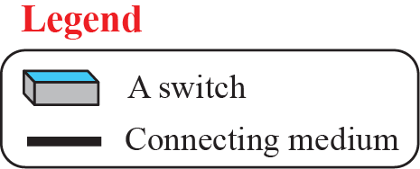
Figure 1.10: A Switched WAN

Slide 19
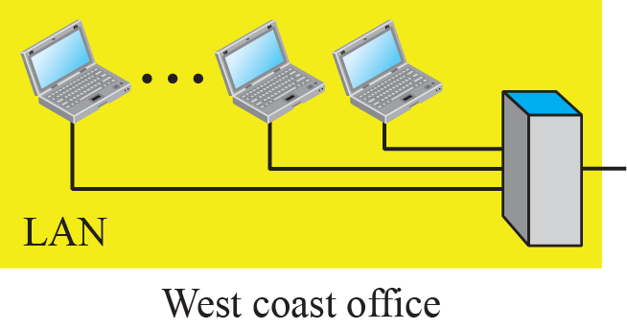
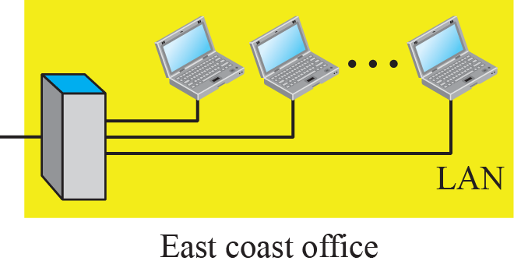
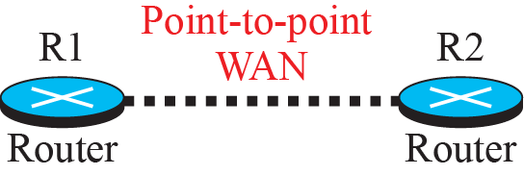
Figure 1.11: An internetwork made of two LANs and one WAN

Slide 20

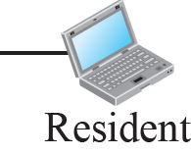
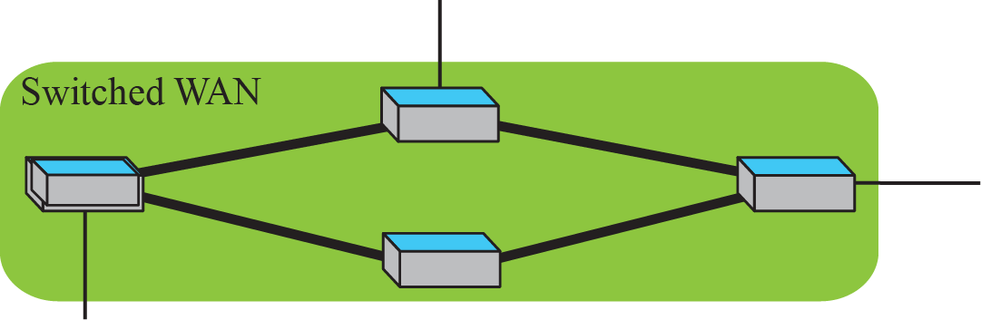
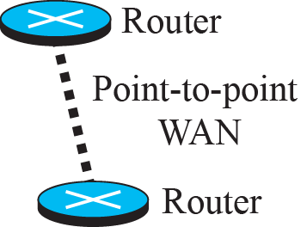
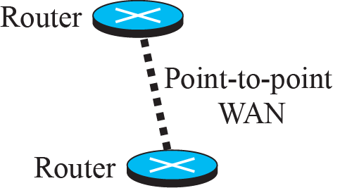
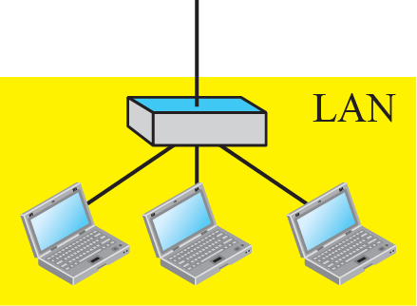
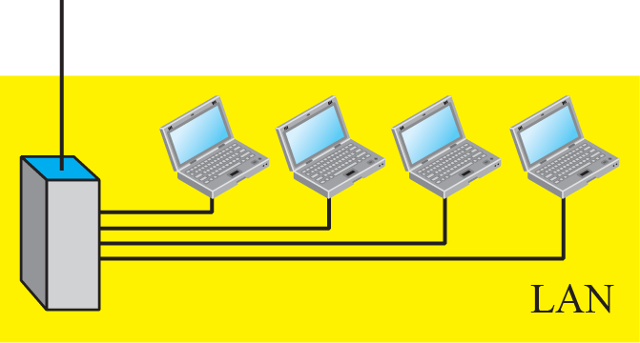
Figure 1.12: A heterogeneous network made of WANs and LANs

Slide 21
1.3.3 Switching
An internet is a switched network in which a switch connects at least two links together. A switch needs to forward data from a network to another network when required. The two most common types of switched networks are circuit-switched and packet-switched networks. We discuss both next.

Slide 22

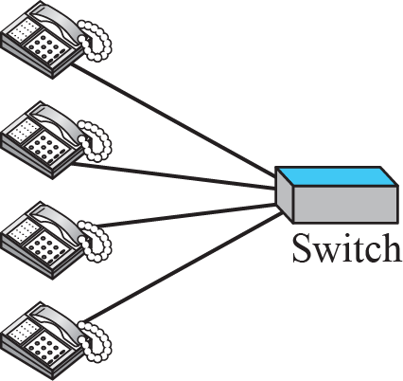
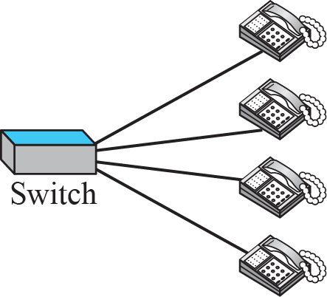
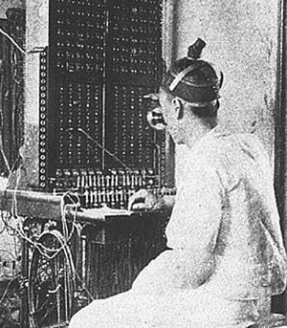
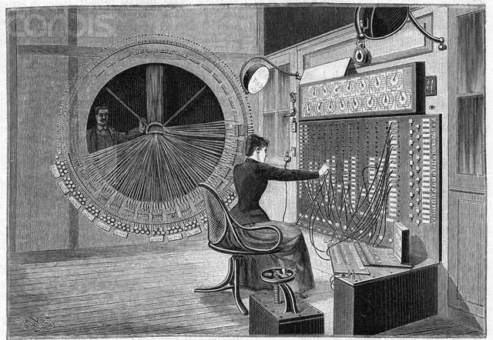
Figure 1.13: A circuit-switched network

Slide 23

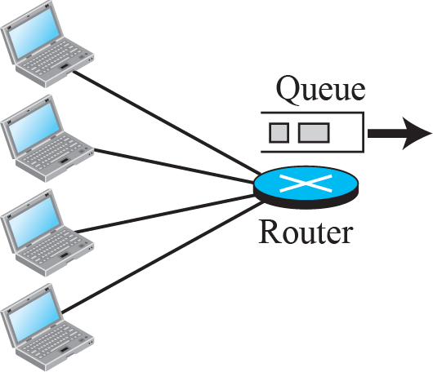
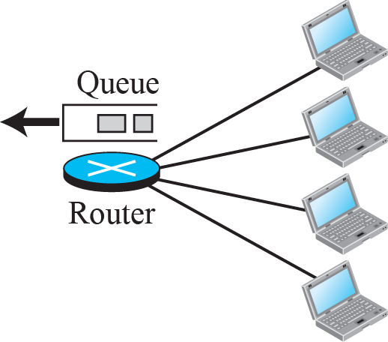
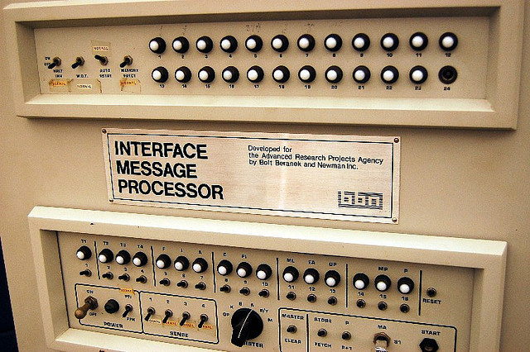
Figure 1.14: A packet-switched network

