Slide 1
Z-Wave vs. ZigBee Protocol
2019.9.11
hkim

Slide 2
Outline
Introduction
Z-wave technology
Z-wave devices
Z-wave vs. ZigBee
Conclusion
Reference

Slide 3
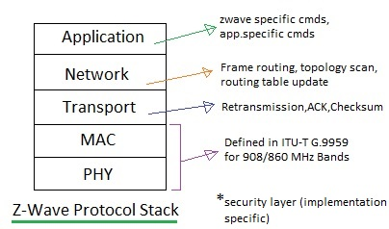
Smart Home Wireless Protocols
Many wireless protocols for smart homes such as INSTEON, ZigBee, and Z-Wave
Z-Wave protocol stack

Slide 4
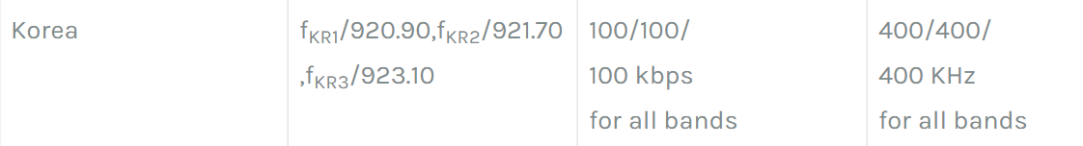
Z-Wave
By Sigma Designs, Inc.
PHY and MAC standardized: ITU-T G.9959
RF (PHY) layer operates in ISM band
30 m (indoors), 100 m (outdoors)
Tx power = 0dBm

Slide 5
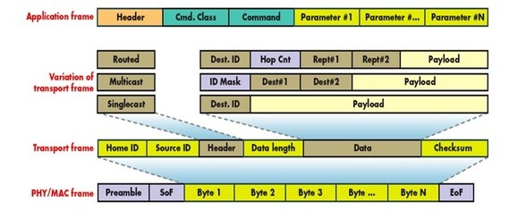
Frame Format

Slide 6
PHY Layer
Preamble insertion
Modulation/demodulation
RF channel selection
Tx and Rx
Coding: Manchester (9.6 kbps) or NRZ (40, 100 kbps)
Modulation: FSK (9.6, 40 kbps) or GFSK (100 kbps)

Slide 7
MAC Layer
Unique network ID number (Home ID)
Up to 232 nodes in one network (Node ID)
Collision avoidance algorithm: CSMA/CA

Slide 8
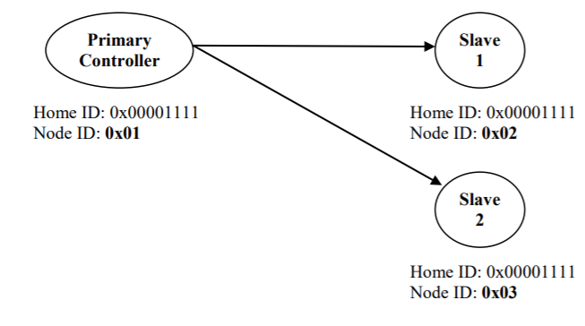
Home ID and Node ID
Home ID is a 32-bit identifier pre-programmed in all controllers
  Slaves will have Home ID=0 initially
Node ID is a 8-bit identifier assigned by the controller

Slide 9
Transfer Layer
A.k.a. Transport layer, but it is not L4
Performs error control: link layer control (LLC)
  Enables reliable data transfer
Transfer layer frame types
  Singlecast (ACKed), Multicast (Not ACKed), Broadcast (Not ACKed)
Support for low-power operation via dedicated wakeup patterns

Slide 10
Network (Routing) Layer
Frame routing, topology scan, routing table updates
  Routing = Tx with correct “repeater” list
  Battery-operated node do not repeat
When multi-hop forwarding is necessary
  Routed Singlecast Frame
  Routed Acknowledge Frame
Source routing: controller computes the routes

Slide 11
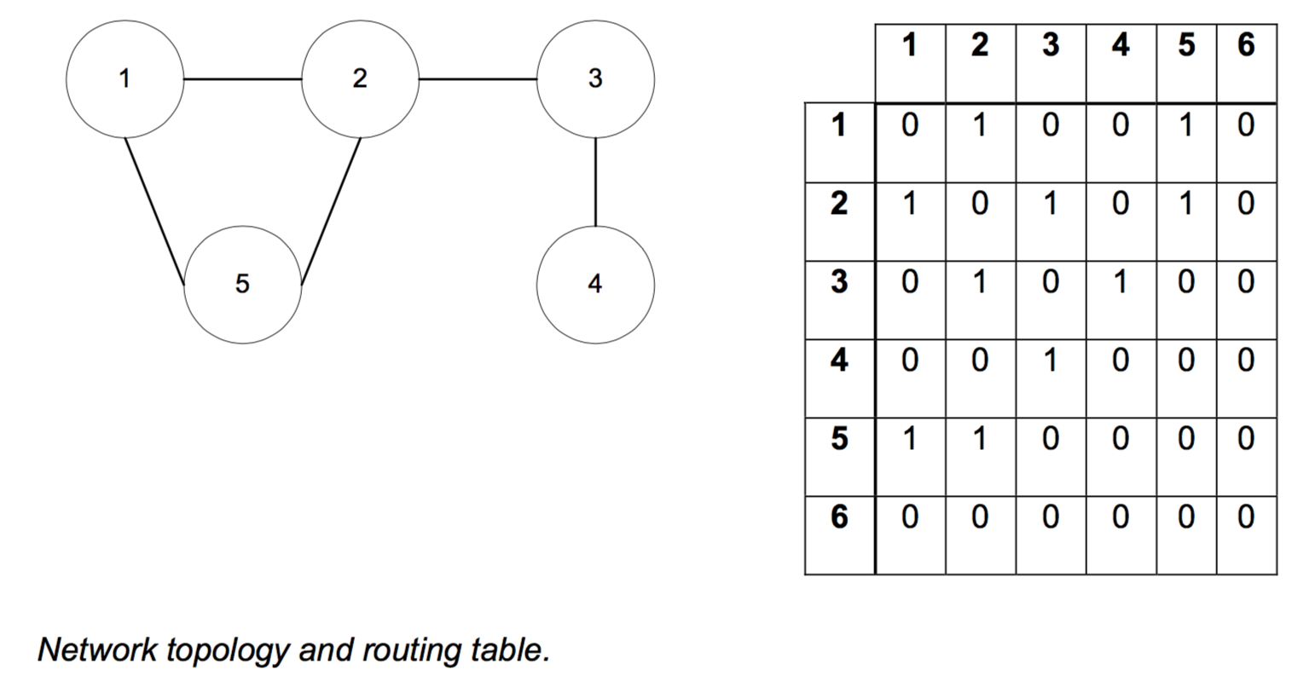
Routing Table

Slide 12
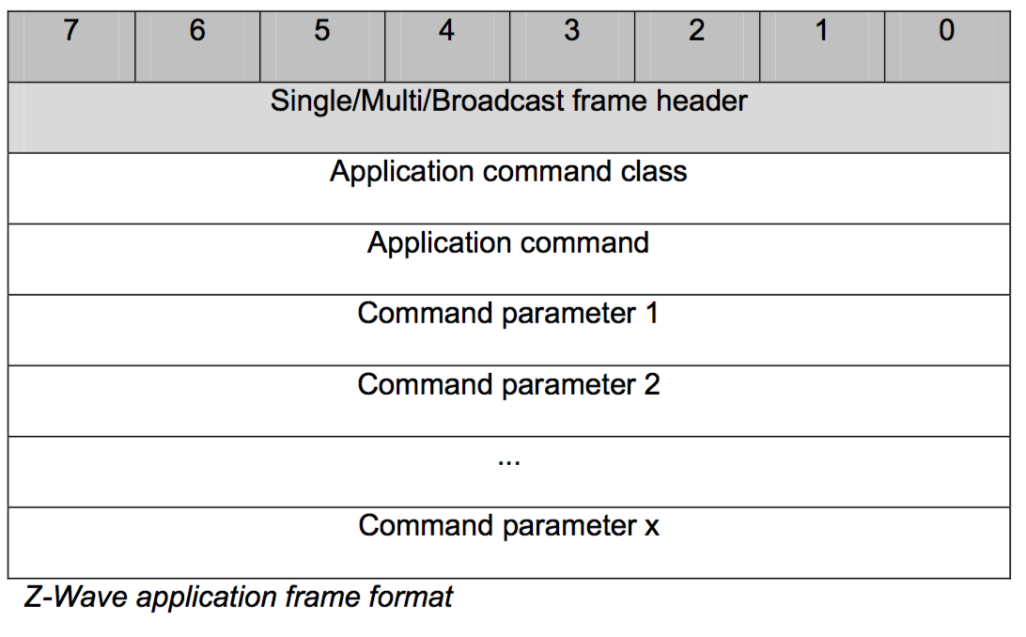
Application Layer

Slide 13
Controllers
One primary and additional secondaries
Primary initially creates network, and manages it
  Include/exclude nodes
  Manages allocation of Home ID and Node ID
  Has full routing table (copies are given to secondaries)
Initiate commands

Slide 14
Slaves
Reply to and execute commands
Does not have routing tables
Also forward commands to other nodes (“repeater”)
  Cannot directly transmit to other nodes unless directed by the commands
  Cf. Routing Slave and Frequently Listening Routing Slave (FLiRS)

Slide 15
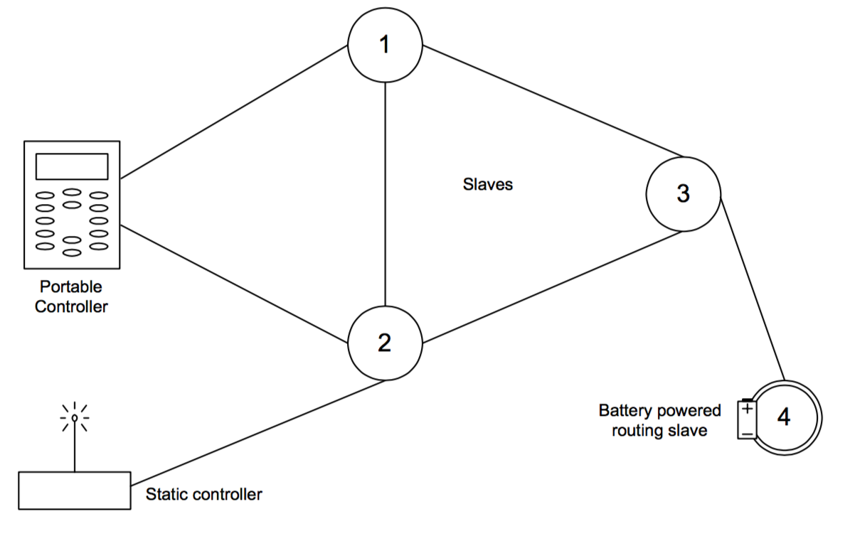
Topology

Slide 16
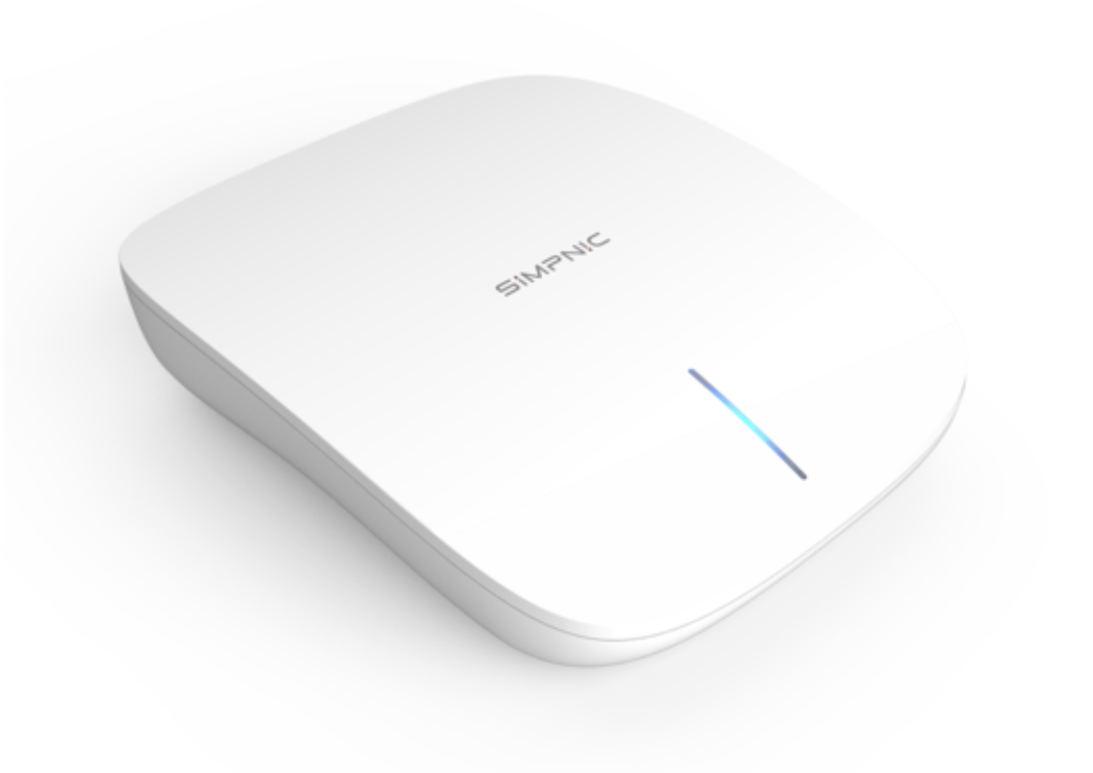
Z-Wave Devices (Controller)
https://simpnic.com/collections/home-automation

Slide 17
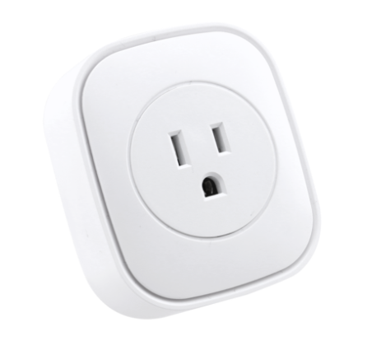
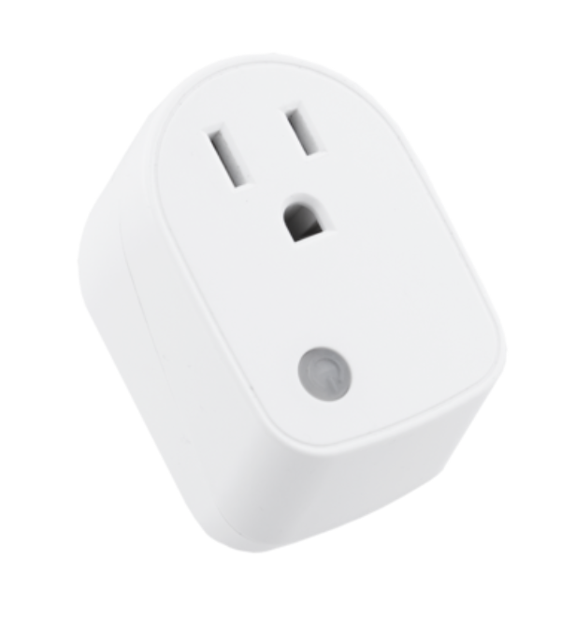
Z-Wave Devices (Slaves)
https://simpnic.com/collections/home-automation

Slide 18
Z-Wave vs. ZigBee
Physical Layer |  | Z-Wave | ZigBee
 | RF band (MHz) | 868/908 (all chips) 2400 (400 series chip) | 868/915/2400
 | Range (m) | 30 (indoors) 100 (outdoors) | 10-100
 | Bit rate (kb/s) | 9.6/40(200 series chip) 200 (only 400 series chip) | 20/40/250
 | Receiver sensitivity (dBm) | -101 (at 40kb/s) | -85 (2.4GHz band) -92 (868/915 MHz bands)

Slide 19
Z-Wave vs. ZigBee (cont.)
Link Layer |  | Z-Wave | ZigBee
 | MAC mechanism | CSMA/CA | TDMA + CSMA/CA (beacon mode) and CSMA/CA (beaconless mode)
 | Message size(Bytes) | 64 (max MAC payload in 200 series chip) | 127 (max)
 | Error control | 8-bit check-sum, ACKs (optional) | 16-bit CRC, ACKs (optional)

Slide 20
Z-Wave vs. ZigBee (cont.)
Communication modes |  | Z-Wave | ZigBee
 | Unicast | Yes | Yes
 | Broadcast | Yes | Yes
 | Multicast | Yes | Yes (NWK and APL layers). Not supported by MAC
 | Other modes | No | Indirect addressing

Slide 21
Z-Wave vs. ZigBee (cont.)
 | Z-Wave | ZigBee
Identifiers | 32-bit (home ID), 8-bit (node ID) | 16-bit and 64-bit MAC addresses 16-bit NWK identifiers
Device types | Controllers and slaves | Corrdinator, router and end device

Slide 22
Z-Wave vs. ZigBee (cont.)
 |  | Z-Wave | ZigBee
Network Layer | Multihop solution | Source routing | Mesh routing, tree routing and source routing
 | Hop limit | 4 | 30/10/5 (Mesh routing/tree routing/source routing)
Application Layer | Command space | 32,768 | 65,536 (clusters)
 | Device type space | N/A | 65,536

Slide 23
Z-Wave vs. ZigBee (cont.)
 | Z-Wave | ZigBee
End-to-end reliability | ACKs | ACKs and control of duplicate packets
Security | 128 bit AES encryption (400 series chip) | Integrity, confidentiality, access control, and key management

Slide 24
Reference
Yassein, Muneer Bani, et al. “Smart Homes Automation Using Z-Wave Protocol.” 2016 International Conference on Engineering & MIS (ICEMIS), 2016
Gomez, Carles, and Josep Paradells. “Wireless Home Automation Networks: A Survey of Architectures and Technologies.” IEEE Communications Magazine, vol. 48, no. 6, 2010, pp. 92–101.
Z-Wave, “Z-Wave Protocol Overview,” v. 4, May 2007.

