Slide 1
2.7 Unicast Address Assignment
Imatitikua Aiyanyo
티티
2015021433

Slide 2
Once a site has been allocated a range of unicast IP addresses, the network administrator must determine how to assign addresses in the address range to each network interface and how to set up the subnet structure

Slide 3
Single Provider/No Network/Single Address
Receive a single IP address from an ISP to be used with a single computer.
  Local “loopback” address (127.0.0.1)
  All Hosts multicast address (224.0.0.1)
If the host is running IPv6,
  Minimum, All Nodes IPv6 multicast address (ff02::1)
  IPv6 loopback address (::1)
  Link – local address for each network interface

Slide 4
Single Provider/Single Network/Single Address
Router is used to provide connectivity to the Internet.
The router forwards packets from the home network to the ISP
It also performs NAT by rewriting the IP addresses in packets being exchanged with the customer’s ISP.
  From the ISP’s point of view, only a single IP address has been used.

Slide 5
Single Provider/Multiple Networks/Multiple Addresses
Often have multiple LANS; Intranet and Internet
Typically a site or network administrator who must decide
  How many IP addresses the site requires
  How to structure subnets at the site
  Which subnets should be internal and which should be external

Slide 6
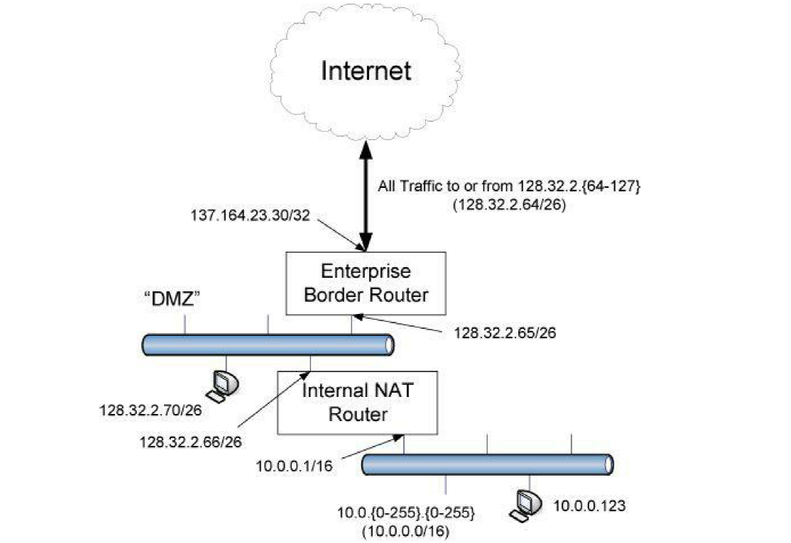
Single Provider/Multiple Networks/Multiple Addresses
It is used to attach servers that can be accessed by users on the Internet
This router can rewrite datagrams entering and leaving the internal network using any of the addresses in its pool.

Slide 7
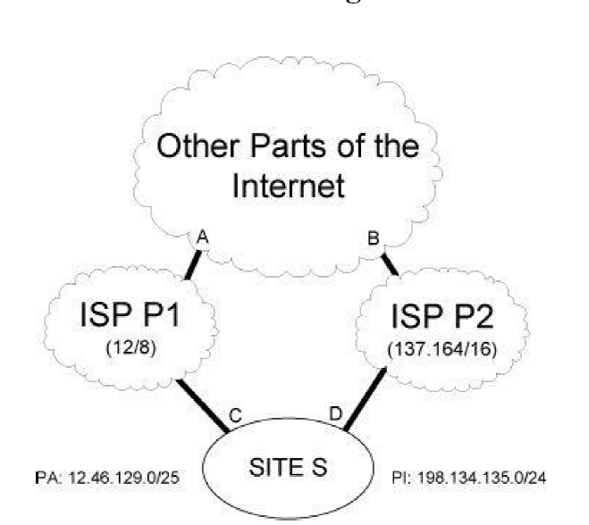
Multiple Providers/Multiple Networks/Multiple Addresses(Multihoming).
The main reason for multihoming is to provide for redundancy in case of failure or for other reasons.

Slide 8
Multiple Providers/Multiple Networks/Multiple Addresses(Multihoming).
IP addresses serve as both identifiers and locators for a network interface attached to the Internet
Protocols that provide this separation are sometimes called identifer/locator separating or id/loc split protocols.
Shim6 introduces a “shim” network-layer protocol that separates the “upper-layer protocol identifier”

Slide 9
Multiple Providers/Multiple Networks/Multiple Addresses(Multihoming).
Multihoming is achieved by selecting which IP address (locator) to use based on dynamic network conditions and without requiring P1 address allocations.
Using public keys of public/private key pairs associated with hosts, Host Identity Protocol (HIP) can be authenticated as having come from a particular host.

