Slide 1
TALENT: Temporal Adaptive Link Estimator with No Training
Tao Liu and Alberto E. Cerpa
Electrical Engineering and Computer Science
University of California – Merced (Est. in 2005)
MengLin

Slide 2
Outline
Introduction
Modeling
System Design
Evaluation
Conclusion

Slide 3
Introduction
Link quality estimation is a fundamental component of the low power wireless protocols and for routing protocols
However, it’s hard to estimate due to dynamic and unpredictable wireless environment
With accurate link quality, routing protocol can establish efficient end-to-end delivery paths and reduce radio transmissions to save energy
Notes:
Good link – no retransmission
Efficient routing tree

Slide 4
Indicator of Wireless Link Quality
Signal to Noise Ratio (SNR) not directly provide by CC2420
Received Signal Strength Indicator (RSSI)
Link Quality Indicator (LQI) in CC24240
ETX, a PRR-based metric is often used and calculated by windowed mean estimator with exponentially weighted moving average (WMEWMA)
Notes:
However, it’s hard to find a good correlation between PHY parameters and Packet Reception Rate (PRR) to show how good Link Quality is.
So PRR based link estimation metrics such as ETX is often utilized.

Slide 5
Problem using PRR-based Metrics
Unable to reflect short temporal link quality variations well, leading to ignore intermediate bursty links
Invalid assumption about current link quality remaining the same all the time
Notes:
ignore the intermediate bursty links [2] that have low average PRR in long term (PRR between 10% and 90%),
but show continuous high quality in short periods
短暫出現但卻可以傳很遠

Slide 6
Reasons for a Estimator or Predictor
Able to leverage the intermediate quality links to increase delivery efficiency and reduce communication costs
Adaptivity
  Tackle dynamics of network
Plug-and-play
  Without pre-deployment efforts to turn the prediction model

Slide 7
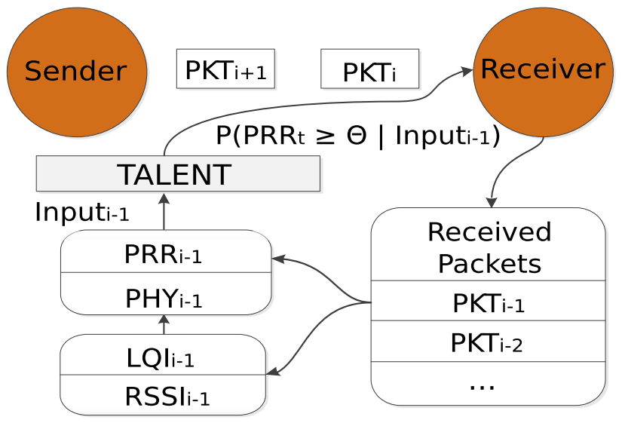
Modeling
Inferring the probability that PRR exceeds a certain threshold 𝛳
Linker layer
Physical layer

Slide 8

Problem Definition
Given W packets as input, determine the probability that the future reception rate on the link will be greater than a predeﬁned threshold θ during a short period of time t.
PRR_{i}: Calculated from the WMEWMA output and with a range between [0,1]
RSSI, SNR and LQI are scaled down to the unit range [0,1]
Denote lost packet as PKT_{i} =[PRR_{i}, 0] since no physical parameter available
Notes:
The output of the model is the probability of the temporal link quality being better than the threshold θ during the time t in the future

Slide 9
Modeling Method
Using Stochastic Gradient Descent (SGD) online learning algorithm to train a logistic regression classiﬁer (LR)
Better performance and simple implementation
Notation
Assume X = <X₁ ...X_{n} > represents the input vector
Y = 1, if PRR_{t} > θ
Y = 0, if PRR_{t} < θ
β is a vector of the weight parameters to be estimated
λ is the learning rate

Slide 10
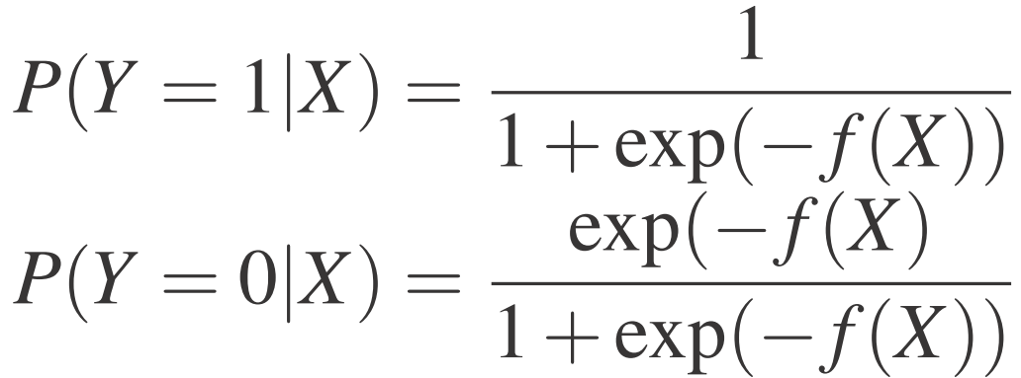
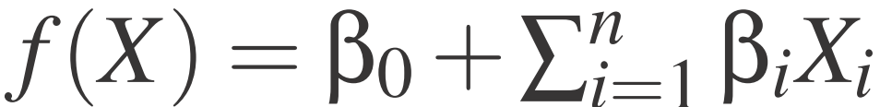
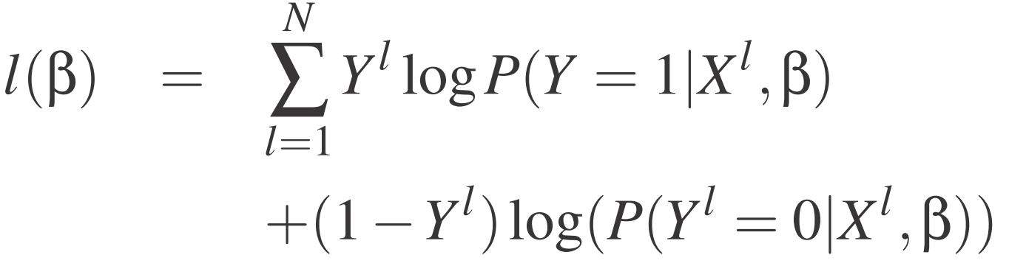
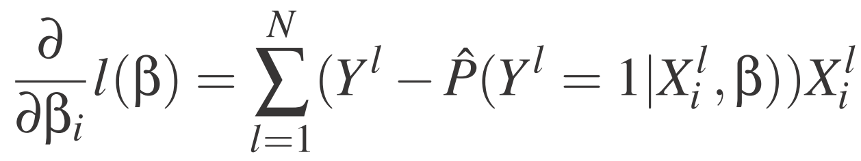

Modeling Method
The logistic regression classiﬁer can be expressed as:
Given a training set of N samples, {(X¹, Y¹)...,(X^{N}, Y^{N})}, training the
logistic regression classiﬁer by maximizing the log of the conditional likelihood,
which is the sum of the log likelihood for each training example
Use the descent gradient to maximize the log likelihood

Slide 11
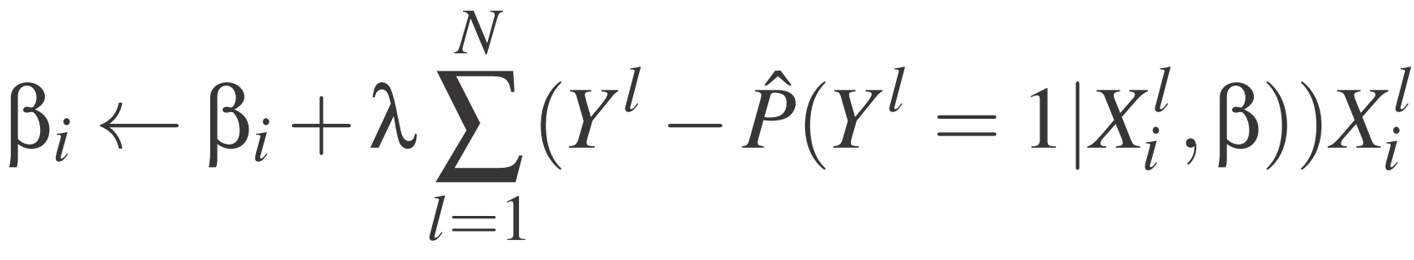
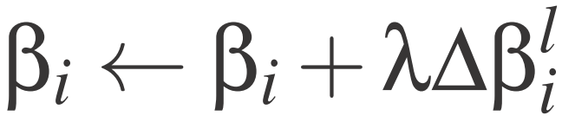
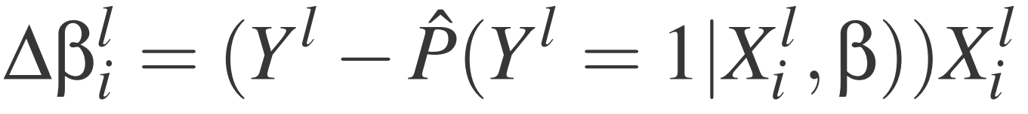
Learning the weights
A common approach is batch training, requiring the entire predeﬁned training set
Another is SGD, requiring single sample only
Online algorithm operates by repetitively drawing a fresh random sample and adjusting the weights on the basis of this single sample only.

Slide 12
Rationality of Online Learning Algo.
From a networking aspect, each packet is a new sample, thus the training dataset continues to grow indeﬁnitely.
Advantages of SGD:
  Its computation speed outperforms batch learning’s
  More adaptive to network changing over time
  More possibly jump to deeper local minimum

Slide 13
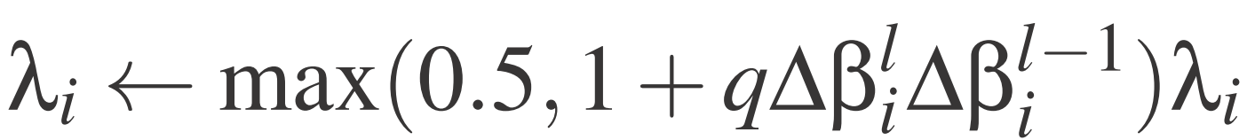
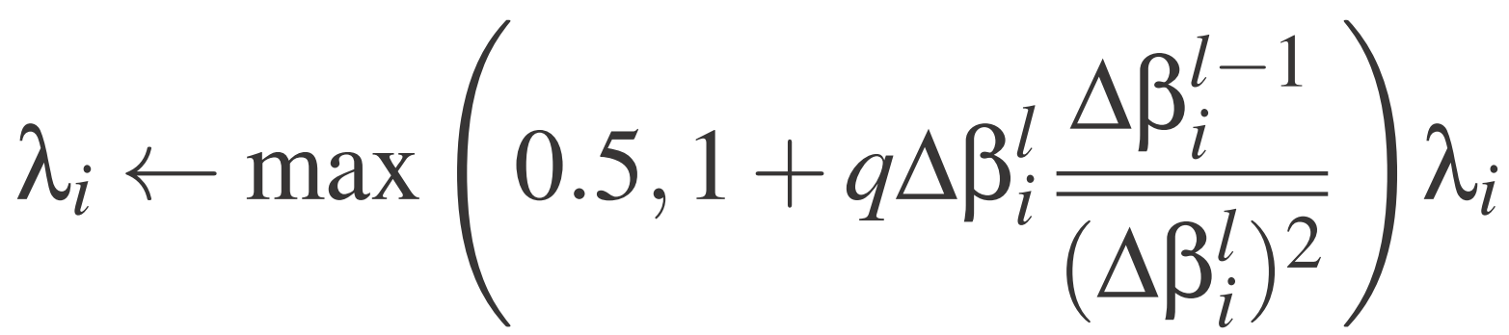
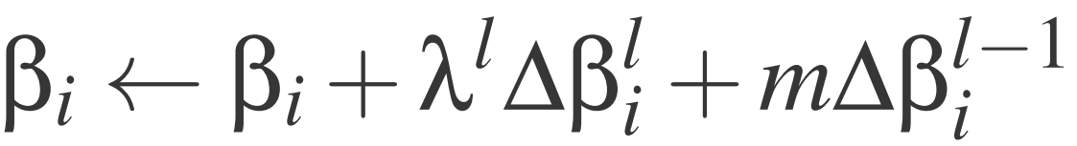
Learning Rate Adaptation
The learning rate λ affects the learning speed and how fast the gradient descent converges
ALAP
s-ALAP with smoothed gradient descent
Extension of SGD with momentum term
q is meta learning rate which controls the step size of learning rate update
, 0 < m < 1

Slide 14
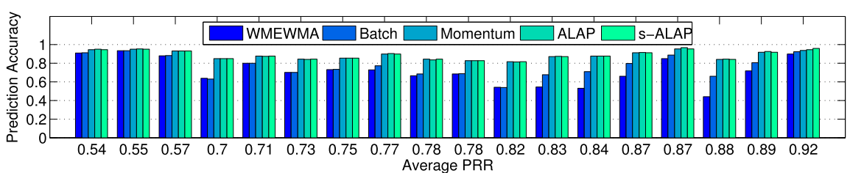
Online Learning Algorithm Evaluation
Packet traces of 54 nodes, sending rate 30 B/0.1s for 1 hour
Record seq. no., RSSI, LQI
Define prediction accuracy as the ratio of the correctly predicted high quality periods to the total number of predictions made
Notes:
doesn’t explain why some of WMEWMA are high while some are low
WMEWMA is worse => WMEWMA estimator could not accurately estimate the link quality variations in the short term.
Batch is also worse => the best model for link quality prediction gradually changes over time due to frequent network dynamics
s-ALAP can select the learning rate adaptively comparing with momentum

Slide 15
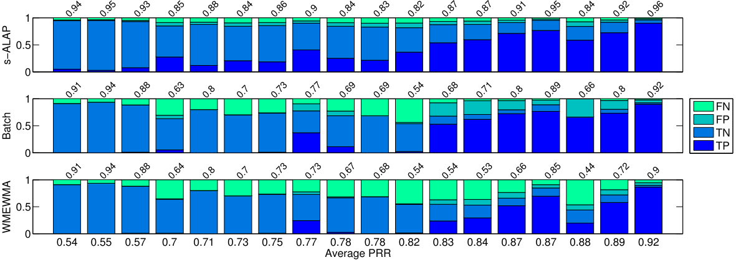
Further Analyses
TP: both the model output and the actual PRR are high (Good link)
TN: the output and the target PRR are both low
FP: the output is high whereas the actual target PRR is low
FN: the output is low whereas the actual target is high
Notes:
The output of the model is the probability of the temporal link quality being better than the threshold θ during the time t in the future
The prediction accuracy is the ratio of the correctly predicted high quality periods to the total number of predictions made
TP cases indicates the percentage of time an intermediate quality link could be used to forward packets with low losses.
Batch:
The batch trained LR model is lower than using s-ALAP, suggesting that having a rigid model can not adjust to the changing network conditions.
WMEWMA :
When the average PRR of the link is close but below the 0.9 threshold, WMEWMA tends to make many FN mistakes because it converges to the average link PRR that is below the threshold.
Hence, WMEWMA fails to predict short intervals of time when the short term PRR is high, {Intermediate burst links} a very common event for a link with average PRR in the high 0.8 range.
< 0.5 have less bursts exceeding very high quality above the 0.9 threshold

Slide 16
Further Analyses
A rigid model for Batch can not adjust to the changing network conditions
Around 0.9, WMEWMA many FN mistakes because it converges to a lower average link PRR
Below 0.5, less bursts exceeding very high quality
Notes:
The output of the model is the probability of the temporal link quality being better than the threshold θ during the time t in the future
The prediction accuracy is the ratio of the correctly predicted high quality periods to the total number of predictions made
TP cases indicates the percentage of time an intermediate quality link could be used to forward packets with low losses.
Batch:
The batch trained LR model is lower than using s-ALAP, suggesting that having a rigid model can not adjust to the changing network conditions.
WMEWMA :
When the average PRR of the link is close but below the 0.9 threshold, WMEWMA tends to make many FN mistakes because it converges to the average link PRR that is below the threshold.
Hence, WMEWMA fails to predict short intervals of time when the short term PRR is high, {Intermediate burst links} a very common event for a link with average PRR in the high 0.8 range.
< 0.5 have less bursts exceeding very high quality above the 0.9 threshold

Slide 17
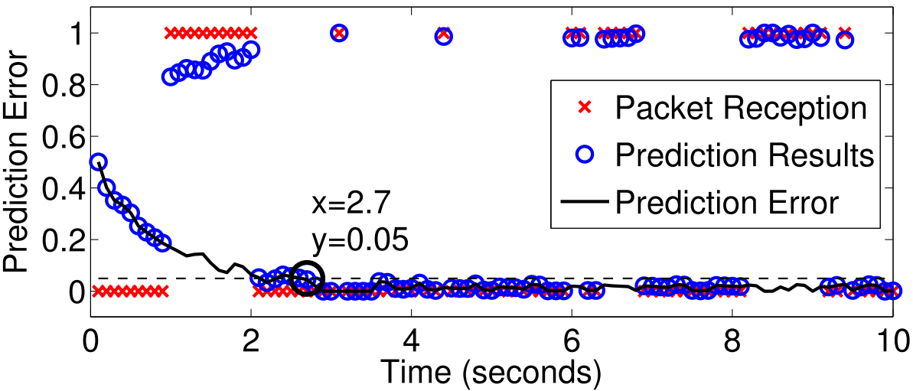
Convergence Speed
The solid line represents the absolute difference between the actual packet reception (1/0) and the model output
On average, SGD with s-ALAP needs 25 ± 4 packets to reduce prediction error to below 5%.
0: lost
1: received
Notes:
從0.5開始加減
By t = 2 . 1s, the prediction error already drops below 5%.
After 2.7s, the error stabilizes and never exceeds the 5%
太屁了 3s 跟 5s馬上預測到…

Slide 18
Summary
LR based models using PRR and LQI values can predict the instantaneous PRR in the near future signiﬁcantly better than WMEWMA for intermediate links
With SGD and s-ALAP, the model is able to adapt to individual links and network dynamics in around 2 to 3 seconds without prior data collection or training

Slide 19
Any question?

Slide 20
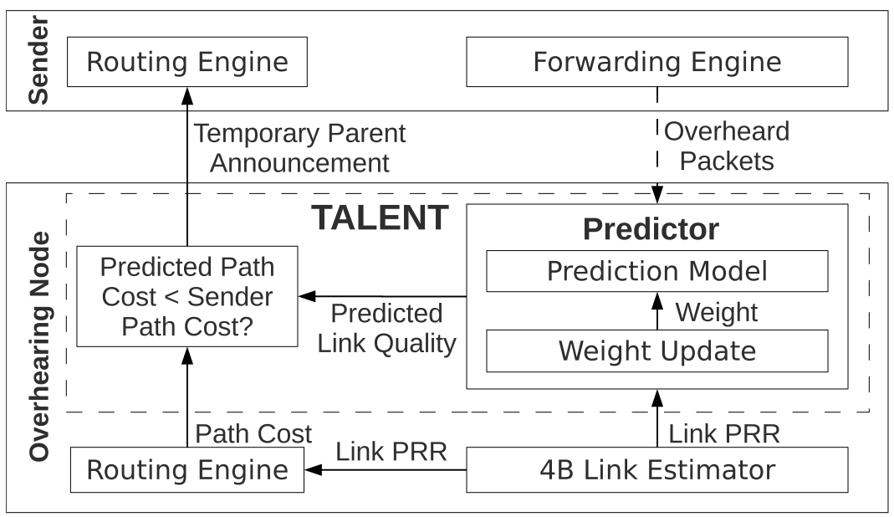
System Design
Receiver initiated: TALENT works in an overhearing node (receiver) and notiﬁes the sender if a better path is available
Temporary Parent Announcement
R
C_{O}
Predictor
(receiver)
O
C_{P}
C_{S→O}
P
S
Sender
C_{S→P}
1. Pred. Out. > 0.5
C_{S→O} + C_{O} > C_{S→P} + C_{P}
2. C_{S→P} + C_{P} > C_{S→O} + C_{O}
Set to min. value: 1
Notes:
Extension module of CTP
if the predicted path cost is smaller than the sender’s current parent,
the overhearing node sends a notification to the sender to be a potential temporary parent (TP)
If the prediction output is greater than 0.5, TALENT considers the link S → O in a high quality period,
and overrides the C_{S→O} with the minimum value of 1

Slide 21
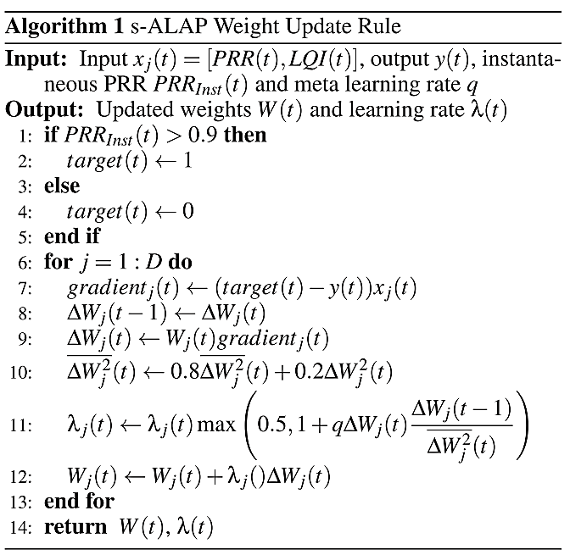
Predictor Implementation
Prediction calculation
  Logistic regression model
  LQI of overheard packets and the estimated PRR (from 4B) of the link as the input
Weight update
Notes:
Once a prediction is calculated, the predictor records the prediction output as well as the inputs,
and then starts to measure the instantaneous PRR after the prediction
The instantaneous PRR is then calculated by dividing the number of packets overheard with the packet gap.

Slide 22
Integration to Existing Network Stack
Routing stability of TALENT and CTP integration
  TALENT should not send any TP notiﬁcation as the path cost itself is not stabilized
Broken links between the sender and the TP
  Wait for CTP’s update – slow
  Set TP loss threshold (miss 5 TP’s ACKs) – quick
Obsolete predictions under low traffic rate
  Invalid prediction after 1 second of the previous update
  Still send to TP and use TP loss threshold to protect
On top of BoX-MAC, quite fit for LPL
  Periodical CCAs for overhearing-based operations
  No address check, so little overhead for non-overhearing node
  Hard to tune wake up interval, set 100ms emperiacally

Slide 23
Experimental Evaluation
Metrics
  end-to-end delivery cost
    the total number of transmissions needed to deliver a packet to the root (including retransmission times)
  loss rate
    the percentage of packets sent but never received at the root
  path length
    the number of hops in a delivery path
Compared with state-of-the-art 4B, STLE, 4C

Slide 24
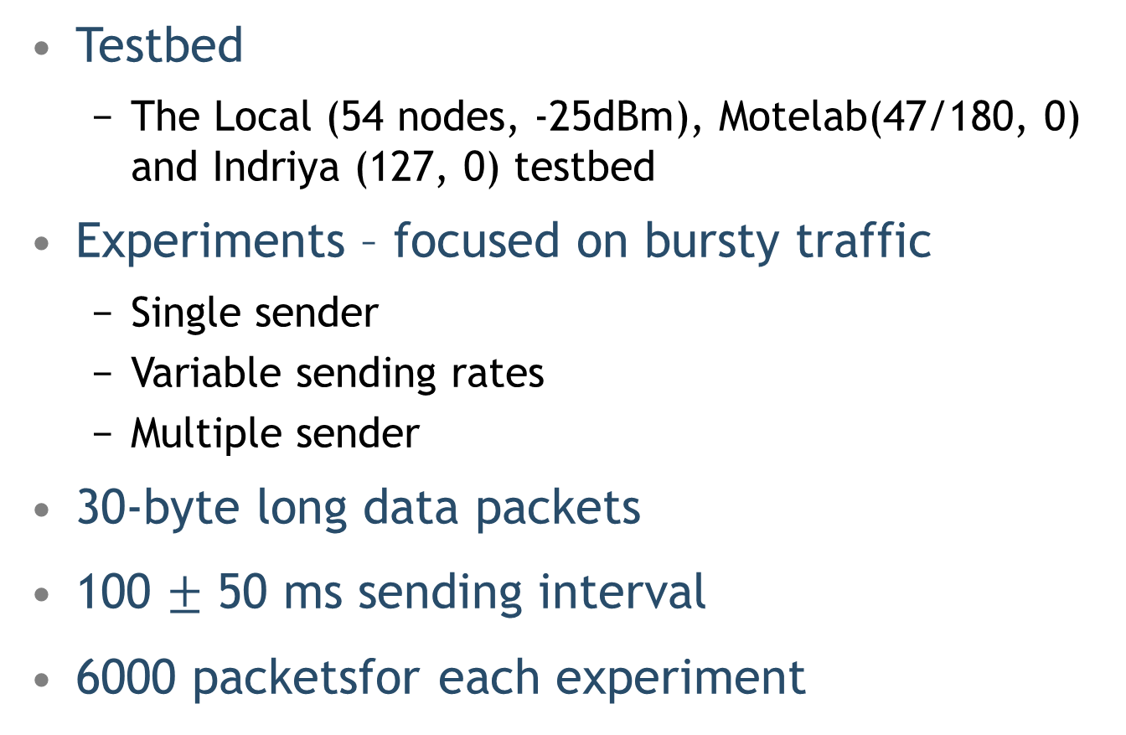
Experimental Setup
Testbed
  The Local (54 nodes, -25dBm), Motelab(47/180, 0) and Indriya (127, 0) testbed
Experiments – focused on bursty traffic
  Single sender
  Variable sending rates
  Multiple sender
30-byte long data packets
100 $±$ 50 ms sending interval
6000 packetsfor each experiment

Slide 25
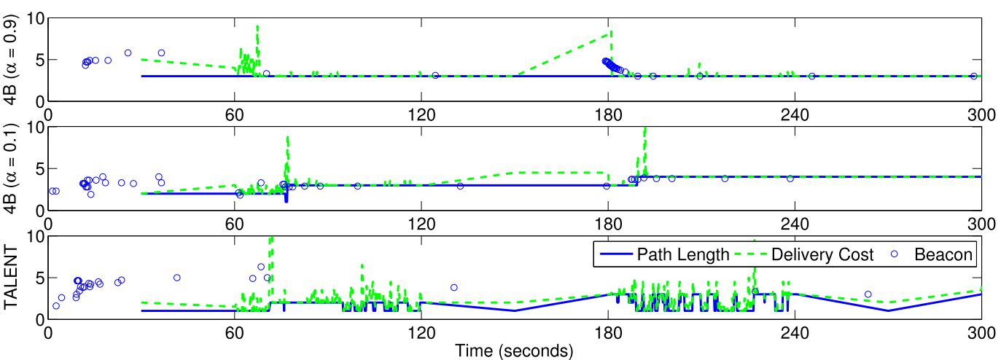
Link Estimation with Bursty Trafﬁc
Short path, but various quality
Long path with good link
Simple network
TALENT, 4B with WMEWMA (α = 0.9): “stable 4B” and 4B (α = 0.1): “reactive 4B”
S
F₁
F₂
F₃
R
The path length and the delivery cost of 4B (stable and reactive) and TALENT during a 5 minutes experiment
Notes:
Stable: 4 hops,
Reactive: 2 hops, at 80 -> 3 hops, at 190 -> 4 hops
TALENT: 1 hop, at 75 -> 1 kops but switch back and forot between 90-120 and 180-240
The beacon packet contains the link quality and delivery cost estimation (ETX) from the beacon sender

Slide 26
Why 4B does not switch back?
4B only rely on CTP using EWMA to update
Exponentially-growing sparse beacon packets and reactive EWMA filter (α = 0.1)
The estimation is hard to adjusted to use the shorter path again
TALENT constantly and actively indicate an available high quality period to CTP for switching back to the shorter path
Notes:
Why 4B does not switch back?
CTP adaptive beaconing policy let all nodes send beacon packet frequently to establish the initial link quality estimations
and select parents at the beginning of the experiments, but when CTP is stable,
the inter-beacon interval grows exponentially. That’s why beacon packets clustered within the first 30 seconds.
4B only rely on CTP using EWMA to update, however, due to sparse beacon packets and reactive EWMA filter,
the estimation is hard to adjust to use the shorter path again.
Since α = 0.1, the sparse beacon packets could not adjust the estimation due to the EWMA filter being fast enough even for the reactive 4B
While TALENT constantly and actively indicate an available high quality period to CTP for switching back to the shorter path.

Slide 27
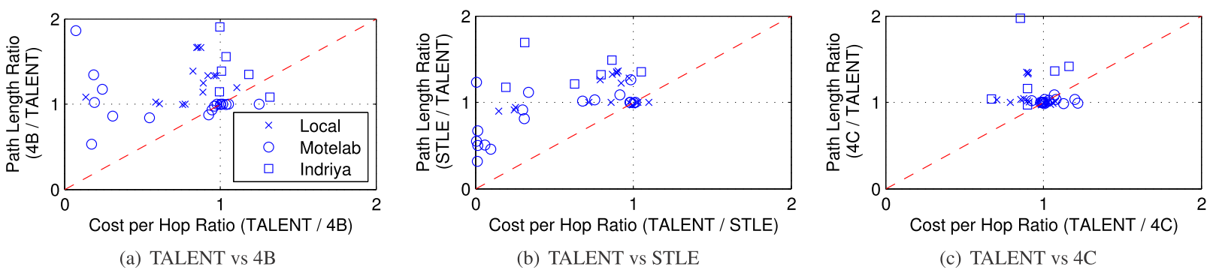
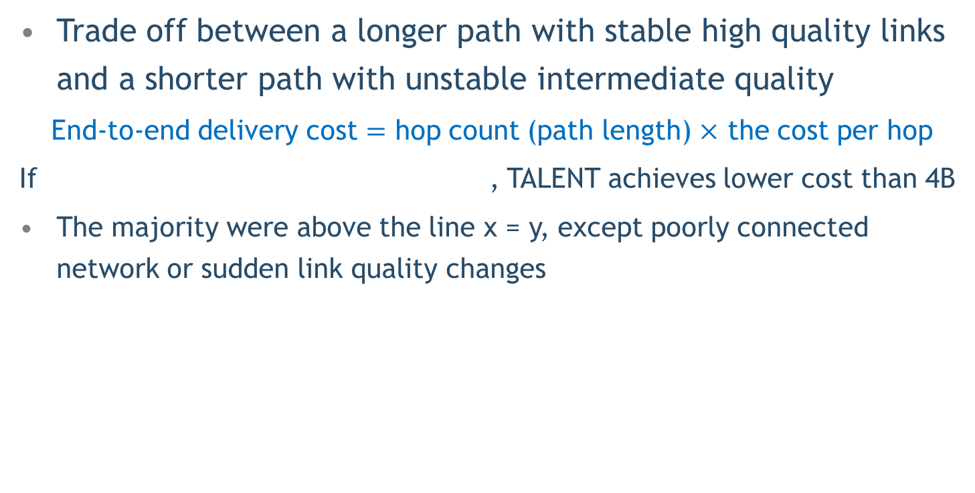
Path Length vs. Delivery Cost
Trade off between a longer path with stable high quality links and a shorter path with unstable intermediate quality
End-to-end delivery cost $=$ hop count (path length) $×$ the cost per hop
If , TALENT achieves lower cost than 4B
The majority were above the line x = y, except poorly connected network or sudden link quality changes
Notes:
1. If the rate of cost per hop increase is smaller than the rate of path length decrease,
the overall cost for delivering packets is reduced.
2. This is due to a poorly connected network and/or sudden link quality changes
that causes 4B and STLE to send excessive retransmissions before switching to another path;
while TALENT enables fast route updates with such network dynamics
by taking advantage of the temporary parent mechanism
3. Motelab Due to the sparsely connected network, the crucial links in the forwarding path were suddenly broken,
in which case the 4B and STLE estimators could not ﬁnd an alternative path fast enough
4. TALENT is still better than 4C on average since 4C was extensively trained using a priori collected training data for each testbed
This additional training cost, together with the propagation of the updated parameters in the case of re-training
that is requiredin a real setting, is not included in the evaluation

Slide 28
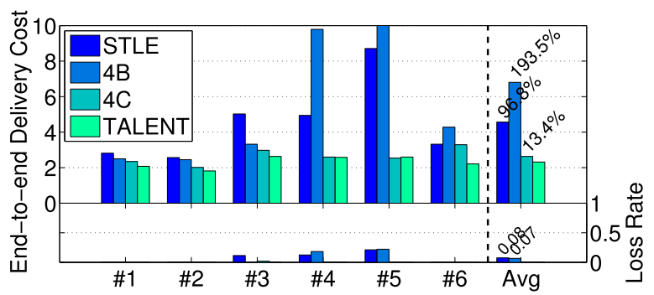
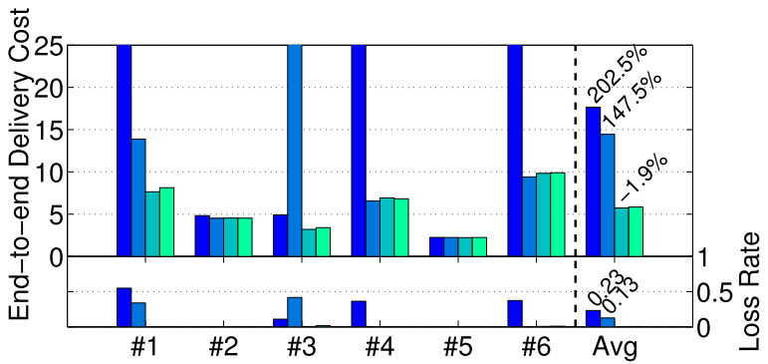
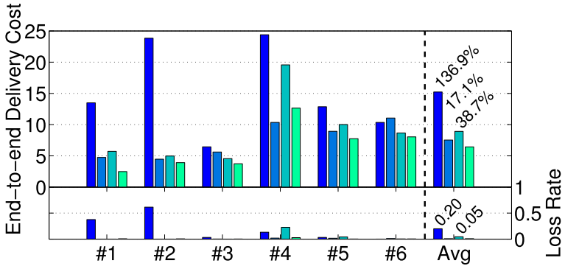
End-to-End Delivery Cost & Loss Rate
X-axis mark is the experiment number
Local Testbed
MoteLab Testbed
Indriya Testbed
Notes:
Only mention #1-#6 mean 5, 6, 11, 25, 42, and 57 nodes for local testbed
Why some are high. Some are low?? Didn’t explain…

Slide 29
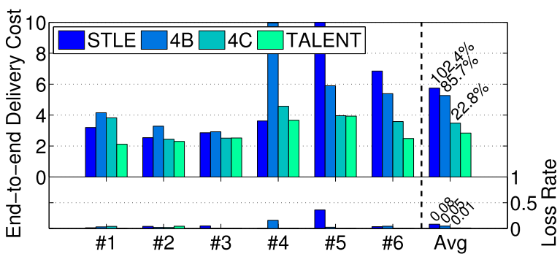
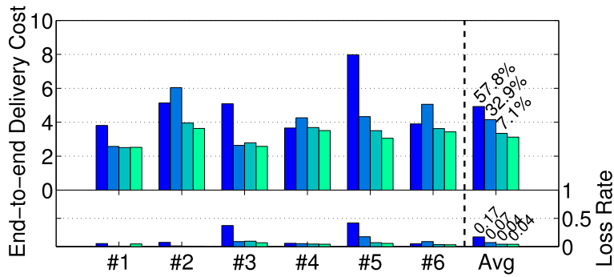
Variable Rate and Multiple Senders
X-axis marks represent 6 various randomized inter-packet intervals
Single Sender
Multiple Senders
Notes:
1. the variable rate does not affect the performance of TALENT signiﬁcantly
2. multiple senders created more data forwarding paths compared with single sender experiments,
Can not see…

Slide 30
Conclusion
Provide an online learning algorithm to predict link quality in the near future and adapt to network dynamics
Not clear analyses for the last twoparts
Little improving over state-of-the-art link estimators
Well organized structure and easy to read

