Slide 1
Section 5.5 : Mobile IP
백호성
2015010691

Slide 2
Outline
Introduction
The Basic Model: Bidirectional Tunneling
Route Optimization (RO)
Issues about mobile IP

Slide 3
Mobile IP
Mobile IP for both IPv4 [RFC5944](MIPv4) and IPv6 [RFC6275]
We focuse on Mobile IPv6
  more flexible
  somewhat easier to explain
  more likely to be deployed in the quickly growing smartphone market
Many features we’ve seen:
  home agents, foreign agents, foreign-agent registration, care-of-addresses, encapsulation (packet-within-a-packet)
Three components to standard
  indirect routing of datagrams
  agent discovery
  registration with home agent

Slide 4
The Basic Model: Terminology
MN : A host that might move
CN : Hosts with which it is communicating
HoA : The MN is given an IP address chosen from the network prefix used in its home network
CoA : When it travels to a visited network, it is given an additional address, called its care-of address
HA : MN’s home agent
Binding : Association between an MN’s HoA and its CoA

Slide 5
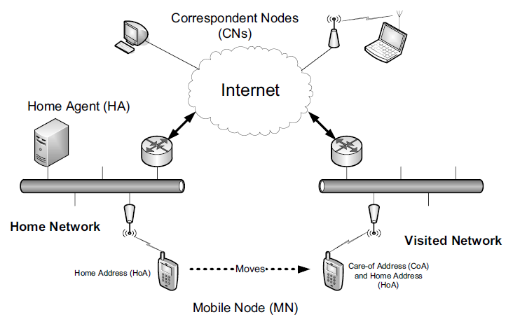
The Basic Model: Bidirectional Tunneling

Slide 6
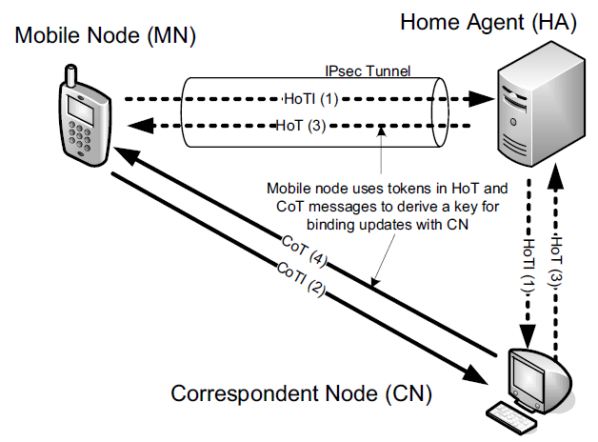
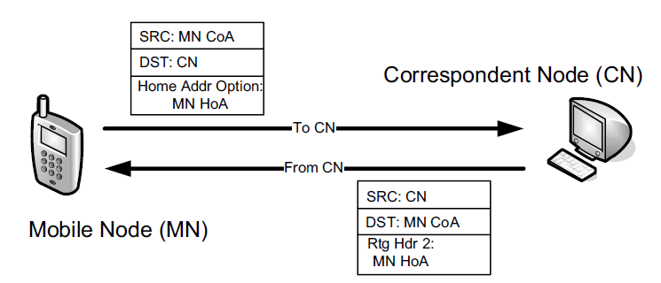
Route Optimization(RO)

Slide 7
Issues about Mobile IP
Running real-time applications (e.g., VoIP) that have latency requirements
Several approaches are being explored to reduce the amount of time required to execute binding updates
  fast handovers [RFC5568]
  modification to MIPv6 called Hierarchical MIPv6 (HMIPv6) [RFC5380]
  proxy MIPv6

