Slide 1
Chapter 5
Analog Transmission
Data on a carrier, and signals moved into the band you were given
Forouzan, Data Communications and Networking, 5th ed., Chapter 5
5.1 Digital-to-analog: ASK, FSK, PSK, QAM
5.2 Analog-to-analog: AM, FM, PM
Textbook figures; printed errors corrected and listed on the errata slide

Slide 2
5.1
Digital-to-analog conversion
5.2
Analog-to-analog conversion
Digital data → one carrier parameter changed
ASK: amplitude, FSK: frequency, PSK: phase
QAM: amplitude + phase, every modern modem
Key numbers: bits per signal element, Hz per baud
Analog signal → shifted to a new band
AM, FM, PM
Purpose: relocation, not conversion
every station: same audio, own RF slot
Chapter 5
Where we are
Chapter 4: low-pass channel, passes down to 0 Hz
Most channels band-pass: radio, voice band, cable TV
line code power near 0 Hz → unusable
carrier moves the power into the window
Physical layer of Wi-Fi, LTE and NR, cable modems, satellite TV, Bluetooth, radio
MCS table of any of these = Section 5.1

Slide 3
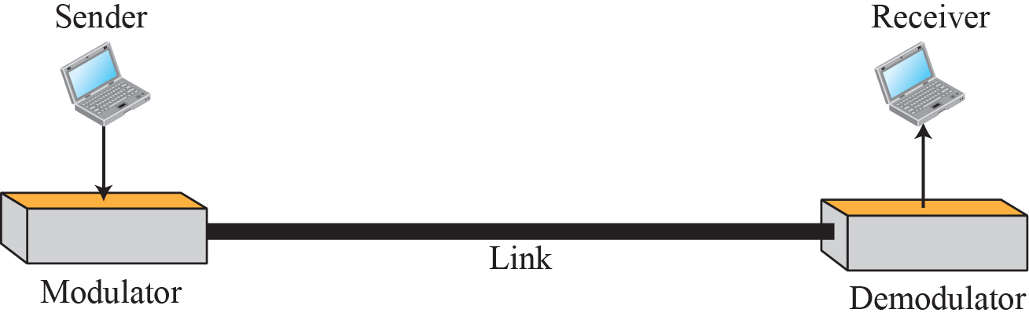
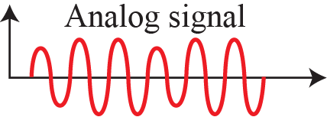
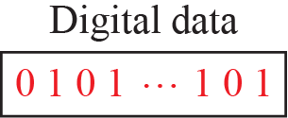
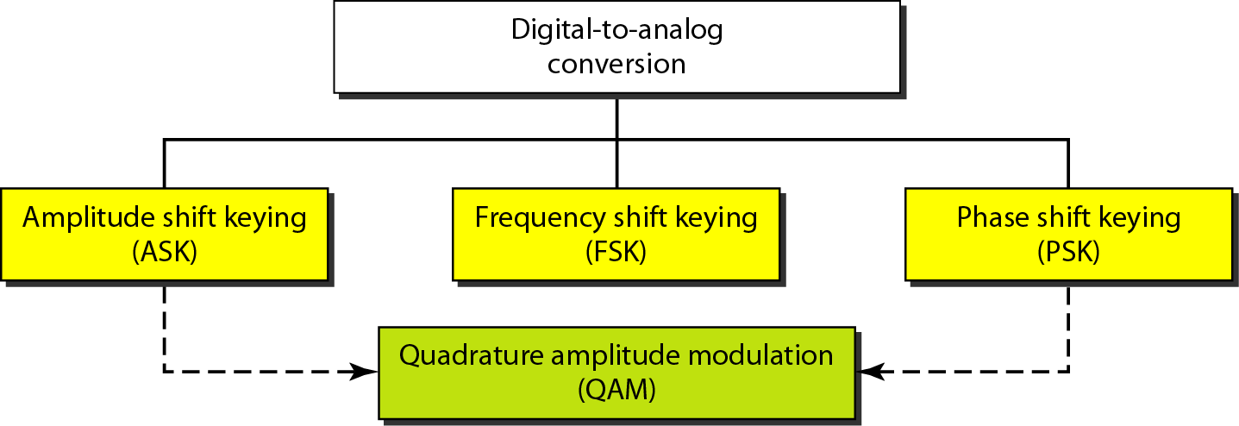
5-1
Digital-to-analog conversion
Figure 5.1
Digital-to-analog conversion
Carrier: sine wave, three knobs
peak amplitude, frequency, phase
One knob: ASK, FSK, PSK
Two knobs, amplitude + phase: QAM, dominant
Figure 5.2
Types of digital-to-analog conversion
5.1
Why a carrier
Band-pass channel: only a window around fc
Modulation: data spectrum placed around fc
Choice of fc = choice of spectrum slot
basis of spectrum sharing

Slide 4
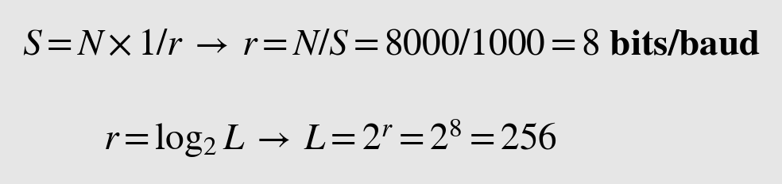
5.1.1
Data element vs. signal element
5.1.1
Bandwidth and carrier
Data element: bit
Signal element: shortest constant piece of carrier
N: bit rate (bps), S: baud rate (baud)
S = N × (1/r), r = log2 L
L: number of distinct signal elements
Analog transmission: S ≤ N
Larger r → lower S → less bandwidth
B proportional to S
FSK: + carrier spacing
Carrier: high-frequency sine, receiver tuned to it
Modulation (shift keying): amplitude, frequency, or phase
Spectrum location: set by fc, not by data
Analogy: baud = vehicle, bit = passenger
Example 5.1
Bit rate from baud rate
Example 5.2
Bits per element and levels
r = 4, S = 1000 baud → N?
N = 8000 bps, S = 1000 baud → r, L?
printed: 8000/10,000 → corrected: 8000/1000

Slide 5
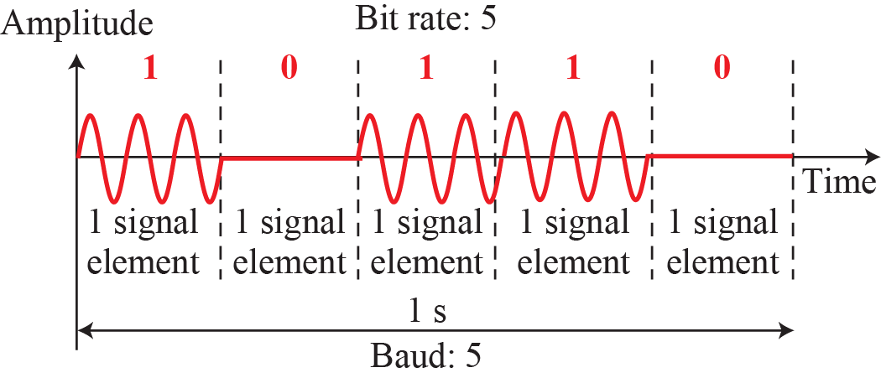
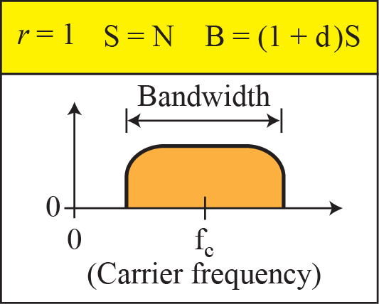
Figure 5.3
Binary amplitude shift keying
5.1.2
Amplitude shift keying
Amplitude varies, frequency and phase fixed
Binary ASK = on-off keying (OOK)
levels: 0 and full carrier amplitude
Multilevel ASK: only inside QAM
Uses
433 MHz car keys, garage remotes
RFID tags
short-reach optical links, laser on/off
5.1.2
Bandwidth of ASK
5.1.2
What d is
B = (1 + d) × S, centred on fc
S ≤ B ≤ 2S
Undefined in the book: excess bandwidth of the pulse shape
d = 0: ideal sinc pulse
exactly S Hz, rings forever in time
0 < d ≤ 1: raised-cosine roll-off
short pulses, more bandwidth
Wi-Fi, LTE, NR: small d

Slide 6
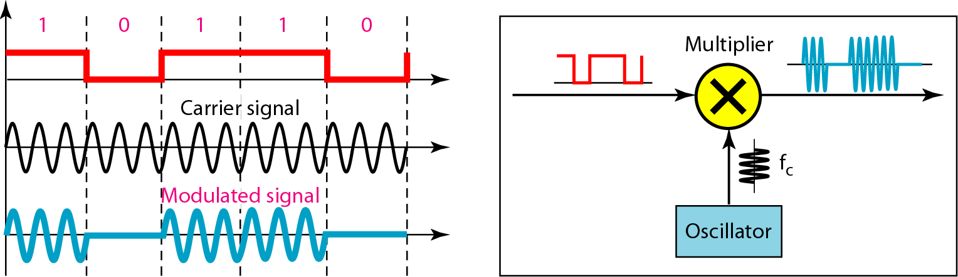
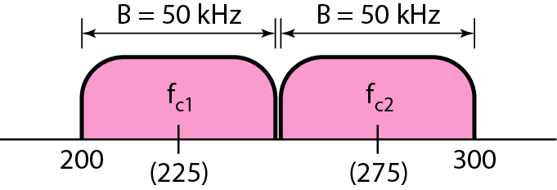
Figure 5.4
Implementation of binary ASK
5.1.2
Implementation
Unipolar NRZ (1 V / 0 V) × carrier
1: carrier on
0: carrier off
One multiplier
cheapest transmitter in the chapter
Example 5.3
ASK in 200 to 300 kHz
Example 5.4
Full-duplex ASK, Figure 5.5
B = 100 kHz, d = 1, r = 1
fc = 250 kHz, band centre
Two carriers: 2 × 50 kHz, 25 kbps each way
same layout as FDD uplink/downlink

Slide 7
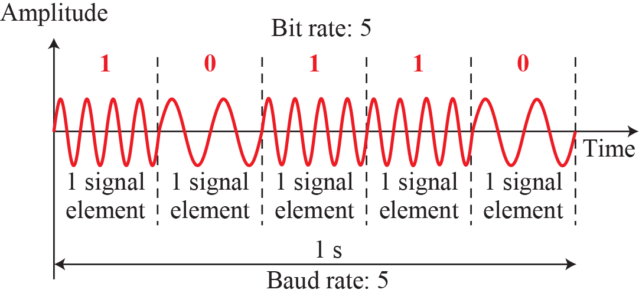
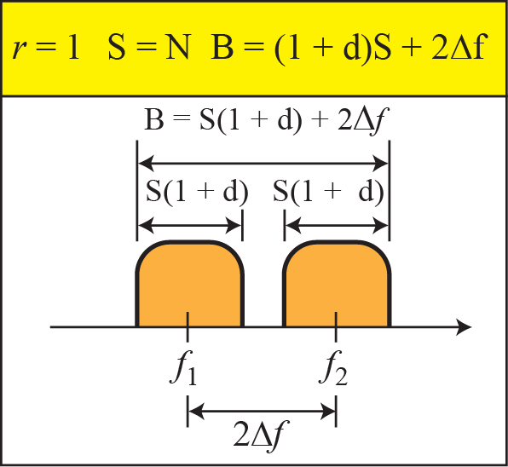
Figure 5.6
Binary frequency shift keying
5.1.3
Frequency shift keying
Frequency varies per signal element
amplitude and phase fixed
BFSK: f1 for 0, f2 for 1, spacing 2Δf
= two OOK signals on two carriers
B = (1 + d) × S + 2Δf
least bandwidth-efficient scheme
Uses: Bluetooth, BLE (GFSK), caller ID
Figure 5.6 exaggerated: real spacing tiny
5.1.3
Bandwidth of BFSK
5.1.3
Minimum spacing 2Δf
Book: min 2Δf = S, "can be shown"
Reason: tones orthogonal over one symbol T = 1/S
Noncoherent receiver, phase ignored: min S
the book's value
Coherent receiver, phase tracked: min S/2
minimum shift keying (MSK); GMSK in GSM

Slide 8
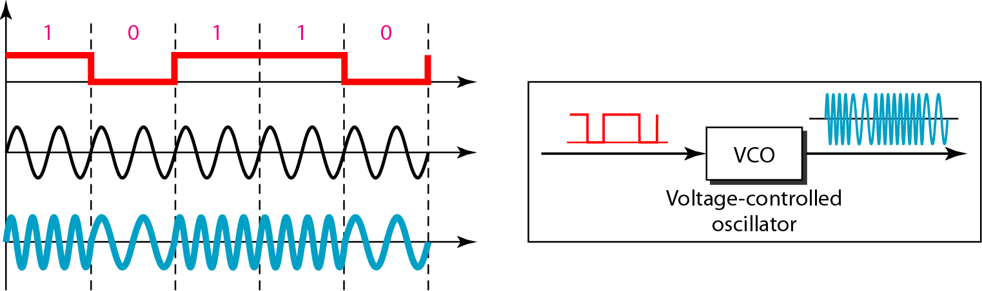
Example 5.5
FSK in the same 100 kHz
5.1.3
Noncoherent vs. coherent
d = 1, 2Δf = 50 kHz chosen
printed 2Δ with subscript f → corrected: 2Δf
ASK: 50 kbps, FSK: 25 kbps
50 kHz spent on carrier spacing
Noncoherent: two OOK modulators
phase jumps at boundaries
Coherent: one VCO
continuous phase
Continuous phase → less out-of-band energy
Figure 5.7
Implementation of BFSK with a voltage-controlled oscillator

Slide 9
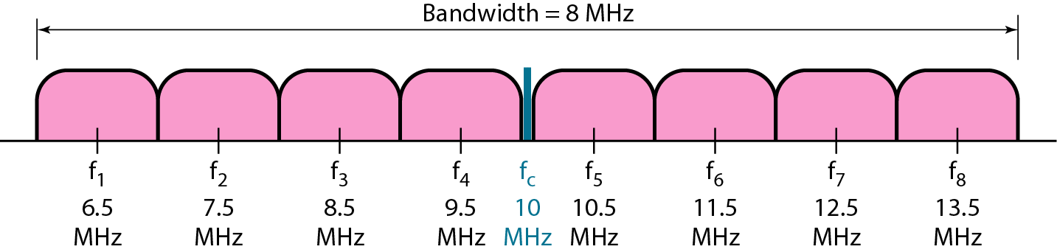
5.1.3
Multilevel FSK
Example 5.6
8-FSK at 3 Mbps
L frequencies, log2 L bits per element
Neighbour spacing 2Δf ≥ S
B = (1 + d)S + (L - 1)·2Δf = (L + d)S
book's B = L × S: only for d = 0
Bandwidth traded for noise immunity
FT8 amateur mode: 8-FSK, 6.25 baud, below noise floor
3 bits/element, 3 Mbps, fc = 10 MHz
L = 2^3 = 8
S = 1 Mbaud → spacing 1 MHz
B = 8 MHz (d = 0)
vs. QPSK, Example 5.7: 12 Mbps in 6 MHz
Figure 5.8
Bandwidth of the MFSK signal in Example 5.6

Slide 10
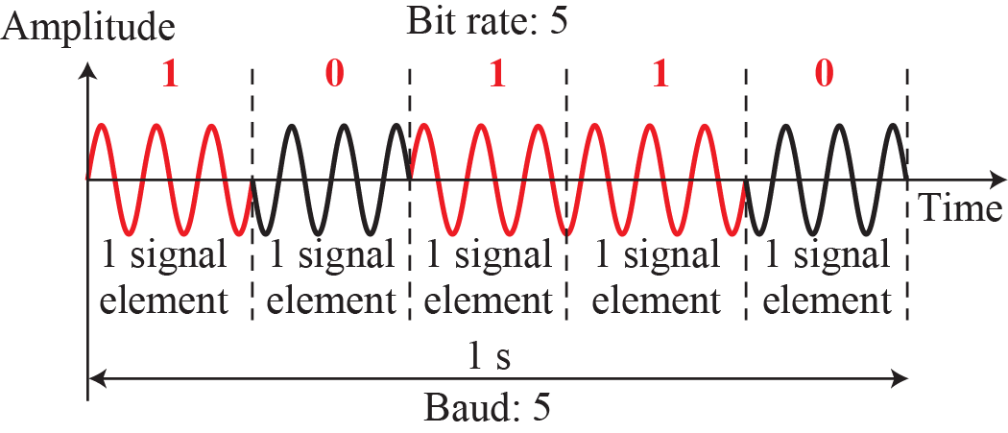
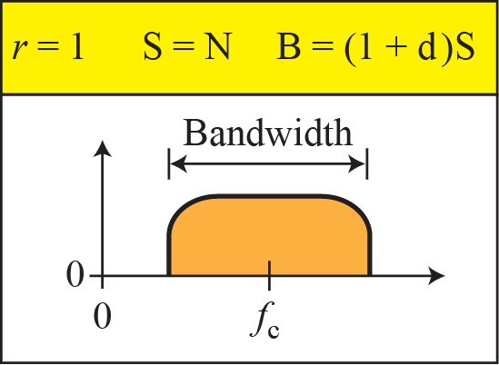
Figure 5.9
Binary phase shift keying
5.1.4
Phase shift keying
Phase varies, amplitude and frequency fixed
BPSK: 0° and 180°
One carrier (FSK: two)
B = (1 + d) × S, same as ASK
Uses
GPS L1 C/A
IEEE 802.11b at 1 Mbps
5.1.4
Bandwidth of BPSK
Correction
Why PSK beats ASK in noise
= binary ASK, no carrier spacing
Book: noise changes amplitude more easily than phase: wrong
noise = random vector, hits amplitude and phase alike
Real reason: distance between signal points
Equal average power
OOK: 0 and √2·A, BPSK: -A and +A
distance ratio √2 → power ratio 2 → 3 dB
BPSK: same error rate at half the power

Slide 11
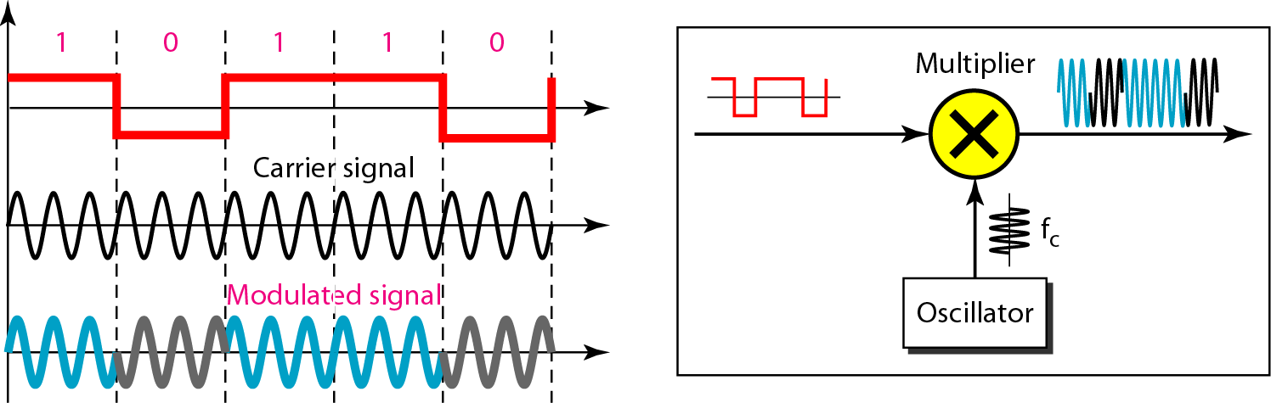
Figure 5.10
Implementation of BPSK
5.1.4
Implementing BPSK
Caption erratum: BASK → BPSK
ASK multiplier + polar NRZ
+V: phase 0°
-V: phase 180°
Same hardware and bandwidth as ASK
Cost vs. FSK: receiver must resolve phase
5.1.4
BPSK → QPSK
Example 5.7
QPSK at 12 Mbps
Two BPSK: in-phase + quadrature (90°)
Serial-to-parallel: alternate bits per branch
Output: 4 phases, ±45°, ±135°
L = 4, r = 2
r = 2 → S = 6 Mbaud
d = 0 → B = 6 MHz
BPSK: 12 MHz

Slide 12
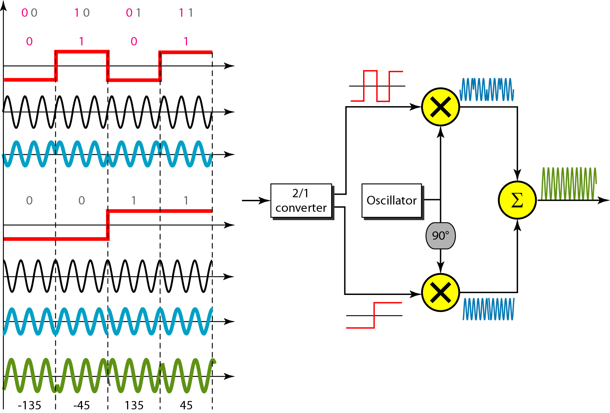
Figure 5.11
QPSK and its implementation
5.1.4
Why QPSK is free
I and Q orthogonal
cos × sin averages to 0 over a symbol
Receiver separates branches perfectly
2× BPSK rate, same band
same error rate per bit
Bit length T in → 2T per branch
half the frequency per branch
Uses: DVB-S, LTE and NR control channels
Same orthogonality → QAM

Slide 13
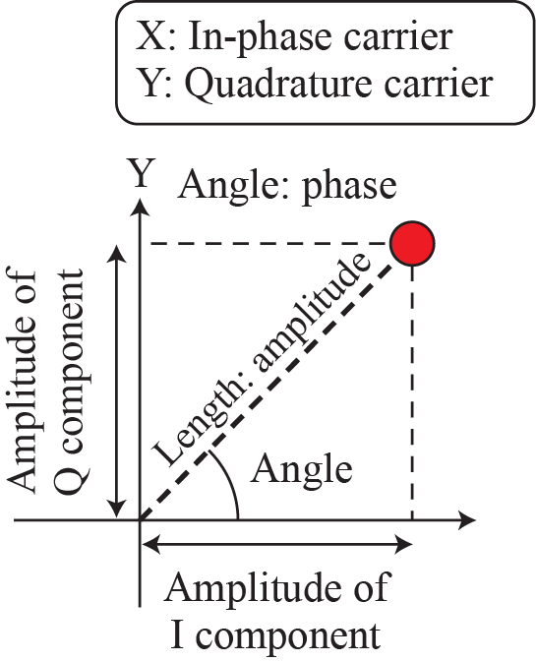
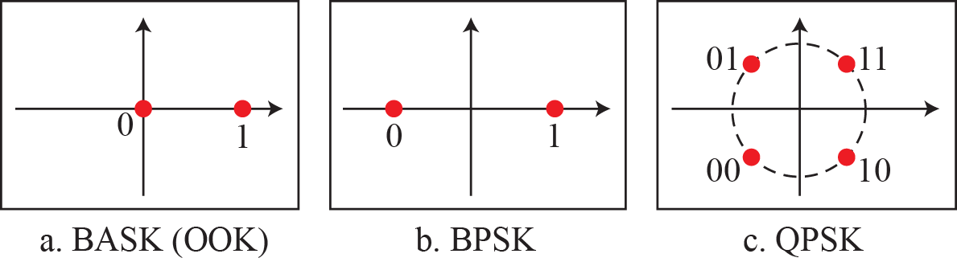
Figure 5.12
Concept of a constellation diagram
5.1.4
Reading a constellation
Dot = signal element, label = its bits
x: in-phase amplitude
y: quadrature amplitude
Length: peak amplitude
Angle: phase
Distance between dots: what noise must overcome
Received cloud vs. spacing: SNR made visible

Slide 14
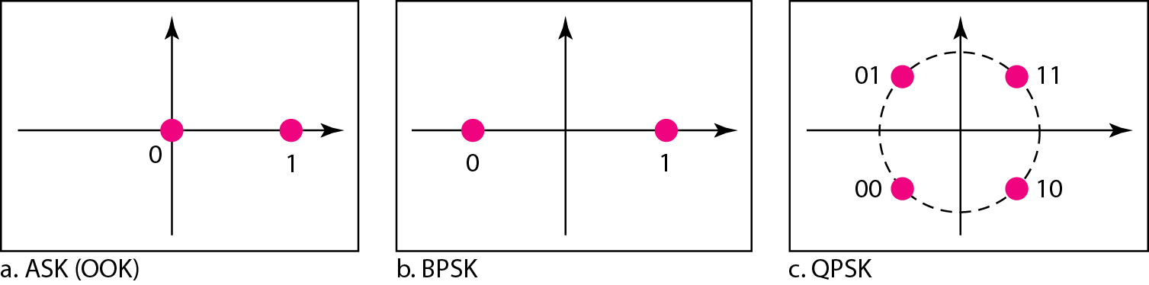
Figure 5.13
Constellation diagrams for OOK, BPSK and QPSK
Example 5.8
Three constellations
5.1.4
What they show
OOK: in-phase only, points 0 and 1
BPSK: in-phase only, points -1 and +1
QPSK: I and Q
amplitude √2, phases ±45°, ±135°
scale by 1/√2 → amplitude 1
OOK: one point wasted at the origin
BPSK: opposite side, 2× distance at same peak
QPSK: second orthogonal axis → second bit
no loss of distance

Slide 15
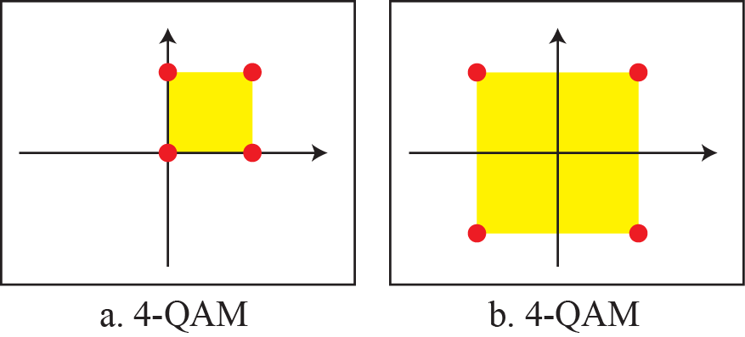
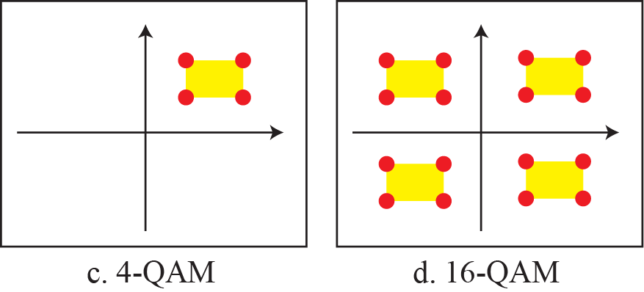
5.1.5
Quadrature amplitude modulation
PSK limit: phases crowd the circle
QAM: amplitude + phase
= multilevel ASK on I and on Q
Points fill the plane: farther apart than PSK
B = (1 + d) × S, as ASK and PSK
Figure 5.14
4-QAM, parts a and b
Figure 5.14
4-QAM and 16-QAM, parts c and d
a. unipolar NRZ per carrier = OOK on both axes
b. polar NRZ per carrier = QPSK
c. two positive levels per carrier
d. 16-QAM: 4 levels per carrier, 4 × 4 = 16
book's "8 levels" counts both carriers

Slide 16
5.1
Which technology uses which scheme today
Scheme
Used in
Why
OOK
433 MHz car keys, RFID, short-reach optical
cheapest receiver
BFSK, GFSK
Bluetooth, BLE, caller ID
constant envelope, cheap amplifier
GMSK
GSM voice
minimum spacing, compact spectrum
MFSK
FT8, weak-signal and deep-space links
decodes below the noise floor
BPSK
GPS L1 C/A, 802.11b 1 Mbps
most robust per watt
QPSK
DVB-S, LTE and NR control channels
2× BPSK rate, same robustness per bit
16 to 256-QAM
LTE, NR, Wi-Fi 4 and 5, cable modems
rate follows SNR via link adaptation
1024-QAM
Wi-Fi 6, NR downlink
high SNR, short range
4096-QAM
Wi-Fi 7, DOCSIS 3.1
12 bits/symbol, very high SNR
Top: cheap, robust receivers. Bottom: most bits per Hz. Channel SNR decides.
5.1.5
Why QAM dominates
16/64/256-QAM: LTE, NR, Wi-Fi
1024-QAM: Wi-Fi 6, NR DL
4096-QAM: Wi-Fi 7, DOCSIS 3.1
+1 bit/symbol ≈ +3 dB SNR
Link adaptation: SNR → constellation, signalled as MCS

Slide 17
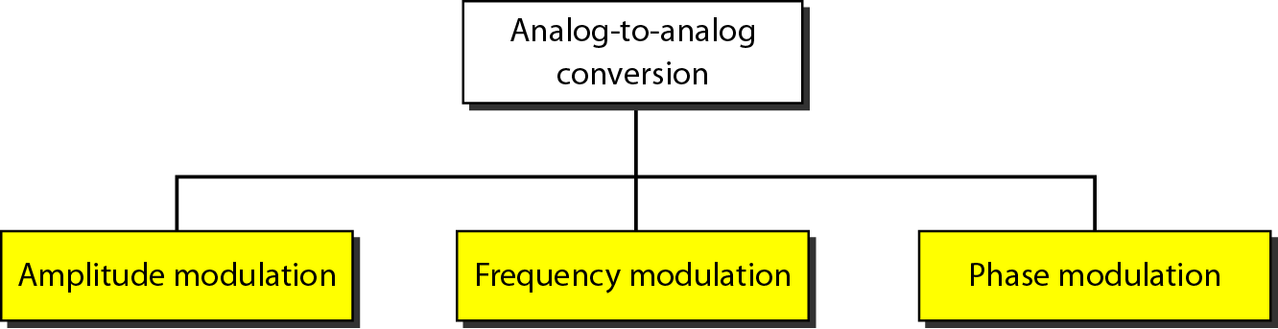
5-2
Analog-to-analog conversion
Figure 5.15
Types of analog-to-analog modulation
Analog information on an analog carrier
Purpose: move to a band-pass channel
Radio: same low-pass audio, one slot per station
AM, FM, PM
FM and PM closely related
5.2
Where it still lives
5.2
Why it survives there
AM: medium-wave broadcast, aviation VHF voice
FM: 88 to 108 MHz broadcast, two-way radio
Elsewhere: replaced by digital (Chapter 4 + Section 5.1)
Broadcast: huge receiver base, trivial receivers
Aviation AM: two calls at once both heard
FM capture would silence the weaker one
5.2
Same three knobs as Section 5.1
Knob
Digital data (5.1)
Analog signal (5.2)
Hardware
Amplitude
ASK
AM
multiplier
Frequency
FSK
FM
VCO
Phase
PSK
PM
differentiator + VCO

Slide 18
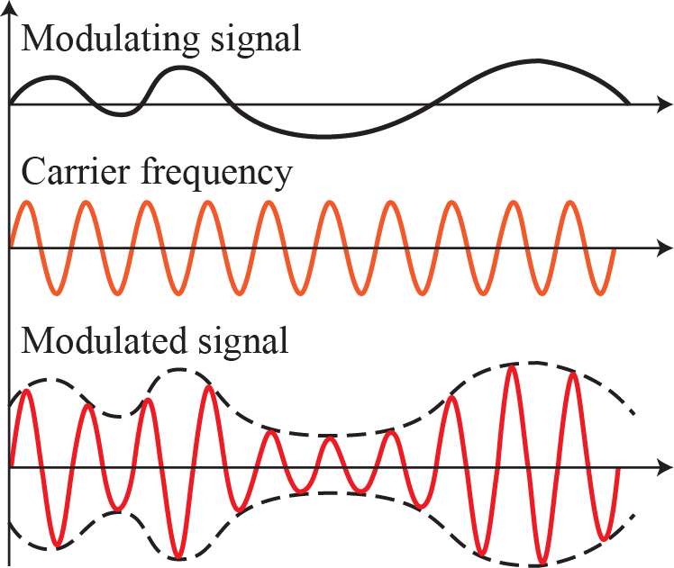
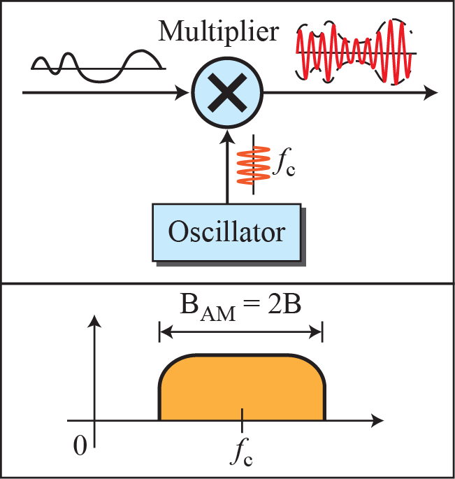
Figure 5.16
Amplitude modulation
5.2.1
AM bandwidth
5.2.1
Amplitude modulation
Amplitude follows the modulating signal
frequency and phase fixed
Modulating signal = envelope
Multiplier, as in ASK
B_AM = 2B
5.2.1
Two sidebands, same information
5.2.1
Who uses which
Upper and lower sideband: mirror images
SSB: one sideband, carrier suppressed
half the bandwidth
2/3 less transmitter power at full modulation
HF voice, amateur and long-distance: SSB
Broadcast: full AM, diode receivers
Aviation VHF: full AM

Slide 19
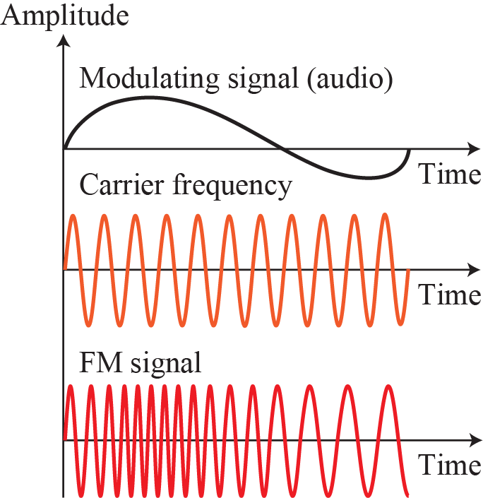
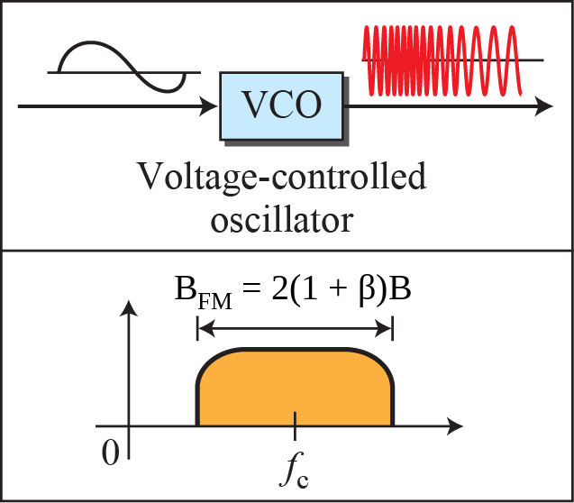
Figure 5.18
Frequency modulation
5.2.2
FM bandwidth, β corrected
5.2.2
Frequency modulation
Frequency follows the modulating signal
amplitude and phase fixed
VCO, as in coherent FSK
Constant amplitude
immune to amplitude noise
cleaner than AM
Correction
β and B_FM = 2(1 + β)B
Figure: b → β
Book: "empirical", "β typically 4": imprecise
β = modulation index = Δf / B
2(1 + β)B = 2(Δf + B): Carson's rule, 1922
≈ 98% of power, a derived estimate

Slide 20
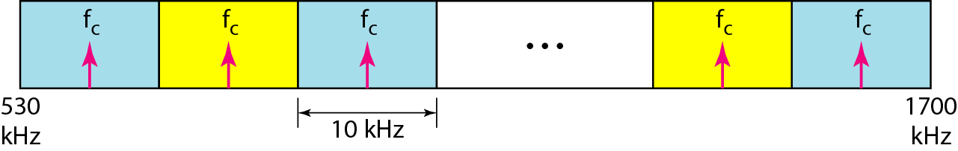
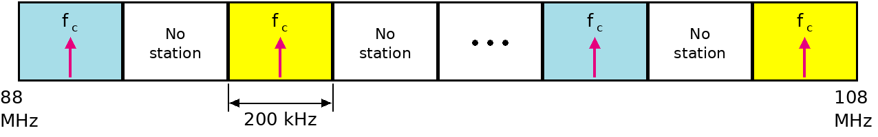
Figure 5.17
AM band allocation, United States
Figure 5.19
FM band allocation, redrawn: deck reused AM figure
5.2.1
AM, book: US, ITU Region 2
5.2.1
AM, Korea: ITU Region 3
5.2.2
FM broadcast, real numbers
Audio 5 kHz → 10 kHz per station
530 to 1700 kHz, 10 kHz apart
1100 kHz → next ≥ 1110 kHz
10 kHz = B_AM with B = 5 kHz
531 to 1602 kHz, 9 kHz grid
120 channels
Audio ≈ 4.5 kHz
Adjacent channels unused in one area
Korean AM frequency = 531 + 9k kHz
88 to 108 MHz, 200 kHz channels
100 channels, 50 per area (book)
Δf = 75 kHz, audio 15 kHz
β = 5, not 4
Carson: 2(75 + 15) = 180 kHz
Stereo multiplex to 53 kHz
256 kHz, transmitters ≈ 400 kHz apart
Korea: same band, grid, deviation

Slide 21
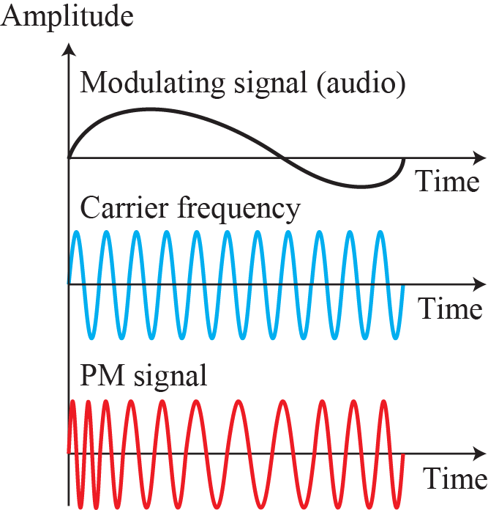
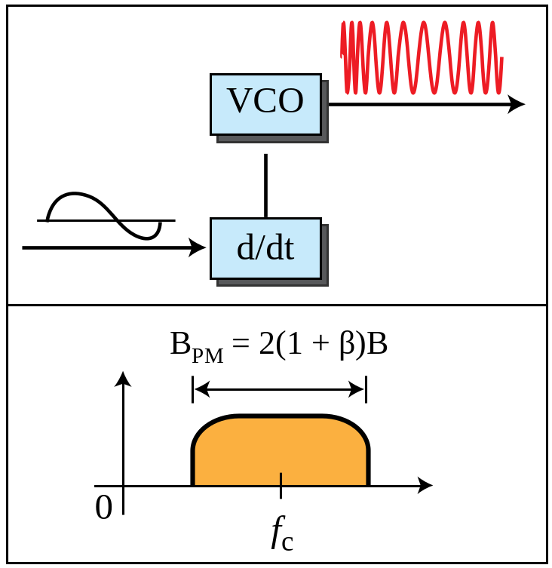
Figure 5.20
Phase modulation
5.2.3
PM bandwidth, β corrected
5.2.3
Phase modulation
Phase follows the modulating signal
amplitude and frequency fixed
FM: frequency shift follows signal
PM: frequency shift follows d/dt of signal
Differentiator + VCO
B_PM = 2(1 + β)B
β ≈ 1 narrowband, 3 wideband
5.2.3
Why PM matters
Figure: b → β
PM and FM: one derivative apart (Appendix E)
Armstrong FM: integrate audio + phase-modulate a crystal
PSK = discrete PM
every QPSK and QAM modem
5.1 and 5.2: same three knobs, same carrier

Slide 22
5.3.3
Summary
5.3.1
Recommended reading (textbook)
Digital-to-analog: carrier changed by digital data
ASK: amplitude
FSK: frequency
PSK: phase
QAM: ASK + PSK on I and Q
Constellation: amplitude and phase per element
Analog-to-analog: for band-pass media
AM: amplitude, FM: frequency, PM: phase
Digital-to-analog: Pearson, Couch, Stallings
Analog-to-analog: Pearson, Couch ch. 5, Stallings
Mathematical treatment: Hsu
Pearson, Basic Communication Theory, 1992
Couch, Digital and Analog Communication Systems, 2001
Stallings, Data and Computer Communications, 7th ed., 2004
Hsu, Analog and Digital Communications, 2003
[Ber96]: cited, missing from the book's list
5.3.2
Key terms
ASK, FSK, PSK, QAM, constellation diagram, carrier signal
digital-to-analog, analog-to-analog, AM, FM, PM

Slide 23
Errata
Corrections to the printed slides and textbook
Where
Printed
Corrected
Objectives slide
FM changes phase
FM changes frequency
Section headings
5.5.1 to 5.5.5
5.1.1 to 5.1.5
Example 5.2
8000/10,000
8000/1000
Example 5.5
2Δ, subscript f
2Δf
Figure 5.10
BASK
BPSK
Figure 5.19, slide deck
AM figure reused
redrawn, 88 to 108 MHz
Figures 5.18, 5.20
2(1 + b)B
2(1 + β)B
MFSK bandwidth
L × S
(L + d) × S
FM broadcast β
4
5, Carson 180 kHz
FM bandwidth
empirical
Carson's rule, 1922
PSK vs. ASK
noise hits amplitude more
point distance, 3 dB

Slide 24
EXPLORE
Digital modulation, seen and heard
Continued
PySDR, Digital Modulation: read QAM symbols by eye in the time plot
https://pysdr.org/content/digital_modulation.html
PySDR, Pulse Shaping: change the roll-off d, watch the spectrum
https://pysdr.org/content/pulse_shaping.html
Salim Wireless, ASK/PSK/FSK constellations: same SNR, which cloud touches its neighbour first
https://www.salimwireless.com/2022/06/constellation-diagram-of-ask-psk-fsk.html
Salim Wireless, M-ary QAM simulator: 16 → 256-QAM at fixed SNR
https://www.salimwireless.com/2025/06/m-ary-qam-simulator.html
WebSDR, University of Twente: find a digital mode on the waterfall
http://websdr.ewi.utwente.nl:8901/
Academo, amplitude modulation: square-wave message: OOK
https://academo.org/demos/amplitude-modulation/
EXPLORE
AM, FM, and analog bandwidth
Continued
Wikipedia, Carson bandwidth rule: stereo FM example, 256 kHz
https://en.wikipedia.org/wiki/Carson_bandwidth_rule
All About Circuits, FM bandwidth: three estimates compared
https://www.allaboutcircuits.com/technical-articles/three-methods-for-estimating-the-transmission-bandwidth-of-fm-signals/
FM Systems, Carson's rule: redo for 5 kHz deviation, 3 kHz audio
https://www.fmsystems-inc.com/carsons-rule-calculating-fm-modulation-bandwidth/
Wikipedia, Medium wave: count channels, 531 to 1602 kHz
https://en.wikipedia.org/wiki/Medium_wave
Wikipedia, AM expanded band: 9 kHz vs. 10 kHz grids
https://en.wikipedia.org/wiki/AM_expanded_band
WebSDR, University of Twente: same voice in AM, then SSB
http://websdr.ewi.utwente.nl:8901/
Academo, amplitude modulation: raise message frequency, watch sidebands
https://academo.org/demos/amplitude-modulation/

