Slide 1

Reconfiguring the Software Radio to Improve Power, Price, and Portability
Ye-sheng Kuo, Patrick Pannuto, Thomas Schmid, and Prabal Dutta
SenSys ‘12 at Toronto

Slide 2
Recent low-power wireless research
“High-Resolution, Low-Power Time Synchronization an Oxymoron No More”
  IPSN ‘10
“Design and Evaluation of a Versatile and Efficient Receiver-Initiated Link Layer for Low-Power Wireless”
  SenSys ‘10
“Efficient Network Flooding and Time Synchronization with Glossy”
  IPSN ‘11
“Low-Power Wireless Bus”
  SenSys ‘12

Slide 3
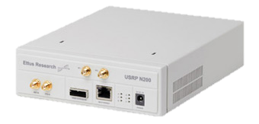
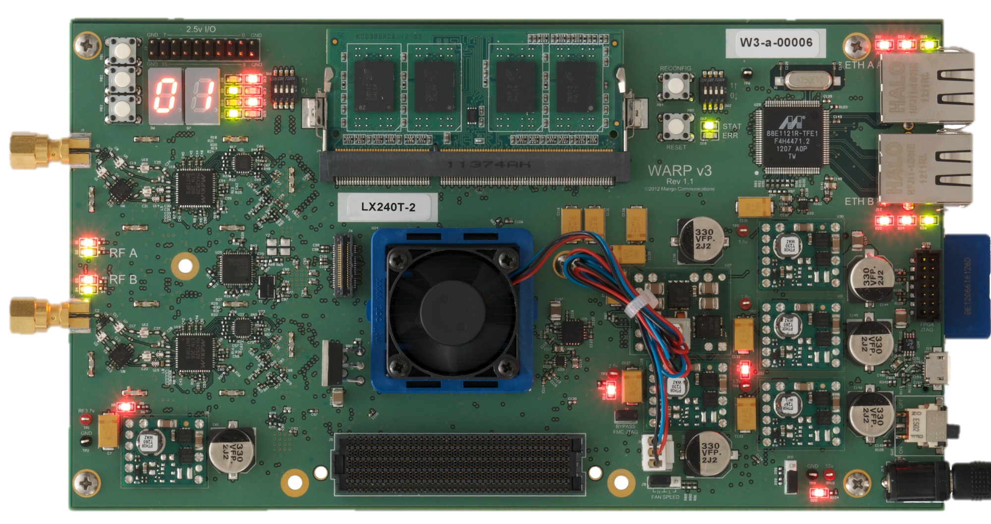
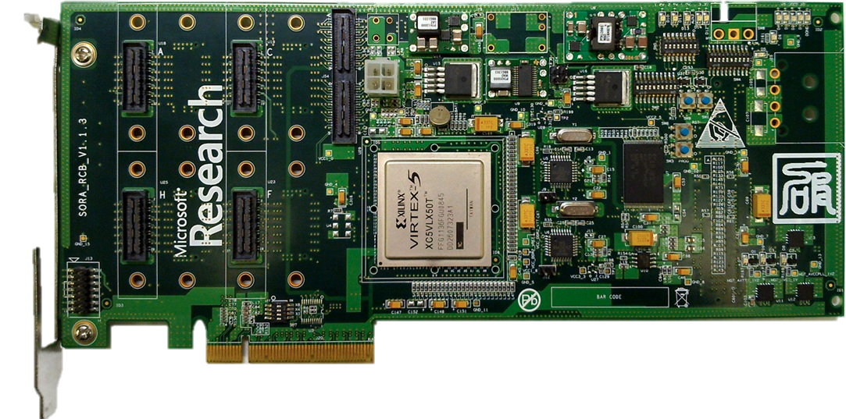
Current SDR platforms
 | USRP2 | USRP E100 | WARP v3 | SORA
Power | ~10 W | ~10 W | ~50 W* | ~100 W
Size | 1760 cm³ | 1760 cm³ | 900 cm³ | 300 cm^{3*}
Cost | $1,700 | $1,300 | $4,900 | $2,000
Low-power wireless research cannot benefit from current SDRs

Slide 4
If we have a low-power portable SDR
Software radios that you could
  Hold in the palm of your hand
  Deploy at very large scale
  Hand out for student labs
Software radios that would enable
  Mobile networking research
  Large-scale, in situ evaluations

Slide 5
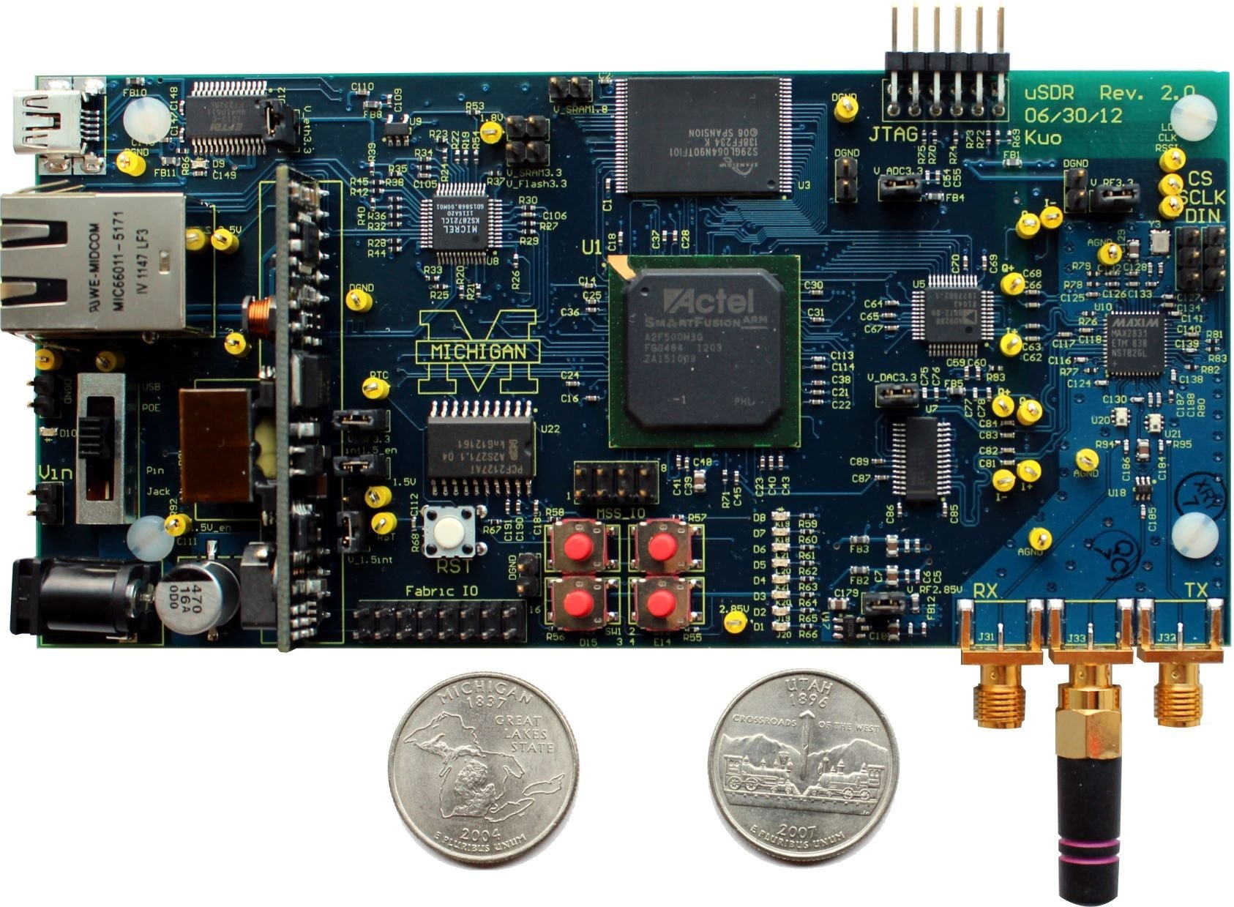
uSDR is low-power, small and low-cost
Power:
  1.4 W maximum
  0.32 W minimum
  Battery-operated
Size:
  203 cm³
Cost:
  ~$150
  (Core SDR Platform, assembled)

Slide 6
Outline
Introduction
Challenges
Architecture Overview
Evaluation
Radio enhancement
Limitation
Conclusion

Slide 7
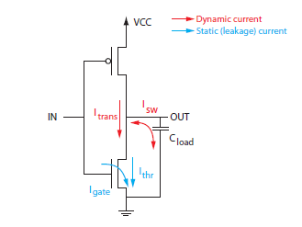
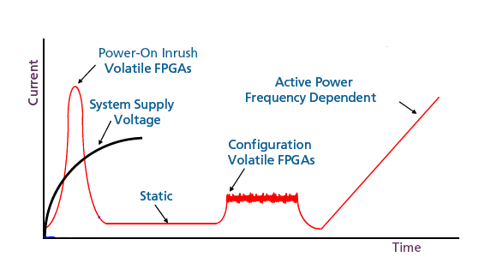
1st challenge: Power
SRAM FPGA
  High in-rush current
  High static power
  Re-configuration required
SRAM FPGA is not able to duty-cycle
Images from www.microsemi.com
Notes:
Reconfiguration -> Latency, Energy

Slide 8
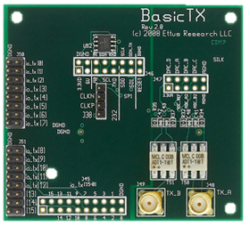
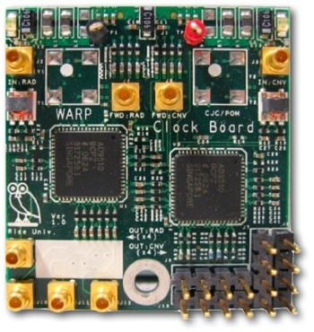
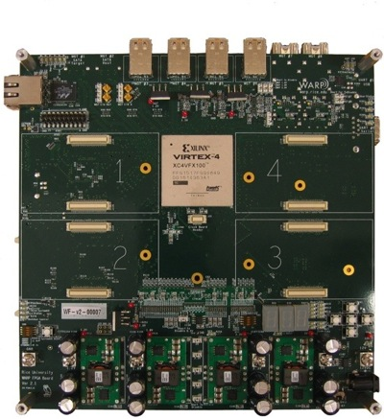
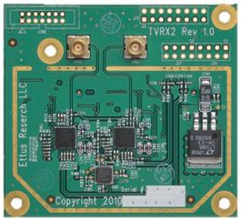
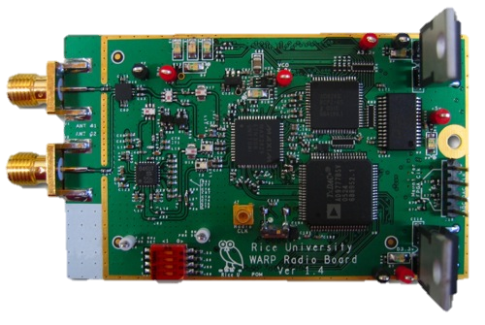
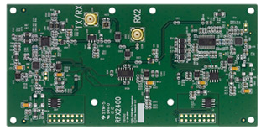
2nd challenge: Size
General purpose
Highly reconfigurable
Modular design
1-250 MHz
TX Board
20 MHz TXCO
Clock Board
50-860 MHz
RX Board x2
2.4, 5 GHz
RF Board
WARP v2 Main
2.3-2.9 GHz
RX/TX Board
Images from Mango communication
Ettus research
Notes:
Tradeoff between modularity and area

Slide 9
3rd challenge: Cost
Modular design
High performance hardware
  Xilinx Virtex-6, (3rd WARP)
    $2,000
  Xilinx Virtex-5, (SORA)
Not standalone

Slide 10
Outline
Introduction
Challenges
Architecture Overview
Evaluation
Radio enhancement
Limitation
Conclusion

Slide 11
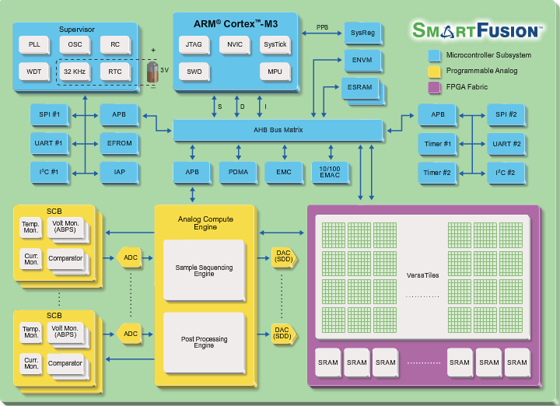
Emerging technology
Microsemi’s SmartFusion
  Hard core ARM Cortex-M3
    80MHz std.
    Embedded SRAM and Flash
  500K system gate FPGA
    Flash-based
    Embedded RAM
  Analog Compute Engine
    Low-speed ADCs/DACs
  High speed interconnect
    Memory-mapped IO
    1.4Gb/s (measured)
Images from www.microsemi.com

Slide 12
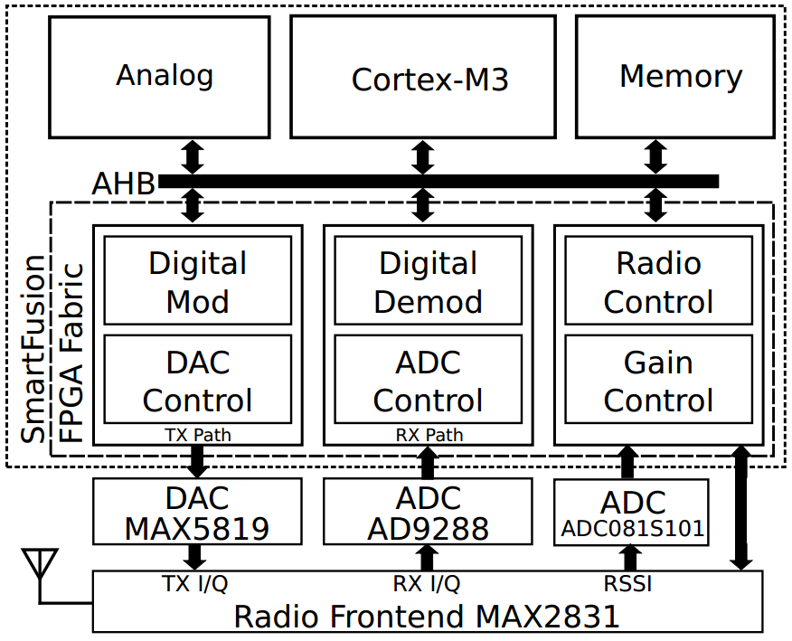
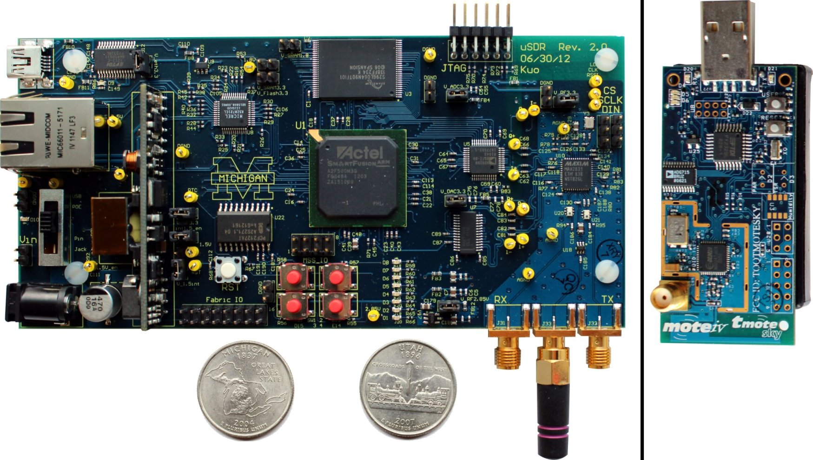
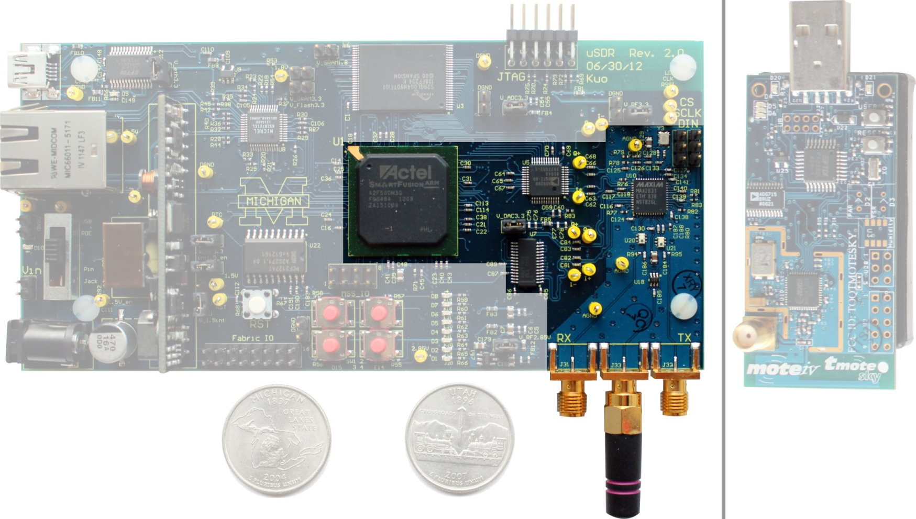
Architecture overview

Slide 13
Highly integrated HW
Baseband processing (PHY, MAC)
  Microsemi SmartFusion
RF Frontend
  Maxim MAX2831
Data converters
  Maxim MAX5189
  Analog Device AD9288
Sacrifice modular design → Size, Cost
Low-power / sleep mode → Power

Slide 14
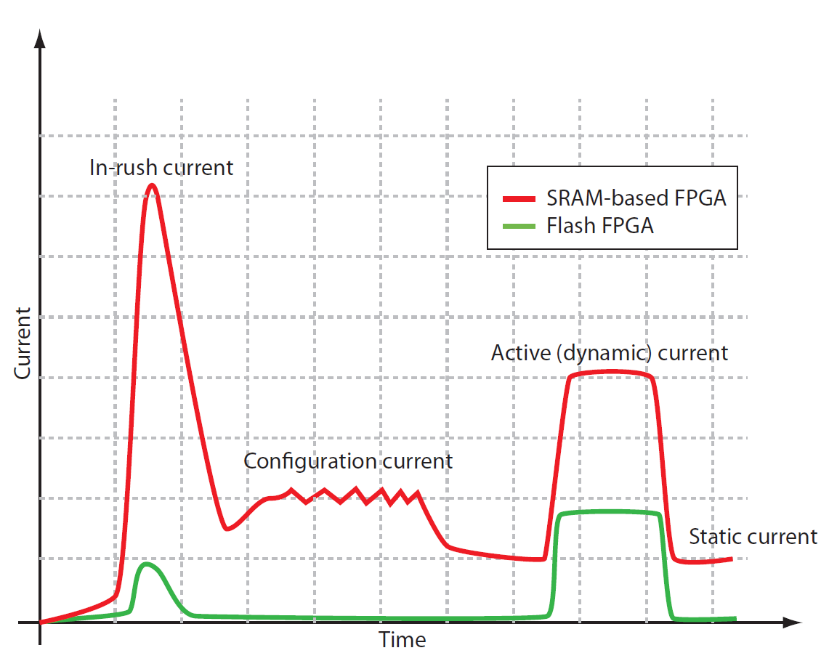
Advantages of Flash-based FPGA
Low in-rush current
Low static power
No configuration process
  No current
  No delay
Limitations
  Lifetime
  Speed
  Area
Images from www.microsemi.com

Slide 15
Outline
Introduction
Challenges
Architecture Overview
Evaluation
Radio enhancement
Limitation
Conclusion

Slide 16
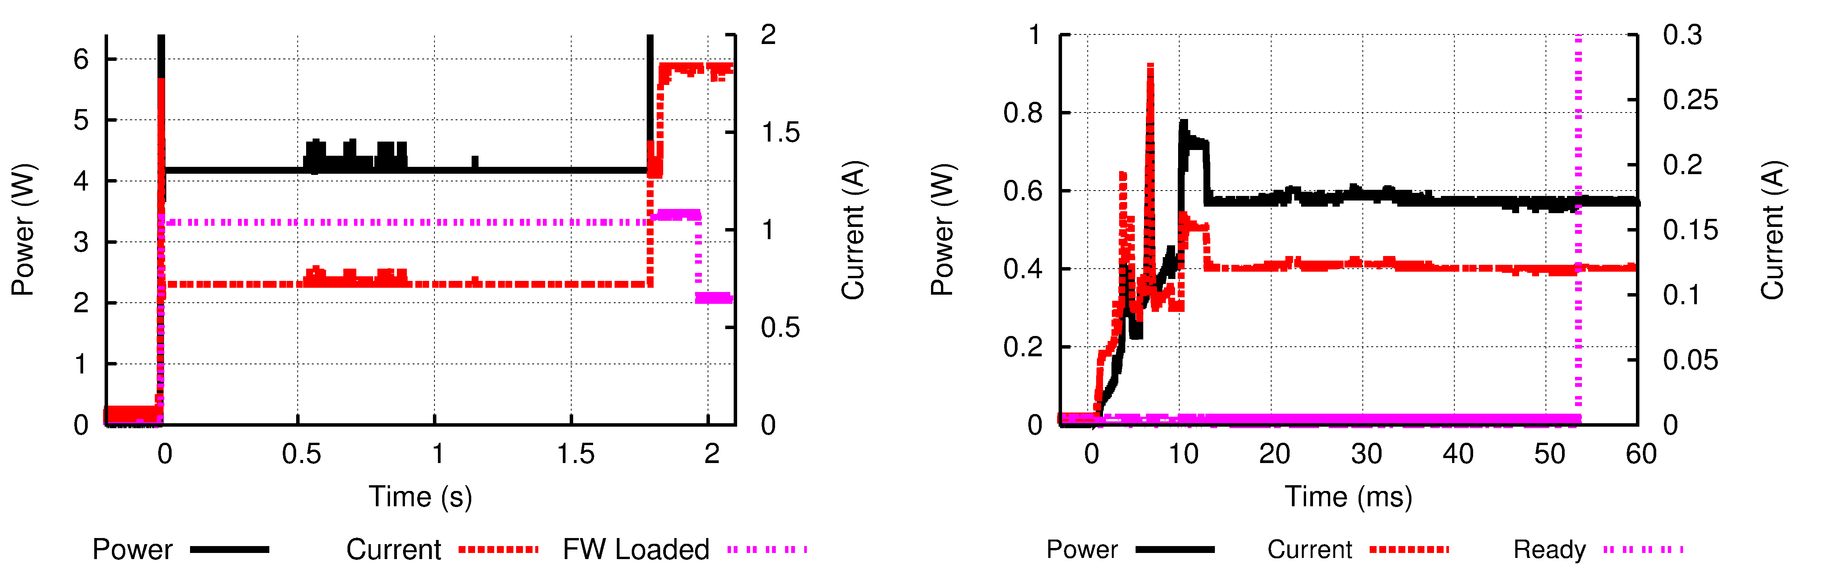
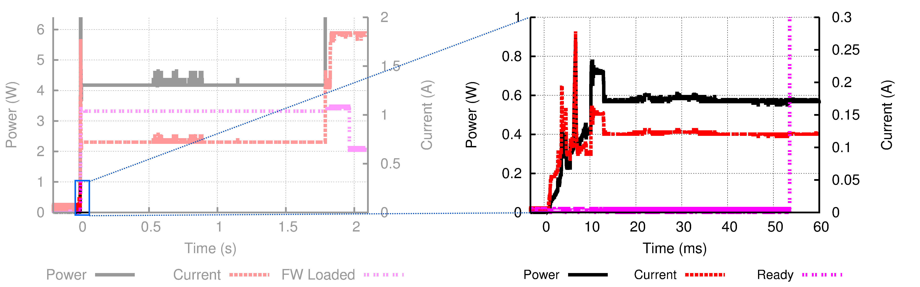
Flash FPGA is better in duty cycling
USRP2
uSDR
 | USRP2 | uSDR
Latency | 1.96 s | 54 ms | 36X
Energy | 9.56 J | 0.028 J | 341X
USRP loads firmware from SD card
Notes:
Piece

Slide 17
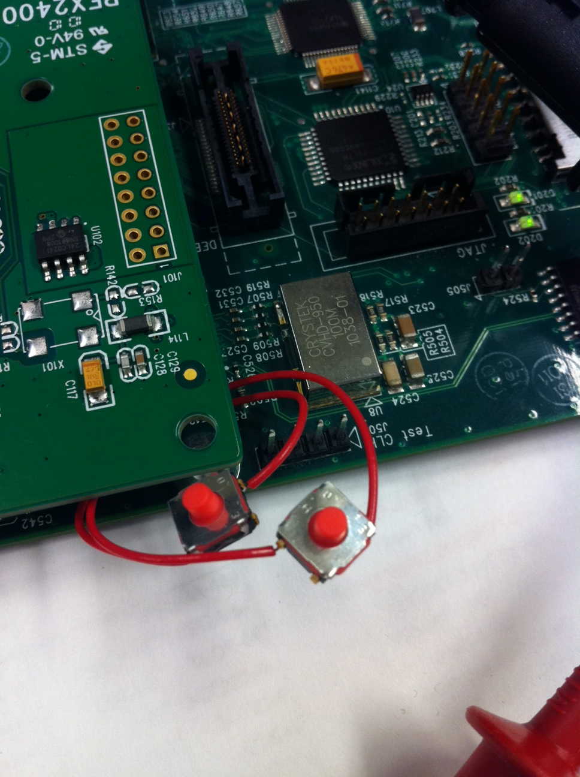
Flash FPGA has low static power
Voltage Rail | SmartFusion (uSDR) Static Current | Spartan (USRP2) Static Current
3.3 V (IO) | 26.9 mA | 79 mA
2.5 V (AUX) | n/a | 88 mA
1.5 V (Core) | 8.0 mA | n/a
1.2 V (Core) | n/a | 80 mA
Static Power | 101 mW | 578 mW
6X improvement
SmartFusion 2 supports Flash*Freeze mode, 1 mW
Two switches are used to detach clock signal
Measurement was made “after” firmware has been loaded

Slide 18

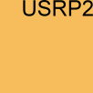


uSDR is portable
Platform | Size (cm³)
SORA | 36000ª
WARP v3 | 900^{b}
USRP2 | 1760
uSDR | 203
a: including a desktop PC
b: assume 3 cm thick
uSDR

Slide 19
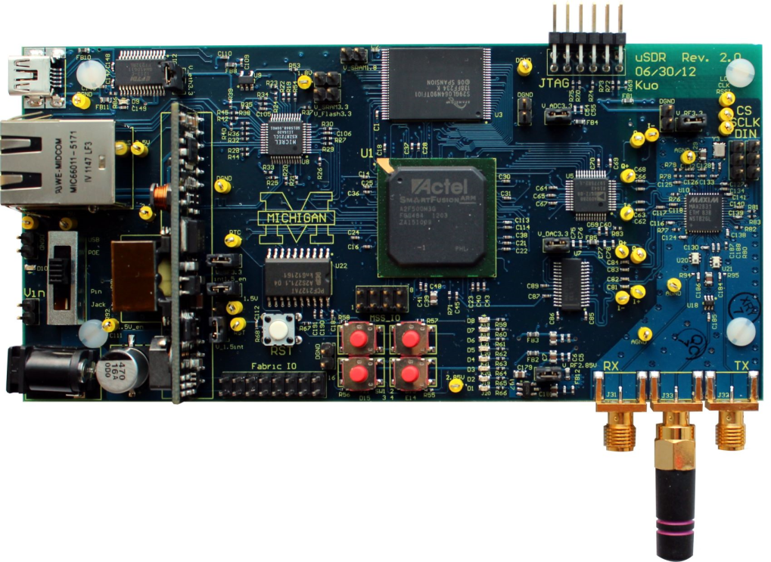
uSDR is low-cost
Desc | Part Number | Cost (1K)
FPGA | A2F500M3G | $45
ADC | AD9288 | $4
DAC | MAX5189 | $5
RF | MAX2831 | $4
Memories |  | $9
PoE | AG9205S | $10
Discrete parts |  | $62
PCB | 6 layers | $25
Assembly |  | $50
Total |  | $214
Platform | Cost
SORA | $2,000
WARP v3 | $4,900
USRP2 | $1,700
uSDR kit | $214
(USD)
Notes:
Insert USD

Slide 20
Outline
Introduction
Challenges
Architecture Overview
Evaluation
Radio enhancement
Limitation
Conclusion
Notes:
Pause…

Slide 21
uSDR is better for low-power research
Fully access to low level control/information
Tight control loop
  Automatic Gain Control (AGC)
Flexible Architecture
  Multiple address recognition
Radio extension
  Hard Glossy
  Automatic Transmission

Slide 22


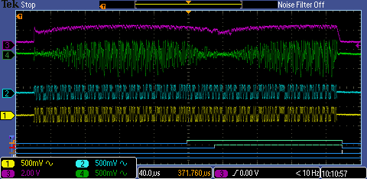
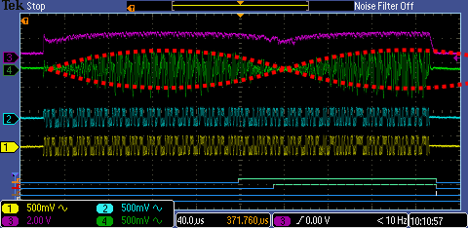
Beat frequency attenuates amplitude
In the concurrent transmission scenario…
  r_{B}(t): received base band signal
  d(t): signal was been transmitted
  ∆f: carrier frequency mismatch between two transmitters
RSSI
RX Base band
TX1 Base band
TX2 Base band

Slide 23
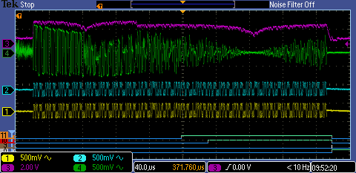
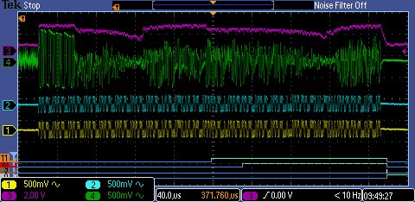
Cont. AGC is better for concurrent TX.
 | SFD-Latched AGC | Continuous AGC
Setting | Latch gain when SFD detected | Changing the gain every 4 us
ARR | 97.27 % | 98.20 %
Gain Latched
SFD-Latched AGC is more vulnerable to local minimum
Notes:
SFD = Start Frame Delimeter

Slide 24
Concurrent transmission fails
Beat frequency
  Amplitude below certain threshold (Δf)
  Number of envelopes in a packet (Δf, packet length)
  Slope of envelope (Δf)
Frequency mismatch
Packet length

Slide 25
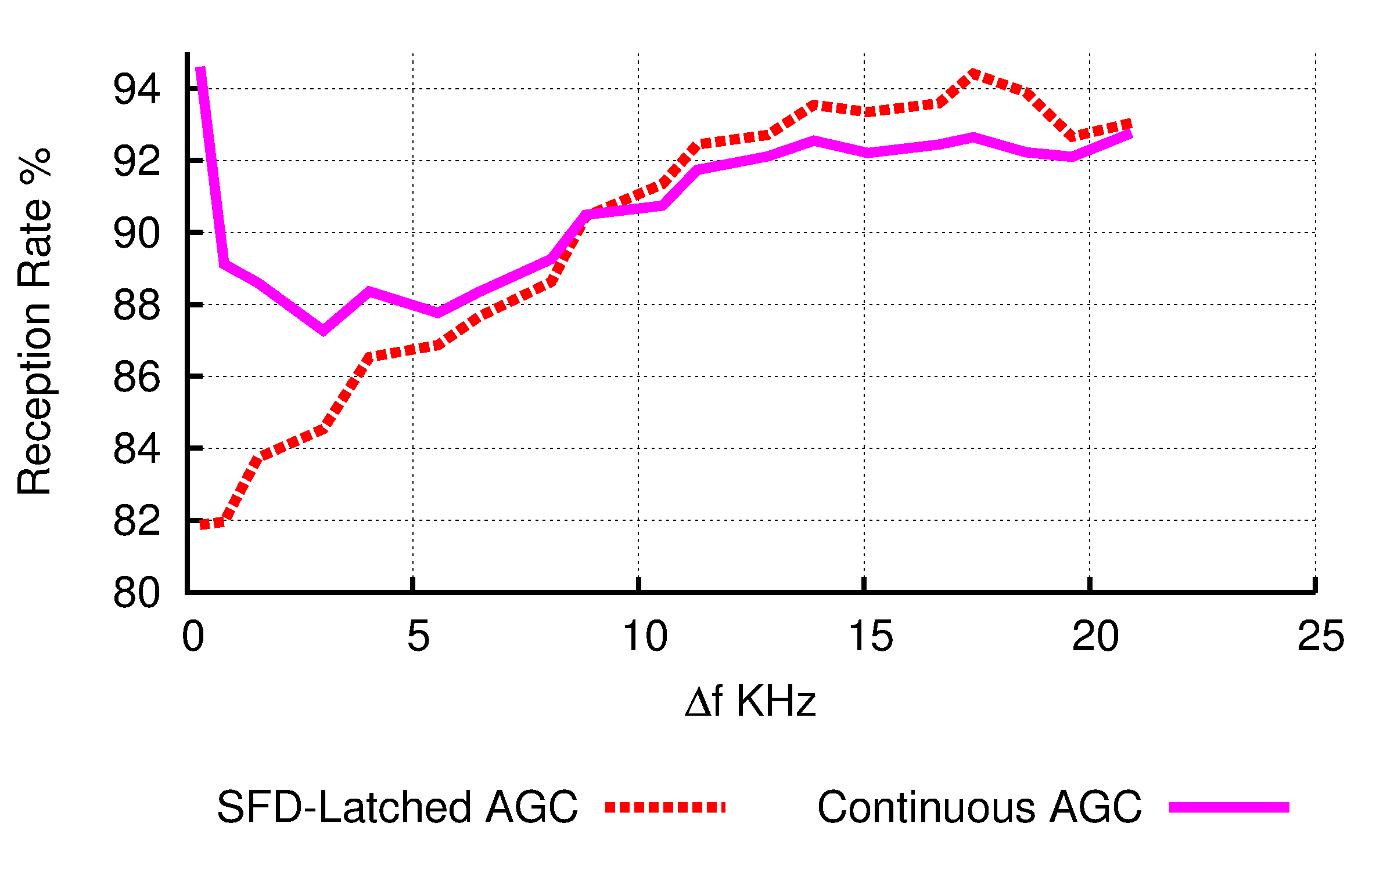
Impact of frequency mismatch
Δf ↓
Beat Freq ↓
Period ↑
Slope ↓
60 Bytes per packet

Slide 26
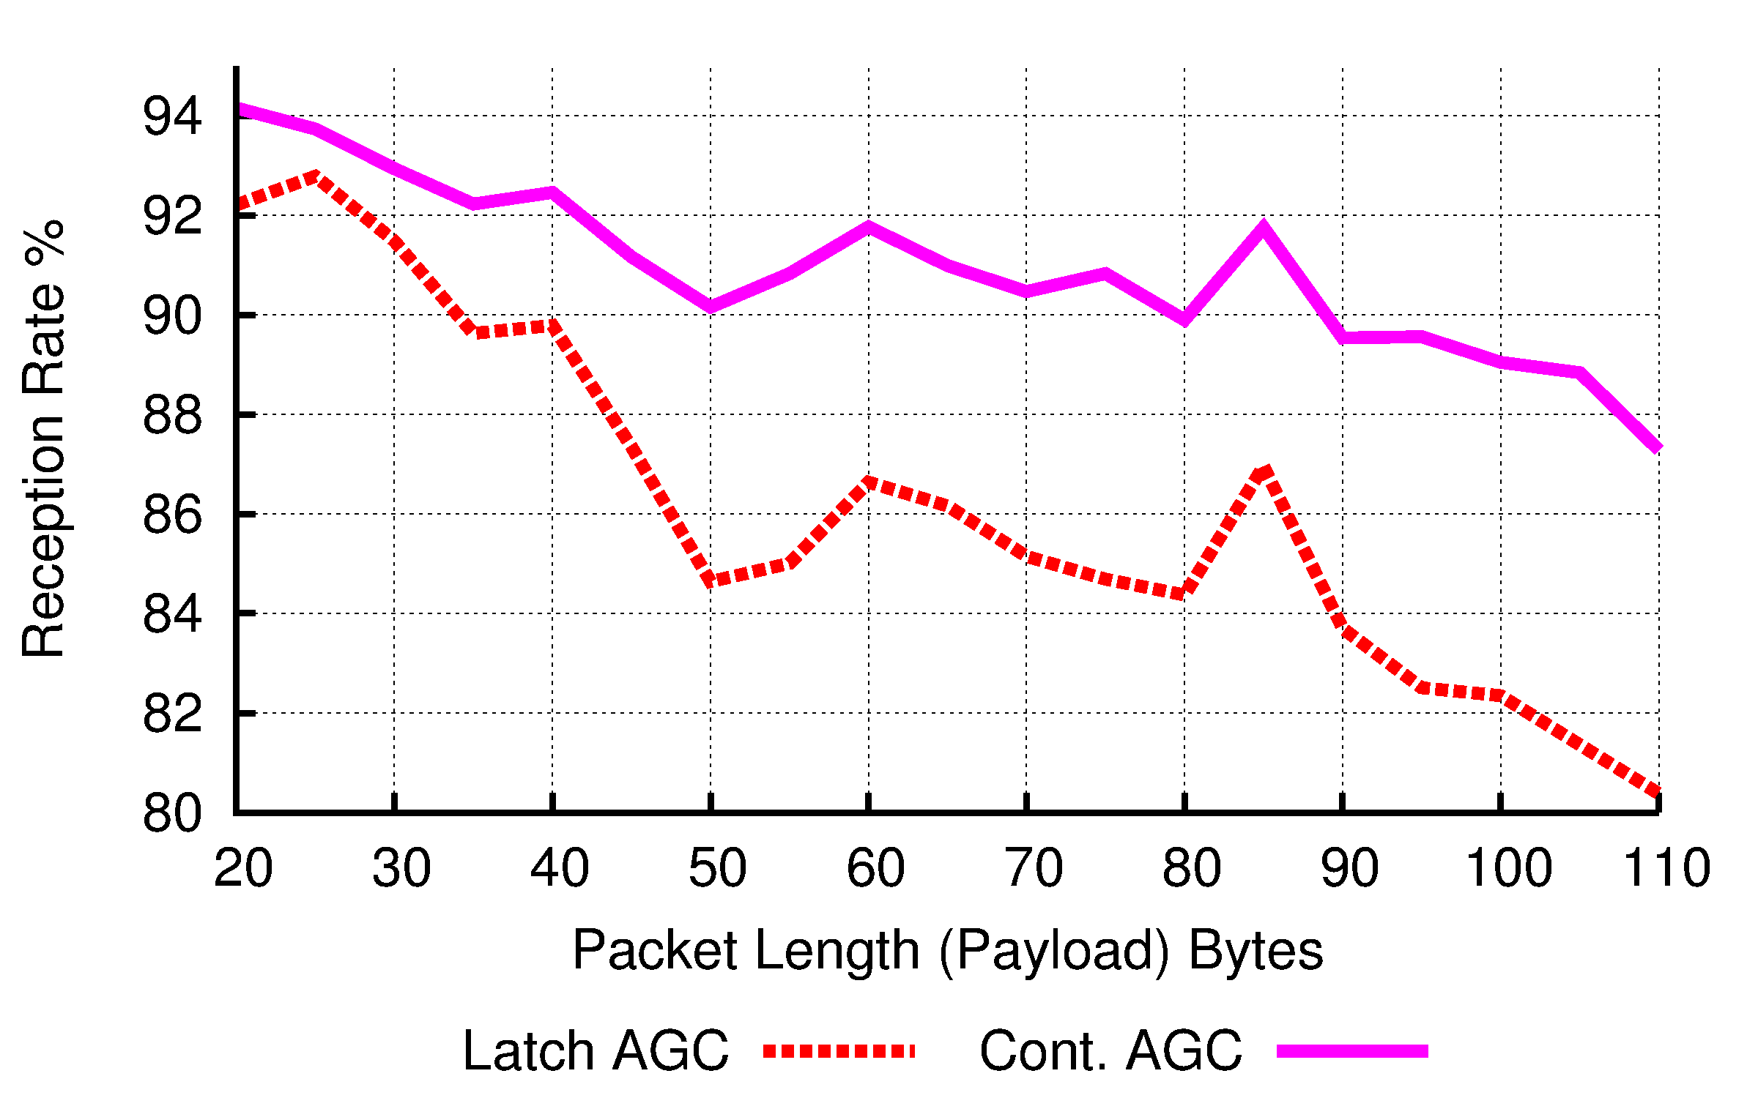
Impact of packet length
Frequency mismatch < 1KHz

Slide 27
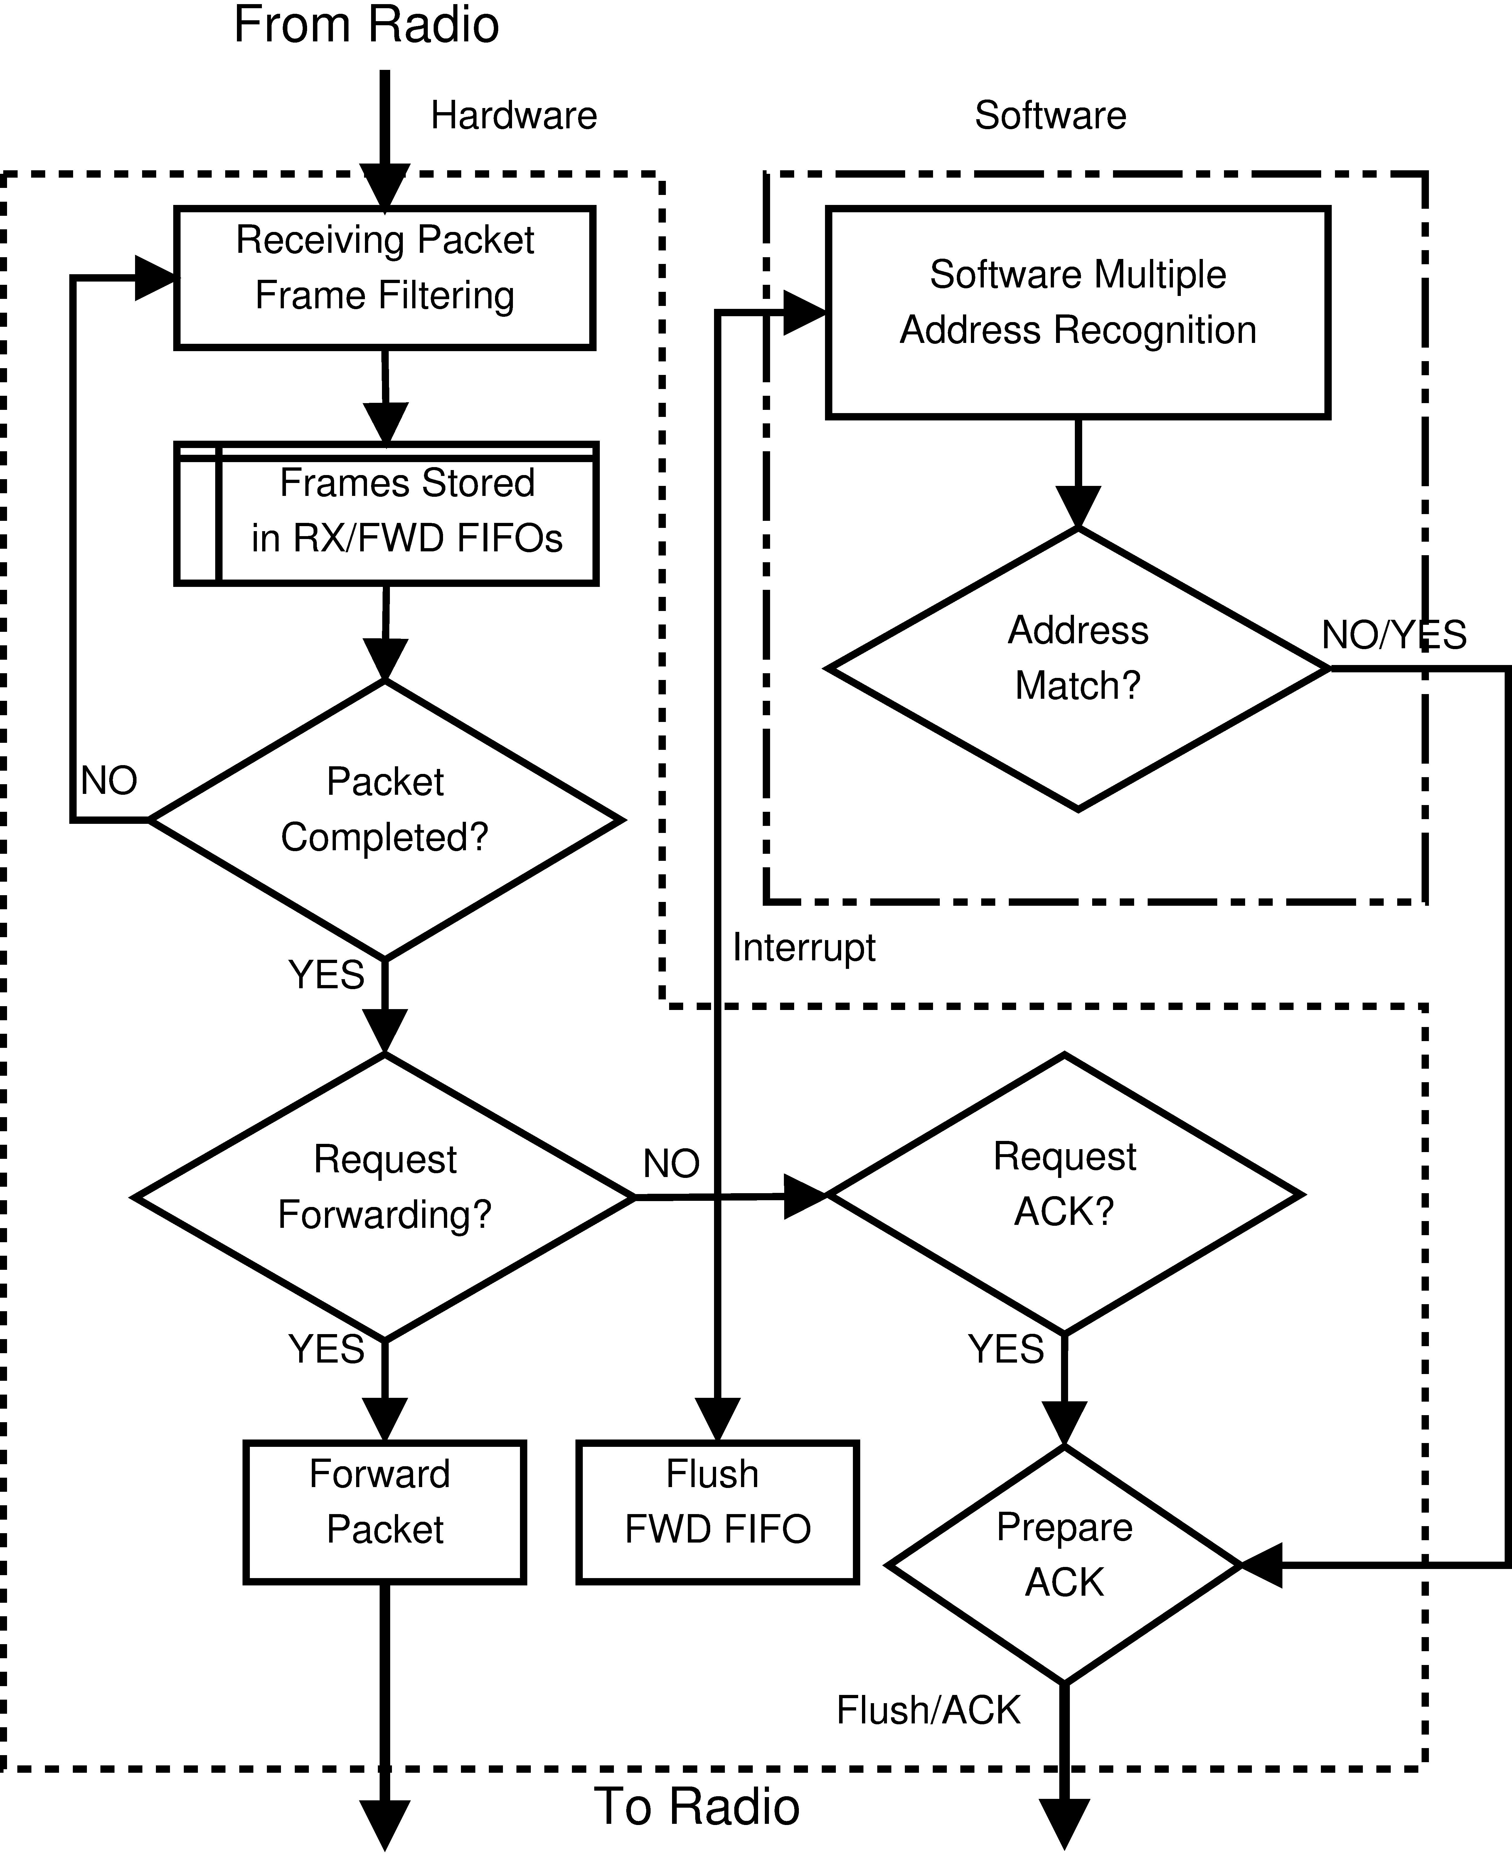
Architecture of uSDR is flexible
High throughput
Low latency
Flexible SW/HW boundary
Memory mapped radio
Enables
  Multiple address recognition
  Rapid frame filtering
  SW/HW time/area trade-off

Slide 28
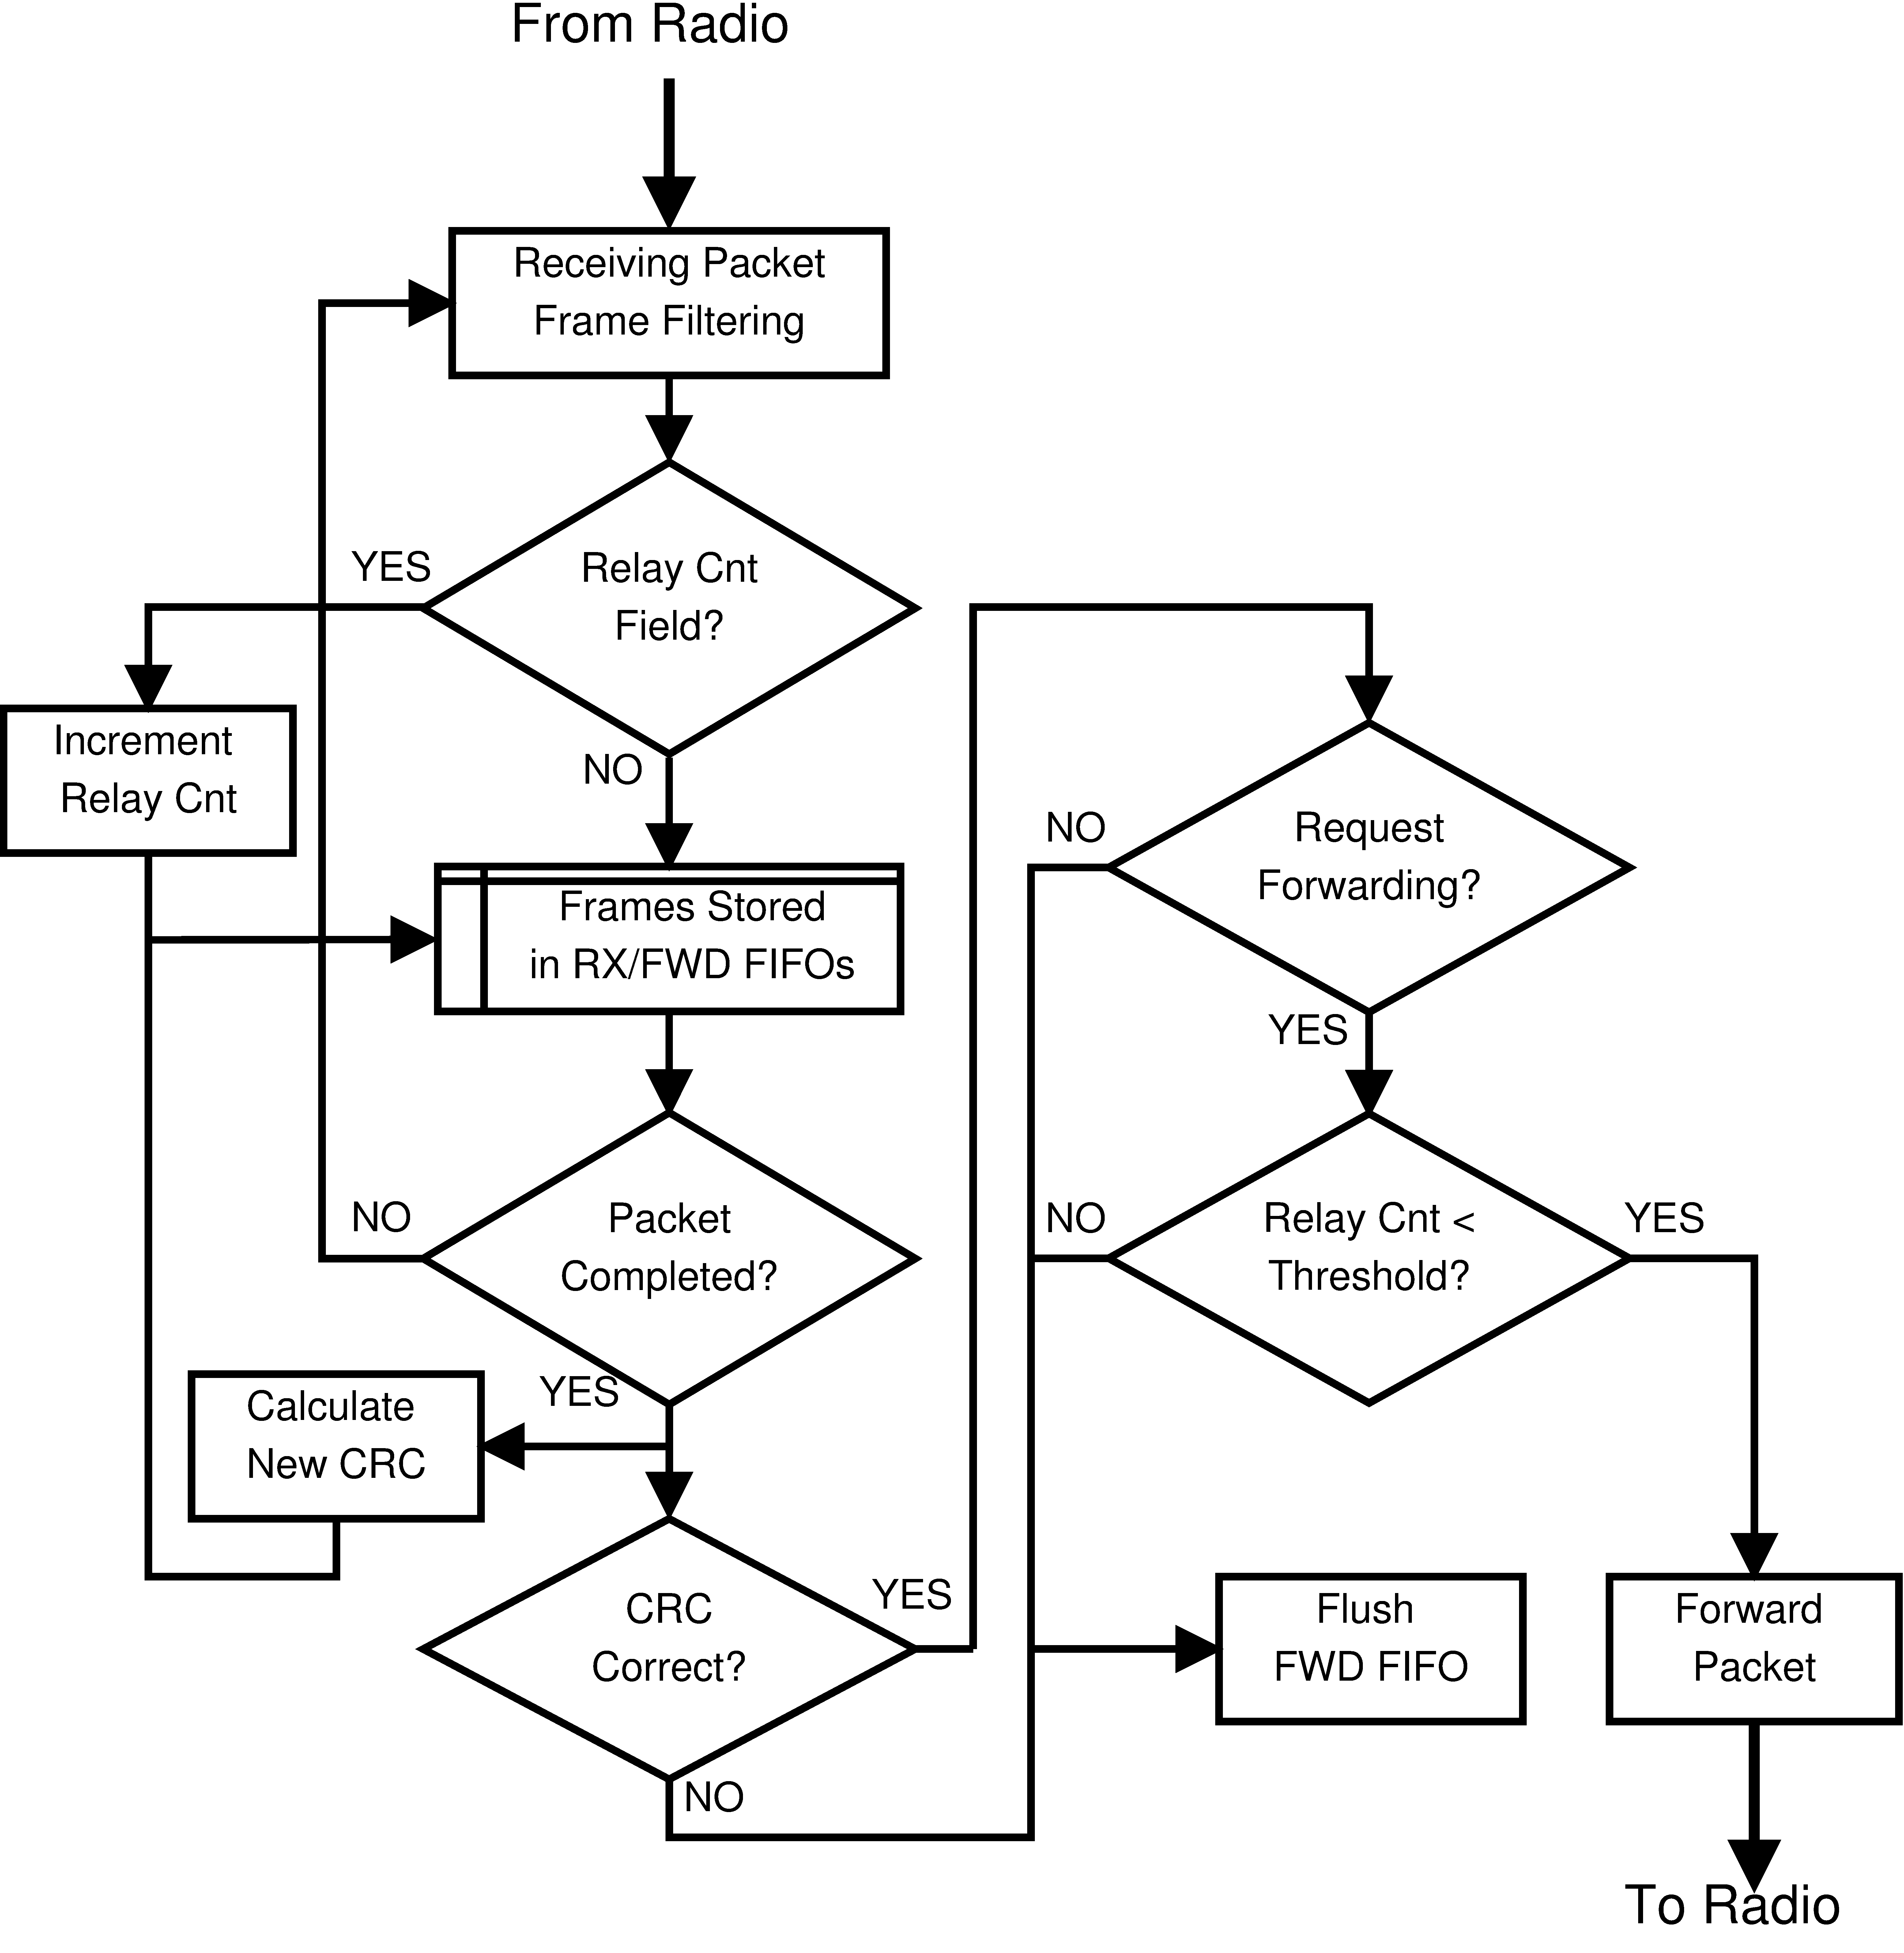
Additional features of uSDR
Hard Glossy
  High speed forwarding
  Precise timing control
  10X faster
Automatic Transmission
  Precise timing control

Slide 29

Running uSDR as a Testbed
Various Power input
  Power Jack, Headers
  PoE, USB
External Memories
  8 MB flash
  16 MB PSRAM
uClinux
  SSHd, telnetd, httpd
  Network File System (NFS)
  FPGA Live programming
Images from www.uclinux.org

Slide 30
Outline
Introduction
Challenges
Architecture Overview
Evaluation
Radio enhancement
Limitation
Conclusion
Notes:
Pause…

Slide 31
Limitations
Relatively fewer FPGA gates/LUTs
Higher power than most motes
Lower performance than SRAM-based FPGA
Fixed frontend limits RF flexibility

Slide 32
Conclusion
uSDR
  A low-power, low-cost and portable SDR platform
  uSDR offers great hardware/software dynamics
  uSDR allows designer to explore wireless protocols
  Better platform for low-power wireless research
Notes:
Allows us

Slide 34
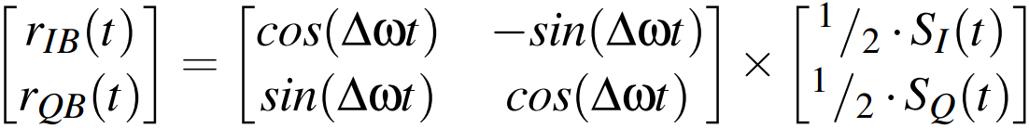

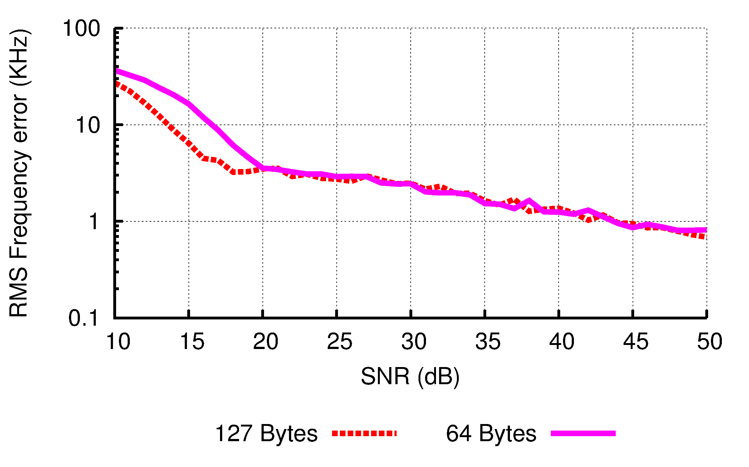
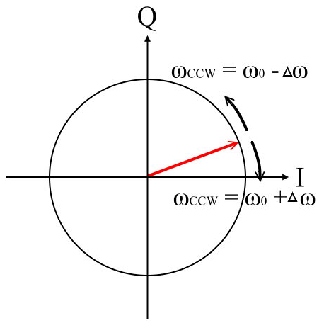
Automatic Frequency Compensation
O-QPSK
  Signal rotates at constant speed
Simulation result
50 KHz apart initially
Freq. step size = 300 Hz

