Slide 1
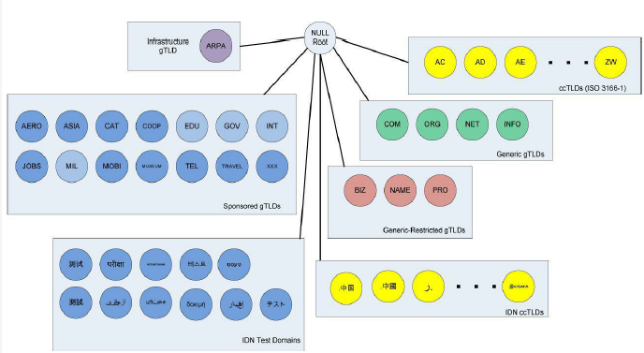
11.2 DNS name space
The set of all names used with DNS constitutes the DNS name space
  Partitioned hierarchically and case insensitive
  Unnamed root at the top
TLDs include gTLDs, ccTLDs, IDN ccTLDs, plus ARPA

Slide 2
11.2 DNS name space
gTLDs are grouped into categories: generic, generic-restricted, and sponsored
  The generic gTLDs are open for unrestricted use
  The others (generic-restricted and sponsored) are limited to various sorts of uses or are constrained as to what entity may assign names from the domain
    E.g. EDU, MIL, GOV, INT
There is a “new gTLD” program in the works that may significantly expand the current set, possibly to several hundred or even thousand
  This program and policies relating to TLD management in general are maintained by the ICANN

Slide 3
11.2 DNS name space
ccTLDs include the two-letter country codes specified by the ISO 3166 standard, plus five that are not: uk (cf. gb), su (Soviet Union), ac (Ascension Islands), eu, and tp (East Timor)
Because some of these two letter codes are suggestive of other uses and meanings, various countries have been able to find commercial windfalls from selling names within their ccTLDs
  E.g. tv

Slide 4
11.2 DNS name space
Fully qualified domain names (FQDNs) with a trailing period indicate that the name is complete; no additional information should be added to the name when performing a name resolution
  Cf. unqualified domain name
  When a system is configured, it is typically assigned a default domain extension and search list
A domain name consists of a sequence of labels separated by periods
  The period is the hierarchy delimiter and descending down the tree takes place from right to left in the name
  Each label can be up to 63 characters long, and an entire FQDN is limited to at most 255 (1-byte) characters

Slide 5
11.2 DNS name space
Hierarchical structure of the DNS name space allows different administrative authorities to manage different parts of the name space
  Scalability
  No single entity is required to administer all the changes for the entire DNS name space

Slide 6
11.3 Name servers and zones
One is supposed to arrange for at least two name servers or DNS servers to hold information about the name space
  Primary vs. secondary
The collection of servers forms the DNS (service) itself
The unit of administrative delegation is called a zone
  A subtree of the DNS name space that can be administered separately from other zones
Every domain name exists within some zone, even the TLDs that exist in the root zone
Whenever a new record is added to a zone, the DNS administrator for the zone allocates a new entry and enters into database

Slide 7
11.3 Name servers and zones
A DNS server can contain information for more than one zone
Conversely, a zone can be divided and delegated
Each zone has a designated owner or responsible party
A primary server contains the zone database in a disk file, and one or more secondary servers obtain copies of the database in its entirety from the primary using a process called a zone transfer
  Both are authoritative name servers

Slide 8
11.4 Caching
Most name servers (except some of the root and TLD servers) also cache zone information they learn, up to a time limit called the time to live (TTL)
  TTL is set and altered by the zone administrator when necessary
  If a zone changes, there still may exist cached data within the network, potentially leading to incorrect DNS resolution behavior until expiry of the TTL
  Some zone administrators, anticipating a change to the zone contents, first reduce the TTL before implementing the change
When answering a query, a server indicates whether the information it is returning has been derived from its cache or from its authoritative copy of the zone
When cached information is returned, it is common for a server to also include the domain names of the name servers that can be contacted to retrieve authoritative information about the corresponding zone

Slide 9
11.4 Caching
Negative caching is also used
  DWORD value MaxNegativeCacheTtl gives the maximum number of seconds that a negative DNS result remains in the resolver cache
In older UNIX-compatible systems, the cache is maintained in a nearby name server, not in the resolvers resident in the clients
In Windows and more recent systems (e.g., Linux), the client can maintain a cache, and it is made available to all applications running on the same system
In Windows, this happens by default, and in Linux, it is a service that can be enabled or disabled
On Windows, the local system’s cache parameters may be modified by editing the following registry entry:
      HKLM\SYSTEM\CurrentControlSet\Services\DNSCache\Parameters

Slide 10
11.4 Caching
DWORD value MaxCacheTtl gives the maximum number of seconds that a DNS record may remain in the resolver cache
  If this value is less than the TTL of a received DNS record, the lesser value controls how long the record remains in cache
In Linux and other systems that support it, the Name Service Caching Daemon (NSCD) provides a client-side caching capability
It is controlled by the /etc/nscd.conf file that can indicate which types of resolutions are cached, along with some cache parameters such as TTL settings

