Slide 1
Industry: Using Dynamic WSNs in Smart Logistics for Fruits and Pharmacy
(ACM Sensys 2011)
Author: Dennis J.A. Bijwaard
Wouter A.P. van Kleunen
Paul J.M. Havinga
Leon Kleiboer
Mark J.J. Bijl
Presented by 박해월

Slide 2
Contents
Introduction
Smart sensing
Wireless network infrastructure
Ambient middleware
Conclusion

Slide 3
Introduction
Temperature-controlled supply chain problems
  Malfunction of refrigerators
  Inaccurate time-stamping
  Delays during transport
Additional challenges of temperature-sensitive pharmaceutical products
    Continuous monitoring
    Integrated view on the global supply chain
    Management of different temperature ranges
    Irreversibility of quality degradation
    Easy installation and operation

Slide 4
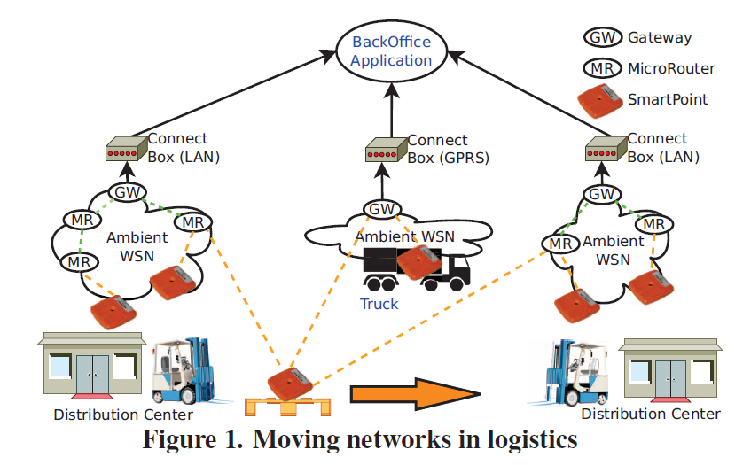
Introduction
SmartPoint
  Digital temperature sensor
  Self-locating
  Calculation, log, flush
ConnectBox
  Remote monitoring
  Maintenance of goods
  Real-time monitoring (GPRS)
Gateway and MicroRouters
  Provide a wireless infrastructure

Slide 5
Contents
Introduction
Smart sensing
Wireless network infrastructure
Ambient middleware
Conclusion

Slide 6

Quality of perishable products
Market globalization
  Important to evaluate the effects of the environment and storage shelf-life time on the quality of the products
Shelf life
  The period of time under defined conditions of storage, after manufacture of packing, for which a food product will remain safe and be fit for use
  Depends significantly on the product’s temperature history

Slide 7
Quality of perishable products
Shelf life predictions
  How long a product or component can age in transport and storage and still remain fit for use in service conditions
  Measuring the amount of degradation that occurs during the ageing process
  Used to implement first-to-expire-first-out logistics, rather than first-in-first-out logistics

Slide 8
Quality of perishable products
Requirements
  Temperature
  Humidity
    Increased loss of water from the produce (low)
    Onset of disease such as Botrytis (high)
  Ethylene
    Premature ripening and then senescence
Humidity and ethylene sensors
  less convenient to use, more costly in resource usage and money

Slide 9
Distributed sensing
Mobile system requirements
  Small in size, robust, autonomous, cheap
Distributed wireless sensors
  The tagged sensors
    Travel along with the products (e.g. Simple temperature sensors)
  The infrastructure sensors
    Installed at strategic places along the transport chain (e.g. Ethylene sensor in the truck and at various places in the warehouse)

Slide 10
Algorithm for shelf life prediction
SmartPoint: energy efficient
  Wake up every 5 minutes for calculating the remaining shelf-life based on sensed temperature and transmitting or logging it, the remaining time they are sleeping
Simplified model
  Calculate the loss of shelf life per day L as a function of the temperature T.
  The remaining shelf life Q(t) at time t is calculated by the initial quality Q_{R} minus the integral over the loss per day

Slide 11
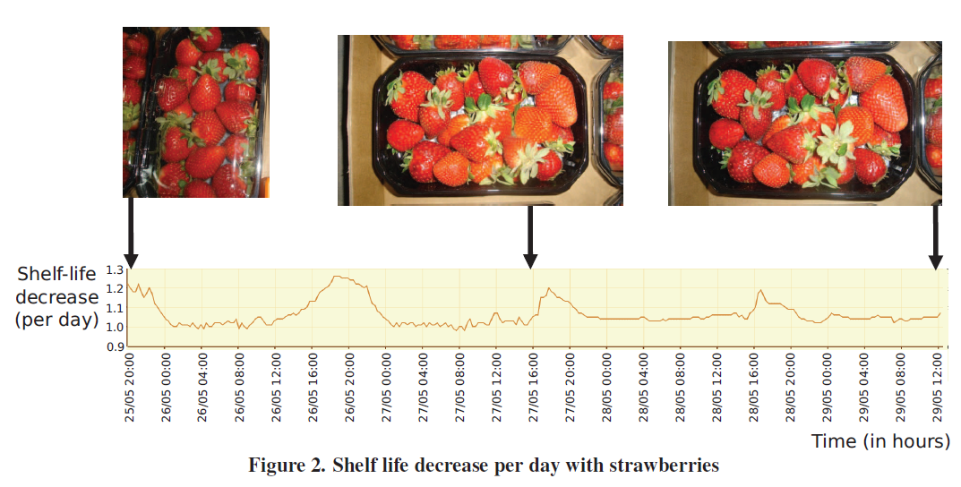
Algorithm for shelf life prediction
Attached to the pallet
Start algorithm, start logging data
Report as a network connectivity is present
Indicate the freshness of products
produced
Leave the production plant
events
Arrive at destination

Slide 12
Contents
Introduction
Smart sensing
Wireless network infrastructure
Ambient middleware
Conclusion

Slide 13
Wireless network infrastructure
MicroRouters
  meshing nodes
Gateway
  forms the connection towards an application
Sensor nodes
  Monitoring the environmental conditions in a certain area

Slide 14
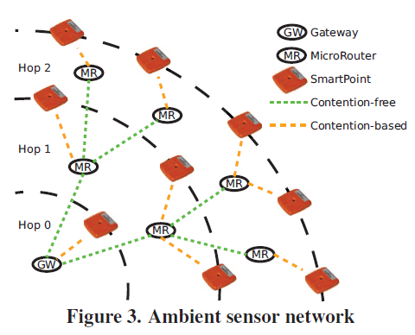
Dynamic wireless sensor networks (DWSN)
IEEE 802.15.4 PHY
  large-scale and low-energy DWSNs
two main layers
  An infrastructure layer with Gateway and MicroRouters
  A layer with SmartPoints

Slide 15
Dynamic wireless sensor networks (DWSN)
Protocols
  Ambient Reliable Transport Protocol (ARTP)
    Acknowledge
  Remote Update Protocol (RUP)
    Transfer large amounts of data to multiple nodes
  Device Driver Interface (DDI)
    Allows users, applications and nodes to access resources in a standardized manner
    Resources are made accessible by implementing drivers
  Rapid Reader Protocol (RRP)
    An out-of-band protocol for high-volume data transfer with a specific node
  Medium Access Control (MAC)
    Contention-free communication between infrastructure nodes
    Contention-based access between infrastructure nodes and SmartPoint devices

Slide 16
DDI
Asynchronous communication
The source or destination on a node
Perform complicated tasks
  Localization based on radio signal strength (RSS)
  Determining the remaining shelf life of perishable goods based on temperature and other measurements

Slide 17
MAC
Distributed TDMA based MAC protocol
  Infrastructure nodes get timeslots from the master gateway
Master gateway
MicroRouter
Scan for a network on startup
Registers with the master gateway
Assign a free timeslot and supply with configuration settings

Slide 18
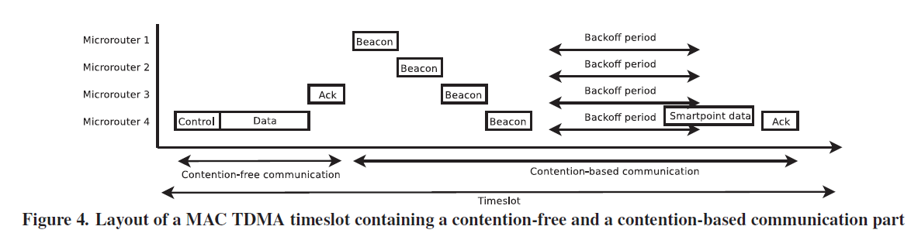
MAC
Contention-free communication
  Infrastructure devices
  Unidirectional communication
  Gateway assign timeslots
Contention-based communication
  SmartPoints with infrastructure device
  Carrier Sense Multiple Access (CSMA) based protocol
  The infrastructure nodes send out beacons enabling the SmartPoints to detect the infrastructure network
  Up to 4 collision-free beacons

Slide 19
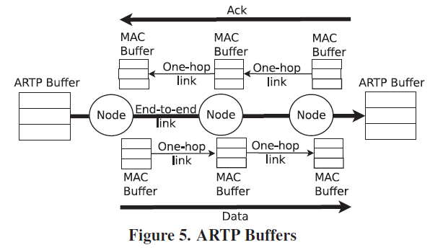
ARTP
End-to-end reliability protocol
Layers
  Data link layer, one hop reliable connection
  Network layer, routing from and to the source
  Transport layer, reliable connection between source and the destination
Setup, running, tear-down

Slide 20
ARTP
Connection setup
  routing back to the source node is done using Dynamic Source Routing (DSR)
    Needed because connections are bidirectional
    Stored in the routing table of the intermediate hops
  Once the initial data packet has been received by the destination, and the returned acknowledgement has been received by the source node, the connection is established
  Routes are continuously updated to ensure connectivity during the lifetime of the connection

Slide 21
ARTP
Connection running
  Source
    Stores a send queue, maximum 17 packets
    Send and resend the packets towards the destination until it receives an acknowledgement
    Once a packet is acknowledged, the packet can be removed from the send buffer
  Destination
    Stores all incoming packets in receive queue
    Send the packets to the application in increasing order of sequence number

Slide 22
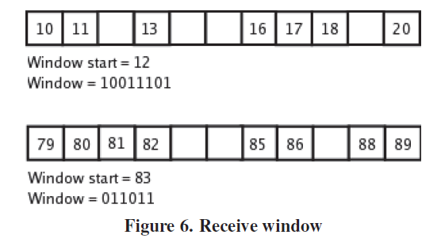
ARTP
Acknowledgement
  The destination specifies the first packet that was not received, which is next sequence number expected in the stream
  The destination stores information about the state of the packets after the first expected packet
    [window start + 1, window start + 16] are acknowledged

Slide 23
ARTP
Acknowledgement aggregation time
  When a packet comes in at the receiver and the receiver will wait for a small period of time before acknowledge the receive window
  Waits for more data packets to come in and checks the total number of packets that can be acknowledged

Slide 24
ARTP
Connection tear-down
  Set the flag in the last packet of the stream
    To inform stream is terminated
  After closing the stream
    receiver will wait for a small period of time to re-acknowledge any resends from the sender
    Sender will close the connection when all packets in the stream have been acknowledged

Slide 25
ARTP
Message cache
  Every hop in the network, lifted from the MAC protocol up to a higher level in the transport protocol
  When a packet is received from the underlying layer, it can be looked up in the message cache
    header of the message
    Source address
    Sequence id
    Retry field

Slide 26
ARTP
Acknowledgement cache
  Stores acknowledgement packets
  Prevents duplicate packets from the underlying protocol to enter the network
  Detect unnecessary resends for packets that are already acknowledged by the destination
  Message cache stores acknowledgement packets
    If the acknowledgement is already in the message cache for the incoming data packet, simply resend the lost acknowledgement and drop the data packet

Slide 27
ARTP
ARTP compared to TCP/IP
  Segments are of fixed size
  Overhead of ARTP is much smaller
    Selective acknowledgements use a bitvector instead of sequence number ranges to reduce the overhead
  ARTP uses a cross-layer approach, explicit congestion status information from the MAC layer
  Message cache and acknowledgement cache
  Congestion control

Slide 28
RUP
Disseminate large files to all infrastructure nodes within the network
Process
parent
child
An initial node is selected, a file is selected to be disseminated
Start broadcasting
Advertisement message
ACK
Want to join
Enter the registration phase
Periodically send an acknowledgement
Enter the data sending phase

Slide 29
RUP
If the parent does not receive any registrations from a child for a long time (5 min), it will stop sending advertisements and the data dissemination process stops for this node.
During the data dissemination phase, all active nodes will send status messages to the gateway.
They will indicate which phase they are in: Advertising, Sending, Receiving or Stopped. They will also indicate how many packets of the file have been successfully send / received.

Slide 30
Contents
Introduction
Smart sensing
Wireless network infrastructure
Ambient middleware
Conclusion

Slide 31
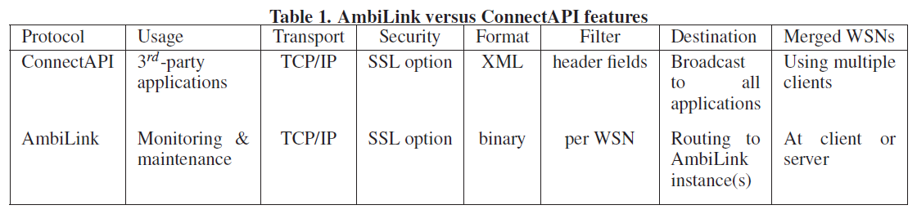
Ambient middleware
Offers the ConnectAPI
  to ease integration with third-party applications using asynchronous XML message over a TCP/IP connection
Offers AmbiLink
  to ease remote monitoring and maintenance of sensor networks using asynchronous binary messages over optionally SSL encrypted TCP/IP connection

Slide 32
Ambient middleware
For both
  Conversion between DDI and respectively their binary and XML counterpart was automated
  Logging and flushing is implemented in the middleware

Slide 33
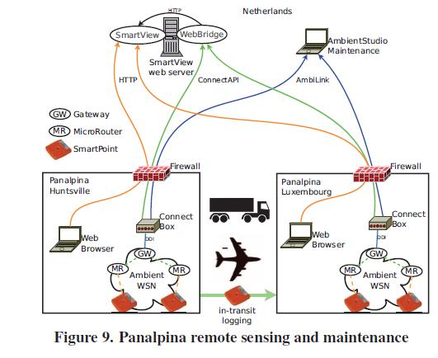
Example deployment

Slide 34
Conclusion
the use of wireless sensor network technologies that enable the efficient and effective monitoring of perishable goods in the supply chain.
a system wide approach in which wireless communication, sensor fusion, data processing, and system architecture interact efficiently to handle the complexity in the logistic supply chain.

