Slide 1

Chapter 8
Switching
Copyright © The McGraw-Hill Companies, Inc. Permission required for reproduction or display.

Slide 2
Chapter 8: Outline
8.1 INTRODUCTION
8.2 CIRCUIT-SWITCHED NETWORK
8.3 PACKET-SWITCHING
8.4 STRUCTURE OF A SWITCH

Slide 3

Chapter 8: Objective
The first section introduces switching. It mentions three methods of switching: circuit switching, packet switching, and message switching. The section then defines the switching methods that can occur in some layers of the Internet model.
The second section discusses circuit-switched networks. It first defines three phases in these types of networks. It then describes the efficiency and delay of these networks.
The third section briefly discusses packet-switched networks. It first describes datagram networks. The section then describes virtual circuit networks.
The last section discusses the structure of a switch. It first describes the structure of a circuit switch. It then explains the structure of a packet switch.

Slide 4
    8-1 INTRODUCTION
A network is a set of connected devices. Whenever we have multiple devices, we have the problem of how to connect them to make one-to-one communication possible. The solution is switching. A switched network consists of a series of interlinked nodes, called switches.

Slide 5
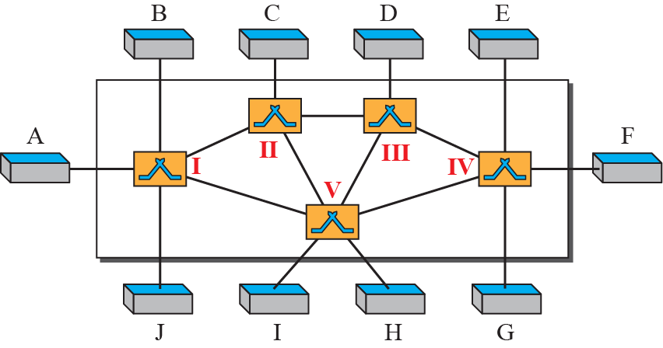
Figure 8.1: Switched network

Slide 6
8.8.1 Three Methods of Switching
Traditionally, three methods of switching have been discussed: circuit switching, packet switching, and message switching. The first two are commonly used today. The third has been phased out in general communications but still has applications. Packet switching can further be divided into two subcategories, virtual-circuit approach and datagram approach, as shown in Figure 8.2.

Slide 7
8.8.2 Switching and TCP/IP Layers
Switching can happen at several layers of the TCP/IP protocol suite: at the physical layer, at the data-link layer, and at the network layer.

Slide 8
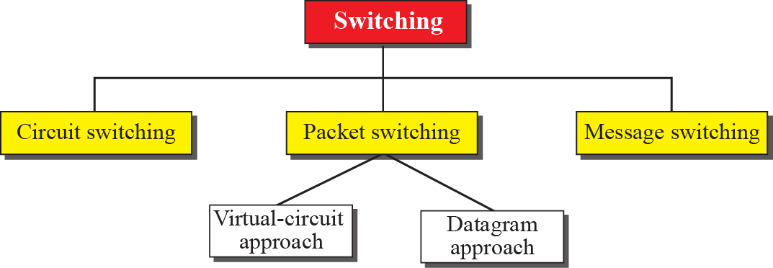
Figure 8.2: Taxonomy of switched networks

Slide 9
    8-2 CIRCUIT-SWITCHED NETWORKS
A circuit-switched network consists of a set of switches connected by physical links. A connection between two stations is a dedicated path made of one or more links. However, each connection uses only one dedicated channel on each link. Each link is normally divided into n channels by using FDM or TDM, as discussed in Chapter 6.

Slide 10
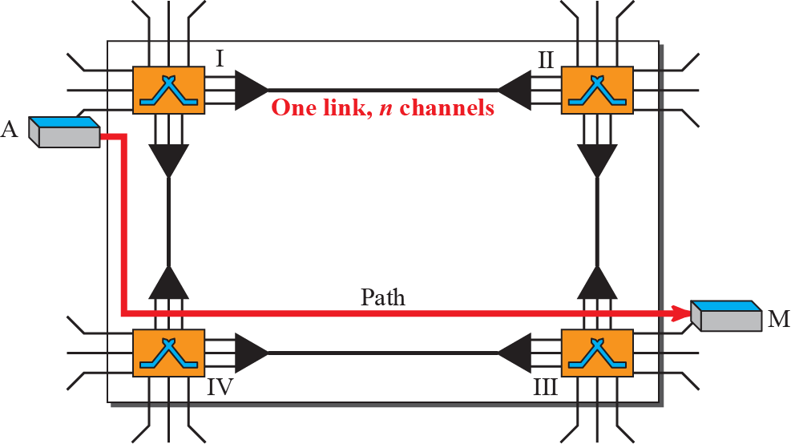
Figure 8.3: A trivial circuit-switched network

Slide 11
Example 8.1
As a trivial example, let us use a circuit-switched network to connect eight telephones in a small area. Communication is through 4-kHz voice channels. We assume that each link uses FDM to connect a maximum of two voice channels. The bandwidth of each link is then 8 kHz. Figure 8.4 shows the situation. Telephone 1 is connected to telephone 7; 2 to 5; 3 to 8; and 4 to 6. Of course the situation may change when new connections are made. The switch controls the connections.
8.11

Slide 12
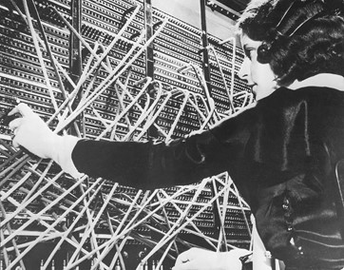
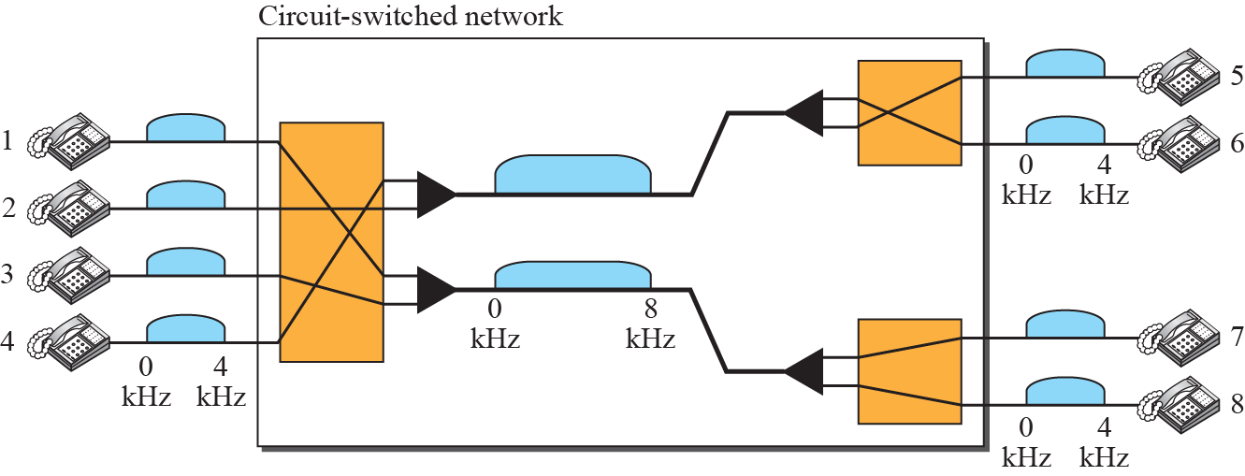
Figure 8.4: Circuit-switched network used in Example 8.1

Slide 13
Example 8.2
As another example, consider a circuit-switched network that connects computers in two remote offices of a private company. The offices are connected using a T-1 line leased from a communication service provider. There are two 4 × 8 (4 inputs and 8 outputs) switches in this network. For each switch, four output ports are folded into the input ports to allow communication between computers in the same office. Four other output ports allow communication between the two offices. Figure 8.5 shows the situation.
8.13

Slide 14
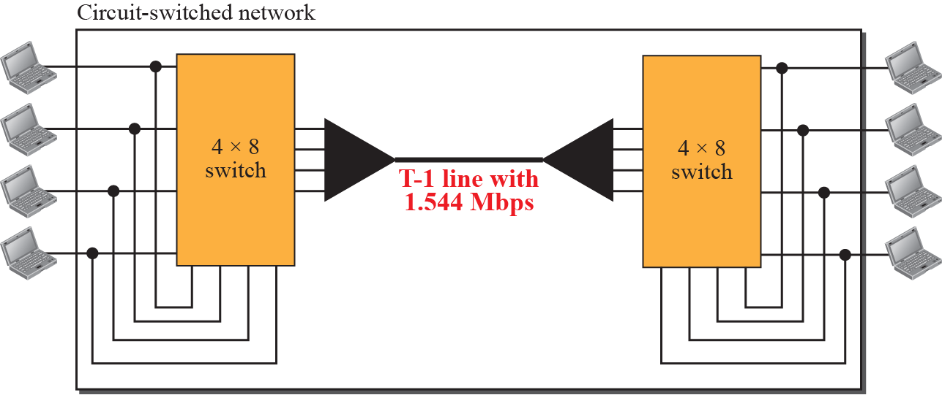
Figure 8.5: Circuit-switched network used in Example 8.2

Slide 15
8.2.1 Three Phases
The actual communication in a circuit-switched network requires three phases: connection setup, data transfer, and connection teardown.

Slide 16
8.2.2 Efficiency
It can be argued that circuit-switched networks are not as efficient as the other two types of networks because resources are allocated during the entire duration of the connection. These resources are unavailable to other connections. In a telephone network, people normally terminate the communication when they have finished their conversation.

Slide 17
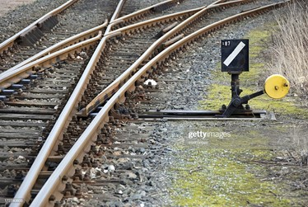
8.2.3 Delay
Although a circuit-switched network normally has low efficiency, the delay in this type of network is minimal. During data transfer the data are not delayed at each switch; the resources are allocated for the duration of the connection. Figure 8.6 shows the idea of delay in a circuit-switched network when only two switches are involved.

Slide 18
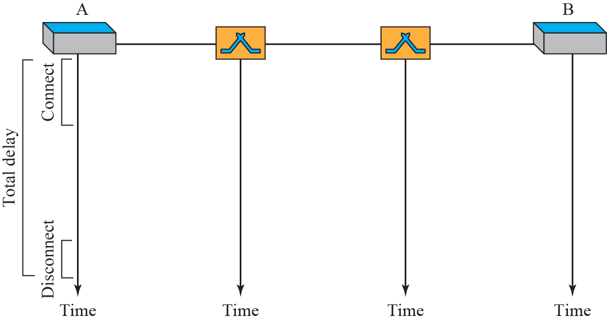
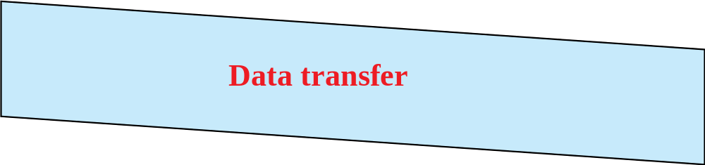
Figure 8.6: Delay in a circuit-switched network

Slide 19
    8-3 PACKET SWITCHING
In data communications, we need to send messages from one end system to another. If the message is going to pass through a packet-switched network, it needs to be divided into packets of fixed or variable size. The size of the packet is determined by the network and the governing protocol.

Slide 20
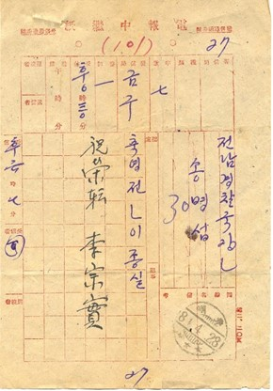

8.3.1 Datagram Networks
In a datagram network, each packet is treated independently of all others. Even if a packet is part of a multipacket transmission, the network treats it as though it existed alone. Packets in this approach are referred to as datagrams.

Slide 21
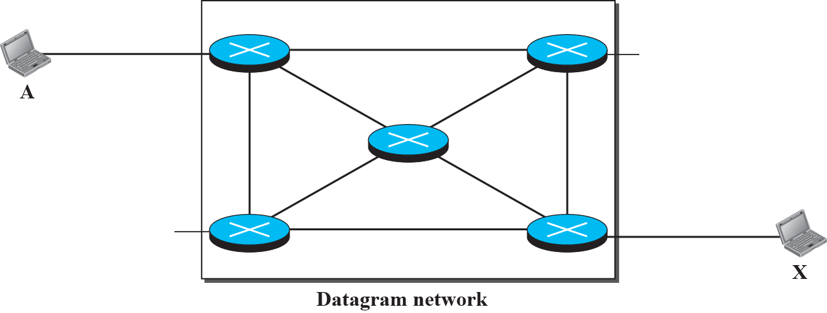






Figure 8.7: A Datagram network with four switches (routers)

Slide 22
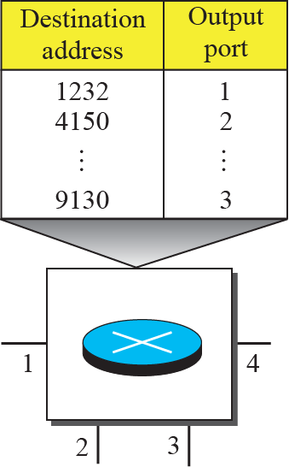
Figure 8.8: Routing table in a datagram network

Slide 23
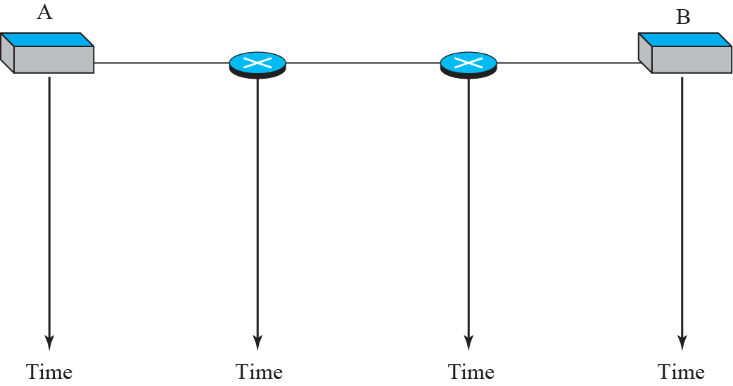




Figure 8.9: Delays in a datagram network

Slide 24
8.3.2 Virtual-Circuit Networks
A virtual-circuit network is a cross between a circuit-switched network and a datagram network. It has some characteristics of both.
Uses “packets” → packet switching
Connection setup and teardown → circuit switching
  Resource reserved: no waiting time

Slide 25
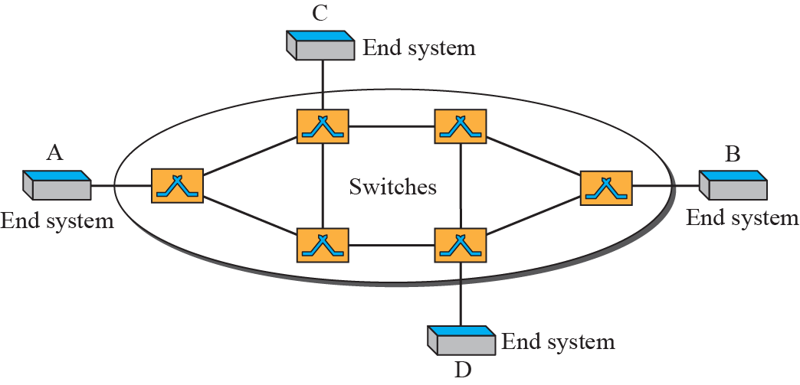
Figure 8.10: Virtual-circuit network

Slide 26
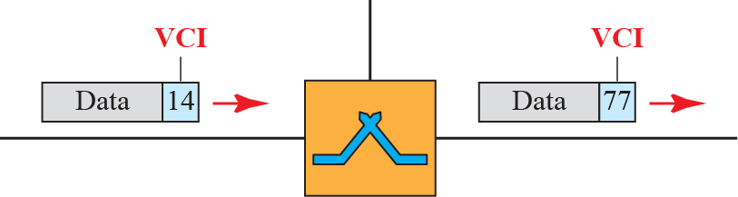
Figure 8.11: Virtual-circuit identifier
Circuit identifier is not address

Slide 27
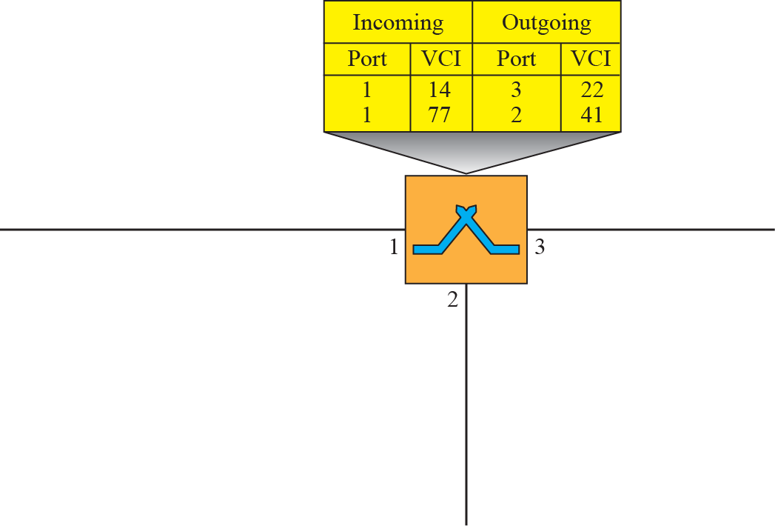



Figure 8.12: Switch and table for a virtual-circuit network

Slide 28
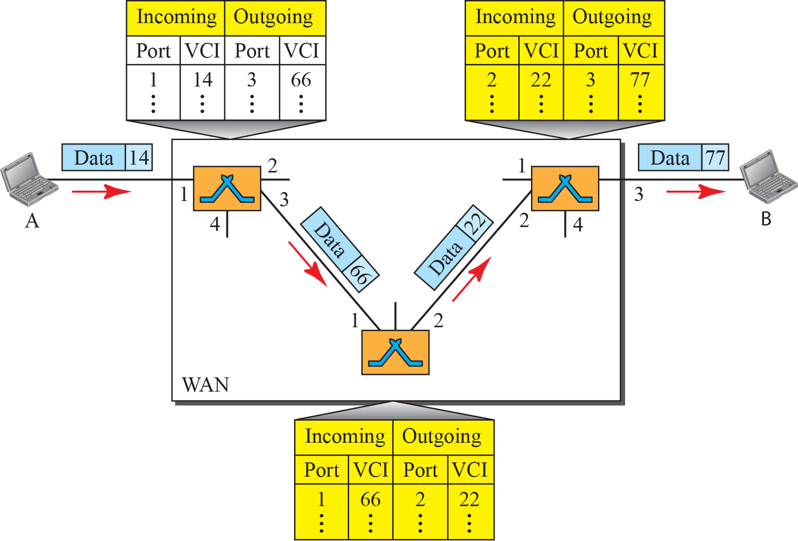
Figure 8.13: Source-to-destination data transfer in a circuit-switch
network

Slide 29
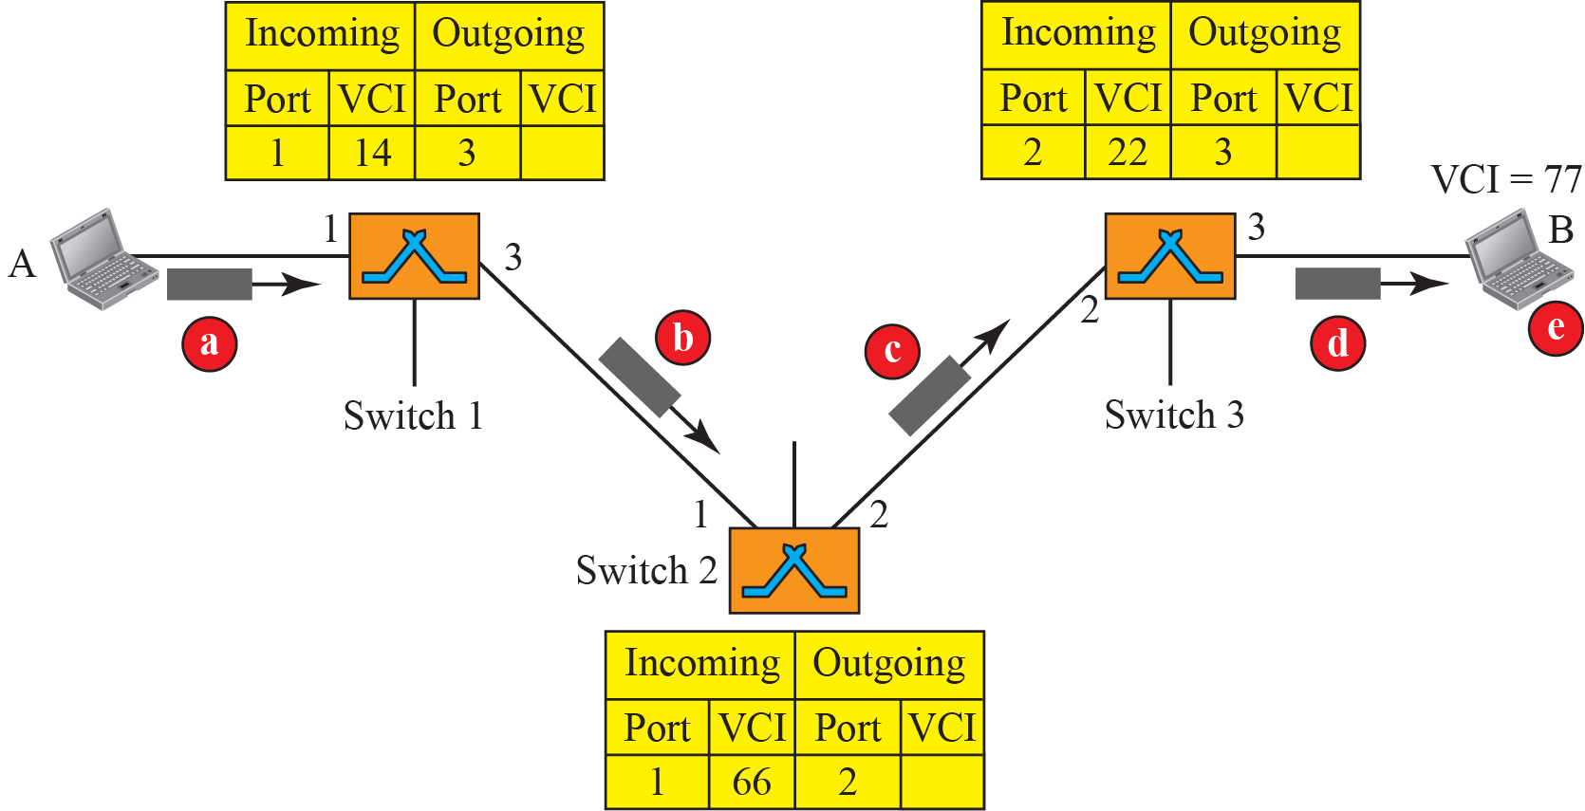
Figure 8.14: Setup request in a virtual-circuit network
VCI is not an address, but we need the destination (“B”) address to set up the VCIs

Slide 30
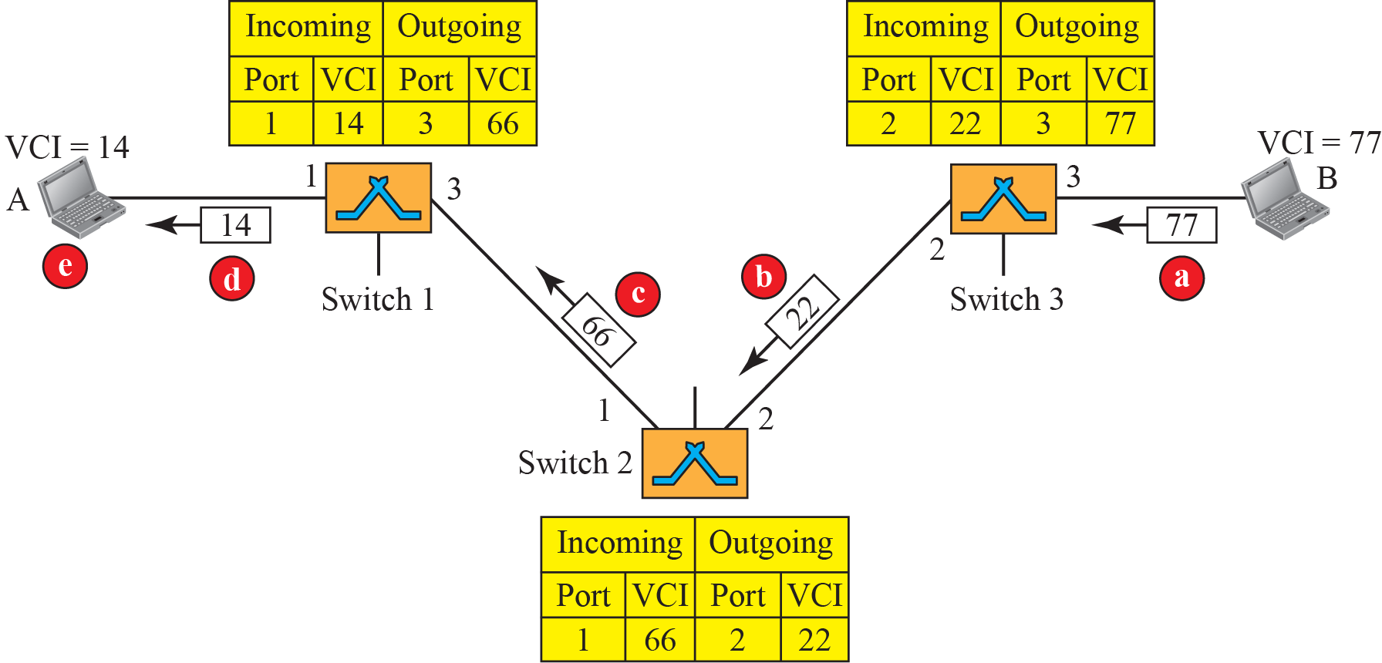
Figure 8.15: Setup acknowledgment in a virtual-circuit network

Slide 31
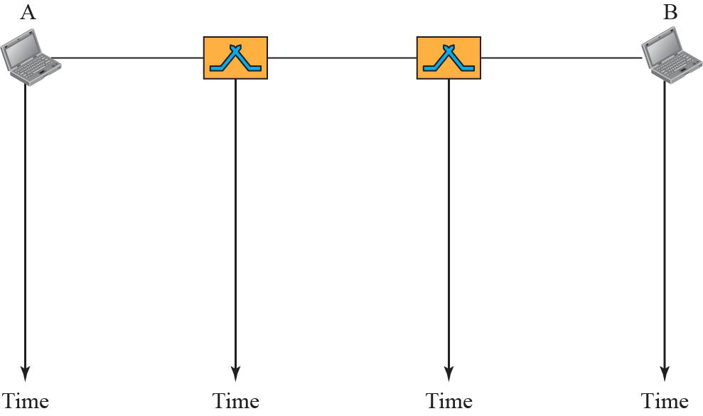


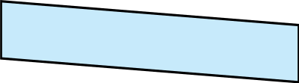

Figure 8.16: Delay in a virtual-circuit network

Slide 32
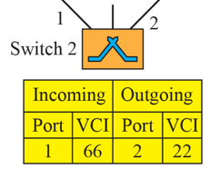
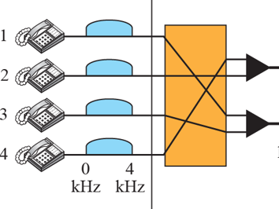
    8-4 STRUCTURE OF A SWITCH
We use switches in circuit-switched and packet-switched networks. In this section, we discuss the structures of the switches used in each type of network.

Slide 33
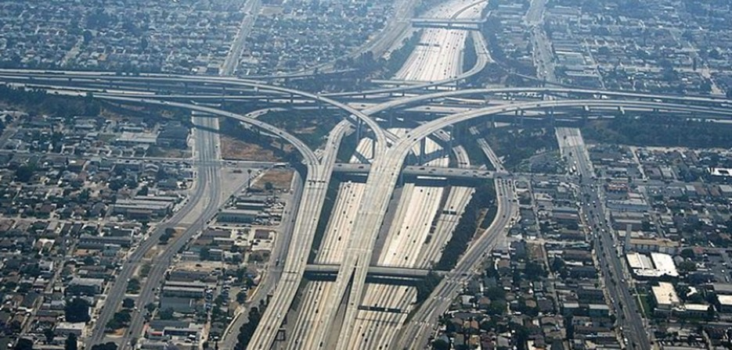
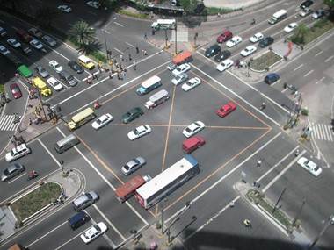
8.4.1 Structure of Circuit Switches
Circuit switching today can use either of two technologies: the space-division switch or the time-division switch.

Slide 34
Space-Division Switch
Crossbar Switch
  Fully connected – large number of crosspoints
    In practice, fewer than 25% are in use at any time
  “Blocking” only if going to the same output
Multistage Switch
  Crossbar switches in several (normally 3) stages
  Saves a lot of crosspoints
  Can block even if not going to the same output

Slide 35
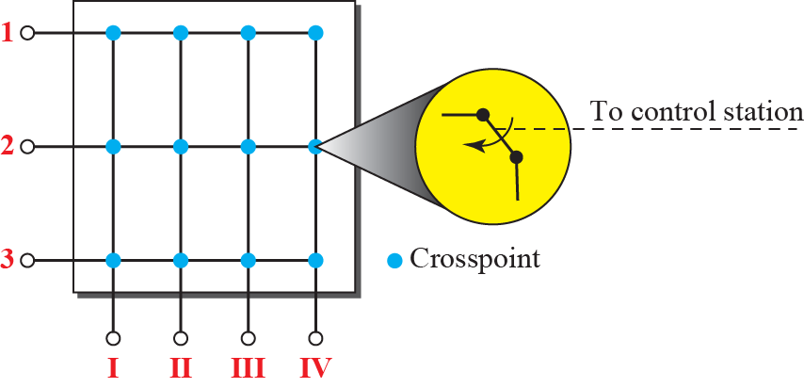
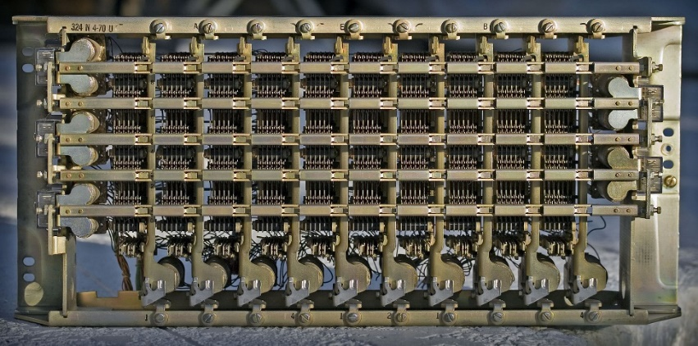
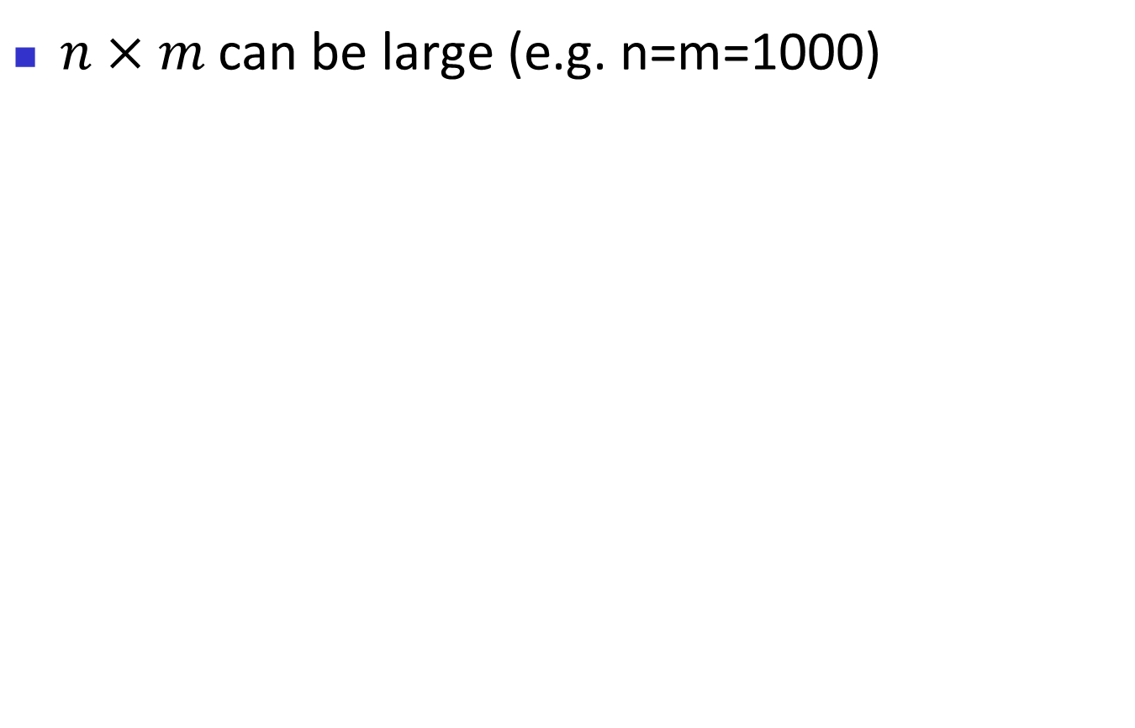
Figure 8.17: Crossbar switch with three inputs and four outputs
$n×m$can be large (e.g. n=m=1000)

Slide 36
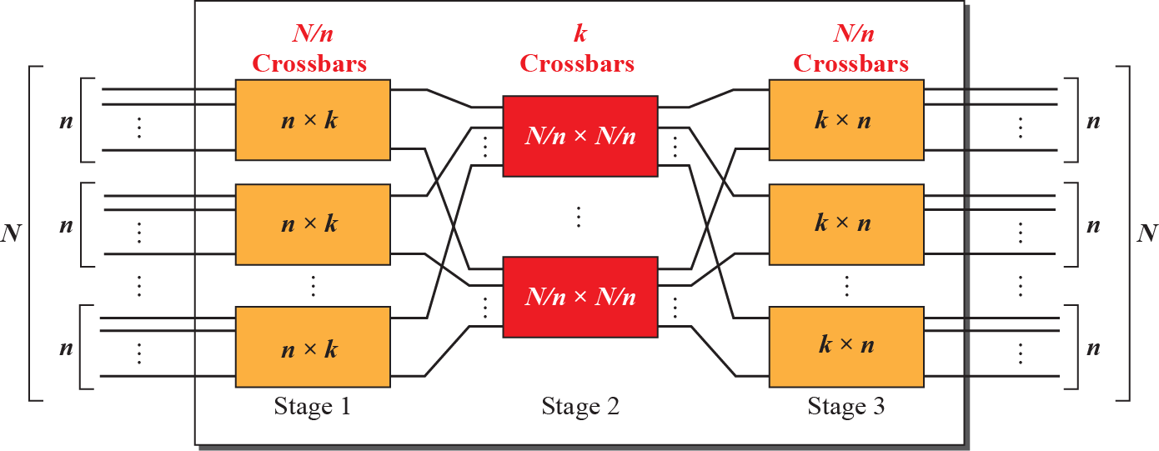

Figure 8.18: Multistage switch
$\frac{N}{n}\left(k×n\right)+k\left(\frac{N}{n}×\frac{N}{n}\right)+\frac{N}{n}\left(k×n\right)=2kN+k{\left(\frac{N}{n}\right)}^{2}≪N^{2}$

Slide 37
Example 8.3
Design a three-stage, 200 × 200 switch (N = 200) with k = 4 and n = 20.
Solution
In the first stage we have N/n or 10 crossbars, each of size 20 × 4. In the second stage, we have 4 crossbars, each of size 10 × 10. In the third stage, we have 10 crossbars, each of size 4 × 20. The total number of crosspoints is
2kN + k(N/n)², or 2000
crosspoints. This is 5 percent of the number of crosspoints in a single-stage switch (200 × 200 = 40,000).
8.37

Slide 38
Blocking in multistage switch
The whole idea of multistage switch is to share the crosspoints in the middle stage
“Blocking”≡ inputs going to different output ports but their paths overlapping
  E.g. Only 4 of 20 inputs can use the first-stage switch at a time
  Does not happen in a single-stage switch

Slide 39
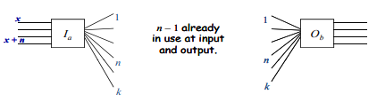
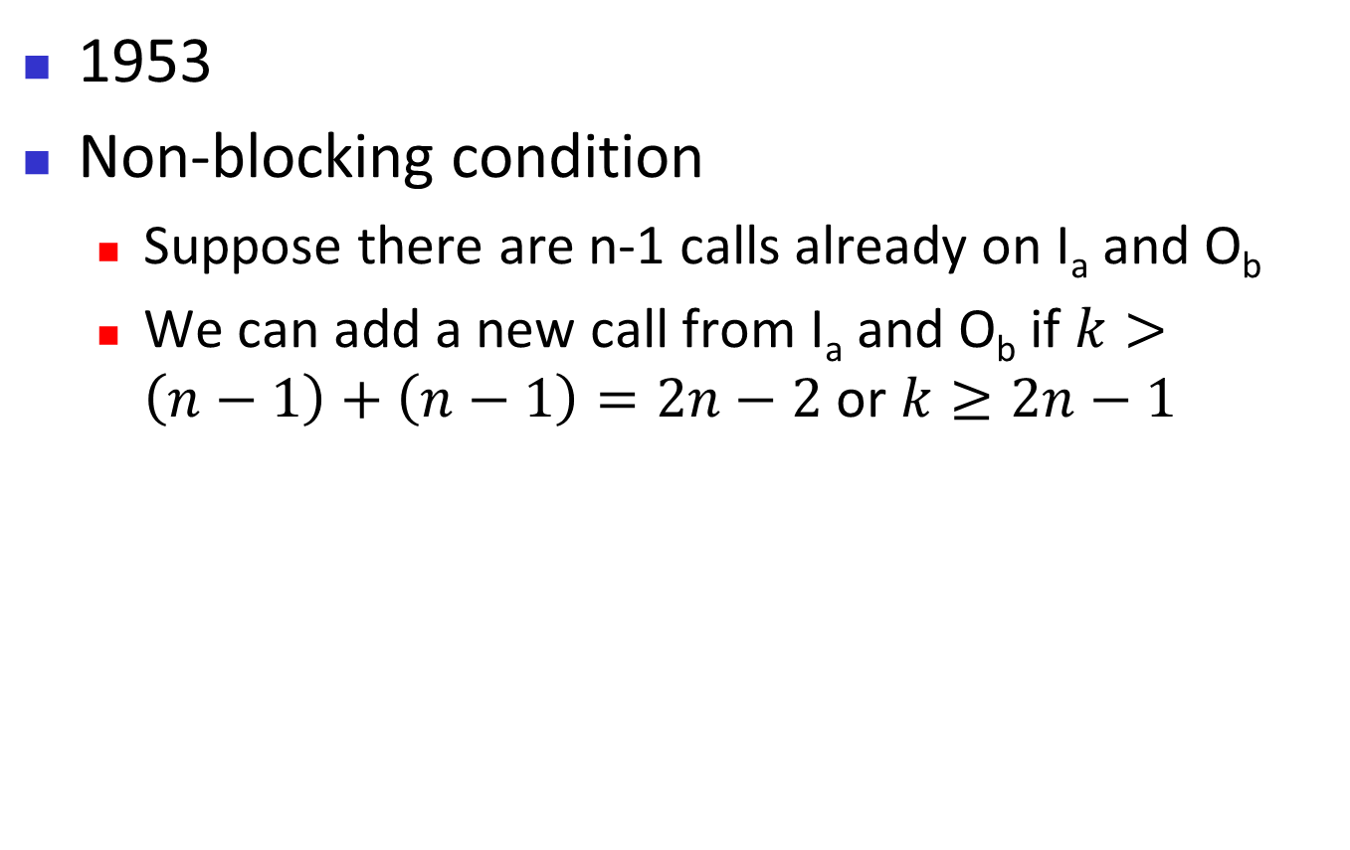
Clos criteria
1953
Non-blocking condition
  Suppose there are n-1 calls already on I_{a} and O_{b}
  We can add a new call from I_{a} and O_{b} if $k>\left(n−1\right)+\left(n−1\right)=2n−2$ or $k≥2n−1$

Slide 40
Example 8.4
Redesign the previous three-stage, 200 × 200 switch, using the Clos criteria with a minimum number of crosspoints.
Solution
We let n = (200/2)^{1/2}, or n = 10. We calculate k = 2n – 1 = 19. In the first stage, we have 200/10, or 20, crossbars, each with 10 × 19 crosspoints. In the second stage, we have 19 crossbars, each with 20 × 20 crosspoints. In the third stage, we have 20 crossbars each with 19 × 10 crosspoints. The total number of crosspoints is 20(10 × 19) + 19(20 × 20) + 20(19 × 10) = 15,200. If we use a single-stage switch, we need 200 × 200 = 40,000 crosspoints. The number of crosspoints in this switch is 38 percent that of a single-stage switch.
8.40

Slide 41
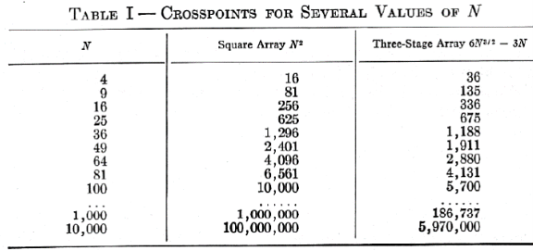
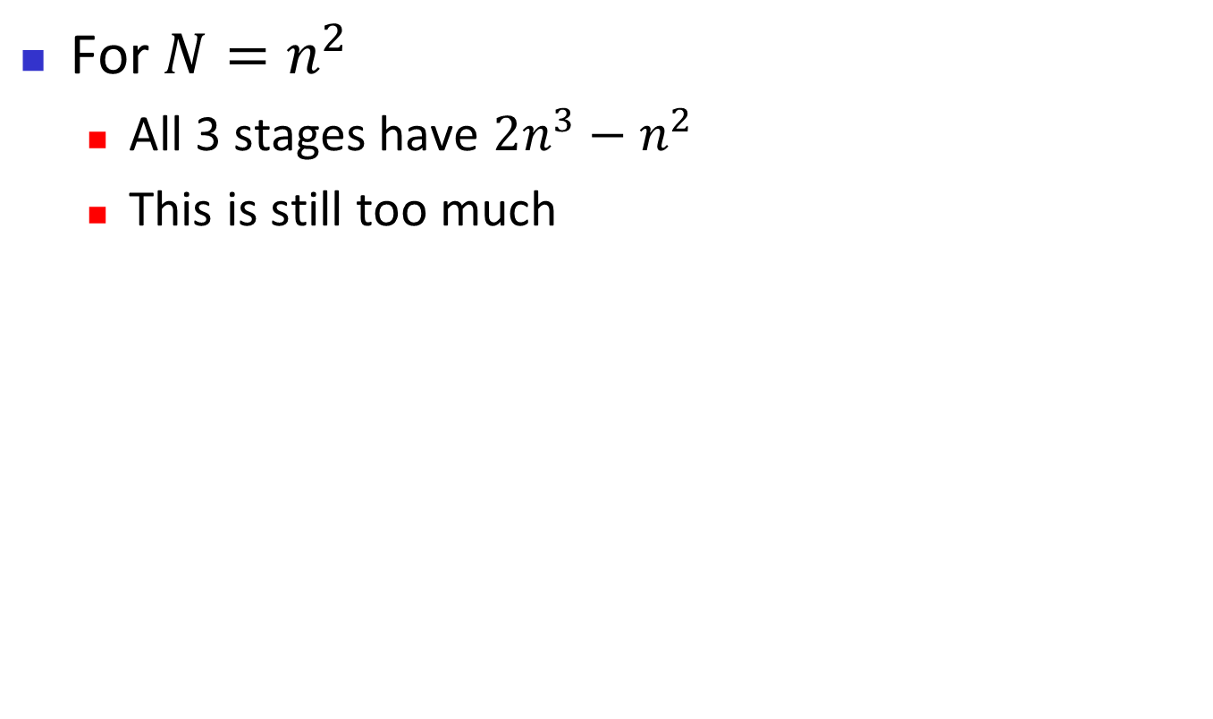
Clos criteria
For $N=n^{2}$
  All 3 stages have $2n^{3}−n^{2}$
  This is still too much

Slide 42
Time-Division Switch
Digital!
No crosspoints necessary, but causes delays

Slide 43
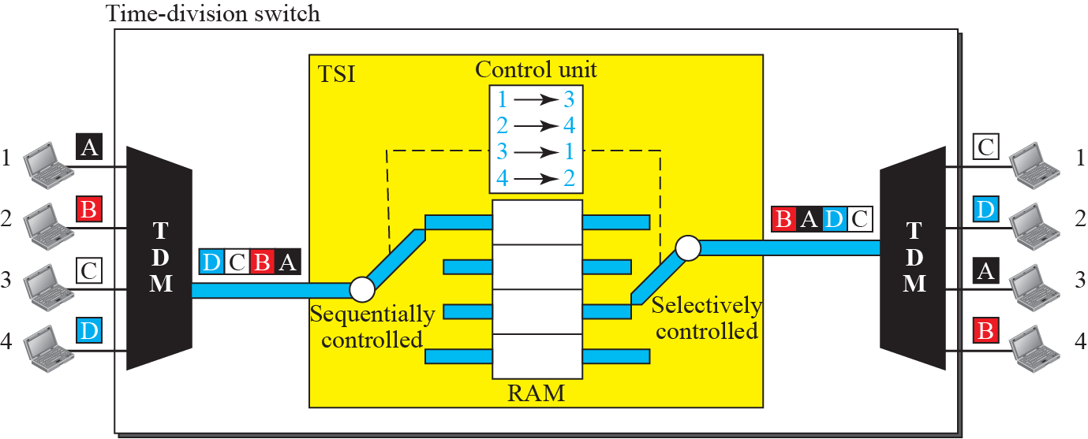
Figure 8.19: Time-slot interchange

Slide 44
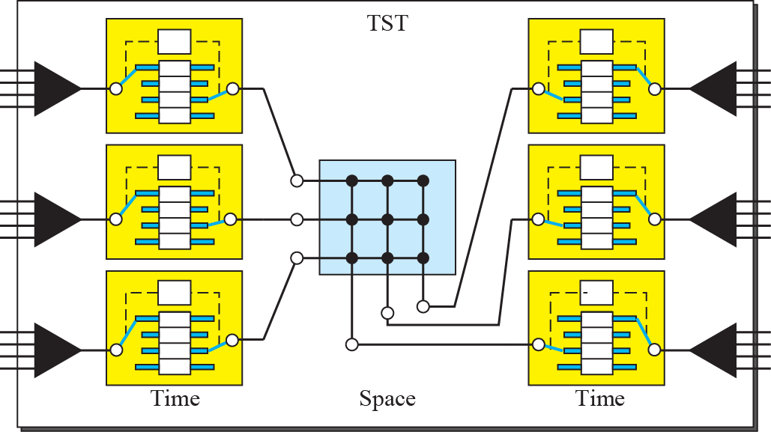
Figure 8.20: Time-space-time switch

Slide 45
8.4.2 Structure of Packet Switches
A switch used in a packet-switched network has a different structure from a switch used in a circuit-switched network. We can say that a packet switch has four components: input ports, output ports, the routing processor, and the switching fabric, as shown in Figure 8.28.
Store and Forward!

Slide 46
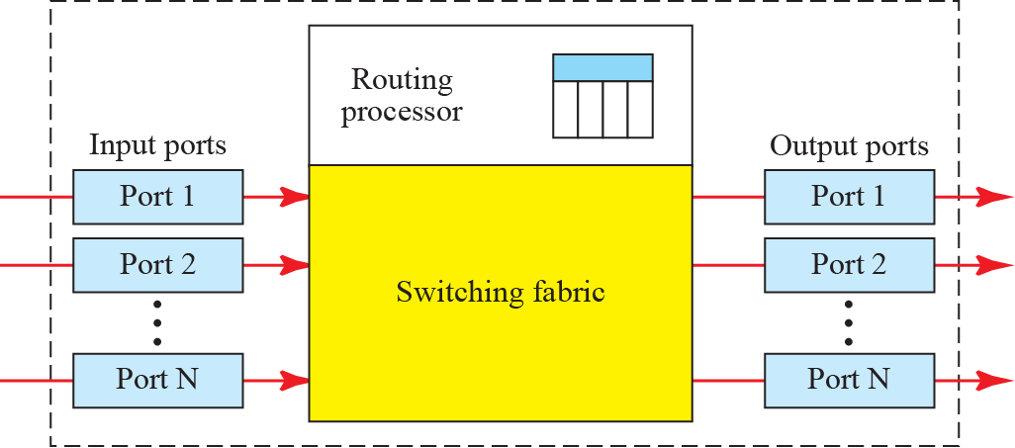
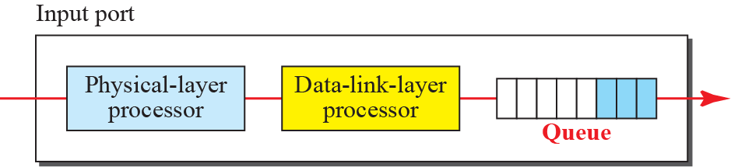
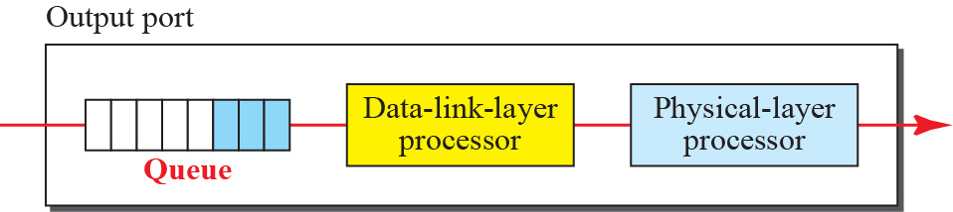
Figure 8.21: Packet switch components

Slide 47

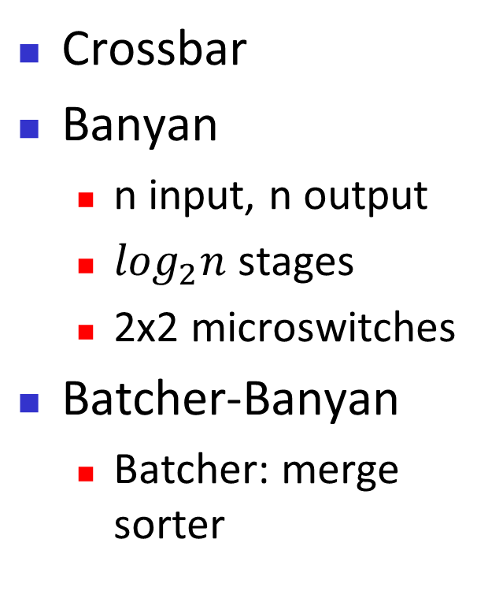
Switching Fabrics
Crossbar
Banyan
  n input, n output
  $\log_{2}n$ stages
  2x2 microswitches
Batcher-Banyan
  Batcher: merge sorter

Slide 48
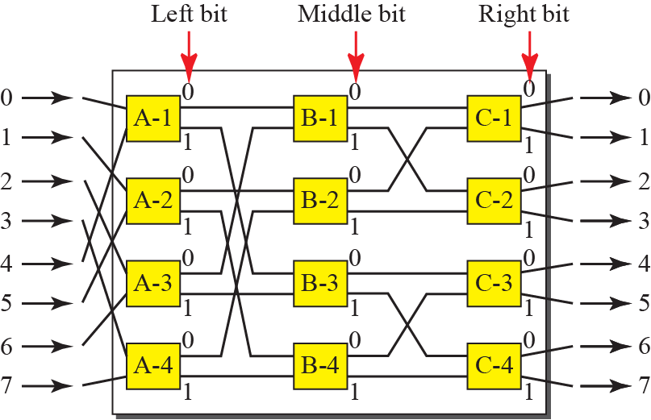
Figure 8.24: A banyan switch

Slide 49
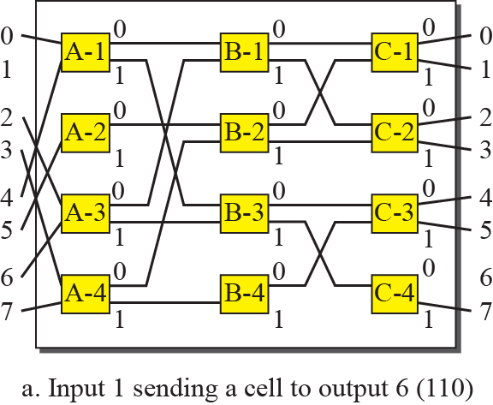

Figure 8.25: Example of routing in a banyan switch (Part a)

Slide 50
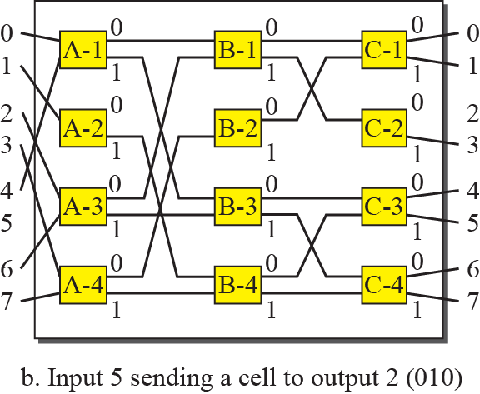

Figure 8.25: Example of routing in a banyan switch (Part b)

Slide 51
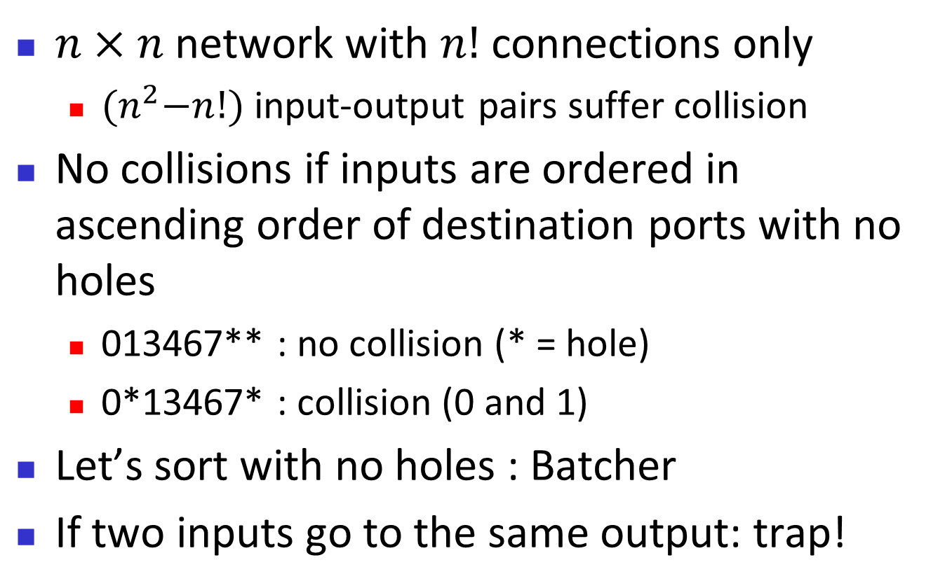
Discussion on Banyan switch
$n×n$ network with $n!$ connections only
  ${(n}^{2}−n!)$ input-output pairs suffer collision
No collisions if inputs are ordered in ascending order of destination ports with no holes
  013467** : no collision (* = hole)
  0*13467* : collision (0 and 1)
Let’s sort with no holes : Batcher
If two inputs go to the same output: trap!

Slide 52
013467**

Slide 53
0*13467*

Slide 54
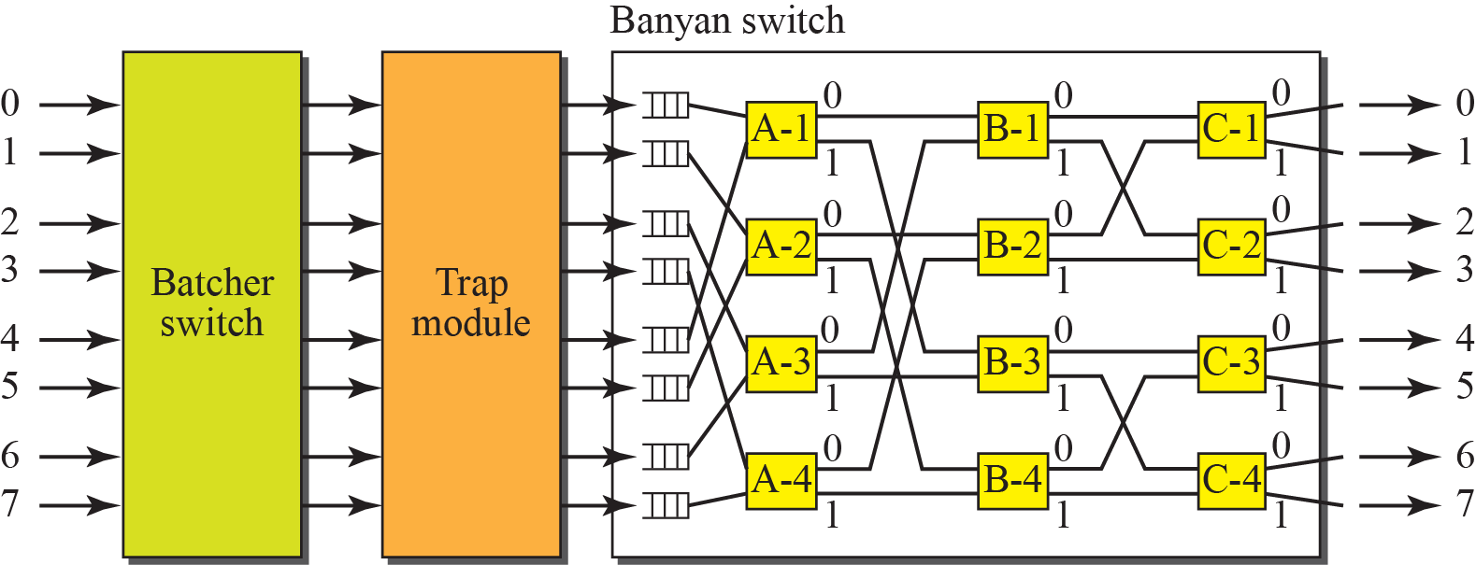
Figure 8.26: Batcher-banyan switch

