Slide 1
WiFi-Enabled Smart Human Dynamics Monitoring
Guo, X., et al.
Stevens Institute of Technology Nj
Sensys`17
Bong-yeol Yu
Operating Systems Lab.
2018. 11. 20.

Slide 2
Contents
Motivation
System overview
Background
Design
Evaluation
Conclusion
Critique

Slide 3
MOTIVATION
Rapid urbanization and socioeconomic
  People spend more time in indoor venues
    e.g., work, social and physical activities
  Exhibit distinct characteristics that reflect different social behaviors
    e.g., crowd size, density distribution and moving patterns
Human dynamics monitoring
  Designing management services
    Caring services for seniors
      Identified as suffering from social isolation
    Management services in community activity rooms
      Planned more effectively

Slide 4
MOTIVATION
Human dynamic monitoring system
  Estimate the number of participants
  Infer human density distribution
    e.g., Space management and planning, inferring the popularity of the activities
  Estimate human walking speed and direction
    e.g., Detect some abnormal activities for the senior people, sleep walker towards dangerous places at night

Slide 5
Overview
Monitoring system of a comprehensive human dynamic information using Channel State Information (CSI) of WiFi
Three aspects of human dynamic information
  Participant estimation
    Semi-supervised learning approach with non-linear regression method
  Human density estimation
    Estimation based on the analysis of the CSI variance histogram
  Walking speed and direction derivation
    Frequency-based classification method based on Total Harmonic Distortion (THD)

Slide 6






Background
CSI Fundamental
  Received wireless signal
    y: receiving signals, x ( ): transmitting signals in vector form, respectively
    : channel response, n: ambient noise
    A_{i}: complex amplitude attenuation for the i^{th} path as
    : phase shift, : propagation delay ( )
  H represents the channel state information
    Dominated by three major factors
      Amplitude attenuation, phase shift and propagation delay

Slide 7
Background
Feasibility study
  Experimental methodology
    To understand the relationship between different human dynamic patterns and CSI
    Conduct in a typical classroom of the size 12m X 5m
      Several chairs and tables are placed
    Two laptops send packets with the fixed rate, 100 pkt/sec, at apart from 5m each other
    5 volunteers participated

Slide 8
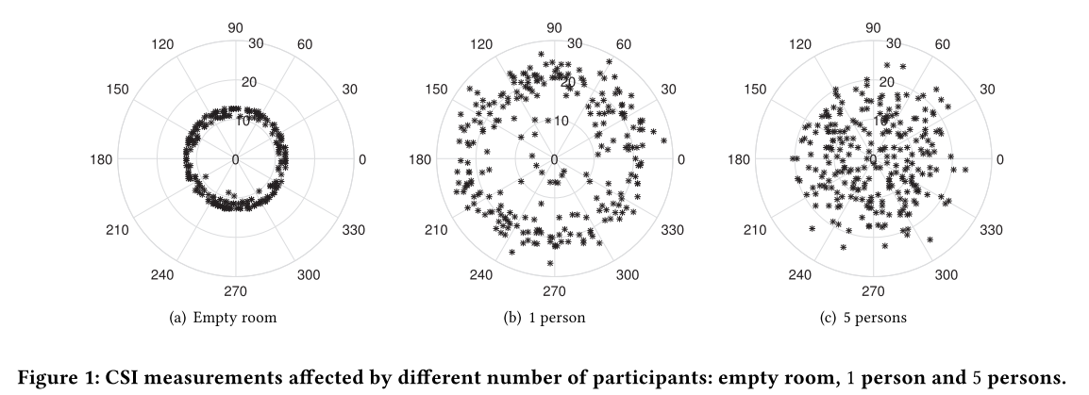
Background
Feasibility study
  Impact of the number of people on CSI
    The presence of people impacts on the wireless signal propagation path
      i.e., reflection and refraction
    CSI measurements
      Stable in an empty room
      Affected with varying number of people

Slide 9
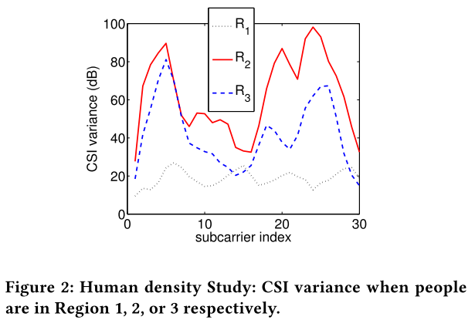
Background
Feasibility study
  Impact of the human density on CSI
    Rationale
      When more people gather at some specific regions, the wireless signal will experience heavier distortions caused by their movements in those regions
    Three people move at three different regions
      Area close to the transmitter
      Area close to the receiver
      Area in the middle of the transmitter/receiver
    CSI distribution can be utilized to perform people
    density estimation

Slide 10
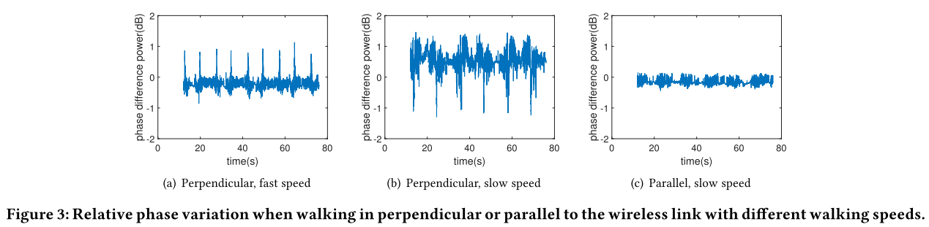
Background
Feasibility study
  Impact of the people walking speed and direction on CSI
    A volunteer to walk back and forth between two ends of a room with different speeds and directions
    Significant differences as the walking speed and direction change

Slide 11
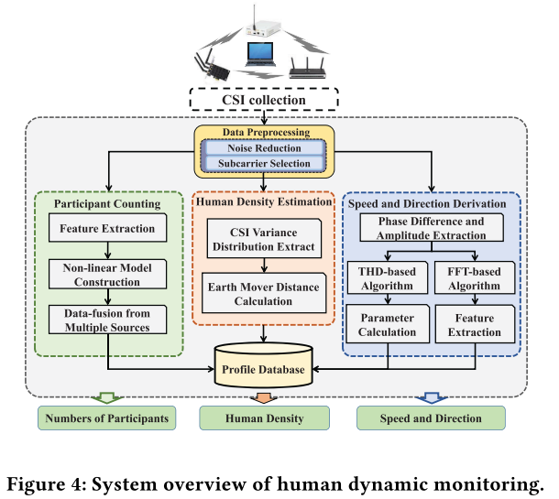
System design
Enable comprehensive human dynamic monitoring
Utilize the readily available CSI information
Use the commodity wireless devices
Estimate human dynamics
  Monitor an area from a macro perspective
    Number of participants and human density
  Monitor a person from a micro perspective
    Speed and direction

Slide 12
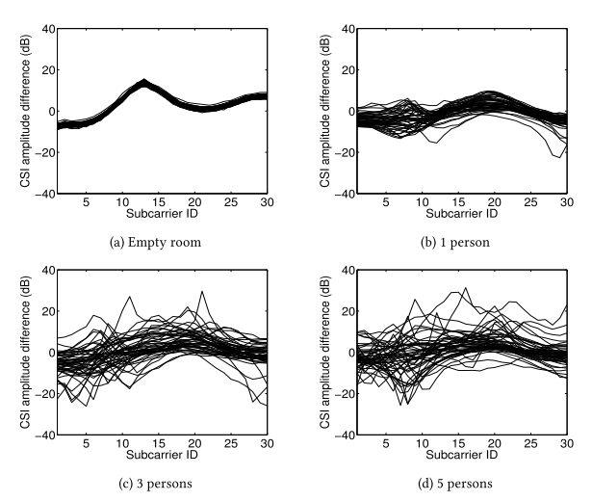
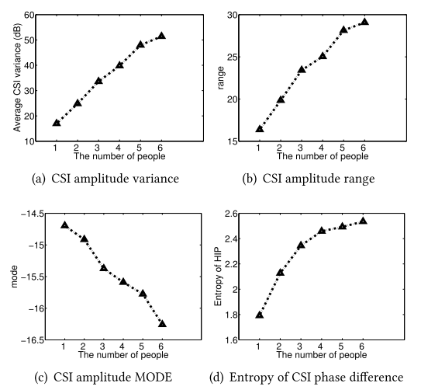
Semi-Supervised Participant Number Estimation
Derive the monotonic relationship
  Between the number of people and CSI statistical features
Feature Extraction
  Use the spatial diversity on the MIMO-enabled WiFi devices
  Extract features from the CSI difference between two antennas
  Features
    CSI amplitude variance
    CSI amplitude range
    CSI amplitude mode
    Entropy of HIP (Hermitian Inner Product)

Slide 13

Semi-Supervised Participant Number Estimation
Feature-based Non-linear Regression
  Formulate the relationship as a non-linear regression model
  Adopt the logistic bounded exponential function
    x: number of people
    a, b, c, d: parameters that control the growth rate and range of the function
  : number of people
  During training process, 4 parameters are derived
  a, b determine the shape and the offset of the model
  c, d determine the shape curvature
    Relatively stable across different environment

Slide 14
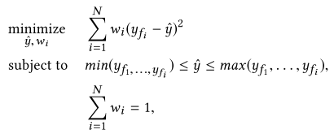
Semi-Supervised Participant Number Estimation
Feature-based Non-linear Regression
  Training sequence
    Collect CSI measurements under five scenarios
      Empty room, 1 to 4 people walking inside the area
    Extract features
    Fit the values into the equation to estimate the parameters
    Minimize the total estimation error produced by these N features
      y_{fi}: output from i^{th} feature, ŷ: fused estimate, w_{i}: weight (determined via experiments)

Slide 15
Semi-Supervised Participant Number Estimation
Feature-based Non-linear Regression
  Adapt at new environment
    Use a semi-supervised learning approach
    Estimate a and b in an empty room
      a and b determine the trend of CSI feature
      i.e., collecting CSI measurement at mid-night or the early morning
    CSI measurement in the empty room updates the model parameters
    Easily adapted to run at different locations with little training efforts

Slide 16


Semi-Supervised Participant Number Estimation
Data Fusion
  Ensure robustness and high accuracy
  Multiple Links
    Multiple transceiver links provide redundant dimensions on CSI collection
      F_{L}: fusion results from multiple links
      F_{Li}: output from the i^{th} link
      W_{Li}: empirical weight
      N_{L}: total number of links,

Slide 17



Semi-Supervised Participant Number Estimation
Data Fusion
  Multiple Channels
    Choose three adjacent orthogonal channels for feature extraction
    CSI readings of a total of 90 subcarriers are collected by automatically switching channels
      F_{C}: fusion results from multiple links, F_{Ci}: output from the i^{th} link
      W_{Li}: empirical weight, N_{c}: total number of channels,
  Combine Equation
    Fusion result
    Use even weight in prototype

Slide 18
Human Density Estimation
Estimate the people density distribution within the area
Training phase
  Divide the monitoring area into four regions
  Construct the profile database for each region with the number of people
Monitoring phase
  Collects CSI and calculates the variance distribution across all subcarriers
  Perform similarity matching by applying the Earth Move Distance (EMD)
    Well-know approach for evaluating the similarity between two probability distributions
    Calculates the minimal cost to transform one distribution into the other
  Derive the EMD by comparing the CSI variance distribution with the profile
    Profile: Available distributions with the area and the number of people
  Identify one of the profile with the minimal cost

Slide 19
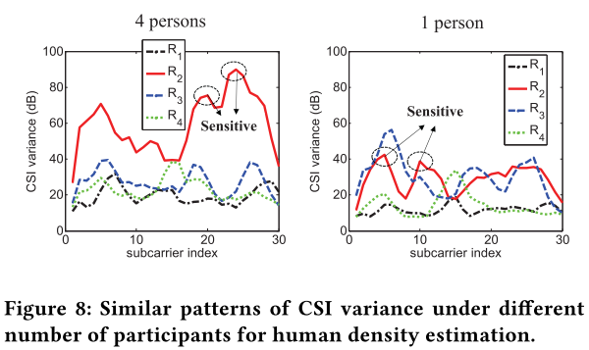
Human Density Estimation
Reduce the labor-extensive profiling process
  Profiles built from a fixed number of people would be enough
  Define sensitive subcarrier
    Its neighbors have lower variance
    Location-dependent, regardless of the number of people and only the value is different
  Profiles have the same series of sensitive subcarriers despite the # person
  Reduce the training size

Slide 20
Walking speed derivation
Total harmonic distortion (THD*) based method
  Achieve accurate speed estimation from CSI readings
  Power level decreases as the working speed increases
Preprocessing
  Subtract the mean value of relative phase from the relative phase across 30 subcarriers
  Identify the periods that capture the walking characteristics of people
  Adopt hypothesis test
    Compare the CSI energy level within a sliding window with a predefined threshold
    If the energy level is constantly below the threshold, marked as a static
  Apply both Butterworth filter and moving average filter
    Environmental impact be effectively removed
*THD is traditionally used to characterize the linearity of audio systems and the power quality of electric power systems

Slide 21
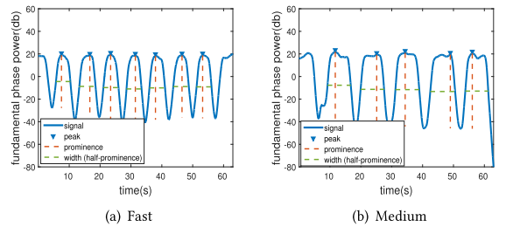
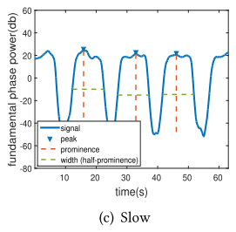
Walking speed derivation
THD analysis
  Performs walking speed estimation
    Walking steps create periodic impacts on the wireless channel
  Extracts the fundamental signal
  Estimation parameter e = h x w
    h: prominence, w: width
  e has a monotonic relationship

Slide 22

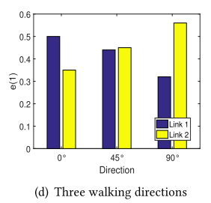
Walking direction estimation
FFT-based algorithm
  Segment CSI measurement using a fixed time window (3~5 seconds)
  Define the frequency distribution
    e(n): frequency distribution of the nth output f_{n} from the FFT operation
    f_{n}: frequency bin (sub-band)
  A volunteer walks three directions
    parallel to link 2 (0˚), walking across both links(45˚),
    and parallel to link 1(90˚)
  e(1) affects more by direction changes than the other bins
    Locates at the lower frequency band

Slide 23
Walking direction estimation
Enhance accuracy using SVM model
  CSI variance
    Fast speed in one direction causes low CSI variance
    Low speed causes high CSI variation
  Uses both CSI frequency distribution and variance on two perpendicular wireless links
  Trains and classifies the walking direction based on the pre-built walking direction profiles
Focus on estimating a single person’s walking direction

Slide 24
Evaluation
System prototype
  Implement on two pairs of laptops equipped with Intel 5300 802.11n NIC
  Both transmitters are configured to transmit packets at 100 pkt/sec
  Work at different WiFi channel to avoid conflicts
  Receivers work at Monitor mode
    Capture and decode the 802.11 frames
    Extract CSI values

Slide 25
Evaluation
Experimental methodology
  Conduct the experiments
    At 5 different indoor venues
    Over a 12-month time period
    With 10 volunteers
    Collect about 10GB CSI data
  Use the channel at both 2.4GHz and 5GHz

Slide 26
Evaluation
Experimental methodology
  Participants and human density estimation
    Conduct at three different indoor scenarios
      Activities room (Location A, 16m X 10m)
      Meeting room (Location B, 13m X 7m)
      Classroom (Location C, 12m X 5m)
    Collect and process over 100 hours of CSI measurements with 10 volunteers
  Walking speed and direction derivation
    THD-based speed estimation algorithm
      Collect 1,296 different walking traces of 4 people
      Two different classroom environments (7m X 6m, small classroom & 12m X 6m, big classroom)
      3 speed level: fast (1.33m/sec), medium (1m/sec) and slow (0.67m/sec)
    Classification based walking direction
      286 experimental samples of 3 people in 3 different directions (0˚, 45˚, 90˚)

Slide 27
Evaluation
Evaluation metrics
  Participant estimation accuracy
    Ratio between the correct instances of participant estimation and the total number of instances
  Human density accuracy
    Ratio between the number of correctly profiles matching and the total number of experiments
  Walking speed and direction accuracy
    Percentage of the correct classification results

Slide 28
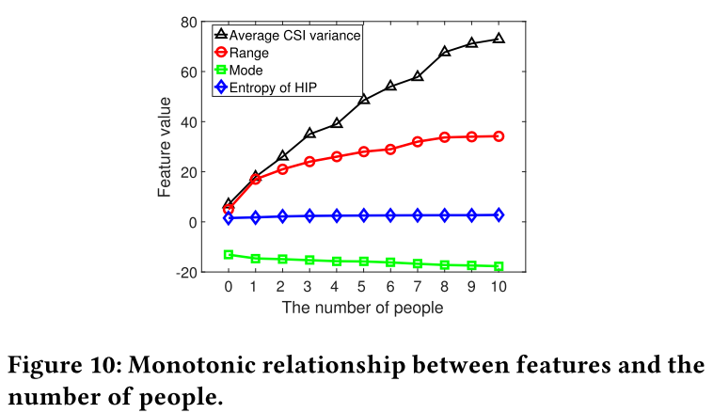
Evaluation
The number of participants estimation
  Non-linear model construction
    Identify the relationship between the number of people and the features from CSI
    All feature monotonically increases or decreases as the number of people increase

Slide 29
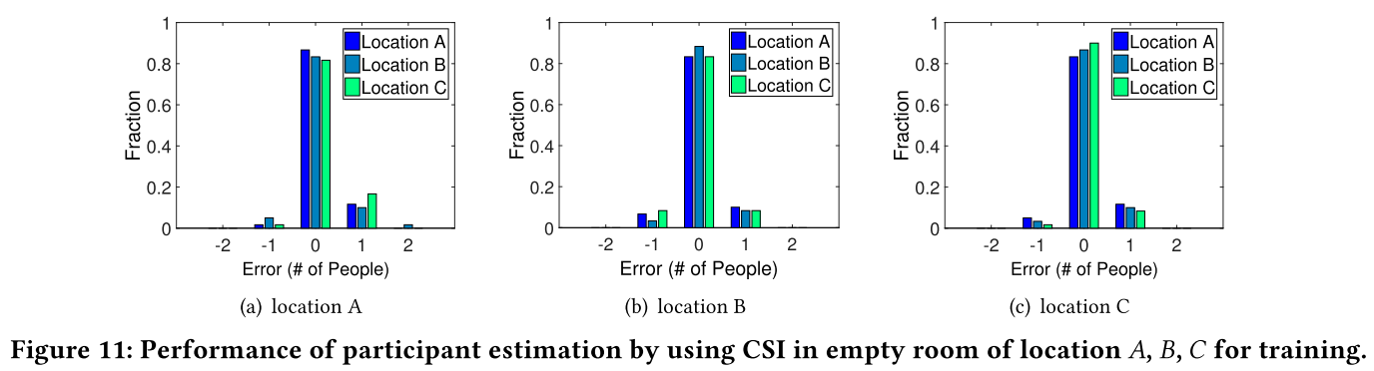
Evaluation
The number of participants estimation
  Semi-supervised learning approach
    Model built upon the CSI profiles at the three different rooms
    Use the model at the same room
      All the rooms have high accuracy (90%, 89%, 91%)
    Use the model at the different room
      Estimation accuracy over 80% even without training

Slide 30
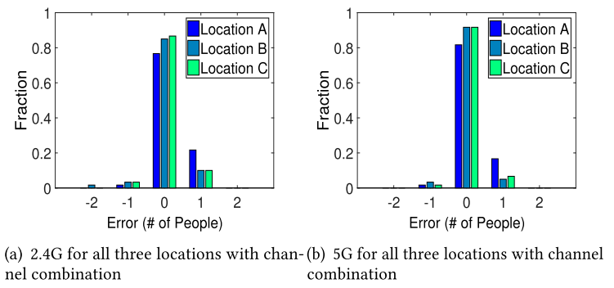
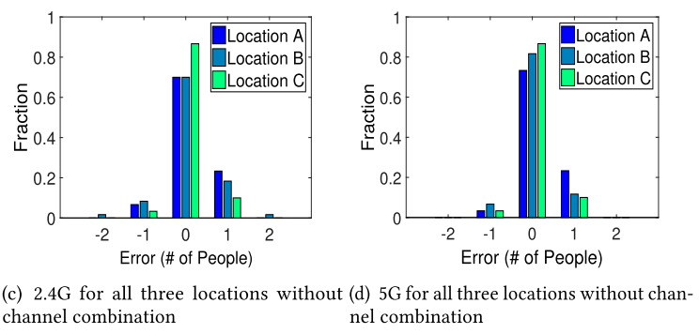
Evaluation
The number of participants estimation
  Data fusion
    Multiple frequency bands
      Overall accuracy at 5GHz outperforms that at 2.4GHz
      Due to the poor link quality at 2.4GHz
    Multiple channels
      Combine the three adjacent orthogonal channels (1, 6, 11 at 2.4GHz and 40, 44, 48 at 5GHz)
      Using more channels improves the performance up to 8%

Slide 31
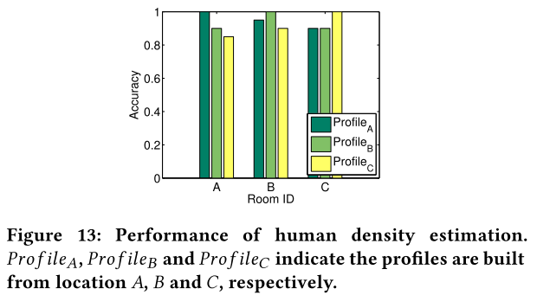
Evaluation
Human density estimation
  Different indoor environments
    Conduct experiments at three different indoor environments
    Steps
      Divide the space of each indoor environment into four regions
      Volunteers move at different regions forming different density distributions
      Collect corresponding CSI measurements (testing data) to compare with predefined CSI profiles (training data)
    Results
      100% accuracy in the same room
      Maintain a high accuracy over 80% in the different room

Slide 32
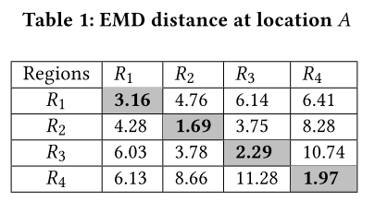
Evaluation
Human density estimation
  Different number of people
    Profiles built upon 3 people in each sub-region and use 4 during the testing phase
    Each cell contains the EMD distance value between the profile (column) and possible candidate (row)
    Minimum distance appears in the diagonal of the table

Slide 33
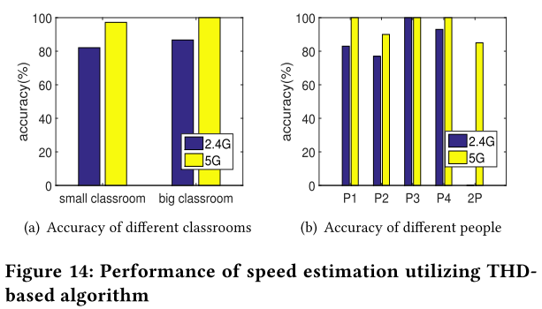
Evaluation
Walking speed estimation
  Average accuracy at 5GHz outperforms that at 2.4GHz
    Due to the heavy interferences at 2.4GHz
  Average accuracy in the big classroom is better than in the small classroom
    Due to less multi-path impacts
  Accuracy of different participants
    2 participants as a group is lower than 1 person
    P2 is lower than others
      When the speed increases, the step frequency
      does not change

Slide 34
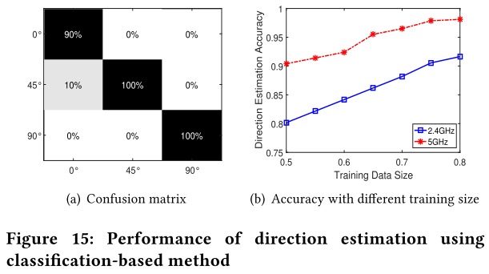
Evaluation
Walking direction derivation
  Achieve an average accuracy of 96.6% for the three walking direction
  The direction estimation performance improves with the number of training size

Slide 35
Conclusion
Human dynamic monitoring system
  Provide a comprehensive view of the human dynamic information using the prevalent WiFi signals
  Use low-cost and device-free approach
  Estimate the human dynamic information using CSI
    Number of participants
    Human density
    People walking speed and direction

Slide 36
Critique
Pros
  CSI 정보만을 통해 사람의 수와 밀도, 움직임을 구함
  각각을 요양시설과 건물관리 등의 유즈케이스에 잘 적용함
Cons
  Feature 추출의 이유와, 몇 실험의 지표 설명이 없음
  12달의 긴 시간 동안 실험을 진행했는데, 오차가 80%~90% 나타남
  방향의 예측 범위가 한정적이고, 사람의 방향과 속도를 예측하는 데는 확장성 문제

Slide 37
Thank you!

