Slide 1

Chapter 2
Network
Models
Copyright © The McGraw-Hill Companies, Inc. Permission required for reproduction or display.

Slide 2
Chapter 2: Outline
2.1 Protocol Layering
2.2 TCP/IP Protocol Suite
2.3 OSI Model

Slide 3
    2-1 PROTOCOL LAYERING
A word we hear all the time when we talk about the Internet is protocol. A protocol defines the rules that both the sender and receiver and all intermediate devices need to follow to be able to communicate effectively. When communication is simple, we may need only one simple protocol; when the communication is complex, we need a protocol at each layer, or protocol layering.

Slide 4
2.1.1 Scenarios
Let us develop two simple scenarios to better understand the need for protocol layering.
In the first scenario, communication is so simple that it can occur in only one layer.
In the second, the communication between Maria and Ann takes place in three layers.

Slide 5
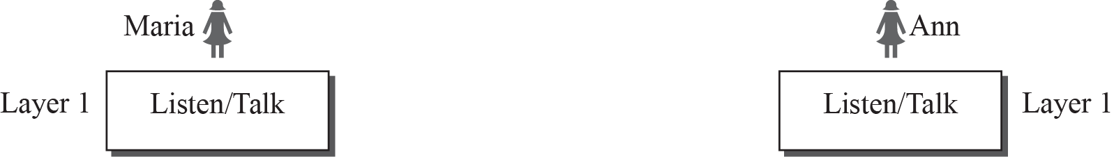
Figure 2.1: A single-layer protocol

Slide 6
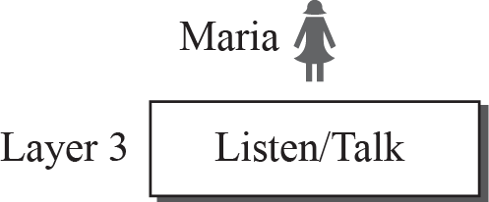
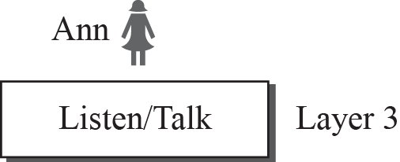
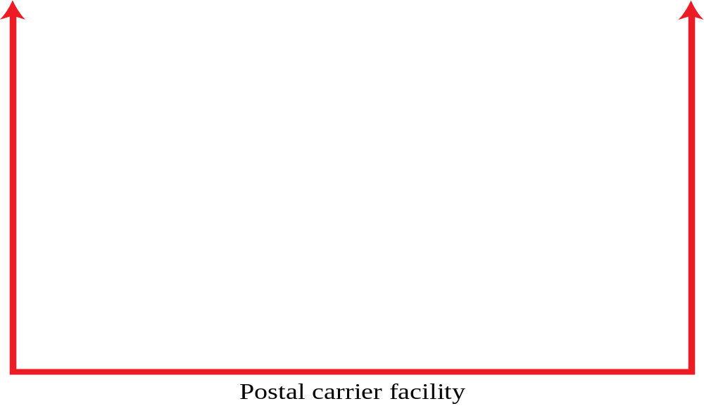

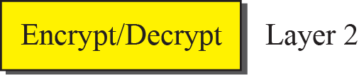
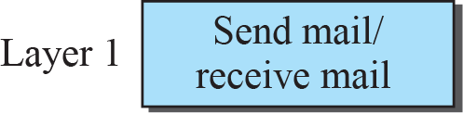
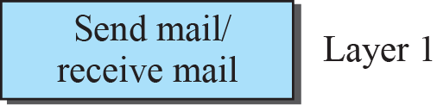
Figure 2.2: A three-layer protocol

Slide 7
2.1.2 Principles of Protocol Layering
Let us discuss two principles of protocol layering.
The first principle dictates that if we want bidirectional communication, we need to make each layer so that it is able to perform two opposite tasks, one in each direction.
The second principle that we need to follow in protocol layering is that the two objects under each layer at both sites should be identical.

Slide 8
2.1.3 Logical Connections
After following the above two principles, we can think about logical connection between each layer as shown in Figure 2.3. This means that we have layer-to-layer communication. Maria and Ann can think that there is a logical (imaginary) connection at each layer through which they can send the object created from that layer. We will see that the concept of logical connection will help us better understand the task of layering we encounter in data communication and networking.

Slide 9
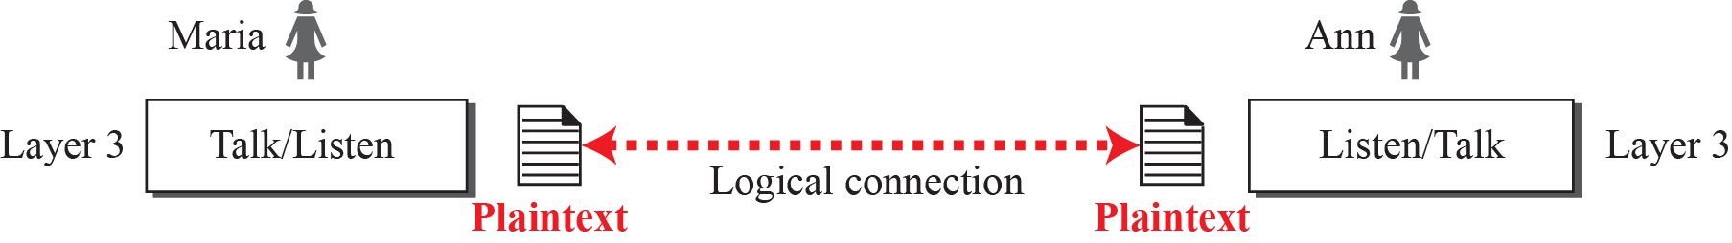
Figure 2.3: Logical connection between peer layers

Slide 10
    2-2 TCP/IP PROTOCOL SUITE
A word we hear all the time when we talk about the Internet is protocol. A protocol defines the rules that both the sender and receiver and all intermediate devices need to follow to be able to communicate effectively. When communication is simple, we may need only one simple protocol; when the communication is complex, we need a protocol at each layer, or protocol layering.

Slide 11
Figure 2.4: Layers in the TCP/IP protocol suite

Slide 12
2.2.1 Layered Architecture
To show how the layers in the TCP/IP protocol suite are involved in communication between two hosts, we assume that we want to use the suite in a small internet made up of three LANs (links), each with a link-layer switch. We also assume that the links are connected by one router, as shown in Figure 2.5.

Slide 13
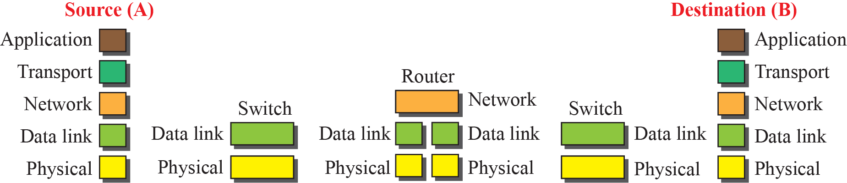
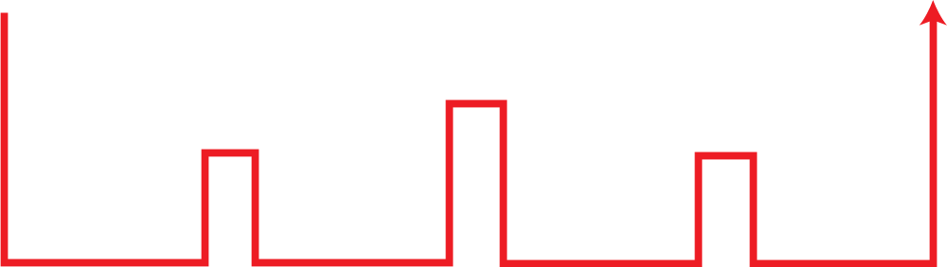
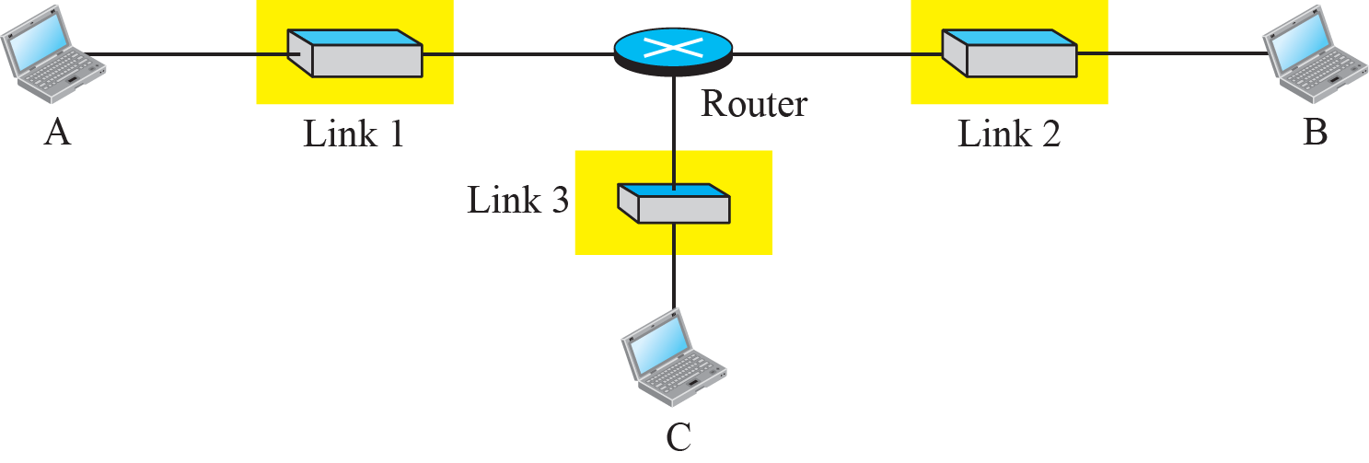
Figure 2.5: Communication through an internet

Slide 14
2.2.2 Layers in the TCP/IP Protocol Suite
After the above introduction, we briefly discuss the functions and duties of layers in the TCP/IP protocol suite. Each layer is discussed in detail in the next five parts of the book. To better understand the duties of each layer, we need to think about the logical connections between layers. Figure 2.6 shows logical connections in our simple internet.

Slide 15
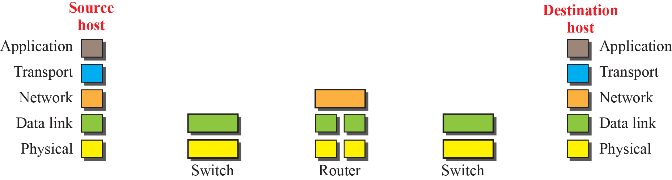
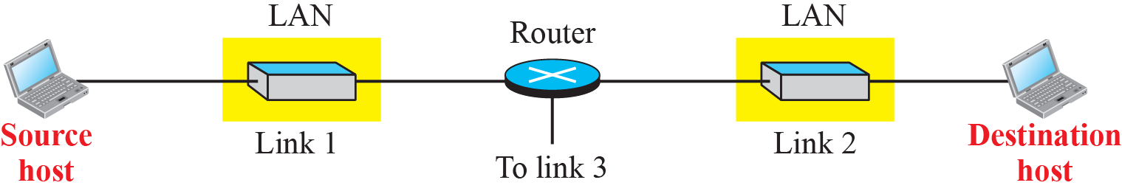
Figure 2.6: Logical connections between layers in TCP/IP
Logical connections

Slide 16
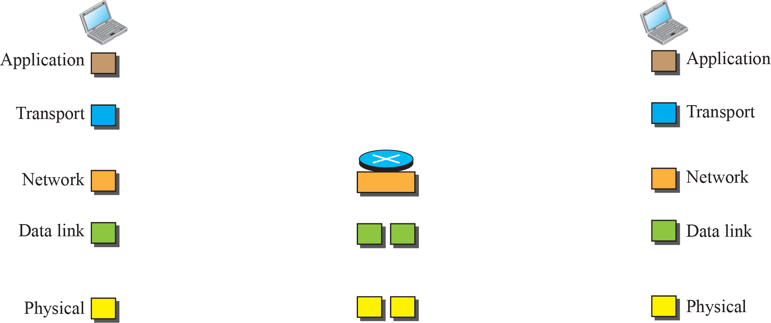
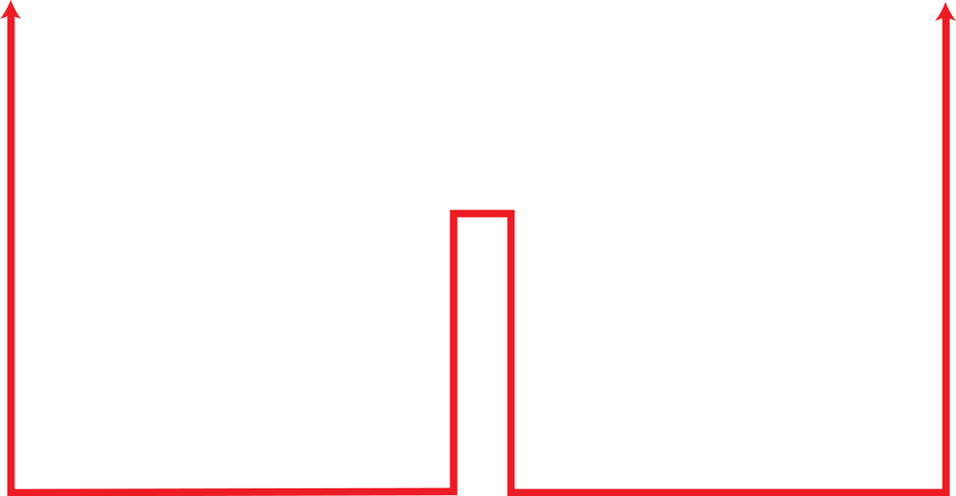
Figure 2.7: Identical objects in the TCP/IP protocol suite
Identical objects (messages)
Identical objects (segment or user datagram)
Identical objects (datagram)
Identical objects (datagram)
Identical objects (frame)
Identical objects (frame)
Identical objects (bits)
Identical objects (bits)

Slide 17
2.2.3 Description of Each Layer
After understanding the concept of logical communication, we are ready to briefly discuss the duty of each layer. Our discussion in this chapter will be very brief, but we come back to the duty of each layer in next five parts of the book.

Slide 18
2.2.4 Encapsulation and Decapsulation
One of the important concepts in protocol layering in the Internet is encapsulation/ decapsulation. Figure 2.8 shows this concept for the small internet in Figure 2.5.

Slide 19
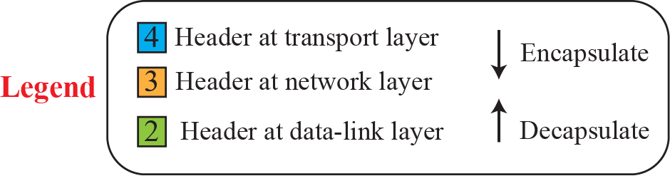
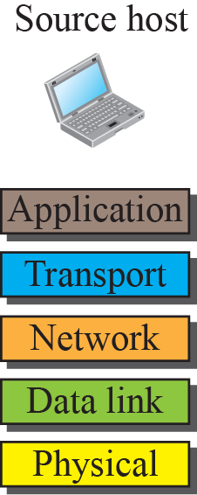
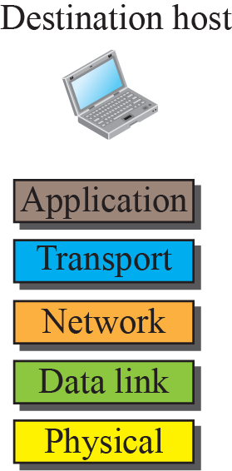
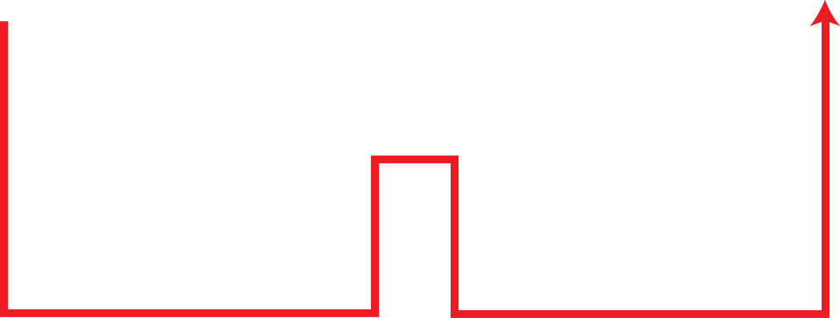
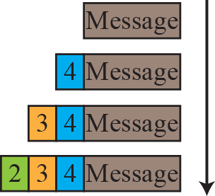
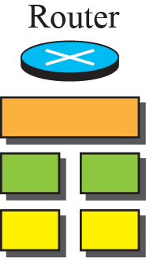
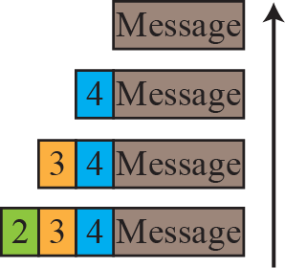
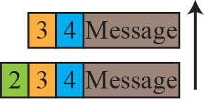
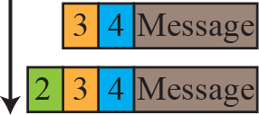
Figure 2.8: Encapsulation / Decapsulation

Slide 20
2.2.5 Addressing
It is worth mentioning another concept related to protocol layering in the Internet, addressing. As we discussed before, we have logical communication between pairs of layers in this model. Any communication that involves two parties needs two addresses: source address and destination address. Although it looks as if we need five pairs of addresses, one pair per layer, we normally have only four because the physical layer does not need addresses; the unit of data exchange at the physical layer is a bit, which definitely cannot have an address.

Slide 21


Figure 2.9: Addressing in the TCP/IP protocol suite

Slide 22
2.2.6 Multiplexing and Demultiplexing
Since the TCP/IP protocol suite uses several protocols at some layers, we can say that we have multiplexing at the source and demultiplexing at the destination. Multiplexing in this case means that a protocol at a layer can encapsulate a packet from several next-higher layer protocols (one at a time); demultiplexing means that a protocol can decapsulate and deliver a packet to several next-higher layer protocols (one at a time). Figure 2.10 shows the concept of multiplexing and demultiplexing at the three upper layers.

Slide 23
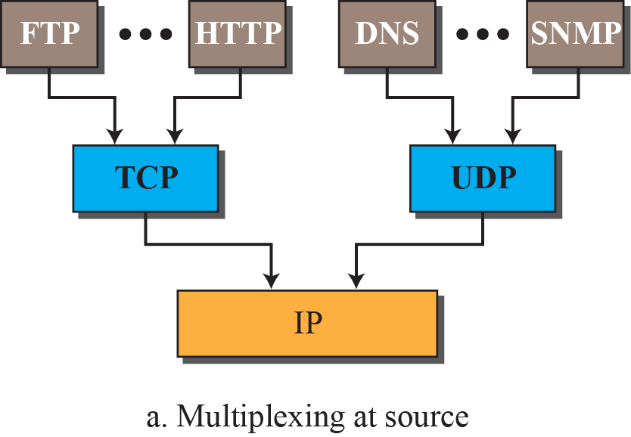
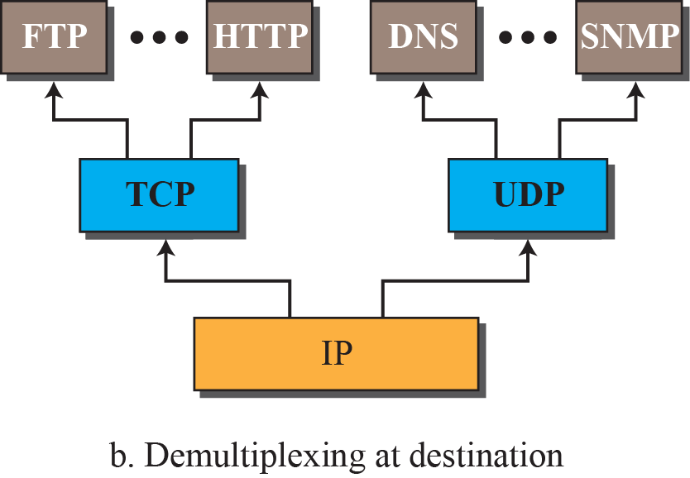
Figure 2.10: Multiplexing and demultiplexing

Slide 24
    2-3 OSI MODEL
A word we hear all the time when we talk about the Internet is protocol. A protocol defines the rules that both the sender and receiver and all intermediate devices need to follow to be able to communicate effectively. When communication is simple, we may need only one simple protocol; when the communication is complex, we need a protocol at each layer, or protocol layering.

Slide 25
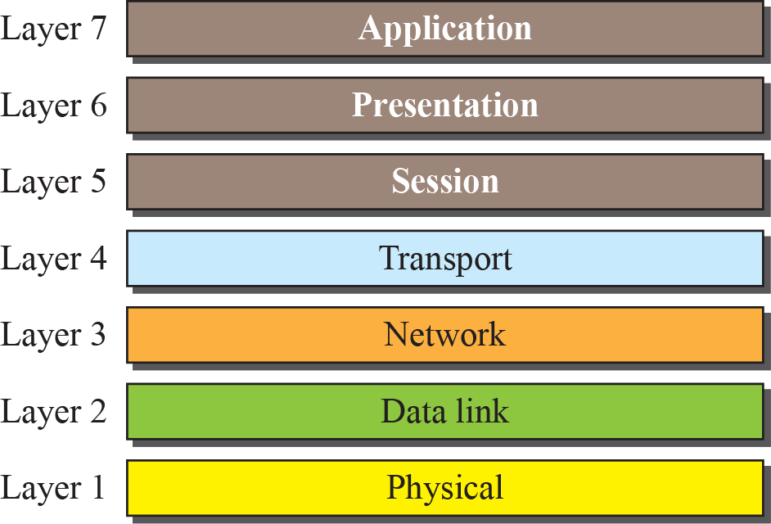
Figure 2.11: The OSI model

Slide 26
2.3.1 OSI versus TCP/IP
When we compare the two models, we find that two layers, session and presentation, are missing from the TCP/IP protocol suite. These two layers were not added to the TCP/IP protocol suite after the publication of the OSI model. The application layer in the suite is usually considered to be the combination of three layers in the OSI model, as shown in Figure 2.12.

Slide 27
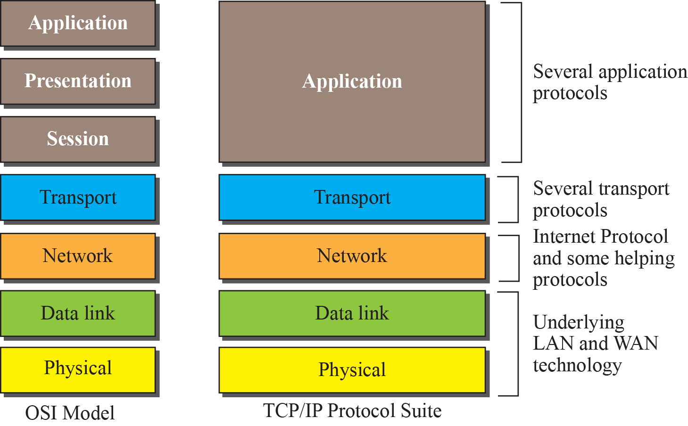
Figure 2.12: TCP/IP and OSI model

Slide 28
2.3.2 Lack of OSI Model’s Success
The OSI model appeared after the TCP/IP protocol suite. Most experts were at first excited and thought that the TCP/IP protocol would be fully replaced by the OSI model. This did not happen for several reasons, but we describe only three, which are agreed upon by all experts in the field.

