Slide 1
Section 5.3: IPv6 Extension Headers
이상욱
2014010243

Slide 2
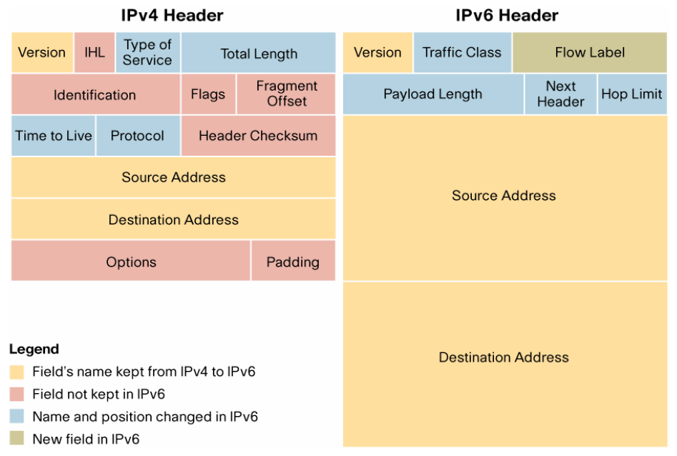
IPv4 and IPv6 Headers

Slide 3
IPv6 Extension Header
Special functions of IP
  Router alert, Source routing, Fragmentation, …
IPv6 provides a more flexible and extensible way of incorporating extensions and options as compared to IPv4
In IPv6, Special functions such as those provided by options in IPv4 can be enabled by adding extension headers that follow the IPv6 header

Slide 4
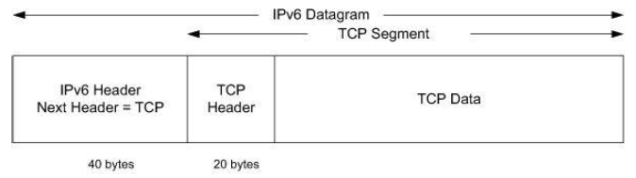
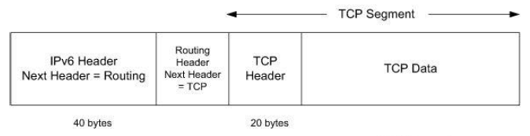
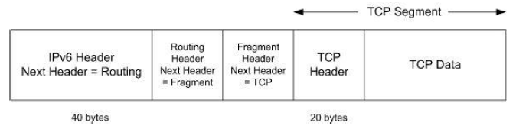
IPv6 Extension Header
Extension headers are chained together with the IPv6 header

Slide 5
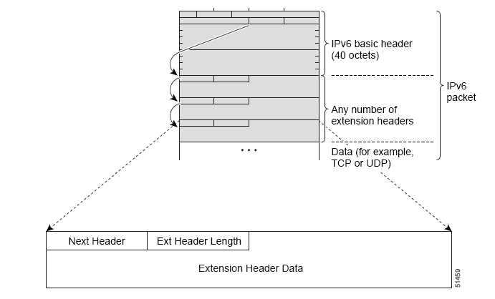
IPv6 Extension Header
The next header field indicates the type of the subsequent header

Slide 6
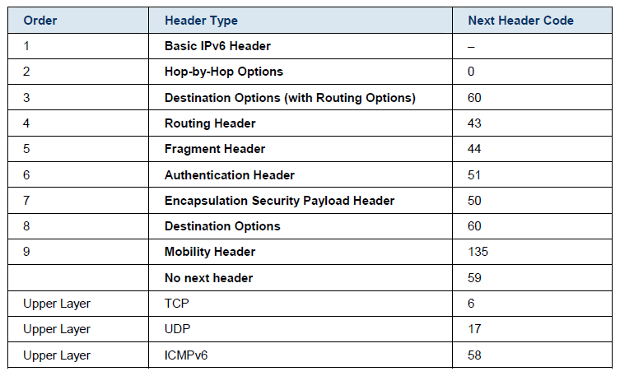
IPv6 Extension Header
Extension headers and order in a packet

Slide 7
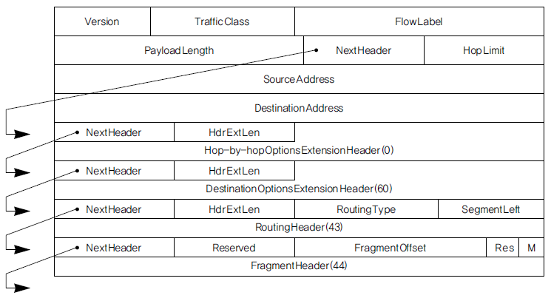
3.5.1 IPv6 Options
Two option extention headers
  Hop-by-Hop Extension Header (Type 0)
    Those relevant to every router along a datagram’s path
  Destination Extension Header (Type 60)
    Those relevant only to the recipient

Slide 8
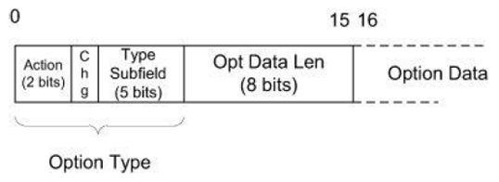
3.5.1 IPv6 Options
Header format
Option Type Subfileds
  Action (2 bits)
    - Unrecognized option action
  Change (1 bit)
    - Option change allowed flag
  Type subfield (5 bits)
    - Remainder of option type

Slide 9
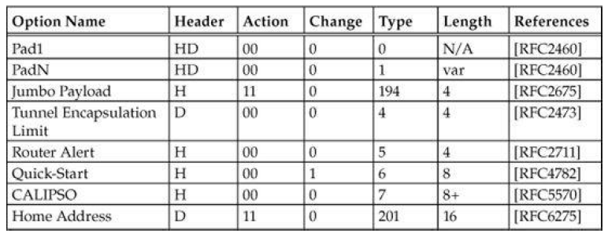

3.5.1 IPv6 Options
Types

Slide 10
3.5.2 Routing Header
Routing extention header
  Provides a mechanism for the sender of an IPv6 datagram to control, at least in part, the path the datagram takes through the network
  Loose source routing / Strict source routing

Slide 11
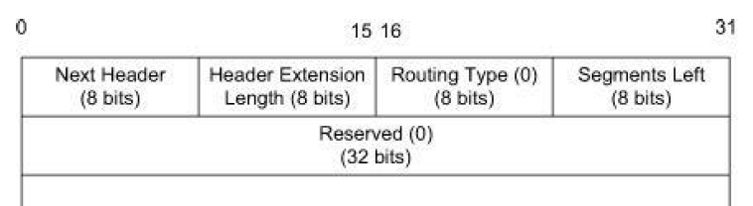
3.5.2 Routing Header
Header format
  Routing type
    0 : Type 0 (RH0)
      Deprecated because of security concerns
    2 : Type 2 (RH2)
      Defined in conjunction with Mobile IP
  Segment left
    Indicates how many route segments remain to be processed
    The number of explicitly listed intermediate nodes still to be visited before reaching the final destination

Slide 12
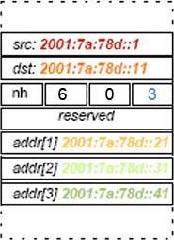
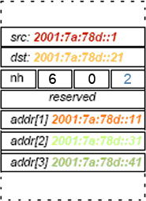
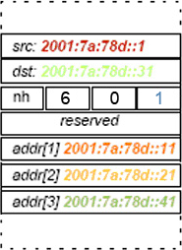
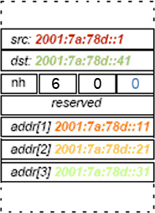
3.5.2 Routing Header
Example

Slide 13
3.5.3 Fragment Header
Fragment extension header
  Used by an IPv6 source when sending a datagram larger than the path MTU of the datagram’s intended destination

Slide 14
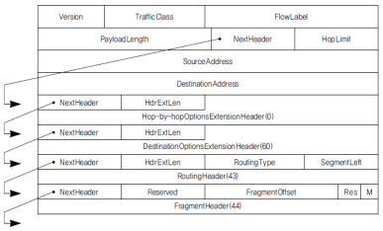
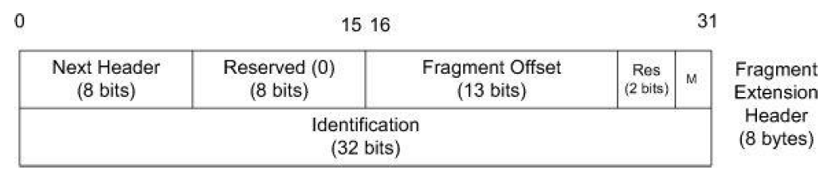
3.5.3 Fragment Header
Header format
  Fragment Offset
    The offset of the payload into the original datagram in 8-byte units
  M(ore fragments)
    A value of 1 indicates that there are the next fragment
    A value of 0 indicates that the fragment is the last

Slide 15
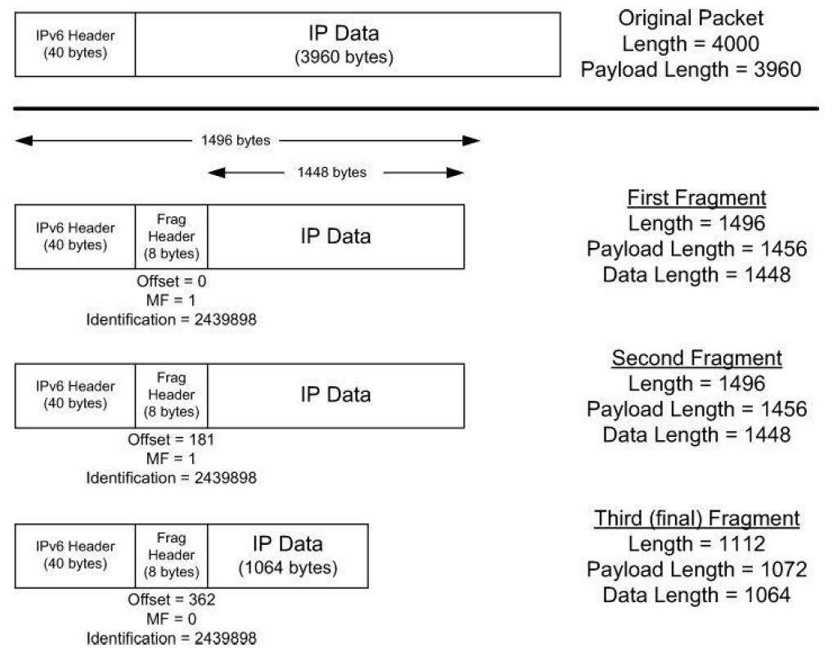
3.5.3 Fragment Header
Example

