Slide 1
10.1 Introduction
UDP is a simple, datagram-oriented, transport-layer protocol that preserves message boundaries
It does not provide error correction, sequencing, duplicate elimination, flow control, or congestion control
  It can provide error detection
  There is no protocol mechanism to prevent high-rate UDP traffic from negatively impacting other network users
  Applications using it have a great deal of control over how packets are sent and processed
  Applications wishing to ensure that their data is reliably delivered or sequenced must implement these protections themselves
Generally, each UDP output operation requested by an application produces exactly one UDP datagram
  Causes one IP datagram to be sent

Slide 2
10.1 Introduction
RFC768 is the official specification of UDP, and it has remained as a standard without significant revisions for more than 30 years
Because of its connectionless character, it has less overhead than other transport protocols
Broadcast and multicast operations are much more straightforward using a connectionless transport such as UDP
Finally, the ability of an application to choose its own unit of retransmission can be an important consideration

Slide 3
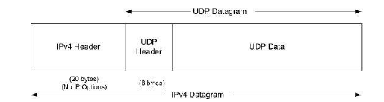
10.1 Introduction
IPv4 Protocol field has the value 17 to indicate UDP
IPv6 uses the same value in the Next Header field
When the size of the UDP datagram exceeds the MTU size, the datagram must be fragmented into more than one IP-layer packet

