Slide 1
4.5: ARP Examples
박준영
2014020853

Slide 2
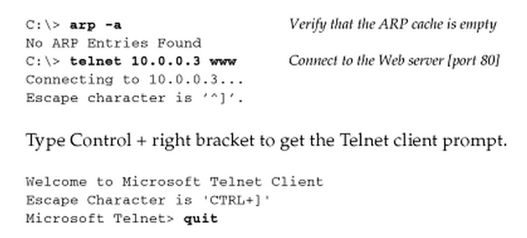
Examples
Two scenarios
  Normal example
  ARP request to a nonexistent host
Tcpdump command to see what happens with ARP
While executing a TCP/IP utility, Telnet

Slide 3
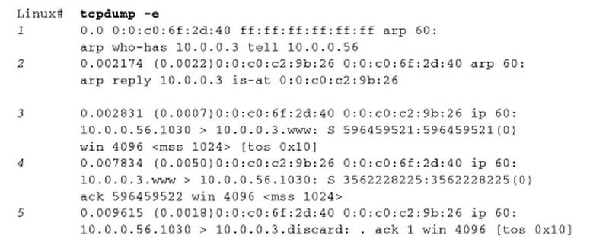
Normal example
Tcpdump command to observe the traffic exchanged

Slide 4
Normal example
0:0:c0:6f:2d:40
  source H/W addr
ff:ff:ff:ff:ff:ff
  destination H/W addr
  Ethernet broadcast address
arp
  Frame Type field is 0x0806
  Either ARP request or reply
60
  Length of the Ethernet frame
  ARP request or reply is always 42 bytes (14 B header + 28 B)
  Frame is padded to the Ethernet minimum, 60 bytes
arp who-has 10.0.0.3 tell 10.0.0.56
  ARP request

Slide 5
Normal example
Arp reply
  Destination address is unicast MAC address
  0:0:c0:6f:2d:40
First TCP segment requesting for a connection
  Destination host’s H/W address obtained through ARP is used
  Details in Chapter 13

Slide 6
Normal example
Relative time (in seconds)
Time difference (in seconds)
ARP request and reply took about 2.2ms
The first TCP segment is sent 0.7ms after this
Thus, the overhead using ARP is less than 3ms
Note that we don’t see an ARP request from 10.0.0.3
  Normally when a system receives an ARP request, it saves the requestor’s hardware address and IP address in ARP cache

Slide 7


ARP request to a nonexistent host
What if the host specified in an ARP request is down or nonexistent?
ARP request is sent every 1 second
  Suggested by [RFC1122]
It depends on the system, protocols being used

