Slide 1
8.3 ICMP Error Messages
2015010662
이재혁

Slide 2
What is ICMP Error Message?
To report some problems to senders as a message format when problems occur on transmission of IP datagrams

Slide 3
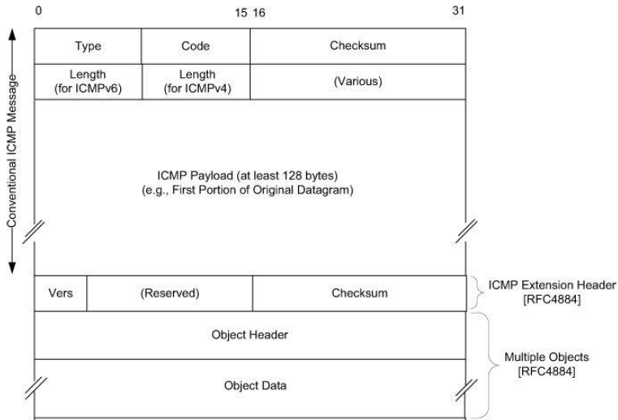
ICMP Error message’s structure

Slide 4
ICMP messages structure
Type : message types
Code : options for type field
Checksum : to confirm that messages arrived well, RFC792 algorithms are used
Length(for ICMPv4/ICMPv6) : indicates the offending datagram size in 32bit word units/in 64bit word units
Plus, some data which is specific to the message type indicated by type and code field (various)
In addition, any other data from the original datagram’s IP payload area (at least 128 bytes)

Slide 5
Exceptions of ICMPv4 Error Messages
It does not regenerated for the generated ICMPv4 error messages on delivery process
If the destination address is broadcast or multicast address
If the sender address is zero address, a loopback, broadcast or multicast address
A fragment other than the first
A datagram sent as a link layer broadcast

Slide 6
Exceptions of ICMPv6 Error Messages
It does not regenerated for the generated ICMPv6 error messages on delivery process
If the sender address is zero address, a loopback, broadcast or multicast address
A datagram sent as a link layer broadcast and multicast
  Exceptions
    Packet Too Big (PTB)
    Parameter Problem message (code 2)

Slide 7
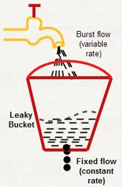
Rate-limiting ICMP messages
Token bucket
CIR : Committed Information Rate (bps)
Bc : Conformed Burst Size (bits)
Be : Excess Burst Size (bits)
Tc : Time Interval (ms)
CIR
token
Bc

Slide 8
Example of Token Bucket
Assumption
  CIR = 64,000bps, Bc = Be = 9,600bits, Tc = 150ms
  => Bucket = Bc + Be = 19,200bits
Tc(0) : data(0) = 6,000, bucket(0) = 9,600
data is sent, remains 9,600-6,000=3,600
Tc(1) : data(1) = 6,000, bucket(1) = 3,600+9,600=13,200
data is sent, remains 13,200-6,000=7,200
Tc(2) : data(2) = 0, bucket(2) = 16,800(7,200+9,600)
Tc(3) : data(3) = 19,200, bucket(3) = 19,200(16,800+9,600=26,400)
7,200 was dropped, data is sent, remains 19,200-19,200=0
Tc(4) : data(4) = 12,800, bucket(4) = 9,600
just 9,600 data is sent, remaining data will send next
Tc(5) : data(5) = 800+3,200, bucket(5) = 9,600
data is sent, remains 9,600-4,000=5,600

Slide 9
Main Error Messages of ICMP
Destination Unreachable (ICMPv4 type 3, ICMPv6 type 1)
Redirect (ICMPv4 type 5, ICMPv6 type 137)
Time Exceeded (ICMPv4 type 11, ICMPv6 type 3)
Parameter Problem (ICMPv4 type 12, ICMPv6 type 4)
Packet Too Big (ICMPv6 type 2)

Slide 10
Destination Unreachable(1)
Host Unreachable(ICMPv4 code 1) & Address Unreachable(ICMPv6 code 3)
  This is generated by a router or host when an IP datagram is sent to a host but for some reason cannot reach the destination
  Ex. The last hop router is attempting to send an ARP to a host that is either missing or down
  For ICMPv6, this can be the result of a failure in the ND process(8.5 section)

Slide 11
Destination Unreachable(2)
Communication Administratively Prohibited(ICMPv4 code 13) & Communication with Destination Administratively Prohibited(ICMPv6 code 1)
  These messages provide the ability to indicate that an administrative prohibition is preventing successful communication with the destination
  The result of a firewall that intentionally drops traffic that fails to comply with some operational policy enforced by the router that sent the ICMP error

Slide 12
Destination Unreachable(3)
Port Unreachable(ICMPv4 code 3/ICMPv6 code 4)
  When an incoming datagram is destined for an application that is not ready to receive it
  Occurs most commonly in conjunction with UDP

Slide 13
Destination Unreachable(4)
Packet Too Big(PTB)(ICMPv4 code 4/ICMPv6 type 2 code 0)
  If an IPv4 router receives a datagram that it intends to forward, and if the datagram doesn’t fit into the MTU, the datagram must be fragmented
  If the arriving datagram’s ‘Don’t fragment’ field is set, it is not forwarded instead of dropping. And the Destination Unreachable (PTB) message is generated (for ICMPv4)
  Is used by the IPv6 PMTUD mechanism, and rare circumstances that a packet arrives that is too large to be carried over the next hop, because routes may change after the operation of PMTUD and after a packet is injected into the network (for ICMPv6)

Slide 14
Destination Unreachable(5)
No Route to Destination(ICMPv6 code 0)
  To differentiate the Host Unreachable message from ICMPv4 because of failure of direct delivery and those that cannot be reached because no route is present
  Is generated only in cases where an arriving datagram must be forwarded w/o using direct delivery, but where no route entry exists to indicate what router to use as a next hop

Slide 15
Destination Unreachable(6)
Beyond Scope of Source Address(ICMPv6 code 2)
  IPv6 uses addresses of different scopes
  It is possible to construct a packet with source & destination addresses of different scopes
  It is possible that the destination address may not be reachable within the same scope
  When a packet with a source address may be destined for a globally scoped destination that requires traversal of more than 1 router, if the source address is of insufficient scope, the packet is dropped
  Is produced to indicate such the problems

Slide 16
Destination Unreachable(7)
Source Address Failed Ingress/Egress Policy(ICMPv6 code 5)
  Is refined version of code 1, to be used when a particular ingress or egress filtering policy is the reason for prohibiting the successful delivery of a datagram
  When a host attempts to send traffic using a source IPv6 address from an unexpected network prefix

Slide 17
Destination Unreachable(8)
Reject Route to destination(ICMPv6 code 6)
  A reject/blocking route is a special routing/forwarding table entry, which indicates that matching packets should be dropped & an ICMPv6 Destination Unreachable Reject Route message should be generated

Slide 18
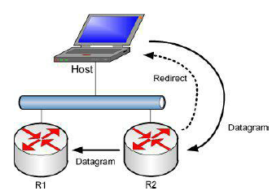
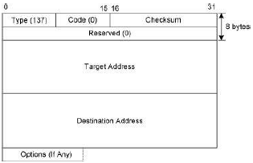
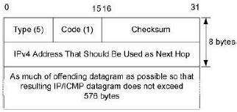
Redirect
If a router receives a datagram from a host & can determine that it is not the correct next hop, the router sends a Redirect message to the host & sends the datagram on to the correct router/host

Slide 19
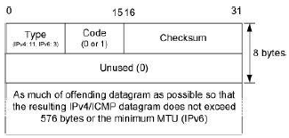
Time Exceeded
When a router discards a datagram because the TTL/Hop Limit field is too low
When a fragmented datagram only partially arrives at its destination, it is used to inform the sender that its overall datagram has been discarded

Slide 20
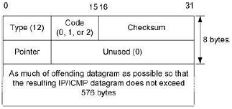
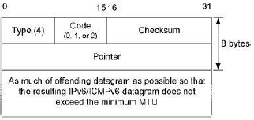
Parameter Problem
It is generated by a host/router receiving an datagram containing some problem in IP header that cannot be repaired

