Slide 1
Ad hoc and Sensor Networks
Chapter 1: Motivation & Applications
Holger Karl

Slide 2
Goals of this chapter
Give an understanding what ad hoc & sensor networks are good for, what their intended application areas are
Commonalities and differences
  Differences to related network types
Limitations of these concepts

Slide 3
Outline
Infrastructure for wireless?
(Mobile) ad hoc networks
Wireless sensor networks
Comparison

Slide 4


Infrastructure-based wireless networks
Typical wireless network: Based on infrastructure
  E.g., GSM, UMTS, …
  Base stations connected to a wired backbone network
  Mobile entities communicate wirelessly to these base stations
  Traffic between different mobile entities is relayed by base stations and wired backbone
  Mobility is supported by switching from one base station to another
  Backbone infrastructure required for administrative tasks
IP backbone
Further networks
Gateways
Server
Router

Slide 5
Infrastructure-based wireless networks – Limits?
What if …
  No infrastructure is available? – E.g., in disaster areas
  It is too expensive/inconvenient to set up? – E.g., in remote, large construction sites
  There is no time to set it up? – E.g., in military operations

Slide 6
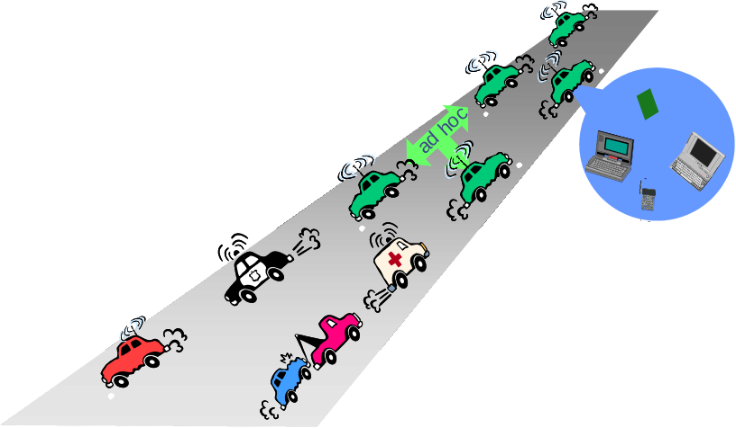











Possible applications for infrastructure-free networks
Factory floor automation
Disaster recovery
Car-to-car communication
Military networking: Tanks, soldiers, …
Finding out empty parking lots in a city, without asking a server
Search-and-rescue in an avalanche
Personal area networking (watch, glasses, PDA, medical appliance, …)
…

Slide 7
Outline
Infrastructure for wireless?
(Mobile) ad hoc networks
Wireless sensor networks
Comparison

Slide 8


Solution: (Wireless) ad hoc networks
Try to construct a network without infrastructure, using networking abilities of the participants
  This is an ad hoc network – a network constructed “for a special purpose”
Simplest example: Laptops in a conference room –
a single-hop ad hoc network

Slide 9
Problems/challenges for ad hoc networks
Without a central infrastructure, things become much more difficult
Problems are due to
  Lack of central entity for organization available
  Limited range of wireless communication
  Mobility of participants
  Battery-operated entities

Slide 10
No central entity ! self-organization
Without a central entity (like a base station), participants must organize themselves into a network (self-organization)
Pertains to (among others):
  Medium access control – no base station can assign transmission resources, must be decided in a distributed fashion
  Finding a route from one participant to another

Slide 11

Limited range ! multi-hopping
For many scenarios, communication with peers outside immediate communication range is required
  Direct communication limited because of distance, obstacles, …
  Solution: multi-hop network
?

Slide 12
Mobility ! Suitable, adaptive protocols
In many (not all!) ad hoc network applications, participants move around
  In cellular network: simply hand over to another base station
In mobile ad hoc networks (MANET):
  Mobility changes neighborhood relationship
  Must be compensated for
  E.g., routes in the network have to be changed
Complicated by scale
  Large number of such nodes difficult to support

Slide 13
Battery-operated devices ! energy-efficient operation
Often (not always!), participants in an ad hoc network draw energy from batteries
Desirable: long run time for
  Individual devices
  Network as a whole
! Energy-efficient networking protocols
  E.g., use multi-hop routes with low energy consumption (energy/bit)
  E.g., take available battery capacity of devices into account
  How to resolve conflicts between different optimizations?

Slide 14
Outline
Infrastructure for wireless?
(Mobile) ad hoc networks
Wireless sensor networks
  Applications
  Requirements & mechanisms
Comparison

Slide 15
Wireless sensor networks
Participants in the previous examples were devices close to a human user, interacting with humans
Alternative concept:
Instead of focusing interaction on humans, focus on interacting with environment
  Network is embedded in environment
  Nodes in the network are equipped with sensing and actuation to measure/influence environment
  Nodes process information and communicate it wirelessly
! Wireless sensor networks (WSN)
  Or: Wireless sensor & actuator networks (WSAN)

Slide 16




WSN application examples
Disaster relief operations
  Drop sensor nodes from an aircraft over a wildfire
  Each node measures temperature
  Derive a “temperature map”
Biodiversity mapping
  Use sensor nodes to observe wildlife
Intelligent buildings (or bridges)
  Reduce energy wastage by proper humidity, ventilation, air conditioning (HVAC) control
  Needs measurements about room occupancy, temperature, air flow, …
  Monitor mechanical stress after earthquakes

Slide 17
WSN application scenarios
Facility management
  Intrusion detection into industrial sites
  Control of leakages in chemical plants, …
Machine surveillance and preventive maintenance
  Embed sensing/control functions into places no cable has gone before
  E.g., tire pressure monitoring
Precision agriculture
  Bring out fertilizer/pesticides/irrigation only where needed
Medicine and health care
  Post-operative or intensive care
  Long-term surveillance of chronically ill patients or the elderly

Slide 18
WSN application scenarios
Logistics
  Equip goods (parcels, containers) with a sensor node
  Track their whereabouts – total asset management
  Note: passive readout might suffice – compare RF IDs
Telematics
  Provide better traffic control by obtaining finer-grained information about traffic conditions
  Intelligent roadside
  Cars as the sensor nodes

Slide 19
Roles of participants in WSN
Sources of data: Measure data, report them “somewhere”
  Typically equip with different kinds of actual sensors
Sinks of data: Interested in receiving data from WSN
  May be part of the WSN or external entity, PDA, gateway, …
Actuators: Control some device based on data, usually also a sink

Slide 20
Structuring WSN application types
Interaction patterns between sources and sinks classify application types
  Event detection: Nodes locally detect events (maybe jointly with nearby neighbors), report these events to interested sinks
    Event classification additional option
  Periodic measurement
  Function approximation: Use sensor network to approximate a function of space and/or time (e.g., temperature map)
  Edge detection: Find edges (or other structures) in such a function (e.g., where is the zero degree border line?)
  Tracking: Report (or at least, know) position of an observed intruder (“pink elephant”)

Slide 21
Deployment options for WSN
How are sensor nodes deployed in their environment?
  Dropped from aircraft ! Random deployment
    Usually uniform random distribution for nodes over finite area is assumed
    Is that a likely proposition?
  Well planned, fixed ! Regular deployment
    E.g., in preventive maintenance or similar
    Not necessarily geometric structure, but that is often a convenient assumption
  Mobile sensor nodes
    Can move to compensate for deployment shortcomings
    Can be passively moved around by some external force (wind, water)
    Can actively seek out “interesting” areas

Slide 22
Maintenance options
Feasible and/or practical to maintain sensor nodes?
  E.g., to replace batteries?
  Or: unattended operation?
  Impossible but not relevant? Mission lifetime might be very small
Energy supply?
  Limited from point of deployment?
  Some form of recharging, energy scavenging from environment?
    E.g., solar cells

Slide 23
Outline
Infrastructure for wireless?
(Mobile) ad hoc networks
Wireless sensor networks
  Applications
  Requirements & mechanisms
Comparison

Slide 24
Characteristic requirements for WSNs
Type of service of WSN
  Not simply moving bits like another network
  Rather: provide answers (not just numbers)
  Issues like geographic scoping are natural requirements, absent from other networks
Quality of service
  Traditional QoS metrics do not apply
  Still, service of WSN must be “good”: Right answers at the right time
Fault tolerance
  Be robust against node failure (running out of energy, physical destruction, …)
Lifetime
  The network should fulfill its task as long as possible – definition depends on application
  Lifetime of individual nodes relatively unimportant
  But often treated equivalently
Notes:
Definition of network lifetime as a homework?

Slide 25
Characteristic requirements for WSNs
Scalability
  Support large number of nodes
Wide range of densities
  Vast or small number of nodes per unit area, very application-dependent
Programmability
  Re-programming of nodes in the field might be necessary, improve flexibility
Maintainability
  WSN has to adapt to changes, self-monitoring, adapt operation
  Incorporate possible additional resources, e.g., newly deployed nodes
Notes:
Definition of network lifetime as a homework?

Slide 26
Required mechanisms to meet requirements
Multi-hop wireless communication
Energy-efficient operation
  Both for communication and computation, sensing, actuating
Auto-configuration
  Manual configuration just not an option
Collaboration & in-network processing
  Nodes in the network collaborate towards a joint goal
  Pre-processing data in network (as opposed to at the edge) can greatly improve efficiency

Slide 27
Required mechanisms to meet requirements
Data centric networking
  Focusing network design on data, not on node identifies (id-centric networking)
  To improve efficiency
Locality
  Do things locally (on node or among nearby neighbors) as far as possible
Exploit tradeoffs
  E.g., between invested energy and accuracy

Slide 28
Outline
Infrastructure for wireless?
(Mobile) ad hoc networks
Wireless sensor networks
Comparison

Slide 29
MANET vs. WSN
Many commonalities: Self-organization, energy efficiency, (often) wireless multi-hop
Many differences
  Applications, equipment: MANETs more powerful (read: expensive) equipment assumed, often “human in the loop”-type applications, higher data rates, more resources
  Application-specific: WSNs depend much stronger on application specifics; MANETs comparably uniform
  Environment interaction: core of WSN, absent in MANET
  Scale: WSN might be much larger (although contestable)
  Energy: WSN tighter requirements, maintenance issues
  Dependability/QoS: in WSN, individual node may be dispensable (network matters), QoS different because of different applications
  Data centric vs. id-centric networking
  Mobility: different mobility patterns like (in WSN, sinks might be mobile, usual nodes static)

Slide 30
Wireless fieldbuses and WSNs
Fieldbus:
  Network type invented for real-time communication, e.g., for factory-floor automation
  Inherent notion of sensing/measuring and controlling
  Wireless fieldbus: Real-time communication over wireless
! Big similarities
Differences
  Scale – WSN often intended for larger scale
  Real-time – WSN usually not intended to provide (hard) real-time guarantees as attempted by fieldbuses

Slide 31
Enabling technologies for WSN
Cost reduction
  For wireless communication, simple microcontroller, sensing, batteries
Miniaturization
  Some applications demand small size
  “Smart dust” as the most extreme vision
Energy scavenging
  Recharge batteries from ambient energy (light, vibration, …)

Slide 32
Conclusion
MANETs and WSNs are challenging and promising system concepts
Many similarities, many differences
Both require new types of architectures & protocols compared to “traditional” wired/wireless networks
In particular, application-specificness is a new issue

