Slide 1
Chapter 4
Digital Transmission
Turning data into a digital signal, and back again
Data Communications and Networking, Forouzan, fifth edition, Chapter 4.
4.1 Digital-to-digital conversion: line coding, block coding, scrambling.
4.2 Analog-to-digital conversion: pulse code modulation and delta modulation.
4.3 Transmission modes: parallel and serial, asynchronous, synchronous and isochronous.
Figures follow the textbook. Equations and Table 4.1 have been corrected where the printed version is wrong, and the corrections are marked.

Slide 2
4.1
Digital-to-digital conversion
4.2
Analog-to-digital conversion
4.3
Transmission modes
Line coding turns a stream of bits into a digital signal.
Block coding adds redundancy so the receiver can stay synchronized.
Scrambling breaks long runs of zeros without adding bits.
Every scheme is judged on four things: levels used, signal rate, whether the receiver can recover timing, and whether the average sits at zero.
Pulse code modulation samples, quantizes and encodes.
The Nyquist rate fixes how often we must sample.
Delta modulation sends the change instead of the value.
Quantization is where the information is lost, and the number of bits per sample is what you pay to lose less.
Parallel transmission uses n wires for n bits.
Serial transmission uses one wire and one bit at a time.
Asynchronous, synchronous and isochronous differ in where synchronization is enforced.
The mode decides how much wiring the link costs and how tightly the two clocks must agree.
Chapter 4
Where we are
Chapter 3 said what a signal is and what a channel does to it. This chapter builds the signal.
Digital data carried by a digital signal is line coding, and analog data turned into digital data is sampling. Both are in this chapter.
Digital data on an analog signal, and analog on analog, are Chapter 5.
Every scheme here trades three things against each other: bandwidth, self-synchronization, and energy at zero frequency.
The chapter is a catalogue of those trades, and the last section asks how the bits are laid out on the wire.

Slide 3
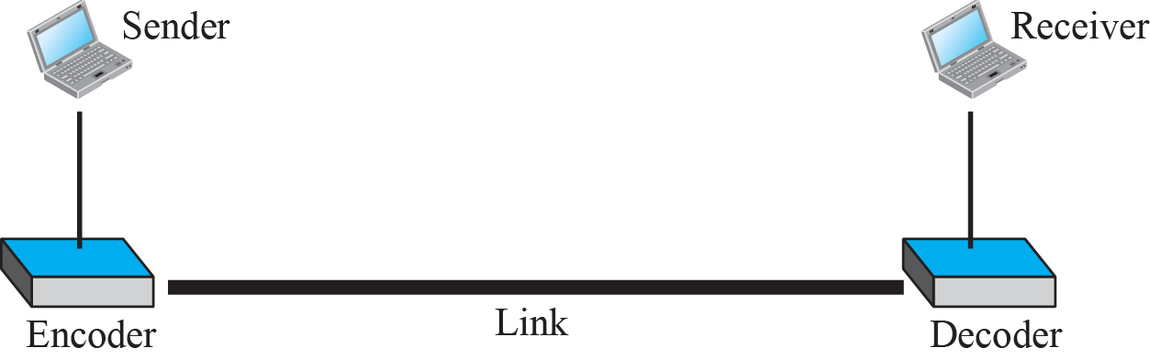
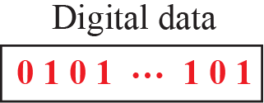
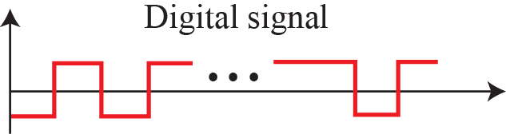
4-1
Digital-to-digital conversion
4.1.1
Line coding
Data can be digital or analog, and so can the signal that carries it. This section represents digital data with a digital signal.
Three techniques are involved. Line coding is always needed. Block coding and scrambling may or may not be.
Line coding is always needed. Block coding and scrambling are added when the channel or the receiver demands them.
The order of the three matters. Block coding runs before line coding, scrambling runs during it.
Data sit in memory as sequences of bits, whatever they represent.
Line coding converts that sequence into a digital signal at the sender, and decoding recovers the bits at the receiver.
Data elements are the bits. Signal elements are the symbols that carry them.
A signal element may carry one bit, several bits, or a fraction of a bit. The ratio is written r.
Everything in this section follows from that ratio and from where the levels sit relative to the time axis.
Figure 4.1
Line coding and decoding

Slide 4
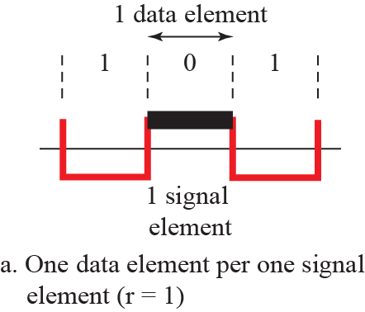
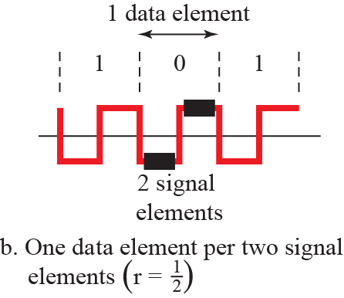
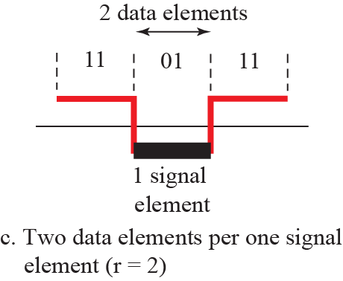
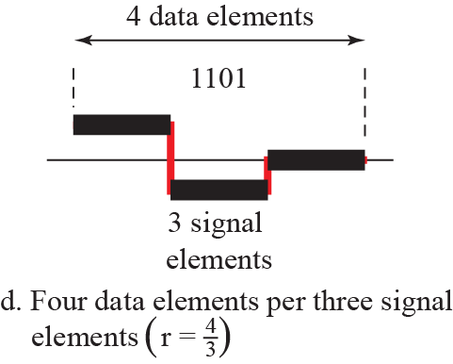
Figure 4.2
Signal elements versus data elements
4.1.1
Data rate and signal rate
Data rate is the number of bits sent in one second, in bits per second. It is also called the bit rate.
Signal rate is the number of signal elements sent in one second, in baud. It is also called the pulse rate, the modulation rate or the baud rate.
The ratio r is the number of data elements carried by one signal element.
The goal is to raise the data rate and lower the signal rate at the same time. In the transport analogy, more people in fewer vehicles.
S = c x N x (1/r) baud, where N is the data rate and c is the case factor.
The worst case needs the largest signal rate and the best case the smallest. In data communications we work with the average.
Bandwidth follows the signal rate, not the data rate. That is why the two are worth separating.
4.1.1
Bandwidth of a digital signal
A digital signal carrying information is nonperiodic, so its bandwidth is continuous and infinite.
Most components have amplitudes small enough to ignore, so the effective bandwidth is finite. That is the bandwidth we mean from here on.
More changes in the signal means more frequencies injected, so the range of frequencies is proportional to the signal rate.
Bmin = c x N x (1/r), and solving for the data rate gives Nmax = (1/c) x B x r.

Slide 5
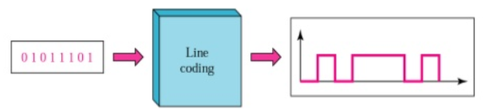
Example 4.1
Average baud rate when r = 1
Example 4.2
Agreement with the Nyquist formula
A signal carries one data element per signal element and the bit rate is 100 kbps. What is the average baud rate for c between 0 and 1?
Take the average value of c as 1/2. The baud rate is then
Chapter 3 gave the maximum data rate of a channel as Nmax = 2 x B x log2 L. Does the formula above agree?
A signal with L levels carries log2 L bits per level. With one level per signal element and the average case c = 1/2, Nmax = (1/c) x B x r = 2 x B x log2 L. The two agree.
4.1.1
What a line code has to get right
Three faults to avoid: baseline wandering, a DC component, and complexity that the hardware cannot afford.
Three properties to pursue: self-synchronization, built-in error detection, and immunity to noise and interference.
No scheme wins on all six, so the choice is set by the channel and by the receiver we can afford.
Complexity is a real constraint, not an aesthetic one. A four-level scheme costs more to interpret than a two-level one, in silicon and in noise margin.
Error detection built into the code catches some errors without a separate check field.
Immunity to noise and interference is what decides whether the scheme survives the medium it is put on.

Slide 6
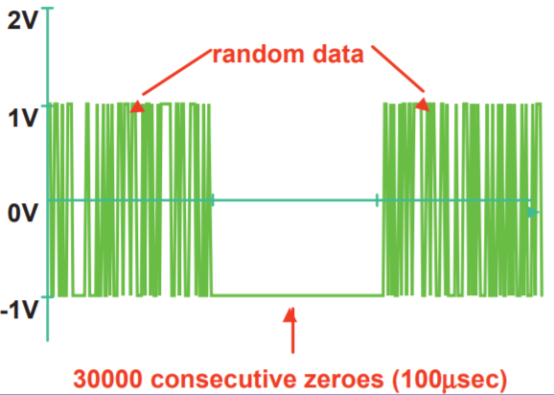
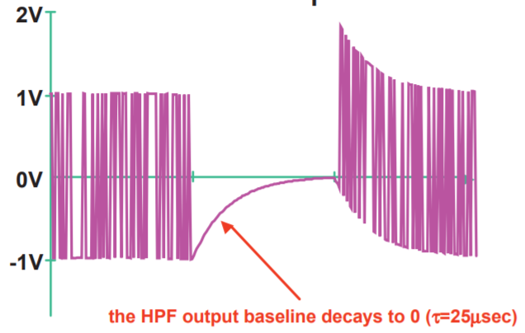
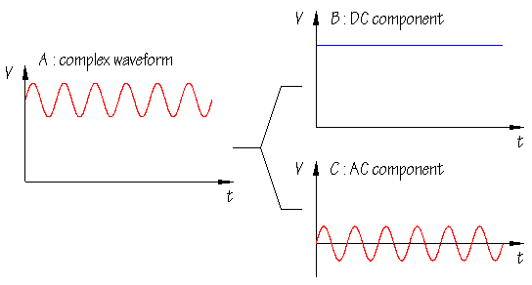
4.1.1
Baseline wandering
Figure
Effect of a long run on the baseline
The receiver keeps a running average of the received signal power. That average is the baseline.
Each incoming signal element is judged against the baseline.
A long string of 0s or 1s drifts the baseline, and the decision threshold drifts with it.
A code that forces transitions bounds the drift.
4.1.1
DC components
Figure
A constant level puts energy at zero frequency
When the signal level stays constant for a while with a nonzero average, the spectrum gains frequencies near zero.
A channel that is not low-pass cannot pass them. A telephone line, for example, passes nothing below about 200 Hz.
A transformer-coupled or capacitively-coupled link blocks them outright.
The energy that goes into the DC term is wasted, because it carries no information.

Slide 7
4.1.1
Baseline wander, physically
4.1.1
What it does to the receiver
Almost every serial link is AC coupled. A series capacitor, or a transformer in the case of Ethernet, sits between transmitter and receiver.
That coupling is there for good reasons. It lets the two ends sit at different common-mode voltages and it isolates them electrically.
A series capacitor is a high-pass filter. It passes edges and blocks anything slow.
A long run of identical bits is a slow signal. During the run the capacitor charges and the received level droops toward zero.
When the data becomes balanced again, the charge left on the capacitor shows up as an offset. That drifting offset is the baseline, and its movement is baseline wander.
The receiver decides each bit against a threshold. The signal has moved and the threshold has not.
On an eye diagram this is vertical closure. The eye height shrinks and the bit error rate climbs.
How far it droops depends on the data pattern, so the edges move in time as well. Measured that way the same effect is called data-dependent jitter.
The book describes this as a running average drifting. The running average is the receiver's estimate of a baseline that is physically moving, not a bookkeeping quantity.
4.1.1
How real links deal with it
Bound the run length. 8B/10B guarantees at most five identical bits in a row and a running disparity within plus or minus two, which is exactly a bound on how far the baseline can move.
Make the capacitor large. PCI Express specifies AC coupling capacitors around 100 nF so the corner frequency sits far below the slowest data pattern the code allows.
Correct it at the receiver. Baseline wander correction adds a low-frequency feed-forward path in parallel with the AC-coupled one and sums the two.
The same phenomenon appears outside networking. A poor electrode contact makes an electrocardiogram wander, and the clinical software has to remove it before it can measure anything.

Slide 8
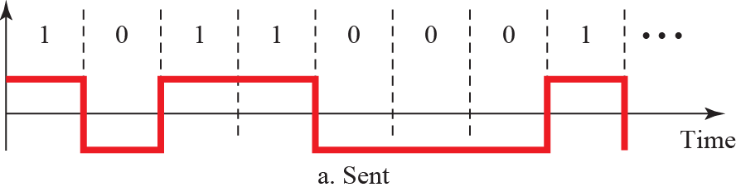
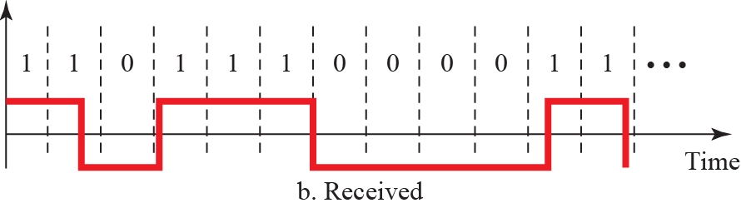
4.1.1
Self-synchronization
Example 4.3
Cost of a 0.1 percent clock error
The receiver bit intervals must line up with the sender bit intervals, so the two clocks must agree.
A self-synchronizing signal carries timing in the data itself, as transitions the receiver can lock to.
The receiver clock runs 0.1 percent fast. At 1 kbps it takes in 1001 bps instead of 1000, gaining one bit each second.
At 1 Mbps it takes in 1,001,000 bps instead of 1,000,000, gaining a thousand. Fast links need tighter clocks, or timing carried in the data.
Figure 4.3
Effect of lack of synchronization
4.1.1
What lack of synchronization costs
The receiver samples at its own bit intervals. If they drift, it reads one bit twice or misses one entirely.
The damage is not a single wrong bit. Every bit after the slip is misaligned, so the rest of the frame is lost.
This is why the codes that follow are judged first on whether the receiver can recover timing from the signal itself.

Slide 9
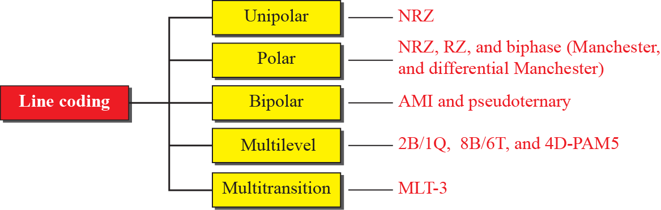
Figure 4.4
Taxonomy of line coding schemes
4.1.2
Line coding schemes
The schemes fall into five broad categories: unipolar, polar, bipolar, multilevel and multiline.
Each category holds several schemes, and later chapters refer back to them by name.
Read the group first and the scheme second. The group tells you where the levels sit relative to the time axis, and that is what sets the DC behaviour.
4.1.2
How to read the rest of this section
For every scheme, ask the same four questions. How many levels does it use? What is the signal rate for a given data rate? Is there a transition the receiver can lock to? Does the average sit at zero?
The answers to those four are the whole of Table 4.1, and they are what the examination will ask for.
Unipolar puts every level on one side of the time axis. Polar puts them on both sides. Bipolar uses three levels but sends one data element as zero.
Multilevel packs several bits into one signal element. Multitransition picks the level from a transition rule instead of from the bit.
The five names are only a filing system. The four questions above are what actually distinguish the schemes.

Slide 10
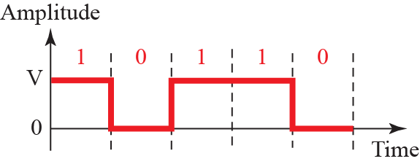
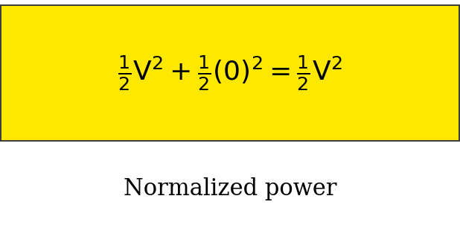
Figure 4.5
Unipolar NRZ scheme
4.1.2
Unipolar NRZ
All signal levels sit on one side of the time axis.
The average value is half the amplitude, so the DC component is as large as it can be.
It also costs twice the power of a polar scheme for the same distance between levels.
It is not used today. It is here because it makes the DC problem obvious.
The normalized power, meaning the power to send one bit per unit line resistance, is twice that of polar NRZ.
That factor of two is the whole argument against it, and it is why the scheme survives only as a teaching example.
The normalized power box in the textbook figure is printed as V squared plus one half times zero squared. The first term needs its one half. The figure here is corrected.
4.1.2
Polar schemes
Polar schemes put the voltages on both sides of the time axis, so one data element is positive and the other negative.
The average of a balanced stream is therefore near zero, which is the whole reason polar replaced unipolar.
Three families follow: NRZ, RZ, and biphase. They differ in how many transitions they force inside a bit interval, and every property in this section follows from that count.

Slide 11
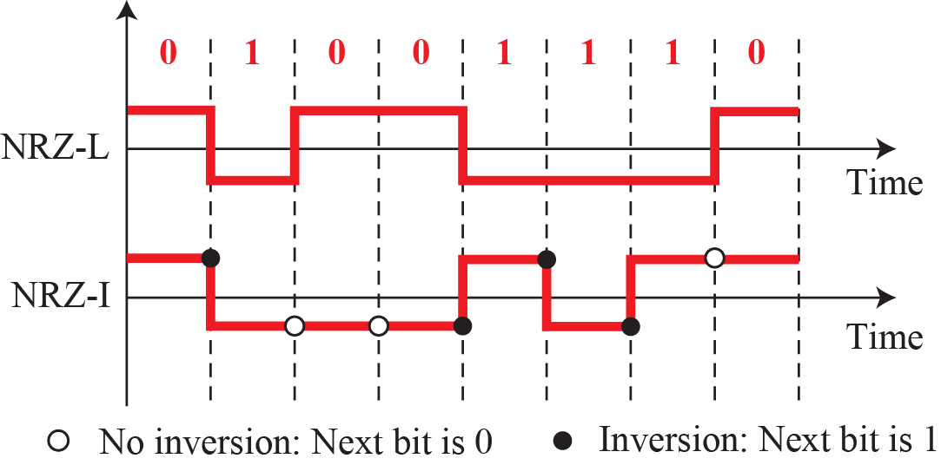
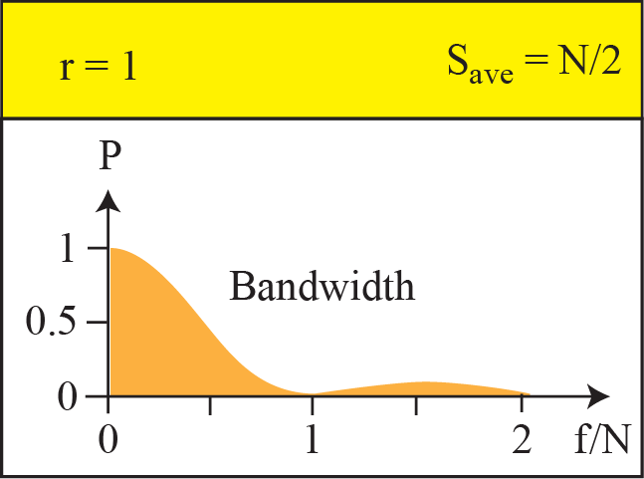
Figure 4.6
Polar NRZ-L and NRZ-I
4.1.2
NRZ-L and NRZ-I
NRZ-L sets the level from the bit value. NRZ-I inverts the level when the bit is 1 and leaves it alone when the bit is 0.
Baseline wandering is a problem in both, and twice as severe in NRZ-L, because NRZ-I at least changes on every 1.
Neither is self-synchronizing, and both put most of their power near zero frequency.
Average signal rate and minimum bandwidth are both N/2.
NRZ-L is used in automotive links and NRZ-I in USB.
A long run of 0s hurts both schemes. A long run of 1s hurts only NRZ-L, because NRZ-I changes level on every 1.
NRZ-L has a further fault. If the polarity of the pair is reversed anywhere in the plant, every 0 reads as a 1 and every 1 as a 0. NRZ-I is immune, because it reads changes rather than levels.
Example 4.4
NRZ-I at 1 Mbps
A system uses NRZ-I to carry 1 Mbps. The average signal rate is S = N/2 = 500 kbaud, and the minimum bandwidth for that baud rate is Bmin = S = 500 kHz.
The same 1 Mbps in Manchester would need 1 MHz. That is the price of the transition that makes Manchester self-synchronizing.

Slide 12
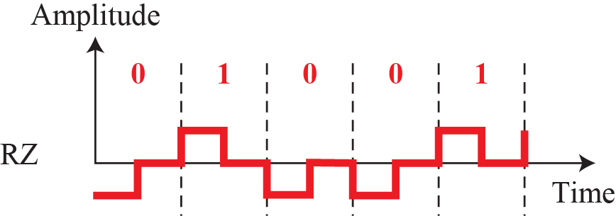
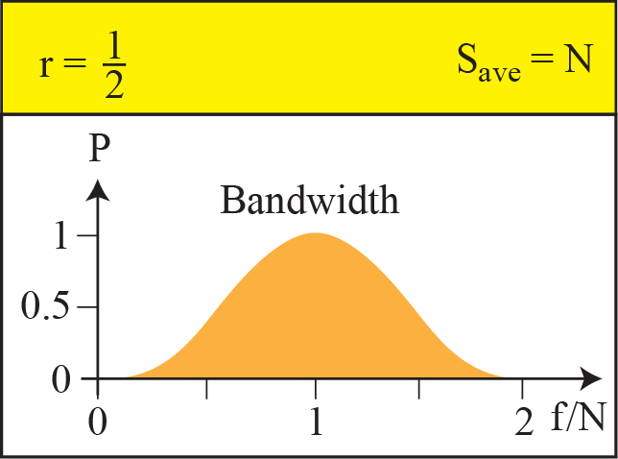
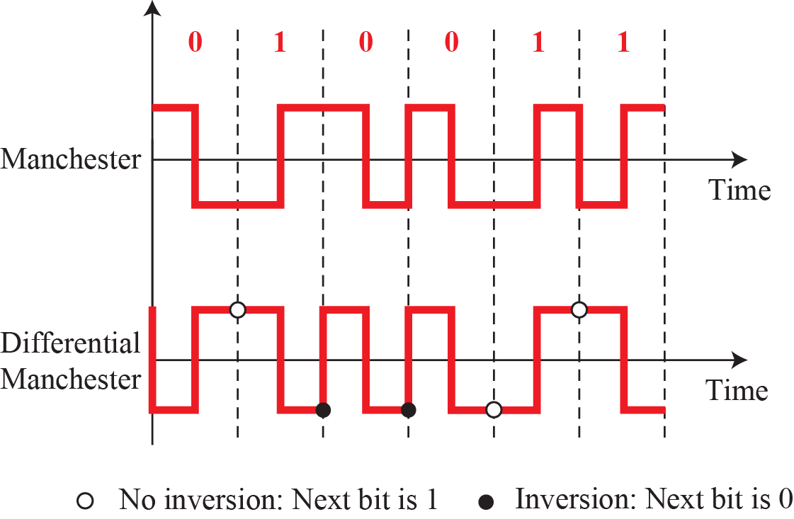
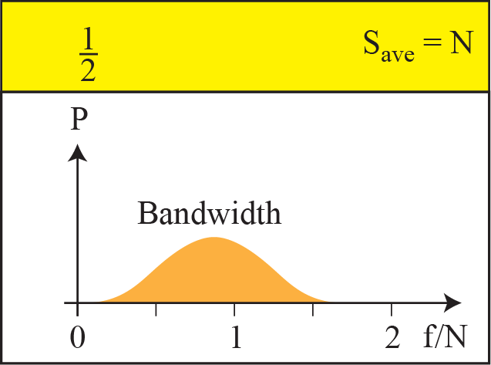
Figure 4.7
Polar RZ scheme
4.1.2
Return to zero
The signal returns to zero in the middle of every bit, so there is a transition in every bit interval whatever the data.
That gives synchronization and removes the DC component.
The price is three levels and twice the transitions, so twice the bandwidth. It is not used in practice.
Figure 4.8
Polar biphase: Manchester and differential Manchester
4.1.2
Biphase
The transition at the middle of the bit carries both timing and data, so no separate clock is needed.
There is no baseline wandering and no DC component.
Signal rate and bandwidth are twice those of NRZ, which is the whole cost of the scheme.
Used in Ethernet, IrDA, RFID and NFC.

Slide 13
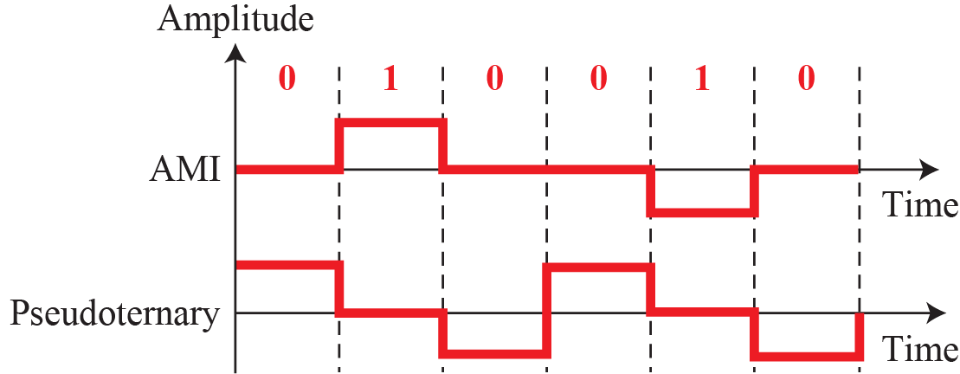
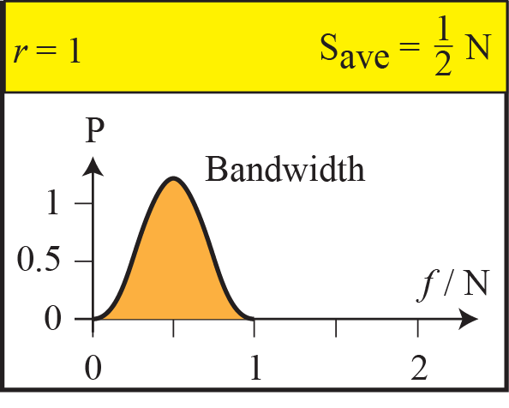
Figure 4.9
Bipolar AMI and pseudoternary
4.1.2
Bipolar schemes
Three levels are used, but one data element is always sent as zero volts and the other alternates between positive and negative.
In AMI the mark, meaning bit 1, alternates. Pseudoternary is the same rule with the roles of 0 and 1 exchanged.
The three levels are not three symbols. Only two data elements exist, and the third level exists so that one of them can alternate.
The three levels are not three symbols. Only two data elements exist, and the third level is there to let one of them alternate.
Because the positive and negative pulses cancel over any long run, the average is zero and no transformer or capacitor in the path is upset.
T1 in North America and E1 in Europe both carry AMI, which is why the scheme still matters.
4.1.2
Why bipolar was built, and what it still fails at
The signal rate is the same as NRZ, but the alternation makes successive pulses cancel, so the amplitude at zero frequency is zero.
That is the property long-distance links need, because transformers and coupling capacitors in the path pass nothing at DC. T1 in North America and E1 in Europe both carry AMI.
A long run of the zero-level element still gives the receiver nothing to lock to, so synchronization fails exactly as it does in NRZ. Section 4.1.4 fixes that without adding a single bit.

Slide 14
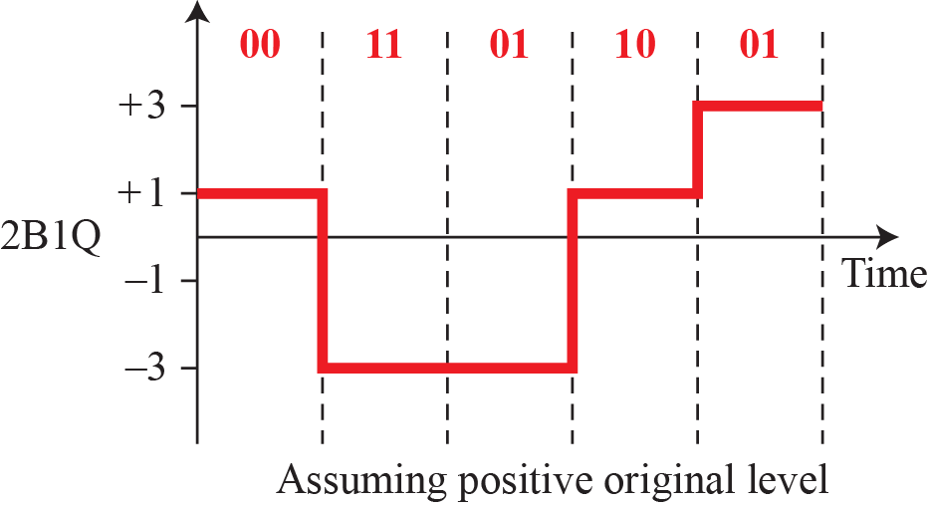
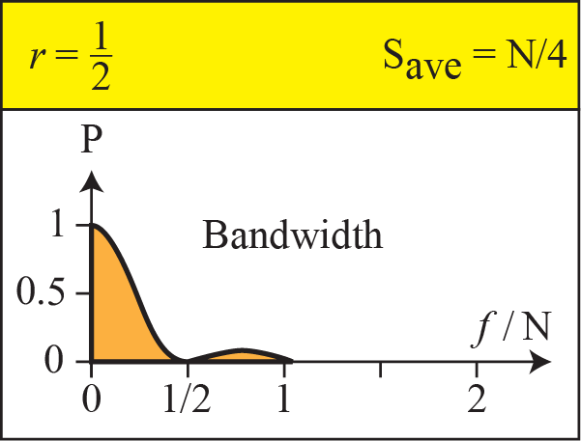
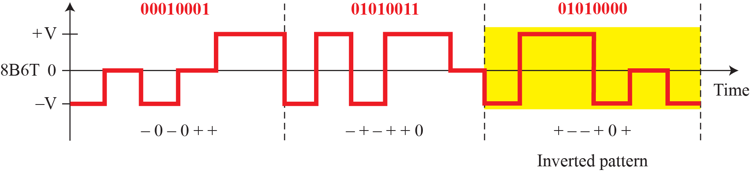
Figure 4.10
Multilevel 2B1Q
4.1.2
Multilevel schemes
Multilevel coding packs m data elements into n signal elements drawn from L levels, written mBnL.
2B1Q sends two bits per signal element using four levels, so the signal rate is half the data rate.
The gain in signal rate is paid for in noise margin, because the levels sit closer together.
2B1Q is not a museum piece. It is what ISDN basic rate and HDSL put on an ordinary telephone pair, which is how the first megabit links reached houses.
Figure 4.11
Multilevel 8B6T

Slide 15
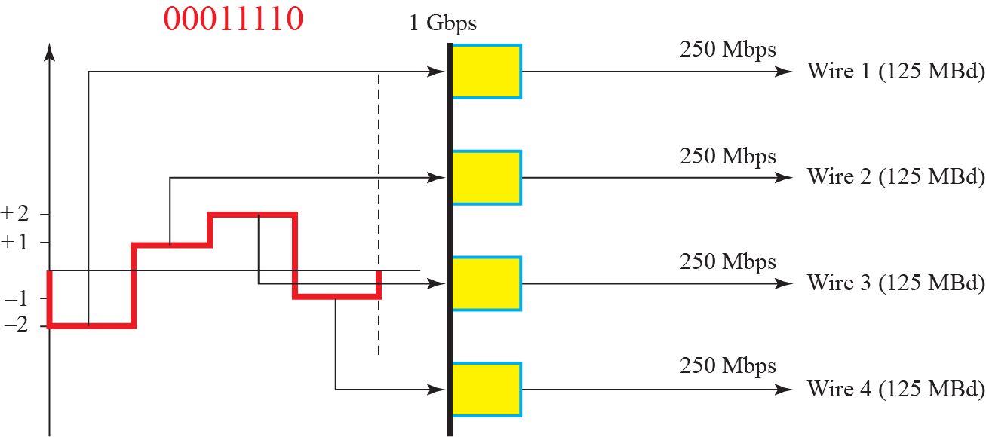
Figure 4.12
Multilevel 4D-PAM5
4.1.2
4D-PAM5
Five levels are used, but one of them is reserved for forward error correction rather than data.
The four remaining levels carry two bits, and the code sends them over four wires at once.
That is how Gigabit Ethernet reaches 1 Gbps over four pairs at 125 Mbaud each.
4.1.2
Multilevel and multiline compared
Multilevel coding spends levels to buy signal rate. Multiline coding spends a transition rule instead, and keeps the level count low.
Both are answers to the same question: how do we carry more bits per symbol without asking the channel for more bandwidth?
The limit on both is the one Chapter 3 set. More levels means less room between them, and noise decides how many the channel will hold.

Slide 16
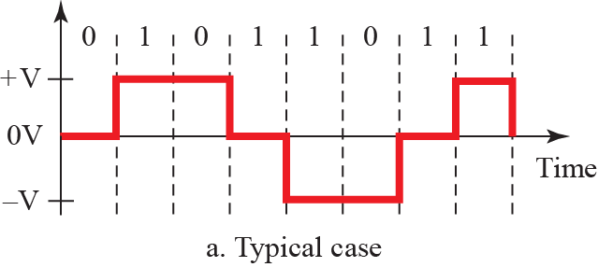
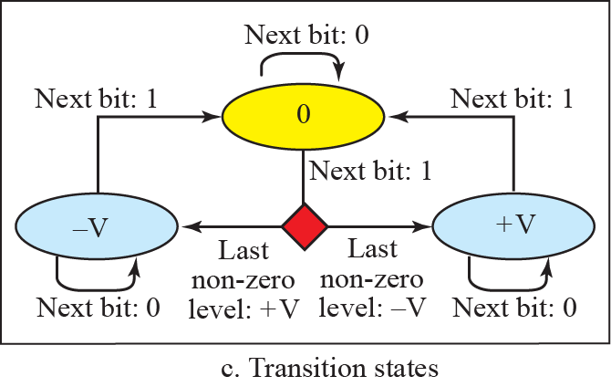
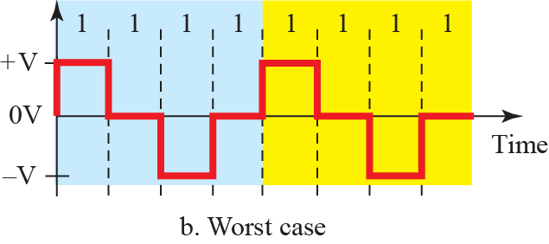
Figure 4.13
Multi-transition MLT-3
4.1.2
MLT-3
Three levels, but the level is chosen by a transition rule rather than by the bit value directly.
No transition on a 0. From a nonzero level a 1 moves to zero. From zero a 1 moves to the opposite of the last nonzero level.
The worst-case input, all 1s, produces a pattern that repeats every four bits.
4.1.2
Why MLT-3 was worth the complexity
The worst case is periodic, so the signal rate is N/4 and the waveform is close to a sine wave rather than a square one.
A near-sinusoidal waveform puts far less energy into high harmonics, so the channel has less work to do.
That is what lets 100 Mbps run inside a channel of less than 32 MHz, which is what Fast Ethernet over copper needed.

Slide 17
Table 4.1
Summary of line coding schemes, corrected
Category
Scheme
Bandwidth
Characteristics
Unipolar
NRZ
B = N/2
Costly in power, no self-synchronization on long runs of 0s or 1s, DC component
Polar
NRZ-L
B = N/2
No self-synchronization on long runs of 0s or 1s, DC component
Polar
NRZ-I
B = N/2
No self-synchronization on long runs of 0s, DC component
Polar
Biphase
B = N
Self-synchronizing, no DC component, twice the bandwidth
Bipolar
AMI
B = N/2
No self-synchronization on long runs of 0s, no DC component
Multilevel
2B1Q
B = N/4
No self-synchronization on long runs of the same pair, DC component
Multilevel
8B6T
B = 3N/4
Self-synchronizing, no DC component
Multilevel
4D-PAM5
B = N/8
Self-synchronizing, no DC component
Multitransition
MLT-3
B = N/4
No self-synchronization on long runs of 0s, no DC component
AMI, corrected. The printed table marks AMI as having a DC component. It does not. Removing the DC component is the entire reason bipolar coding exists, and the book says so three pages earlier.
MLT-3, corrected. The printed table gives B = N/3. The book's own derivation has the pattern +V 0 -V 0 repeating every four bits, so the signal rate and the minimum bandwidth are N/4. That also matches 100BASE-TX, where 125 Mbaud gives a 31.25 MHz fundamental.
2B1Q and MLT-3, completed. The printed rows leave the DC status blank. 2B1Q has a DC component and MLT-3 does not.
8B6T, explained. The average signal rate is one half times N times six eighths, or 3N/8. The practical minimum bandwidth is close to 6N/8, which is the 3N/4 in the table. Both numbers are correct and the book states them in different places.

Slide 18
4.1.2
Where the power spectrum plots come from
4.1.2
Reading the four spectra
The book prints a bandwidth plot beside every scheme and never says where the curve came from. This is the derivation in outline.
The bit stream is random, so the transmitted signal is a stochastic process. A Fourier transform is not defined for it, and the power spectral density is used instead.
Write the signal as a train of identical pulses whose amplitudes are set by the data. The density then factors into two independent parts.
The first is the energy spectrum of one pulse, fixed by the pulse shape alone. A rectangular pulse of width T gives a sinc-squared envelope with its first null at f = 1/T.
The second comes from the statistics of the amplitude sequence, that is from the coding rule, through the autocorrelation of that sequence.
Pulse shape sets the envelope. The coding rule decides what is carved out of it.
Polar NRZ: amplitudes independent and equally likely, so only the zero-lag term survives. The spectrum is the bare sinc-squared, first null at f = N, half the power below N/2. That is where B = N/2 comes from.
Unipolar NRZ: the same envelope plus an impulse at f = 0, because the mean amplitude is not zero. That impulse is the DC component, drawn as a spike in the book.
Biphase: the pulse is a half-width doublet, so the envelope is zero at f = 0 and peaks near f = N. No DC and twice the bandwidth, both from the pulse shape alone.
AMI: successive marks alternate, so the one-lag autocorrelation is negative. That forces the spectrum to zero at f = 0 and at f = N and puts the power at N/2.
EXPLORE
Where to check this
Continued
Stanford EE179, Lecture 14. The derivation in the form used above.
https://web.stanford.edu/class/ee179/lectures/notes14.pdf
KFUPM EE370, Lecture 27. Polar NRZ worked term by term.
https://faculty.kfupm.edu.sa/EE/wajih/files/EE%20370/EE%20370,%20Lecture%2027.pdf
GaussianWaves, line codes in Matlab and Python. Plots each measured spectrum. Run it against the book's figures.
https://www.gaussianwaves.com/2021/01/line-code-demonstration-in-matlab-and-python/
UBC ELEC 3525, laboratory 6. Measures NRZ, Manchester and 4B5B with MLT-3 on instruments.
https://people.ece.ubc.ca/~edc/3525.jan2018/lab6.pdf

Slide 19
4.1
Which technology uses which scheme today
Scheme
Where it is used
Why that choice
Unipolar NRZ
TTL-level serial between chips, simple optical on-off links
Cheapest to build, and the DC term does not matter over 10 cm
NRZ-L
RS-232, CAN and LIN inside vehicles
Slow enough that a separate clock or bit stuffing is enough
NRZ-I
USB low and full speed
Bit stuffing after six 1s forces the transition NRZ-I lacks
Manchester
10BASE-T Ethernet, RFID, NFC, IrDA, DALI
Self-clocking, and at 10 Mbps the doubled bandwidth is free
Differential Manchester
IEEE 802.5 Token Ring
Reads changes, so a reversed pair does not invert the data
AMI with B8ZS
T1 carrier, North America
No DC on a transformer-coupled span, timing restored without extra bits
HDB3
E1 carrier, Europe and most of Asia
Same idea, acting after four zeros instead of eight
2B1Q
ISDN basic rate U interface, HDSL
Two bits per symbol on a pair that was laid for voice
8B6T
100BASE-T4
Three levels on four pairs of Category 3 cable already in the wall
4D-PAM5
1000BASE-T Gigabit Ethernet
Four pairs at 125 Mbaud each, which Category 5 can carry
MLT-3
100BASE-TX Fast Ethernet
Holds the fundamental at 31.25 MHz, under the emission limit
4B/5B
100BASE-TX, FDDI
Bounds the run of zeros before MLT-3 sees the data
8B/10B
1000BASE-X, Fibre Channel, SATA, PCI Express 1 and 2, USB 3.0
25 percent overhead buys DC balance and control symbols
Above 10 Gbps the 25 percent overhead of 8B/10B is intolerable. 10GBASE-R uses 64B/66B and PCI Express 3.0 and later use 128B/130B, where a scrambler replaces the lookup table and the overhead falls to 3 percent and 1.5 percent.

Slide 20
EXPLORE
Line codes, and what they look like on a real wire
Continued
Wikipedia, Manchester code. The reference article for polar biphase.
Try: Check why the mid-bit transition carries clock and data at once.
https://en.wikipedia.org/wiki/Manchester_code
Wikipedia, 8b/10b encoding. The block code behind Gigabit Ethernet and PCI Express.
Try: Find the run-length and disparity bounds the code guarantees.
https://en.wikipedia.org/wiki/8b/10b_encoding
Ben Eater, Analyzing actual Ethernet encoding. A live 10BASE-T link on an oscilloscope.
Try: Watch him recover the clock from the waveform alone.
https://www.youtube.com/watch?v=i8CmibhvZ0c
Ben Eater, Networking tutorial. Thirteen videos that start at a bare copper wire.
Try: Parts 1 to 4 build a line-coded link from nothing.
https://www.youtube.com/playlist?list=PLowKtXNTBypH19whXTVoG3oKSuOcw_XeW
SparkFun, logic analyzer with sigrok PulseView. A twenty dollar analyzer and open software.
Try: Capture a serial line and decode it yourself.
https://learn.sparkfun.com/tutorials/using-the-usb-logic-analyzer-with-sigrok-pulseview
Hackaday, logic analyzers: decoding and monitoring. How a protocol decoder turns edges into bytes.
Try: Read it before you try to write a decoder of your own.
https://hackaday.com/2024/04/15/logic-analyzers-decoding-and-monitoring/
Academo, virtual oscilloscope. A scope in the browser, fed by your microphone.
Try: Switch the input to a square wave and look at the edges.
https://academo.org/demos/virtual-oscilloscope/
Falstad, Fourier Series applet. Harmonics you can add and remove by hand.
Try: Cut the high harmonics and watch a square wave round off.
https://www.falstad.com/fourier/
Wikipedia, Gibbs phenomenon. What a truncated spectrum does to a sharp edge.
Try: Note that the overshoot stays near 9 percent however many terms you keep.
https://en.wikipedia.org/wiki/Gibbs_phenomenon
Wikipedia, Square wave. The closed form of the series a line coder has to carry.
Try: Check where the odd harmonics and the falling amplitudes come from.
https://en.wikipedia.org/wiki/Square_wave_(waveform)

Slide 21
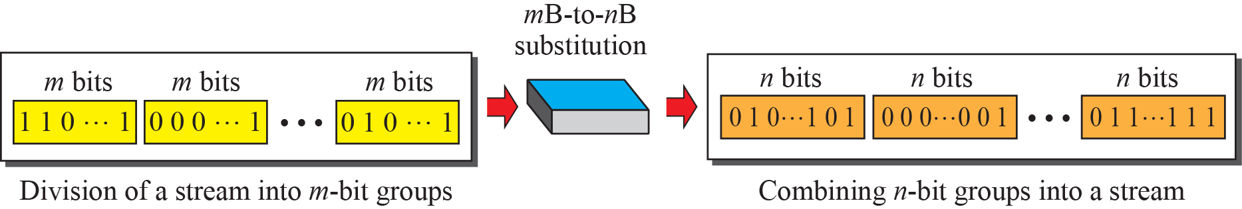
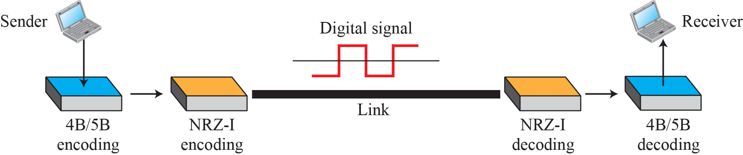
4.1.3
Block coding
Figure 4.14
Block coding concept
Line coding on its own cannot guarantee synchronization or detect errors, because it has no spare bits to spend.
Block coding buys that redundancy by changing a block of m bits into a block of n bits, with n larger than m. It is written mB/nB.
The redundant patterns are chosen so that no legal output has a long run of one level, and so that some received blocks are recognizably illegal.
The blocks are chosen so that no legal output word has a long run of one level, which is where synchronization comes from.
Because only some of the 2^n words are legal, a received word outside the set is a detected error.
Block coding does not replace line coding. It runs first and hands its output to the line coder.
Figure 4.15
4B/5B block coding ahead of NRZ-I
4.1.3
4B/5B
NRZ-I loses synchronization on a long run of 0s. 4B/5B guarantees no more than three consecutive 0s in the coded stream.
The cost is a 25 percent rise in the signal rate, and the DC component of NRZ-I is still there.

Slide 22
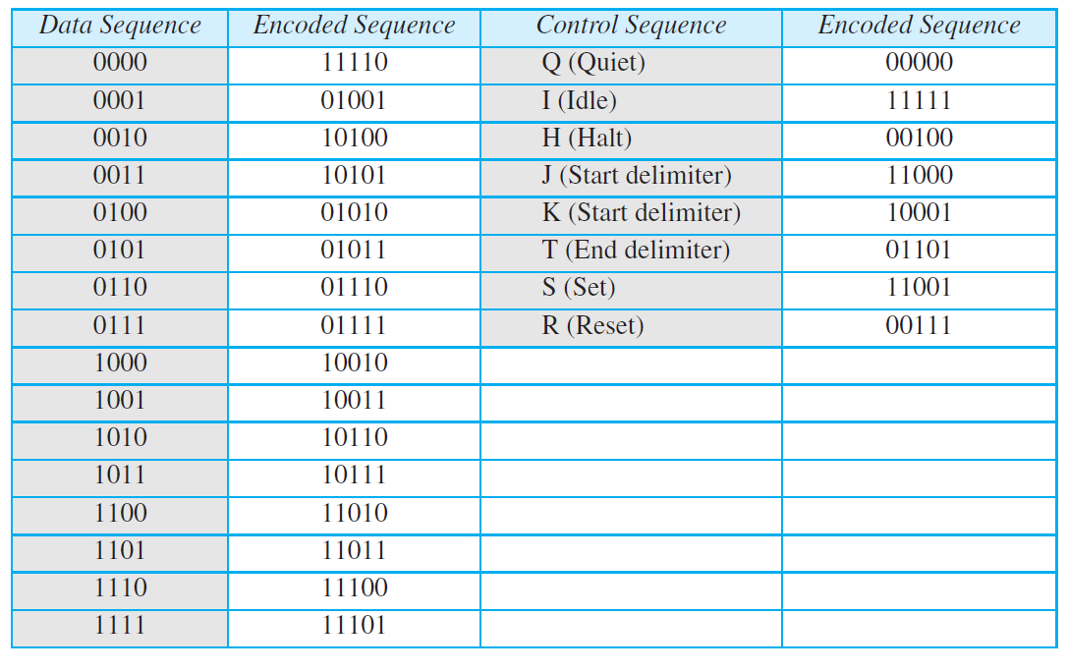
Table 4.2
4B/5B mapping codes
4.1.3
What the spare code words buy
Sixteen data blocks need sixteen of the thirty-two available five-bit words.
The rest are either control words, used for start and end delimiters and idle, or invalid, so a received invalid word is a detected error.
That is the redundancy paying for itself twice, once in synchronization and once in error detection.
Example 4.5
1 Mbps with 4B/5B against Manchester
4B/5B first raises the bit rate to 1.25 Mbps. With NRZ-I the minimum bandwidth is N/2, or 625 kHz.
Manchester on its own needs a minimum bandwidth of 1 MHz.
The first choice costs less bandwidth but keeps a DC component. The second costs more bandwidth and has none. The channel decides which price you pay.

Slide 23
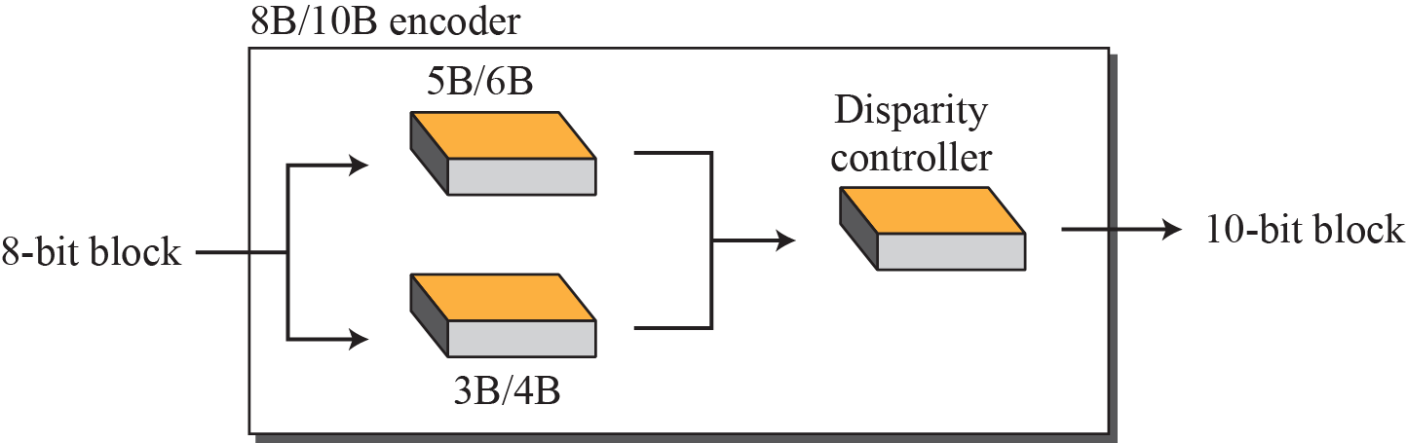
Figure 4.17
8B/10B block encoding
4.1.3
8B/10B
Eight bits become ten, so there are 1024 code words for 256 data blocks.
The encoder is built as a 5B/6B stage and a 3B/4B stage with a disparity controller between them.
The disparity controller tracks how many 1s and 0s have been sent and picks the version of the next word that pulls the running count back toward zero.
The redundancy is larger than 4B/5B, so error detection is better as well.
The running disparity is the count of 1s against 0s sent so far. Holding it near zero is what keeps the average at zero.
Used in Gigabit Ethernet, Fibre Channel, PCI Express and SATA, so it is the block code most students will meet in practice.
4.1.4
Scrambling
Biphase is fine for a short link but too wide for a long one. Block coding ahead of NRZ leaves a DC component. Bipolar AMI has neither problem, but a long run of 0s still breaks synchronization.
What a long-distance link needs is a scheme that adds no bits, keeps synchronization, and keeps the average at zero.
Scrambling substitutes a fixed pattern of other levels for a long run of zero-level pulses, at encoding time rather than before it. B8ZS and HDB3 are the two in common use.
Scrambling adds no bits, so the data rate and the signal rate are exactly those of the underlying bipolar scheme.

Slide 24
4.1.3
Why 8B/10B is split into 5B/6B and 3B/4B
4.1.3
What the partition buys
The split is not arbitrary and it is not a five-and-three division of the data for its own sake.
A sub-block can be DC balanced on its own only if its length is even, because balance means half the bits are 1s. Six and four are even. Two five-bit outputs would each be permanently unbalanced by one bit, and the imbalance would accumulate.
So the eight input bits are cut as five plus three precisely because that produces six-bit and four-bit outputs.
5B/6B has twenty balanced six-bit words for thirty-two inputs, and 3B/4B has six balanced four-bit words for eight inputs. The remainder are stored as complementary pairs and the encoder picks whichever one pulls the running count back toward zero.
Hardware cost. A single 8B/10B table would need 256 entries with two alternates each. A 5B/6B table needs 32 and a 3B/4B table needs 8, and Widmer and Franaszek assigned the code points so that translation flips as few bits as possible.
One disparity counter. Running disparity is computed through the six-bit stage and handed to the four-bit stage, so the two sub-coders share one piece of state.
Near-optimal performance anyway. The result has a maximum run length of 5 and a maximum digital sum variation of 6, close to the theoretical limit for any 8B/10B code.
The source is Widmer and Franaszek, A DC-balanced, partitioned-block, 8B/10B transmission code, IBM Journal of Research and Development 27(5), 1983, and US patent 4,486,739.
4.1.3
The same reasoning, one generation later
The 25 percent overhead that buys all of this is affordable at 1 Gbps and painful at 10. A 10 Gbps link paying it would have to run the wire at 12.5 Gbps.
So 10GBASE-R and PCI Express 3.0 abandoned the lookup table. They scramble the payload with a self-synchronizing polynomial and add only a two-bit header per 64 or 128 bits.
Scrambling gives transitions and DC balance with high probability rather than by guarantee. The bound on run length is statistical, not absolute, which is the price of dropping from 25 percent overhead to 3 percent and then to 1.5 percent.
The trade in this chapter never disappears. It only moves. Guarantees cost bits, and when bits become expensive enough, engineers accept probabilities instead.

Slide 25
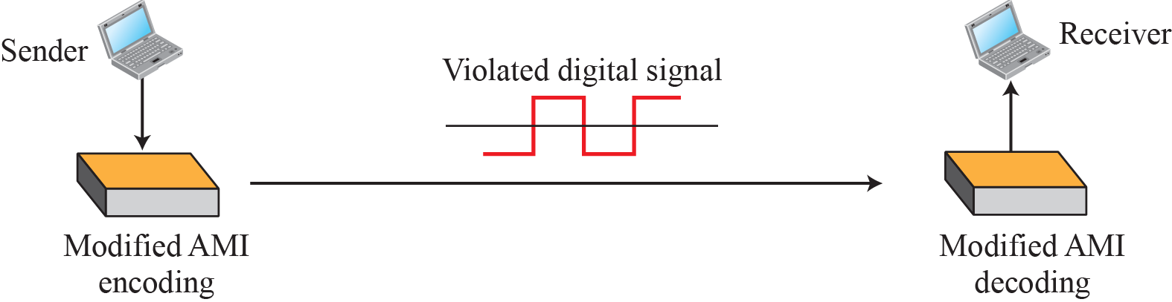
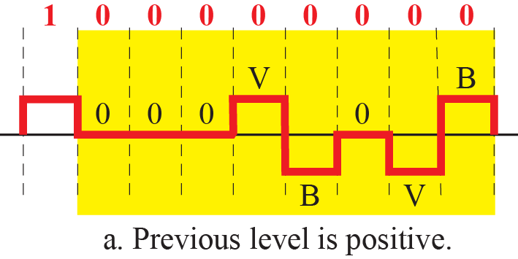
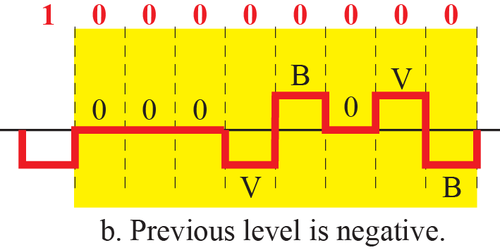
Figure 4.18
AMI used with scrambling
4.1.4
Where scrambling sits
Scrambling is done at the same time as encoding, not as a separate pass before it, so the number of bits never changes.
The substituted pattern deliberately violates the alternation rule of AMI. That violation is the signal to the receiver, which then knows to put the zeros back.
Figure 4.19
B8ZS, two cases
4.1.4
B8ZS and HDB3
B8ZS replaces eight consecutive 0s with 000VB0VB, where V is a violation of the alternation rule and B obeys it. The pattern is chosen so the average stays at zero.
HDB3 replaces four consecutive 0s with 000V or B00V, choosing between them by whether the number of nonzero pulses since the last substitution is odd or even.
Both are used in North American and European carrier systems respectively.

Slide 26
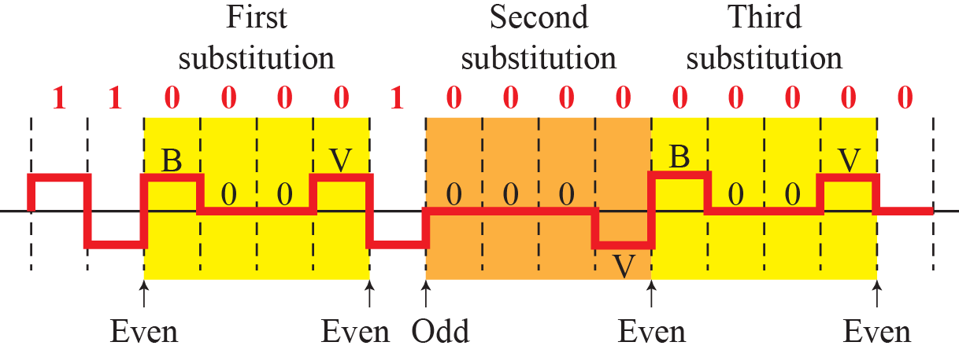
Figure 4.20
HDB3 substitution in four situations
4.1.4
Why two rules
The choice between 000V and B00V exists only to keep the running average at zero.
If an odd number of nonzero pulses has been sent since the last substitution, 000V alone balances. If the count is even, the extra B is needed.
Neither rule adds a bit, so the data rate and the signal rate are untouched. That is the property that scrambling was invented for.
B8ZS is the North American convention and HDB3 the European one. The difference is only the run length they act on, eight zeros against four.
Both work by breaking the alternation rule on purpose. A violation cannot occur by accident, so the receiver reads it as an instruction rather than as data.
4.1
Section 4.1 in one line
Line coding decides the signal rate, the bandwidth and the DC content. Block coding buys synchronization and error detection with extra bits. Scrambling buys synchronization with no extra bits at all.
Which of the three you need is decided by the channel, not by the data. A short dedicated link can afford Manchester. A long carrier link cannot, and that is why AMI with B8ZS or HDB3 is what runs on it.

Slide 27
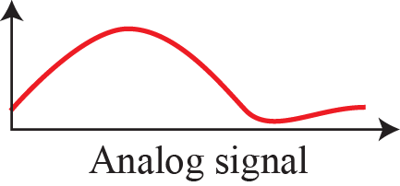
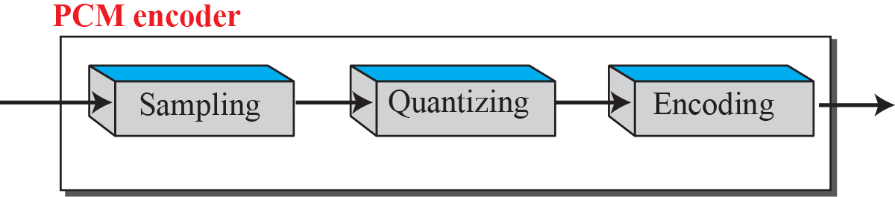
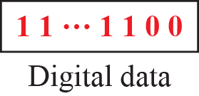
4-2
Analog-to-digital conversion
4.2.1
Pulse code modulation
Section 4.1 started from digital data. A microphone or a camera hands us an analog signal instead.
Chapter 3 argued that a digital signal is the better thing to transmit, so the tendency is to convert.
Two techniques are covered: pulse code modulation and delta modulation.
Chapter 3 argued that digital signals survive repeaters and analog signals accumulate noise. That is why the conversion is worth doing.
The cost is bandwidth, and Section 4.2 ends by putting a number on it.
PCM is the common technique for digitizing an analog signal.
The encoder has three processes in series: sampling, quantization, and encoding.
Each stage loses something, and the design question is how much loss to accept for how few bits.
Sampling turns continuous time into discrete time. Quantization turns continuous amplitude into discrete amplitude. Encoding turns the result into bits.
Only the first is reversible. The second discards information permanently, and no decoder recovers it.
G.711, the standard that fixes 8000 samples per second at 8 bits, dates from 1972 and is still what a telephone call starts as.
Figure 4.21
Components of a PCM encoder

Slide 28
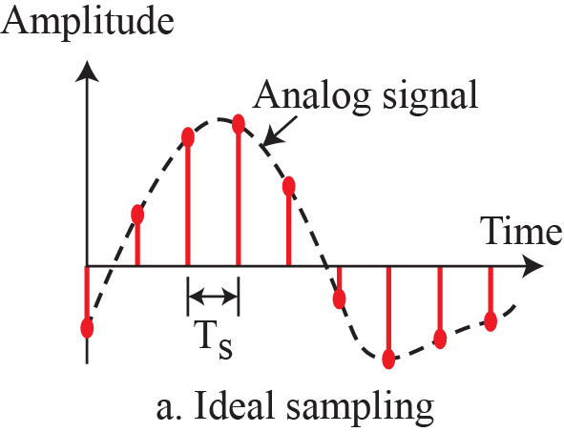
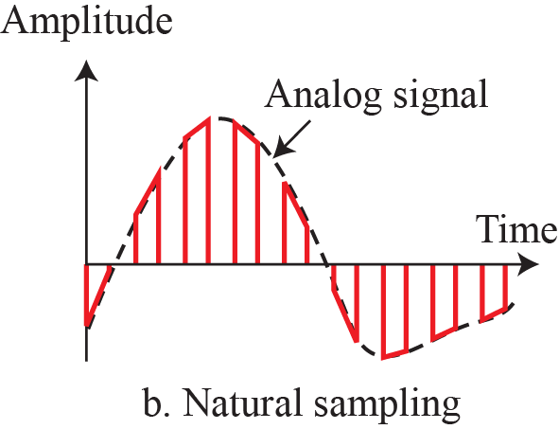
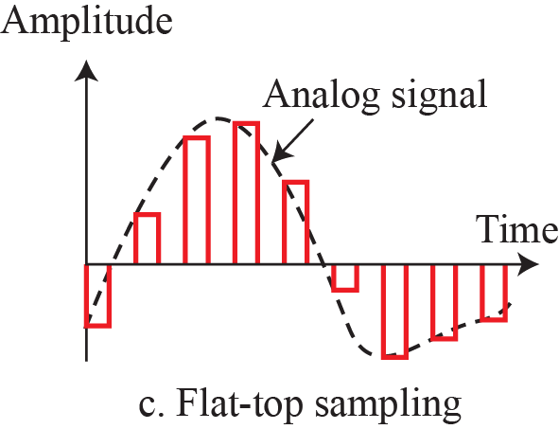
Figure 4.22
Three sampling methods for PCM
4.2.1
Sampling
Sampling takes the value of the analog signal at equal intervals. The interval is Ts and the sampling rate is fs = 1/Ts.
Ideal sampling takes an instantaneous value, which no circuit can do exactly.
Natural sampling follows the signal for the width of the pulse. Flat-top sampling holds the value taken at the start of the interval, which is what sample-and-hold hardware actually does.
Flat-top is the one used in practice, and it is the one the rest of the section assumes.
Sampling is also called pulse amplitude modulation, because its output is a train of pulses whose amplitudes follow the signal.
The output is still analog in amplitude. It becomes digital only after quantization.
4.2.1
The sampling interval
The interval between samples is Ts and the sampling rate is fs = 1/Ts. Everything that follows depends on choosing fs correctly, and Section 4.2.1 gives the rule that fixes it.
The output of sampling is a train of pulses whose amplitudes follow the signal, which is why sampling is also called pulse amplitude modulation.
That output is discrete in time but still continuous in amplitude. It is not yet digital, and the next stage is what makes it so.

Slide 29
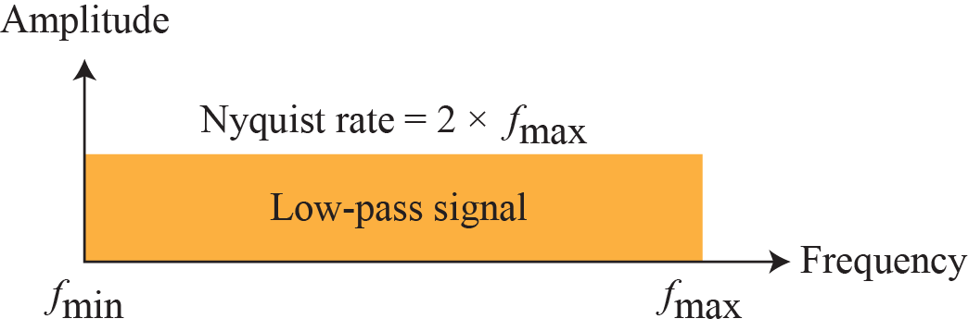
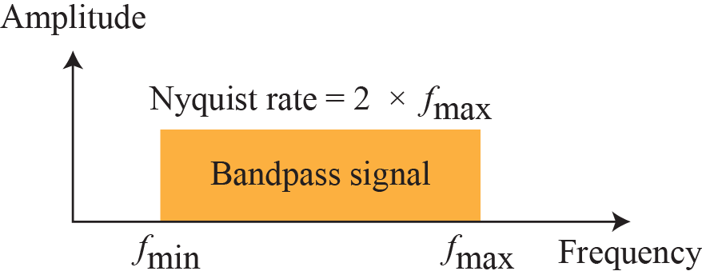
4.2.1
Sampling rate
Figure 4.23
Nyquist rate for low-pass and bandpass signals
The Nyquist condition is that the sampling rate be at least twice the highest frequency in the signal.
The highest frequency, not the bandwidth. The two are the same only for a low-pass signal that starts at zero.
For a bandpass signal the rate must be at least twice the bandwidth, but you also need to know where the band sits.
Example 4.6
Sampling one sine wave three ways
Sample a sine wave at fs = 4f, at fs = 2f, and at fs = f, then try to recover it.
At the Nyquist rate the recovery is a good approximation of the original. Sampling faster gives the same approximation and wastes samples.
Sampling below the Nyquist rate produces a signal that does not resemble the original at all, and no amount of processing afterwards recovers it.

Slide 30
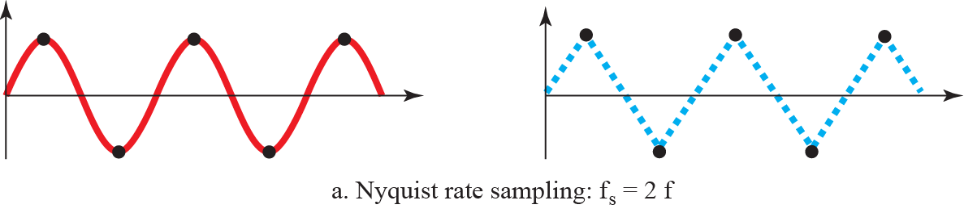
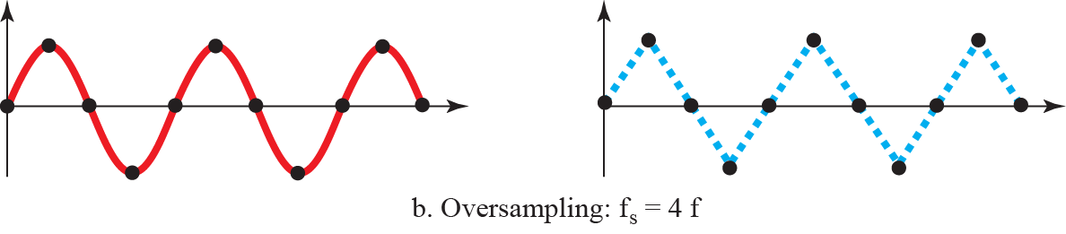
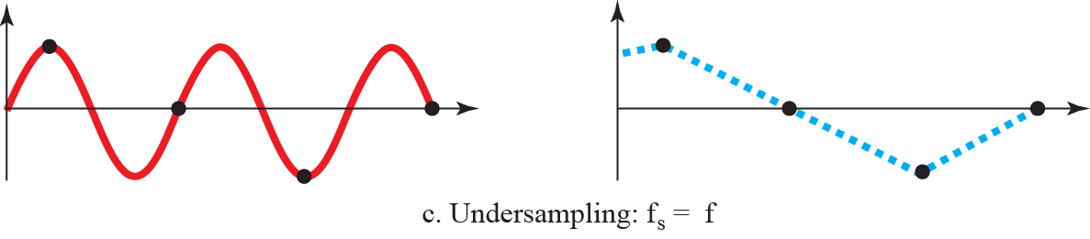
Figure 4.24
Recovery of a sine wave at three sampling rates

Slide 31




Figure 4.25
Sampling a clock that has only one hand
Example 4.7
Aliasing
The backward rotation of a wheel in a film is undersampling. Film runs at 24 frames per second, so a wheel turning more than 12 times per second is sampled too slowly and appears to run backwards.
The false low frequency has a name, and it is the reason the Nyquist condition is a condition and not a guideline.

Slide 32
4.2.1
Aliasing in video, worked out
4.2.1
Rolling shutter, a second kind of aliasing
A camera samples the world at its frame rate. A wheel turning f times per second, filmed at fs frames per second, is the same Nyquist problem with rotation in place of amplitude.
If a spoke advances slightly less than one spoke spacing between frames, the eye joins the two positions the short way and the wheel appears to turn backwards. What you see is the alias frequency, and a reversed direction is a negative alias.
If it advances exactly one spacing, the wheel appears frozen. Videos of helicopter rotors that look faked are this case.
Cinema runs at 24 frames per second, so any rotation faster than 12 per second aliases. That is why the effect is a staple of old westerns.
The cure is the one from Chapter 3. Filter before sampling. A longer shutter time is a low-pass filter in time and the illusion weakens.
Most phone cameras read the sensor line by line rather than all at once, so the bottom of a frame is captured milliseconds after the top.
A propeller crossing the frame during that scan is sampled at a different instant on every row, so the blades come out bent, detached or melted.
This is spatial aliasing stacked on top of temporal aliasing. Vertically adjacent rows violate the sampling theorem because the scene moved between them.
A global shutter sensor exposes the whole frame at once and the artifact disappears. That is a large part of why such sensors cost more.
EXPLORE
See it
Continued
Wikipedia, wagon-wheel effect. The temporal aliasing case, with the negative-frequency reading of the reversal.
https://en.wikipedia.org/wiki/Wagon-wheel_effect
Wikipedia, rolling shutter. Skew, wobble and the detached propeller blades, with example images.
https://en.wikipedia.org/wiki/Rolling_shutter
Wikipedia, stroboscopic effect. The same aliasing produced by flickering light rather than by a shutter.
https://en.wikipedia.org/wiki/Stroboscopic_effect
ScienceABC, why wheels appear to spin backwards. A readable walk through both the frame-rate and the rolling-shutter versions.
https://www.scienceabc.com/eyeopeners/wheels-appear-spinning-backwards-high-speeds

Slide 33
Example 4.8
Telephone voice
Example 4.9
A low-pass signal of 200 kHz
Example 4.10
A bandpass signal of 200 kHz
Telephone companies assume a maximum voice frequency of 4000 Hz, so the sampling rate is 8000 samples per second.
The choice is not arbitrary. It is the bandwidth the network reserved for a voice channel, decided before the sampling rate was.
The bandwidth of a low-pass signal runs from 0 to f, so the highest frequency is 200 kHz and the minimum sampling rate is 400,000 samples per second.
Here the minimum sampling rate cannot be found. We are not told where the band starts or ends, so we do not know the maximum frequency in the signal.
4.2.1
Quantization
Sampling leaves pulses whose amplitudes take any value between the minimum and the maximum. There are infinitely many of them, so they cannot be encoded as they stand.
Assume amplitudes between Vmin and Vmax, divide the range into L zones each of height delta = (Vmax - Vmin)/L, and assign the values 0 to L-1 to the midpoints.
Each sample is then approximated by the quantized value of the zone it falls in.
L depends on how far the amplitude swings and how accurately the signal must be recovered. Audio normally uses 256 levels and video several thousand.
Choosing a small L saves bits and raises the error. Choosing a large L does the reverse. Nothing else in the chain is affected by the choice.
For a signal whose amplitude swings only between two values, two levels are enough. Voice needs many more.

Slide 34

Figure 4.26
Quantization and encoding of a sampled signal
4.2.1
Reading the chart
The value above each sample is the actual amplitude. The first row is the normalized amplitude, meaning the amplitude divided by delta.
The quantization process picks the value at the middle of the zone, so the second row differs from the first. The difference is the normalized error in the third row.
The fourth row is the quantization code and the fifth is the encoded word. The fifth row is the output of the whole conversion.
The error in the third row never goes away. It is bounded by half a zone, and shrinking it means adding levels, which means adding bits.

Slide 35

4.2.1
Quantization error and SNR
Example 4.11
SNR of the eight-level example
The error on any sample lies between minus delta/2 and plus delta/2, so the error is bounded but never zero.
For L levels and nb bits per sample the signal-to-quantization-noise ratio is SNRdB = 6.02 nb + 1.76 dB.
Every extra bit per sample buys about 6 dB. That is the exchange rate between bit rate and fidelity.
Where the amplitude distribution is not uniform, nonuniform zones do better. Companding compresses large amplitudes at the sender and expands them at the receiver, which gives more weight to the strong signals and less to the weak.
Eight levels means 3 bits per sample, so SNRdB = 6.02(3) + 1.76 = 19.82 dB.
Raising the number of levels raises the SNR, at the cost of more bits per sample.
Example 4.12
Bits per sample for a telephone line
A subscriber line must hold SNRdB above 40. Solving 6.02 nb + 1.76 > 40 gives the minimum number of bits per sample.
Telephone companies usually assign 7 or 8 bits per sample.
The book prints the result as n = 6.35. It should read nb, and the inequality is SNRdB above 40, so nb = 7.

Slide 36
4.2.1
Why every bit is worth 6 dB
4.2.1
What it actually sounds like
The error on a sample lies between minus delta over two and plus delta over two. Over many samples it behaves like a uniform random variable on that interval.
Its mean square value is delta squared over twelve. That is the noise power, and it does not depend on the signal at all.
Doubling the number of levels halves delta and divides the noise power by four, which is 6.02 dB. Adding the 1.76 dB that comes from the peak-to-rms ratio of a full-scale sine gives SNRdB = 6.02 nb + 1.76.
Because the noise power is fixed while the signal power is not, the ratio is worst on quiet passages, which is exactly where the ear is most sensitive.
Quantization error is not really noise. It is correlated with the signal, so it is heard as distortion rather than hiss, and it appears on fades and reverb tails rather than on loud passages.
At 8 bits per sample the distortion on a fade is unmistakable. At 16 bits you have to raise the volume on a decaying tail to find it.
Dither, a small amount of noise added before quantizing, decorrelates the error and turns harsh distortion into a steady hiss the ear ignores. It raises the noise floor by roughly 4.8 dB, and it is worth it.
Companding in the telephone system is the same trade made differently. Fine steps where the signal is quiet, coarse steps where it is loud.
EXPLORE
Hear it
Continued
AudioCheck, dynamic range, dithering and noise shaping. The same recording at 16 bits, at 8 bits, and at 8 bits with dither. Listen on headphones.
https://www.audiocheck.net/audiotests_dithering.php
SoundGuys, audio bit depth explained. Plots the quantization error directly at 2, 4 and 8 bits.
https://www.soundguys.com/audio-bit-depth-explained-23706/
CMUSE, quantization noise calculator. Put in a bit depth and read out the step size, the noise floor and the SNR.
https://www.cmuse.org/quantization-noise-calculator
iZotope, what is dithering in audio. Why adding noise on purpose improves the result.
https://www.izotope.com/en/learn/what-is-dithering-in-audio

Slide 37




4.2.1
Encoding
Example 4.13
Digitizing the human voice
After quantization each sample becomes an nb-bit code word, where nb = log2 L.
In the eight-level example a quantization code of 2 is encoded as 010 and 5 as 101.
The bit rate follows directly: bit rate = sampling rate x bits per sample = fs x nb.
The voice holds frequencies from 0 to 4000 Hz, so the sampling rate is 8000 samples per second. At 8 bits per sample:
4.2.1
Recovering the original signal
Figure 4.27
Components of a PCM decoder
The decoder turns each code word back into a pulse that holds its amplitude until the next one, which produces a staircase.
A low-pass filter with the same cutoff as the original signal smooths the staircase back into an analog signal.
If the signal was sampled at or above the Nyquist rate and there were enough quantization levels, the result is the original signal. Amplification restores its maximum and minimum.
Sampling above the Nyquist rate does not improve the recovery, it only spends samples.
What does improve it is more quantization levels, and that costs bits per sample rather than samples per second.

Slide 38
4.2.1
PCM bandwidth
Example 4.14
4 kHz of voice, digitized
Substituting N = nb x fs = nb x 2 x Banalog into Bmin = c x N x (1/r) gives the bandwidth the digitized signal needs.
For a NRZ or bipolar signal, where 1/r = 1, and the average case c = 1/2, this reduces to Bmin = nb x Banalog.
The digital signal needs nb times the bandwidth of the analog signal it replaces. That is the price of digitization, and it is paid in exchange for everything Chapter 3 said about noise accumulating on analog links.
The factor nb is the number of bits per sample, so the bandwidth penalty is exactly the fidelity you asked for.
A voice channel of 4 kHz digitized at 8 bits per sample needs 32 kHz, and that is what the carrier system was built around.
Sending the analog signal needs a channel of 4 kHz.
Digitizing it at 8 bits per sample needs 8 x 4 kHz = 32 kHz.
4.2.1
Maximum data rate and minimum bandwidth
The Nyquist result of Chapter 3 can be derived from the sampling theorem. Filter the digital signal to B Hz, treat it as analog, sample it at 2B samples per second and quantize with L levels. Extra levels are useless because the signal only had L.
The resulting bit rate is N = fs x nb = 2 x B x log2 L, which is Nmax.
Turned around, with the data rate and the number of levels fixed, Bmin = N / (2 x log2 L) Hz.
Both results are Chapter 3 seen from the sampling side. Nothing new is assumed, only the sampling theorem and the definition of a signal element.

Slide 39



4.2.2
Delta modulation
Figure 4.28
The process of delta modulation
PCM is complex. Delta modulation is the simplest of the schemes built to reduce that complexity.
PCM finds the amplitude of each sample. DM finds only the change since the previous sample, and sends one bit for it.
There are no code words. Bits go out one after another, 1 for a rise of delta and 0 for a fall.
A 1 means the signal rose by delta since the last sample and a 0 means it fell. Nothing else is sent.
One bit per sample instead of nb bits is the saving, and tracking error on fast transitions is the cost.
Delta modulation is still in service as CVSD, in public-safety and military radio and in the Bluetooth SCO voice link.
Figure 4.29
Delta modulation components
Figure 4.30
Delta demodulation components

Slide 40

4-3
Transmission modes
Figure 4.31
Data transmission modes
Once the signal exists, the question is how the bits are laid out on the wiring.
Do we send one bit at a time, or group them and send the groups?
Binary data crosses a link in one of two modes, parallel or serial, and serial splits into three.
4.3.1
Parallel transmission
4.3.2
Serial transmission
Group the bits into blocks of n and send all n at once, over n separate wires.
The advantage is speed. All else being equal, n wires move data n times faster than one.
The disadvantage is cost, and it grows with distance. Parallel transmission is therefore limited to short runs inside a machine or between machines standing next to each other.
One bit follows another, so one channel carries the data instead of n.
The cost falls by roughly a factor of n, which is why every link that leaves the box is serial.
Conversion is needed at both ends, parallel to serial at the sender and serial to parallel at the receiver, because communication inside the machine is parallel.

Slide 41






Figure 4.32
Parallel transmission
Figure 4.33
Serial transmission
4.3.2
Three ways to time a serial stream
4.3
Choosing a mode
Asynchronous enforces timing inside a byte only. Gaps between bytes may be any length.
Synchronous enforces timing across a whole frame, with no gaps and no framing bits.
Isochronous enforces timing across the entire stream, so the arrival rate itself is fixed.
Parallel buys speed with wires, so it stays short.
Asynchronous buys tolerance of an irregular sender and pays overhead on every byte.
Synchronous buys throughput by demanding that the clocks hold.

Slide 42







Figure 4.34
Asynchronous transmission
4.3.2
Asynchronous
A start bit and one or more stop bits frame each byte, and the receiver resynchronizes on every start bit.
Timing is re-established byte by byte, so a slow or uneven source is fine. A keyboard is the standard case.
The framing bits and the gaps are overhead, which makes it the slowest of the three.
The UART in every microcontroller is this figure. Its start bit, stop bit and idle gap are exactly what is drawn here.
Figure 4.35
Synchronous transmission
4.3.2
Synchronous and isochronous
Bits go out as one stream with no gaps and no framing bits. The receiver counts them off and regroups them.
Removing the gaps and the framing bits is what makes it faster, and it is what high-speed links use.
Isochronous fixes the rate of the whole stream, which real-time audio and video need.

Slide 43
EXPLORE
Sampling, quantization, and the bits on the wire
Continued
DSPRelated, sampling and aliasing. An interactive sampler with the alias drawn in.
Try: Push the signal past half the sampling rate and watch the alias appear.
https://www.dsprelated.com/foundations/sampling.php
Wikipedia, Nyquist-Shannon sampling theorem. The theorem behind the whole of Section 4.2.
Try: Read the bandpass case, which the lecture only stated.
https://en.wikipedia.org/wiki/Nyquist%E2%80%93Shannon_sampling_theorem
Wikipedia, Aliasing. What a violated sampling rule looks like in practice.
Try: Find the everyday examples at the end of the article.
https://en.wikipedia.org/wiki/Aliasing
Wikipedia, Delta modulation. The one-bit alternative to PCM.
Try: Look up slope overload, the failure DM has and PCM does not.
https://en.wikipedia.org/wiki/Delta_modulation
Wikipedia, adaptive differential PCM. Where the 64 kbps voice channel goes next.
Try: See how G.711 and G.726 halve the bit rate of a call.
https://en.wikipedia.org/wiki/Adaptive_differential_pulse-code_modulation
Chrome Music Lab, Spectrogram. The spectrum of your own voice, live.
Try: Find the highest frequency you actually produce, then judge the 4 kHz assumption.
https://musiclab.chromeexperiments.com/Spectrogram/
Academo, spectrum analyzer. The same measurement with a readable frequency axis.
Try: Read the highest frequency off the axis and double it.
https://academo.org/demos/spectrum-analyzer/
Falstad, Fourier Series applet. Aliasing seen in the frequency domain.
Try: Press Resample repeatedly and find the harmonics nobody sent.
https://www.falstad.com/fourier/
SparkFun, logic analyzer with sigrok PulseView. A decoder that shows the framing, not just the data.
Try: Capture an asynchronous line and find the start and stop bits.
https://learn.sparkfun.com/tutorials/using-the-usb-logic-analyzer-with-sigrok-pulseview
Ben Eater, Networking tutorial. The framing problem, worked through on hardware.
Try: Part 5 explains why the receiver needs framing at all.
https://www.youtube.com/playlist?list=PLowKtXNTBypH19whXTVoG3oKSuOcw_XeW

