Slide 1
Lowering the Barriers to Large-Scale Mobile Crowdsensing
Hotmobile 2013
Yu Xiao, Pieter Simoens, Kiryong Ha, Mahadev Satyanarayanan
Carnegie Mellon University
&
Padmanabhan Pillai
Intel labs

Slide 2
Contents
Introduction
Obstacles to crowd scaling
Proposed solution
  System architecture
  Crowd bootstrap
  Benefits of our design
Challenges
  Virtualization overhead
  Migration-induced reconfiguration
  Standardization of sensing interfaces
Conclusion

Slide 3
Introduction
The focus shifted from individual sensing towards crowdsensing
  Individuals with sensing and computing devices collectively sharing information to measure and map phenoma of common interest
  Initially, crowdsensing inputs were analyzed offline, but recently analyzed real-time
Scale is the key to success of crowdsensing applications
  However, the physical sensor like GPS have rarely been scaled up to more than 1,000 participants

Slide 4
Obstacles to crowd scaling
  Heterogeneity of sensing hardware and mobile platforms
    3 popular software platform ; Android, iOS, Windows 8
      These cannot be run on the others
    Different versions of a particular platform are incompatible
      Due to changes in hardware or software APIs
    So, the complexity of the crowdsensing application space grows with cross product of the number of platforms and the number of applications

Slide 5
Cont.
  Burden today’s crowdsensing applications place on users
    Each user must install a separate proprietary application to participate
    Deployment of single application is limited by the rate at which users adopt and install
      It needs weeks or months
    Today’s mobile operating systems are designed to shield app from each other
      Self-contained and does not share information each other

Slide 6
Cont.
  Increasing network bandwidth demands of emerging crowdsensing applications
    Not only demand computing power, but also network bandwidth to send data
    100 Gbps links support just 18,000 users in 1080p video streams
      Upload video to cloud, 360p resolution needs 0.6 Mbps, 1080p needs 5.6 Mbps
    So, 1-2 Tbps can support 1 million users
To overcome these, rethinking the structure and deployment model is needed

Slide 7
Proposed solution
Separation of data collection and sharing from application-specific logic
Removal of application installation on smartphones from the critical path of application deployment
Decentralization of processing, and data aggregation near the source of data

Slide 8
System architecture
3-tier system
1st layer is composed of mobile devices
  Forwarding data to proxy VMs which is in 2nd layer
2nd layer comprises of distributed cloud infrastructure close to mobile devices
  Access or aggregation network
  Distributed cloud is akin to cloudlet which is small data center
3rd layer is composed of application server
  Deploying the application VMs by its coordinating entity

Slide 9
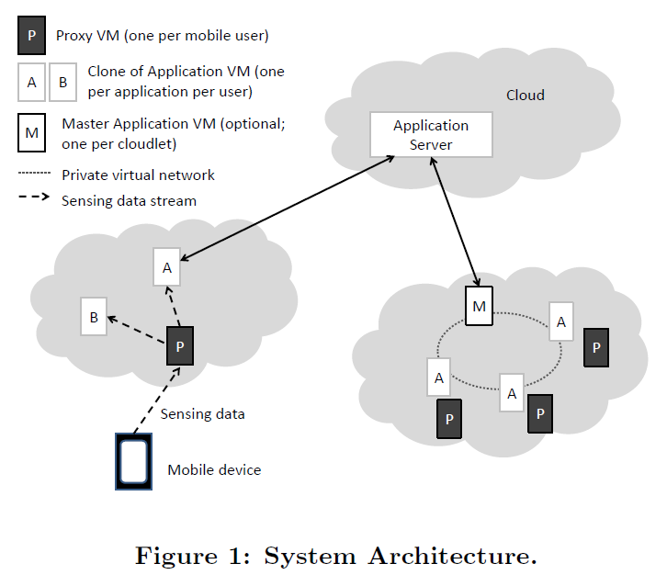
System architecture

Slide 10
Cont.
Each proxy VM is associated with a single mobile device
  Ensuring network resources to transfer data from the mobile device is minimized
  Application collects data and proxy VM handles it
The proxy VM is an extension of the mobile device into the cloudlet
  Can perform custom data preprocessing
  Data is forwarded to one or more application VMs
Application VMs perform data processing steps to each crowdsensing application
  Each application VM hosts a single crowdsensing application
    Not customized specific mobile platform
Application server can initiate the master application VM (MAVM)
  Coordinate, clone, and configure the application VMs on the cloudlet
  Aggregate data before forwarding results

Slide 11
Cont.
Our deployment model have 2 assumptions
  Architecture depends on distributed cloud infrastructure near the user
    For the purpose of energy savings and latency reduction
  Our approach assumes a standard API exists for the data transfer between the proxy VM and the associated application VMs
    The output data can be represented as a few integers
    Combining such data with standardized XML format descriptions
    Several programming frameworks have proposed

Slide 12
Crowd Bootstrap
The task generator (ex. Smartphone) constructs and sends a task description to the application server
Application server parses the task description and find the target from registry
Application server contacts the cloudlet daemon and request MAVM be created
MAVM uses a cloudlet-local registry to discover proxy VMs
MAVM requests participation from the mobile users through the proxy VMs
MAVM will request the cloudlet daemon to create application VMs
MAVM configures the networking setup, while proxy VM add the new application VM to the list
Notes:
.

Slide 13
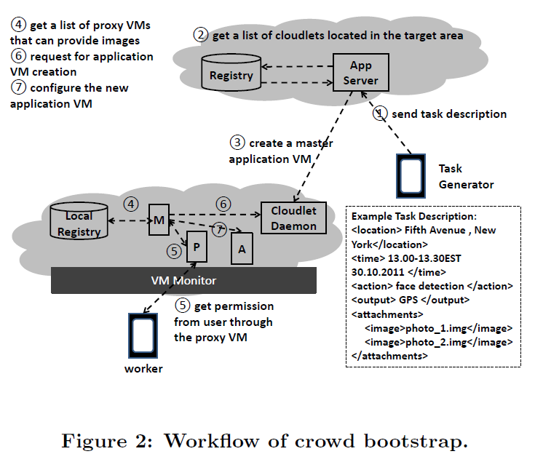

Slide 14
Benefits of our design
Separating the process of data collection and sharing from application-specific processing
  Developer can focus on latter, rather than porting their application to a myriad of mobile platforms
    Increasing the choices in programming languages
    Free to use a variety of programming models
Providing higher degree of privacy by possessing own proxy VMs
Flexible in partitioning work between the proxy VM and mobile device

Slide 15
Cont.
Reducing the burden on users and their mobile devices for participating crowdsensing
  Users only need to install one app for participating the crowd
    Not proprietary apps
  Demands on mobile device can be reduced
    Reduction in data transmission helps save energy
  Performing processing and data aggregation close to the data sources
    Reducing the traffic on wide-area networks
    Reducing network latency by avoiding long-distance transmission through backbone networks

Slide 16
Challenges
Virtualization overhead
Migration-induced reconfiguration
Standardization of sensing interfaces

Slide 17
Virtualization overhead
Virtualization create a flexible platform
  These advantage come at the price of both VM creation overhead & need for more advanced inter-VM communication management
Once VM monitor starts, it reserve all the memory for VM
Solution is
  Reduction the number of running VMs
  Adopting the advanced VM cloning mechanism

Slide 18
Migration-induced reconfiguration
Physical mobility of a device trigger the migration of the proxy VM and application VM
  The IP address of both may change
To maintain connection, automated advanced network reconfiguration is needed
  Including network addressing, NAT settings and firewall setup in VM
Due to this overhead, IP-based may not adequate on performance
  Non-IP-based solution such as Host Identify Protocol
  But these protocols still need to be evaluated in real networks

Slide 19
Standardization of sensing interfaces
Standard format has not been made yet for communication
  Between proxy VMs and application VMs

Slide 20
Conclusion
Existing deployment model for crowdsensing applications does not support
  Efficient crowd scaling over heterogeneous mobile platforms
  Data sharing between crowdsensing applications
Exploring the potential usage of VM-based cloudlets for lowering the barriers to scaling up crowdsensing applications
There are many challenges

