Slide 1
Section 10.2: UDP Header
서경진
2015010493

Slide 2
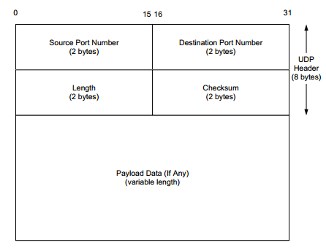
UDP Header
In UDP, port numbers are positive 16-bit numbers, and the source port number is optional; it may be set to 0 if the sender of the datagram never requires a reply
Transport protocols such as TCP, UDP, and SCTP [RFC4960] use the destination port number to help demultiplex incoming data from IP.

Slide 3
Section 10.3: UDP Checksum

Slide 4
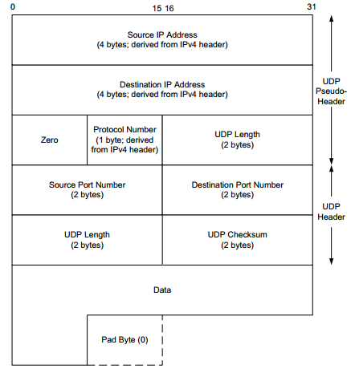
UDP Checksum
It covers the UDP header, the UDP data, and a pseudo-header (defined later in this section).
It is computed at the initial sender and checked at the final destination.
The length of the UDP datagram can be an odd number of bytes, whereas the checksum algorithm adds 16-bit words (always an even number of bytes).
UDP (as well as TCP) computes its checksum over a 12-byte pseudo-header derived (solely) from fields in the IPv4 header or a 40-byte pseudo-header derived from fields in the IPv6 header.

Slide 5
Section 10.5: UDP and IPv6

Slide 6
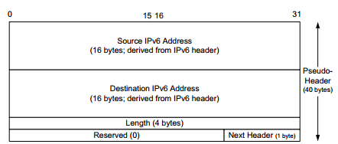
UDP and IPv6
when UDP is used with IPv6, a pseudo-header checksum, common to both UDP and TCP, is required (by Section 8 of [RFC2460]). The construction of the pseudo-header is given in Figure
First, in IPv6, the minimum MTU size is 1280 bytes (as opposed to the 576 bytes required by IPv4 as the minimum size required to be supported by all hosts).
IPv6 supports jumbograms (packets larger than 65,535 bytes).

Slide 7
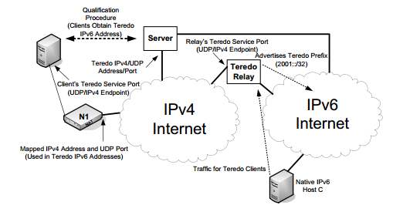
UDP and IPv6
Teredo (also called Teredo tunneling) transports IPv6 datagrams in the payload area of UDP/IPv4 datagrams for systems that have no other IPv6 connectivity options.
Teredo clients are IPv4/IPv6 hosts that implement a Teredo tunneling interface. Such interfaces are assigned special Teredo addresses using the 2001::/32 IPv6 prefix after having successfully engaged in a “qualification” procedure, described in the next paragraph. Teredo servers, which serve a general purpose similar to STUN servers, are used to help establish direct tunnels of Teredo-encapsulated IPv6 packets through NATs.

Slide 8
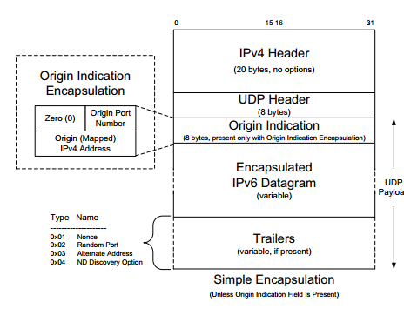
UDP and IPv6
The RA contains a Prefix Information option with a valid Teredo prefix (see Chapter 2). The Origin Indication provides the client with knowledge of its own mapped address and port information.
A Teredo address (see Figure 10-7) contains the Teredo prefix (2001::/32), the IPv4 address of the Teredo server, a 16-bit Flags field detailed in the next paragraph, followed by the mapped port number and mapped IPv4 address.

Slide 9
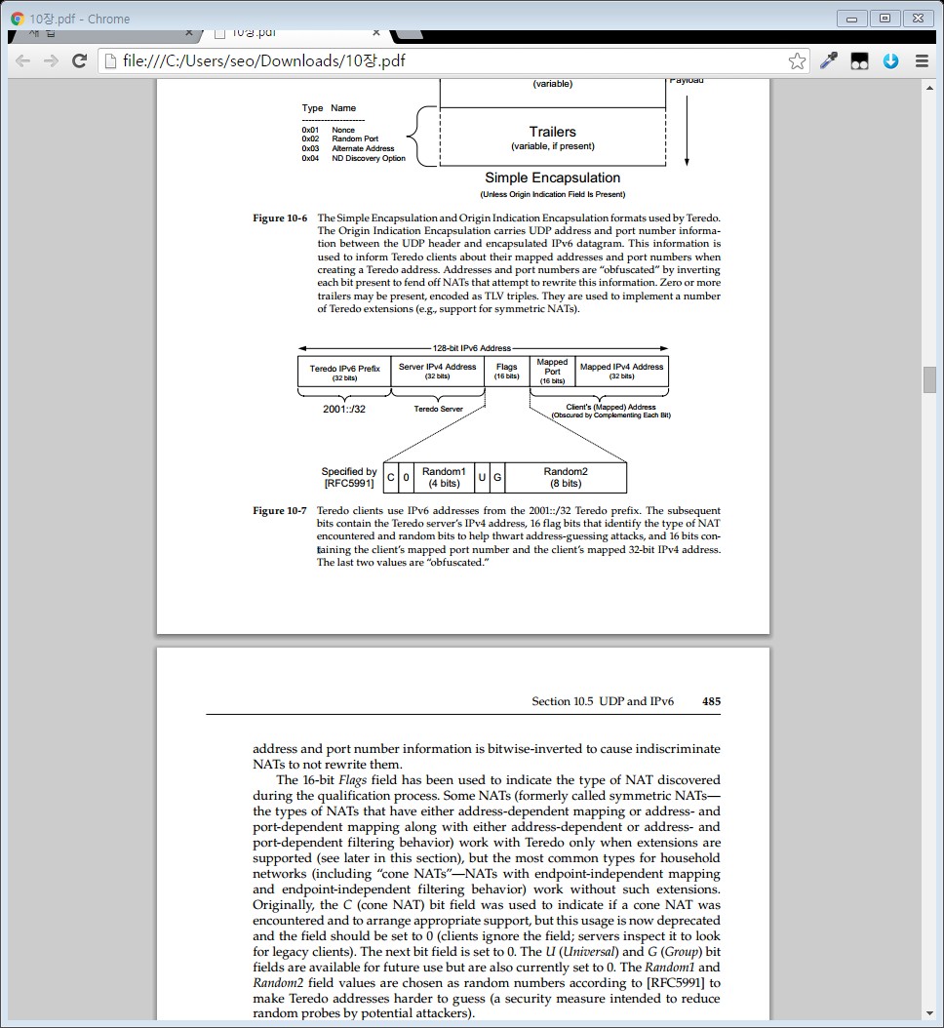
UDP and IPv6
the C (cone NAT) bit field was used to indicate if a cone NAT was encountered and to arrange appropriate support, but this usage is now deprecated and the field should be set to 0
The U (Universal) and G (Group) bit fields are available for future use but are also currently set to 0. The Random1 and Random2 field values are chosen as random numbers according to [RFC5991] to make Teredo addresses harder to guess

Slide 10
UDP and IPv6
When a qualified client has a packet to send to an IPv6 host (i.e., one that does not use a Teredo address), it first determines whether it already knows a Teredo relay for the destination. If so, the packet is sent using Simple Encapsulation. If not, the client formats an ICMPv6 Echo Request containing a large (e.g., 64-bit) random number and sends it to the IPv6 destination by way of the Teredo server.
The server forwards this packet to the destination IPv6 host.
The receiving host sees an incoming IPv6 datagram with the source address equal to the Teredo address of the client.
It forms an Echo Reply, which is routed to the nearest Teredo relay.
As of [RFC6081], Teredo can support a number of optional extensions, several of which help to support Teredo operation with symmetric NATs.

Slide 11
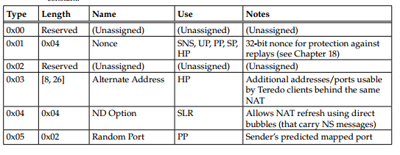
UDP and IPv6
The Nonce trailer contains a 32-bit random value that is unique for each message. It is a security measure to guard against replay attacks (see Chapter 18) and is used with either HP or SNS (IPv4 address, port) pairs.
The ND Option trailer includes 1 byte that indicates either TeredoDiscoverySolicitation (0x00) or TeredoDiscoveryAdvertisement (0x01). In the first case, the receiver is requested to respond with a direct bubble (i.e., sent directly between Teredo clients) containing the second form of message

Slide 12
UDP and IPv6
the C (cone NAT) bit field was used to indicate if a cone NAT was encountered and to arrange appropriate support, but this usage is now deprecated and the field should be set to 0
The U (Universal) and G (Group) bit fields are available for future use but are also currently set to 0. The Random1 and Random2 field values are chosen as random numbers according to [RFC5991] to make Teredo addresses harder to guess

Slide 13
Section 10.6. UDP-Lite

Slide 14
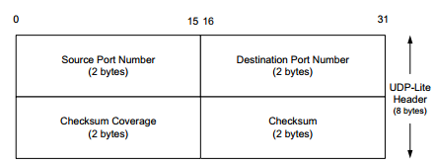
UDP-Lite
A protocol called UDP-Lite or UDPLite [RFC3828] addresses this issue by modifying the conventional UDP protocol to provide partial checksums.
UDP-Lite modifies the UDP header by replacing the (redundant) Length field with a Checksum Coverage field

