Slide 1
MoodScope:
Building a Mood Sensor from Smartphone Usage Patterns
_Robert LikamWa, Yunxin Liu, Nicholas D. Lane, Lin Zhong _ MobiSys 2013
박해월

Slide 2
Contents
Introduction
Background and Motivational Application
Related Work
User Study and Field Data Collection
The Design of MoodScope Models
Mood Inference Engine
MoodScope Social Sharing Application
Discussion and Future Work
Conclusions

Slide 3
Introduction
A mood “sensor” as a vital next step in enhancing the context-awareness of mobile devices

Slide 4
MoodScope: peer into usage data and infer mood
Approach
  Smartphones have rich information about us
  People use smartphone differently in different mood states
MoodScope
  Require no extra hardware sensors
  Does not rely on the use of microphone or camera
  Lightweight and power efficient
    Runs in the background, monitoring traces of user’s smartphone usage
  Application-independent
    Easy deploy on existing smartphones
Notes:
2. where we have been, with whom we communicate, what applications we use, and even more.
10. MoodScope is easy to deploy on existing smartphones without any modification to the OS and applications.

Slide 5
Main Contribution
Demonstrate the feasibility of inferring mood from smartphone usage
  Daily mood averages estimate accuracy 66% , gradually grows 93% over two months of training
Make discoveries regarding mood and mood inference
  Categorized application usage and phone calls are strong indicators of mood
Design a user-friendly mood journaling tool to effectively collect user mood data
Describe a lightweight, power-efficient, and easy-to-deploy realization of MoodScope, consuming only 3.5 milli-Watt-hours over a day
  Also include an API for developers
Notes:
• We demonstrate the feasibility of inferring mood from smartphone usage, paving the way for energy-efficient, privacy-preserving systems that automatically infer user mood. Validated with a two-month dataset collected from 32 users, our system, MoodScope, estimates users’ daily mood averages with an accuracy of 66% which gradually grows to 93% over two months of training.
• The data from 32 users also allows us to make novel discoveries regarding mood and mood inference: We show that how mood affects smartphone usage is personal; a general model performs significantly worse than personalized models. We show that categorized application usage and phone calls are strong indicators of mood for our participants.
• We design a user-friendly mood journaling tool to effectively collect user mood data. Beyond data collection, it provides useful functions for users to review their mood history and thus encourages them to provide accurate ground truth.
• We describe a lightweight, power-efficient, and easy-todeploy realization of MoodScope, consuming only 3.5 milli-Watt-hours over a day. We also include an API for developers to interface with mood, which we use to develop and deploy a sample mood-sharing application.

Slide 6
Background and Motivational Applications
The Science of Mood
Motivational Applications

Slide 7
Mood: is an affective state
Mood vs. Emotion
  Mood is typically less intensely felt by an individual and tends to last longer than emotion
  Mood is normally a reaction to a cumulative sequence of events while emotion is more spontaneous reaction or feeling caused by a specific event
  Mood is more internal, while emotion is more visible to others.
[Psychology] 3 models to describe and measure affect
  Circumplex mood model
  Discrete categories – Ekman’s six basic categories
  Positive and Negative Affect Schedule (PANAS) model – checklist, 20 items

Slide 8
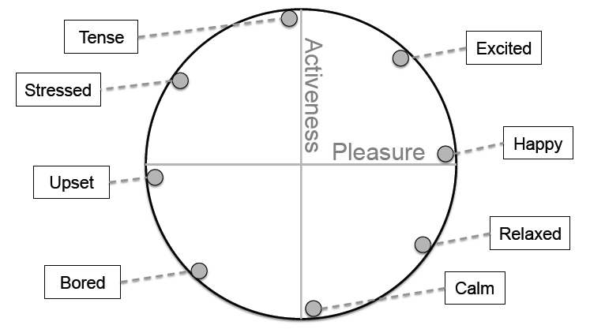
Mood Model: Circumplex mood model

Slide 9
Motivational Applications:
Automatic mood sensing can enable various applications
Mood logger and browser
  Recall valuable moments, understand the influence of factors on mood, help improve mental health
Mood sharing
  Share mood with friends via social networks (convert mood states into a single sentence or through a colored icon)
Mood-enhanced applications
  Music players could automatically create mood-based playlists
  Smartphones could change their theme, wallpaper or ringtone settings
  Web, image, and/or video search could filter results

Slide 10
Related Work
Existing automated approaches for affect recognition

Slide 11
Related Work: sensor-based techniques
Recognizing emotions from voice and video
  Momentary smiles tell little about long-term mood states
  The facial or spoken expressions may not reflect their true feelings
  Sensing and computational burden on a smartphone
Alternative physiological signals
  Skin conductance, heart rate, breath rate, blood pressure, skin temperature
  Difficult-to-fake indications of affective states
  Key limitation – requires additional hardware

Slide 12
Related Work: sensor-based techniques
Leveraging signals from smartphones
  Classify users emotions based on typing characteristics
  Use smartphone usage patterns to model personality
  Emotion-related smartphone applications do not study automated mood or emotion inference
Comparison to MoodScope
  Exploits pre-existing usage patterns of an individual
  Avoids invasive image and audio data, design a mood recognition engine on current smartphone Oses
  Run continuously in the background without compromising phone battery life

Slide 13
User Study and Field Data Collection
Pre-Study Focus Group
Field Study
Post-Study Focus Group

Slide 14
Participants:
32 jailbroken iPhone users from China and the USA
24 college and graduate students, 2 software engineers, 1 web editor, 1 salesman, 1 teacher
Aged between 18 and 29 with 11 females
25 in Beijing, China and 7 at a US university
  Participants from Beijing took part in two focus group discussions
Compensated with RMB500 or $75 USD and became eligible for and iPad 2 raffle after completion of the study

Slide 15
Pre-Study Focus Group:
To gather insight into what data we should collect
Two-part pre-study focus group
  Impact of mood changes on smartphone usage habits
  Opinions on mood sharing
Results
  All but one indicted that they use different applications and/or communicate with different sets of people depending on their mood and would like their smartphone settings to automatically change with their moods
  All but one responded that they would like to publish their mood through SNS
  All indicated that they would like to share their mood within certain social circles
  All interested in seeing others’ mood, particularly of their friends

Slide 16
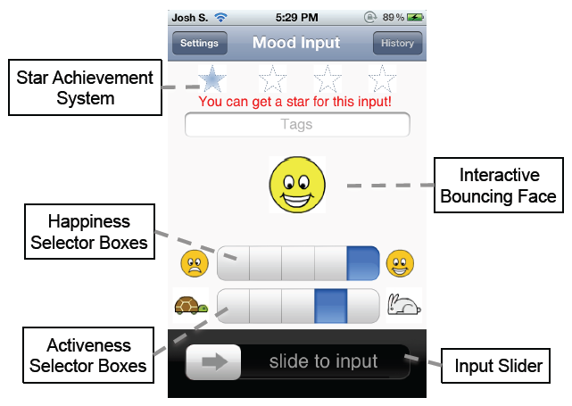
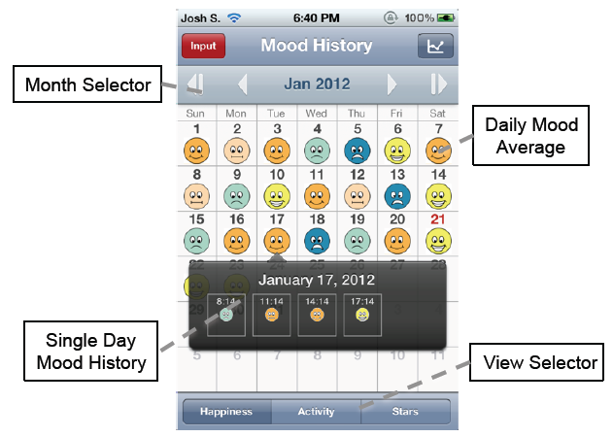
Field Study:
Mood Journaling Application

Slide 17
Field Study:
Smartphone Interaction Logger
Users are asked to input their mood at least four times a day, with at least three hours between each input
Logger
  Captures user behavior by using daemons operating in the background, Requiring no user interaction
  Date archived nightly to a server over a cell data or Wi-Fi connection
  Hashing all private user data
Using these data, create feature tables for mood models

Slide 18
Post-Study Focus Group: Ask for opinions about usability and effectiveness of mood journaling application
Feedback
  All but one indicated the application is easy to use, the other participant had suffered a bug of our application, which fixed once it was reported
  Only three reported that prompting for four mood inputs per day was too frequent, two of them explained that their mood didn’t change quickly
  All but one stated that they entered their mood immediately after receiving a reminder at least 50% of the time, main reasons for non-immediate inputs were that they were busy or not convenient
Limitation of mood journaling application
  Sometimes affective state could change faster than every three hours
  Primary focuses: minimize burden of entry and capture long-lasting mood states

Slide 19
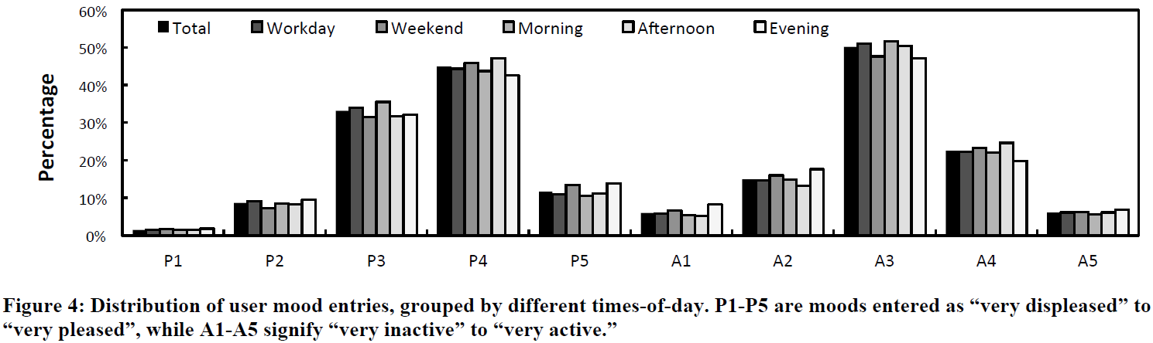
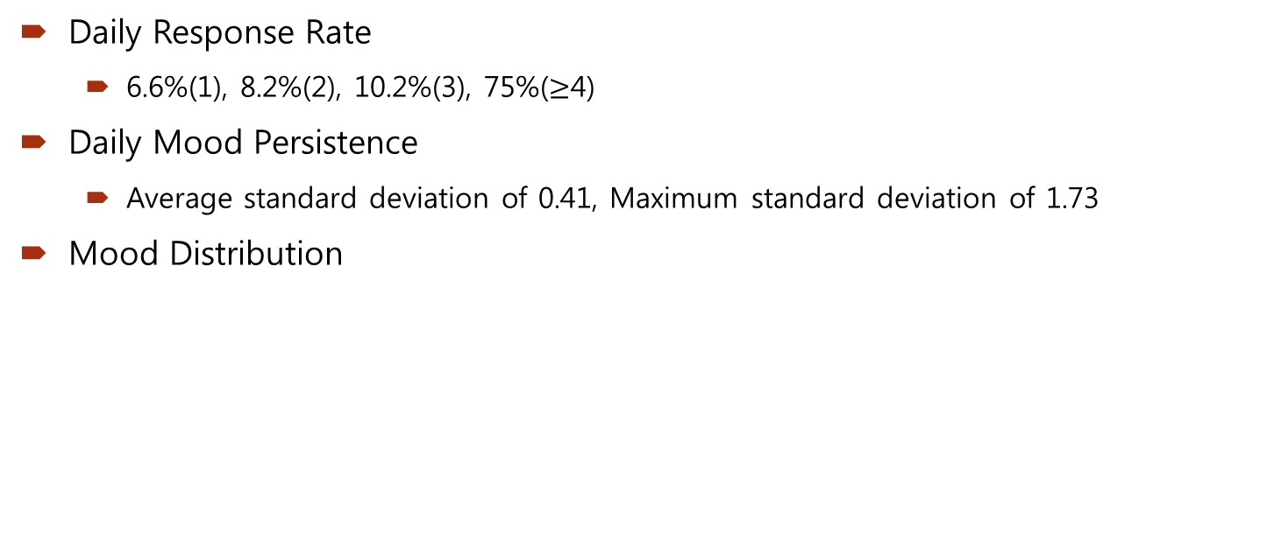
Characteristics of User Mood Entries:
Mood is fairly constant and slow-to-change
Daily Response Rate
  6.6%(1), 8.2%(2), 10.2%(3), 75%($≥$4)
Daily Mood Persistence
  Average standard deviation of 0.41, Maximum standard deviation of 1.73
Mood Distribution

Slide 20
Smartphone Usage Data
Smartphone Usage Data
  15,683 phone calls
  36,989 SMSes
  13,476 emailes
  142,633 instances of application usage
    1,678 unique applications
  27,411 Web visits
  1,146 unique clustered location records
Use these smartphone usage data and the self-reported mood entries to train mood models in MoodScope

Slide 21
The Design of MoodScope Models
The crux of MoodScope is in its ability to estimate a user’s mood

Slide 22
Daily Averages as MoodScope Output
Separate the mood inputs into their two dimensions
Average all inputs in a calendar day.
The resulting average moods for each of the sixty days of training act as sixty pairs of labels for our mood model
A robust estimation of daily mood averages serves as the output of MoodScope’s Mood Inference Engine

Slide 23
Usage Records as MoodScope Input
Build MoodScope’s inference feature table on the usage records collected by logger
Mood-sensitive behavior
  Social interaction
  Routine activity
Indirectly observe these patterns
  Through a variety of social interaction and routine activity relative frequency histograms

Slide 24
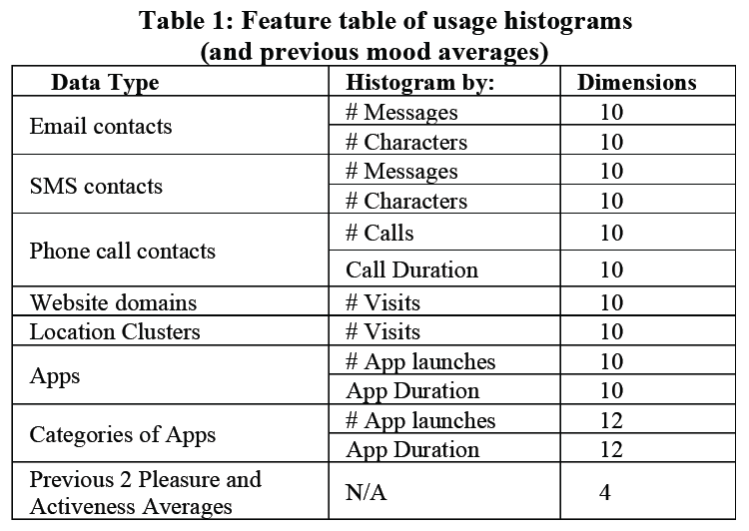
Usage Records as MoodScope Input:
Initial feature table

Slide 25
Internal Model of MoodScope:
Multi-Linear Regression
The daily averages of mood are non-integer numerical values
  Use least-squares multiple linear regression
Use Leave-One-Out-Cross-Validation(LOOCV)
  Trains the model on all but one of the samples and validates the model on the remaining sample

Slide 26
Internal Model of MoodScope:
Sequential Forward Selection of Features
Choose a subset of relevant features to accelerate the learning process
Sequential Forward Selection (SFS) – pick a subset Y of the feature table that will give the best regression
  Y starts out as an empty set
  SFS iterates, finding the feature x which is not already in Y that provides the best fit to the data
    Minimizing the mean error of the fit, adds x to Y, continues to iterate
  SFS stop running when it reaches a local minimum
Through this process, SFS appropriately select the data’s most representative features, reducing the dimensionality of feature table

Slide 27
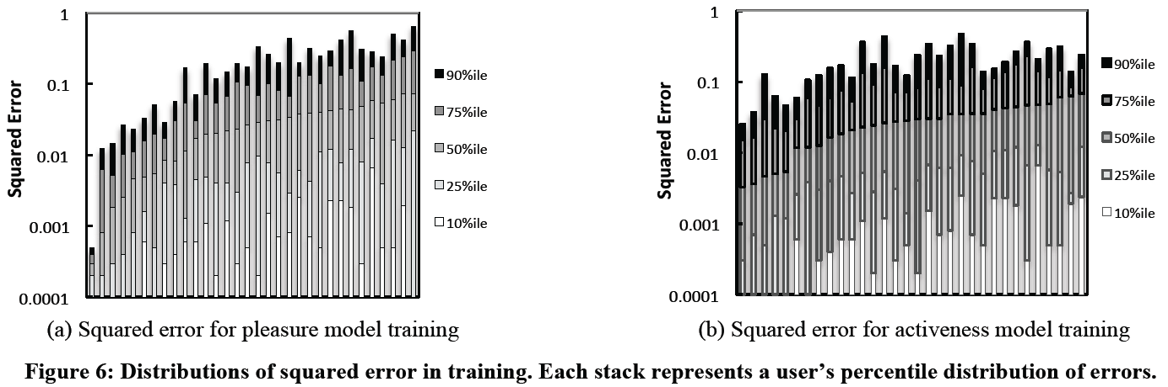
Internal Model of MoodScope:
Personalized Mood Model

Slide 28
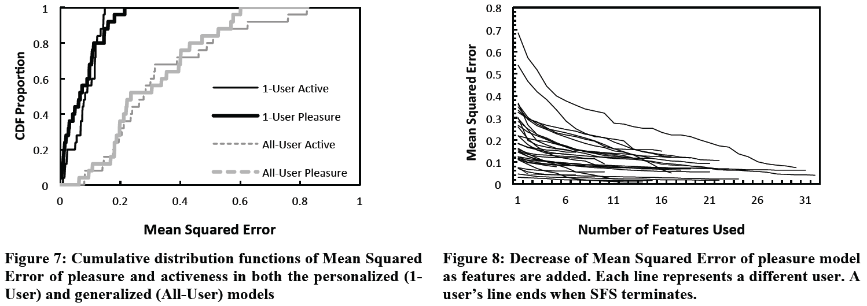
Internal Model of MoodScope:
Personalized Mood Model

Slide 29
Internal Model of MoodScope:
All-User Mood Model
Attempt to reduce the amount of training required by the training by forming a “one-size-fits-all” mood model created from an aggregate of all of the users’ data
“one-size-fits-all” mood model
  Remove a user’s data from our dataset
  Preform a multi-linear regression on the remaining data
  Apply the model to the user’s data and compute the mean-squared-error of the computed mood
Only 66% of pleasure estimates, 67% of activeness estimates are off by less than 0.25 squared-error

Slide 30
Internal Model of MoodScope:
Hybrid Mood Model Approaches
Blend together the respective strengths of the personalized (high accuracy) and all-user (no user training) modeling approaches
  Combine a small amount of user-specific training data with larger amounts of training data collected from the general user population
Fit a multi-linear regression model with a modified objective function that prioritizes reducing residual errors related to personalized training data above errors related to training data sourced from the rest of the population
  As a result, the hybrid model is able to incorporate unique characteristics in how an individual user’s smartphone data relate to their mood while also capturing the coarse-grain patterns that are common across all people

Slide 31
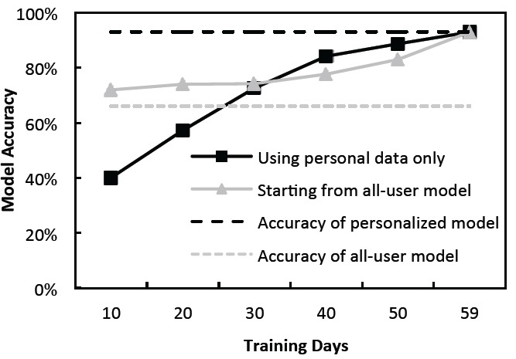
Internal Model of MoodScope:
Hybrid Mood Model Approaches

Slide 32
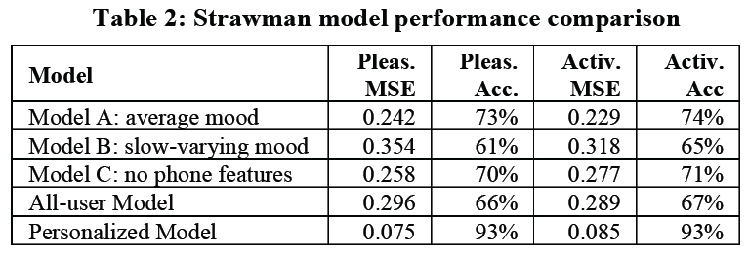
Internal Model of MoodScope:
Comparison to Strawman Models

Slide 33
Internal Model of MoodScope:
Predicting Two-Dimensional Mood
Two months of personalized training data
  Each dimension is within 0.25 squared error for 93% of the days
  85% of the estimated two-dimensional daily moods are within 0.25 squared error
Significantly better than
  Random guessing at 4% accuracy
  Choosing the most common mood (P4, A3) at 25.4% accuracy

Slide 34
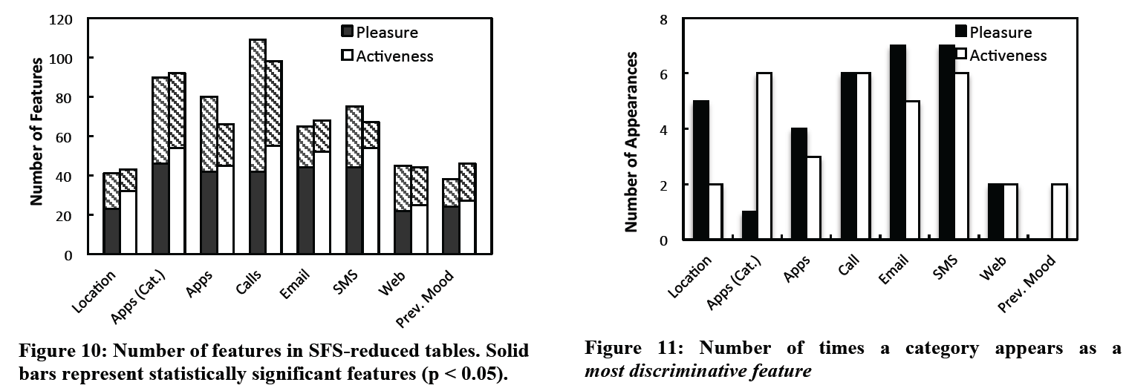
Feature Table Characteristics:
Discriminative Features

Slide 35
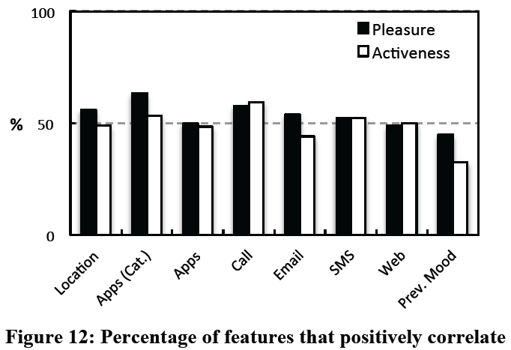
Feature Table Characteristics:
Positively and Negatively Correlated Features

Slide 36
Mood Inference Engine
Training on the Cloud
Inference on the Phone

Slide 37
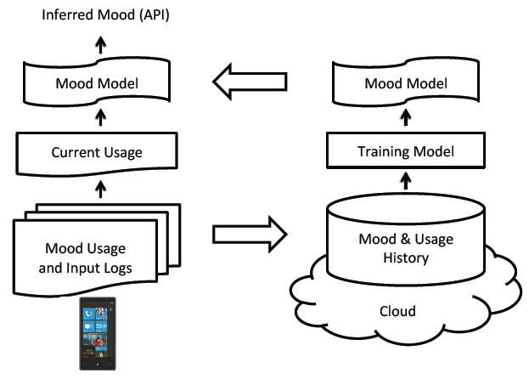
Mood Inference Engine

Slide 38
Training on the Cloud
Performs a combination of SFS and multi-linear regression
A collection of Unix bash scripts and Perl scripts – 815 lines of code
Models are trained using MATLAB scripts that perform multi-linear regression with feature selection
Use the Hybrid Mood Model to bootstrap the training mechanism
On a QuadCore 2.4GHz Intel i7 processor, these two stages take on average 12 minutes at 100% computation to train a single mood model

Slide 39
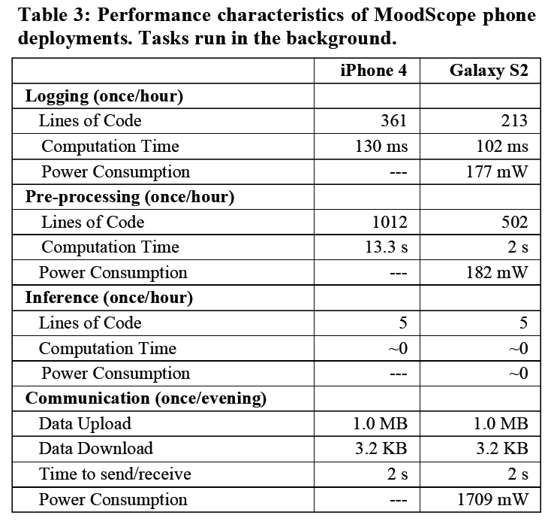
Inference on the Phone

Slide 40
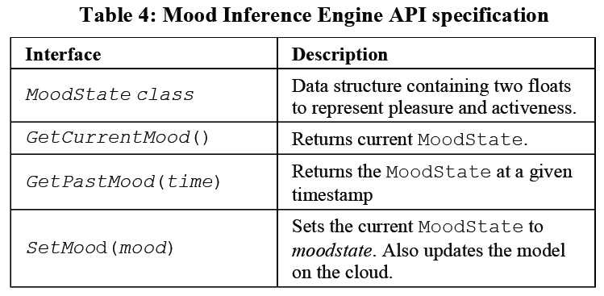
Application Programming Interface

Slide 41
MoodScope
Social Sharing Applicatioin
An end-to-end demonstration of a fully functional mood-aware application

Slide 42
Discussion and Future Work
Small-scale Validation
Entering Mood Four Times Daily
Factor Capturing Limitation
Privacy Preserving Mechanisms

Slide 43
Conclusions
Mood inference, a vital next step for application context-awareness
Study the possibility of mood-inference from smartphone usage analysis, using statistical regression techniques, regress the daily average of mood.
Also find that phone calls and categorized applications strongly predicted mood
Build a Mood Inference Engine that can apply mood models to smartphone user data in real time

