Slide 1
Hand Gesture-based Visual User Interface for Infotainment
(AutomotiveUI ’12)
무선데이터통신연구실 박해월

Slide 2
Contents
Introduction
Hand Gesture-based Visual User Interface For Infotainment
Experimental Validation in LISA Testbeds
Experimental Evaluation
Conclusion

Slide 3
Introduction
A real-time vision-based system
  that discriminates hand gestures performed by in-vehicle front-row seat occupants for accessing the infotainment system
Focus on infotainment-based interactions
  in particular, posing an alternative to the current mainstream tactile (buttons) interaction that may require the driver to look away from the road

Slide 4
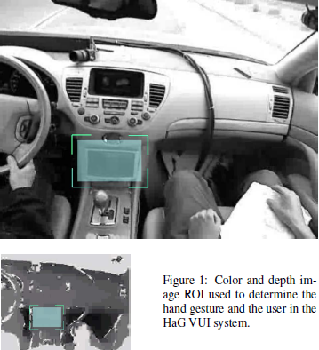
HaG VUI
(Hand Gesture-based Visual User Interface for infotainment system)

Slide 5
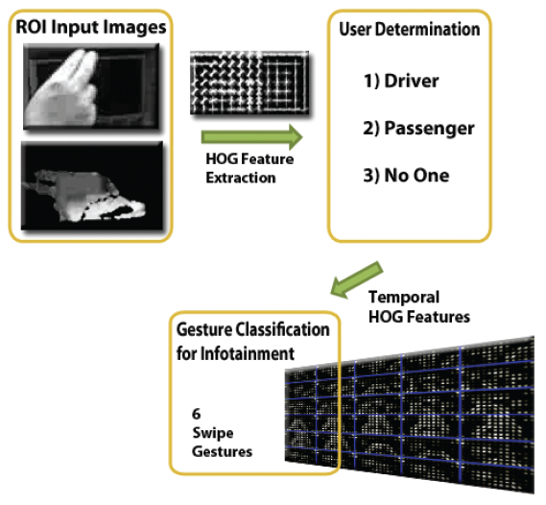
HaG VUI
(Hand Gesture-based Visual User Interface for infotainment system)

Slide 6
HaG VUI
(Hand Gesture-based Visual User Interface for infotainment system)
The initial user determination part
  Modified histogram-of-oriented-gradients (HOG) image descriptor
    CHENG, S. Y., AND TRIVEDI, M. M. Vision-based infotainment user determination by hand recognition for driver assistance. IEEE Transactions on Intelligent Transportation Systems 11, 3 (September 2010), 759–764.
  Support vector machine (SVM)
    Machine learning algorithm
    Classify the current user in the ROI
      Driver, passenger, no one

Slide 7
HaG VUI
(Hand Gesture-based Visual User Interface for infotainment system)
Modified HOG descriptor
  Take the gradient of image patch
  Divide the gradient image into small cells
  Within each cell, quantize the angles (orientation) of the gradient vectors and bin them to form a histogram
  Concatenation of the resulting histogram from each cell forms the final HOG descriptor for the image patch

Slide 8
HaG VUI
(Hand Gesture-based Visual User Interface for infotainment system)
Extracts gesture characteristics
  Collect the HOG feature vector
  Form a ‘histogram image’
    Collection of HOG feature vectors
  Perform a second HOG feature extraction on this temporal sequence of feature vectors
  Use SVM to classify the gesture

Slide 9
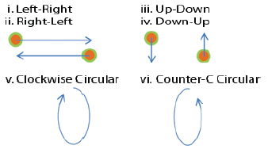
Experimental Validation in LISA Testbeds

Slide 10
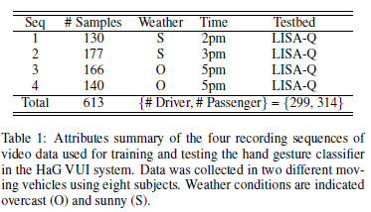
Experimental Validation in LISA Testbeds

Slide 11
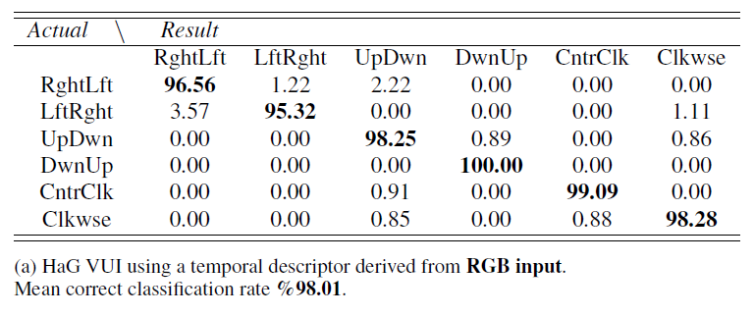
Experimental Evaluation

Slide 12
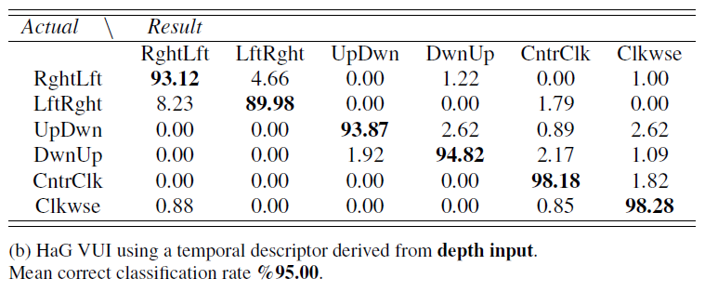
Experimental Evaluation

Slide 13
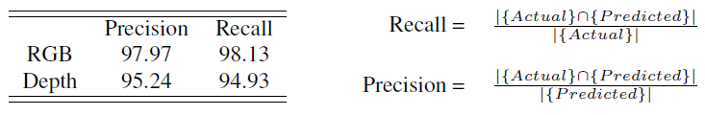
Experimental Evaluation

Slide 14
Conclusion
The result of this work suggests that a reliable vision-based system in the volatile environment of the vehicle interior is feasible
Future work
  Further evaluate the robustness of the system
  Dynamic ROI
  Incorporation of RGB and depth

