Slide 1
Section #4.2: An Example(ARP)
최병준
2015020802

Slide 2
4.2 An Example(ARP)
The most basic decision it makes is whether that service is local (part of the same IP subnetwork) or remote
ARP operates only when reaching those systems on the same IP subnet.
For this example, then, let us assume that we use a Web browser to contact the following URL:
http://10.0.0.1

Slide 3
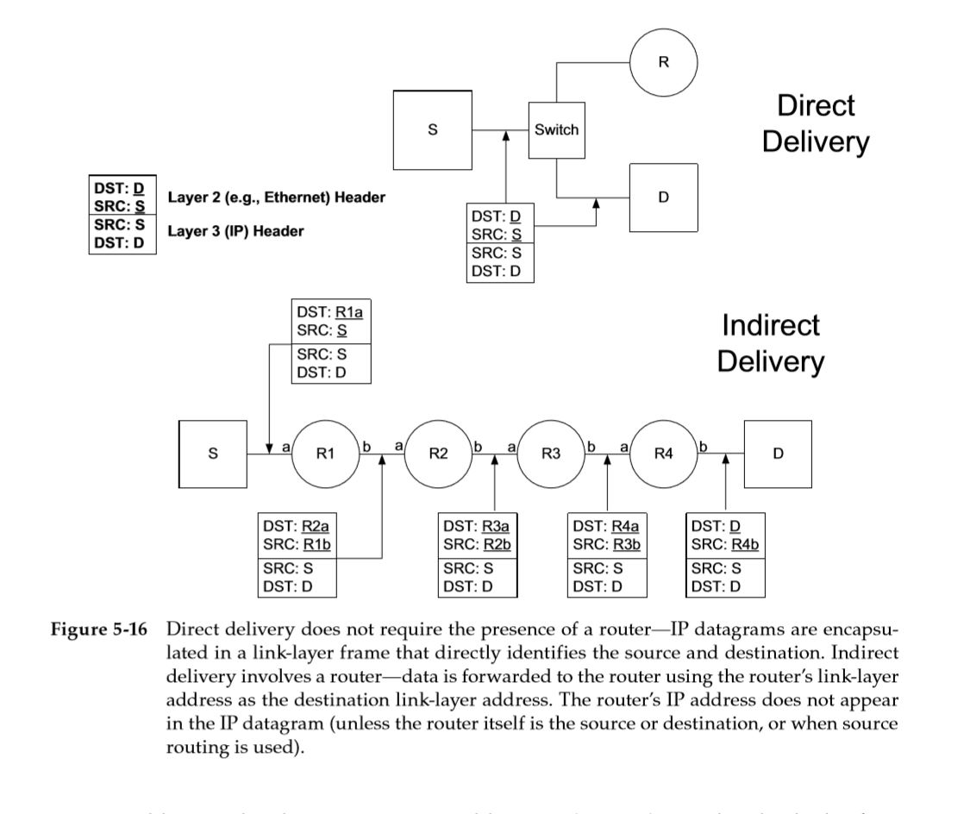
4.2.1 Direct Delivery and ARP
Direct Delivery

Slide 4

4.2.1 Direct Delivery and ARP
ARP Example
지난 학기 우등생인
2015020802 학번의 학생에게
장학증서를 전달해야겠군.

Slide 5
4.2.1 Direct Delivery and ARP
ARP Example
하지만 우등생의 학번만 알지
주소를 모르니 우편을 보낼 수가
없군.

Slide 6

4.2.1 Direct Delivery and ARP
ARP Example
(내 얘긴 아니군)
여기 학번이 2015020802인 학생이 있다면 수업 후에
집 주소 좀 내게 알려주게
(내 학번이 아니야)
(아 내 학번이다!)

Slide 7

4.2.1 Direct Delivery and ARP
ARP Example
교수님 아까 찾으셨던 2015020802
최병준 입니다. 제 집주소는
경기도 안양시 만안구…

Slide 8

4.2.1 Direct Delivery and ARP
ARP Example
아 자네였군.
그래 어디 보자 2015020802 학번의 주소는 경기도..

Slide 9

4.2.1 Direct Delivery and ARP
ARP Example
앞으로는 이 메모를 보고
우편을 보내면 OK구만!

Slide 10
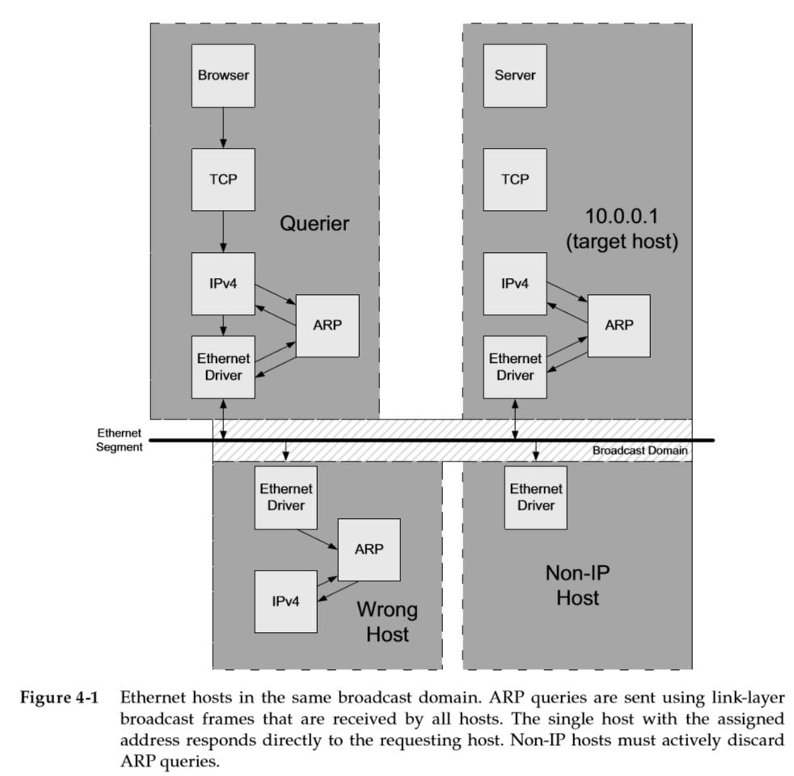
4.2.1 Direct Delivery and ARP
1.
The application calls a special function to parse the URL
The application uses the 32-bit IPv4 address 10.0.0.1

Slide 11
4.2.1 Direct Delivery and ARP
2.
The application asks the TCP protocol
to establish a connection with 10.0.0.1.

Slide 12
4.2.1 Direct Delivery and ARP
3.
TCP attempts to send a connection request segment to the remote host by sending an IPv4 datagram to 10.0.0.1

Slide 13
4.2.1 Direct Delivery and ARP
4.
The datagram can be sent directly to that address without going through a router

Slide 14
4.2.1 Direct Delivery and ARP
5.
The sending host must convert the
32-bit IPv4 destination address
into
a 48-bit Ethernet-style address
This is the function of ARP

Slide 15
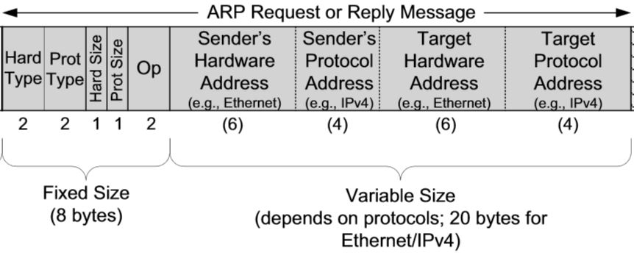
4.2.1 Direct Delivery and ARP
6-1.
ARP sends an Ethernet frame called an ARP request to every host on the shared link-layer segment

Slide 16
4.2.1 Direct Delivery and ARP
6-2.
“If you are configured with IPv4 address 10.0.0.1 as one of your own, please respond to me with your MAC address.”

Slide 17
4.2.1 Direct Delivery and ARP
7-1.
With ARP, all systems in the same broadcast domain receive ARP requests.
Provided there exists an attached system using the IPv4 address specified in the request, it alone responds with an ARP reply

Slide 18
4.2.1 Direct Delivery and ARP
7-2.
The reply does not ordinarily use broadcast but is directed only to the sender.
The host receiving the ARP request also learns of the sender’s IPv4-to-MAC address mapping at this time and records it in memory for later use

Slide 19
4.2.1 Direct Delivery and ARP
8.
The ARP reply is then received by the original sender of the request, and the datagram that forced the ARP request/reply to be exchanged can now be sent.

Slide 20
4.2.1 Direct Delivery and ARP
9.
The sender now sends the datagram directly to the destination host using the Ethernet address learned by the ARP

Slide 21
4.2.1 Direct Delivery and ARP
ARP is used in multi-access link-layer networks running IPv4, where each host has its own primary hardware address
Point-to-point links such as PPP (see Chapter 3)
do not use ARP.
When these links are established,
the system is told of the addresses
in use at each end of the link.

