Slide 1
8.2 : ICMP Messages
김우일
2015011157

Slide 2
ICMP : Internet Control Message Protocol
IP protocol alone provides no direct way for the failure to make it to their destinations.
IP provides no direct way of obtaining diagnostic information.
To address these deficiencies, a special protocol called the Internet Control Message Protocol(ICMP) is used.
ICMP is neither a network nor a transport protocol but lies somewhere between the two.
ICMP does not provide reliability for IP.
It indicates certain classes of failures and configuration information.

Slide 3
ICMP Message Format
ICMP messages are encapsulated for transmission within IP datagrams.
All ICMP messages begin with 8-bit Type and Code fields, followed by a 16-bit Checksum.
The type and code values are different for ICMPv4 and ICMPv6.
0bit |  | 8bit |  | 16bit |  |  | 32bit
Type | Code | Checksum
Contents Depend on Type and Code (variable)

Slide 4
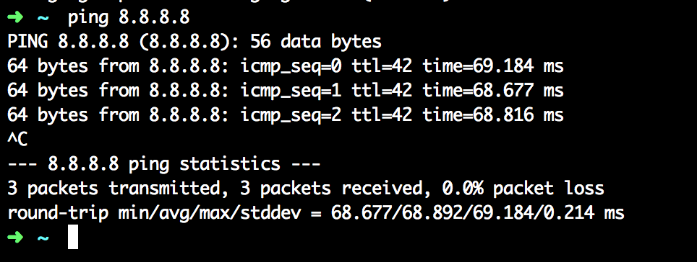
ICMP example : ping

Slide 5
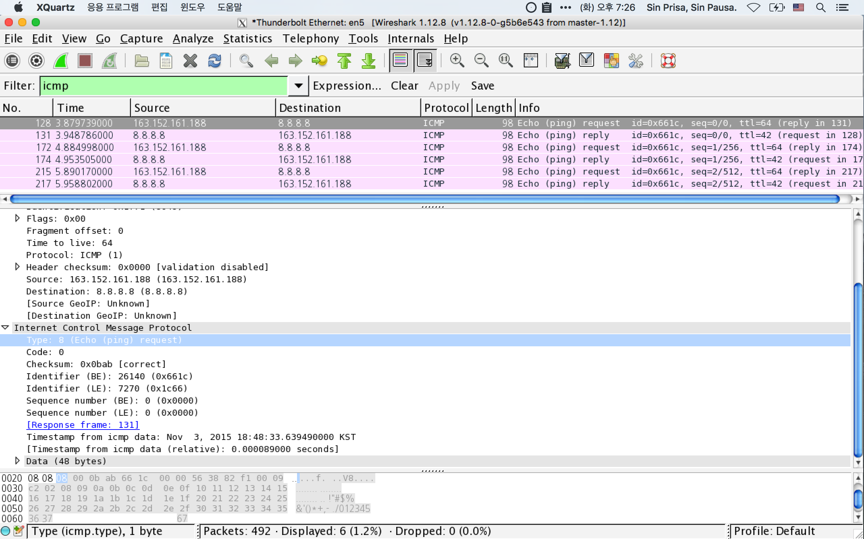
ICMP example : ping

Slide 6
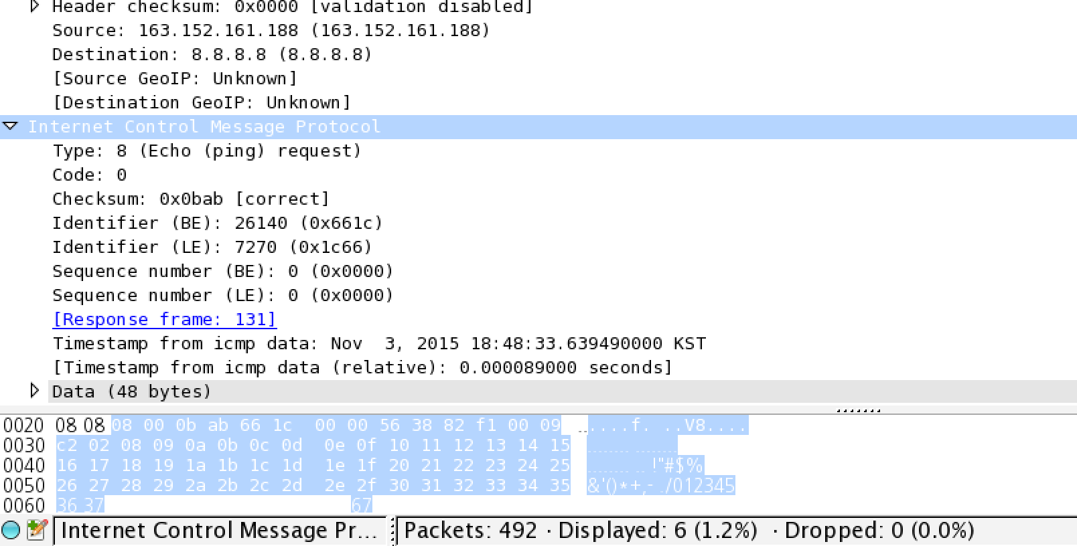
ICMP example : ping

Slide 7
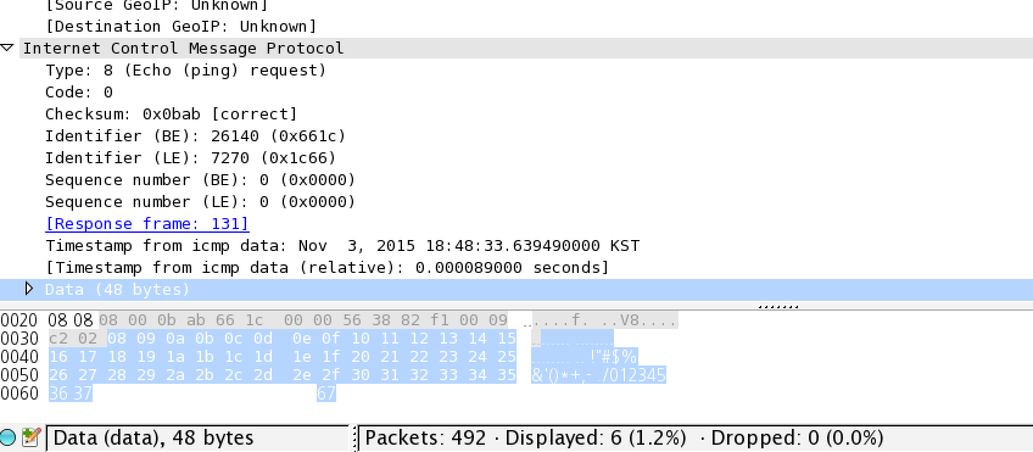
ICMP example : ping

Slide 8
Standard ICMPv4 Message type
0 Echo Reply
3 Destination Unreachable
4 Source Quench (Deprecated)
5 Redirect
8 Echo
9 Router Advertisement
10 Router Solicitation
11 Time Exceeded
12 Parameter Problem

Slide 9
ICMPv4 Code (type 3)
- Destination Unreachable
0 Net Unreachable
1 Host Unreachable
2 Protocol Unreachable
3 Port Unreachable
4 Fragmentation Needed and Don't Fragment was Set

Slide 10
ICMPv4 Code (type 11)
Time Exceeded
0 Time to Live exceeded in Transit
1 Fragment Reassembly Time Exceeded

Slide 11
ICMPv6 standard message types
- ICMPv6 Error Messages (0 to 127)
1 Destination Unreachable
2 Packet Too Big
3 Time Exceeded
4 Parameter Problem
100 Private experimentation
101 Private experimentation
127 Reserved for expansion of ICMPv6 error messages

Slide 12
ICMPv6 standard message types
- ICMPv6 Error Messages (128 to 255)
128 Echo Request
129 Echo Reply
130 Multicast Listener Query
131 Multicast Listener Report
132 Multicast Listener Done
133 Router Solicitation (NDP)
134 Router Advertisement (NDP)
135 Neighbor Solicitation (NDP)
136 Neighbor Advertisement (NDP)
137 Redirect Message (NDP)
141 Inverse Neighbor Discovery Solicitation Message
142 Inverse Neighbor Discovery Advertisement Message
143 Multicast Listener Discovery (MLDv2) reports (RFC 3810)

Slide 13
ICMPv6 standard message types
- ICMPv6 Error Messages (128 to 255)
144 Home Agent Address Discovery Request Message
145 Home Agent Address Discovery Reply Message
146 Mobile Prefix Solicitation
147 Mobile Prefix Advertisement
148 Certification Path Solicitation (SEND)
149 Certification Path Advertisement (SEND)
151 Multicast Router Advertisement (MRD)
152 Multicast Router Solicitation (MRD)
153 Multicast Router Termination (MRD)
155 RPL Control Message
200, 201 Private experimentation
255 Reserved for expansion of ICMPv6 informational messages

Slide 14
Processing of ICMP Messages
The processing of incoming messages varies from system to system.
Generally, the incoming informational requests are handled automatically by the OS.

Slide 15
ICMPv6 messages processing rules
Unknown ICMPv6 error messages must be passed to the upper-layer process that produced the datagram causing the error.
Unknown ICMPv6 informational messages are dropped.
ICMPv6 error messages include as much of the original IPv6 datagram that caused the error as will fit without making the error message datagram exceed the minimum IPv6 MTU(1280 bytes)
When processing ICMPv6 error messages, the upper-layer protocol type is extracted from the original or “offending” packet and used to select the appropriate upper-layer process. If this is not possible, the error message is silently dropped after any IPv6-layer processing.
There are special rules for handling errors. (8.3)
An IPv6 node must limit the rate of ICMPv6 error messages it sends.

