Slide 1
AUTOSAR Technical Overview
Jihun Ha
Korea University

Slide 2
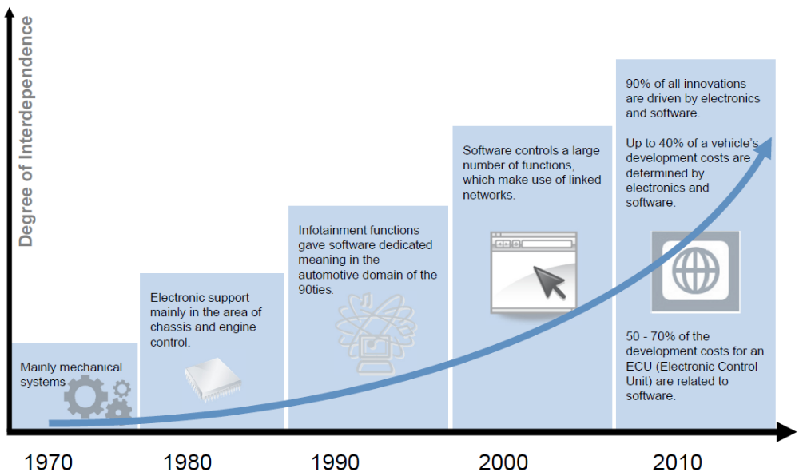
Increasing Complexity in Vehicle Development

Slide 3
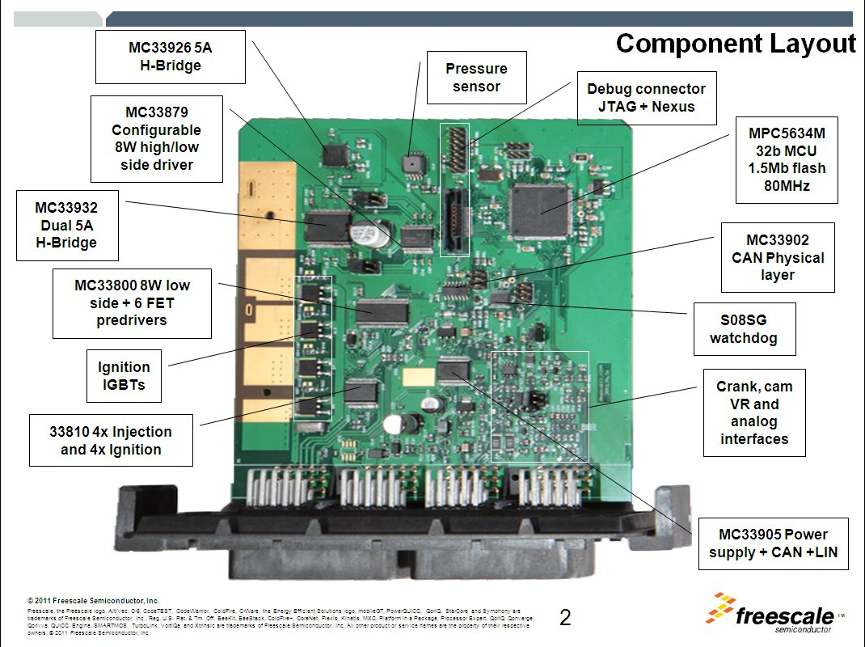
Example news
- Calling all petrolheads: Configurable aftermarket ECUs for sale!

Slide 4
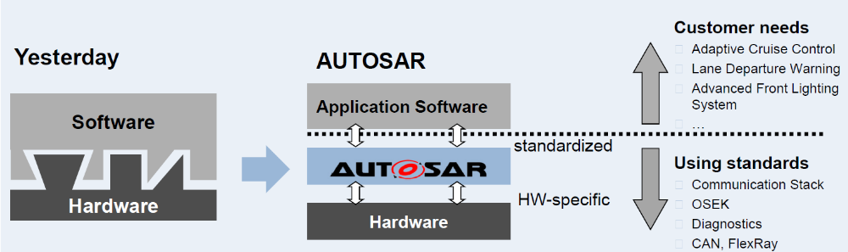
Why do we need AUTOSAR?
AUTOSAR (AUTomotive Open System Architecture)
  A partnership of automotive manufacturers and suppliers
  Purpose: to develop and establish a de-facto open industry standard for automotive E/E architectures

Slide 5
Why do we need AUTOSAR?
Main motivations
  Manage increasing E/E complexity associated with growth in functional scope
  Improve flexibility for product modification, upgrade and update
  Improve scalability of solutions within and across product lines
  Improve quality and reliability of E/E systems
  Enable detection of errors in early design phases

Slide 6
Why do we need AUTOSAR?
Main Goals
  Fulfillment of future vehicle requirements, such as, availability and safety, SW upgrades/ updates and maintainability
  Increased scalability and flexibility to integrate and transfer functions
  Higher penetration of "Commercial off the Shelf" SW and HW components across product lines
  Improved containment of product and process complexity and risk
  Cost optimization of scalable systems

Slide 7
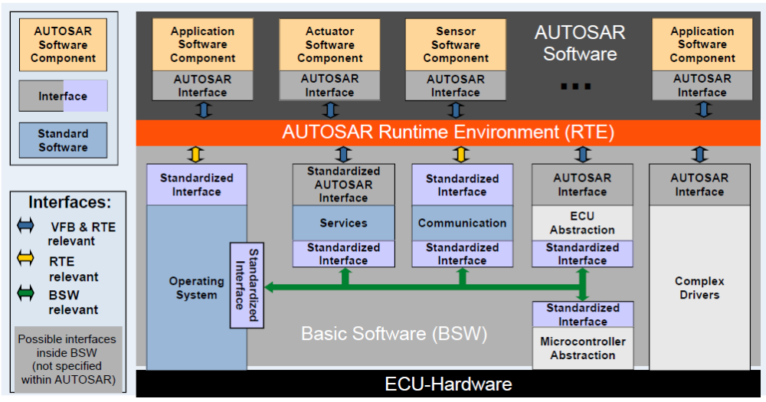
AUTOSAR’s Layered Architecture

Slide 8
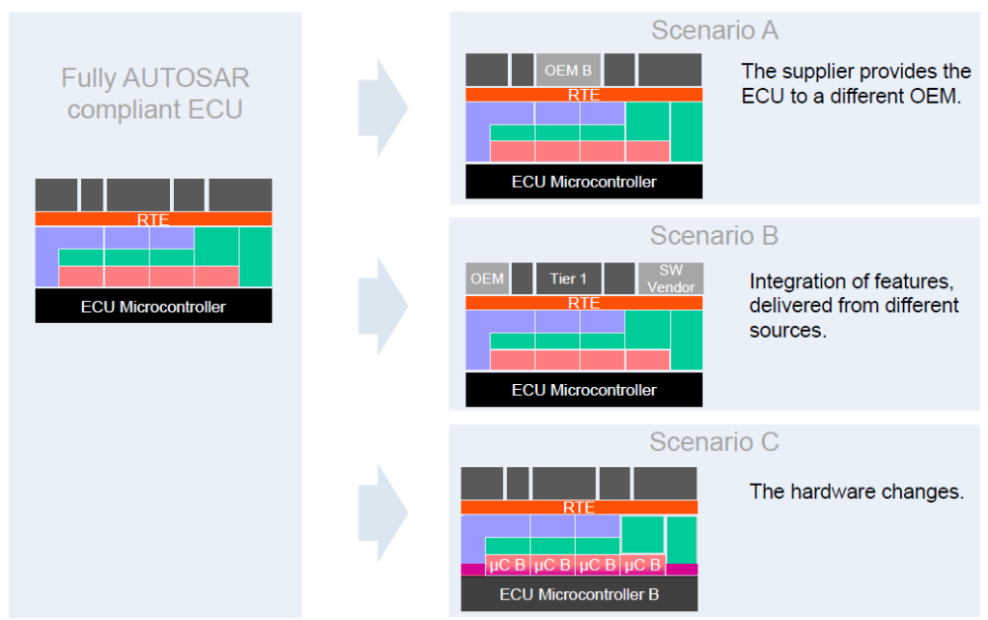
Benefits of Standardized Software Architecture
- Re-Usability of BSW Modules and SW Components

Slide 9
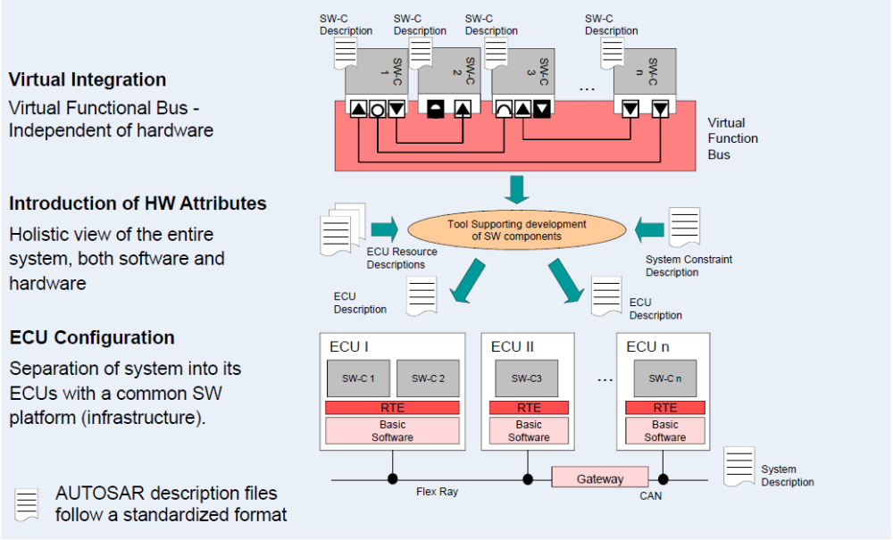
AUTOSAR Methodology
AUTOSAR defines a standardized methodology how to deploy SW on an ECU.

Slide 10
AUTOSAR Software Components
Fundamental design concept is separation between infrastructure and application
Application consists of interconnected software components
Atomic software component: a software component can not be distributed over several ECUs
AUTOSAR software component implementation is independent from the infrastructure

Slide 11
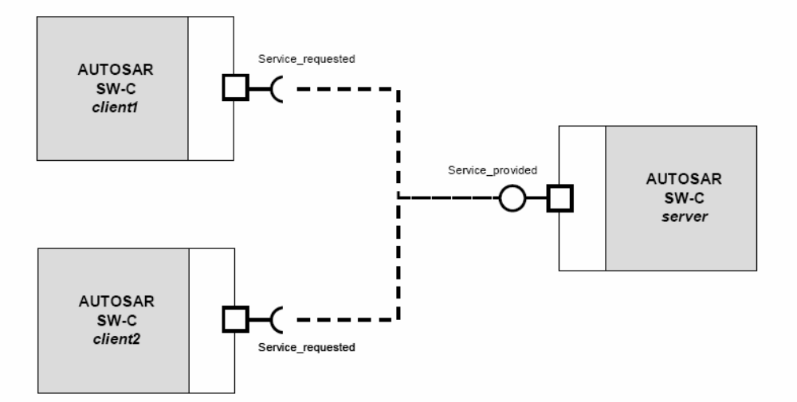
Communication Patterns
Client-Server
  Server: provider of service
  Client: user of service
  Client initiates communication
  Single component can be server and client
  Synchronous and asynchronous communication is possible

Slide 12
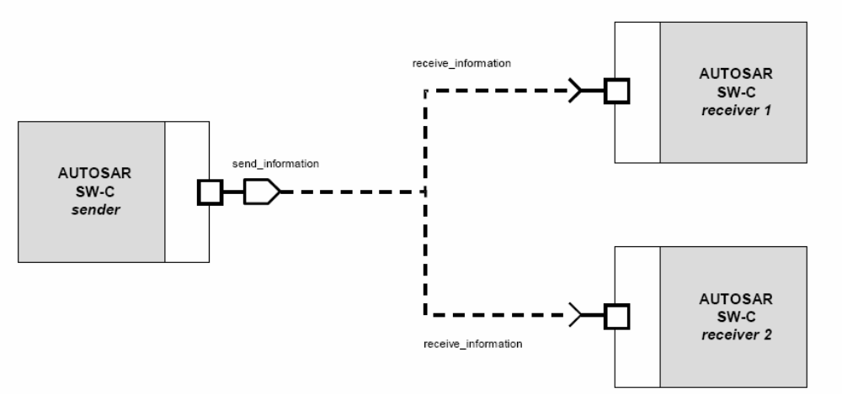
Communication Patterns
Sender-Receiver
  Asynchronous distribution of information
  No response from receivers
  Sender does not know the number or identity of the receivers

Slide 13
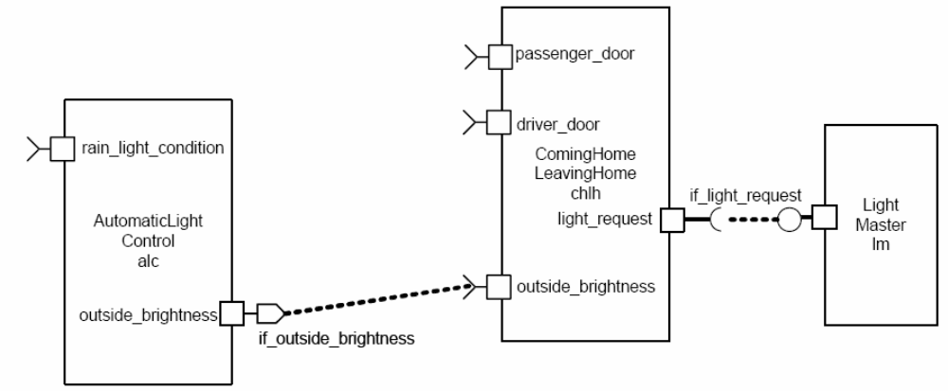
Example

Slide 14
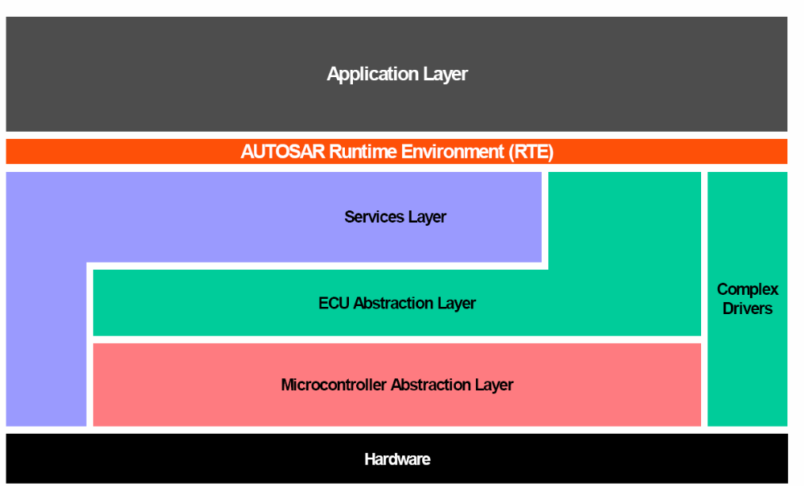
Layered Software Architecture

Slide 15
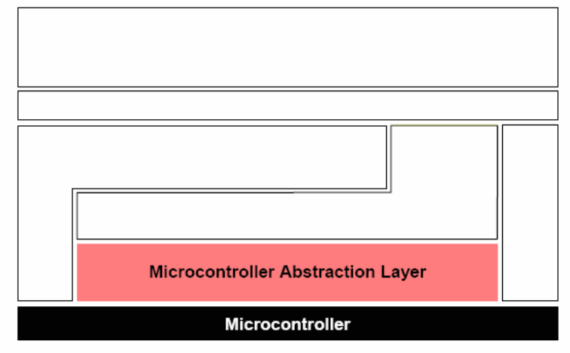
Layered Software Architecture
Microcontroller Abstraction Layer:
  Lowest software layer of the Basic Software
  Makes higher software independent of Microcontroller

Slide 16
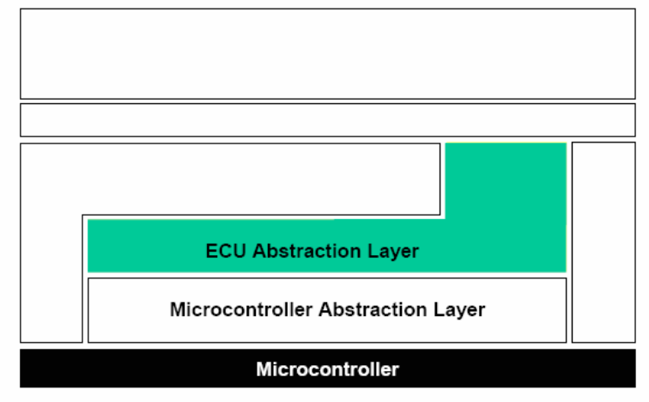
Layered Software Architecture
ECU Abstraction Layer:
  Interfaces the drivers of Microcontroller Abstraction Layer
  Makes higher software layers independent of ECU hardware layout
  Offers access to I/O Signals

Slide 17
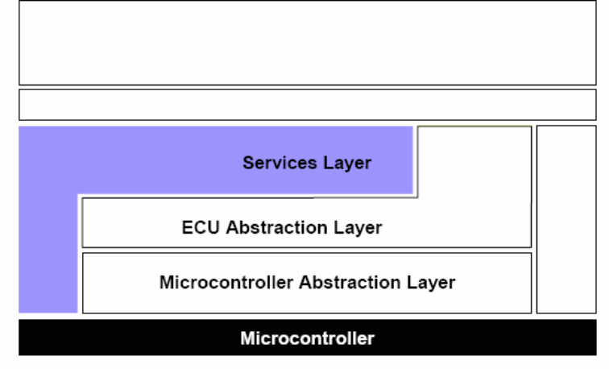
Layered Software Architecture
Service Layer:
  Highest layer of the Basic Software
  Offers Memory Services, Diagnostic Services, ECU state management
  Provides basic services for application and basic software modules

Slide 18
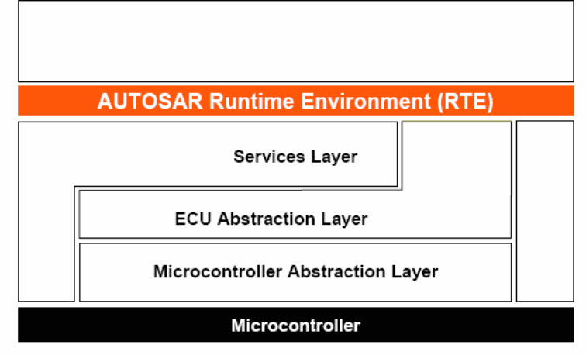
Layered Software Architecture
Runtime Environment:
  Middleware Layer
  Provides communication services for the application software
  Makes AUTOSAR Software Components independent from the mapping to a specific ECU

Slide 19
Layered Software Architecture
Application Layer:
  “Component style”
  Software components communicate with other components and/or services via the RTE

Slide 20
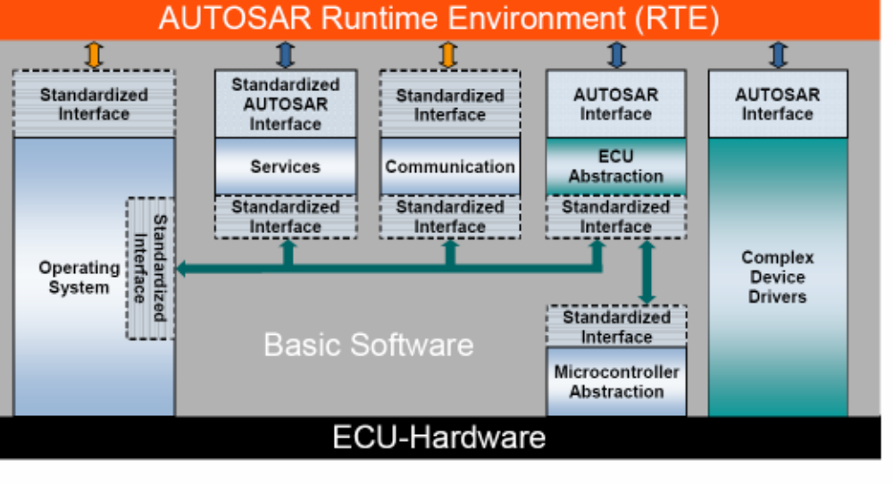
AUTOSAR Basic Software
Services
  All system services
    e.g. NVRAM, flash and memory management, diagnostic protocols
Communication
  Communication framework
    e.g. CAN, LIN, FlexRay…
  I/O management and the network management
Operating System
  Standard OSEK OS (ISO 17356-3) is used as basis for the AUTOSAR OS
  They can differ from ECU to ECU but if a proprietary OS is used the interfaces to the AUTOSAR Components have to be AUTOSAR compliant.

Slide 21
AUTOSAR Basic Software
Microcontroller Abstraction
  All access to the Hardware is routed through the Microcontroller Abstraction layer
  This is needed to avoid direct access to microcontroller registers from higher-level software
ECU Abstraction
  It provides a software interface to the electrical values of any specific ECU to ensure the hardware independence of higher-level software
Complex Device Driver (CDD)
  It provides direct access to hardware for resource critical applications
    e.g. injection control, electric valve control

