Slide 1
802.11ac: The Fifth
Generation of Wi-Fi
Technical White Paper
CISCO

Slide 2
Contents
Introduction
What Is 802.11ac?
  Drivers of 802.11ac
  How Does 802.11ac Go so Fast?
  How Do We Make 802.11ac Robust?
Summary

Slide 3
Introduction
802.11ac is a faster and more scalable version of 802.11n
802.11ac achieves its raw speed increase by pushing on three dimensions:
  More channel bonding, increased from the maximum of 40MHz in the 802.11n, now up to 80 or even 160 MHz (for 117% or 333% speed-ups)
  Denser modulation, now using 256 QAM, up from 802.11n’s 64QAM(for a 33% speed burst at shorter)
  More MIMO. Whereas 802.11n stopped at four spatial streams, 802.11ac goes all the way to eight(for another 100% speed-up)
802.11ac products
  First generation : around 80 MHz and delivering up to 433 Mbps (low end),
  867 Mbps (mid-tier), or 1300 Mbps(high end)
  Second generation : more channel bonding and spatial streams
  at up to 3.47 Gbps
Multiuser MIMO(MU-MIMO)
  An AP to send multiple frames to multiple clients at the same time over the same frequency spectrum

Slide 4
What Is 802. 11ac?
Drivers of 802.11ac
  One of the goals of 802.11ac
    To deliver higher levels of performance that are commensurate with Gigabit Ethernet networking
      Seemingly “instantaneous” data transfer experience
      A pipe fat enough that delivering high quality of experience (QoE) is straightforward
  In the consumer space
    Multiple channels of high-definition content delivered to all areas of the house
  Enterprise has different challenges
    Delivering network with enterprise-class speeds and latencies
    High-density environments with scores of clients per AP
    The increased adoption of video streaming

Slide 5
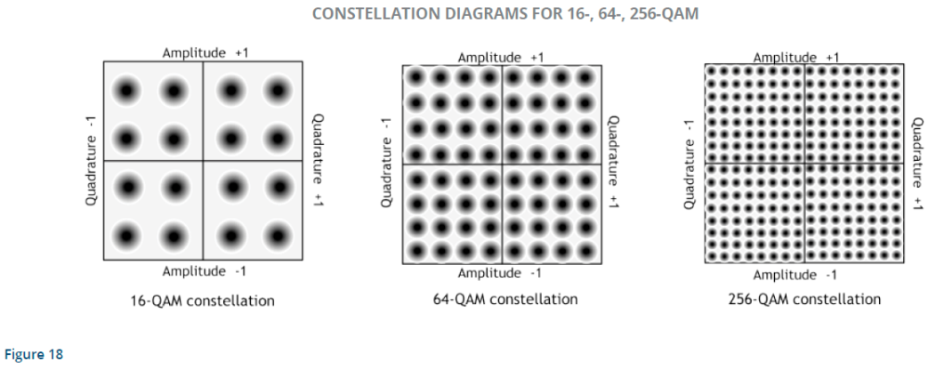
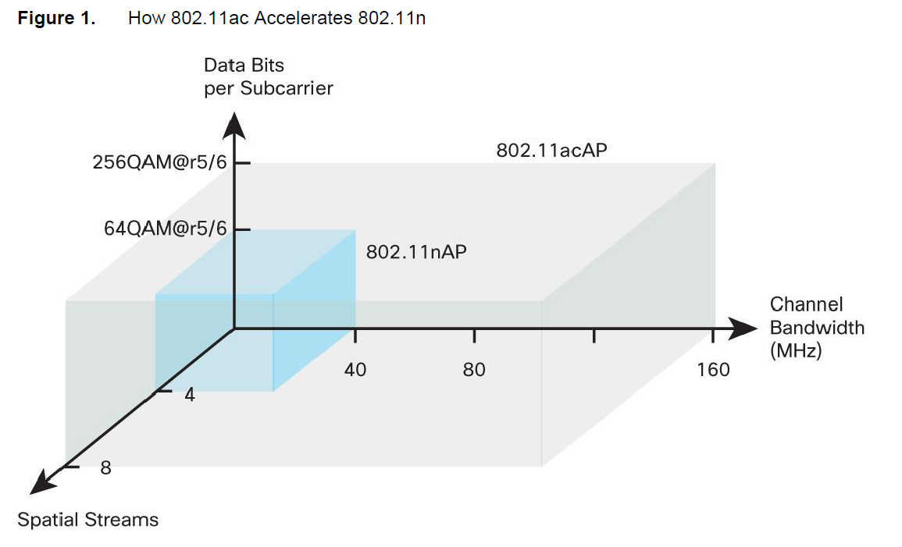
What Is 802. 11ac?
How Does 802.11ac Go So Fast?
  Channel bandwidth, constellation density,
  and number of spatial streams

Slide 6
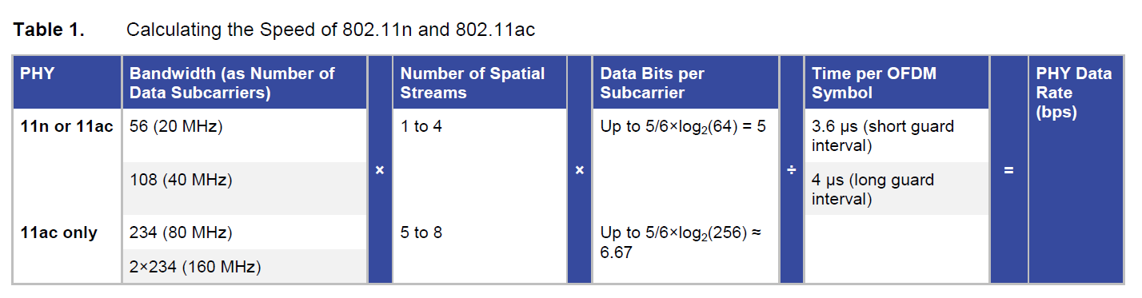
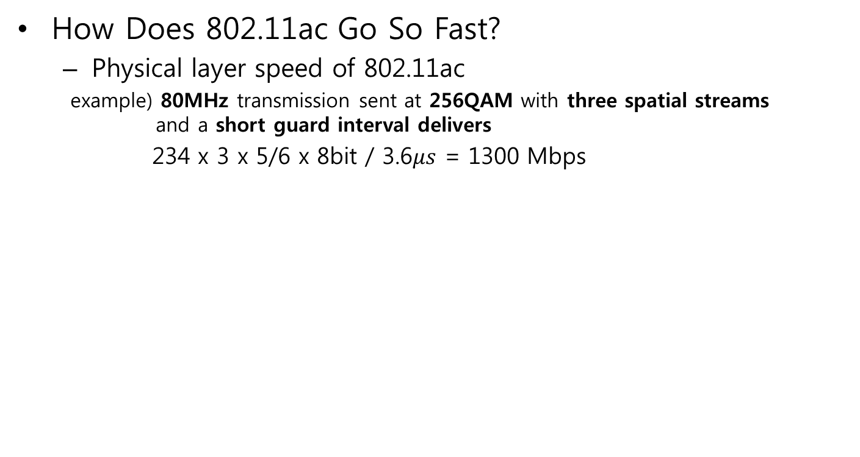
What Is 802. 11ac?
How Does 802.11ac Go So Fast?
  Physical layer speed of 802.11ac
  example) 80MHz transmission sent at 256QAM with three spatial streams
  and a short guard interval delivers
  234 x 3 x 5/6 x 8bit / 3.6$μs$ = 1300 Mbps

Slide 7
What Is 802. 11ac?
How Does 802.11ac Go So Fast?
  Channel bandwidth
    Increasing channel bandwidth to 80MHz yields a 2.16 times speed-up
    160MHz offers a further doubling
    Nothing is for free
      Consume more spectrum, and transmit power over twice as many subcarriers, so the speed doubles, but the range for that doubled speed is slightly reduced
  Data Bits per subcarrier
    Going from 64QAM to 256QAM also helps, by another 8/6 = 1.33 times
    Being closer together, more sensitive to noise, so 256QAM helps most at shorter range where 64QAM is already reliable
    256QAM doesn’t require more spectrum or more antennas than 64QAM
  Number of spatial streams
    Speed is directly proportional to the number of spatial streams
    More spatial streams require more antennas, RF connectors, and RF chains at transmitter and receiver

Slide 8
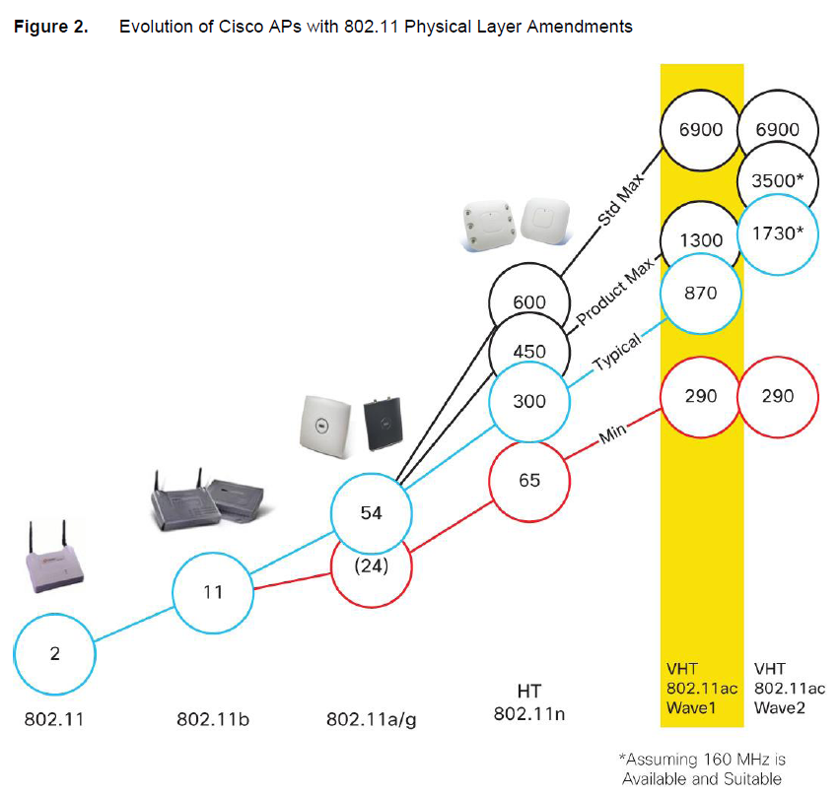
What Is 802. 11ac?

Slide 9
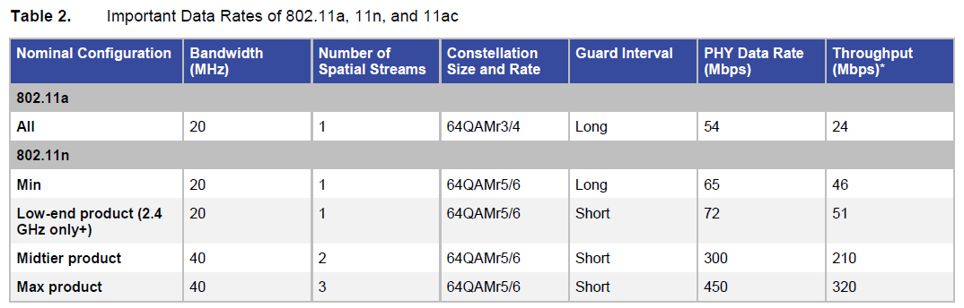
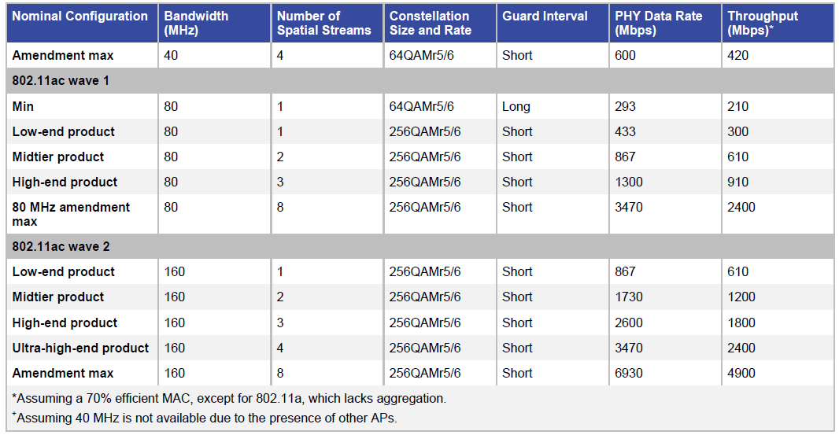

Slide 10
What Is 802. 11ac?
How Do We Make 802.11ac Robust?
  Technology Overview
    Operate only in the 5GHz band
      Avoids much of the interference at 2.4 GHz, including Bluetooth headsets and microwave ovens
      Provides a strong incentive for users to upgrade their mobile devices to be dual band so that the 5GHz band is more universally usable
    Higher order modulation, up to 256QAM; additional channel bonding, up to 80 or 160 MHz; and more spatial streams, up to eight
    802.11ac continues some of the more valuable features of 802.11n
      Option of short guard interval (for a 10% speed bump)
      Advanced low-density parity check(LDPC) forward error-correcting codes
    Various space time block codes (STBCs) are allowed as options (MIMO)
      802.11n defined the core STBC modes of 2x1, 4x2 and also 3x2 and 4x3 as extension modes (extension modes offered little gain for their additional complexity and have not made it to products)
      802.11ac defines the core 2x1, 4x2, 6x3, and 8x4 STBC modes

Slide 11
What Is 802. 11ac?
How Do We Make 802.11ac Robust?
  Technology overview
    Performing channel sounding for beam-forming: so-called explicit compressed feedback
    Wider channel bandwidths of 802.11ac
      Mandates extensions to the RTS/CTS mechanism, stronger clear-channel assessment(CCA) requirements
      New primary channel selection rules
    Multiuser MIMO
      Challenging to get right

Slide 12
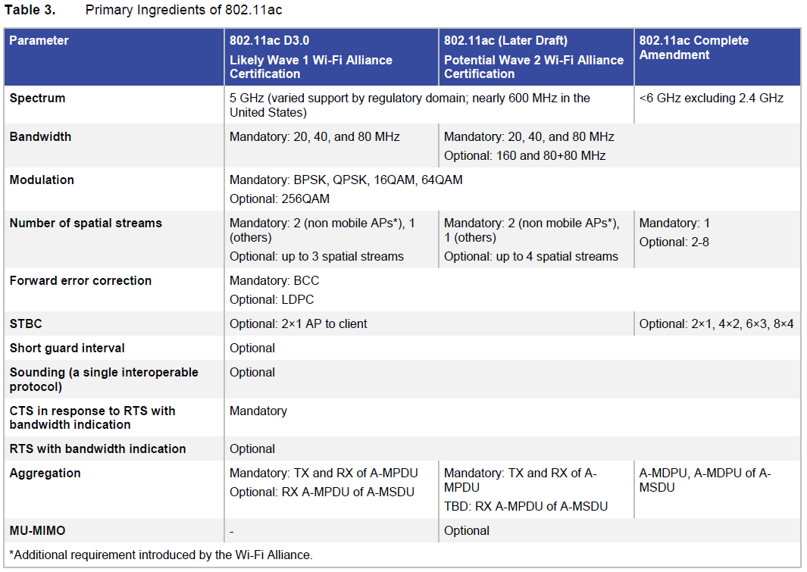

Slide 13
What Is 802. 11ac?
How Do We Make 802.11ac Robust?
  Difference Between 802.11ac and 802.11n
    802.11ac has avoided the battles of 802.11n and instead has focused on extending the tremendous advances made in 802.11n to deliver the next generation of speed and robustness
    802.11n pioneered aggregation through the selective use of A-MPDU, A-MSDU, and A-MPDU of A-MSDU, and 802.11ac actually requires every 802.11ac transmission to be sent as an A-MPDU aggregate
    802.11ac extends the 802.11n channel access mechanism: virtual carrier sense and backoff occur on a single 20MHz primary channel

Slide 14
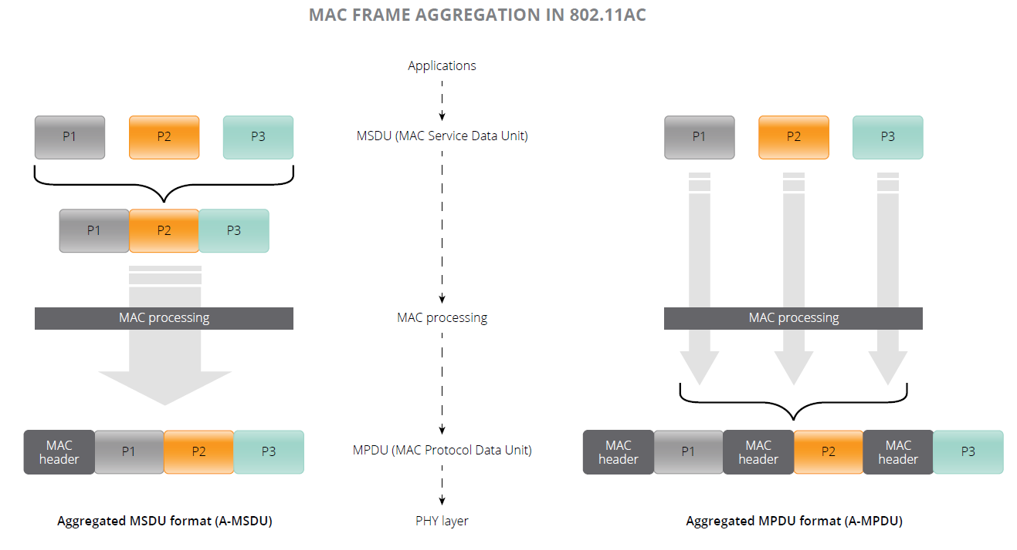
What Is 802. 11ac?
A-MSDU & A-MPDU

Slide 15
What Is 802. 11ac?
How Do We Make 802.11ac Robust?
  Standards-Based Beamforming
    Any device (with multiple antennas) can beamform to any other device at any time
    802.11ac adds the opportunity for the receiver to help the beamforming transmitter to do a better job of beamforming – “sounding”
      It enables the beamformer to precisely steer its transmitted energy toward the receiver
      802.11ac defines a single, though optional, protocol for one 802.11ac device to sound other 802.11ac devices
    A device, typically an AP, sends a “VHT Null Data Packet (NDP) Announcement” frame
      To contain the address of the AP and of the target recipients
      Immediately followed by a “VHT Null Data Packet” intended for those target recipients. Each intended recipient measures the RF channel from AP to itself using the preamble of the VHT NDP and compresses the channel
    Explicit compressed feedback (ECFB) is known to provide the most precise estimate of the channel that takes into account all the imperfections at transmitter and receiver
      ECFB comes with a lot of overhead: the VHT NDP Announcement frame, the VHT NDP itself, and the frame carrying the compressed feedback
      For an AP with 4 antennas, the compressed feedback varies from 180 to 1800 bytes, depending on the number of client antennas and level of compression
      Sounding just one single-antennas 80 MHz client takes about 250 microseconds

Slide 16
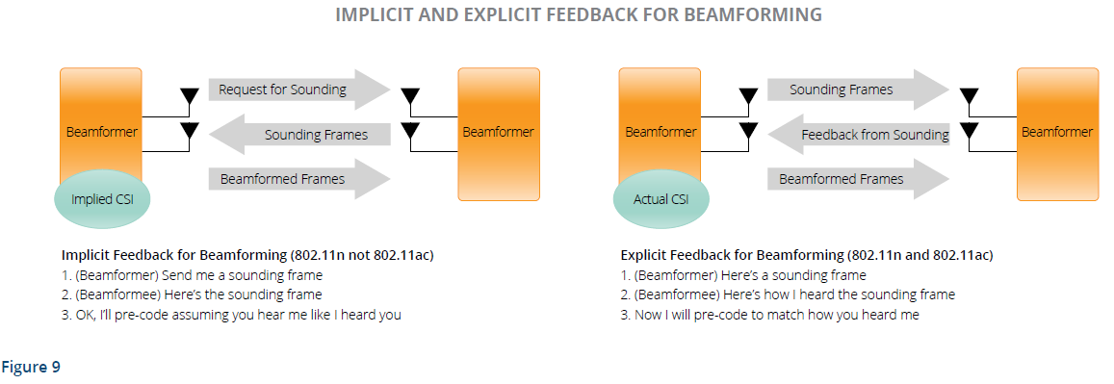
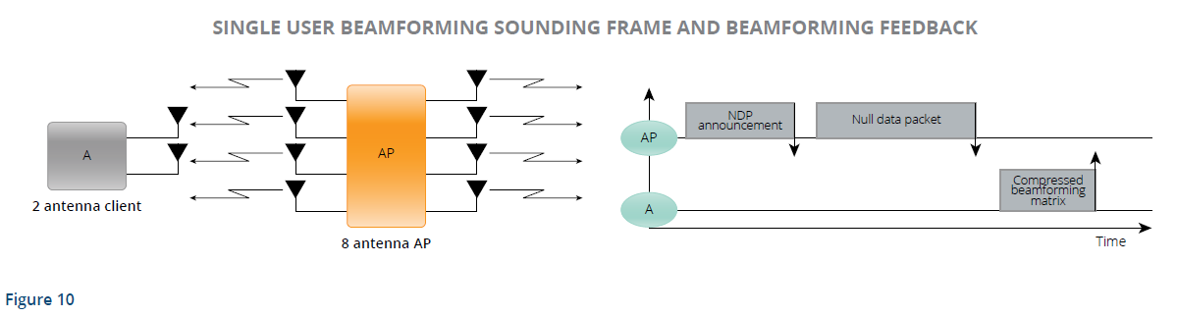
What Is 802. 11ac?
IMPLICIT AND EXPLICIT FEEDBACK FOR BEAMFORMING

Slide 17
What Is 802. 11ac?
How Do We Make 802.11ac Robust?
  RTS/CTS with Bandwidth Indication
    802.11ac AP operating on 80 MHz (or 160 MHz) should still be capable of allowing 802.11a or 802.11n clients
    Beacons are sent on one 20 MHz channel, known as primary channel, within that 80 MHz
    AP and all clients associated to the AP receive and process every transmission
      Overlaps this primary channel
      Extract virtual carrier sense from the frames they can decode
    AP could be nearby other uncoordinated APs
      APs could be preexisting 802.11a or 802.11n APs, and their primary channels could be any 20 MHz within the 80 MHz of the 802.11ac AP
        Different APs and their associated clients have a different virtual carrier sense , so can transmit at different times on the different subchannels, including overlapping time
        → Defines an enhanced RTS/CTS

Slide 18
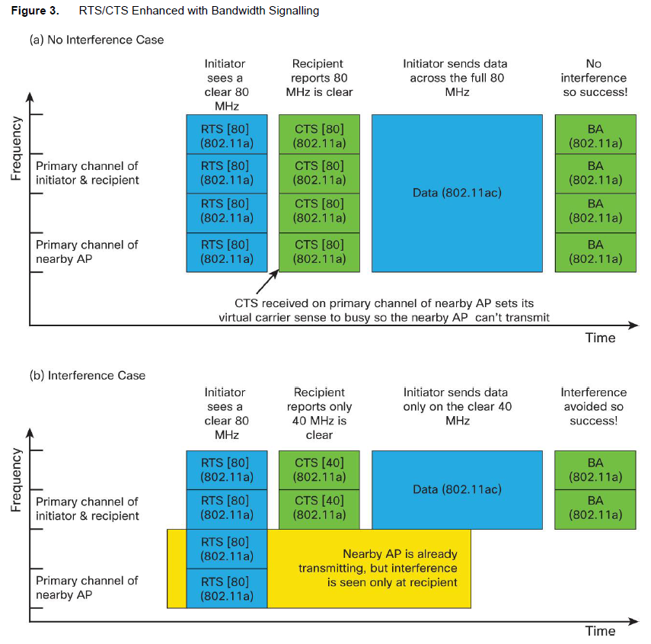
What Is 802. 11ac?
How Do We Make 802.11ac Robust?
  RTS/CTS with Bandwidth Indication
RTS/CTS can be used to find when channel bandwidth is clear and how much
RTS is normally sent in an 802.11a PPDU frame format
Basic 802.11a transmission, which is 20 MHz wide, is replicated another three times to fill the 80 MHz (or another seven times to fill 160 MHz)
Every nearby device receives an RTS that device can understand on its primary channel
Every device hears the RTS has its virtual carrier sense set to busy

Slide 19
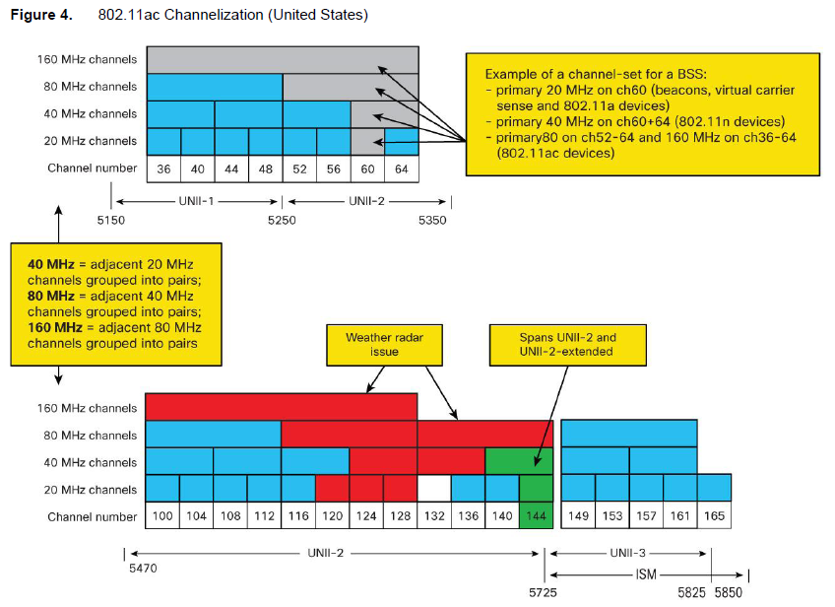
What Is 802. 11ac?
How Do We Make 802.11ac Robust?
  Channelization and 80+80 MHz (number of channels)
20 to 25 20 MHz channels
8 to 12 40 MHz channels
4 to 6 80 MHz channels
1 or 2 160 MHz channels

Slide 20
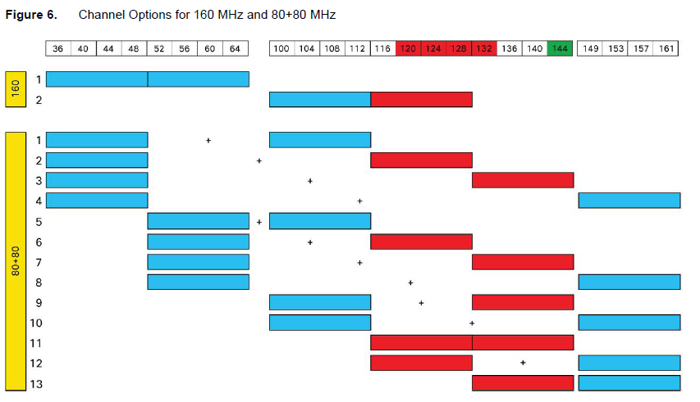
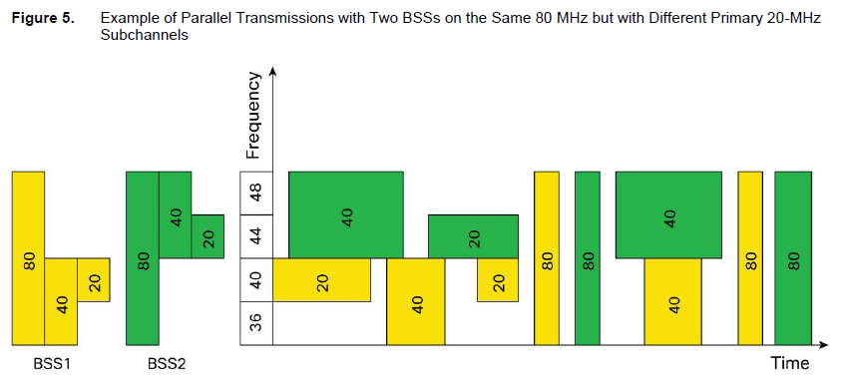
What Is 802. 11ac?
How Do We Make 802.11ac Robust?
  Radio Resource Management
    Complicated task
    Avoid channels with radar (if present)
    Tend to avoid a channel that overlaps with other 20, 40, 80, 160, or 80+80 MHz Aps nearby

Slide 21
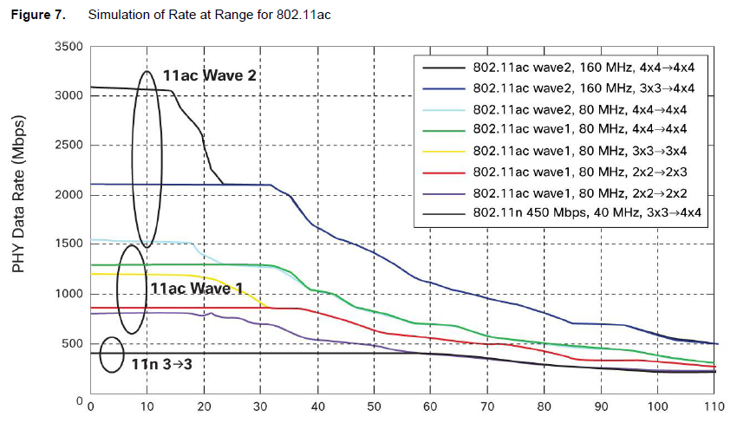
What Is 802. 11ac?
How Do We Make 802.11ac Robust?
  Rate at Range

Slide 22
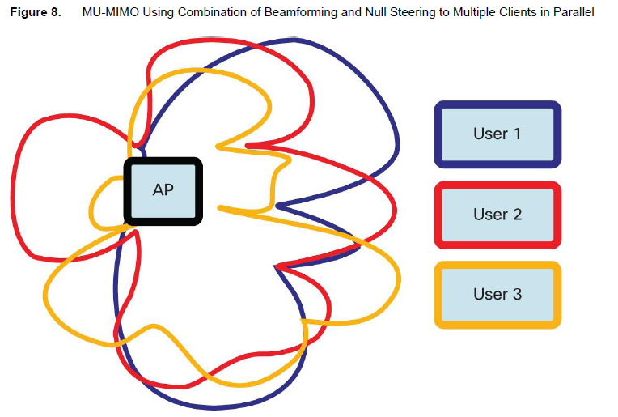
What Is 802. 11ac?
How Do We Make 802.11ac Robust?
  MU-MIMO
    802.11n – A device can transmit multiple spatial streams at once, but only directed to a single address (SU-MIMO)
    802.11ac – An AP is able to use its antenna resources to transmit multiple frames to different clients, all at the same time and over the same frequency spectrum
“null steering”
- AP minimize the energy for user 1 in the direction of user 2 and user 3

Slide 23
Summary
802.11ac is an improved version of 802.11n offering higher speeds over wider bandwidths
802.11ac is worth having when it is available, and especially when the client mix converges to being dominated by 802.11ac devices
IT administrators looking to invest in wireless LANs in the near term should strongly consider 802.11n APs that are field upgradable to 802.11ac

