Slide 1
Internet Control Message Protocol (ICMP)
Chapter 8

Slide 2
8.0 ICMP Overview
Classification
  Together with data delivery overcoming technology differences (IP) and routing, ICMP is functionally a Layer 3 protocol
  From the encapsulation perspective (carried inside IP), it can be viewed as a Layer 4 protocol
Roles
  Reports IP datagram delivery failures (errors) back to the sender
    IP protocol number = 1
  Diagnosis and information acquisition
    Ping, tracert
    Default router address, etc. → today DHCP has taken over this role

Slide 3
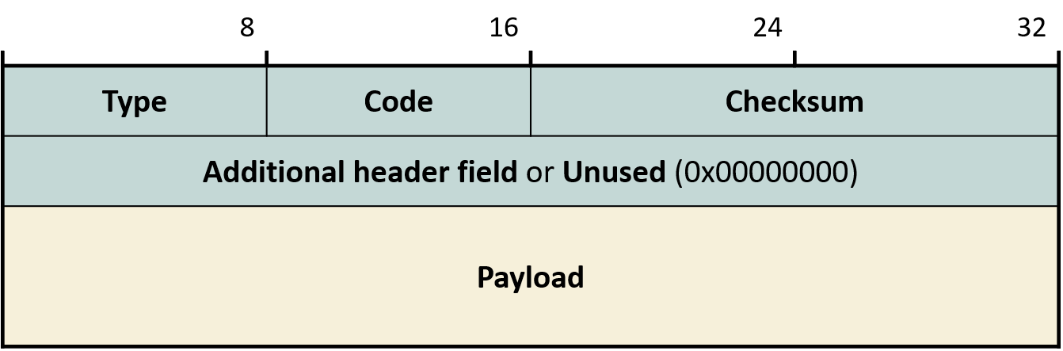
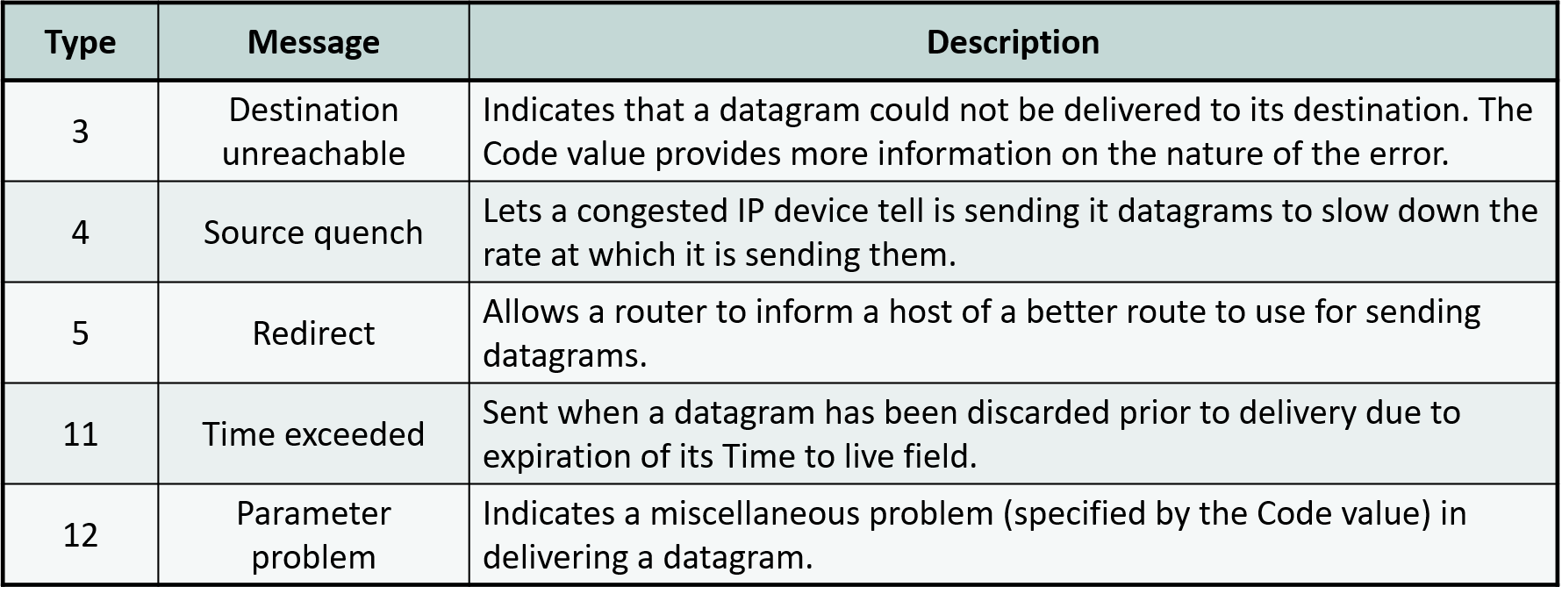
8.1 ICMP Message Format
Type - major category, Code - sub-category
Error message types

Slide 4
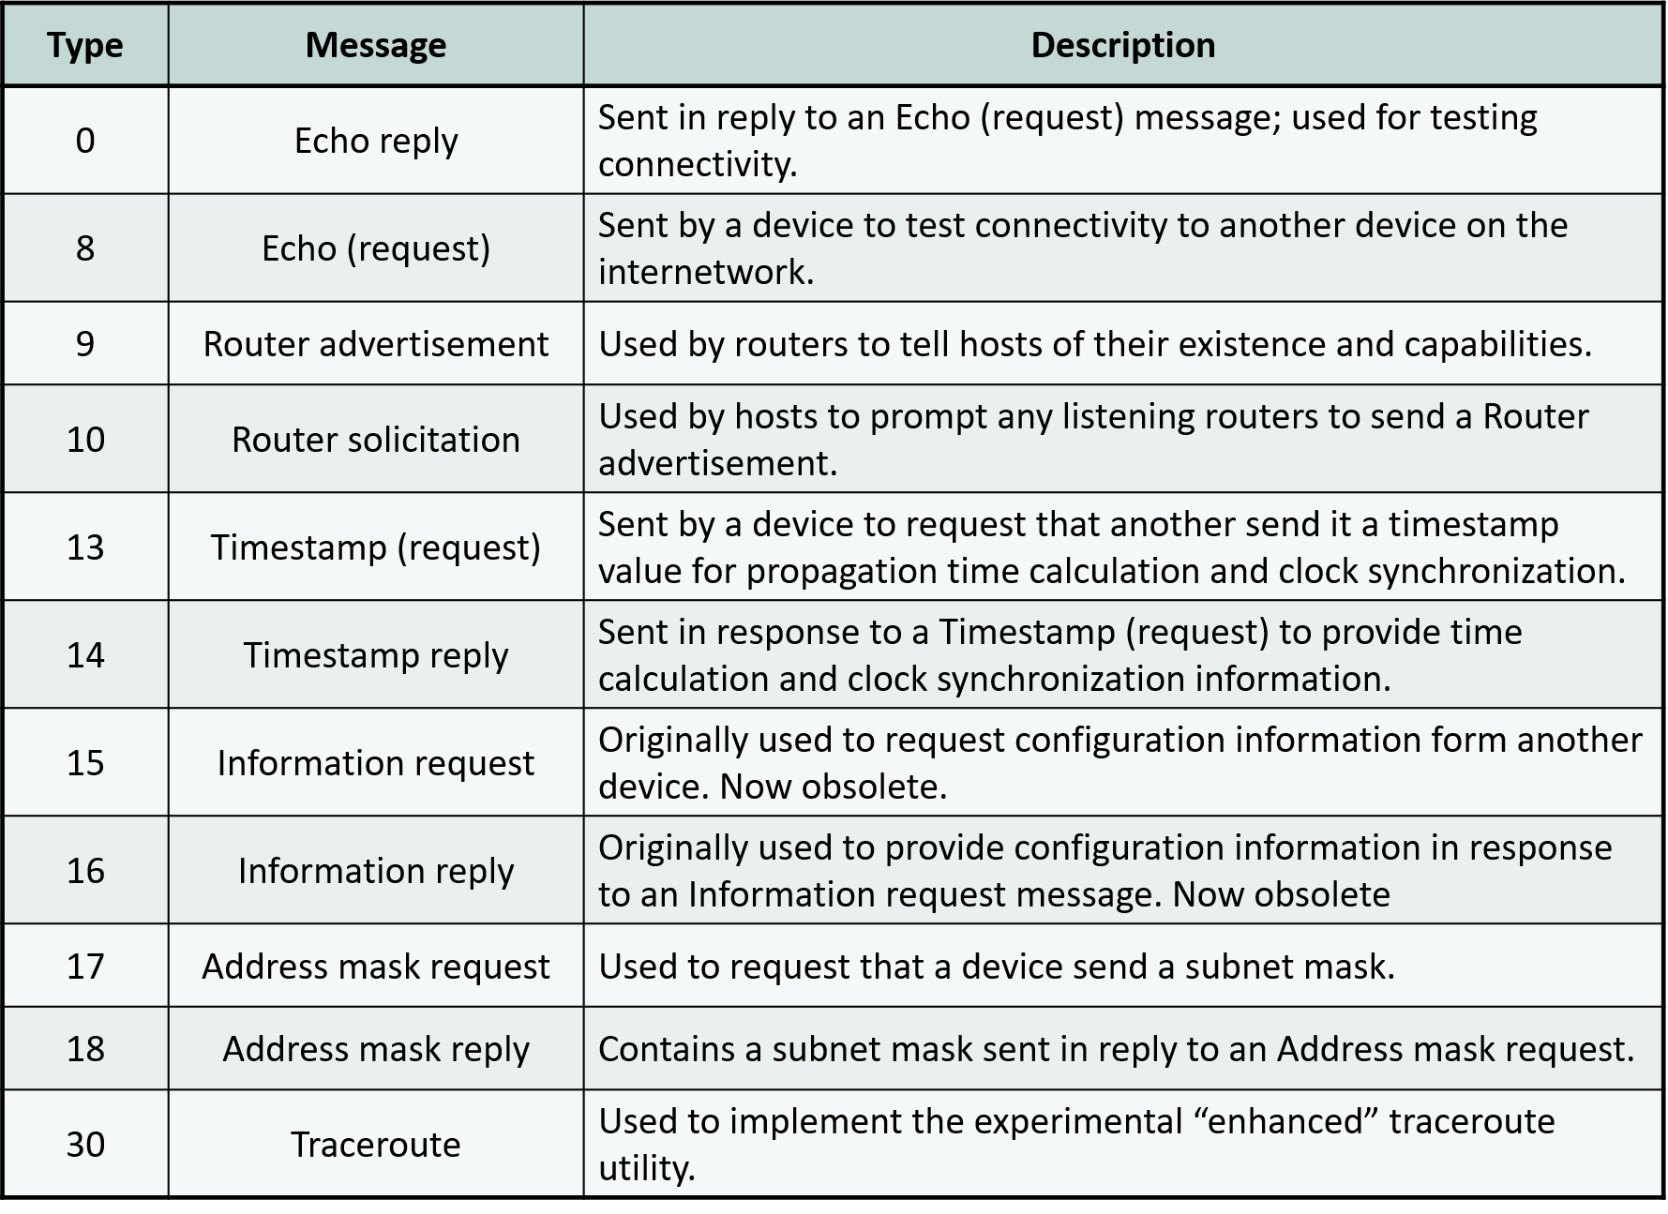
8.1 ICMP Message Format
Information request/reply message types

Slide 5
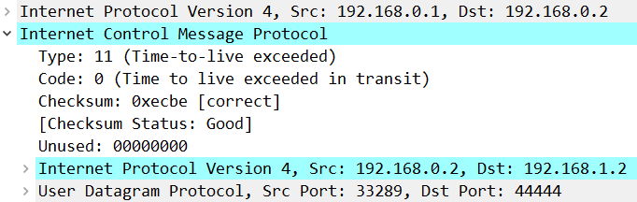
8.2 ICMP Error Messages
When an IP datagram fails to reach its destination and is dropped, report the cause to the sender
  So that the sender can address the cause
    If that condition does not apply, no ICMP error message is sent
Format
  The front portion of the dropped IP datagram is cut and placed in the ICMP error message payload
    IP header + at least 8 bytes of IP payload: IP addresses and port numbers (= sending process)

Slide 6
8.2 ICMP Error Messages
Cases where ICMP error messages are NOT generated
  IP datagrams carrying ICMP error messages
  IP datagrams dropped due to checksum failure caused by IP header errors
  IP datagrams sent to multicast or broadcast addresses
  When the source IP address is unsuitable for return (e.g., 0.0.0.0)
  Non-first fragments of a fragmented IP datagram

Slide 7
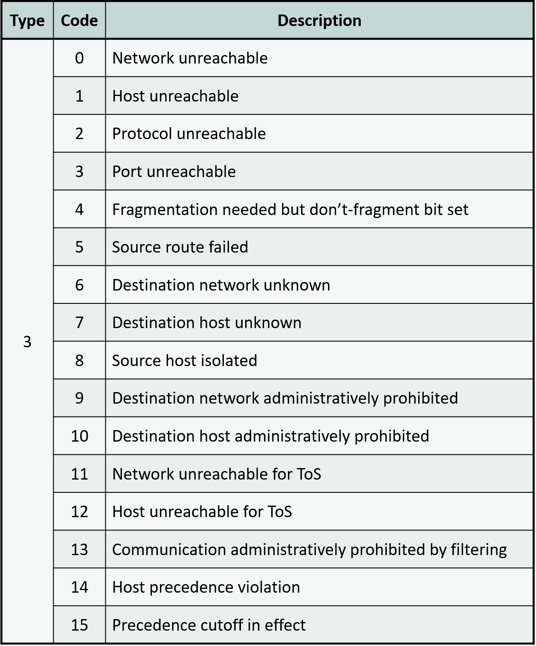
8.2 ICMP Error Messages
Destination Unreachable error

Slide 8
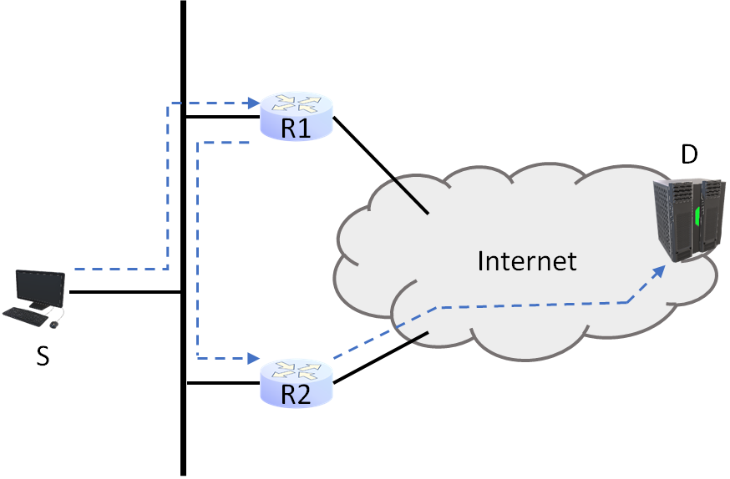
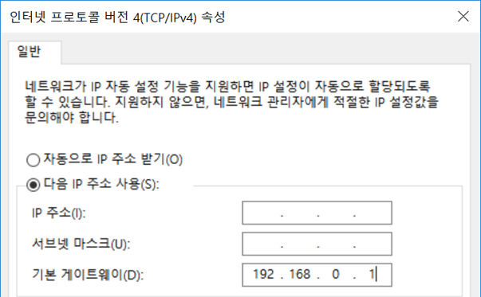
8.2 ICMP Error Messages
Destination Unreachable error - redirect
    In IPv6, reclassified as an information message rather than an error
  Special situation
    Situation where multiple routers connected to the Internet can be selected
    For a specific destination ("D"), one router ("R2") is closer, but the default route's next hop is a different router ("R1")

Slide 9
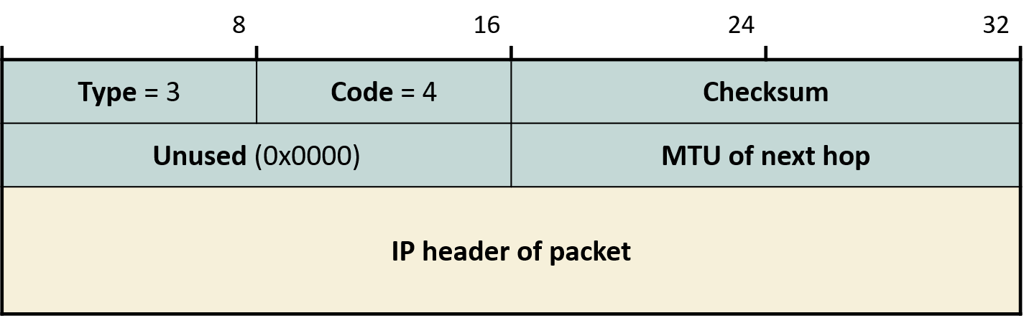
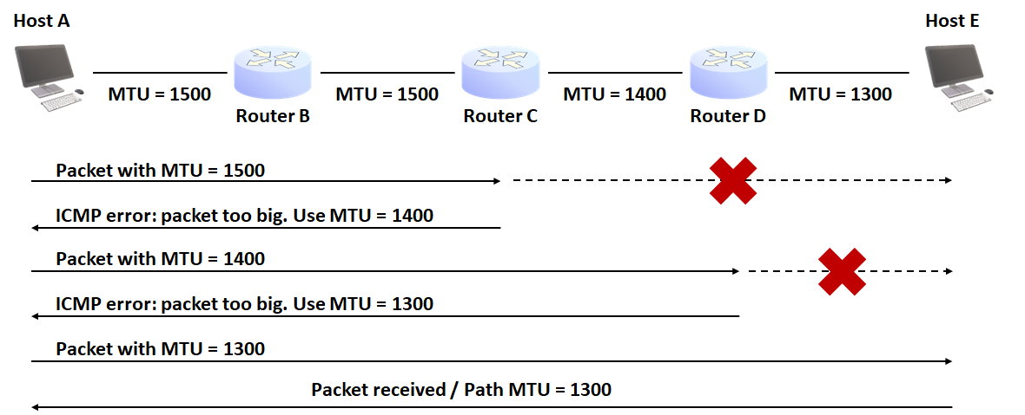
8.2 ICMP Error Messages
Destination Unreachable error - fragmentation needed but DF set

Slide 10
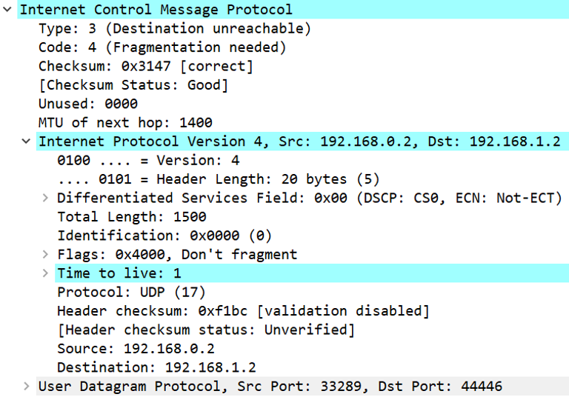
8.2 ICMP Error Messages
Destination Unreachable error - frag. needed but DF set

Slide 11
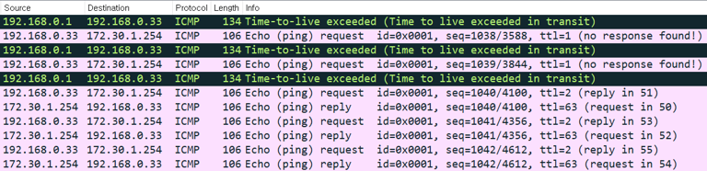
8.2 ICMP Error Messages
Time Exceeded error
  TTL=0 before reaching destination
  After reaching destination, some fragments did not arrive
    Standard timeout = 15 sec
  Tracert: a clever use of TTL
    Windows uses ICMP Echo Request
    Linux sends UDP datagrams with port numbers unlikely to be in use
      ICMP Port Unreachable is the traceroute termination condition  Windows: ICMP Echo Reply

Slide 12
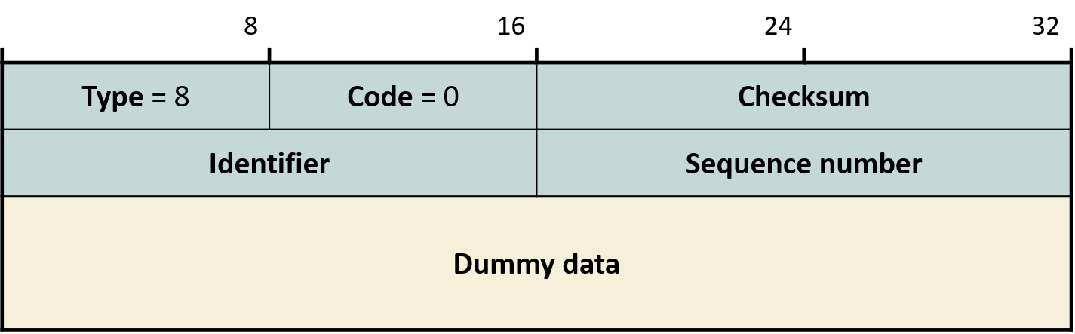
8.3 ICMP Information Query/Reply Messages
Ping = ICMP Echo Request + ICMP Echo Reply
  Otherwise rarely used in IPv4
  DHCP has taken over most of the roles
  ICMP Echo Request packet format
    Identifier: unique value per process (unused in Windows)
    Sequence number: value used by the sender to match requests with replies

Slide 13
8.4 ICMPv6
Expanded role
  Replaces the roles of ARP and IGMP from IPv4
  Overall framework largely preserved
    Errors and information request/reply
Notable differences between ICMPv6 and ICMPv4
  With IP fragmentation removed, datagrams larger than MTU are unconditionally dropped → Packet Too Big error
    Unlike IPv4, multicast is also sent!
  ICMP information request/reply actively used in Neighbor Discovery
    Replaces ARP
  ICMP Redirect classified as information, not error

Slide 14
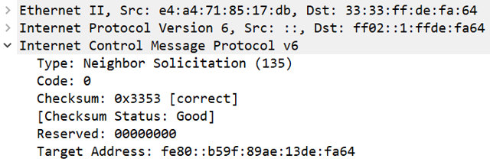
8.4 ICMPv6
Neighbor Discovery
  Neighbor Solicitation (NS) = (formerly) ARP request
    Receiver: uses SNM address
    Sender: unspecified address → case where the reply must be sent via All-Nodes Multicast

Slide 15
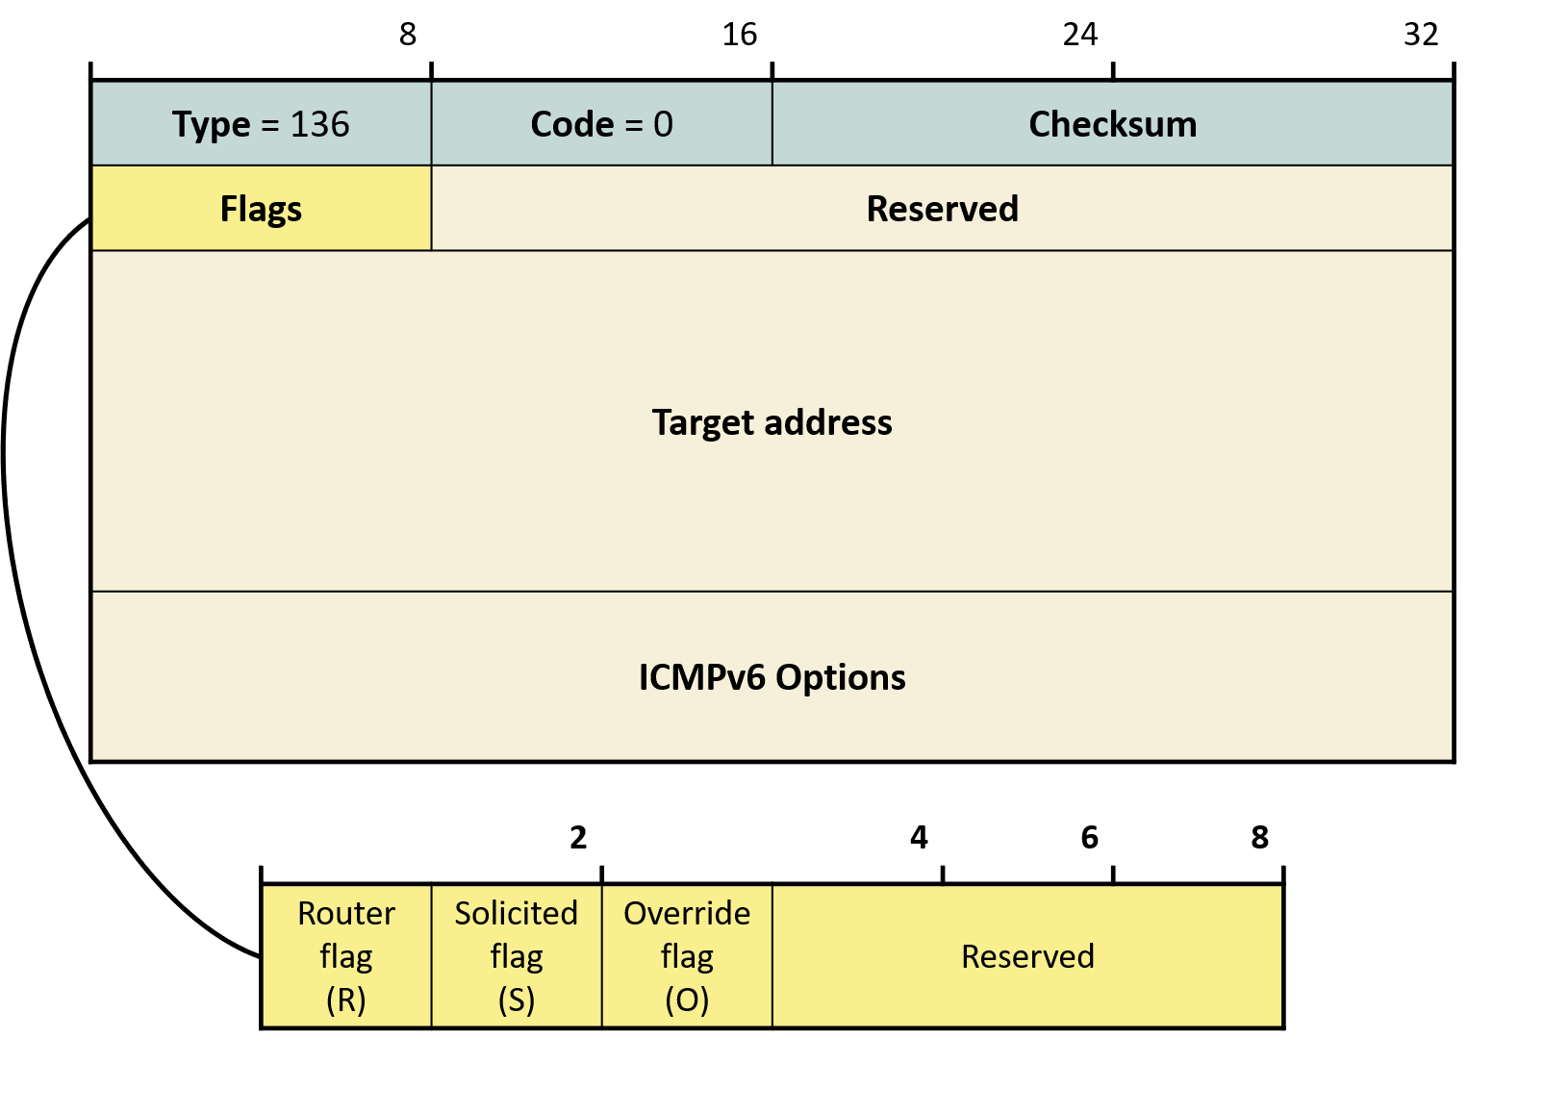
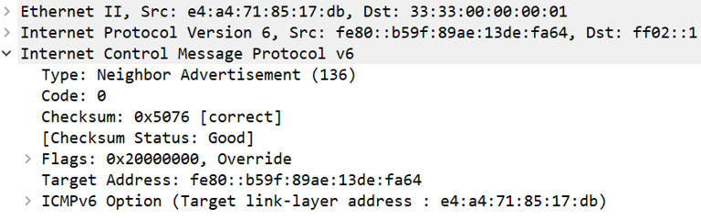
8.4 ICMPv6
Neighbor Discovery
  Neighbor Advertisement (NA) = (formerly) ARP reply
    S(solicited)=1: in response to an NS
    S=0: unsolicited (gratuitous)
      R: sent by a router
      O: override - update cache entry
  Unlike ARP: (1) target is target (2) "reply" updates third-party mappings

