Slide 1
Chapter 11
Data Link Control (DLC)
Frames, flow and error control, HDLC and PPP
Forouzan, Data Communications and Networking, 5th ed., Chapter 11
11.1 DLC services, 11.2 data-link protocols, 11.3 HDLC, 11.4 PPP
Today panels: framing, link-layer ARQ, HDLC family and PPP in use now
Figures 11.1 to 11.29 and Tables 11.1 to 11.3 all included, flow diagrams build step by step
Errata: printed slides and textbook

Slide 2
11.1
DLC services
11.1.1
Framing
New
Data-link layer = DLC + MAC
DLC: node-to-node procedures, dedicated or broadcast link
Functions: framing, flow control, error control, connection handling
Physical layer: bit synchronization, same bit duration and timing
Data-link layer: frame synchronization, where each frame starts and ends
Analogy, envelope: delimiter + sender and receiver addresses
Destination address: where the frame goes
Source address: lets the receiver acknowledge
Many small frames, not one big one: one bit error → resend only the frame hit
Frame size: fixed (ATM cell) or variable (LANs, HDLC, PPP)
Variable size needs delimiters: character- or bit-oriented
Network layer
Part IV: end to end
Data link control (DLC)
Chapter 11: node to node
Media access control (MAC)
Chapter 12: shared links
Physical layer
Part II: bits as signals
11.1.1
Fixed-size frames still need delineation
New
HEC-based cell delineation (ITU-T I.432)
Fixed size: no flag, frame length known in advance
Book: "size itself is the delimiter": only after the receiver has locked onto a boundary
ATM cell: 53 bytes = 5-byte header + 48-byte payload
5th header byte = HEC, CRC-8 over the first 4
Delineation: HUNT bit by bit, PRESYNC for δ cells, SYNC lost after α failures
Same idea: T-1 frame alignment (Chapter 6), GFP over SDH/OTN today
test HEC at
every bit position
check HEC
cell by cell
locked: cell
boundaries known
correct HEC
δ correct
in a row
HUNT
PRESYNC
SYNC
incorrect HEC
α incorrect in a row

Slide 3
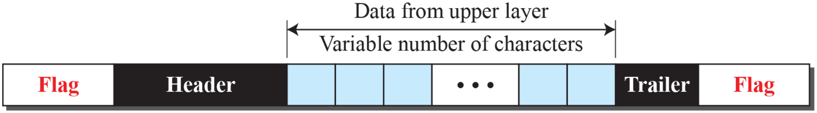
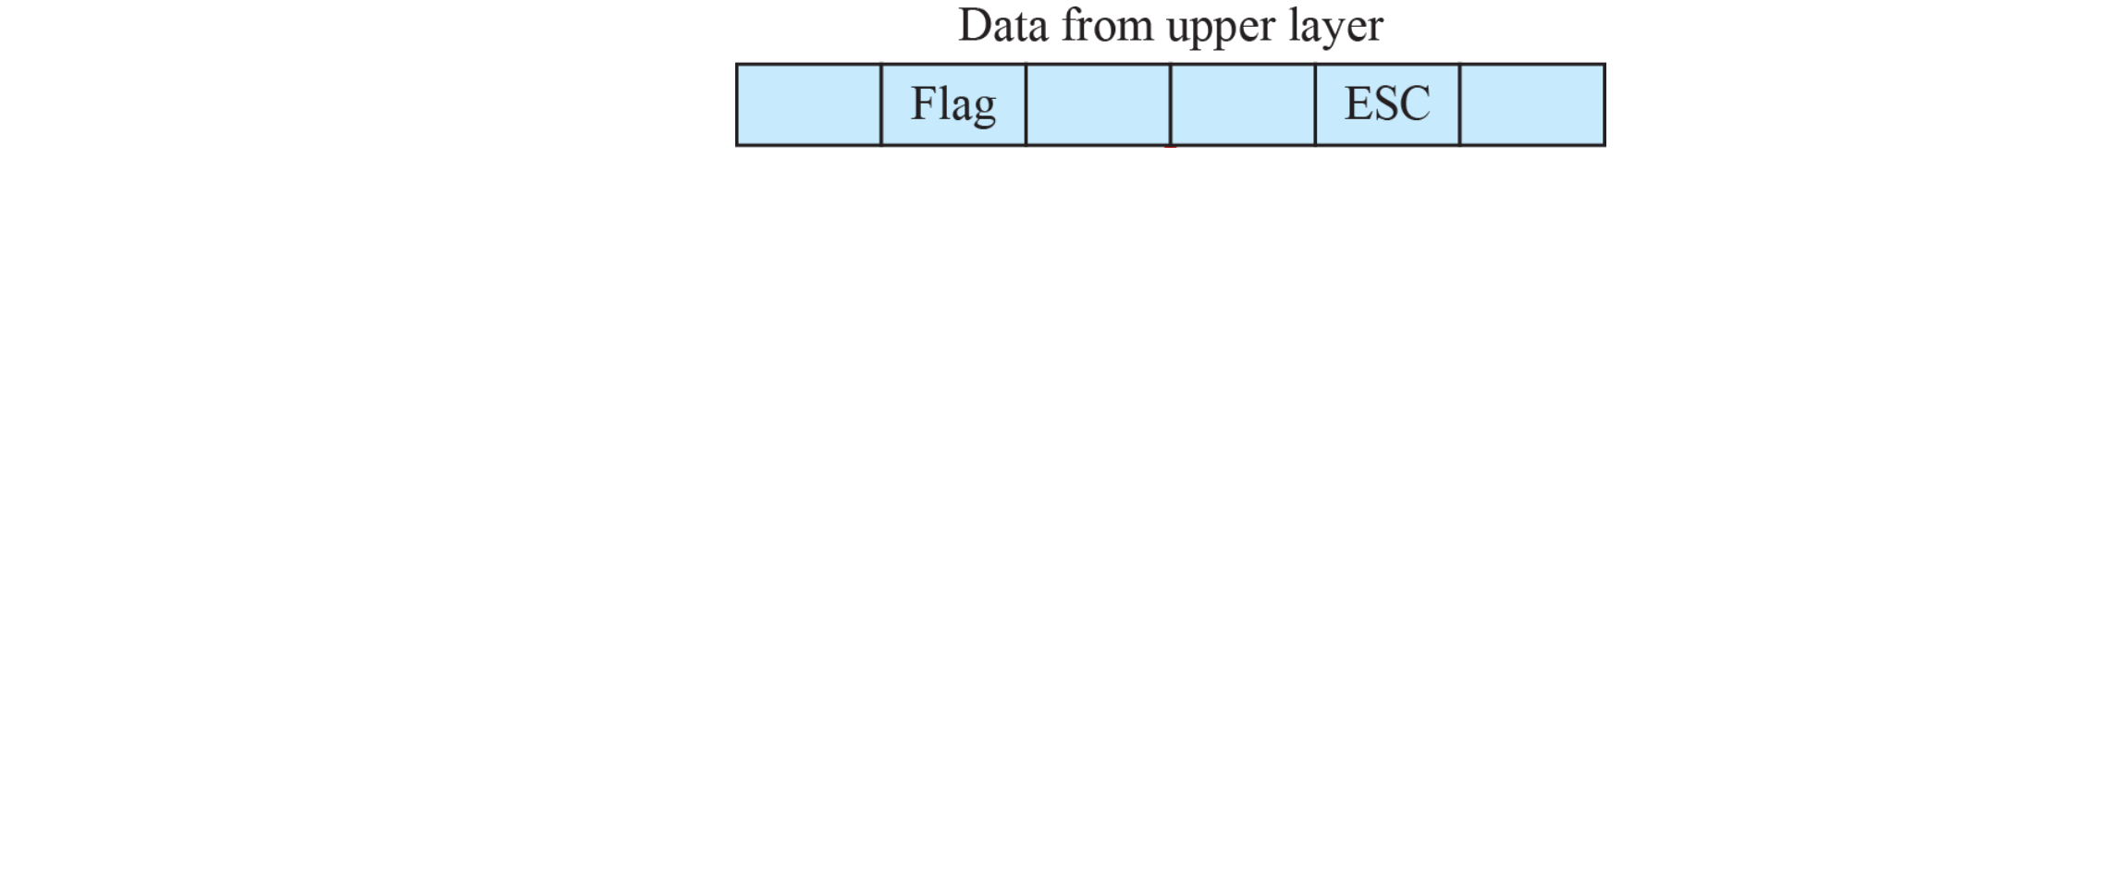

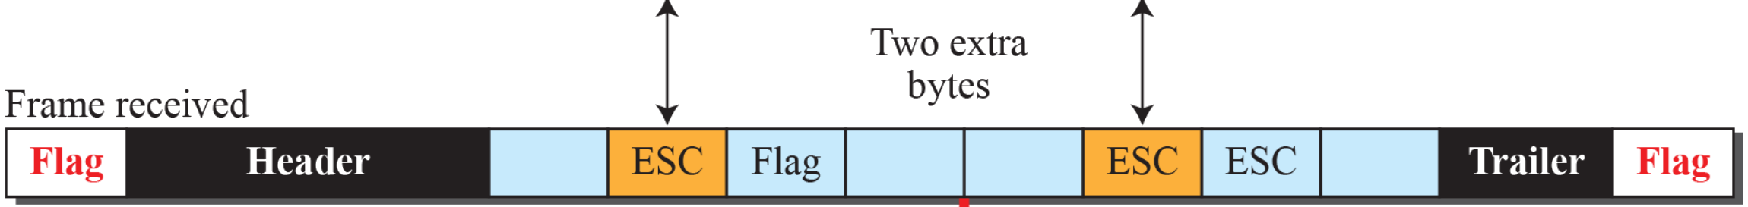

11.1.1
Character-oriented framing
Figure 11.1
A frame in a character-oriented protocol
Data: 8-bit characters, e.g. ASCII
Header: addresses, control. Trailer: error-detection bits (Chapter 10)
Flag: one protocol-dependent special byte at start and end
Fine while only text crossed the link
Binary data (images, audio, video): any byte value may appear
Flag pattern inside data → receiver sees a false end of frame
11.1.1
Byte stuffing
Figure 11.2
Byte stuffing and unstuffing
Sender: insert ESC before every data byte equal to Flag or ESC
Receiver: remove ESC, keep the next byte as data
ESC inside data also escaped: ESC ESC, else a data ESC + Flag is misread
Receiver order: find the flags first, then unstuff
Overhead: 0 to 100%, worst case every byte escaped
Book: Unicode breaks byte stuffing? No: stuffing ignores content, any byte stream works
PPP's real rule: ESC 0x7D, then the byte XOR 0x20 (11.4.2)
Notes:
Figure 11.2 builds in 3 clicks: stuffed frame, received frame, unstuffed data.

Slide 4
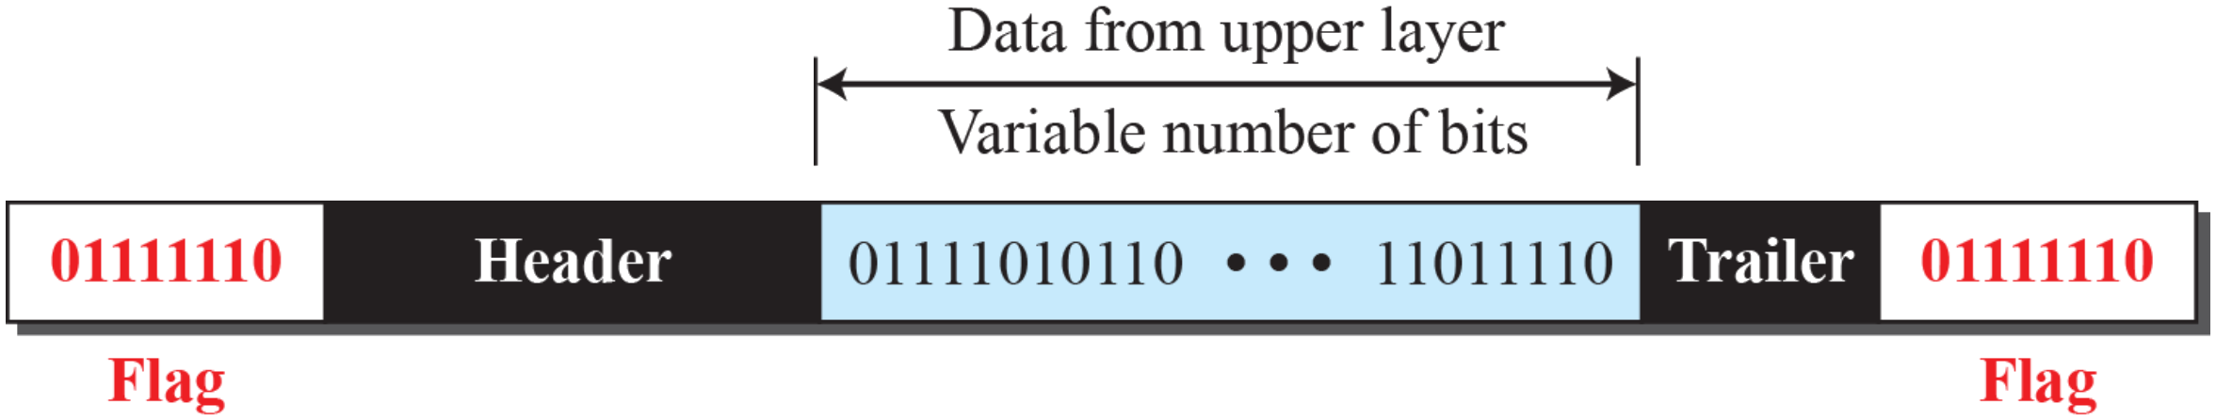
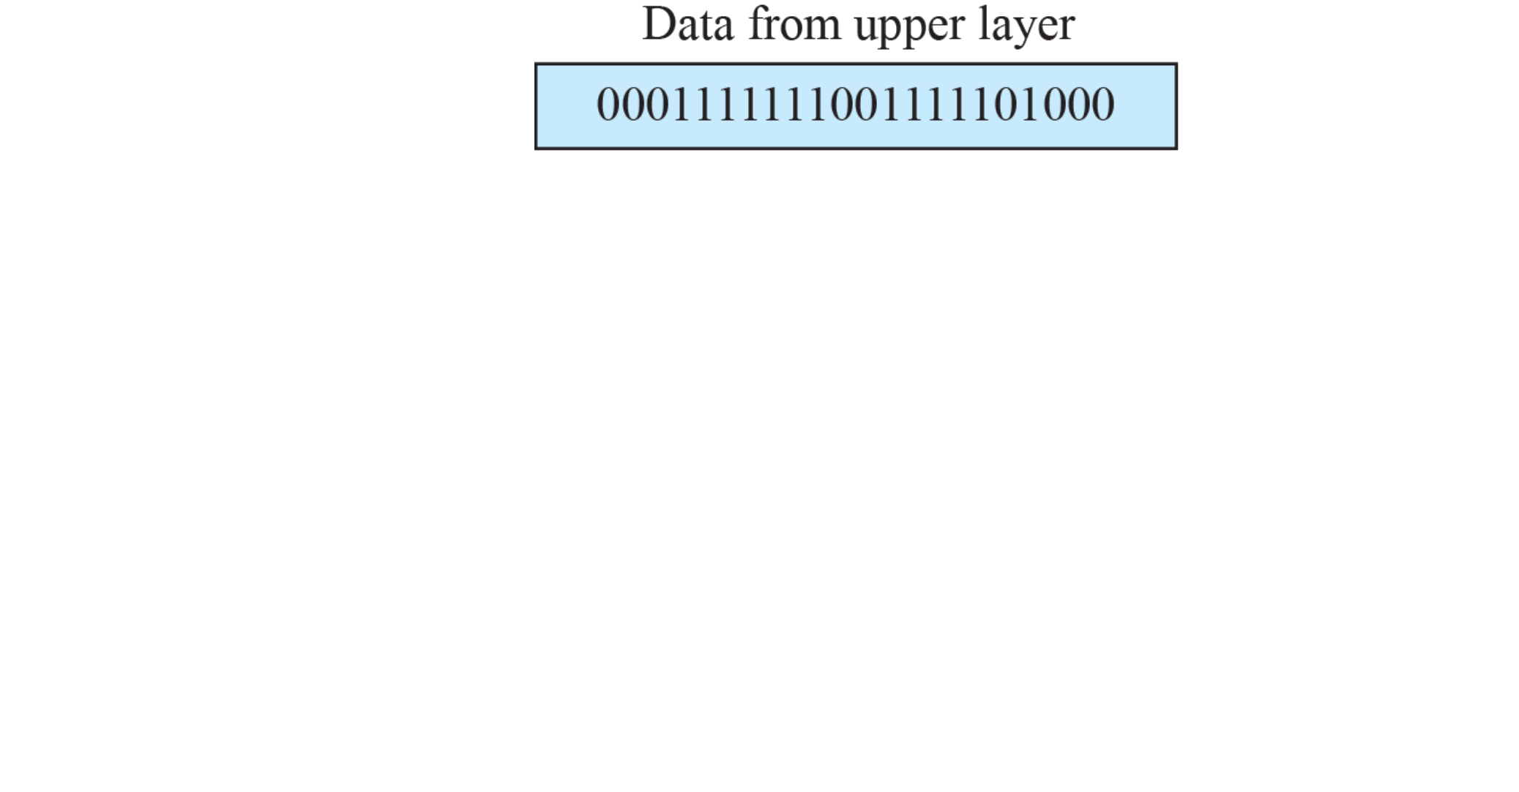



11.1.1
Bit-oriented framing
Figure 11.3
A frame in a bit-oriented protocol
Data: a bit sequence, any content
Flag: 01111110 (0x7E) at both ends
Bit stuffing: 0 then five 1s → insert 0, whatever the next bit
Receiver: 0, five 1s, 0 → drop that 0. 0, six 1s, 0 → flag. Seven or more 1s → abort
Stuffed frame never holds six 1s in a row: flag stays unique
Overhead: at most 1 bit per 5 data bits (20%)
11.1.1
Bit stuffing, worked example
Figure 11.4
Bit stuffing and unstuffing
Data: 0001111111001111101000
Sent: 000111110110011111001000
Two stuffed 0s, each after a 0 and five 1s
1st: inside a run of seven 1s
2nd: next data bit already 0, stuffed anyway
Flag-like data 01111110 → sent as 011111010
Real flags never stuffed: receiver finds flags, then removes stuffed 0s
Same trick elsewhere: USB (after six 1s), CAN (after five equal bits), for clock recovery
Notes:
Figure 11.4 builds in 3 clicks: stuffed frame, received frame, unstuffed data.

Slide 5
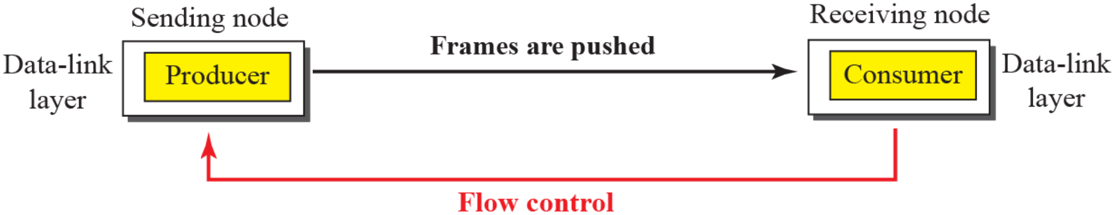
Today
Where frame boundaries come from now
Link | Frame boundary | Stuffing
HDLC, PPP (serial, SONET/SDH) | Flag 0x7E | Bit or byte stuffing
USB 1.x and 2.0 | SYNC pattern, end-of-packet line state | Bit stuffing after six 1s, keeps NRZI transitions
CAN bus | Start-of-frame bit, fixed field layout | Stuff bit after five equal bits
Ethernet | Preamble + SFD, PHY code groups mark start and end (8b/10b, 64b/66b) | None
GFP over SDH/OTN (G.7041) | 2-byte length + CRC-16 core header, hunted like ATM | None
Wi-Fi A-MPDU | 4-byte delimiter: length, CRC-8, signature 0x4E | None
5G NR MAC | Size known from the grant (DCI), subheaders carry lengths | None
Trend: not bit-oriented, as the book says, but length fields and PHY coding, no stuffing
11.1.2
Flow control
Figure 11.5
Flow control at the data-link layer
Producer faster than consumer: consumer overwhelmed, frames dropped
Feedback: receiver tells sender to stop or slow down
Buffers at both DLCs: receiver buffer full → "stop", space again → "send more"
Example 11.1: one-slot buffer, slot empty → "send the next frame" = the ACK of Stop-and-Wait

Slide 6
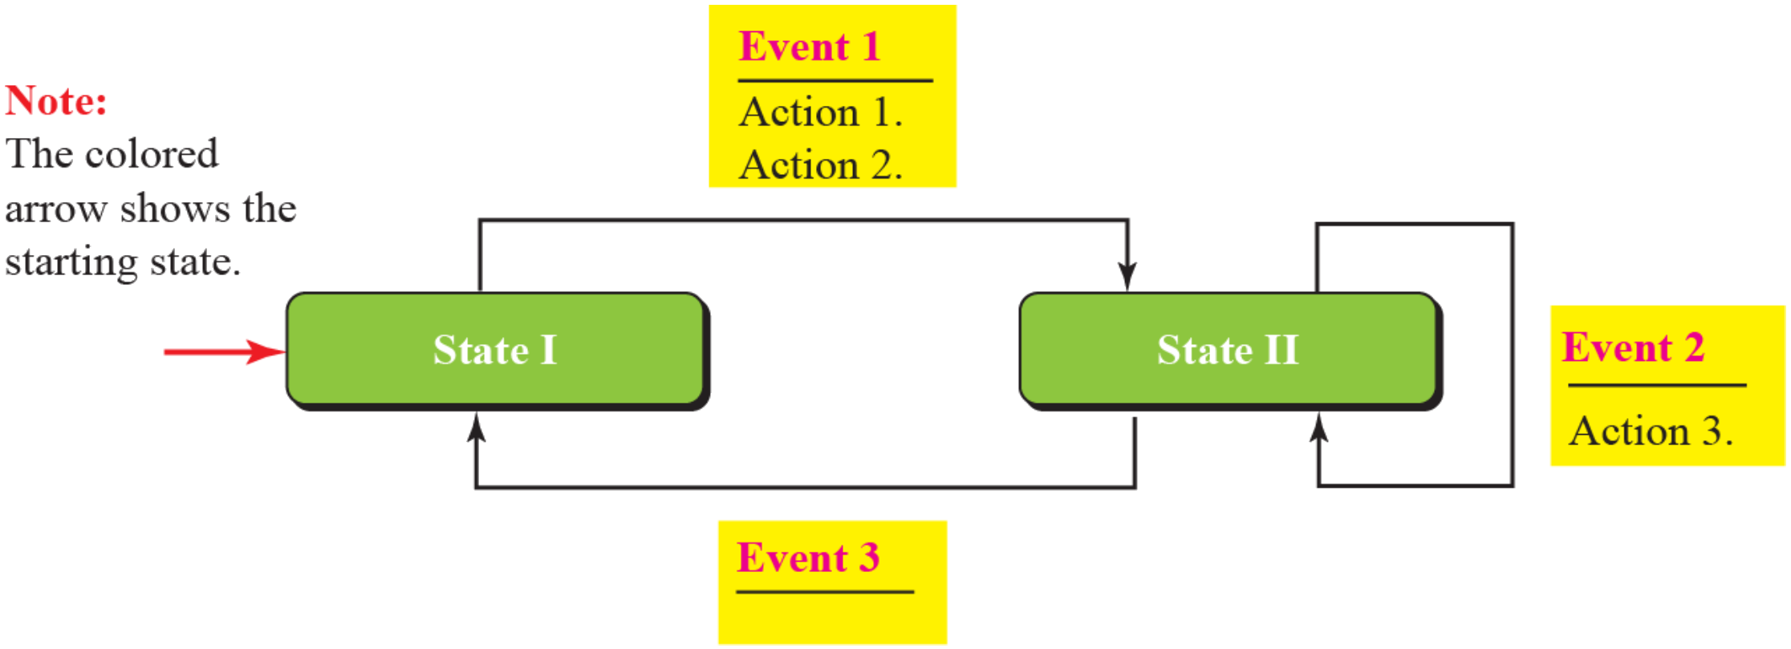
11.1.2
Error control
11.1.3
Connectionless and connection-oriented
Physical layer unreliable → error control at DLC
CRC: added by sender in the trailer (FCS), checked by receiver
Book says "header": it is the trailer
Method 1: corrupted → silently discard, intact → deliver (Ethernet)
Method 2: corrupted → discard, intact → deliver + ACK
ACK serves flow and error control
No ACK before timeout → sender assumes loss
NAK: explicit negative acknowledgment (HDLC REJ, SREJ)
Connectionless: independent, unnumbered frames, no ordering
Not "no physical link": no relation between frames
Most LAN data-link protocols
Connection-oriented: setup → transfer → teardown
Frames numbered, delivered in order
Some point-to-point links (HDLC ABM, PPP), wireless LANs, WANs
11.2
Data-link protocols and FSMs
Figure 11.6
An example FSM
Classic four: Simple, Stop-and-Wait, Go-Back-N, Selective-Repeat
This chapter: first two, all four in Chapter 23
Book: last two "disappeared" → alive in wireless links (Today)
FSM: event → actions (maybe none) + next state (maybe same)
Figure 11.6: two states
State I, event 1 → actions 1, 2 → State II
State II, event 2 → action 3, stay
State II, event 3 → no action → State I
Book text: "three states", "event 1 → action 3": wrong

Slide 7
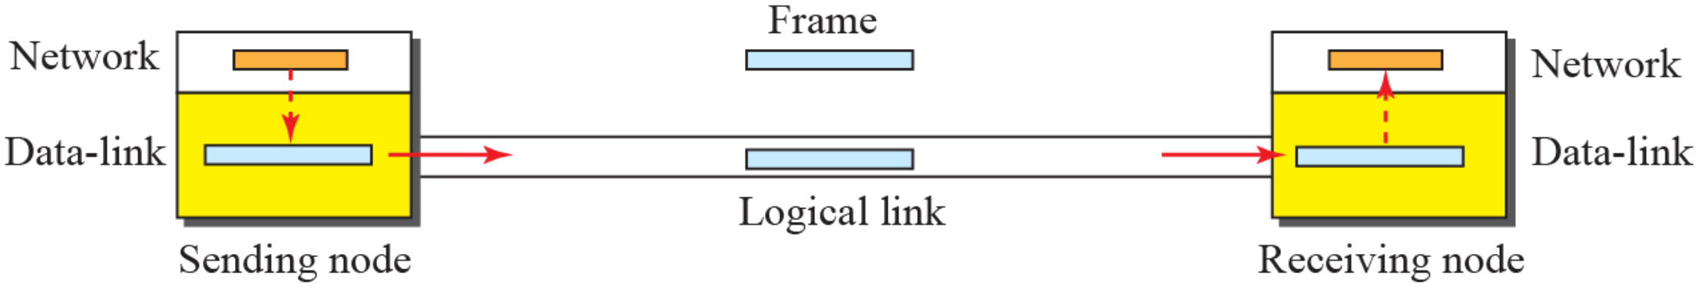
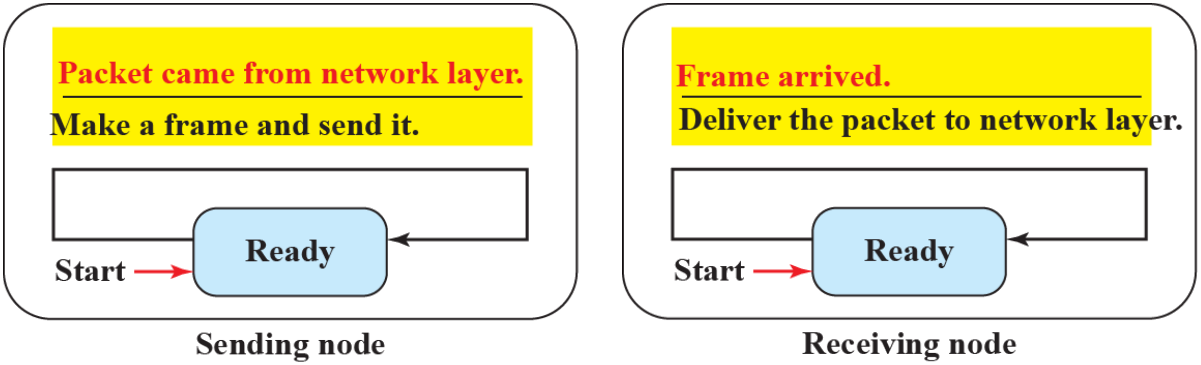
11.2.1
Simple protocol
Figure 11.7
Simple protocol
No flow control, no error control
Assumption: receiver handles every frame at once, never overwhelmed
Sender DLC: packet from network layer → frame → send
Receiver DLC: frame → extract packet → deliver
11.2.1
FSMs of the Simple protocol
Figure 11.8
FSMs for the simple protocol
One state each: Ready
Sender: waits for a packet from its network layer
Packet came → make a frame, send it, stay Ready
Receiver: waits for a frame from the link
Frame arrived → deliver the packet, stay Ready

Slide 8
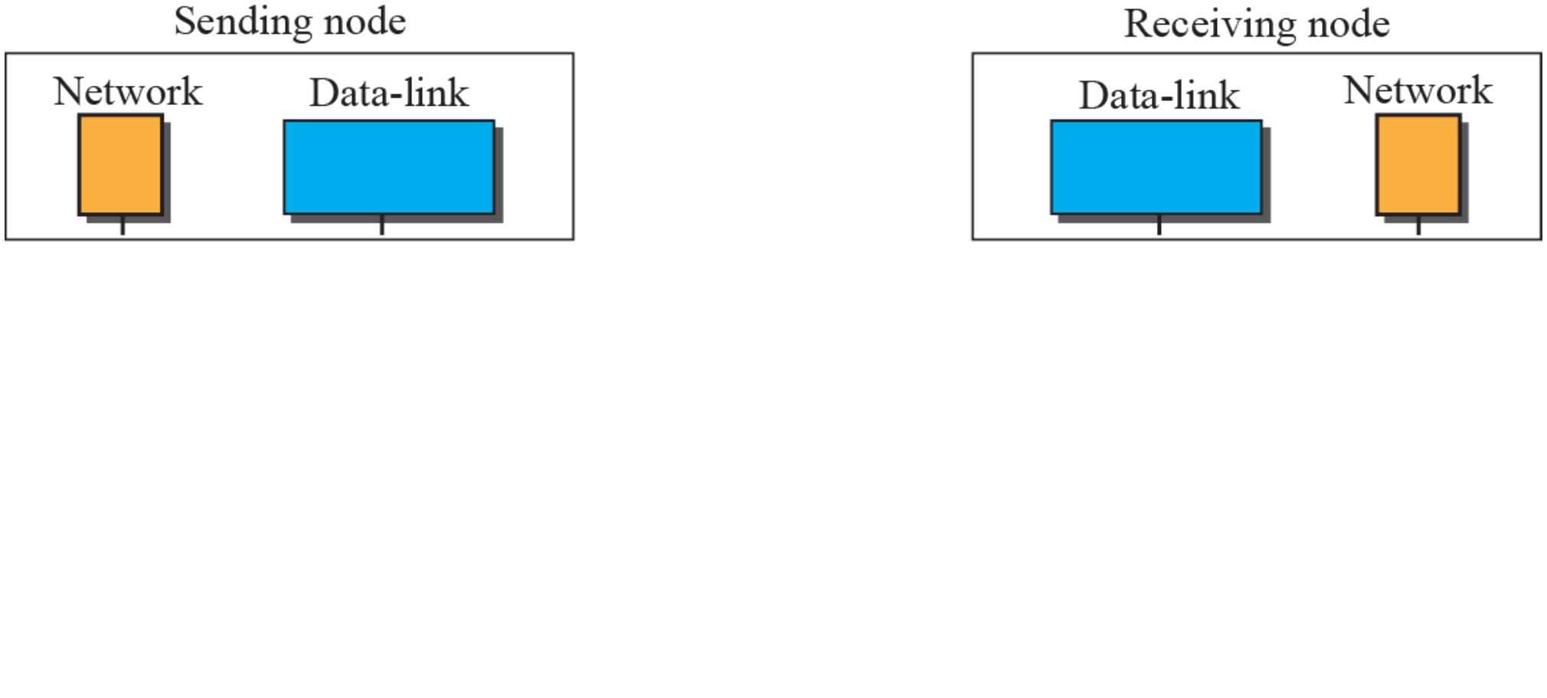
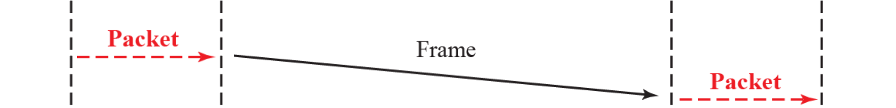
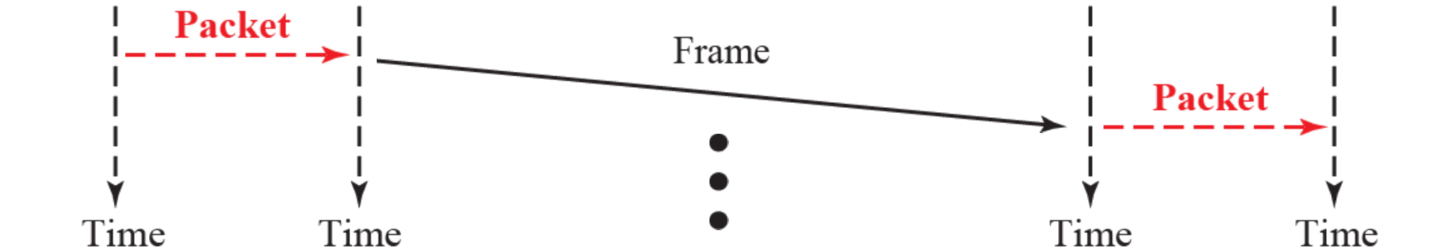
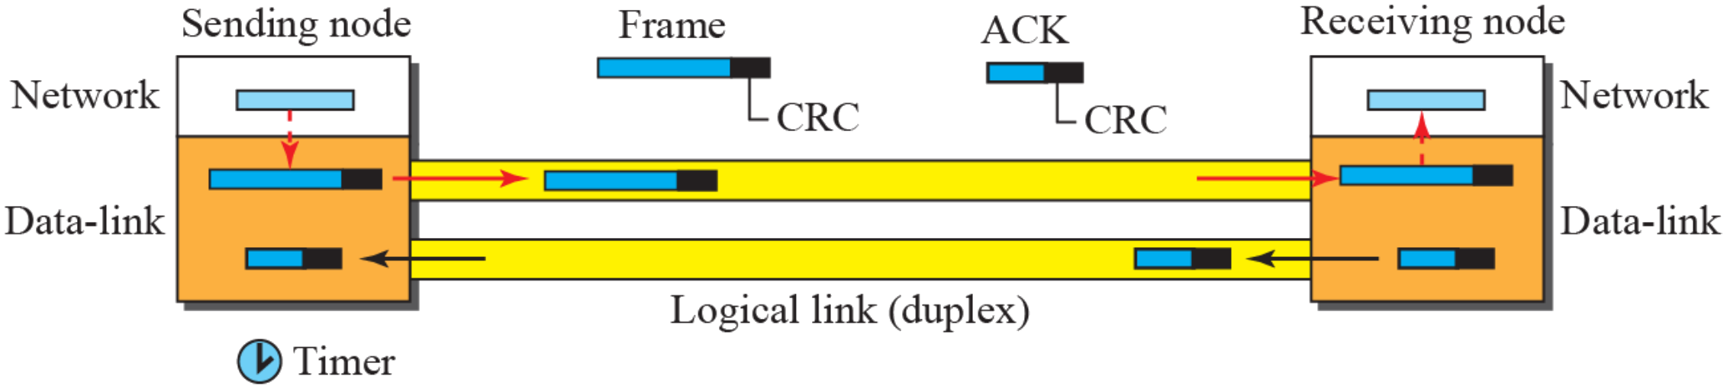
Example 11.2
Simple protocol in action
Figure 11.9
Flow diagram for Example 11.2
Sender: frames back to back, no waiting
Receiver: delivers each packet on arrival
Nothing flows back: no ACK, no feedback
Safe only if the receiver keeps up and the link never errs
11.2.2
Stop-and-Wait protocol
Figure 11.10
Stop-and-Wait protocol
Flow control + error control
One frame at a time: wait for ACK before the next
CRC on each data frame: corrupted → silently discarded, receiver silence = lost or corrupted
Timer: started at each send
ACK in time → stop timer, send next frame
Timeout → resend the saved copy
Copy kept until its ACK arrives: at most one frame and one ACK on the link
Notes:
Figure 11.9 builds in 2 clicks, one frame each.

Slide 9
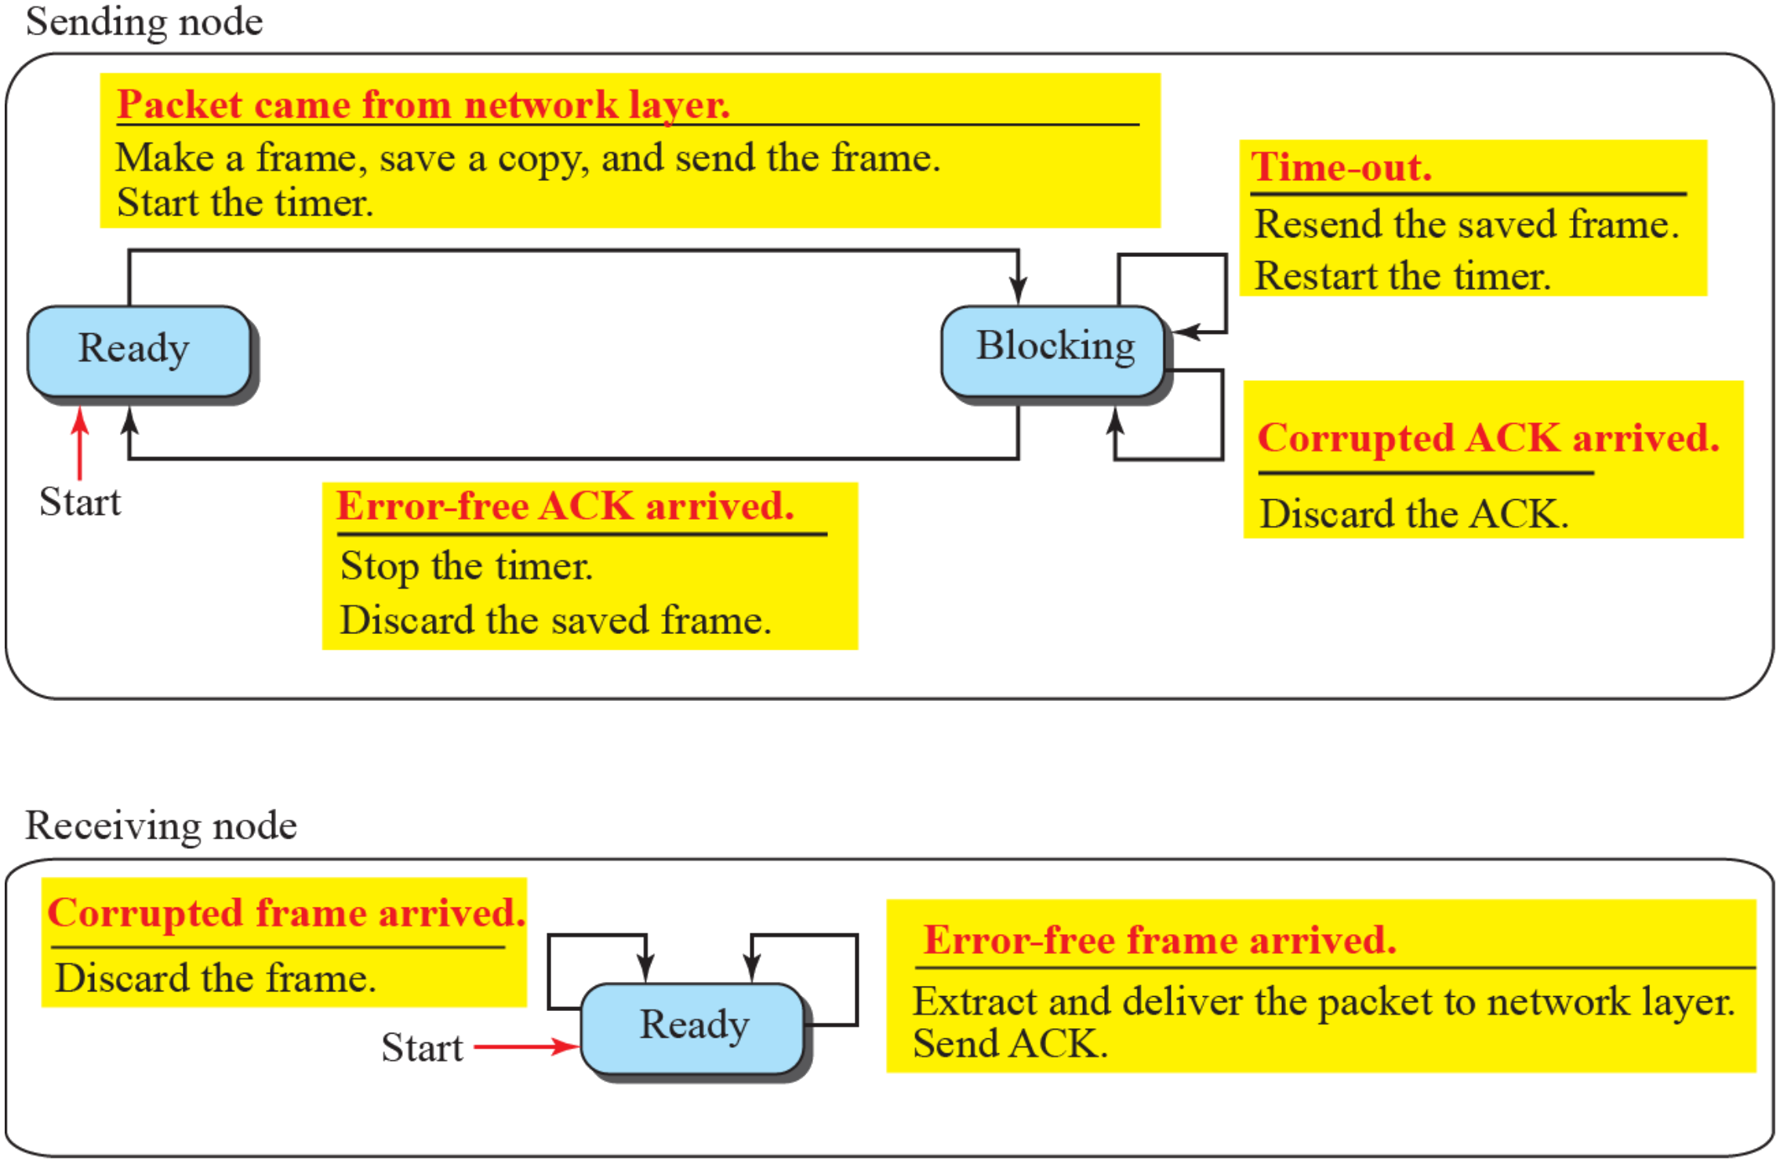
11.2.2
Stop-and-Wait FSMs
Figure 11.11
FSM for the Stop-and-Wait protocol
Sender, Ready
Packet arrives → make frame, save copy, start timer, send → Blocking
Sender, Blocking
Timeout → resend saved frame, restart timer
Corrupted ACK → discard it
Error-free ACK → stop timer, discard copy → Ready
Receiver, always Ready
Error-free frame → deliver packet, send ACK
Corrupted frame → discard

Slide 10
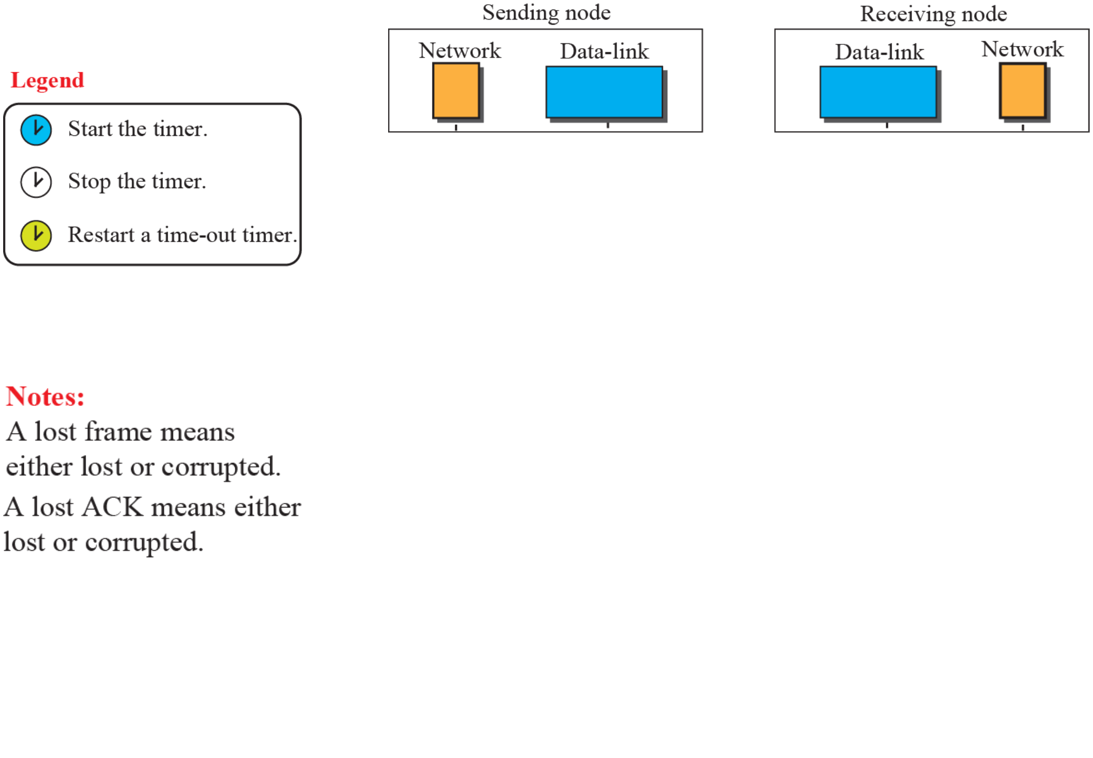
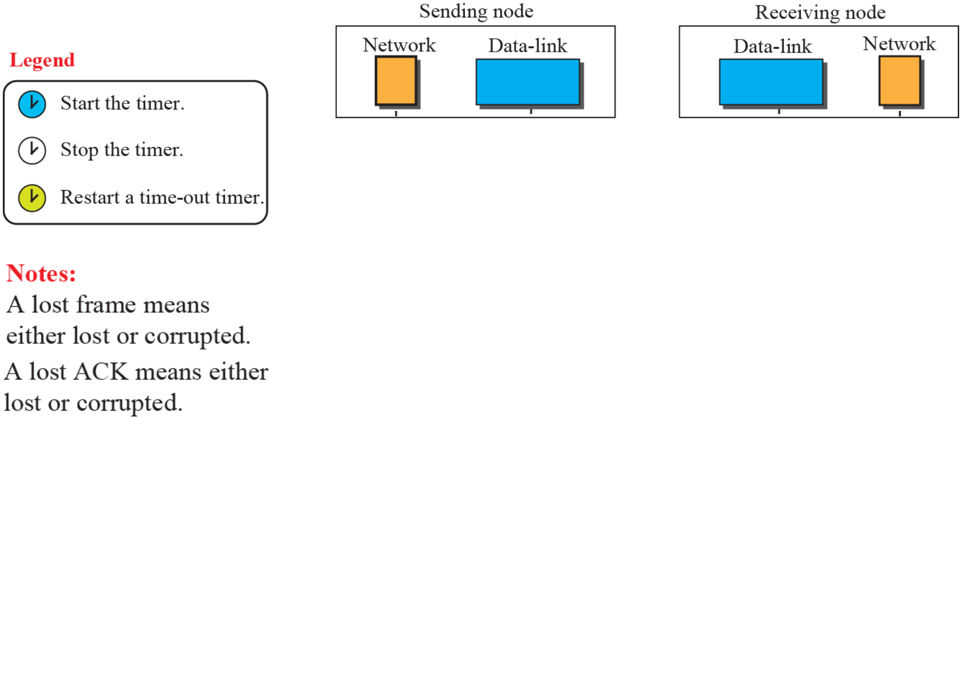
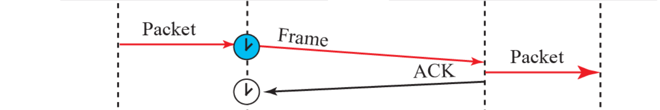
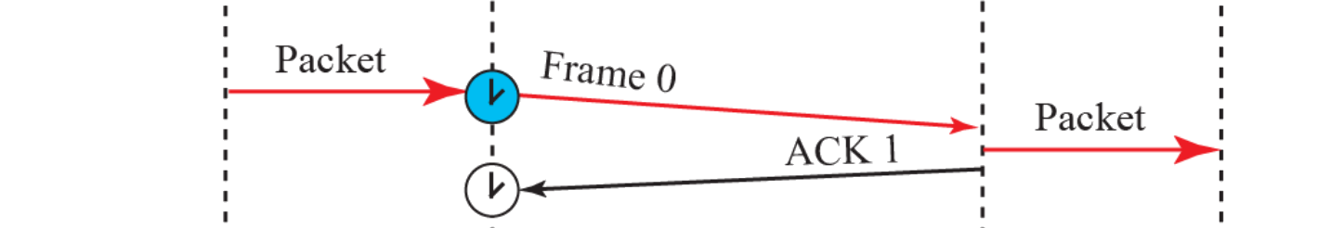
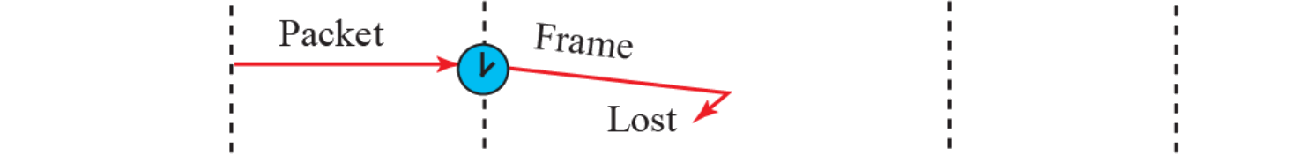
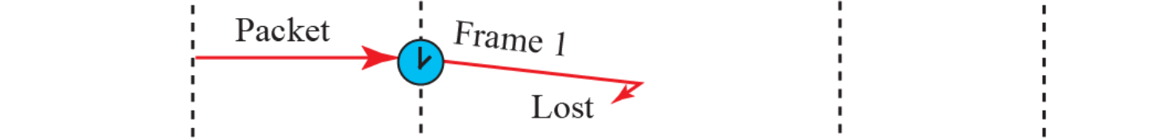
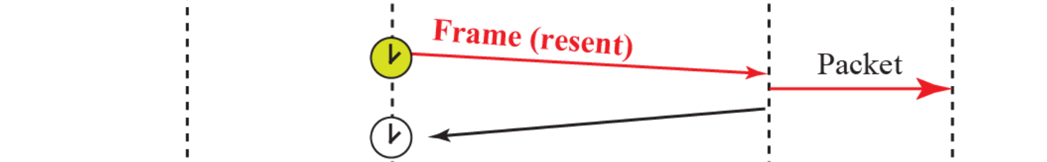
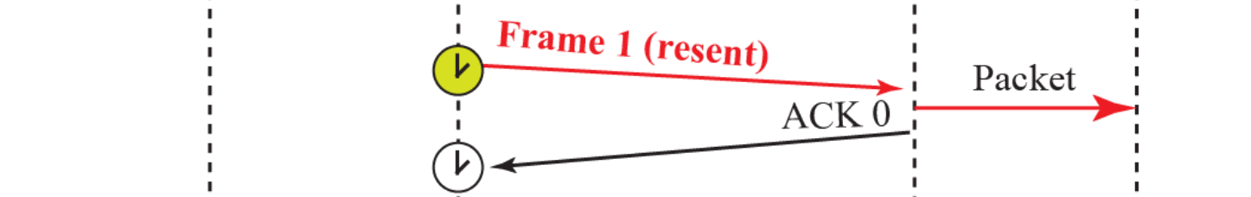
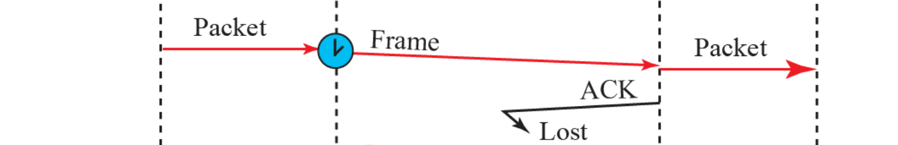
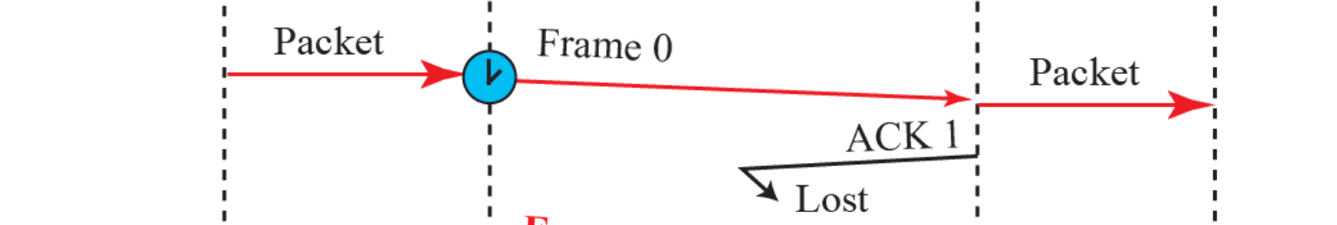
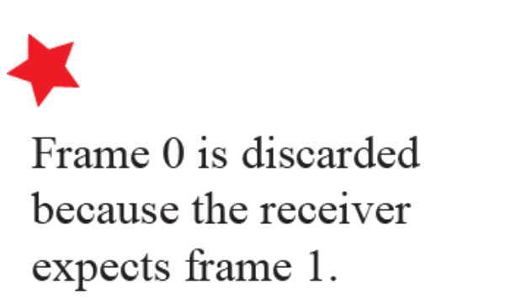
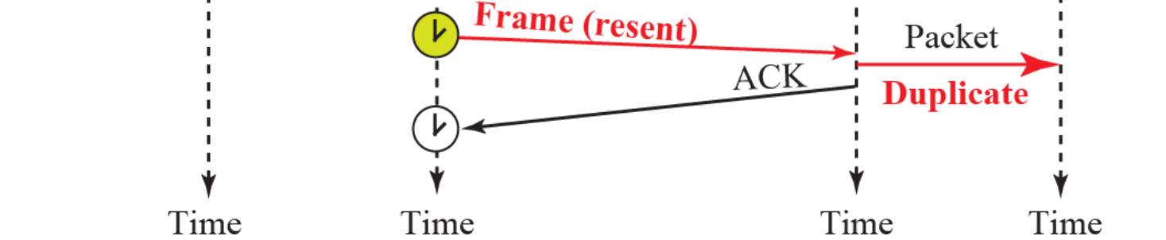
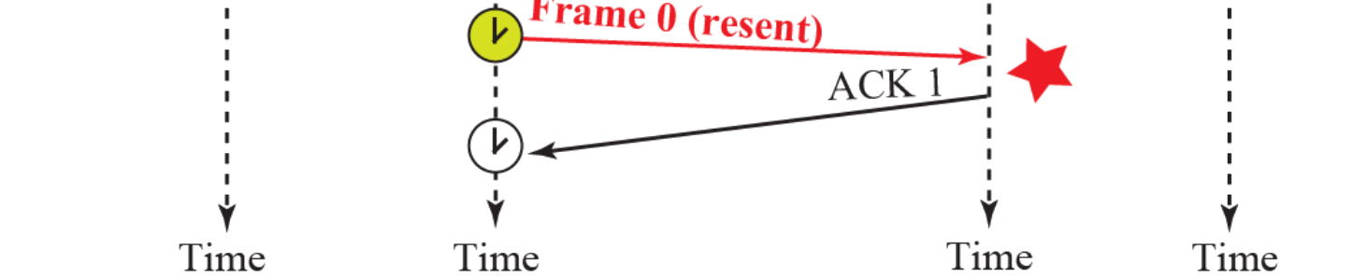
Example 11.3
Lost frame, lost ACK
Example 11.4
Sequence and acknowledgment numbers
Frame 1: sent, acknowledged
Frame 2: lost → timeout → resent
Frame 3: delivered, ACK lost → timeout → resent
Packet 3 delivered twice: duplicate
Fix: number the frames and the ACKs
Seq 0, 1, 0, 1, … ACK 1, 0, 1, 0, …: ACK n = next frame expected
1 bit suffices: one frame outstanding
Frame 1 lost → resent → ACK 0
ACK 1 lost → Frame 0 resent: receiver expects 1, discards it, re-sends ACK 1
In use: Bluetooth LE link layer, 1-bit SN and NESN
Figure 11.12
Flow diagram for Example 11.3
Figure 11.13
Flow diagram for Example 11.4
Notes:
Figures 11.12 and 11.13 each build in 5 clicks, one exchange per click. Run 11.12 first, then 11.13.

Slide 11
11.2.3
Piggybacking and link efficiency
Today
Link-layer ARQ in use
Piggybacking: ACK rides on reverse data, HDLC N(R), TCP
Stop-and-Wait on long links: U = T_{f} / (T_{f} + RTT)
1 Gbps, 1500 bytes: T_{f} = 12 μs
100 m LAN, RTT ≈ 1 μs: U ≈ 92%
1000 km fiber, RTT ≈ 10 ms: U ≈ 0.12%
Fix: many frames in flight
Go-Back-N, Selective Repeat (Chapter 23)
Parallel Stop-and-Wait processes (HARQ)
Link | Scheme | Numbers, window
Bluetooth LE | Stop-and-Wait | 1-bit SN, NESN
Wi-Fi | Stop-and-Wait + Block Ack | Window 64 to 1024
LTE, NR HARQ | Parallel Stop-and-Wait | 8 (LTE), 16 (NR), 32 (NTN)
LTE, NR RLC AM | Selective Repeat | NR: 12- or 18-bit SN
LAPB, LAPD | Go-Back-N with REJ | Modulo 8 or 128
Ethernet, PPP | None, drop bad frames | TCP recovers
11.3
HDLC
Today
HDLC family in use
High-level Data Link Control: bit-oriented, ISO/IEC 13239
Links: point-to-point, multipoint
Book: "implements Stop-and-Wait" → sliding window
3-bit numbers: 7 outstanding, 7-bit: 127
REJ → Go-Back-N, SREJ → Selective Repeat
Book: "theoretical" → HDLC family still deployed
Not the Ethernet frame: no flags, no stuffing
Protocol | Where it runs
LAPB | X.25 (legacy), AX.25 packet radio
LAPD, LAPDm, LAPF | ISDN D channel, GSM radio signaling, Frame Relay
Cisco HDLC | Cisco serial WAN default
PPP framing | RFC 1662, Packet over SONET/SDH
IEEE 802.2 LLC | I, S, U control field on 802 LANs
IEC 62056-46 | Electricity meter reading

Slide 12
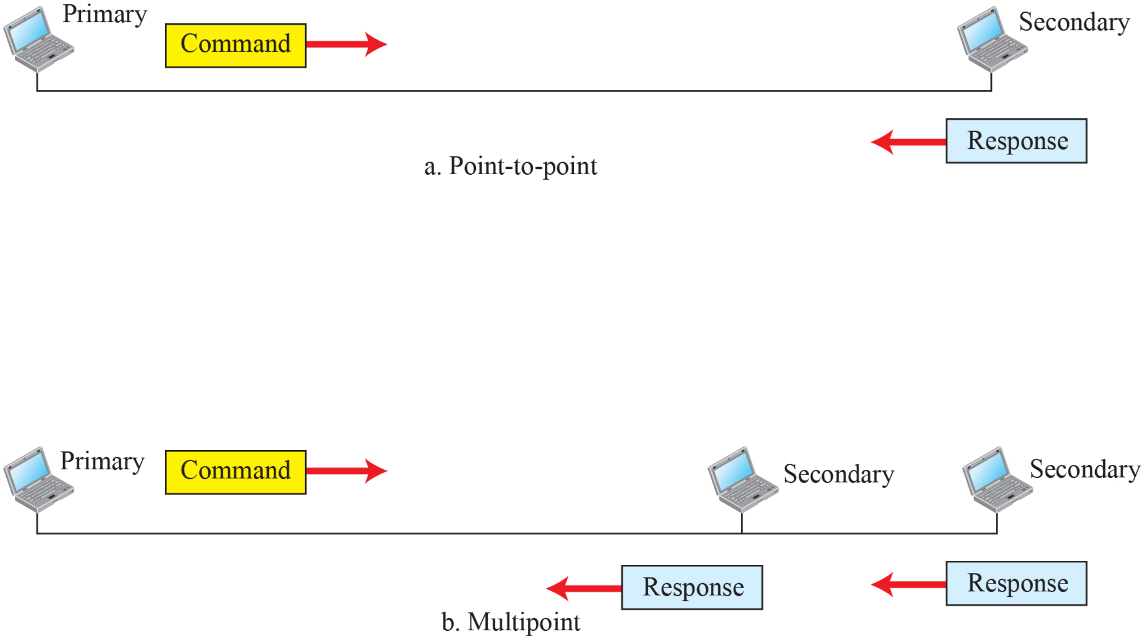
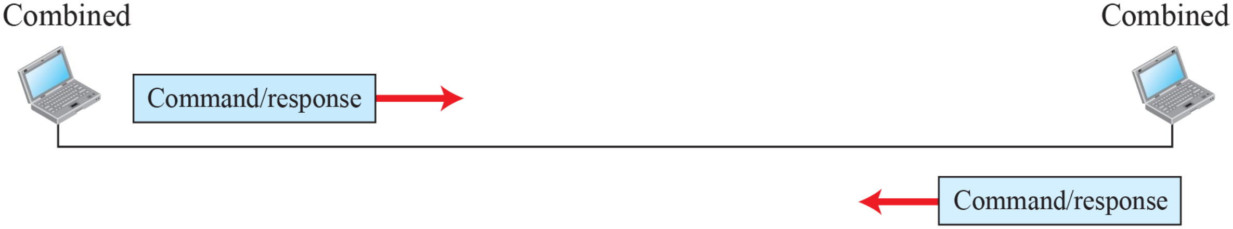
11.3.1
NRM, normal response mode
Figure 11.14
Normal response mode
Unbalanced configuration
One primary: sends commands
Secondaries: only respond
Point-to-point or multipoint (polling)
11.3.1
ABM, asynchronous balanced mode
Figure 11.15
Asynchronous balanced mode
Balanced, point-to-point only
Combined stations: each primary + secondary, peers
Common mode today (LAPB, LAPD)

Slide 13
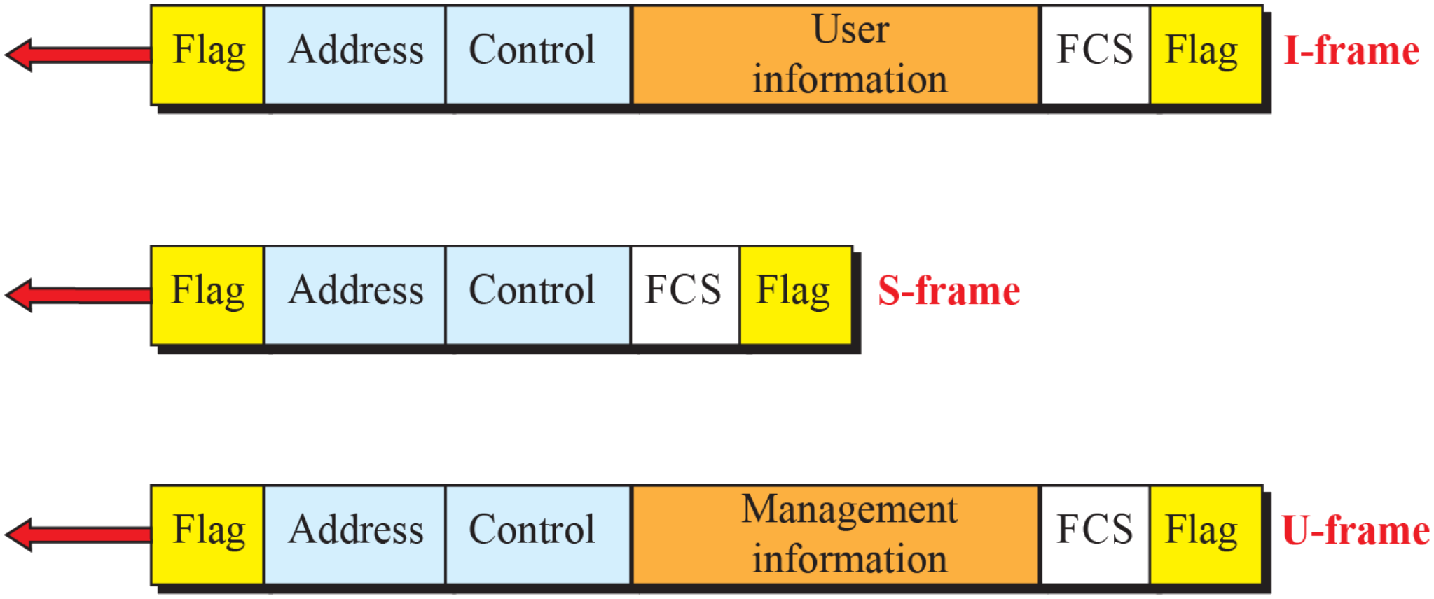
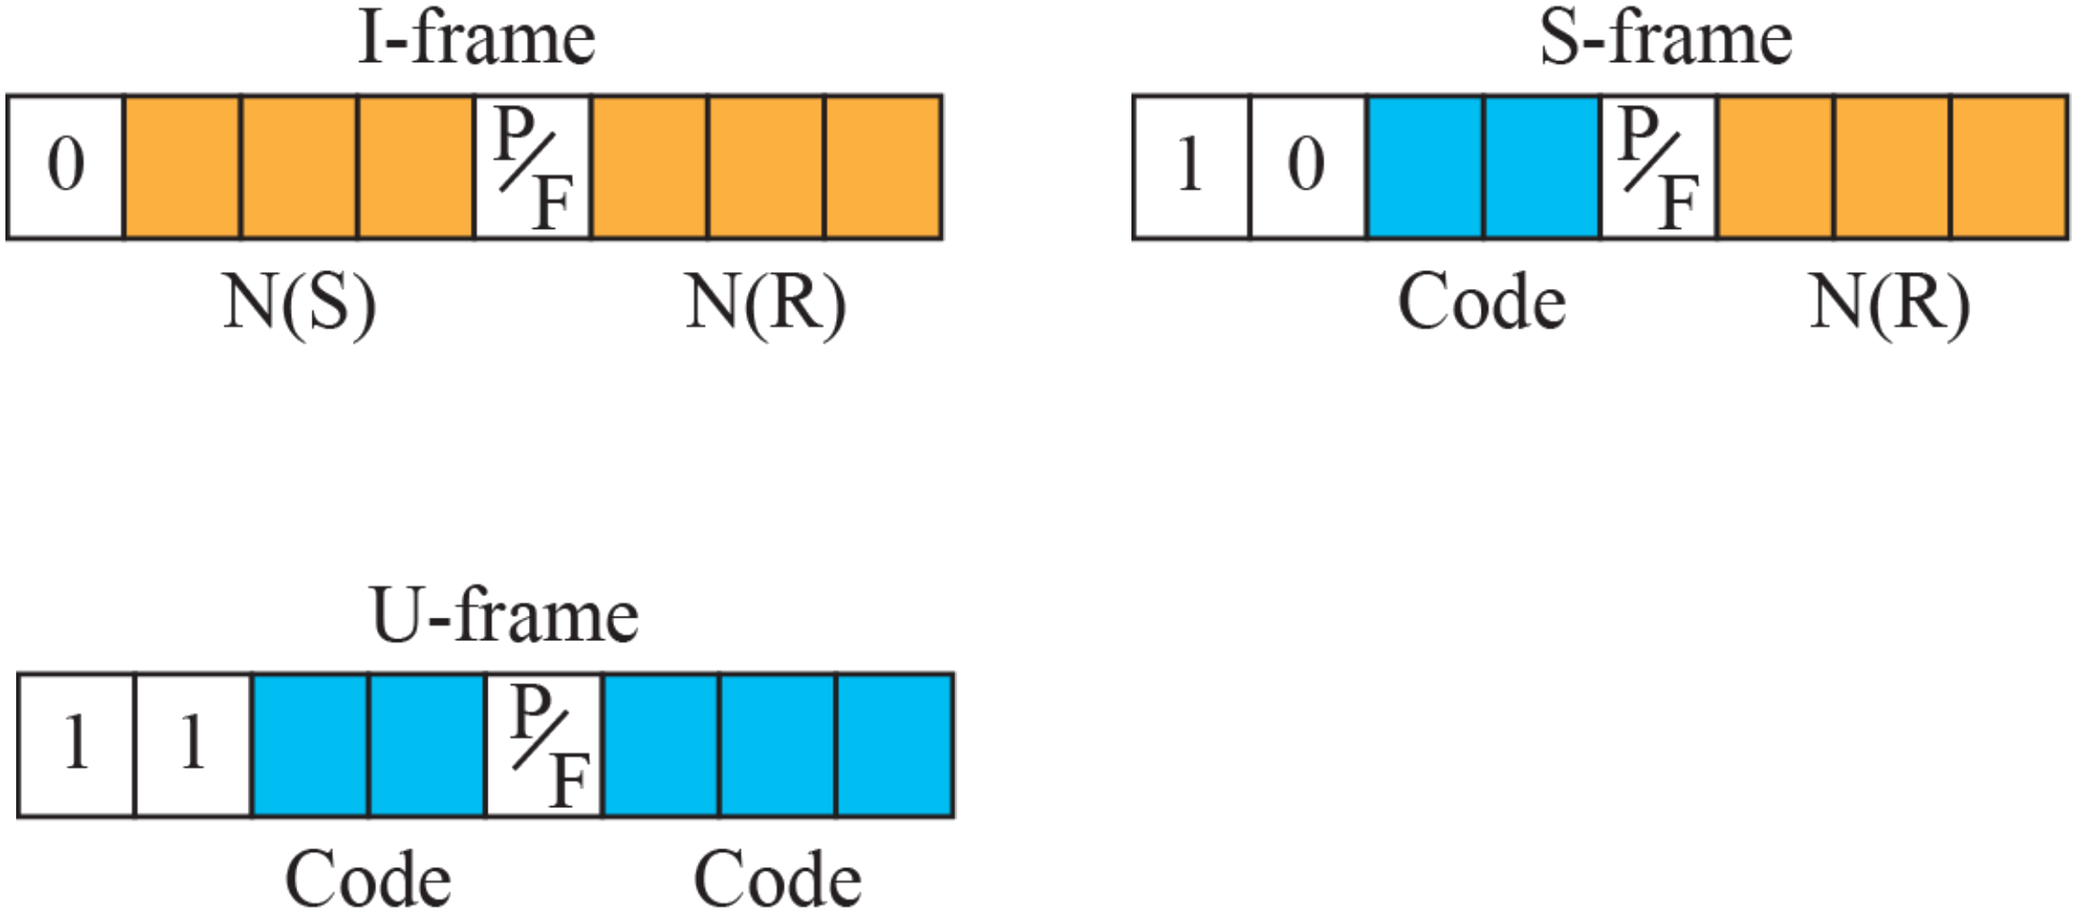
11.3.2
HDLC frames
Figure 11.16
HDLC frames
I-frame: user data + piggybacked control
S-frame: flow and error control only, no information field
U-frame: link management
Flag: 01111110, back-to-back frames may share one
Address: secondary station, 1 or more bytes
From primary: "to" address, from secondary: "from" address
Control: 1 or 2 bytes. Information: user or management data
FCS: CRC-16 or CRC-32
11.3.2
Control field
Figure 11.17
Control field format for the different frame types
First bits = type: 0 → I, 10 → S, 11 → U
I-frame: N(S) 3 bits, P/F, N(R) 3 bits
N(R): piggybacked ACK, next frame expected
P/F: Poll (primary → secondary), Final (secondary → primary)
S-frame codes, with N(R): RR 00 ACK, RNR 10 ACK but busy, REJ 01 NAK (Go-Back-N), SREJ 11 NAK (Selective Repeat)
U-frame: 2 + 3 code bits → up to 32 types
Extended mode: 2-byte control, 7-bit N(S) and N(R)

Slide 14
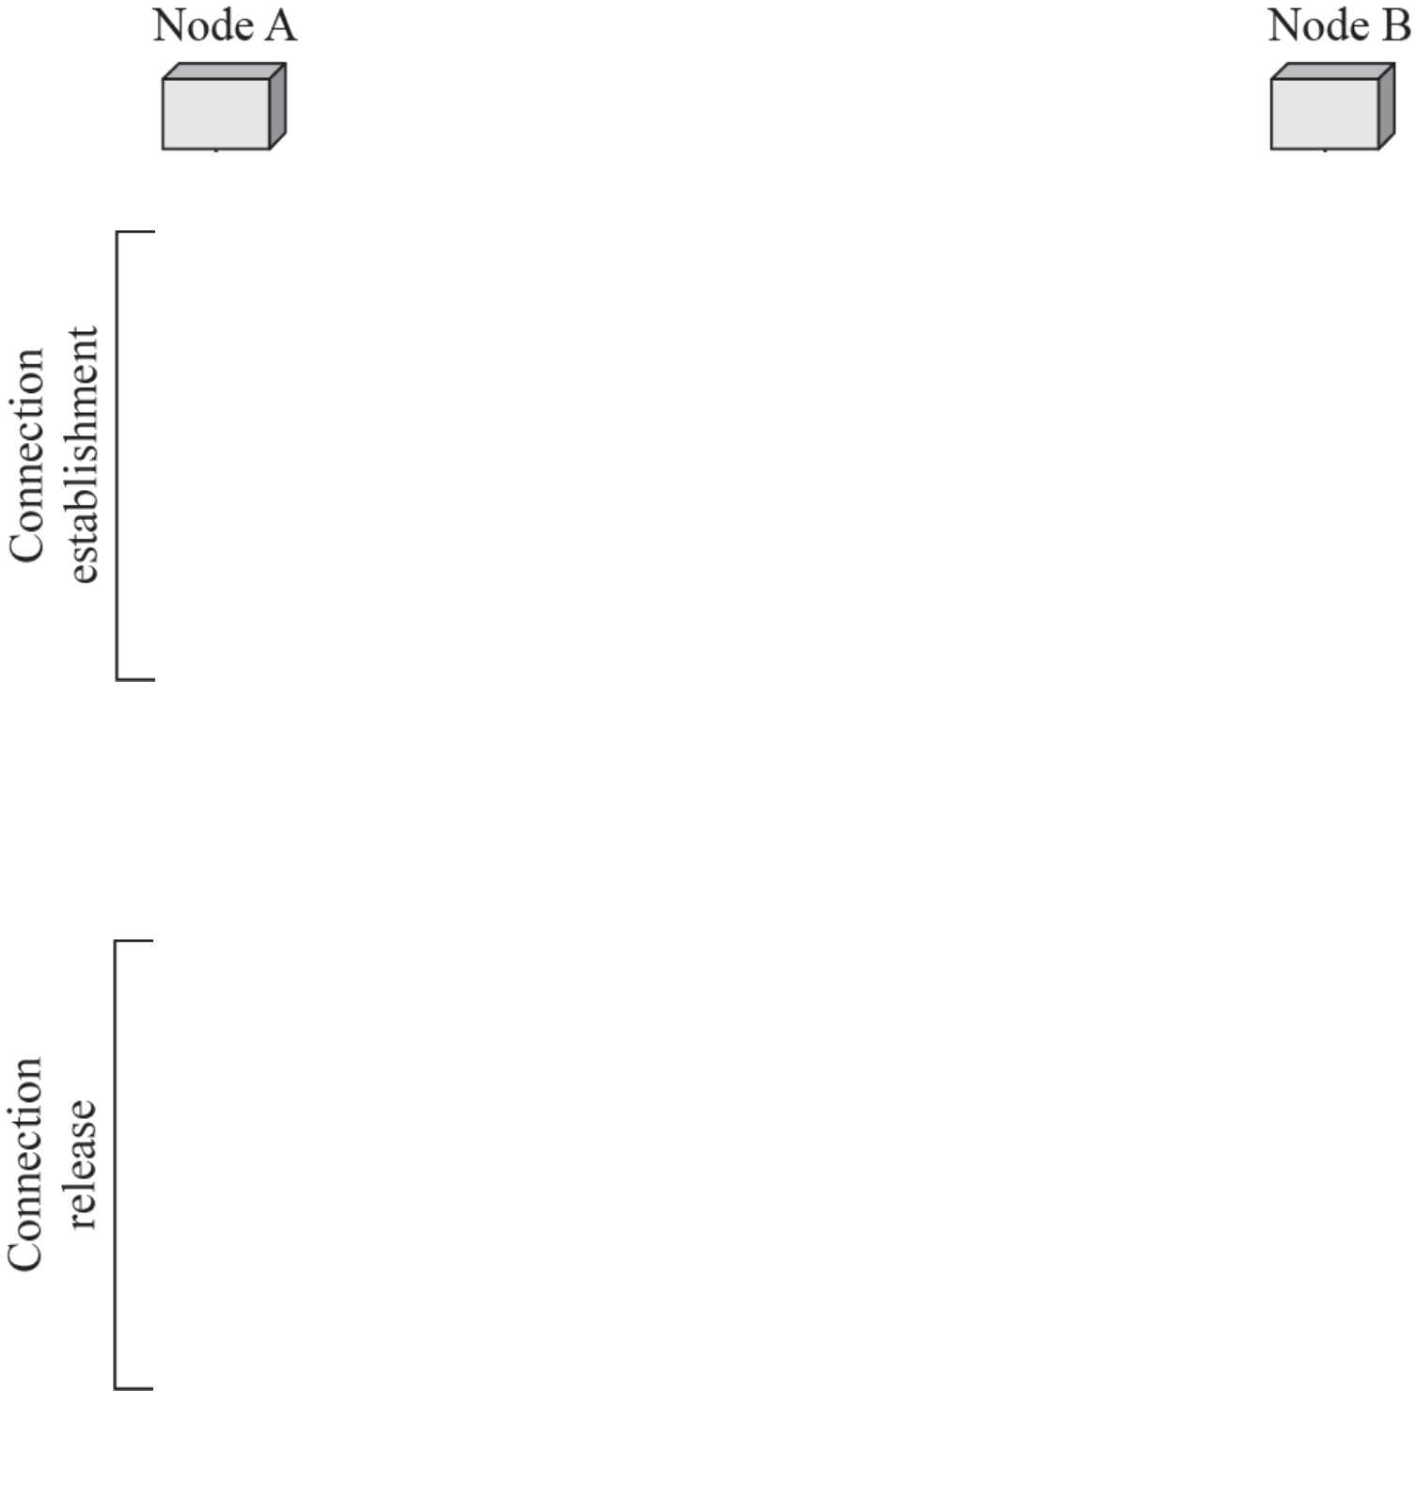
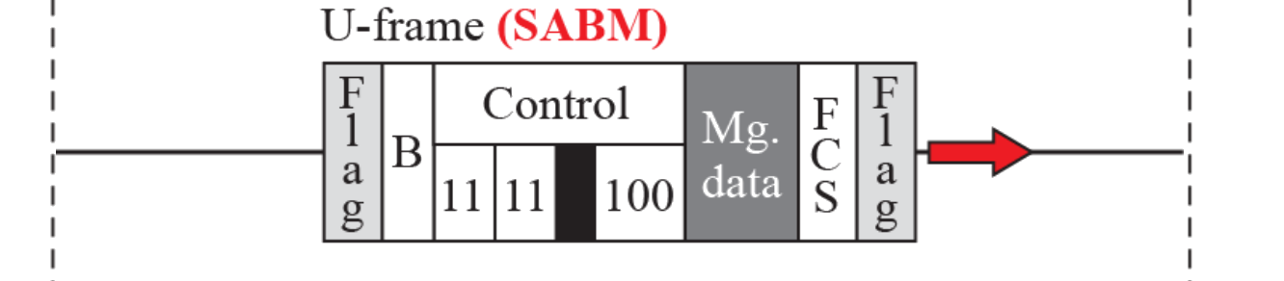
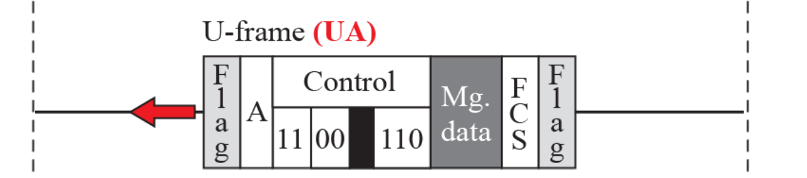
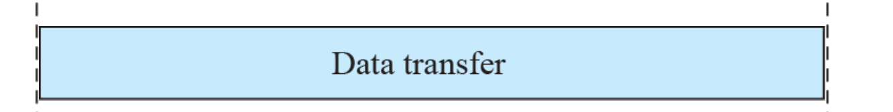
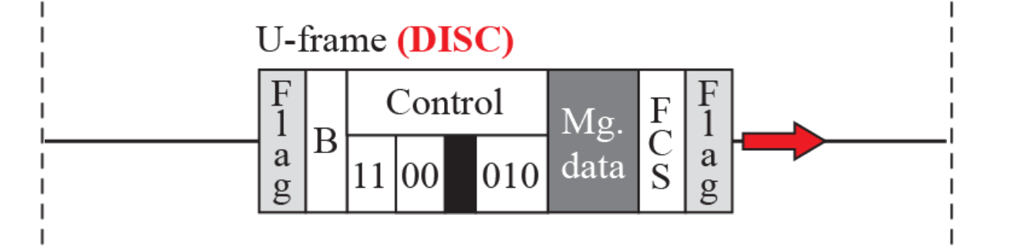
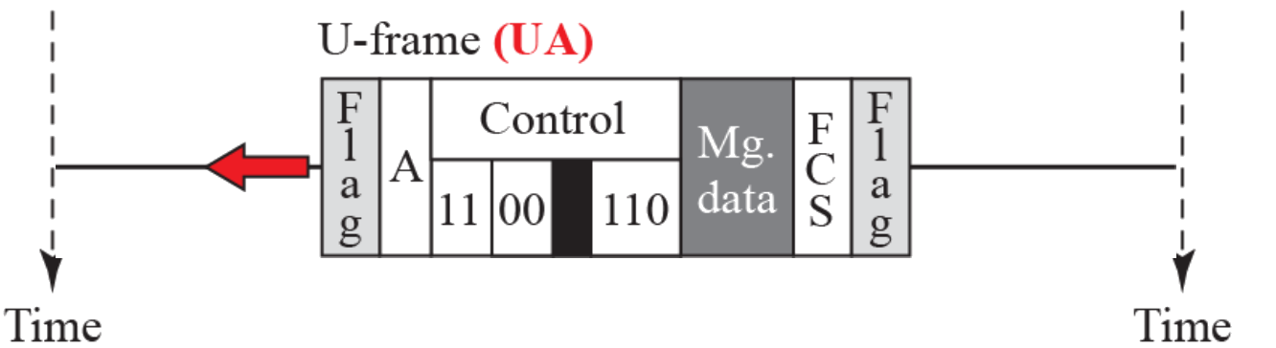
Example 11.5
Connection setup and release
Figure 11.18
Example of connection and disconnection
SABM, A → B: set asynchronous balanced mode
UA, B → A: unnumbered acknowledgment
Data transfer: I-frames and S-frames
DISC, A → B: disconnect, UA from B confirms
Book figure: UA from B carries address A → B, a response carries its sender's address
11.3.2
Common U-frames
Frame | Meaning | Code bits | Byte
SABM | Set asynchronous balanced mode | 11, 100 | 0x2F
SNRM | Set normal response mode | 00, 001 | 0x83
UA | Unnumbered acknowledgment | 00, 110 | 0x63
DISC | Disconnect | 00, 010 | 0x43
DM | Disconnected mode | 11, 000 | 0x0F
FRMR | Frame reject | 10, 001 | 0x87
UI | Unnumbered information, PPP's 0x03 | 00, 000 | 0x03
Code bits: 2 before P/F, 3 after. Byte with P/F = 0, bit 1 sent first
Notes:
Figure 11.18 builds in 5 clicks: SABM, UA, data transfer, DISC, UA.

Slide 15

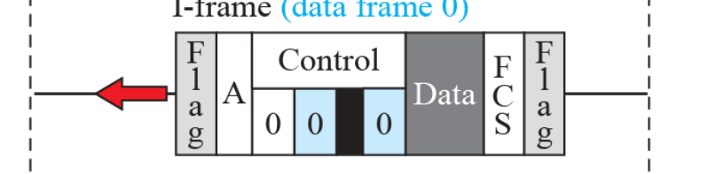
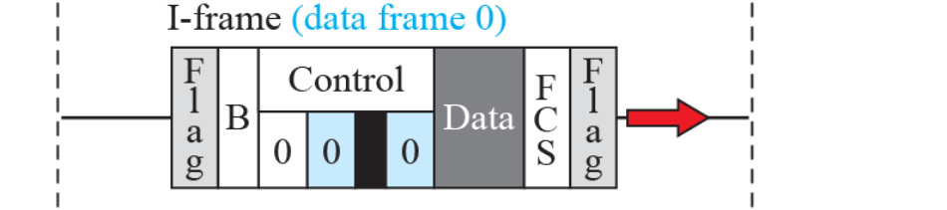
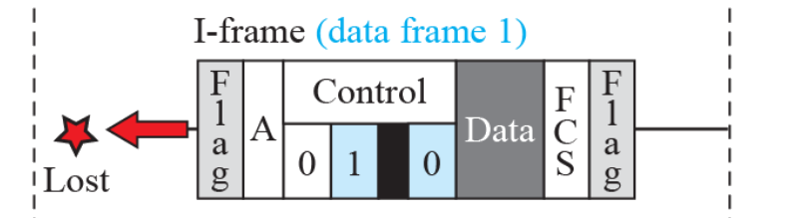
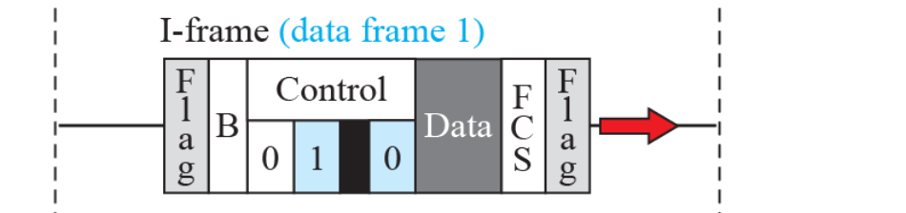
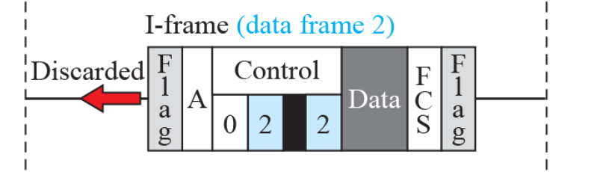
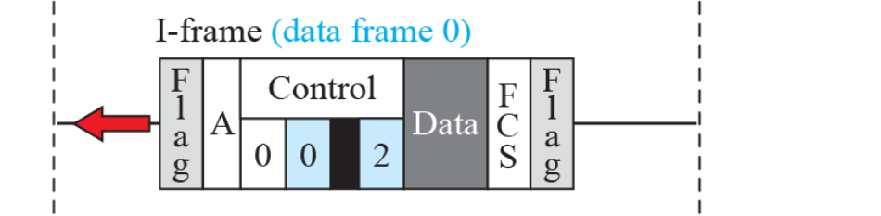
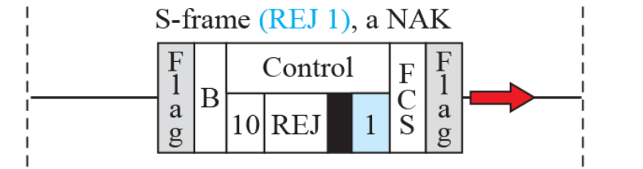
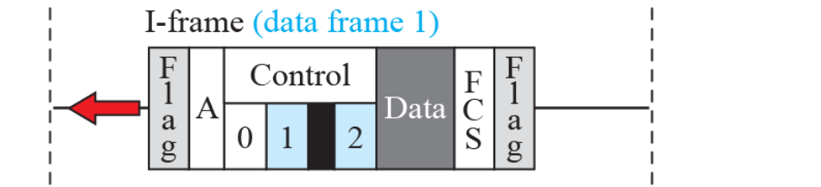
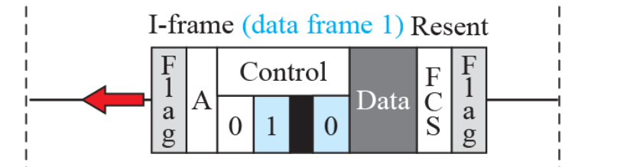
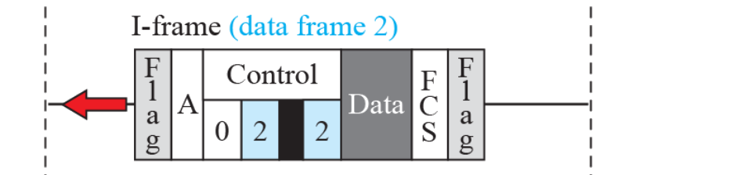
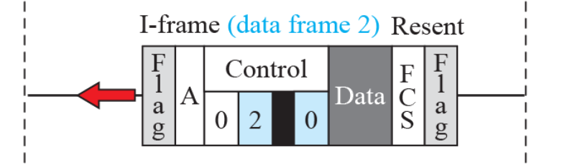
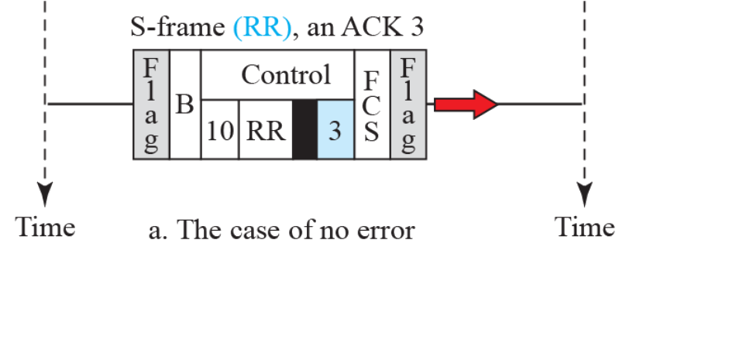
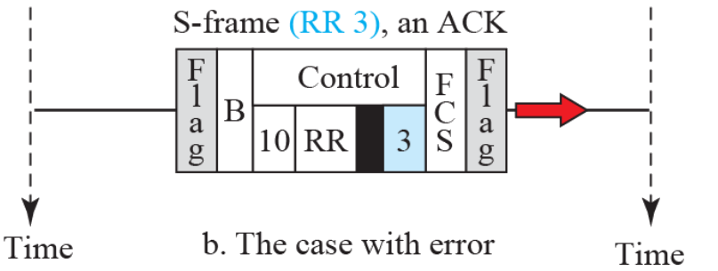
Example 11.6
Piggybacking with and without error
Figure 11.19
Example of piggybacking with and without error
a. No error
A → B: I0, I1 with N(R) = 0, nothing from B yet
B → A: I0, I1, I2 with N(R) = 2, A's 0 and 1 received
A has no data: RR 3 acknowledges B's 0, 1, 2
b. Error
B's I1 lost, I2 out of order → discarded
A → B: REJ 1, a NAK: resend from 1 (Go-Back-N)
B resends I1, I2 → A answers RR 3
Book figure: discarded I2 shows N(R) = 2 → 0
Three frames outstanding: HDLC is not Stop-and-Wait
Notes:
Figure 11.19 builds in 13 clicks: six frames of case a, then seven frames of case b.

Slide 16

11.4
PPP services
11.4.2
PPP framing
Point-to-Point Protocol: RFC 1661 (1994)
Book: most users reach the ISP by dial-up modem
Dial-up nearly gone, PPP lives on in PPPoE, L2TP, cellular modems
Provides: frame format, link negotiation (LCP), several network layers (one NCP each)
Optional authentication: PAP, CHAP, later EAP
Address configuration: IPCP gives the user an address
Multilink PPP: an extension (RFC 1990), not a new version
Does not provide: flow control, error recovery, multipoint addressing
CRC detects, bad frame silently dropped
Book: "packets out of order" → a single link keeps order: frames get lost, not reordered
Flag 0x7E, Address 0xFF (all stations), Control 0x03 (HDLC UI)
Protocol: 2 bytes, 1 if compression negotiated
Payload: up to 1500 bytes by default (MRU)
FCS: CRC-16, or CRC-32 if negotiated
Asynchronous links (RFC 1662): send 0x7D, then the byte XOR 0x20
7E → 7D 5E, 7D → 7D 5D
Bytes below 0x20 escaped by default, ACCM option relaxes it
Bit-synchronous links: HDLC bit stuffing instead
Padding optional: flags mark the end (book: "needed")
Figure 11.20
PPP frame format

Slide 17


11.4.3
Transition phases
Figure 11.21
Transition phases
Dead: no carrier, line quiet
Establish: carrier detected, LCP negotiates options
Authenticate: only if agreed, PAP or CHAP, failure → Terminate
Network: NCP, e.g. IPCP, configures the network layer
Open: data transfer
Terminate: LCP Terminate-Request and Terminate-Ack, carrier dropped → Dead
RFC 1661 names: Link Dead, Establishment, Authentication, Network-Layer Protocol, Termination
11.4.4
LCP packet
Figure 11.23
LCP packet encapsulated in a frame
Carried with Protocol 0xC021
Code: packet type (Table 11.1)
ID: matches a reply to its request
Length: whole LCP packet
Information: options as type, length, data

Slide 18
Table 11.1
LCP packets
Table 11.2
Common options
Code | Packet type | Description
0x01 | Configure-request | Contains the list of proposed options and their values
0x02 | Configure-ack | Accepts all options proposed
0x03 | Configure-nak | Announces that some options are not acceptable
0x04 | Configure-reject | Announces that some options are not recognized
0x05 | Terminate-request | Request to shut down the line
0x06 | Terminate-ack | Accept the shutdown request
0x07 | Code-reject | Announces an unknown code
0x08 | Protocol-reject | Announces an unknown protocol
0x09 | Echo-request | A type of hello message to check if the other end is alive
0x0A | Echo-reply | The response to the echo-request message
0x0B | Discard-request | A request to discard the packet
Option | Default
Maximum receive unit | 1500
Authentication protocol | None
Protocol field compression | Off
Address and control field compression | Off
11.4.4
Code groups
1 to 4: configuration (Establish)
5, 6: termination
7 to 11: monitoring, debugging
11.4.4
Option negotiation
Configure-Request: lists proposed options
Ack: all accepted, Nak: some values unacceptable, counter-proposal, Reject: some options unknown
Echo-Request and Echo-Reply: keepalive, e.g. PPPoE sessions

Slide 19

11.4.4
Multiplexing in PPP
Figure 11.22
Multiplexing in PPP
One link, several protocols: told apart by the Protocol field
LCP 0xC021: link setup, options, keepalive, teardown
Authentication: PAP 0xC023, CHAP 0xC223
NCPs: IPCP 0x8021, IPv6CP 0x8057, …
Data: IPv4 0x0021, IPv6 0x0057
Pattern: NCP 0x8xxx configures data 0x0xxx
NCP packets configure only: never carry user data
One LCP, two classic APs, one NCP per network layer

Slide 20

11.4.4
PAP
Figure 11.24
PAP packets encapsulated in a PPP frame
Password Authentication Protocol: RFC 1334, Protocol 0xC023
Two steps
User → system: user name + password
System → user: Authenticate-Ack or Authenticate-Nak
Codes: 1 Request, 2 Ack, 3 Nak
Password in clear text: anyone on the link reads it
Book figure: Ack and Nak carry Msg-Length + Message, not a user name
Today
PAP and CHAP now
PPPoE logins: PAP or CHAP still carry the subscriber account
MS-CHAPv2: broken in 2012, avoid
PAP: only inside an encrypted tunnel

Slide 21

11.4.4
CHAP
Figure 11.25
CHAP packets encapsulated in a PPP frame
Challenge Handshake Authentication Protocol: RFC 1994, Protocol 0xC223
Three-way handshake
System → user: Challenge, a fresh random value
User → system: Response = MD5(ID, secret, challenge)
System computes the same → Success or Failure
Password never crosses the link, replayed response useless
Codes: 1 Challenge, 2 Response, 3 Success, 4 Failure
Weakness: both ends store the secret in clear, MD5 dated
Today
EAP, the successor born in PPP
EAP (RFC 2284, 1998, now RFC 3748): one framework, many methods
Now in: 802.1X Wi-Fi and Ethernet (WPA2/WPA3-Enterprise), 5G (EAP-AKA′)

Slide 22



11.4.4
NCP, IPCP, data, Multilink
Figure 11.26
IPCP packet encapsulated in PPP frame
One NCP per network layer: IPCP 0x8021, IPv6CP 0x8057, OSI 0x8023, Xerox NS IDP 0x8025
IPCP: LCP codes 1 to 7 (Table 11.3), options: user IP address, DNS servers (RFC 1877)
IPv6CP: only a 64-bit interface identifier, prefix via SLAAC or DHCPv6
User data: Protocol 0x0021 for IPv4 (0x0057 IPv6, 0x0023 OSI)
Multilink PPP (RFC 1990): one logical link over several links, fragments with Protocol 0x003D, sequence number, begin and end bits
Table 11.3
Code values for IPCP packets
Figure 11.27
IP datagram encapsulated in a PPP frame
Code | IPCP packet
0x01 | Configure-request
0x02 | Configure-ack
0x03 | Configure-nak
0x04 | Configure-reject
0x05 | Terminate-request
0x06 | Terminate-ack
0x07 | Code-reject
Figure 11.28
Multilink PPP

Slide 23






Example 11.7
A PPP session
Figure 11.29
An example
Establish: LCP Configure-Request, Configure-Ack
Options: PAP, address and control field compression
Authenticate: PAP Request, Ack
Network: IPCP Configure-Request, Configure-Ack
Data transfer: IP packets, Protocol 0x0021
Terminate: LCP Terminate-Request, Terminate-Ack
IPCP alone can close: LCP stays up for another NCP
Book figure errors
PAP Ack: code 02, carries a Message, not a Name
LCP frames always keep FF 03, even after compression is agreed
Notes:
Figure 11.29 builds in 5 clicks: establish, authenticate, network, data transfer, terminate.

Slide 24
Today
PPP today
New
PPPoE encapsulation and the 1492-byte MTU
Dial-up modem PPP: nearly gone
PPPoE (RFC 2516): PPP sessions over Ethernet, DSL and many fiber ISPs
6-byte PPPoE + 2-byte PPP header → IP MTU 1492, RFC 4638 allows 1500
LCP Echo as keepalive
L2TP (RFC 2661, RFC 3931): PPP tunneled over IP, wholesale broadband, VPNs
Cellular: PPP between host and modem (AT commands), no PPP in the LTE and 5G core
Ethernet payload ≤ 1500 bytes
Ethernet
header
PPPoE
header
PPP
Protocol
IP packet
FCS
14 bytes
6
2
≤ 1492 = 1500 − 6 − 2
4
Today
Framing and error control across today's links
Link | Frame boundary | Error control
HDLC (LAPB) | Flag + bit stuffing | CRC-16, Go-Back-N with REJ
PPP, PPPoE | Flag + byte stuffing, or Ethernet framing (PPPoE) | CRC, discard only
Ethernet | Preamble + SFD, PHY code groups | CRC-32, discard only
Wi-Fi | PHY length field, A-MPDU delimiters | CRC-32, ACK and Block Ack
5G NR | Grant size (DCI), MAC subheaders | CRC-24, HARQ + RLC ARQ
Bluetooth LE | Access address + length field | CRC-24, Stop-and-Wait (SN, NESN)

Slide 25
Errata
Corrections to the textbook and the original slides (1 of 2)
Where | Printed | Corrected
Book 11.1.1, fixed size | size itself is the delimiter | boundary must be found first (ATM: HEC hunting)
Book 11.1.1, byte stuffing | 16- and 32-bit Unicode characters conflict with it | stuffing ignores content: any byte stream works
Book 11.1.2 | CRC added to the frame header | CRC in the trailer (FCS)
Book Figure 11.6 and text | caption: connectionless and connection-oriented service, text: three states, event 1 → action 3 | generic FSM example: two states, event 2 → action 3
Book 11.2 | Go-Back-N, Selective Repeat gone from the data-link layer | alive: Wi-Fi Block Ack, LTE and NR RLC, LAPB REJ
Book 11.3, deck slide 32 | HDLC implements Stop-and-Wait | sliding window: up to 7 (127) outstanding, REJ, SREJ
Book 11.3, deck objectives | HDLC is the basis of Ethernet | only 802.2 LLC, Ethernet has no flags or stuffing
Book 11.3.2 | U-frame control field paragraph printed twice | printed once
Deck slide 7 | ATM: 53 bytes packet | 53-byte cell
Summary
Chapter 11 in one panel
Framing: flags + byte or bit stuffing, fixed size + HEC hunting, or length fields
Stop-and-Wait: 1-bit numbers stop duplicates, wastes long links
HDLC: I, S, U frames, N(S) and N(R), RR, RNR, REJ, SREJ, sliding window
PPP: byte-stuffed HDLC-like frame, LCP → authentication → NCP → data

Slide 26
Errata
Corrections to the textbook and the original slides (2 of 2)
Where | Printed | Corrected
Book Figure 11.18 | UA from node B carries address A | B: a response carries its sender's address
Book Figure 11.19b | discarded I-frame 2 with N(R) = 2 | N(R) = 0, as in its resend
Book 11.4, deck slide 43 | most users connect over dial-up modems | PPPoE, L2TP, cellular modems (Today panel)
Book 11.4.1 | Multilink PPP is a new version of PPP | an extension (RFC 1990)
Book 11.4.1 | no sequence numbers → out-of-order packets | single link keeps order: loss, not reordering
Book 11.4.2 | padding needed, no length field | padding optional (RFC 1661), flags mark the end
Book 11.4.2, deck slide 45 | escape = insert 01111101 | insert 0x7D, then send the byte XOR 0x20 (RFC 1662)
Book Figure 11.24 | Ack and Nak carry user name | Msg-Length + Message (RFC 1334)
Book Figure 11.29 | Authenticate-ack code 01 with Name, LCP Terminate without Address and Control | code 02 with Message, LCP always keeps FF 03 (RFC 1661)
EXPLORE
Try it
Try it: bit-stuff 0111111011111100 by hand, then unstuff it
Try it: Stop-and-Wait over a 36,000 km satellite hop at 10 Mbps: utilization?
Try it: capture a PPPoE login in Wireshark: PADI, PADO, LCP, PAP or CHAP, IPCP

