Slide 1
A Middlebox-Cooperative TCP for a non End-to-End Internet
Ryan Craven
Naval Postgraduate School
Rober Beverly
Naval Postgraduate School
Mark Allman
ICSI
(SIGCOMM 2014)
2014.08.11 박해월

Slide 2
Introduction
Middleboxes actively interpose on communication
  Implementing acceptable use policies
  Maintaining regulatory compliance
  Thwarting attacks
  Limiting or balancing resources
  Generating revenue
Unfortunately, there are some side effects
  Make the task of debugging networks even harder
  Non-malicious and unintentional middlebox behavior
    Legacy equipment, non-standard implementations and misconfigurations

Slide 3
TCP/IP Misinterpretation
At least 25% of the paths tested traversed a middlebox whose behavior depended on the packet’s transport-layer
Unintentional and unintended middlebox behaviors
  Sequence Number Translations
    Renders selective acknowledgment information useless
  Options
    MSS, Window Scaling option, Multipath TCP
  Type of Service
    In IPv4, a byte for “type-of-service” redefined to two bits for Explicit Congestion Notification (ECN) and six bits for Differentiated Services Code Point (DSCP)

Slide 4
TCP HICCUPS
Handshake-based Integrity Check of Critical Underlying Protocol Semantics
  an incrementally deployable improvement on TCP to reveal packet header manipulation to both ends of a TCP connection
Requirements
  In-band, lightweight, symmetric feedback, incrementally deployable, middlebox-cooperative, end-to-end, granularity
HICCUPS benefits TCP in two primary ways:
  Allow it to more safely increase the use of performance-enhancing extensions – ECN, Multipath TCP
  Provides early warning of potential middlebox-induced issues with an extension that is enabled by default – SACK, Window Scaling

Slide 5
Overloading Header Fields
A total of 64 bits
  The 32-bit initial TCP initial sequence number (ISN)
  The 16-bit initial IP Identification field (IPID)
  The 16-bit initial TCP flow control window (RCVWIN)
Add randomness to ISN integrity function
  Place the random salt value in the lower half of the ISN and exclusive or (XOR)-encode the integrity information in the upper half of the ISN with the same salt value

Slide 6
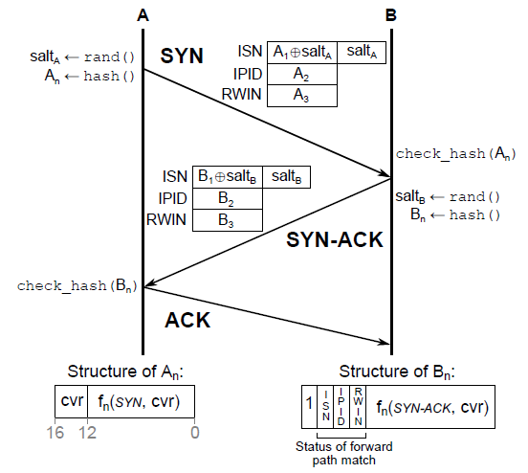
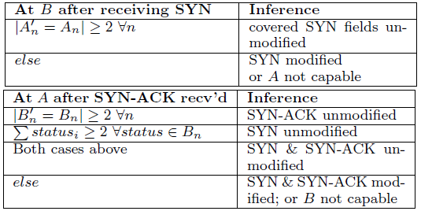
Integrity Exchange

Slide 7
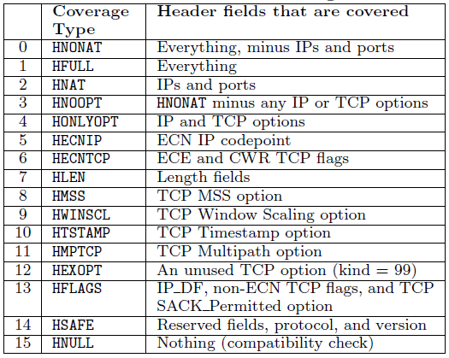
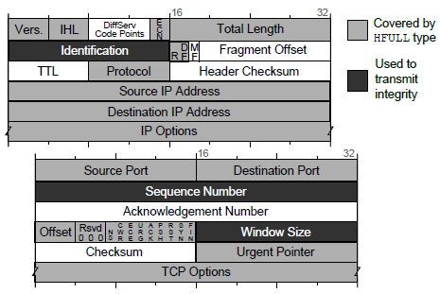
What Header Field Was Modified

Slide 8
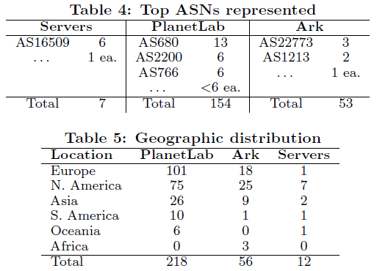
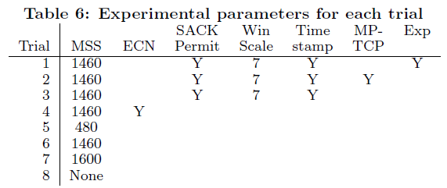
Experimental Infrastructure & Parameters
3,288 pairs of distinct hosts
26,304 directed path/port pairs

Slide 9
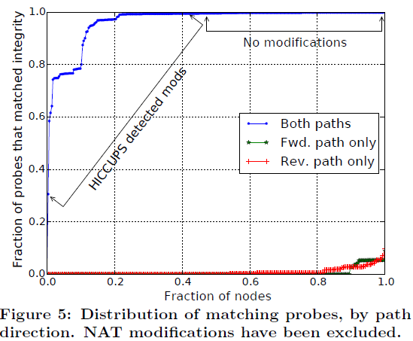
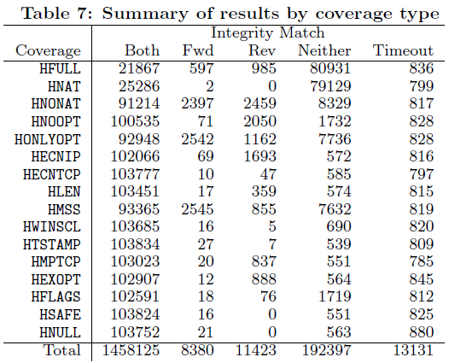
Detected Modifications

Slide 10
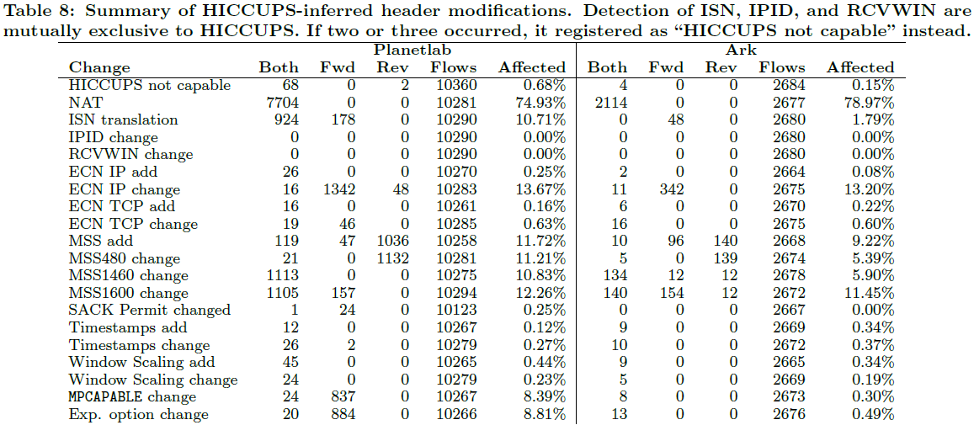
Integrity field modification

Slide 11
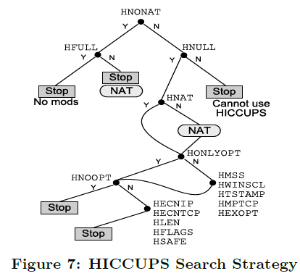
Complete Path Knowledge
HFULL vs HNULL
HNONAT->HNULL
  N: terminate the search in the event that either the other endpoint (due to lack of capability)
  Y: middleboxes along the path (due to downgrading the integrity) prevent HICCUPS from being used

Slide 12
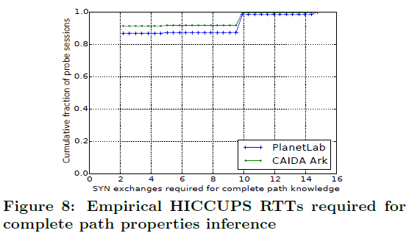
Expected Interaction Required
For PlanetLab
  261,185 SYN / 83,712 flows = 3.1 SYN/flow
For Ark
  58,083 SYN / 21,504 flows = 2.7 SYN/flow
About 85% of flows
  HNONAT and HFULL

Slide 13
Conclusion & Future work
Conclusion
  Present TCP HICCUPS that reveals packet header manipulation to both sides of TCP connection, enabling endpoints to make the inferences needed to best adapt to middleboxes along their paths
  TCP HICCUPS enables new diagnostic capabilities for network operators to help troubleshoot middlebox configurations on both forward and reverse data planes
Future work
  Refine the efficient search strategy
  Continue survey of Internet paths, analyzing header modifications and their impact over many more types of paths

