Slide 1
Bring Personalized Intelligence to Smartwatch
| Final Presentation
Junghyuk Park
Nov 20, 2016

Slide 2
Motivation
How to extend smartwatch battery life?
How to bring more personalized intelligence to smartwatch?
Passive
Active
Passive
Active
Passive
Active
00:00
6:00
12:00
18:00
24:00
00:00
6:00
12:00
18:00
24:00
[ Smartwatch Usage of Typical User ]
[ Smartwatch Usage of Night Worker ]

Slide 3
Problem Definition
Let smartwatch go into the sleep mode as much as it can!
Problems waking smartwatch from sleep mode
  Acquiring wake lock from watch face and background service
  Network connection between smartwatch and smartphone (Wi-Fi, Bluetooth)
How to find deep sleep mode phase from smartwatch usage?
  No interaction between user and smartwatch
Passive
Active
Passive
Active
Passive
Active
00:00
6:00
12:00
18:00
24:00
00:00
6:00
12:00
18:00
24:00
Deep Sleep
Deep Sleep
Deep Sleep
[ Smartwatch Usage A]
[ Smartwatch Usage B]

Slide 4
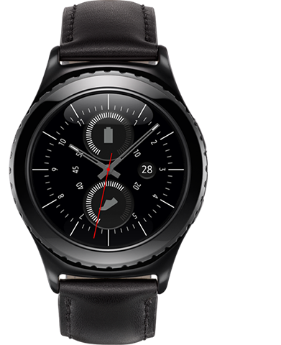
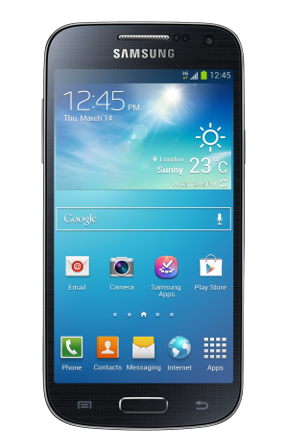
Proposed Solution Approach
Let smartwatch learn personalized usage pattern and devise models to predict a deep sleep mode phase.
Perform learning step at smartphone and then pass a built model to smartwatch.
Find a deep sleep mode phase and suspend all tasks to reduce the battery consumption as much as possible.
Smartwatch
Smartphone
1
Training
Data
2
Pre-processing
3
Prediction
5
Model
4
Learning
[ Proposed Framework For Personalized Intelligence In Smartwatch ]

Slide 5
Evaluation | Prototype Implementation
A watch face application runs on Samsung Galaxy S2
  Galaxy S2 has computing power equivalent to current generation smartwatch.
  Bluetooth network connection to smartphone is established for management.
  The application collects activities of user to learn usage pattern.
Support Vector Machine (SVM) classifier
  Classifier: active mode(1), passive mode(0)
  Feature: hour of a day
The watch face application suspends Bluetooth device on passive mode to save energy consumption autonomously without user interaction.
 | Samsung Galaxy S2 | Samsung Gear S2
CPU | 1.2 GHz dual-core ARM Cortex-A9 | 1 GHz dual-core ARM Cortex-A7
Memory | 1 GB | 512 MB
Power | 1,650 mAh | 250 mAh
Device | CPU | Training Time
Linux Desktop | i7 CPU | 4 Min
Galaxy S2 | Exynos 4210 Dual-core 1.2 GHz Cortex-A9 | N/A
Galaxy S6 | Exynos 7420 (4x1.5 GHz & 4x2.1 GHz) | 33 Min
[ Hardware Specification ]
[ SVM Training Performance: 144 features, 16,000 records ]

Slide 6
Evaluation | Experiment Results
The proposed solution saves energy consumption by 25%
[ Smartwatch Usage ]
Active
Passive
Active
17:00
22:00
09:00
17:00
Deep Sleep

