Slide 1
TCP/IP Networking
Domain Name System
Hyogon Kim
Korea University

Slide 2
Introduction
DNS is the most frequently used application level protocol
But unlike other application level protocols, it forms the Internet infrastructure
Born in 1984, standardized in 1987 [RFC 1035]
  Pre-DNS era : hosts.txt file maintained at SRI

Slide 3
Why domain name?
The IP Internet only recognizes IP address, a 32-bit number, for delivery
  Likewise, telephone networks only recognize telephone numbers for call setup
Unfortunately, humans are not good at memorizing numbers, so let’s have a “nickname” for an IP address
For translation, let’s have DNS

Slide 4
What is a “domain”?
A domain is a naming domain
  In Korea University, only .korea.ac.kr allowed
Domain name space is the global, logical, and hierarchical (tree-shaped) naming structure
  A domain is a subtree of the domain name space
  The domain name is the “name” of the domain
Physical manifestation of the domain name space is a distributed database

Slide 5
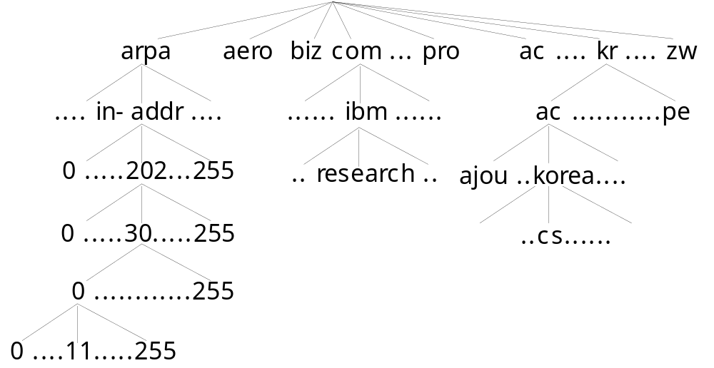
Domain Name Space

Slide 6
What is a domain name?
Each node in the domain name tree has a label, which is up to 63 bytes
  The root node has a null label “”
Domain name is case-insensitive
  SaMsUnG.Co.kR
  Samsung.CO.kr
  SAMSUNG.CO.KR

Slide 7
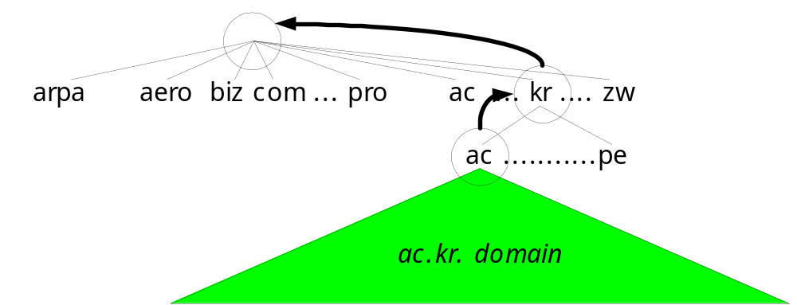
Domain name
A domain name of a node is the concatenation of the labels, read from the node through the root node
  Labels are delimited by “.”
  E.g. “nic.samsung.co.kr.”

Slide 8
FQDN
Fully qualified domain name contains the root label
  imail00 (X), imail00.samsung.co.kr (X)
  imail00.samsung.co.kr. (O)
DNS protocol uses only FQDN
The resolver must complete if the given domain name is not FQDN
  /etc/resolv.conf

Slide 9
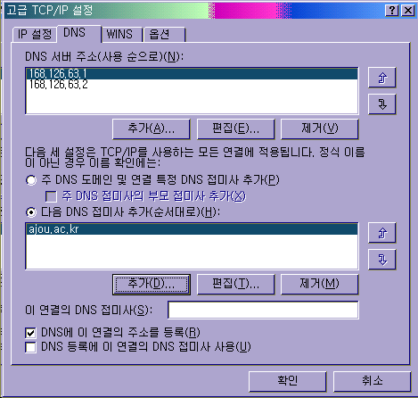
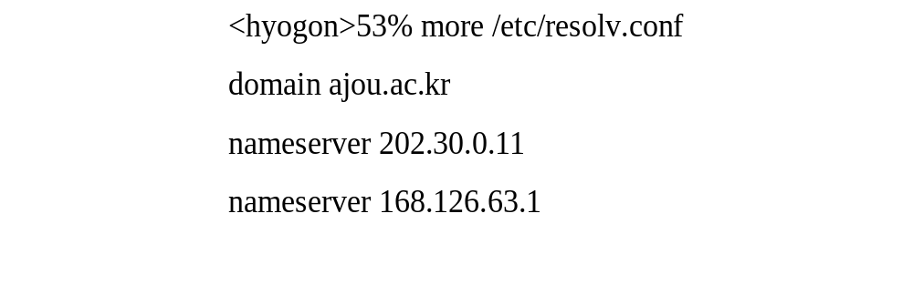
FQDN

Slide 10
What’s in a domain name?
A domain name (and the denoted node thereby) can have a set of associated “resource records (RRs)”: e.g., samsung.co.kr has
A | 203.254.192.15
NS | nic.samsung.co.kr red.samsung.co.kr green.samsung.co.kr
MX | imail00.samsung.co.kr
SOA | Postmaster: root@nic.samsung.co.kr, etc.

Slide 11
DNS is a distributed database
A zone is a subset of the domain name space that is physically managed in the same database
  Each zone has an authoritative name server
arpa
aero biz com ... pro
ac .... kr .... zw
.... in-addr ....
...... ibm ......
ac .……….co.…....pe
0 .....202...255
.. research ..
ajou ..korea....
….samsung....
0 .....30.....255
..madang......
nic…red…green..imail00
0 ............255
0 ....11.....255

Slide 12
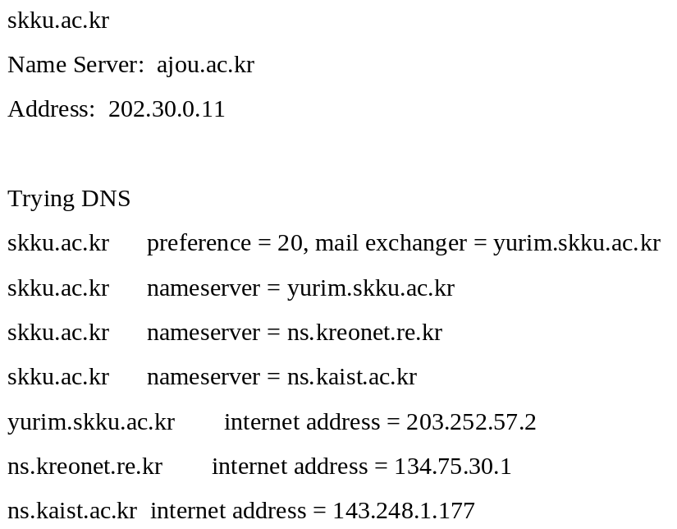
Authoritative name servers
For reliability, multiple authoritative name servers are placed in different locations

Slide 13
Authoritative name servers
When the authoritative name servers are not physically dispersed, the affected domain loses logical connectivity
  Physical connectivity still exists
  Access by IP address works fine
Microsoft incident, Jan. 4, 2002
  Microsoft authoritative servers are on the same subnet, and the router to the subnet fails
  Global access to .msnbc.com & .microsoft.com blocked for 2 days

Slide 14
Domain name registration
Means writing RRs for the domain name in the authoritative name server(s)
Only the authoritative name server(s) for the registered domain need to update
  Other authoritative name servers are not affected

Slide 15
Zone
Authoritative name servers maintain the zone file
Primary and secondary (both are authoritative)
  Primary has the zone file in hard disk
  Secondary gets it from primary upon boot-up – zone transfer

Slide 16
Primary integrity
Primary authoritative server must maintain integrity!
  It is the single source of the master copy
NSI incident, July 18, 1997
  .com & .net master copy corrupted
  Distributed to secondaries (secondary root servers)
  Internet access to .com & .net globally blocked for 4 hours

Slide 17
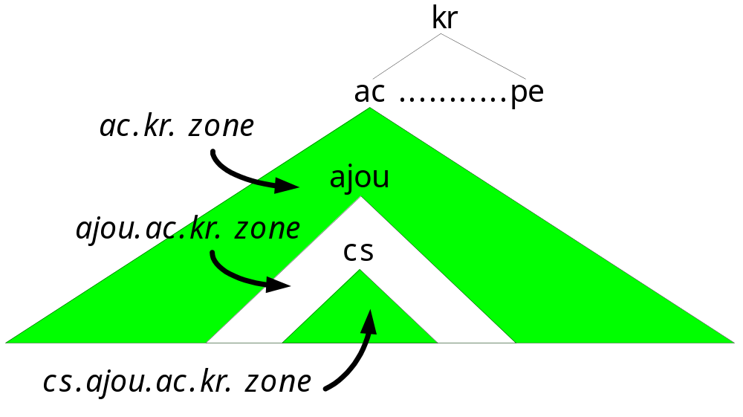
Delegation
A zone can be split into multiple sub-zones
Zones can be separately managed

Slide 18
Top-level domains
ARPA (address and routing protocol area)
  Not Advanced Research Project Agency
  Used for number-to-name mapping
gTLD (general Top Level Domains)
  .com, .net, .org maintained by VeriSign
ccTLD (country-code Top Level Domains)
  .kp : North Korea – uses its “own (juche?)” DNS
  .to : tonga – frequently used by “Warez” sites

Slide 19
Domain Name Space
11.0.30.202.in-addr.arpa name = ajou.ac.kr.
11.0.30.202.in-addr.arpa name = madang.ajou.ac.kr.

Slide 20
ARPA domain
Currently, used for IP address ➔ domain name translation
If this domain does not exist, reverse lookup (“PTR query) will have to search all A record for the given IP address
Look like IP addresses but they are domain names

Slide 21
ARPA domain
IP address w.x.y.z is corresponds to the domain name z.y.x.w.in-addr.arpa
Why not w.x.y.z.in-addr.arpa? Delegation!
  in-addr.arpa → root servers
  202.in-addr.arpa → APNIC server
  30.202.in-addr.arpa → KRNIC server
  0.30.202.in-addr.arpa → Ajou server

Slide 22
ARPA zones
11.0.30.202.in-addr.arpa and madang.ajou.ac.kr are in totally different zones!
Registration of arpa domain names is done separately
  A record registration does not mean PTR record registration will be done automatically
  Frequently done for free - in the future?

Slide 23
PTR query
> set querytype=PTR
> 11.0.30.202.in-addr.arpa.
Server: 202.30.0.11
Address: 202.30.0.11#53
11.0.30.202.in-addr.arpa name = ajou.ac.kr.
11.0.30.202.in-addr.arpa name = madang.ajou.ac.kr.

Slide 24
ARPA domain
Being augmented with ENUM : E.164 identifier to * mapping [RFC 2916]
  Email address
  URL
  SIP address
  Fax number
  Telephone number
  Etc.
Basically, convergence of PSTN and Internet
arpa
in-addr
e164
8
2
2
…

Slide 25
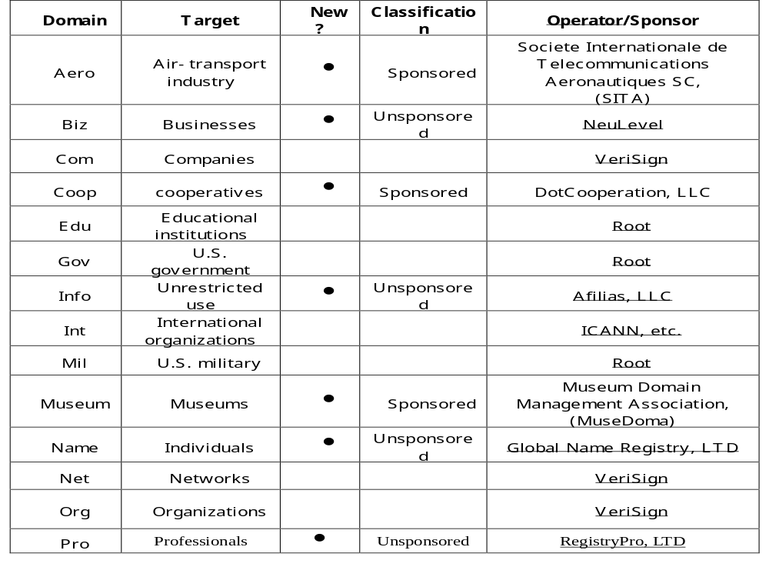
General TLD (gTLD)

Slide 26
gTLD
Incumbent 7 gTLDs
  Com, net, org, gov, int, mil, edu
7 new gTLDs ratified by ICANN
  General use: biz, info
  Personal use: name
  Profit restricted domain: pro
  Non-profit restricted domains: museum, aero, coop

Slide 27
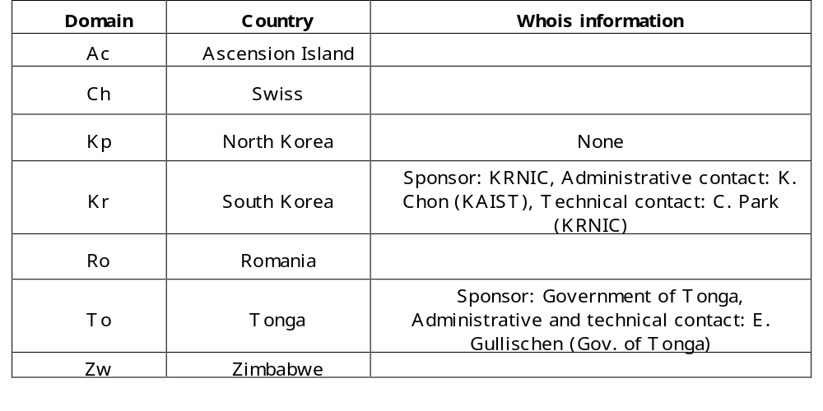
ccTLD
244
Given to every country even if it does not have any Internet infrastructure

Slide 28
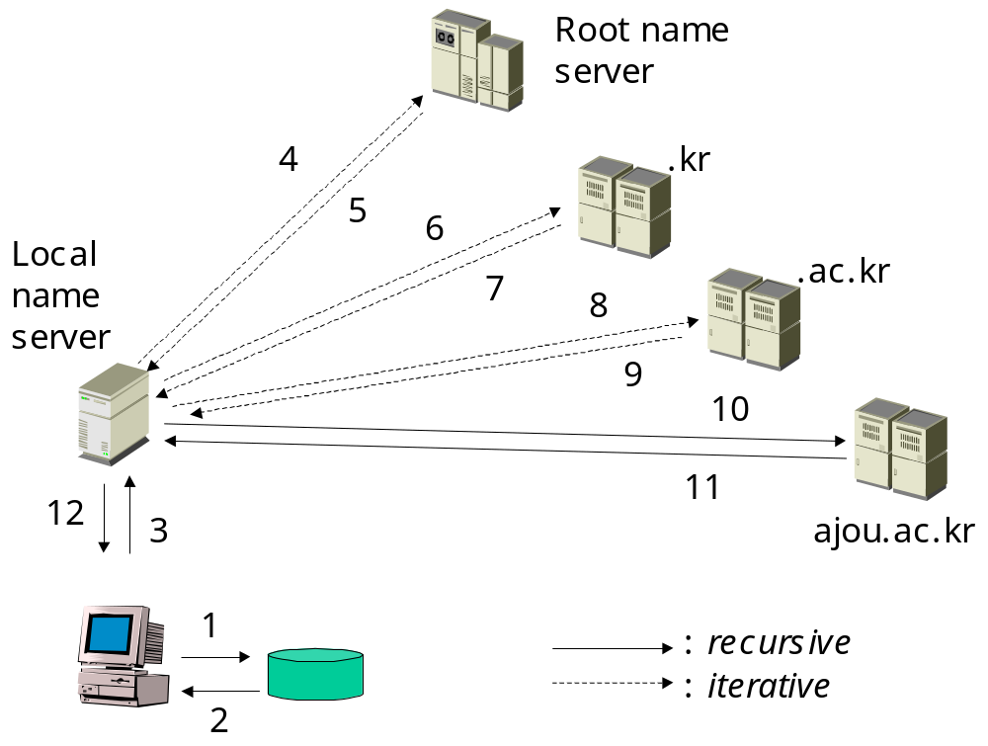
What happens when we click on a hyperlink?
http://ilab.ajou.ac.kr/talks/200301.html

Slide 29
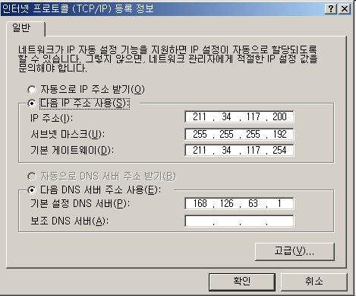
“Local” name server
Is the default name server

Slide 30
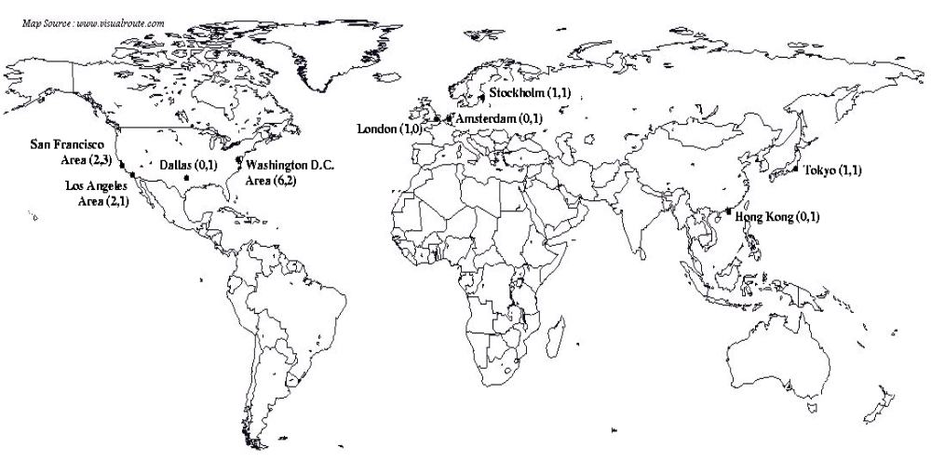
Servers in the higher hierarchy
13 root servers and 13 gTLD servers

Slide 31
Root name servers
13: [A-M].root-servers.net
  A (Virginia, US), D (Maryland, US), H (Maryland, US), I (Stockholm, SE) are most popular
  C (Virginia, US), G (Virginia, US), J (Virginia, US), K (London, UK), L (California, US), M (Tokyo, JP) are not
Have NS records for TLDs + .edu, .gov, .mil data

Slide 32
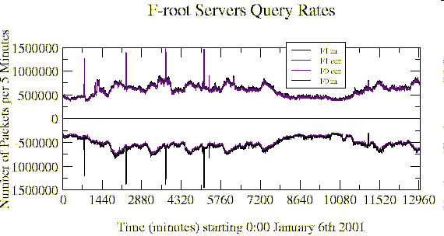
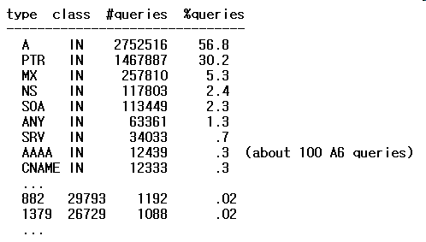
Root name servers

Slide 33
Root name servers
5K queries/s (F), 12K queries/s (A)
20% of all queries bogus TLD
  E.g., .local, .localhost, .msft, .domain, etc.
14% are bogus A queries
  E.g., asking for IP address of an IP address

Slide 34
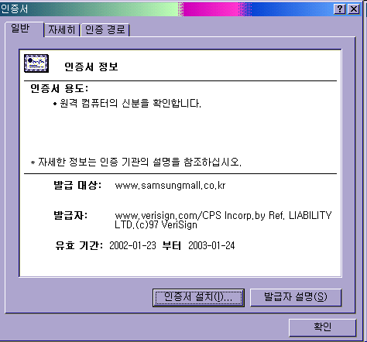
gTLD servers
13: [A-M].gtld-servers.net
Under the administration of VeriSign
As of June 2002
  .com 77.70%
  .net 13.50%
  .org 8.79%

Slide 35
DNS protocol
Runs on UDP, port 53
  Except for zone transfer and TC=1
  Packet size is limited to 512B
Very simple transaction-style
  Send 1 packet, receive 1 packet

Slide 36
DNS packet format
Identification matches queries with answers
  Server and client can be the same, answer can arrive out of order
Identification
Flags
# of questions
# of answer RRs
# of authority RRs
# of additional RRs
Questions (variable #)
Answers (variable # of RRs)
Authority (variable # of RRs)
Additional information (variable # of RRs)

Slide 37
DNS packet format
Flags
  QR: 1=query, 0=response
  Opcode=0 [1: inverse → deprecated]
  Authoritative Answer
  TrunCated
  Recursion Desired, Recursion Available
  Rcode=0

Slide 38
DNS packet format
Representation of domain names in the packet
Only 1 “long” representation
  Repetitions are coded as 2B pointers
6
m
a
d
a
n
g
4
a
j
o
u
2
a
c
2
k
r
0

Slide 39
Queries
Recursive query asks for answers
  70-80% of authoritative servers answers to recursive queries
Iterative query gets referrals
  Root servers do not allow recursive queries

Slide 40
Retransmissions
DNS uses UDP
  Packet loss must be dealt with by DNS protocol itself
DNS does not say much about …
  Client must try other servers before retransmitting the query
  Retransmissions must be spaced between 2 to 5 seconds

Slide 41
Retransmissions
BSD client policy
  Do not send the same query to more than 3 servers
  Exponentially back-off retransmission timeout after each cycle (3 servers lookup)
  Servers looked up determines timeout
  Stop at 4 cycles
    Max = 4 * 3 = 12

Slide 42

Retransmissions
BIND (server)
  Trace RTTs for up to 16 higher level servers
  Sort the expected RTTs in increasing order
  Maximum 3 queries per server
    Max = 16 * 3 cycles = 48
  Before back-off :
  Back-off after each cyle

Slide 43

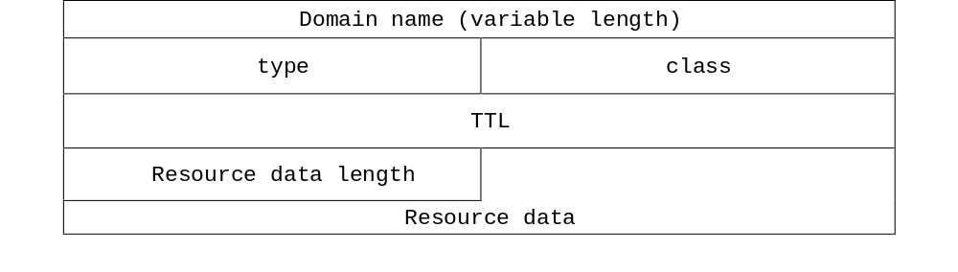
Questions (in queries/replies)

Slide 44
Answers (in replies)
Authoritative positive
  Normal answer from authoritative server
Positive
  Answer from non-authoritative server
Referral
  Next server to ask (“authority”)
Negative
  Even authoritative name server cannot find the answer

Slide 45
Resource records (RR)
Records corresponding to a domain name
A domain name can have multiple resource records
  Not just IP address!

Slide 46
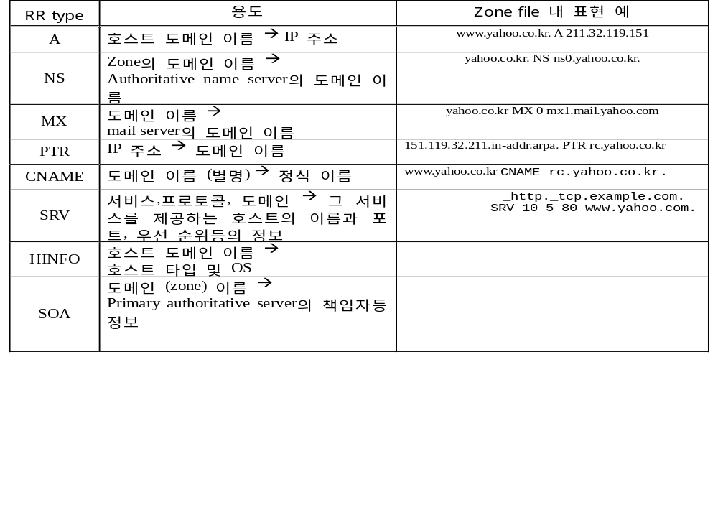
RR types

Slide 47
RR types
NS = Name Server
  Each zone must have a NS RR with the same name with the zone
  After delegation, mother zone has NS RR to the child + A record of the child NS (“glue record”)

Slide 48
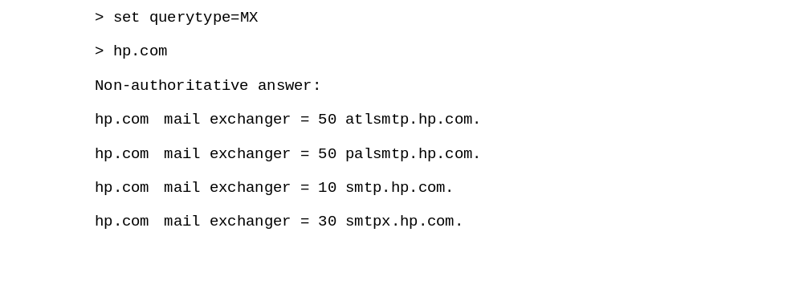
RR types
MX = Mail eXchange
  Small priority values have precedence
Mail server always tries MX query before sending an email
  wykim@hp.com → wykim@smtp.hp.com
  If fails, use A record

Slide 49


RR types
CNAME = Canonical NAME
  To remember a domain name easily (25% of popular domain names)
  To run multiple servers on the same machine
  “Alias chain” (even length 4)

Slide 50
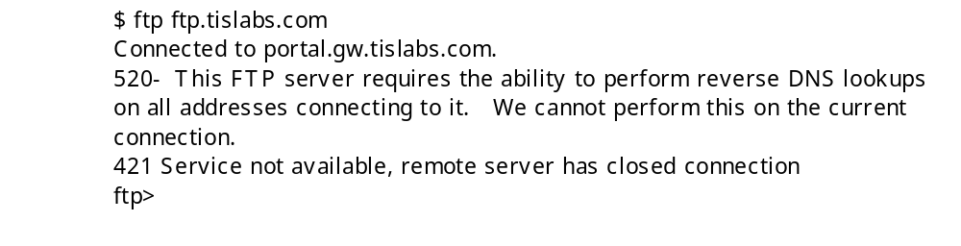
RR types
PTR = PoinTeR

Slide 51
RR types
SRV = SeRVice
  Weight for load sharing between equal priority servers

Slide 52
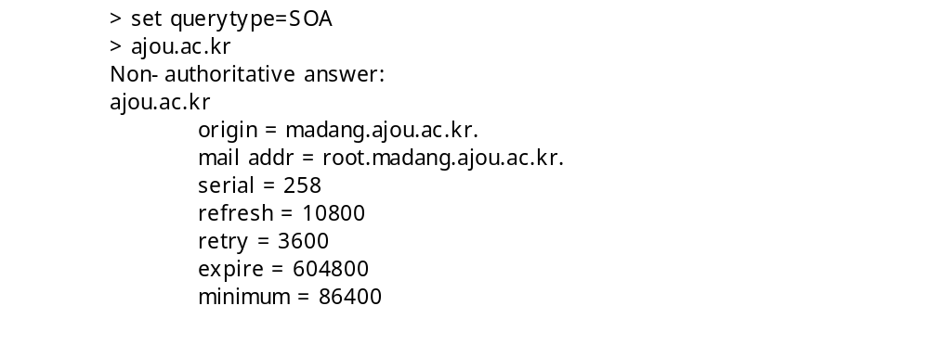
RR types
SOA = Start Of Authority
  Origin: primary authoritative name server
  Hostmaster: root.madang.ajou.ac.kr → root@madang.ajou.ac.kr

Slide 53
RR types
SOA = Start Of Authority
  Serial number: zone file version at primary
  Secondary checks primary for zone transfer every refresh
  If failed, check after retry until expire
  Minimum: TTL of RRs in the zone
    24 hrs most popular, followed by 1 hr and 1-2 hrs
    During zone update: < 10min

Slide 54
Caching
RRs obtained from the authoritative server is kept for a prescribed duration (“TTL”)
  Reduces the load on the DNS infrastructure
Microsoft incident, Jan. 4, 2002
  Microsoft authoritative servers are on the same subnet, router to the subnet fails, load on an observed root server explodes 750-fold for .msnbc.com and .microsoft.com
  Global access to .msnbc.com / .microsoft.com blocked for 2 days

Slide 55



Caching
After 2-hour TTL expires, everyone begins to knock on the root name servers
download.microsoft.com?

Slide 56
Negative caching
BIND 8 and 9, Windows 2000
  About 90% of servers implement it as of 2001
When authoritative name server gives negative answer, resolver caches the negative answer for a preset duration
  Typically 10 minutes
  Otherwise, top level servers will be harassed by retransmissions

Slide 57
Round-robin DNS
Server: ns.hananet.net
Address: 210.94.0.7
Name: cnn.com
Addresses: 64.236.16.20, 64.236.16.52, 64.236.16.84, 64.236.16.116, 64.236.24.4, 64.236.24.12, 64.236.24.20, 64.236.24.28

Slide 58
Attack on root name servers
Oct. 22, 2002 but “test” run already recorded on Oct. 7
DDoS using ICMP (smurf?)
Last only an hour – stopped before TLD NS RR TTLs expire
  No visible impact this time
In the wake, VeriSign moves one of its 2 root servers to another location, to a different part of its network
  These guys obviously didn’t learn from the Microsoft incident

Slide 59
Conclusion
DNS started as a distributed database and a companion protocol mainly to implement name-to-address mapping
DNS has evolved into a critical infrastructure for modern Internet
  Indispensable for N2A, A2N, email, VoIP, etc.
  Imagine a world without Phonebook nor 114!
Caching plays a vital role to maintain the performance
U.S. has a vested interest in managing TLDs to not lose the control of the Internet

