Slide 1
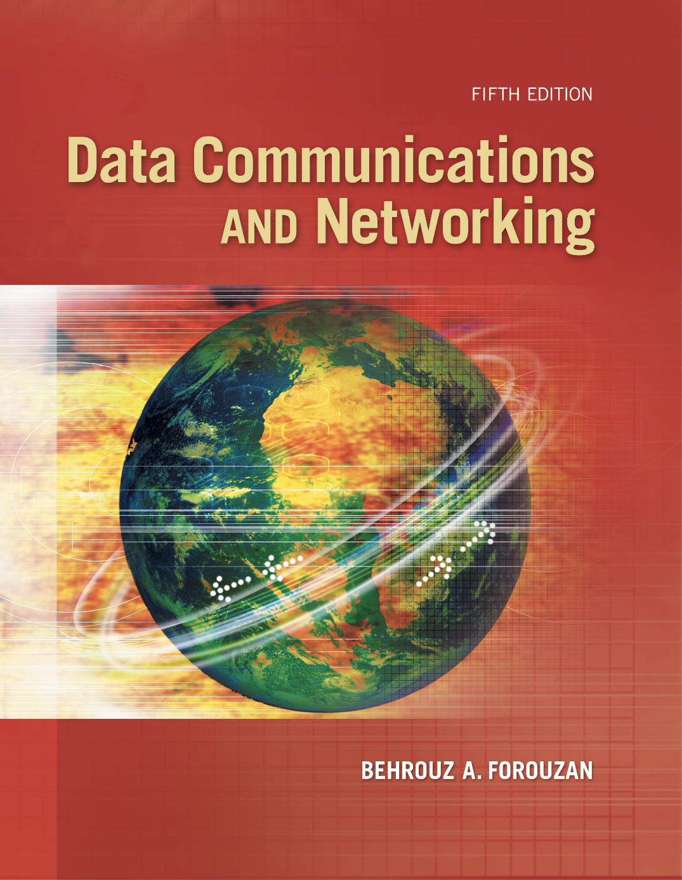
Chapter 9
Introduction
To
Data-Link
Layer
Copyright © The McGraw-Hill Companies, Inc. Permission required for reproduction or display.

Slide 2
Chapter 9: Outline
9.1 INTRODUCTION
9.2 LINK-LAYER ADDRESSING

Slide 3

Chapter 9: Objective
The first section introduces the data-link layer. It starts with defining the concept of links and nodes. The section then lists and briefly describes the services provided by the data-link layer. It next defines two categories of links: point-to-point and broadcast links. The section finally defines two sub-layers at the data-link layer that will be elaborated on in the next few chapters.
The second section discusses link-layer addressing. It first explains the rationale behind the existence of an addressing mechanism at the data-link layer. It then describes three types of link-layer addresses. The section discusses the Address Resolution Protocol (ARP), which maps the addresses at the network layer to addresses at the data-link layer.

Slide 4
    9-1 INTRODUCTION
The Internet is a combination of networks glued together by connecting devices (routers or switches). If a packet is to travel from a host to another host, it needs to pass through these networks. Figure 9.1 shows the same scenario we discussed in Chapter 3, but we are now interested in communication at the data-link layer.

Slide 5
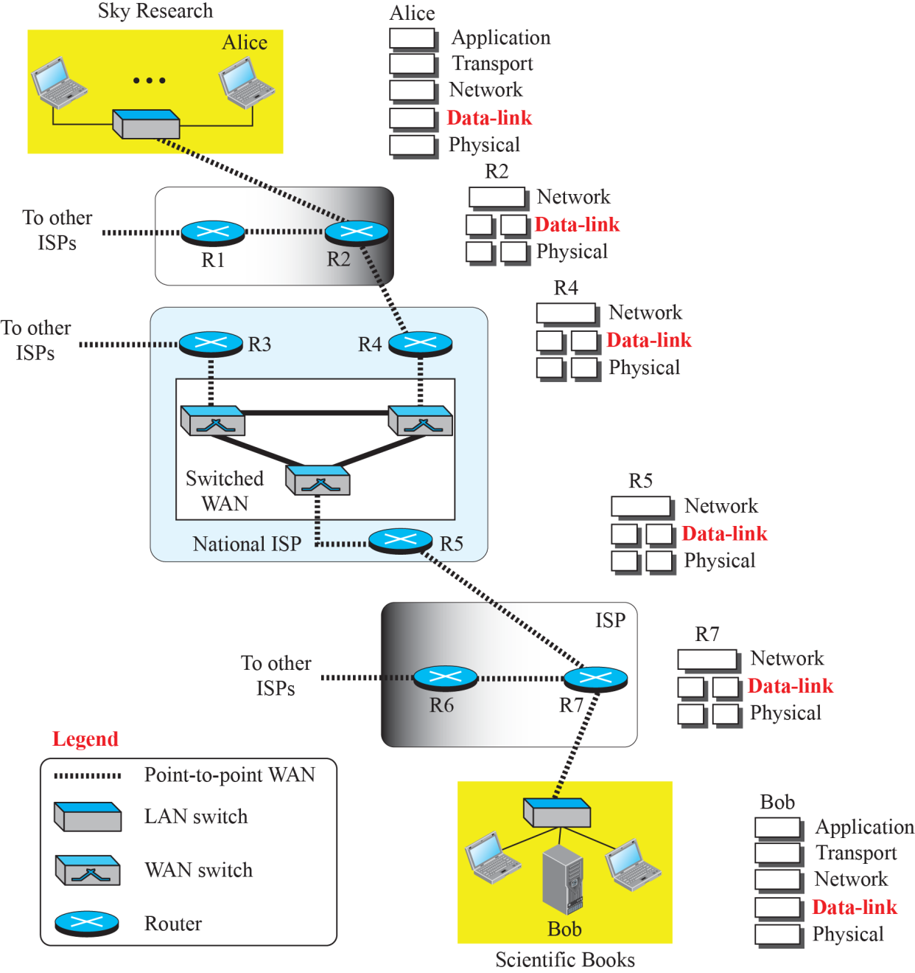
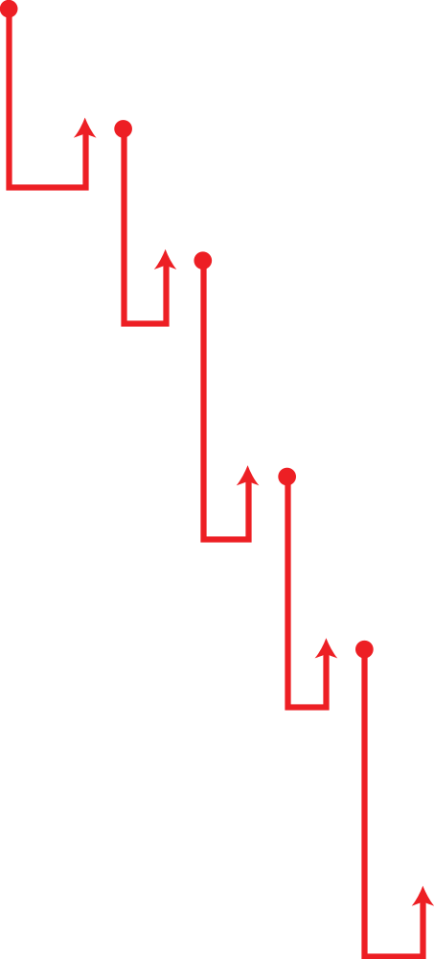
Figure 9.1: Communication at the data-link layer

Slide 6

The world in less than 30 steps
C:\Users\사용자>tracert www.unipi.it
1 4 ms 2 ms 2 ms homehub.olleh.com [172.30.1.254]
2 8 ms * * 125.143.149.126
3 9 ms 8 ms 6 ms 61.78.43.71
4 7 ms 9 ms 8 ms 112.189.15.145
5 * * * 요청 시간이 만료되었습니다.
6 8 ms 22 ms 16 ms 112.174.42.178
7 29 ms 18 ms 29 ms 112.174.85.126
8 136 ms 136 ms 136 ms 112.174.87.18
9 144 ms 141 ms 144 ms be4382.ccr41.lax05.atlas.cogentco.com [38.104.84.189]
10 141 ms 140 ms 142 ms be3359.ccr42.lax01.atlas.cogentco.com [154.54.3.69]
11 154 ms 156 ms 154 ms be2932.ccr32.phx01.atlas.cogentco.com [154.54.45.161]
12 173 ms 193 ms 202 ms be2930.ccr21.elp01.atlas.cogentco.com [154.54.42.78]
13 231 ms 226 ms 219 ms be2928.ccr42.iah01.atlas.cogentco.com [154.54.30.161]
14 246 ms 257 ms 270 ms be2690.ccr42.atl01.atlas.cogentco.com [154.54.28.129]
15 202 ms 210 ms 224 ms be2113.ccr42.dca01.atlas.cogentco.com [154.54.24.221]
16 207 ms 228 ms 244 ms be2807.ccr42.jfk02.atlas.cogentco.com [154.54.40.109]
17 307 ms 327 ms 338 ms be3628.ccr42.par01.atlas.cogentco.com [154.54.27.170]
18 328 ms 319 ms 326 ms be3093.ccr22.mrs01.atlas.cogentco.com [130.117.50.166]
19 328 ms 300 ms 313 ms be3636.rcr51.goa01.atlas.cogentco.com [130.117.2.22]
20 326 ms 340 ms 351 ms be3575.rcr51.rom01.atlas.cogentco.com [154.54.57.65]
21 299 ms 297 ms 299 ms 149.6.22.74
22 301 ms 303 ms 297 ms rx1-rm2-rx1-pi1.pi1.garr.net [90.147.80.206]
23 302 ms 299 ms 323 ms rx1-pi1-ru-unipi.pi1.garr.net [193.206.136.14]
24 296 ms 298 ms 297 ms wwwnew2.unipi.it [131.114.21.42]
My desktop
Korea
Crossing Pacific
Crossing Atlantic
France
Italy
Pisa
University of Pisa

Slide 7
9.1.1 Nodes and Links
Communication at the data-link layer is node-to-node. A data unit from one point in the Internet needs to pass through many networks (LANs and WANs) to reach another point. Theses LANs and WANs are connected by routers. It is customary to refer to the two end hosts and the routers as nodes and the networks in between as links. Figure 9.2 is a simple representation of links and nodes when the path of the data unit is only six nodes.

Slide 8
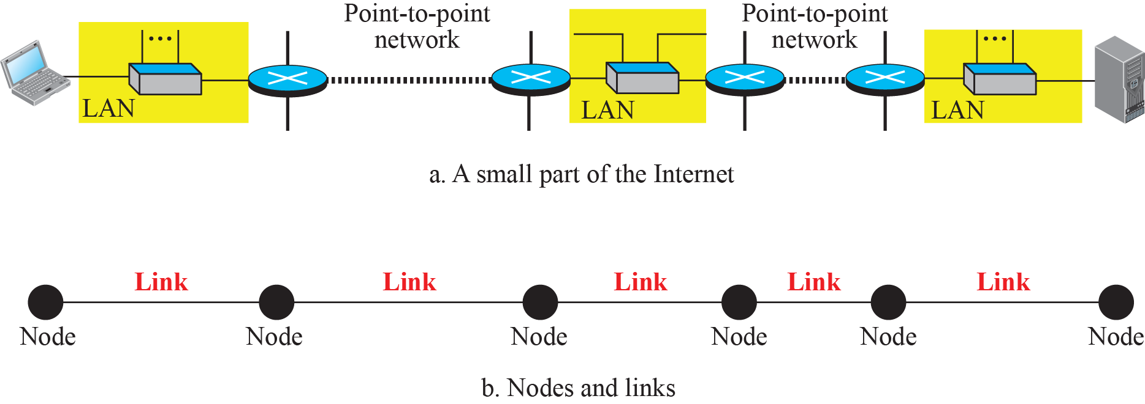
Figure 9.2: Nodes and Links

Slide 9
9.1.2 Services
The data-link layer is located between the physical and the network layers. The data-link layer provides services to the network layer; it receives services from the physical layer. Let us discuss services provided by the data-link layer.

Slide 10
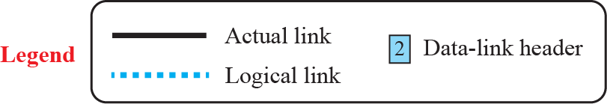
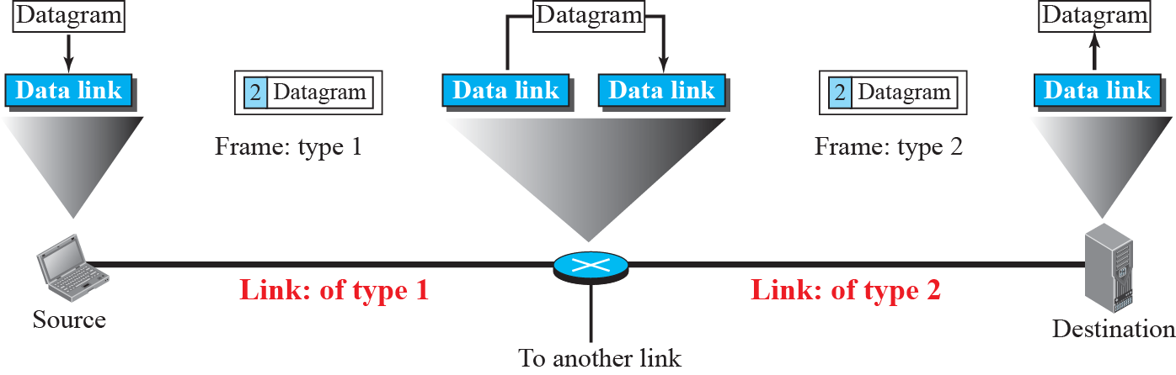
Figure 9.3: A communication with only three nodes

Slide 11
Major functions of datalink layer
Framing
Flow control
Error control

Slide 12
9.1.3 Two Categories of Links
Although two nodes are physically connected by a transmission medium such as cable or air, we need to remember that the data-link layer controls how the medium is used. We can have a data-link layer that uses the whole capacity of the medium; we can also have a data-link layer that uses only part of the capacity of the link. In other words, we can have a point-to-point link or a broadcast link.

Slide 13
9.1.4 Two Sublayers
To better understand the functionality of and the services provided by the link layer, we can divide the data-link layer into two sublayers: data link control (DLC) and media access control (MAC). This is not unusual because, as we will see in later chapters, LAN protocols actually use the same strategy.

Slide 14
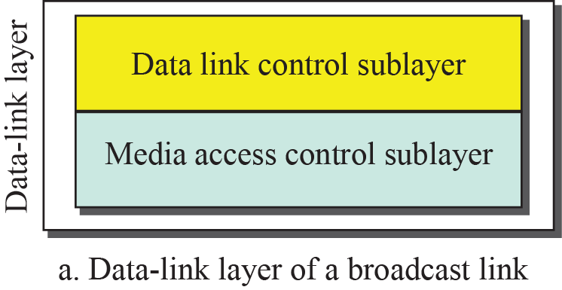
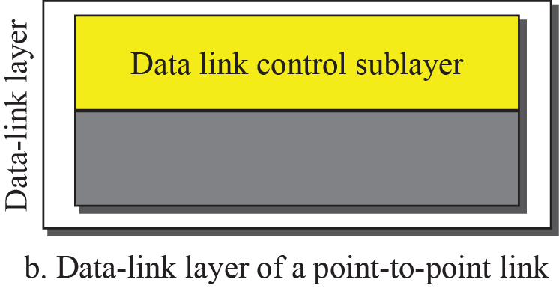
Figure 9.3: Dividing the data-link layer into two sublayers

Slide 15
    9-2 LINK-LAYER ADDRESSING
In Chapter 18, we will discuss IP addresses as the identifiers at the network layer. However, in a internetwork such as the Internet we cannot make a datagram reach its destination using only IP addresses. The source and destination IP addresses define the two ends but cannot define which links the packet should pass through.

Slide 16
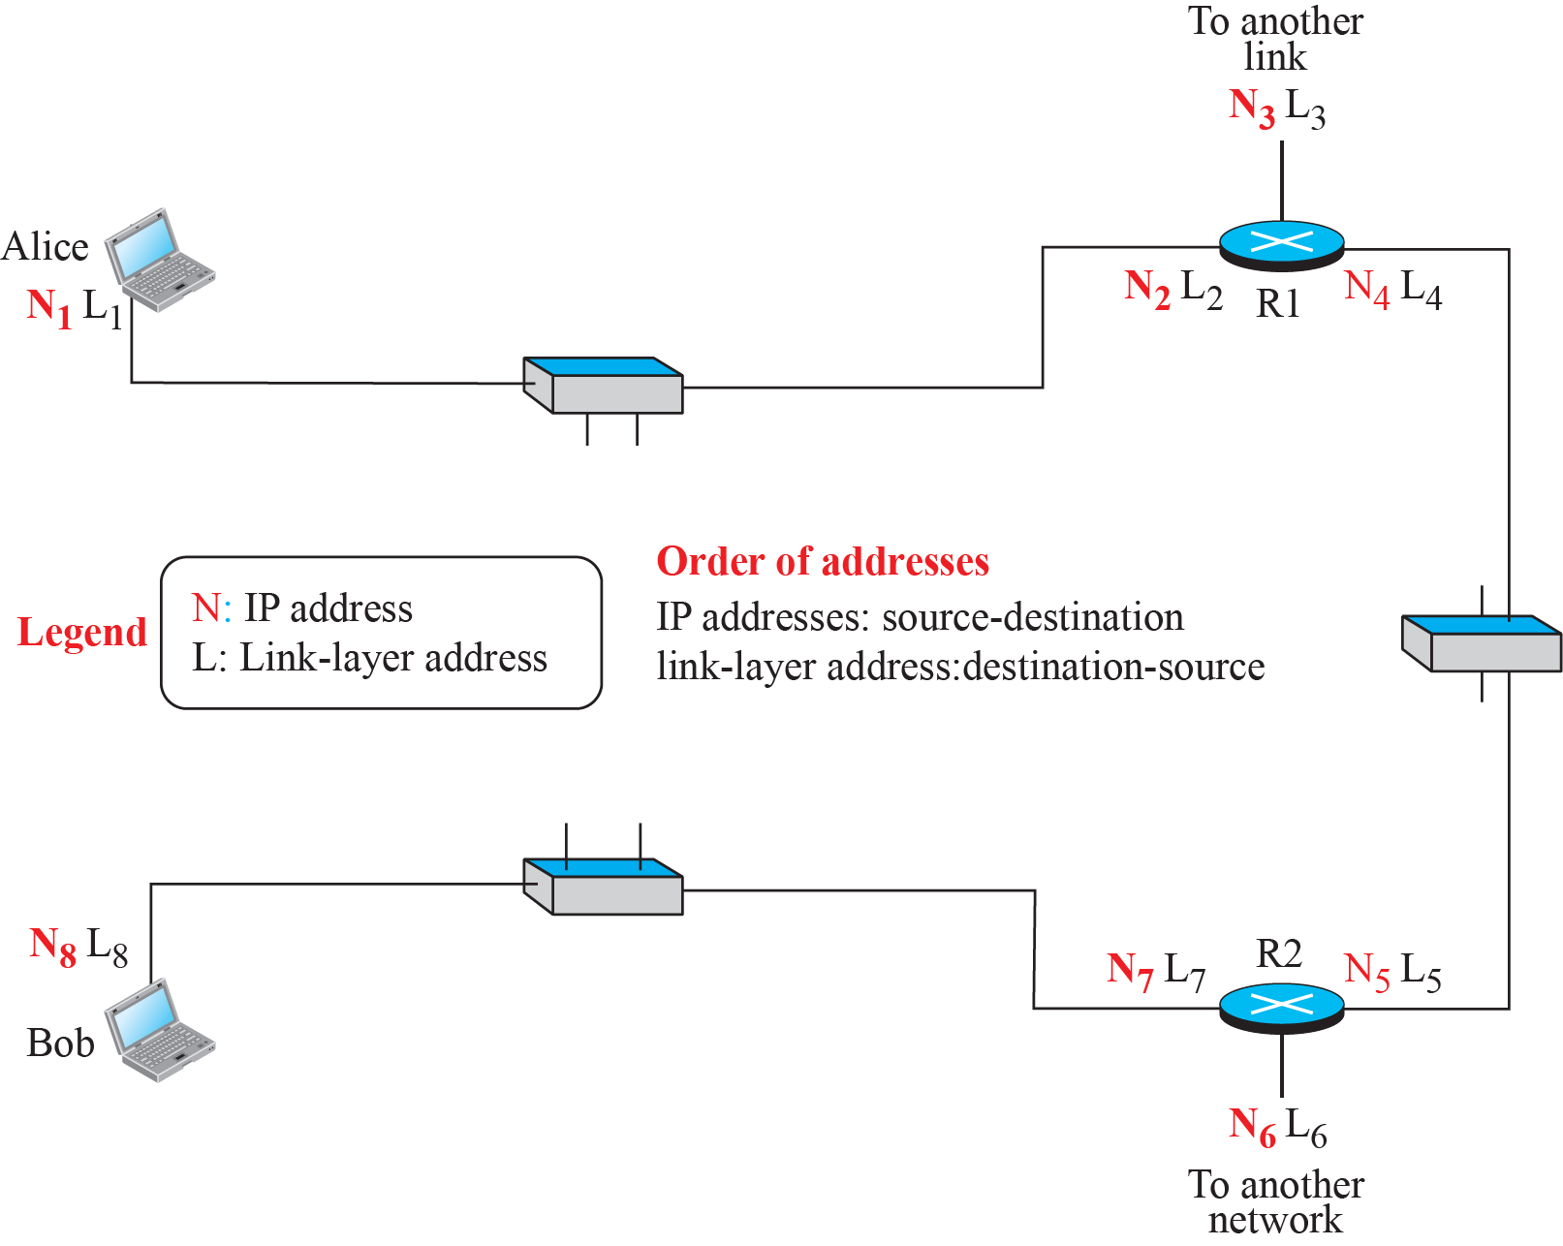
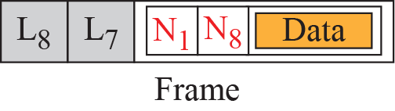
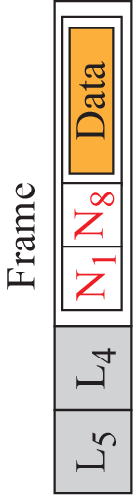
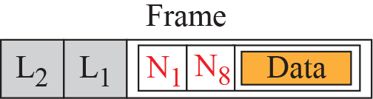
Figure 9.5: IP addresses and link-layer addresses in a small internet

Slide 17
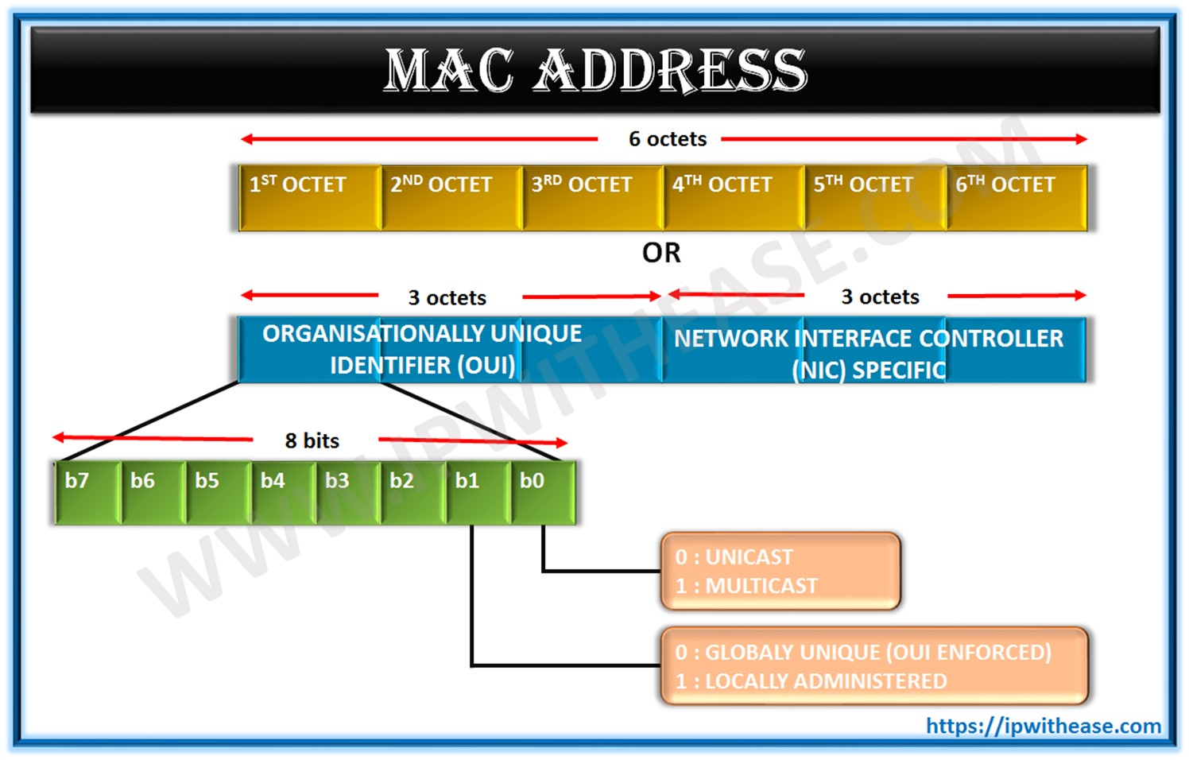
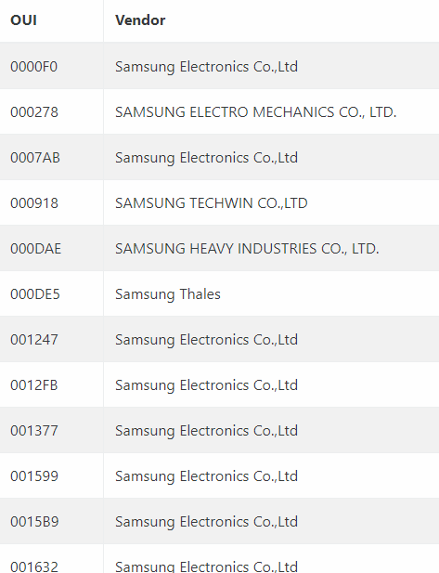
9.2.1 Three Types of addresses
Some link-layer protocols define three types of addresses: unicast, multicast, and broadcast. (managed by IEEE Standards Association)
$3000 (per year)

Slide 18
Example 9.1
As we will see in Chapter 13, the unicast link-layer addresses in the most common LAN, Ethernet, are 48 bits (six bytes) that are presented as 12 hexadecimal digits separated by colons; for example, the following is a link-layer address of a computer. The second digit needs to be an even number.
A2:34:45:11:92:F1
9.18

Slide 19
Example 9.2
As we will see in Chapter 13, the multicast link-layer addresses in the most common LAN, Ethernet, are 48 bits (six bytes) that are presented as 12 hexadecimal digits separated by colons. The second digit, however, needs to be an odd number in hexadecimal. The following shows a
multicast address:
A7:34:45:11:92:F1
9.19

Slide 20
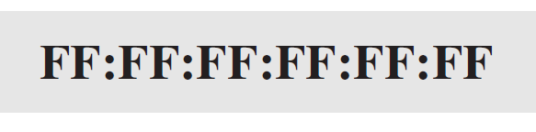
Example 9.3
As we will see in Chapter 13, the broadcast link-layer addresses in the most common LAN, Ethernet, are 48 bits, all 1s, that are presented as 12 hexadecimal digits separated by colons. The following shows a broadcast address:
9.20

Slide 21
9.2.2 ARP
Anytime a node has an IP datagram to send to another node in a link, it has the IP address of the receiving node. However, the IP address of the next node is not helpful in moving a frame through a link; we need the link-layer address of the next node. This is the time when the Address Resolution Protocol (ARP) becomes helpful.

Slide 22
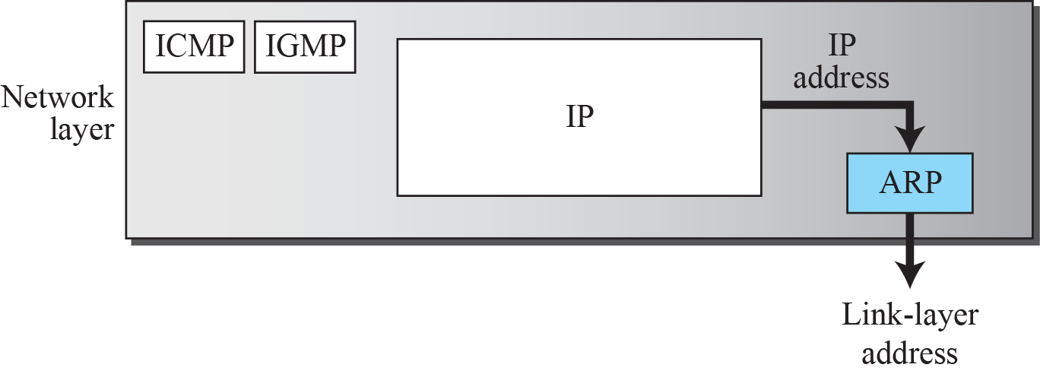
Figure 9.6: Position of ARP in TCP/IP protocol suite
C:\Users\사용자>arp -a
인터페이스: 172.30.1.4 --- 0x14
인터넷 주소 물리적 주소 유형
172.30.1.43 48-e2-44-27-c7-21 동적
172.30.1.254 00-07-89-82-0d-aa 동적
172.30.1.255 ff-ff-ff-ff-ff-ff 정적
224.0.0.2 01-00-5e-00-00-02 정적
224.0.0.22 01-00-5e-00-00-16 정적
224.0.0.251 01-00-5e-00-00-fb 정적
224.0.0.252 01-00-5e-00-00-fc 정적
239.255.255.250 01-00-5e-7f-ff-fa 정적
255.255.255.255 ff-ff-ff-ff-ff-ff 정적

Slide 23
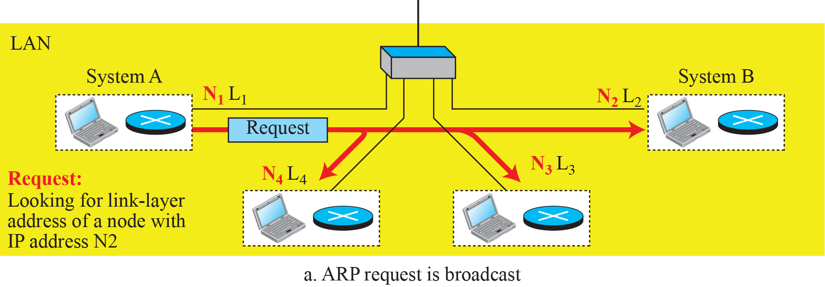
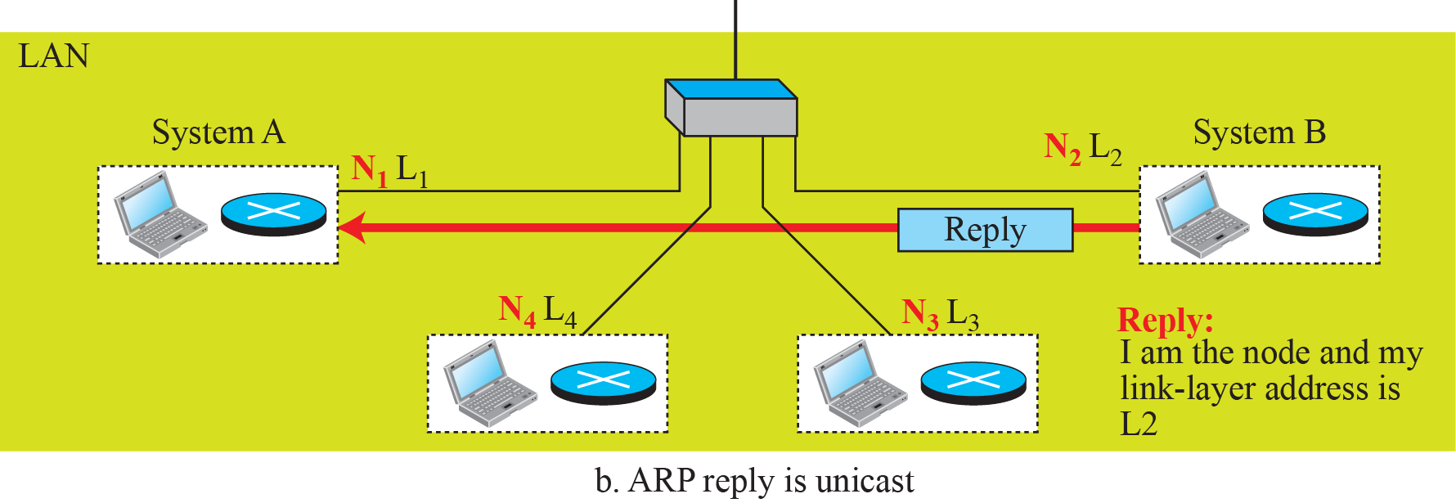
Figure 9.7: ARP operation

Slide 24
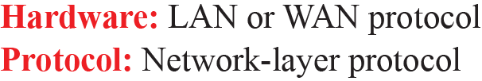
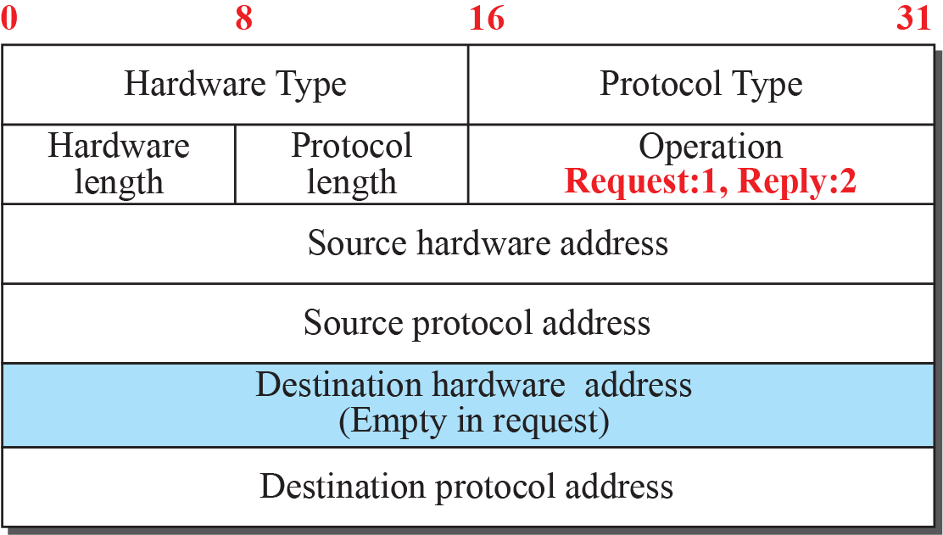
Figure 9.8: ARP packet

Slide 25
Example 9.4
A host with IP address N1 and MAC address L1 has a packet to send to another host with IP address N2 and physical address L2 (which is unknown to the first host). The two hosts are on the same network. Figure 9.9 shows the ARP request and response messages.
9.25

Slide 26
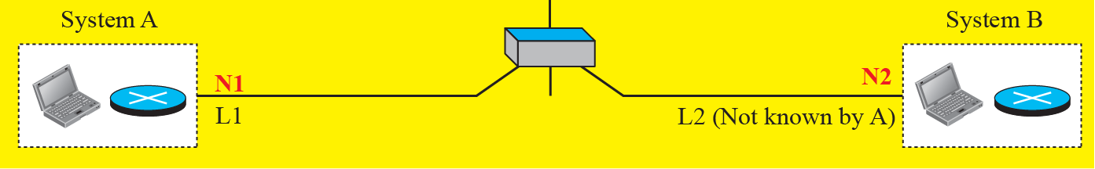
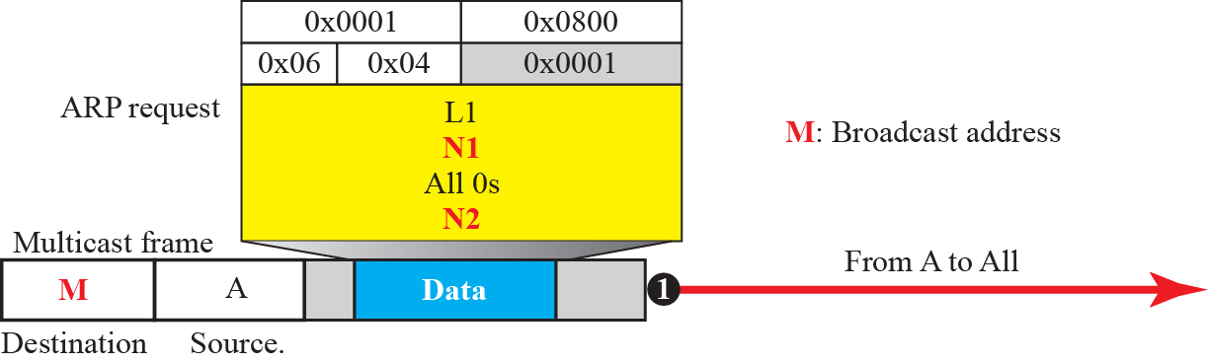
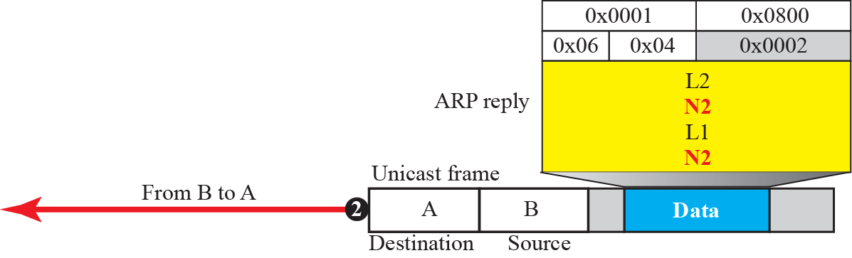
Figure 9.9: Example 9.4

Slide 27
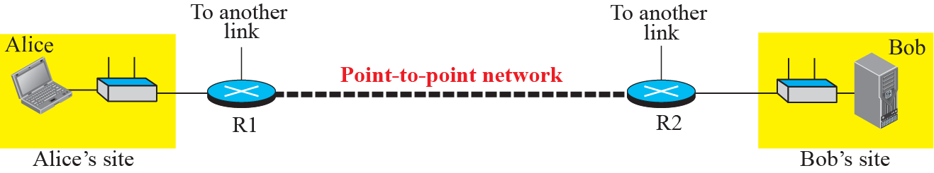
Figure 9.10: The internet for our example

Slide 28
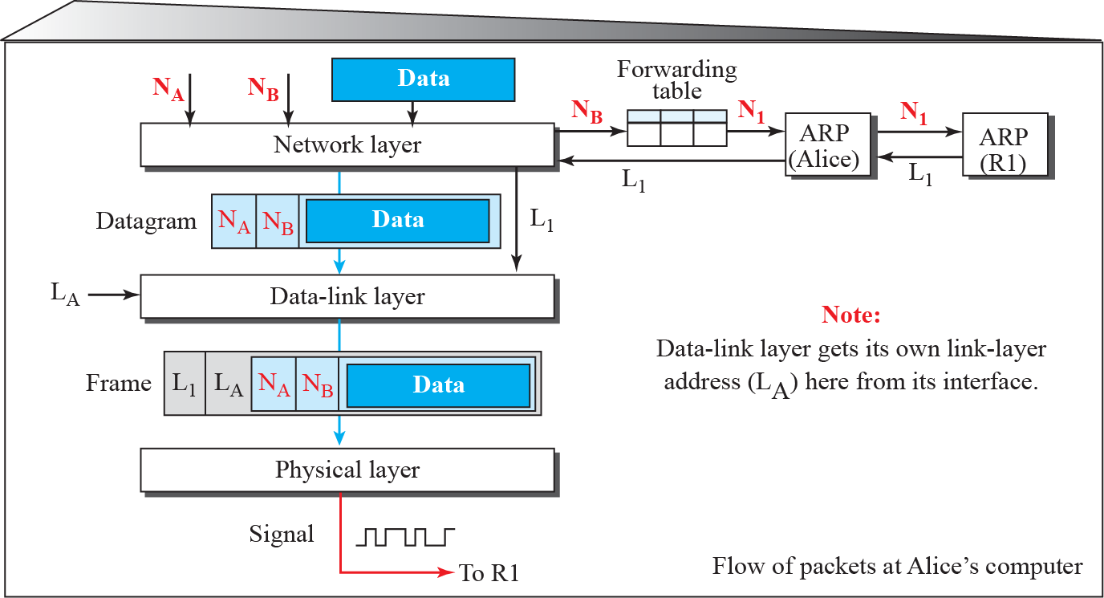
Figure 9.11: Flow of packets at Alice site

Slide 29
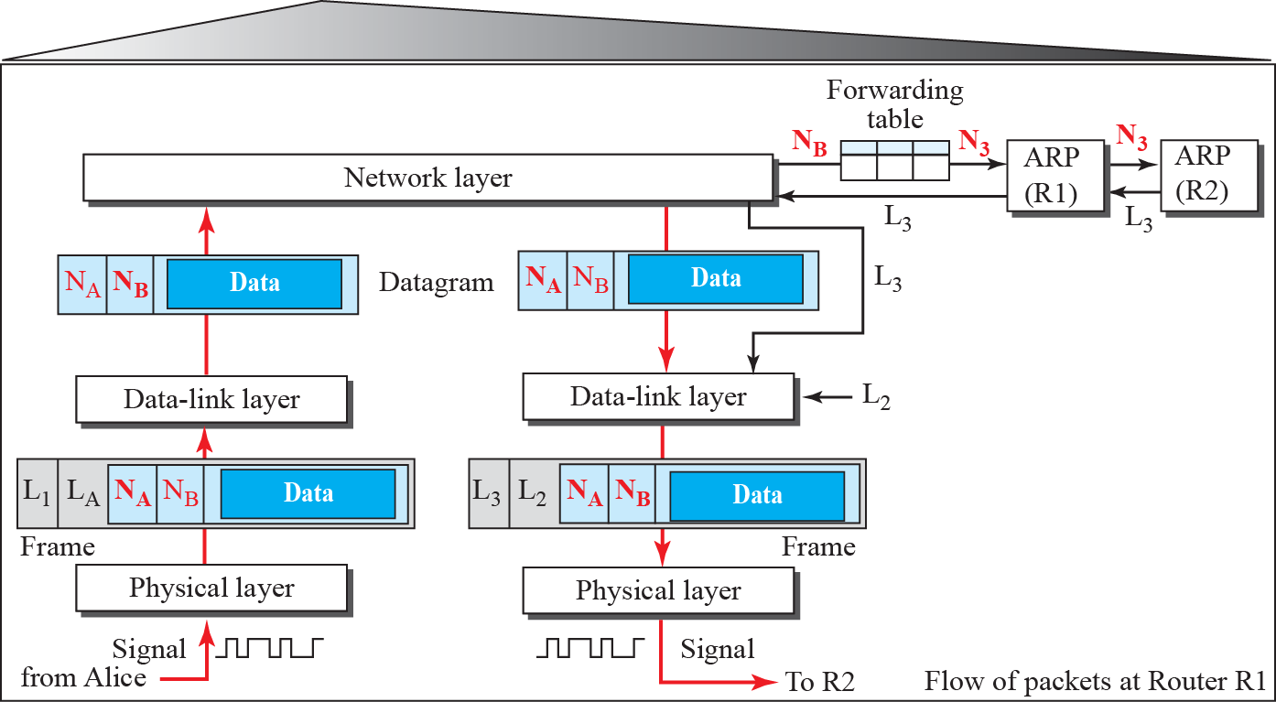
Figure 9.12: Flow of activities at router R1

Slide 30
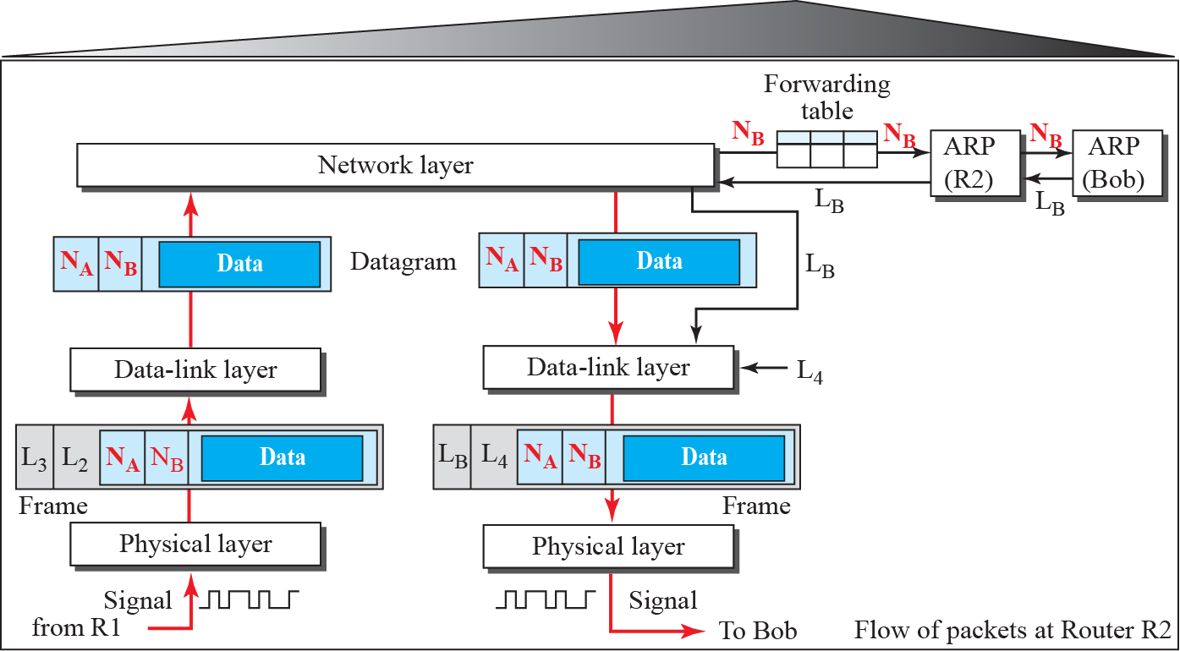
Figure 9.13: Flow of activities at router R2

Slide 31
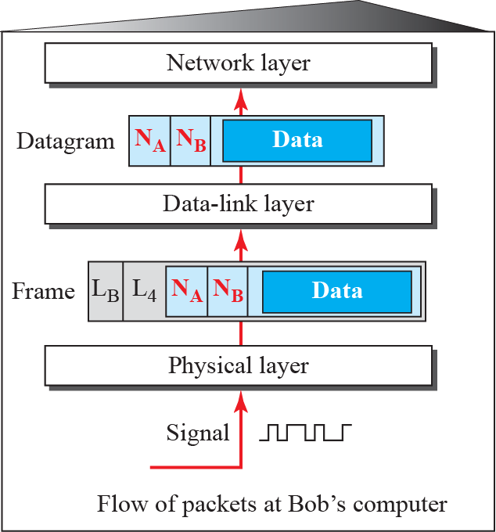
Figure 9.14: Activities at Bob’s site

