Slide 1
3.3 Full Duplex, Power Save,
Autonegotiation, and 802.1X Flow Control
2015010662
Lee Jae Hyeck
2015. 09. 16

Slide 2
Outline
Introduction
Duplex Mismatch
Power Management
  Wake-On LAN, Magic Packets
Link-Layer Flow Control

Slide 3
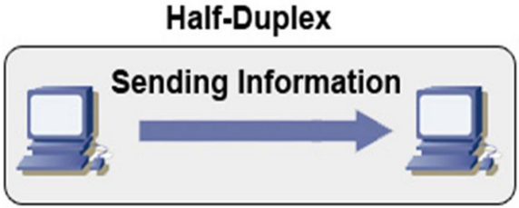
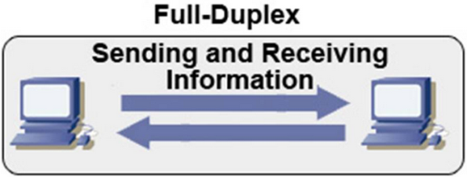
Introduction
Ethernet
  Half-duplex : a shared cable, one at the same time, 10Mb/s, collision detection (Ex. Walkie Talkie)
  Full-duplex : a shared cable, sending & receiving at the same time, 100Mb/s (Ex. cellphone)

Slide 4
Introduction
Auto-negotiation
  To seamless communicate and exchange for packets with each other
  To meet some information such as speed and duplex among devices automatically
  The information is exchanged at the physical layer using signals

Slide 5
Duplex Mismatch
Interoperability problems
  When a device supports different duplex configuration with others
  When the auto-negotiation of one end of link is disabled
Collision
Half-Duplex
Full-Duplex
Performance Degradation

Slide 6
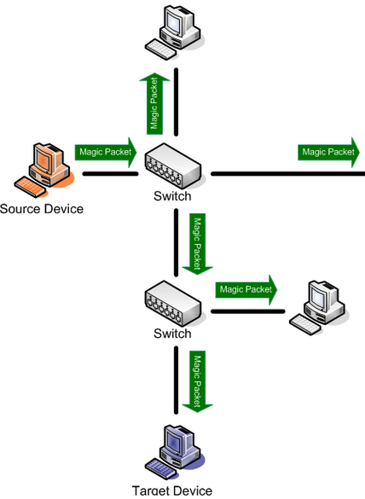
Power Management
Wake-On LAN (WoL)
  An Ethernet standard that allows a computer to be turned on or awakened by a network message (Magic packet)
  Ex. Linux# ethtool –s eth0 wol umgb
Device to signal a wake-up
u : unicast
m : multicast
b : broadcast
g : magic packet

Slide 7
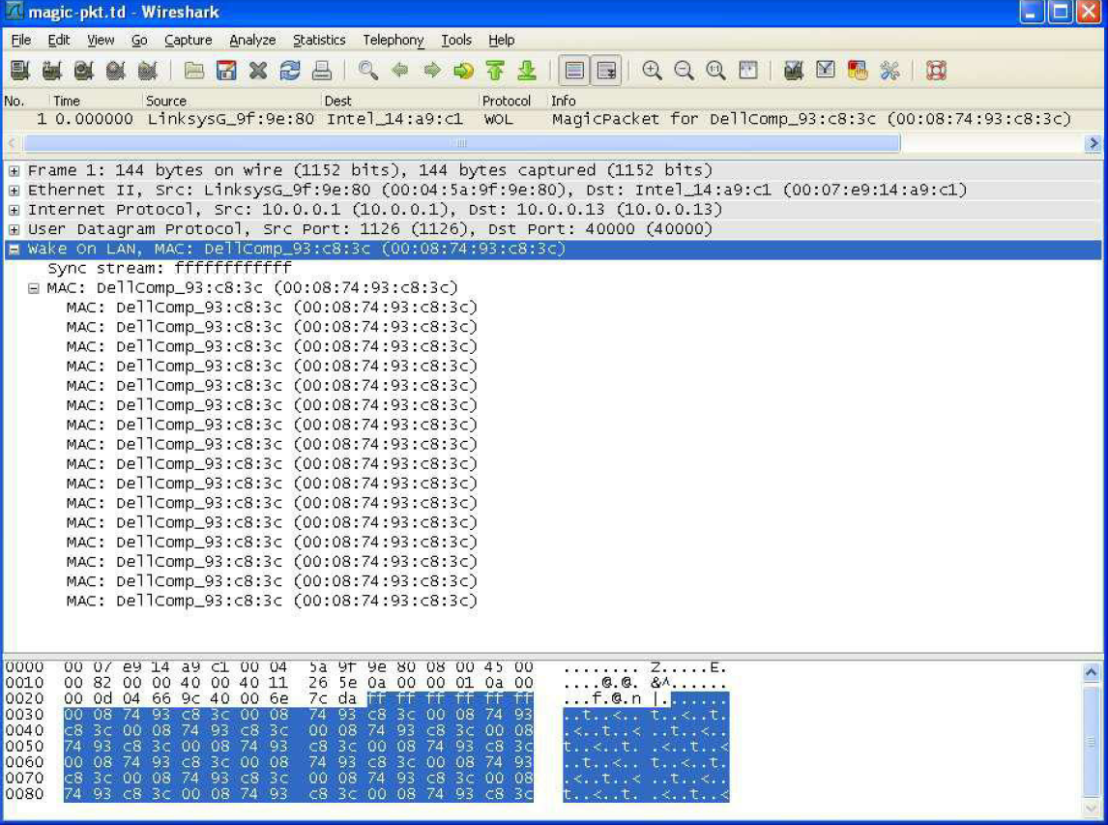
Power Management
Magic Packets
  A broadcast frame within its payload 6 bytes
  0xFF, Followed by 16 repetitions of the target device’s MAC address
  Features
    Requires destination device’s MAC address
    Doesn’t provide a delivery confirmation
    Requires h/w support of WoL

Slide 8
Link-Layer Flow Control
When multiple stations send to a same destination
  If the total traffic exceeds the link rate, frames are stored in the intermediate switches
  If this situation persists for a long time, frames may be dropped
Flow Control
  By sending a signal frames between switches and NICs
  Is called PAUSE messages, which are contained in MAC control frames and used only on full-duplex links
  Include a hold-off time value (how long the sender should pause before continuing to transmit)

Slide 9
Link-Layer Flow Control
Flow Control negative side effect
  When multiple stations are sending via a switch, it may send PAUSE frames to all hosts
  This utilization of the switch’s memory may not effective even though the hosts were not responsible for much of the traffic passing

