Slide 1
Chapter 3: Outline
Chapter 3
Data and Signals
3.1
Introduction to
the Physical Layer
Periodic Analog Signals
3.2
Digital Signals
Where we are
3.3
Layer 1 of the tower, in detail.
Everything a bit has to survive between one device and the next.
Data becomes a signal, the signal travels through a medium that damages it, and the damage sets a hard ceiling on how fast we may send.
That ceiling, and how to measure our distance from it, is the whole chapter.
Transmission Impairment
3.4
Data Rate Limits
3.5
Copyright © The McGraw-Hill Companies, Inc. Permission required for reproduction or display.
Performance
3.6

Slide 2
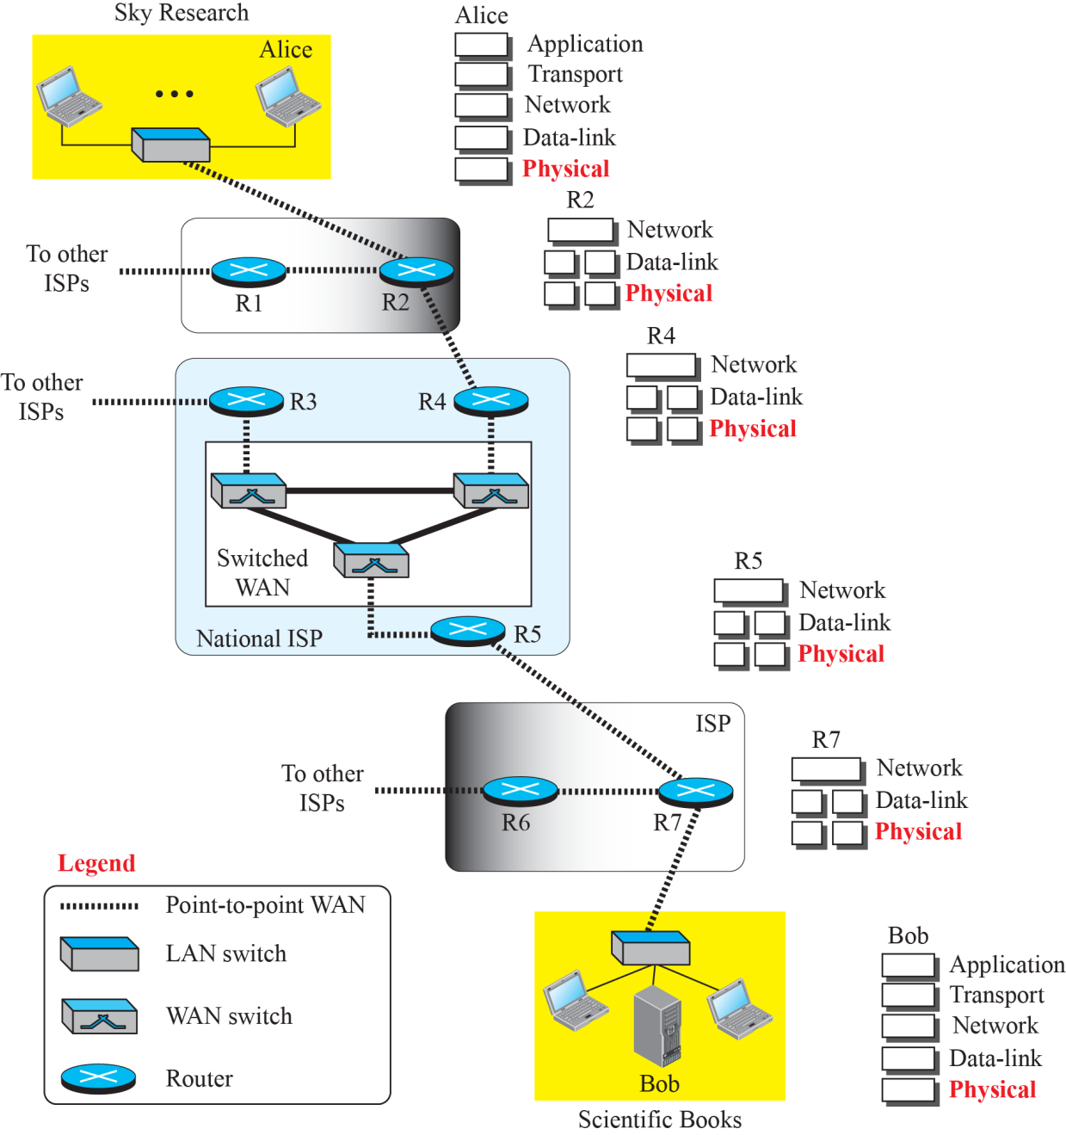
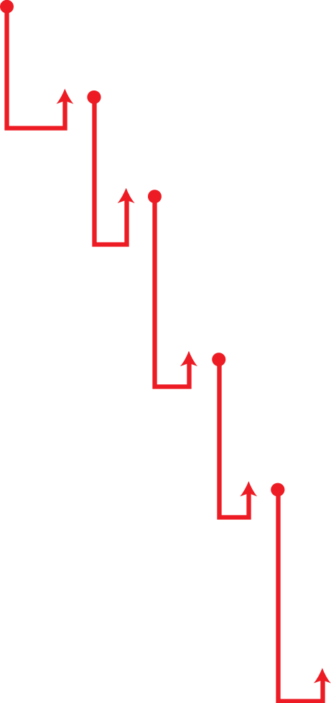
3-1
DATA AND SIGNALS
3.3
Figure 3.1
Communication at the physical layer
3.4
Figure 3.1 shows a scenario in which a scientist working in a research company, Sky Research, needs to order a book related to her research from an online bookseller, Scientific Books.
3.1.1
Analog and Digital Data
3.5
Data can be analog or digital.
The term analog data refers to information that is continuous; digital data refers to information that has discrete states.
For example, an analog clock that has hour, minute, and second hands gives information in a continuous form; the movements of the hands are continuous.
On the other hand, a digital clock that reports the hours and the minutes will change suddenly from 8:05 to 8:06.
3.1.2
Analog and Digital Signals
3.6
Like the data they represent, signals can be either analog or digital.
An analog signal has infinitely many levels of intensity over a period of time.
As the wave moves from value A to value B, it passes through and includes an infinite number of values along its path.
A digital signal, on the other hand, can have only a limited number of defined values.
Although each value can be any number, it is often as simple as 1 and 0.

Slide 3
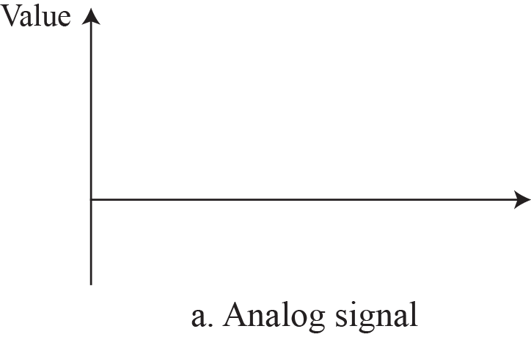

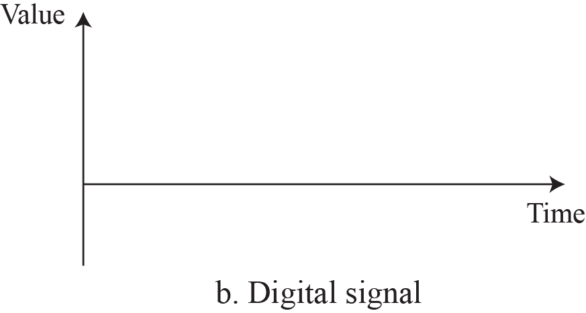

Figure 3.2
Comparison of analog and digital signals
3.7
3.1.3
Periodic and Nonperiodic
3.8
A periodic signal completes a pattern within a measurable time frame, called a period, and repeats that pattern over subsequent identical periods.
The completion of one full pattern is called a cycle.
A nonperiodic signal changes without exhibiting a pattern or cycle that repeats over time.
Both analog and digital signals.

Slide 4
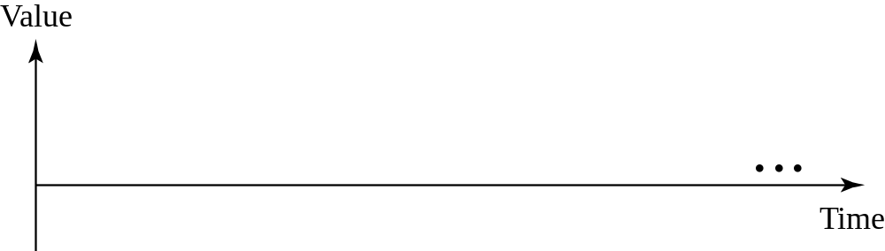

3-2
PERIODIC ANALOG SIGNALS
Periodic analog signals can be classified as simple or composite.
A simple periodic analog signal, a sine wave, cannot be decomposed into simpler signals.
A composite periodic analog signal is composed of multiple sine waves.
3.9
3.2.1
Sine Wave
3.10
3.2.1
Three parameters
The sine wave is the most fundamental form of a periodic analog signal.
When we visualize it as a simple oscillating curve, its change over the course of a cycle is smooth and consistent, a continuous, rolling flow.
Figure 3.3 shows a sine wave.
Each cycle consists of a single arc above the time axis followed by a single arc below it.
A sine wave is fully described by three parameters: peak amplitude, frequency, and phase.
Peak amplitude is the highest intensity, proportional to the energy the signal carries.
For an electric signal, peak amplitude is measured in volts.
Figure 3.3
A sine wave
3.11

Slide 5
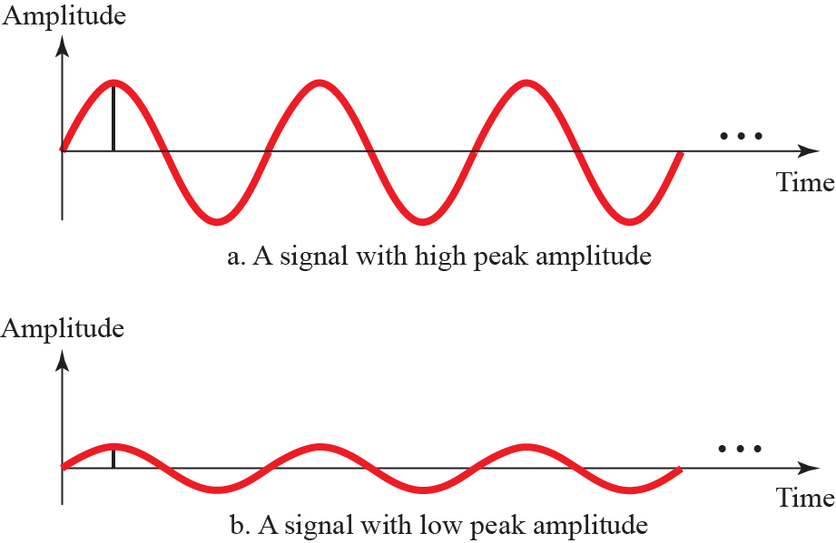
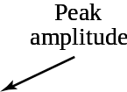
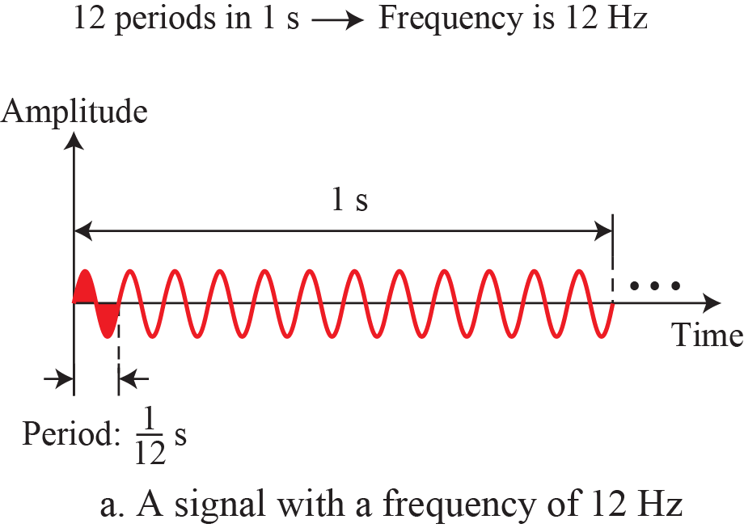
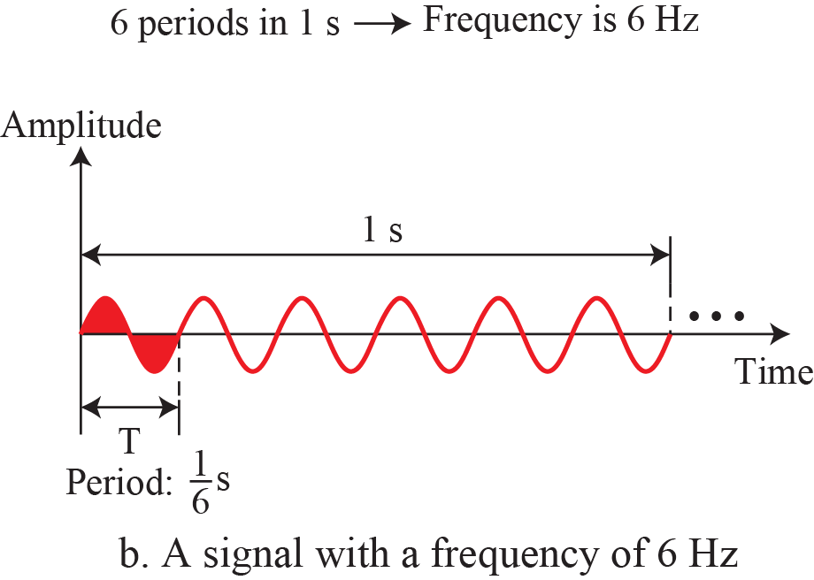
Figure 3.4
Two signals with two different amplitudes
3.12
Example 3.2
3.14
The voltage of a battery is a constant; this constant value can be considered a sine wave, as we will see later.
For example, the peak value of an AA battery is normally 1.5 V.
Figure 3.5
Two signals with the same phase and frequency, but different amplitudes
3.15
Example 3.1
3.13
The power in your house can be represented by a sine wave with a peak amplitude of 155 to 170 V. However, it is common knowledge that the voltage of the power in U.S. homes is 110 to 120 V. This discrepancy is due to the fact that these are root mean square (rms) values.
The signal is squared and then the average amplitude is calculated.
The peak value is equal to 2^{1/2} × rms value.

Slide 6
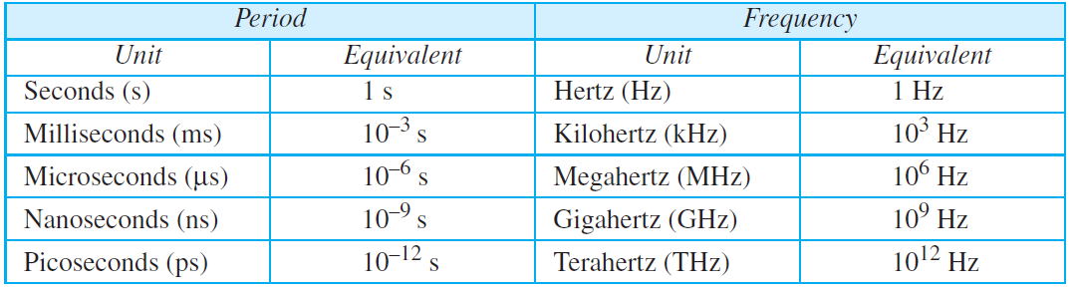
3.2.1
Period and frequency
Example 3.4
3.17
Period is the time one cycle takes, measured in seconds.
Frequency is the number of periods in one second, measured in hertz.
The two are inverses: f = 1/T and T = 1/f.
A signal that never changes has frequency zero.
A signal that changes instantaneously has infinite frequency.
Express a period of 100 ms in microseconds.
Solution
From Table 3.1 we find the equivalents of 1 ms (1 ms is 10^{–3} s) and 1 s (1 s is 10⁶ μs).
We make the following substitutions:
Table 3.1
Units of period and frequency
3.16

Slide 7
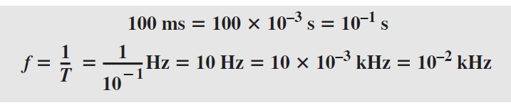

Example 3.4
3.17
Example 3.5
3.19
Express a period of 100 ms in microseconds.
Solution
From Table 3.1 we find the equivalents of 1 ms (1 ms is 10^{–3} s) and 1 s (1 s is 10⁶ μs).
We make the following substitutions:
The period of a signal is 100 ms.
What is its frequency in kilohertz?.
Solution
First we change 100 ms to seconds, and then we calculate the frequency from the period (1 Hz = 10^{–3} kHz).
Example 3.3
3.18
The power we use at home has a frequency of 60 Hz (50 Hz in Europe).
The period of this sine wave can be determined as follows:
This means that the period of the power for our lights at home is 0.0166 s, or 16.6 ms.
Our eyes are not sensitive enough to distinguish these rapid changes in amplitude.
3.2.2
Phase
3.20
The term phase, or phase shift, describes the position of the waveform relative to time 0. If we think of the wave as something that can be shifted backward or forward along the time axis, phase describes the amount of that shift.
It indicates the status of the first cycle.

Slide 8
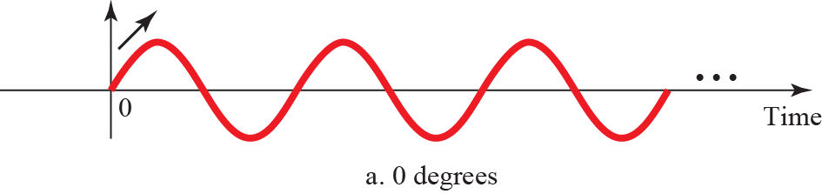
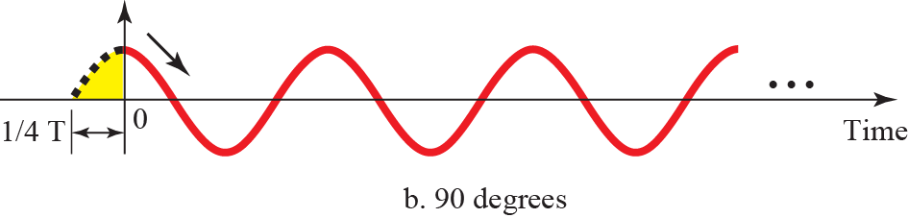

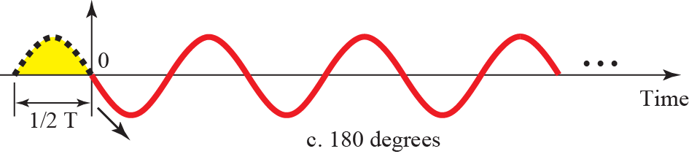
Figure 3.6
Three sine waves with different phases
3.21
Example 3.6
3.22
A sine wave is offset 1/6 cycle with respect to time 0. What is its phase in degrees and radians?
Solution
We know that 1 complete cycle is 360°. Therefore, 1/6 cycle is
3.2.2
Reading phase
Phase gives the position of the waveform relative to time 0.
At 0 degrees the wave starts at zero amplitude and is rising.
At 90 degrees it starts at peak amplitude and is falling.
At 180 degrees it starts at zero amplitude and is falling.

Slide 9


3.2.3
Wavelength
3.23
3.2.3
Wavelength and speed
Wavelength is another characteristic of a signal traveling through a transmission medium.
Wavelength binds the period or the frequency of a simple sine wave to the propagation speed of the medium (see Figure 3.7).
Wavelength is propagation speed times period, so wavelength is speed divided by frequency.
Frequency does not depend on the medium, but wavelength does.
In optical fibre, wavelength is normally quoted in micrometres.
Figure 3.7
Wavelength and period
3.24
3.2.4
Time and Frequency Domains
3.25
A sine wave is comprehensively defined by its amplitude, frequency, and phase.
We have been showing a sine wave by using what is called a time domain plot.
The time-domain plot shows changes in signal amplitude with respect to time (it is an amplitude-versus-time plot).
Phase is not explicitly shown on a time-domain plot.

Slide 10
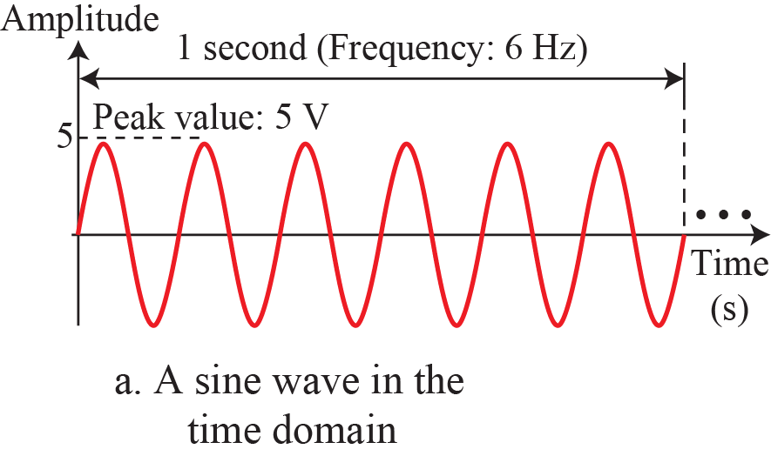
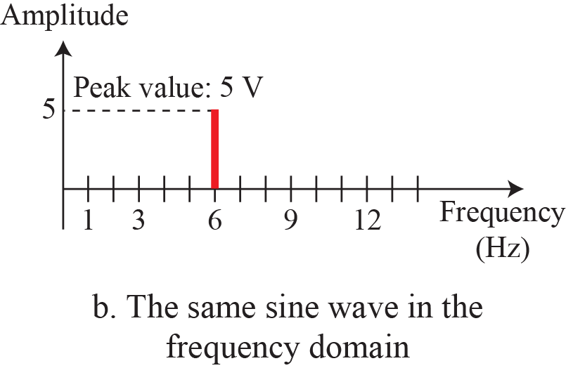
Figure 3.8
The time-domain and frequency-domain plots of a sine wave
3.26

Slide 11
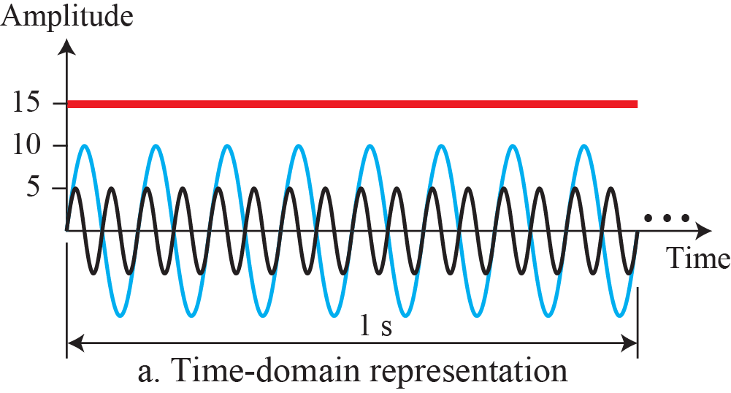
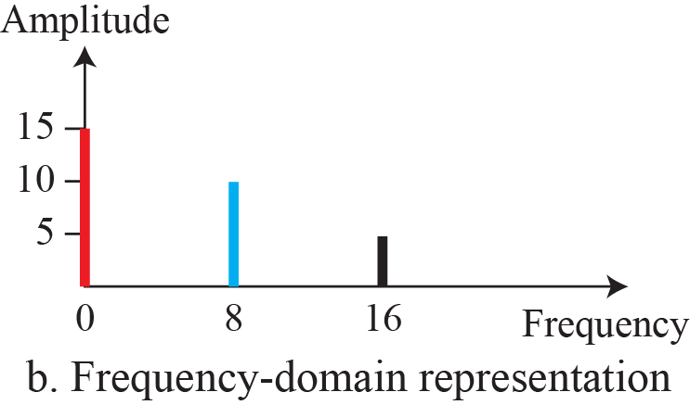
Example 3.7
3.27
3.2.5
Composite Signals
3.29
The frequency domain is more compact and useful when we are dealing with more than one sine wave.
For example, Figure 3.9 shows three sine waves, each with different amplitude and frequency.
All can be represented by three spikes in the frequency domain.
So far, we have focused on simple sine waves.
Simple sine waves have many applications in daily life.
We can send a single sine wave to carry electric energy from one place to another.
For example, the power company sends a single sine wave with a frequency of 60 Hz to distribute electric energy to houses and businesses.
As another example, we can use a single sine wave to send an alarm to a security center when a burglar opens a door or window in the house.
In the first case, the sine wave is carrying
energy; in the second, the sine wave is a signal of danger.
Figure 3.9
The time domain and frequency domain of three sine waves
3.28

Slide 12
EXPLORE
Data, signals, and the three parameters of a sine wave
Continued
Ben Eater, Networking tutorial. Thirteen short videos that start at a bare copper wire.
Try: Watch parts 1 to 4 before the next lecture.
https://www.youtube.com/playlist?list=PLowKtXNTBypH19whXTVoG3oKSuOcw_XeW
Ben Eater, Analyzing actual Ethernet encoding. A live 10BASE-T link on an oscilloscope.
Try: Notice that the data leaves as an analog waveform.
https://www.youtube.com/watch?v=i8CmibhvZ0c
Academo, virtual oscilloscope. A scope in the browser, fed by your microphone.
Try: Whistle, freeze the trace, read your own period.
https://academo.org/demos/virtual-oscilloscope/
PhET, Waves Intro. Water, sound and light from one control panel.
Try: Vary amplitude alone, then frequency alone.
https://phet.colorado.edu/en/simulations/waves-intro
PhET, Wave on a String. Propagation speed is set by the medium, not the source.
Try: Hold frequency, change tension, watch the wavelength.
https://phet.colorado.edu/en/simulations/wave-on-a-string
Chrome Music Lab, Sound Waves. Air molecules drawn as moving dots under a keyboard.
Try: Compare a low key with a high key.
https://musiclab.chromeexperiments.com/Sound-Waves/
Academo, spectrum analyzer. The oscilloscope input, seen in the frequency domain.
Try: Hum a note and read its frequency off the axis.
https://academo.org/demos/spectrum-analyzer/
Chrome Music Lab, Spectrogram. Frequency against time, in colour, from the microphone.
Try: Compare a whistle with a vowel.
https://musiclab.chromeexperiments.com/Spectrogram/
Academo, all demos. A catalogue of small physics and signal demonstrations.
Try: Open Wave Interference and Beat Frequency.
https://academo.org/demos/
Falstad, mathematics and physics applets. A shelf of simulations built by one physicist.
Try: Browse the wave section for anything you want moving.
https://www.falstad.com/mathphysics.html

Slide 13
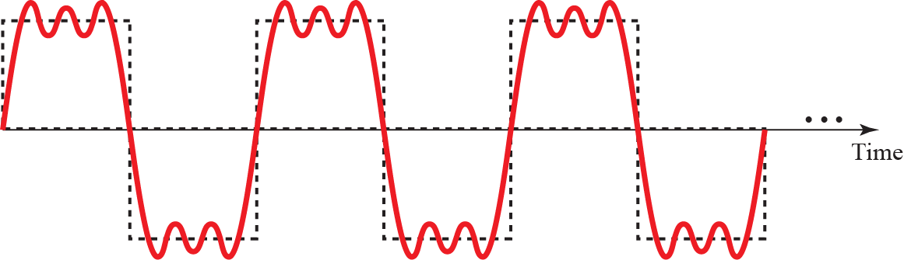
Example 3.8
3.30
Figure 3.10 shows a periodic composite signal with frequency f.
This type of signal is not typical of those found in data communications.
We can consider it to be three alarm systems, each with a different frequency.
The analysis of this signal can give us a good understanding of how to
decompose signals.
It is very difficult to manually decompose this signal into a series of simple sine waves.
However, there are tools, both hardware and software, that can help us do the job.
We are not concerned
about how it is done; we are only interested in the result.
Figure 3.11 shows the result of decomposing the above signal in both the time and frequency domains.
Figure 3.10
A composite periodic signal
3.31

Slide 14
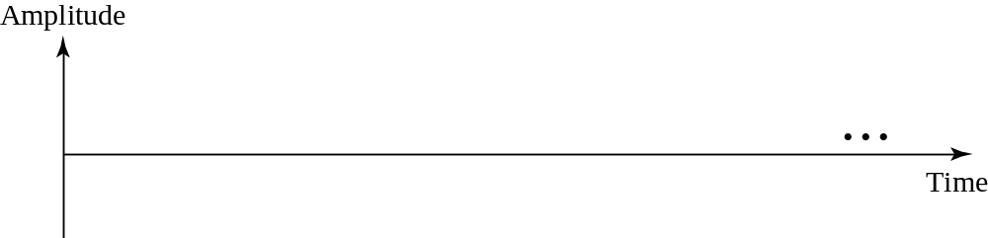

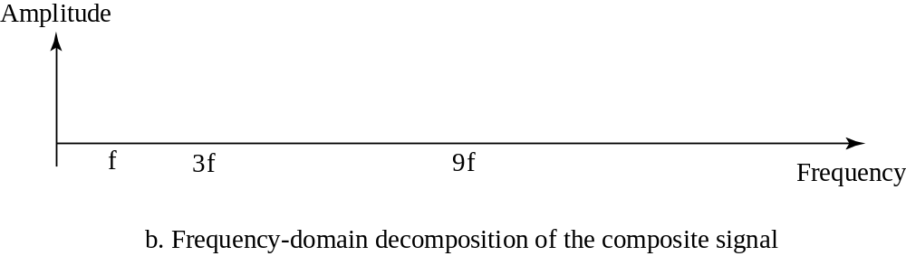
Figure 3.11
Decomposition of a composite periodic signal
3.32
3.2.5
Harmonics
A periodic composite signal decomposes into discrete sine waves at f, 3f, 9f and so on.
Only integer multiples of the fundamental frequency appear.
The amplitudes fall as the frequency rises.

Slide 15
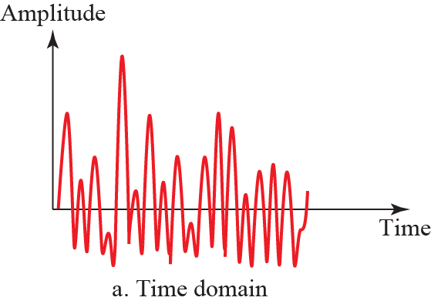
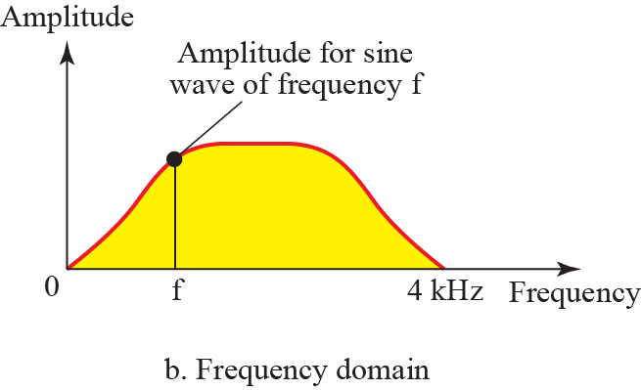
Example 3.9
3.33
Figure 3.12 shows a nonperiodic composite signal.
It can be the signal created by a microphone or a telephone set when a word or two is pronounced.
In this case, the composite signal cannot be periodic, because that implies that we are repeating the same word or words with exactly the
same tone.
Figure 3.12
Time and frequency domain of a non-periodic signal
3.34

Slide 16
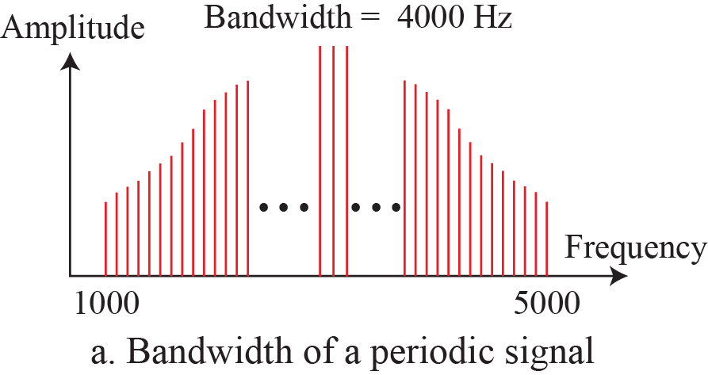
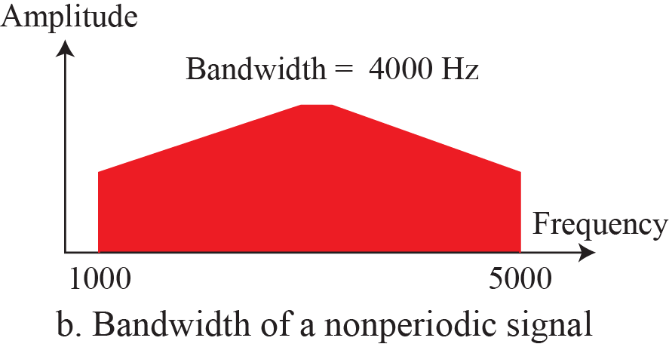
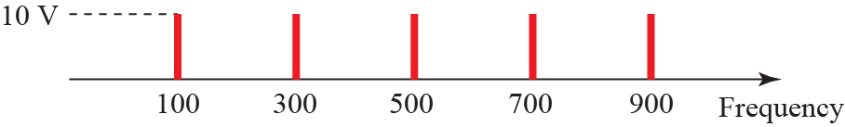


3.2.5
Nonperiodic composites
Figure 3.13
The bandwidth of periodic and nonperiodic composite signals
3.36
A nonperiodic composite signal decomposes into a continuous range of frequencies, not discrete spikes.
Its frequency-domain plot is therefore a continuous curve.
3.2.6
Bandwidth
3.35
The range of frequencies contained in a composite signal is its bandwidth.
The bandwidth is normally a difference between two numbers.
For example, if a composite signal contains frequencies between 1000 and 5000, its bandwidth is 5000 − 1000, or 4000.
Example 3.10
3.37
If a periodic signal is decomposed into five sine waves with frequencies of 100, 300, 500, 700, and 900 Hz, what is its bandwidth? Draw the spectrum, assuming all components have a maximum amplitude of 10 V.
Solution
Let f_{h} be the highest frequency, f_{l} the lowest frequency, and B the bandwidth.
Then
Figure 3.14
The bandwidth for example 3.10
3.38

Slide 17
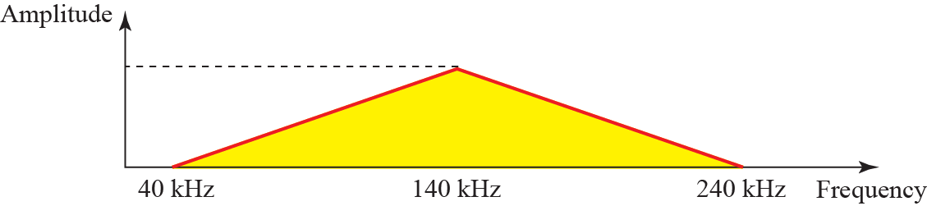
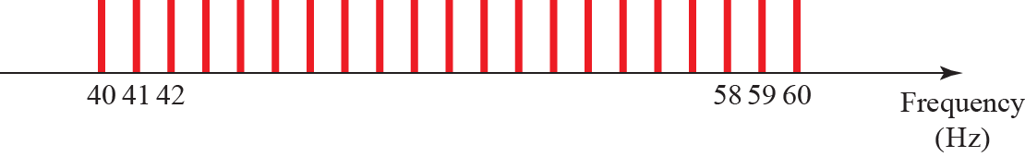
Example 3.11
3.39
Example 3.12
3.41
A periodic signal has a bandwidth of 20 Hz.
The highest frequency is 60 Hz.
What is the lowest frequency? Draw the spectrum if the signal contains all frequencies of the same amplitude.
Solution
Let f_{h} be the highest frequency, f_{l} the lowest frequency, and B the bandwidth.
Then
The spectrum contains all integer frequencies.
We show this by a series of spikes (see Figure 3.15).
A nonperiodic composite signal has a bandwidth of 200 kHz, with a middle frequency of 140 kHz and peak amplitude of 20 V. The two extreme frequencies have an amplitude of 0. Draw the frequency domain of the signal.
Solution
The lowest frequency must be at 40 kHz and the highest at 240 kHz.
Figure 3.16 shows the frequency domain and the bandwidth.
Figure 3.16
The bandwidth for example 3.12
3.42
Figure 3.15
The bandwidth for example 3.11
3.40
Example 3.13
3.43
An example of a nonperiodic composite signal is the signal propagated by an AM radio station.
In the United States, each AM radio station is assigned a 10-kHz bandwidth.
The total bandwidth dedicated to AM radio ranges from 530 to 1700 kHz.
We will show the rationale behind this 10-kHz bandwidth in Chapter 5..

Slide 18
Example 3.14
3.44
Example 3.15 (continued)
3.46
Another example of a nonperiodic composite signal is the signal propagated by an FM radio station.
In the United States, each FM radio station is assigned a 200-kHz bandwidth.
The total bandwidth dedicated to FM radio ranges from 88 to 108 MHz.
We will show the rationale behind this 200-kHz bandwidth in Chapter 5.
Therefore, we need 11,025,000 / 2 = 5,512,500 cycles per second, or Hz.
The bandwidth needed is 5.5124 MHz.
This worst-case scenario has such a low probability of occurrence that the assumption is that we need only 70 percent of this bandwidth, which is 3.85 MHz.
Since audio and synchronization signals are also needed, a 4-MHz bandwidth has been set aside for each black and white TV channel.
An analog color TV channel has a 6-MHz bandwidth.
Example 3.15
3.45
Another example of a nonperiodic composite signal is the signal received by an old-fashioned analog black-and-white TV. A TV screen is made up of pixels (picture elements) with each pixel being either white or black.
The screen is scanned 30 times per second.
If we assume a resolution of 525 × 700 (525 vertical lines and 700 horizontal lines), which is a ratio of 3:4, we have 367,500 pixels per screen.
If we scan the screen 30 times per second, this is 367,500 × 30 = 11,025,000 pixels per second.
The worst-case scenario is alternating black and white pixels.
In this case, we need to represent one color by the minimum amplitude and the other color by the maximum amplitude.
We can send 2 pixels per cycle.

Slide 19
EXPLORE
Composite signals, harmonics, and bandwidth
Continued
PhET, Fourier: Making Waves. Eleven harmonic amplitudes under your mouse.
Try: Build a square wave, then play the Wave Game.
https://phet.colorado.edu/en/simulations/fourier-making-waves
Falstad, Fourier Series applet. A waveform above, its harmonic amplitudes below.
Try: Press Square, then drag Number of Terms up from 1.
https://www.falstad.com/fourier/
Jez Swanson, Interactive Introduction to Fourier Transforms. An illustrated article you scroll through and touch.
Try: Draw a waveform and read off its frequencies.
https://www.jezzamon.com/fourier/
3Blue1Brown, But what is the Fourier Transform?. Twenty animated minutes on the transform itself.
Try: Watch until the signal is wound around a circle.
https://www.youtube.com/watch?v=spUNpyF58BY
Wikipedia, Fourier series. The reference article, with animations at the head.
Try: Play the square-wave synthesis and count the terms.
https://en.wikipedia.org/wiki/Fourier_series
Wikipedia, Square wave. The closed form of the series we approximate.
Try: Check where the odd harmonics come from.
https://en.wikipedia.org/wiki/Square_wave_(waveform)
BetterExplained, Interactive Guide to the Fourier Transform. A plain-language route to the same result.
Try: Read this if the mathematics arrived first.
https://betterexplained.com/articles/an-interactive-guide-to-the-fourier-transform/
DSPRelated, building a square wave from sine waves. Harmonics added one at a time, with a short quiz.
Try: Take the quiz at the end.
https://www.dsprelated.com/foundations/sum-of-sinusoids.php
WebSDR, University of Twente. A real shortwave receiver, tuned from a browser.
Try: Measure the width of one broadcast station.
http://websdr.ewi.utwente.nl:8901/
Chrome Music Lab, Spectrogram. A live picture of how much spectrum a sound occupies.
Try: Compare a flute with a cymbal.
https://musiclab.chromeexperiments.com/Spectrogram/

Slide 20
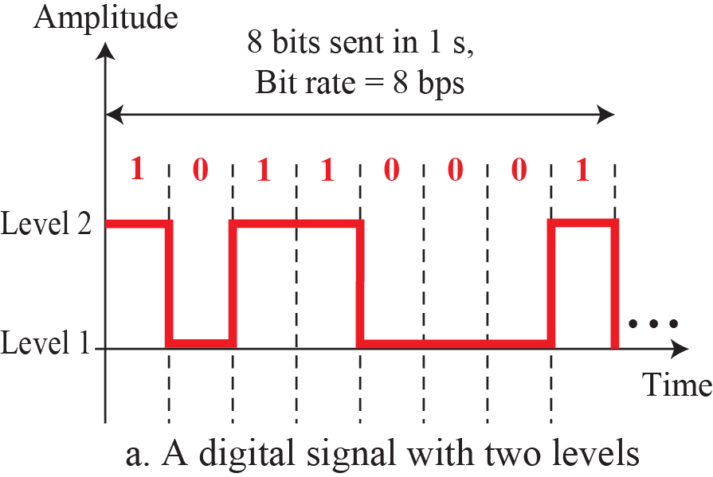
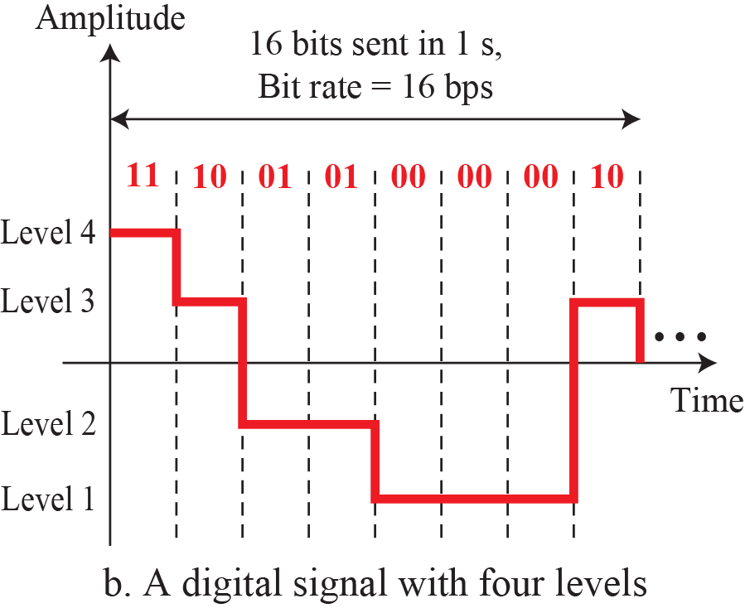
3-3
DIGITAL SIGNALS
3.47
Figure 3.17
Two digital signals: one with two signal levels and the other with four signal levels
3.48
In addition to being represented by an analog signal, information can also be represented by a digital signal.
For example, a 1 can be encoded as a positive voltage and a 0 as zero voltage.
A digital signal can have more than two levels.
In this case, we can send more than 1 bit for each level.
Figure 3.17 shows two signals, one with two levels
and the other with four.
3.3.1
Bit Rate
3.51
Most digital signals are nonperiodic, and thus period and frequency are not appropriate characteristics.
Another term—bit rate (instead of frequency)—is used to describe digital signals.
The bit rate is the number of bits sent in 1s, expressed in bits per second (bps).
Figure 3.17 shows the bit rate for two signals.
3.3.1
Levels and bits
A signal with L levels carries log²L bits per level.
Two levels give 1 bit per level, four levels give 2 bits per level.
Bits per level must be an integer, so L is normally a power of 2.

Slide 21



Example 3.16
3.49
Example 3.18
3.52
A digital signal has eight levels.
How many bits are needed per level? We calculate the number of bits from the following formula.
Each signal level is represented by 3 bits.
Assume we need to download text documents at the rate of 100 pages per second.
What is the required bit rate of the channel?
Solution
A page is an average of 24 lines with 80 characters in each line.
If we assume that one character requires 8 bits, the bit rate is
Example 3.17
3.50
Example 3.19
3.53
A digital signal has nine levels.
How many bits are needed per level? We calculate the number of bits by using the formula.
Each signal level is represented by 3.17 bits.
However, this answer is not realistic.
The number of bits sent per level needs to be an integer as well as a power of 2. For this example, 4 bits can represent one level.
A digitized voice channel, as we will see in Chapter 4, is made by digitizing a 4-kHz bandwidth analog voice signal.
We need to sample the signal at twice the highest frequency (two samples per hertz).
We assume that each sample requires 8 bits.
What is the required bit rate?
Solution
The bit rate can be calculated as

Slide 22

Example 3.20
3.54
3.3.3
Digital As Composite Analog
3.56
What is the bit rate for high-definition TV (HDTV)?
Solution
HDTV uses digital signals to broadcast high quality video signals.
The HDTV screen is normally a ratio of 16 : 9 (in contrast to 4 : 3 for regular TV), which means the screen is wider.
There are 1920 by 1080 pixels per screen, and the screen is renewed 30 times per second.
Twenty-four bits represents one color pixel.
We can calculate the bit rate as
The TV stations reduce this rate to 20 to 40 Mbps through compression.
Based on Fourier analysis (See Appendix E), a digital signal is a composite analog signal.
The bandwidth is infinite, as you may have guessed.
We can intuitively come up with this concept when we consider a digital signal.
A digital signal, in the time domain, comprises connected vertical and horizontal line segments.
A vertical line in the time domain means a frequency of infinity: a horizontal line in the time domain means a frequency of zero.
Going from a frequency of zero to a frequency of infinity implies all frequencies in between are
part of the domain.
3.3.2
Bit Length
3.55
We discussed the concept of the wavelength for an analog signal: the distance one cycle occupies on the transmission medium.
We can define something similar for a digital signal: the bit length.
The bit length is the distance one bit occupies on the transmission medium.

Slide 23
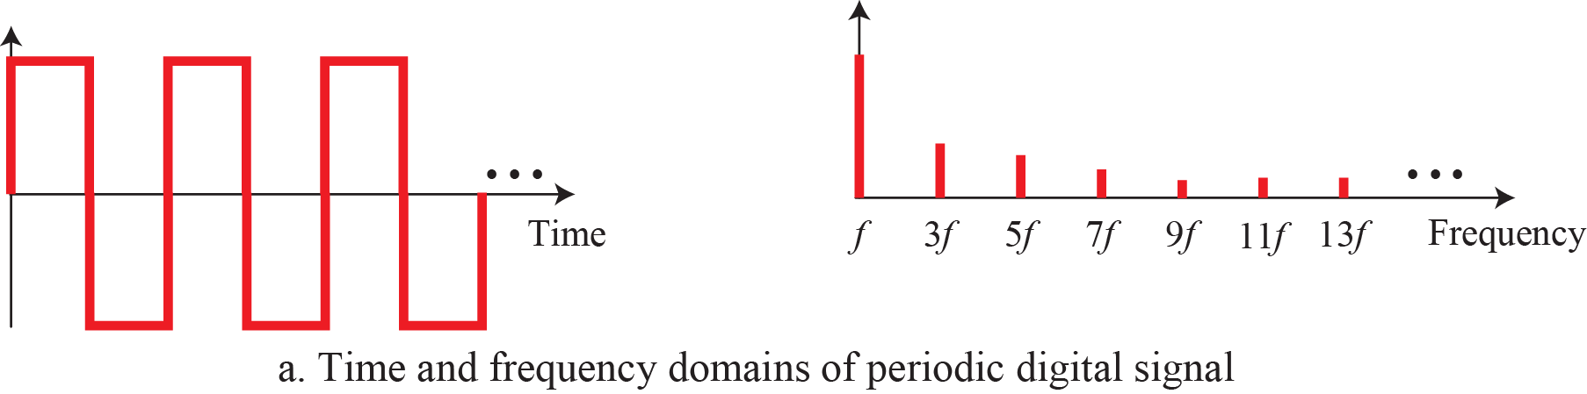
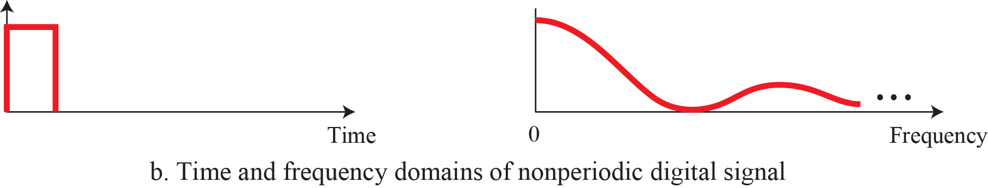
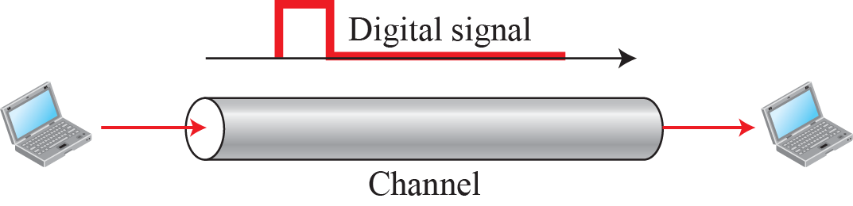
Figure 3.18
The time and frequency domains of periodic and nonperiodic digital signals
3.57
3.3.4
Transmission of Digital Signals
3.58
The previous discussion asserts that a digital signal, periodic or nonperiodic, is a composite analog signal with frequencies between zero and infinity.
For the remainder of the discussion, let us consider the case of a nonperiodic digital signal, similar to the ones we encounter in data communications.
The fundamental question is, how can we send a digital signal from point A to point B?
We can transmit a digital signal by using one of two different approaches: baseband transmission or broadband transmission (using modulation).
Figure 3.19
Baseband transmission
3.59
3.3.3
Discrete versus continuous
Both bandwidths are infinite.
A periodic digital signal has discrete frequencies.
A nonperiodic one has a continuous spectrum.

Slide 24
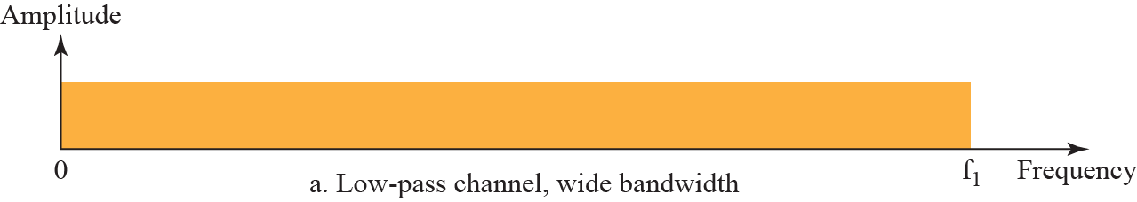
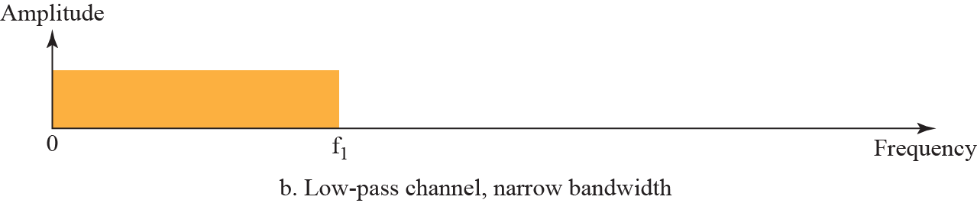
3.3.4
Baseband transmission
3.3.4
Wide and narrow channels
Baseband transmission sends the digital signal without converting it to analog.
It requires a low-pass channel, one whose bandwidth starts at zero.
A dedicated medium, such as a cable between two computers, provides such a channel.
A low-pass channel of infinite bandwidth is ideal and unobtainable.
A wide-bandwidth channel passes enough harmonics for the data to be recovered.
A narrow-bandwidth channel keeps only the lowest harmonics, so the received signal is a rough approximation.
Figure 3.20
Bandwidth of two low-pass channels
3.60

Slide 25
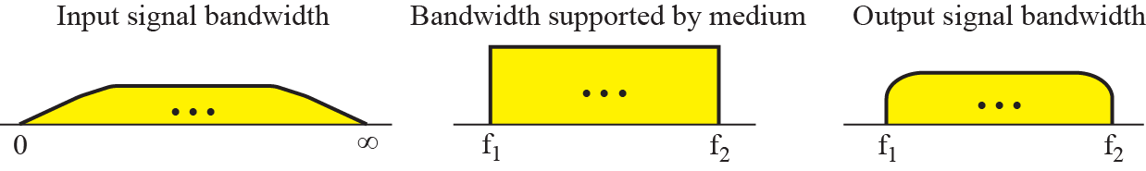
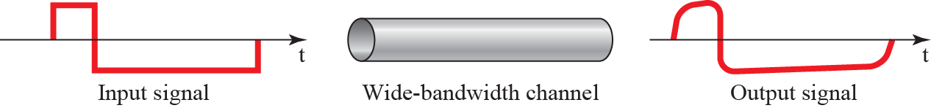
Figure 3.21
Baseband transmission using a dedicated medium
3.61
Example 3.21
3.62
An example of a dedicated channel where the entire bandwidth of the medium is used as one single channel is a LAN. Almost every wired LAN today uses a dedicated channel for two stations communicating with each other.
In a bus topology LAN with multipoint connections, only two stations can communicate with each other at each moment in time (timesharing); the other stations need to refrain from sending data.
In a star topology LAN, the entire channel between each station and the hub is used for communication between these two entities.
We study LANs in Chapter 13.

Slide 26
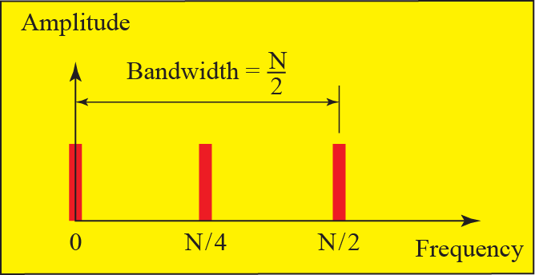
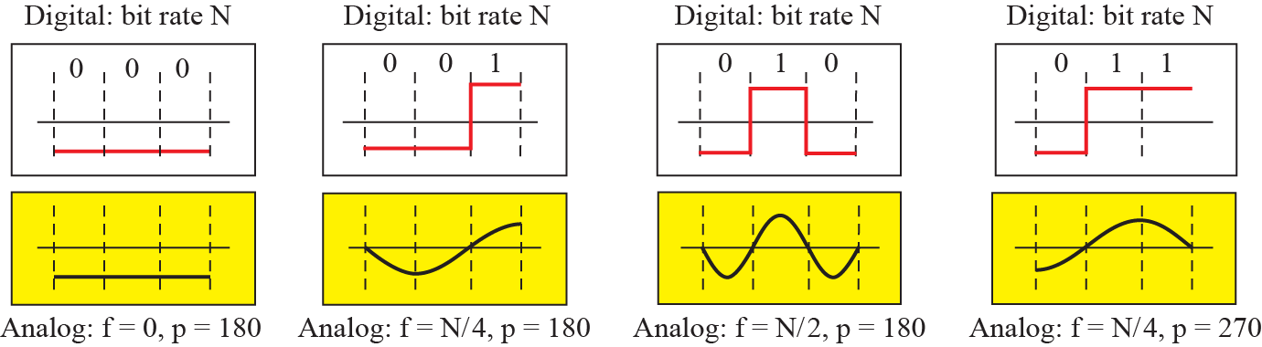
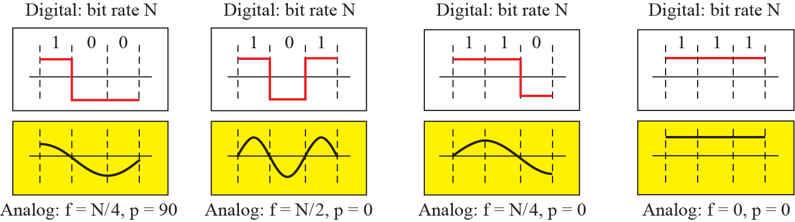
Figure 3.22
Rough approximation of a digital signal (part 1)
3.63
Figure 3.22
Rough approximation of a digital signal (part 2)
3.64

Slide 27
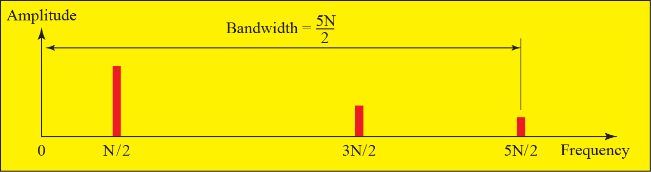
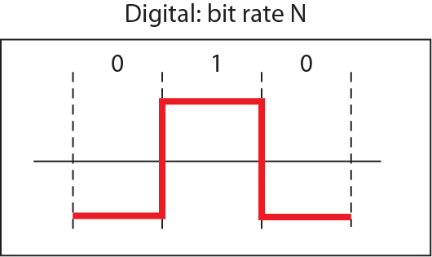
Figure 3.23
Simulating a digital signal with first three harmonics (part I)
3.65

Slide 28
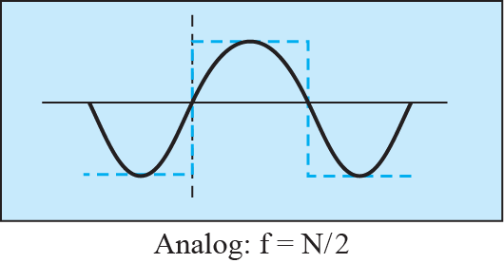
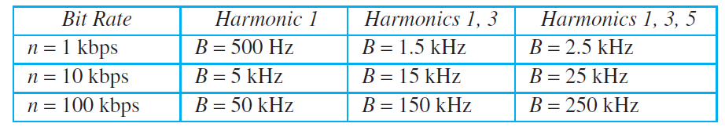
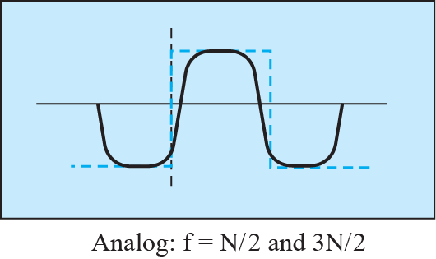
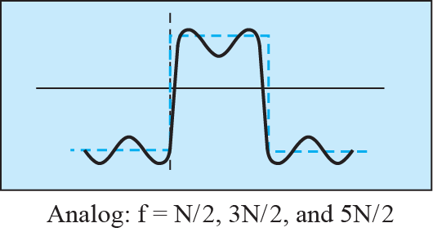
Figure 3.23
Simulating a digital signal with first three harmonics (part II)
3.66
Table 3.2
Bandwidth requirements
3.67
Example 3.22
3.68
What is the required bandwidth of a low-pass channel if we need to send 1 Mbps by using baseband transmission?
Solution
The answer depends on the accuracy desired.
a.
The minimum bandwidth, a rough approximation, is B bit rate /2, or 500 kHz.
We need a low-pass channel with frequencies between 0 and 500 kHz.
b.
A better result can be achieved by using the first and the third harmonics with the required bandwidth B = 3 × 500 kHz = 1.5 MHz.
c.
A still better result can be achieved by using the first, third, and fifth harmonics with B = 5 × 500 kHz = 2.5 MHz.
3.3.4
Harmonics and bandwidth
More harmonics give a closer approximation of the digital signal.
Each added harmonic raises the bandwidth the channel must supply.
Table 3.2 lists what the first, the first three, and the first five harmonics cost.

Slide 29
Example 3.23
3.69
We have a low-pass channel with bandwidth 100 kHz.
What is the maximum bit rate of this channel?
Solution
The maximum bit rate can be achieved if we use the first harmonic.
The bit rate is 2 times the available bandwidth, or 200 kbps.

Slide 30
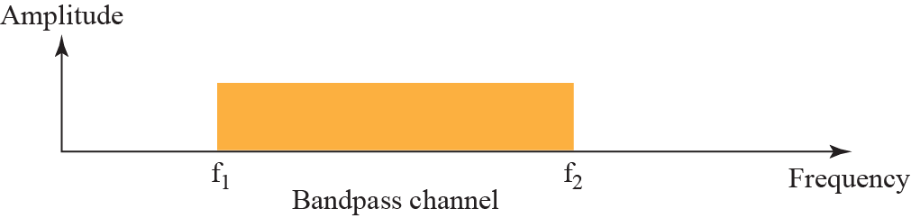
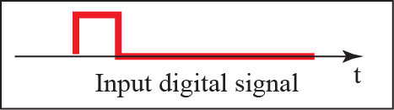
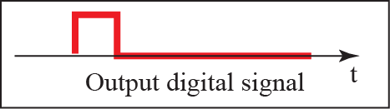
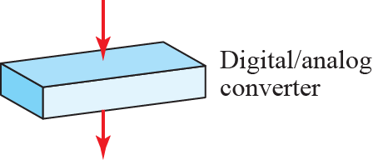




Figure 3.24
Bandwidth of a band-pass channel
3.70
3.3.4
Broadband transmission
Broadband transmission converts the digital signal to analog by modulation.
A carrier of a single frequency is altered to follow the digital signal.
The result is a composite signal, so a bandpass channel is enough.
Figure 3.25
Modulation of a digital signal for transmission on band-pass channel
3.71

Slide 31
Example 3.24
3.72
An example of broadband transmission using modulation is the sending of computer data through a telephone subscriber line, the line connecting a resident to the central telephone office.
These lines, installed many years ago, are designed to carry voice (analog signal) with a limited bandwidth.
Although this channel can be used as a low-pass channel, it is normally considered a bandpass channel.
One reason is that the bandwidth is so narrow (4 kHz) that if we treat the channel as low-pass and use it for baseband transmission, the maximum bit rate can be only 8 kbps.
The solution is to consider the channel a bandpass channel, convert the digital signal from the computer to an analog signal, and send the analog signal.
Example 3.25
3.73
A second example is the digital cellular telephone.
For better reception, digital cellular phones digitize analog voice.
Although the bandwidth allocated to a company providing digital cellular phone service is very wide, we still cannot send the digitized signal without conversion.
The reason is that we have only a band-pass channel available between caller and callee.
For example, if the available bandwidth is W and we allow 1000 couples to talk simultaneously, this means the available channel is W/1000, just part of the entire bandwidth.
We need to convert the digitized voice to a composite analog signal before transmission.

Slide 32
EXPLORE
Digital signals, harmonics, and modulation
Continued
DSPRelated, building a square wave from sine waves. The bandwidth table with the waveform drawn for you.
Try: Compare the first one, three and five harmonics.
https://www.dsprelated.com/foundations/sum-of-sinusoids.php
Wikipedia, Gibbs phenomenon. Why a truncated series never settles at an edge.
Try: Note that the overshoot stays near 9 percent.
https://en.wikipedia.org/wiki/Gibbs_phenomenon
GaussianWaves, Gibbs phenomenon demonstrated. The same effect worked through with plots and code.
Try: Follow the plots as the term count rises.
https://www.gaussianwaves.com/2010/04/gibbs-phenomena-a-demonstration/
Falstad, Fourier Series applet. Harmonics you can delete one by one.
Try: Right-click a harmonic to cut everything above it.
https://www.falstad.com/fourier/
Falstad, Digital Filters applet. A filter you shape by hand, acting on a live signal.
Try: Build a low-pass filter and push a square wave in.
https://www.falstad.com/dfilter/
Academo, amplitude modulation. A carrier and an envelope, drawn and played.
Try: Raise the modulating frequency, watch the sidebands.
https://academo.org/demos/amplitude-modulation/
WebSDR, University of Twente. One receiver, several demodulation schemes.
Try: Switch one station between AM, FM and SSB.
http://websdr.ewi.utwente.nl:8901/
Ben Eater, Analyzing actual Ethernet encoding. Baseband on a dedicated medium, measured.
Try: Look at the rounded corners of the received pulses.
https://www.youtube.com/watch?v=i8CmibhvZ0c
PhET, Fourier: Making Waves. A third screen, for wave packets.
Try: Open the Wave Packet screen and narrow the spacing.
https://phet.colorado.edu/en/simulations/fourier-making-waves
Jez Swanson, Interactive Introduction to Fourier Transforms. The same decomposition, applied to images.
Try: Read the section on JPEG compression.
https://www.jezzamon.com/fourier/

Slide 33





3-4
TRANSMISSION IMPAIRMENT
3.74
3.4.1
Attenuation
3.76
Signals travel through transmission media, which are not perfect.
The imperfection causes signal impairment.
This means that the signal at the beginning of the medium is not the same as the signal at the end of the medium.
What is sent is not what is received.
Three causes of impairment are attenuation, distortion, and noise (see Figure 3.26).
Attenuation means a loss of energy.
When a signal, simple or composite, travels through a medium, it loses some of its energy in overcoming the resistance of the medium.
That is why a wire carrying electric signals gets warm, if not hot, after a while.
Some of the electrical energy in the signal is converted to heat.
To compensate for this loss, amplifiers are used to amplify the signal.
Figure 3.27 shows the effect of attenuation and amplification.
Figure 3.26
Causes of impairment
3.75
Figure 3.27
Attenuation and amplification
3.77

Slide 34

3.4.1
The decibel
The decibel measures the relative strength of two signals, or of one signal at two points.
dB = 10 log₁₀ (P₂ / P₁), where P₁ and P₂ are the powers at the two points.
A negative value means attenuation, a positive value means amplification.
Decibels add along a path, so gains and losses in cascade can be summed.
Example 3.26
3.78
Suppose a signal travels through a transmission medium and its power is reduced to one half.
This means that P₂ = 0.5 P₁.
In this case, the attenuation (loss of power) can be calculated as
A loss of 3 dB (−3 dB) is equivalent to losing one-half the power.
Example 3.27
3.79
A signal travels through an amplifier, and its power is increased 10 times.
This means that P₂ = 10P₁.
In this case, the amplification (gain of power) can be calculated as

Slide 35



Figure 3.28
Decibels for Example 3.28
3.80
Example 3.29
3.82
Sometimes the decibel is used to measure signal power in milliwatts.
In this case, it is referred to as dB_{m} and is calculated as dB_{m} = 10 log10 P_{m}, where P_{m} is the power in milliwatts.
Calculate the power of a signal if its dB_{m} = −30.
Solution
We can calculate the power in the signal as
Example 3.28
3.81
One reason that engineers use the decibel to measure the changes in the strength of a signal is that decibel numbers can be added (or subtracted) when we are measuring several points (cascading) instead of just two.
In Figure 3.28 a signal travels from point 1 to point 4. The signal is attenuated by the time it reaches point 2. Between points 2 and 3, the signal is amplified.
Again, between points 3 and 4, the signal is attenuated.
We can find the resultant decibel value for the signal just by adding the decibel measurements between each set of points.
In this case, the decibel value can be calculated as
Example 3.30
3.83
The loss in a cable is usually defined in decibels per kilometer (dB/km).
If the signal at the beginning of a cable with −0.3 dB/km has a power of 2 mW, what is the power of the signal at 5 km?
Solution
The loss in the cable in decibels is 5 × (−0.3) = −1.5 dB. We can calculate the power as

Slide 36


3.4.2
Distortion
3.84
Figure 3.29
Distortion
3.85
Distortion means that the signal changes its form or shape.
Distortion can occur in a composite signal made of different frequencies.
Each signal component has its own propagation speed (see the next section) through a medium and, therefore, its own delay in arriving at the final destination.
Differences in delay may create a difference in phase if the delay is not exactly the same as the period duration.
3.4.3
Noise
3.86
Noise is another cause of impairment.
Several types of noise, such as thermal noise, induced noise, crosstalk, and impulse noise, may corrupt the signal.
Thermal noise is the random motion of electrons in a wire, which creates an extra signal not originally sent by the transmitter.
Induced noise comes from sources such as motors.
Crosstalk is the effect of one wire on the other.

Slide 37





Figure 3.30
Noise
3.87
Figure 3.31
Two cases of SNR: a high SNR and a low SNR
3.88
3.4.3
Signal-to-noise ratio
Example 3.31
3.89
SNR is the ratio of average signal power to average noise power.
It states how badly noise corrupts the signal.
A high SNR means little corruption, a low SNR means heavy corruption.
The power of a signal is 10 mW and the power of the noise is 1 μW; what are the values of SNR and SNR_{dB}?
Solution
The values of SNR and SNR_{dB} can be calculated as follows:
3.4.3
SNR in decibels
SNR is a ratio of two powers, so it is usually quoted in decibels.
SNR_{dB} = 10 log₁₀ SNR.

Slide 38
Example 3.32
3.90
The values of SNR and SNR_{dB} for a noiseless channel are
Solution
We can never achieve this ratio in real life; it is an ideal.

Slide 39



3-5
DATA RATE LIMITS
A very important consideration in data communications is how fast we can send data, in bits per second, over a channel.
Two theoretical formulas were developed to calculate the data rate: one by Nyquist for a noiseless channel, another by Shannon for a noisy channel.
3.91
3.5.1
Noiseless Channel: Nyquist Bit Rate
3.92
Example 3.34
3.94
For a noiseless channel, the Nyquist bit rate formula defines the theoretical maximum bit rate.
Consider a noiseless channel with a bandwidth of 3000 Hz transmitting a signal with two signal levels.
The maximum bit rate can be calculated as
Example 3.33
3.93
Does the Nyquist theorem bit rate agree with the intuitive bit rate described in baseband transmission?
Solution
They match when we have only two levels.
We said, in baseband transmission, the bit rate is 2 times the bandwidth if we use only the first harmonic in the worst case.
However, the Nyquist formula is more general than what we derived intuitively; it can be applied to baseband transmission and modulation.
Also, it can be applied when we have two or more levels of signals.
Example 3.35
3.95
Consider the same noiseless channel transmitting a signal with four signal levels (for each level, we send 2 bits).
The maximum bit rate can be calculated as

Slide 40
Example 3.36
3.96
Example 3.37
3.98
We need to send 265 kbps over a noiseless channel with a bandwidth of 20 kHz.
How many signal levels do we need?
Solution
We can use the Nyquist formula as shown:
Since this result is not a power of 2, we need to either increase the number of levels or reduce the bit rate.
If we have 128 levels, the bit rate is 280 kbps.
If we have 64 levels, the bit rate is 240 kbps.
Consider an extremely noisy channel in which the value of the signal-to-noise ratio is almost zero.
In other words, the noise is so strong that the signal is faint.
For this channel the capacity C is calculated as
This means that the capacity of this channel is zero regardless of the bandwidth.
In other
words, we cannot receive any data through this channel.
Example 3.38
3.99
We can calculate the theoretical highest bit rate of a regular telephone line.
A telephone line normally has a bandwidth of 3000 Hz (300 to 3300 Hz) assigned for data communications.
The signal-to-noise ratio is usually 3162. For this channel the capacity is calculated as
This means that the highest bit rate for a telephone line is 34.860 kbps.
If we want to send data faster than this, we can either increase the bandwidth of the line or improve the signal-to-noise ratio.
3.5.2
Noisy Channel: Shannon Capacity
3.97
In reality, we cannot have a noiseless channel; the channel is always noisy.
In 1944, Claude Shannon introduced a formula, called the Shannon capacity, to determine the theoretical highest data rate for a noisy channel:

Slide 41



Example 3.39
3.100
Example 3.41
3.103
The signal-to-noise ratio is often given in decibels.
Assume that SNR_{dB} = 36 and the channel bandwidth is 2 MHz.
The theoretical channel capacity can be calculated as
We have a channel with a 1-MHz bandwidth.
The SNR for this channel is 63. What are the appropriate bit rate and signal level?
Solution
First, we use the Shannon formula to find the upper limit.
The Shannon formula gives us 6 Mbps, the upper limit.
For better performance we choose something lower, 4 Mbps.
Then we use the Nyquist formula to find the number of signal levels.
Example 3.40
3.101
When the SNR is very high, we can assume that SNR + 1 is almost the same as SNR. In these cases, the theoretical channel capacity can be simplified to C  B  SNR_{dB}/3. For example, we can calculate the theoretical capacity of the previous example as
3.5.3
Using Both Limits
3.102
In practice, we need to use both methods to find the limits and signal levels.
Let us show this with an example.

Slide 42
EXPLORE
Impairment, and the ceiling it sets on the data rate
Continued
Altium, What is an eye diagram?. The picture engineers use to judge a real link.
Try: Learn which impairment closes the eye in which axis.
https://resources.altium.com/p/what-eye-diagram
WebSDR, University of Twente. A receiver with a real noise floor.
Try: Compare an empty frequency with a strong station.
http://websdr.ewi.utwente.nl:8901/
Academo, spectrum analyzer. Noise seen rather than heard.
Try: Speak, then run a fan beside the microphone.
https://academo.org/demos/spectrum-analyzer/
TeleGeography, submarine cable map. Every intercontinental cable, with its length.
Try: Pick a cable and apply a loss per kilometre.
https://www.submarinecablemap.com
Wikipedia, Shannon-Hartley theorem. The capacity formula and where it comes from.
Try: Read the assumptions the bound rests on.
https://en.wikipedia.org/wiki/Shannon%E2%80%93Hartley_theorem
Wikipedia, Nyquist-Shannon sampling theorem. The other half of the limit in this chapter.
Try: Follow the article through to aliasing.
https://en.wikipedia.org/wiki/Nyquist%E2%80%93Shannon_sampling_theorem
Wikipedia, Aliasing. What a violated sampling rule looks like.
Try: Find the everyday examples at the end.
https://en.wikipedia.org/wiki/Aliasing
DSPRelated, sampling and aliasing. An interactive sampler with the alias drawn in.
Try: Push the signal past half the sampling rate.
https://www.dsprelated.com/foundations/sampling.php
Falstad, Fourier Series applet. The same failure, in the frequency domain.
Try: Press Resample and find the phantom harmonics.
https://www.falstad.com/fourier/
Ingenu, Back to basics: the Shannon-Hartley theorem. Spectral efficiency as a radio engineer uses it.
Try: See how far 256-QAM sits from the bound.
https://www.ingenu.com/2016/07/back-to-basics-the-shannon-hartley-theorem/

Slide 43
3-6
PERFORMANCE
Up to now, we have discussed the tools of transmitting data (signals) over a network and how the data behave.
One important issue in networking is the performance of the network—how good is it? In this section, we introduce terms that we need for future chapters.
3.104
3.6.1
Bandwidth
3.105
Example 3.43
3.107
One characteristic that measures network performance is bandwidth.
However, the term can be used in two different contexts with two different measuring values: bandwidth in hertz and bandwidth in bits per second.
If the telephone company improves the quality of the line and increases the bandwidth to 8 kHz, we can send 112,000 bps by using the same technology as mentioned in Example 3.42.
3.6.1
Two meanings of bandwidth
Bandwidth in hertz is the range of frequencies a channel passes.
Bandwidth in bits per second is the number of bits the channel can carry.
The two are proportional: raising the bandwidth in hertz raises the bandwidth in bits per second.
3.6.2
Throughput
3.108
The throughput is a measure of how fast we can actually send data through a network.
Although, at first glance, bandwidth in bits per second and throughput seem the same, they are different.
A link may have a bandwidth of B bps, but we can only send T bps through this link with T always less than B.
Example 3.42
3.106
The bandwidth of a subscriber line is 4 kHz for voice or data.
The bandwidth of this line for data transmission
can be up to 56,000 bps using a sophisticated modem to change the digital signal to analog.

Slide 44

3.6.3
Latency (Delay)
3.109
Example 3.45
3.111
The latency or delay defines how long it takes for an entire message to completely arrive at the destination from the time the first bit is sent out from the source.
We can say that latency is made of four components: propagation time, transmission time, queuing time and processing delay.
What is the propagation time if the distance between the two points is 12,000 km? Assume the propagation speed to be 2.4 × 10⁸ m/s in cable.
Solution
We can calculate the propagation time as
The example shows that a bit can go over the Atlantic Ocean in only 50 ms if there is a direct cable between the source and the destination.
Example 3.44
3.110
3.112
Example 3.46
A network with bandwidth of 10 Mbps can pass only an average of 12,000 frames per minute with each frame carrying an average of 10,000 bits.
What is the throughput of this network?
Solution
We can calculate the throughput as
The throughput is almost one-fifth of the bandwidth in this case.
What are the propagation time and the transmission time for a 2.5-KB (kilobyte) message if the bandwidth of the network is 1 Gbps? Assume that the distance between the sender and the receiver is 12,000 km and that light travels at 2.4 × 10⁸ m/s.
Solution
We can calculate the propagation and transmission time as
Note that in this case, because the message is short and the bandwidth is high, the dominant factor is the propagation time, not the transmission time.

Slide 45

Example 3.47
3.113
What are the propagation time and the transmission time for a 5-MB (megabyte) message (an image) if the bandwidth of the network is 1 Mbps? Assume that the distance between the sender and the receiver is 12,000 km and that light travels at 2.4 × 10⁸ m/s.
Solution
We can calculate the propagation and transmission times as
We can calculate the propagation and transmission times as
3.6.4
Bandwidth-Delay Product
3.114
Bandwidth and delay are two performance metrics of a link.
However, as we will see in this chapter and future chapters, what is very important in data communications is the product of the two, the bandwidth-delay product.
Let us elaborate on this issue, using two hypothetical cases as examples.

Slide 46


Figure 3.32
Filling the links with bits for Case 1
3.115
Figure 3.33
Filling the pipe with bits for Case 2
3.116
3.6.4
Filling the link
The bandwidth-delay product is the number of bits that fill the link.
It matters when data goes out in bursts and the sender waits for an acknowledgement.
Keeping the link busy needs at least that many bits in flight.

Slide 47



Example 3.48
3.117
We can think about the link between two points as a pipe.
The cross section of the pipe represents the bandwidth, and the length of the pipe represents the delay.
We can say the volume of the pipe defines the bandwidth-delay product, as shown in Figure 3.34.
Figure 3.34
Concept of bandwidth-delay product
3.118
3.6.5
Jitter
3.119
Another performance issue that is related to delay is jitter.
We can roughly say that jitter is a problem if different packets of data encounter different delays and the application using the data at the receiver site is time-sensitive (audio and video data, for example).
If the delay for the first packet is 20 ms, for the second is 45 ms, and for the third is 40 ms, then the real-time application that uses the packets endures jitter.
We discuss jitter in greater detail in Chapter 28.

Slide 48
EXPLORE
Bandwidth, latency, and the bandwidth-delay product
Continued
Cloudflare, Speed Test. Throughput, latency, jitter and loss in one run.
Try: Compare idle latency with latency under load.
https://speed.cloudflare.com/
Waveform, Bufferbloat test. Latency under load, reported as a grade.
Try: Run it on Ethernet, then again on Wi-Fi.
https://www.waveform.com/tools/bufferbloat
Bufferbloat.net, tests for bufferbloat. Measurement procedures rather than one button.
Try: Ping while a large download saturates the link.
https://www.bufferbloat.net/projects/bloat/wiki/Tests_for_Bufferbloat/
Colin Scott, Latency numbers programmers should know. Memory, disk and network delays on one scale.
Try: Slide the year forward and find what never improves.
https://colin-scott.github.io/personal_website/research/interactive_latency.html
samwho, Latency numbers, visualised. The same figures drawn as areas rather than digits.
Try: Use it to fix the orders of magnitude in your head.
https://samwho.dev/numbers/
Grace Hopper on the nanosecond. Eleven point eight inches of wire, held up to a class.
Try: Watch it once. It runs under two minutes.
https://www.youtube.com/watch?v=9eyFDBPk4Yw
TeleGeography, submarine cable map. Landing points and cable lengths worldwide.
Try: Read a cable length, compute the propagation time.
https://www.submarinecablemap.com
TeleGeography, 2026 submarine cable map. The printed edition, with route capacity statistics.
Try: Look at how capacity divides across the Pacific.
https://resources.telegeography.com/2026-submarine-cable-map
Wikipedia, Bufferbloat. Delay produced by the network itself.
Try: Read it for where jitter comes from.
https://en.wikipedia.org/wiki/Bufferbloat
Cloudflare Radar, Internet quality. Latency and jitter aggregated by country and network.
Try: Compare Korea with a country across a long cable.
https://radar.cloudflare.com/quality

