Slide 1
YouProve: Authenticity and Fidelity in Mobile Sensing
Author : Peter Gilbert, Jaeyeon Jung,
Kyungmin Lee, Henry Qin, Daniel Sharkey, Anmol Sheth
and Landon P. Cox
The 9th ACM Conference on Embedded Networked Sensor Systems (SenSys 2011)
Minja Kim
Korea University

Slide 2
Outline
Introduction
Background
YouProve
Implementation
Evaluation
Conclusion
YouProve Demo

Slide 3
Introduction
Mobile sensing services have tremendous opportunities
The next generation of Internet platforms promises to support service like:
  Citizen journalism(CNN’s iReport)
  Mobile social services(Foursquare, Micro-Blog,…)
  Many kinds of monitoring(traffic, parking, prices,…)
Want to share sensitive data.
Devices have sensors and talk to the cloud
Data is often sensitive(e.g., location, images).

Slide 4
Introduction
Data authenticity is crucial for service correctness
  User-generated content is increasingly important
  Injection of false data can have dire consequences
Solution
  Equip phones with trustworthy sensors capable of signing their readings and to require clients to return unmodified signed data to a service
  Trusted hardware such as Trusted Platform Module(TPM) can serve as the foundation of a solution.
But
  Requiring clients to send unmodified data is impractical
  Mobile clients require the flexibility to trade-off data fidelity for efficient resource usage and greater privacy
YouProve
  A framework for verifying how data is captured and modified on a sensor-equipped mobile phone
  YouProve’s key approach : Type-specific analysis of derived sensor data.

Slide 5
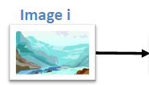
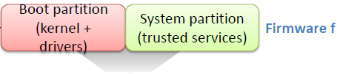





Background
Trusted Platform Module (TPM)
  Includes private key, can compute hashes, sign statements
Pertinent functionality
  Trustworthy attestation of trusted computing base (i.e., the firmware)
Allows services to verify authenticity of raw sensor data
  Service must trust TPM and device firmware
  Verify hash in signed statement matches hash of received image
Problem : Data cannot be modified!!

Slide 6
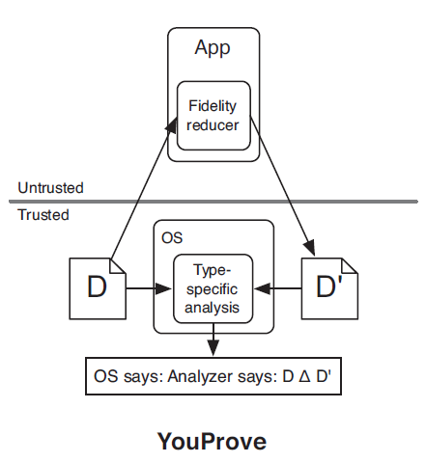
Design Consideration
Be a trustworthy sensing platform built on Android
  allows a client to control the fidelity of data it submits
  allows sensing services to verify that the meaning of source data is preserved across any modifications.
Allow application to directly modify data
  Allows unmodified third-party apps to directly perform fidelity reduction at any point in a data item’s life time.
Fidelity-reducing operation : e.g., cropping or blurring subregions
Fig 1. YouProve Design

Slide 7
YouProve

Slide 8
YouProve
YouProve consists of four trusted software components responsible for performing the following tasks:
  Logging sensor data returned by the Android platform in response to requests from apps
  Tracking data derived from sensor readings as it is manipulated by untrusted third-party apps
  Analyzing the content of a derived data item and its source reading
  Attesting to the results of content analysis and the integrity of the software platform.

Slide 9
Logging Sensor Reading
It is necessary for the trusted platform
  collect a full-fidelity copy of any sensor reading returned to an application
  protect the integrity of the stored copy as long as a user wishes to generate fidelity certificates for data derived from the reading
Logging Procedure
  Assign a unique ID to each sensor (camera, audio, location, ...)
  Stores the original copy to a file
  Writes a database entry with
    a timestamp
    type-specific metadata
    a pointer to the original copy on the FS
    a digest(SHA1) of its contents

Slide 10
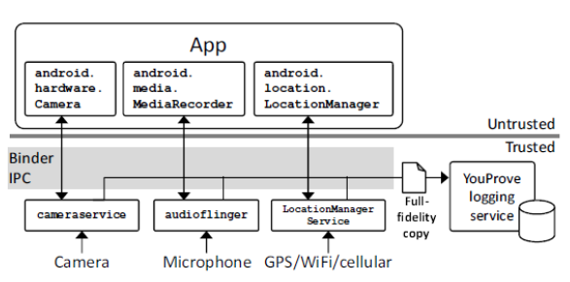
Logging Sensor Reading
Fig 2. Logging sensor readings

Slide 11
Tracking Derived Data
TaintDroid information-flow monitoring framework
  Enables comparisons between a full-fidelity source item and a derived version of the source
  Attaches a taint tag encoding the 32-bit unique ID assigned to the sensor reading before the platform returns sensor data to a user app
    This ID serves as the primary key for the entry in the log database
If tainted data is appending to a file or IPC message already marked with a different ID,
  the file or message is marked with a newly allocated ID

Slide 12
Analyzing Content
Report the differences between an original sensor reading and a derived data item.
Analyzing approach
  to divide a derived data item into smaller region
  To attempt to match the content of each region to that of a corresponding region in the source sensor reading
    Photos : divided by rectangular grid
    Audio : considers time segments

Slide 13
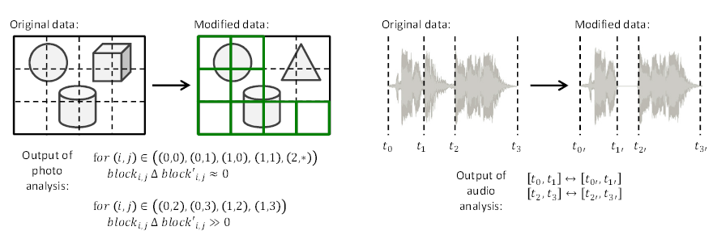
Overview of Photo and Audio Content Analysis

Slide 14
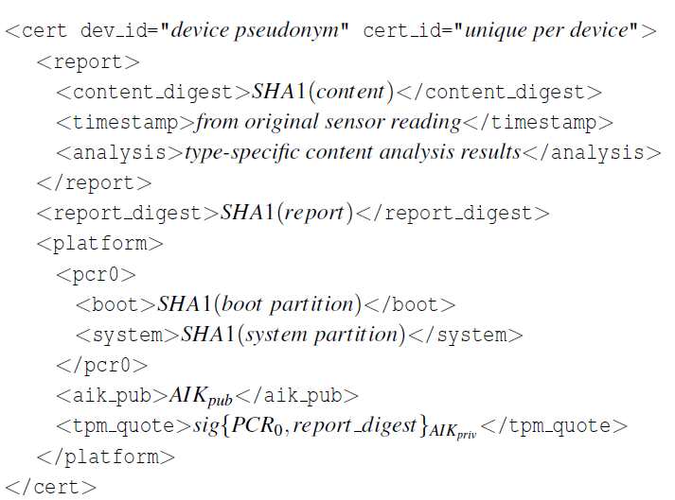
Attesting to Analysis and Platform
YouProve’s attestation service generates fidelity certificates
  Report the results of type-specific analysis and a timestamp for the original reading
  Contain information about the device’s software platform
    Allowing remote verifiers to decide whether or not to trust reports generated by the device
Fig 3. Format of a Fidelity Certificate

Slide 15
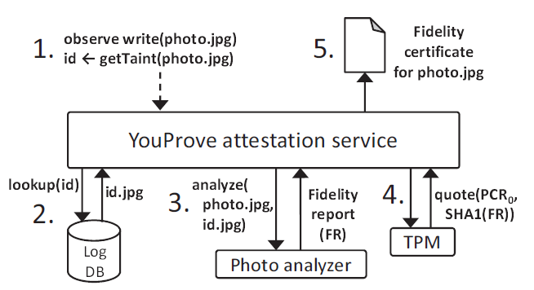
Attesting to Analysis and Platform
Fig 4. Steps for Attestation

Slide 16
Type-Specific Analyzers
Overview
can be implemented by using well-known audio-analysis and computer-vision libraries
  compare the content of a source item (e.g., an original audio clip or photo) to the content of a derived version of the item
Summarizes the software configuration of a device as well as how closely the content of a derived data item matches its source

Slide 17
Type-Specific Analyzers
: Photo Content
The goal of YouProve’s photo analysis is to identity regions of derived photo
Analysis utilizes two well-known techniques from computer vision:
  Speeded-Up Robust Features (SURF)
  Sum of Squared Differences (SSD)
SURF facilitates matching regions in two images by locating “keypoints” such as corners, and then computing a feature vector called a descriptor to represent each keypoint.
  A “matching” between the descriptors in two images can be found by computing the distance between the vectors.
SSD is useful for approximating the visual similarity of two equal-sized blocks of image content.
  It is a simple metric that computes the difference between the value of a pixel in the first image and the corresponding pixel in the second image, and then sums the square of these differences over all pixels in the block.
PPSSD (Per-Pixel Sum of Squared Difference)
  Defined a block size-independent metric to account for different block sizes
  The SSD value for a block divided by its area in pixels

Slide 18
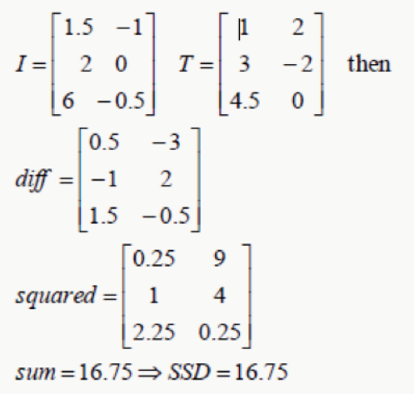
SSD Simple Example
Matrix difference = I - T;
Matrix squared = difference*difference;

Slide 19
Type-Specific Analyzers
: Audio Content
At a high level, YouProve’s audio analyzer extracts sequences of spectral peak frequencies from the source and derived audio clips and applies local sequence alignment to find matching time segments.
The use of spectral peak analysis to compare audio data was inspired by the Shazam audio recognition system. The technique is well-suited for analysis because spectral peaks are a central feature in human hearing and thus are independent of audio encoding.
They are largely maintained across transformations that preserve the way audio will be perceived (e.g., compression). To identify time segments in a modified clip which preserve sequences of spectral peak frequencies from a source clip, YouProve uses a modified version of Smith-Waterman algorithm for local sequence alignment.

Slide 20
Implementation

Slide 21
Implementation
Nexus One smartphone on Android 2.2
YouProve’s logging and attestation services are implemented in
approximately 2,000 lines of Java code
Nexus One does not include a TPM chip. Instead, was ported a popular open-source TPM emulator to Android, along with the TrouSerS open-source TCG stack
Prototype photo and audio analyzers are written in C++ and C, respectively
The audio analyzer uses the open-source LibXtract and FFTW libraries for converting audio samples into frequency bins. We ported these libraries to the Android platform
The photo analyzer uses the SURF implementation from the popular open-source computer-vision library OpenCV
In addition, was used the open-source Taint-Droid information-flow tracking framework, which we updated from Android 2.1 to 2.2

Slide 22
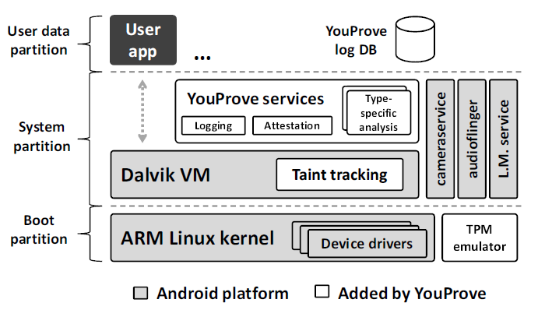
YouProve Prototype Architecture

Slide 23
Testing
The basis for our test dataset was a diverse collection of 69 photos taken on a college campus using a Nexus One.
  Subject matter included individual students, crowds, buildings, offices, landscapes, walls with flyers, and bookshelves full of books.
  The photos varied in level of detail, level of focus, and quality of lighting.
  All photos were taken at the default resolution of 1944x2592 pixels.
  We then used the ImageMagick image-editing tool to apply two classes of modifications to our photos.
Global modifications included cropping, scaling, and JPEG compression.
  We consider these modifications to preserve the meaning of the source.
  Cropping test cases were created by cropping out either the top, bottom, left, or right half of an image, leaving a rectangular half-image.
  Scaling maintained aspect ratio while reducing each dimension to either 75%, 50%, or 25% of its original size.
  Compression produced JPEGs at 75%, 50%, and 25% quality.
Local modifications included overlaying a black box, pasting in a small photo, pasting in a large photo, or blurring a region.
  We consider these modifications to alter the meaning of the source.

Slide 24
Evaluation

Slide 25
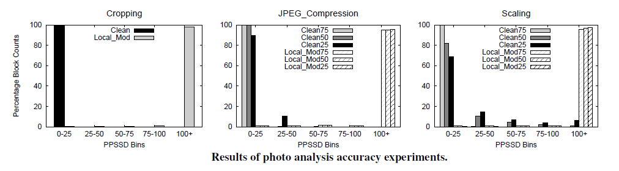
Photo Analysis
Clean -> Blocks that are untouched by a local modification
Low PPSSD values -> There are fewer blocks with only minor changes reduced the number of locally modified blocks
To conclude, photo analyzer is robustness and has good accuracy.
Notes:
Cropping case demonstrate that SURF is highly accurate in mapping cropped photo to the corresponding region in the source.

Slide 26
Audio Analysis
The test cases used to evaluate audio analysis were derived from 5-minute clips of an excerpt from Vivaldi’s The Four Seasons, a stand-up comedy show, an excerpt from the iconic “I Have A Dream” speech, and an undergraduate lecture.
Starting with these four clips, we used the Sound eXchange (SoX) tool to generate derivations from the following transformations:
  extracting and removing subclips
  splicing in other audio
  inserting silences
  applying lossy (MP3) compression
  dithering
  normalizing
  pitch altering

Slide 27
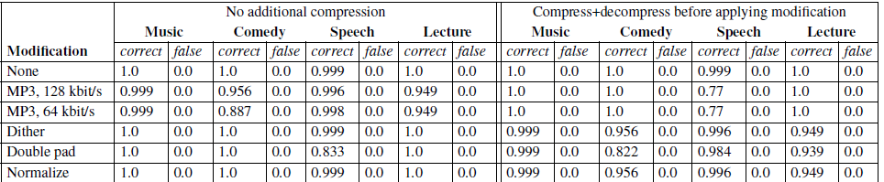

Audio Analysis

Slide 28
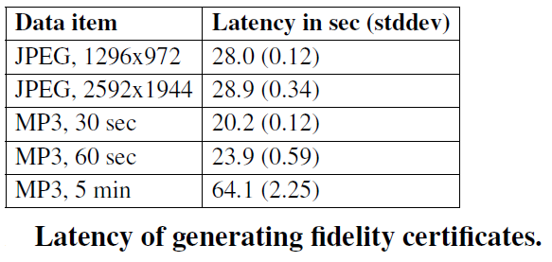
Performance Evaluation

Slide 29
Conclusion
This paper has presented the design and implementation of YouProve, a system that enables mobile sensing services to verify that contributed data has not been manipulated in a way that alters its original meaning while allowing clients to use untrusted editing applications to directly control the fidelity of data they upload.
The key to YouProve’s approach is providing analytic bases of trust for remote services. YouProve relies on trusted, content type-specific analyzers running on the mobile device to generate reports summarizing differences between a derived data item and an original sensor reading.
Logging source data does not noticeably affect application responsiveness
Content analyzers are accurate and complete their tasks in under 70 seconds for 5-minute audio clips and under 30 seconds for 5-megapixel photos.

Slide 30
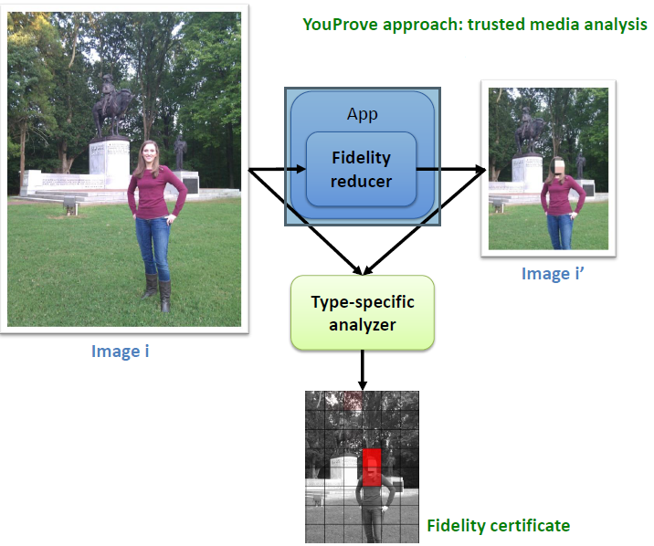
YouProve Example

Slide 31

YouProve Demo
http://www.youtube.com/watch?v=zgA1YxK39Yc

Slide 32
Questions
?

